Slide 1
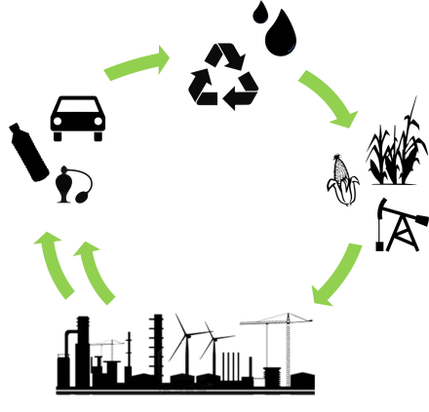
The Engineering Grand Challenges and Green Engineering
WATER

Slide 2
The Grand Challenge: Water
Notes:
The NAE grand challenge to provide access to clean water is multifaceted.
In the developed world, our ability to turn on a faucet and get potable water is an engineering feat that has inherent issues.
In the developing world, access to clean water sources remains an imminent part of daily life.
In order to talk about the engineering challenges, let’s first provide a short history of water supply

Slide 3
A history of drinking water
Water supply
Drinking water treatment
Wastewater treatment
Schroeder, M. History of drinking water: A fluid timeline. May 30, 2014
Notes:
The timeline shown here highlights some major events that have led us from supplying water to providing safe drinking water to preventing waste in our water streams.
Good resource: http://www.itia.ntua.gr/getfile/778/2/documents/2007WSTWSReviewPP.pdf

Slide 4
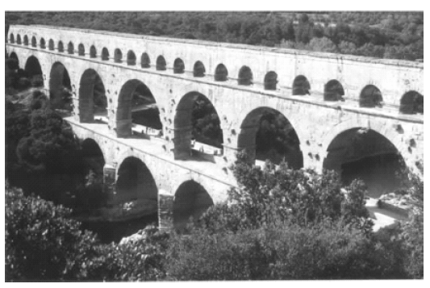
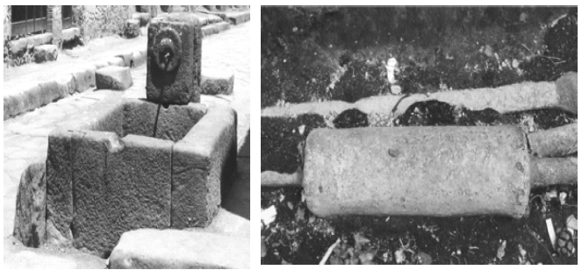
Water supply
144 BC: Roman aqueducts carry water to the city for drinking water
Aqueduct bridge
Public Fountain Lead pipe
Mays, L. Water Sci . Technol: Water Supply 2007
Schroeder, M. History of drinking water: A fluid timeline. May 30, 2014
Notes:
Bringing piped water into a city at a large scale (previously piped water from groundwater cisterns were developed by the Greeks)
Gravity fed system to public fountains
http://www.itia.ntua.gr/getfile/778/2/documents/2007WSTWSReviewPP.pdf

Slide 5
Drinking water treatment
1804: Paisley, Scotland: First municipality to provide water filtration for an entire city
Huisman. Slow Sand Filtration. WHO 1974
Schroeder, M. History of drinking water: A fluid timeline. May 30, 2014
Notes:
Preliminary water treatment
The supposition that every person deserved clean water to drink and bathe in was related to the general philosophical themes of the Enlightenment period in Europe.
This plant would provide filtered water to every household within the city limits. The Scottish water treatment plant depended upon slow sand filters designed by Robert Thom, an important scientist of the Scottish Enlightenment. -- http://www.historyofwaterfilters.com/
http://www.who.int/water_sanitation_health/publications/ssf9241540370.pdf

Slide 6
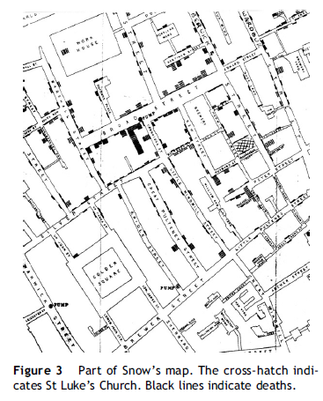
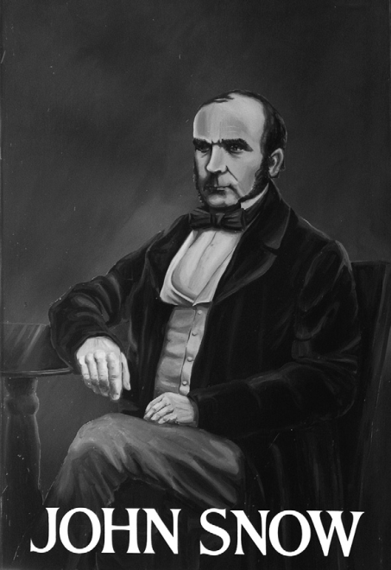
Drinking water contamination
1854:Cholera outbreak in London spread via drinking water
Newsom J. Hospital Infection. 2006
Schroeder, M. History of drinking water: A fluid timeline. May 30, 2014
Notes:
Water contamination – first time that it was introduced that water can lead to the spread of disease
Chlorine was first recognized as a valuable chemical in treating water when John Snow used it to purify the cholera-causing water of the Broad Street Pump. Noting the disinfecting nature of chlorine and its ability to curb cholera deaths, government officials in Great Britain began to chlorinate the public drinking water. This application of chlorine resulted in a sharp decline in deaths from typhoid, as well (Christman, 1998) --http://www.historyofwaterfilters.com/
Newsom, S. W. B. "Pioneers in infection control: John Snow, Henry Whitehead, the Broad Street pump, and the beginnings of geographical epidemiology." Journal of Hospital Infection 64.3 (2006): 210-216.

Slide 7
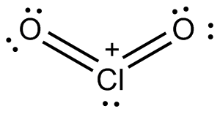
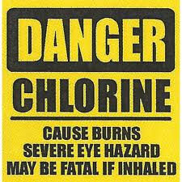
Drinking water treatment: chlorine
1890: Use of chlorine in municipal water systems in England. (US – 1908)
Schroeder, M. History of drinking water: A fluid timeline. May 30, 2014
Notes:
Use of chlorine as a disinfectant – advanced water treatment – moves to US

Slide 8
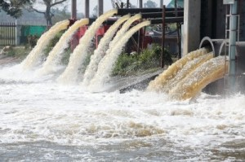
Water Pollution and wastewater
1974: Congress passes the Safe Drinking Water Act in response to water pollution
Schroeder, M. History of drinking water: A fluid timeline. May 30, 2014
Notes:
“By the late 1960s, more and more man–made chemicals were being used in industry and agriculture. There was scientific proof that these chemicals were making their way into the nation's drinking water through street and farm runoff, leakages from underground disposal tanks, and factory waste.
In 1972, drinking water safety first became a major public issue when scientists studying the Mississippi River found 36 industrial pollutants present in the Louisiana area water supply.” - http://centeroncongress.org/safe-drinking-water-act
“The Clean Water Act, like the discovery of the microscope and the disastrous effects of cholera and typhoid epidemics throughout the world, sparked renewed interest in water filtration. It became law that every city in the nation install a water treatment plant, and it became a national goal to have clean water, once more, by 1985 (Outwater, 1996). Because industrial waste was viewed as the main culprit of contaminated water, industrial plants were the main targets of the law. Over the next few decades, the U.S. government expended billions of dollars in grants to industries to create environment-friendly waste management techniques. Cities were also given grant money to install water treatment plants. Eventually, the sludge in the rivers and water supplies of the nation began to disappear.” --http://www.historyofwaterfilters.com/clean-water-act.html

Slide 9
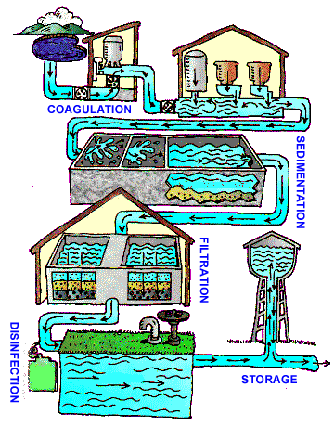
Drinking water treatment
Notes:
Modern drinking water treatment processes allow us to have the water we expect from our taps, but it is not without problems.
https://www.cdc.gov/healthywater/drinking/public/water_treatment.html

Slide 10
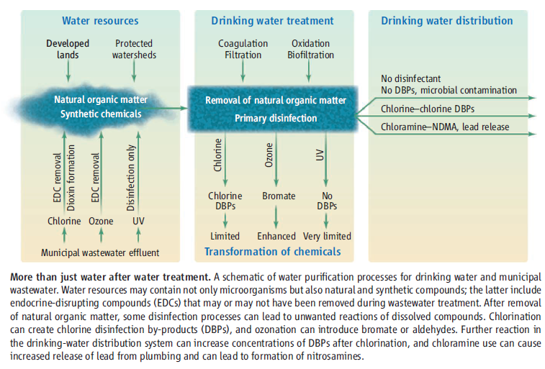
The chlorine dilemma
Sedlak, D and von Gunten, U.. Science 2011
Notes:
Notes on chloramine:
Chloramination is the process of disinfecting water using chloramines, compounds of chlorine and ammonia. 
The use of chloramines in the United States has evolved since the early 1900’s to become a very popular water treatment alternative – second only to the use of free chlorine.
 Chloramines offer a less aggressive disinfectant residual that reacts more slowly and remains longer in the distribution system. 
Given more stringent disinfection byproduct regulations, chloramination can be an appealing alternative to the use of free chlorine as a means of limiting DBP formation – especially THMs. 
Also of benefit, fewer taste and odor concerns are reported by consumers of chloraminated water.
For a drinking water utility, chloramination may or may not be a good alternative to free chlorination. 
The source water type and quality and the overall treatment process required to produce potable drinking water are primary factors to consider. 
Even with the full range of benefits provided by the use of chloramines, additional consideration must be given to the secondary impacts associated with chloramination – primarily the potential for nitrification within the distribution system.
With chloramination, an additional chemical must be purchased, stored, and applied to the process.  To form the preferred chloramine compound, the appropriate weight ratio of chlorine and ammonia must be determined and then carefully managed.  Free ammonia entering the distribution system must be limited to reduce the potential for nitrification.  Beyond that, it may be necessary to incorporate any number of steps to actively control nitrification.
Sedlak, David L., and Urs von Gunten. "The chlorine dilemma." Science 331.6013 (2011): 42-43.

Slide 11
Regulated substances
2009:
EPA update to list of water contaminants
Schroeder, M. History of drinking water: A fluid timeline. May 30, 2014
Notes:
Some substances are not removed from drinking water treatment.
Disinfection by-products
Anthropogenic chemicals accrue
https://www.epa.gov/ground-water-and-drinking-water/table-regulated-drinking-water-contaminants

Slide 12
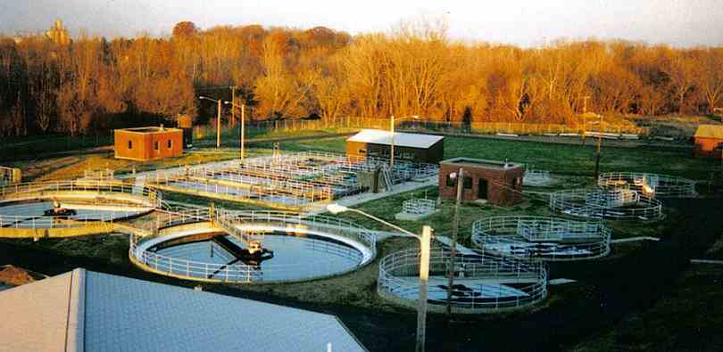
Wastewater treatment plant
Notes:
Now there are also regulations on wastewater treatment
www.epa.ohio.gov

Slide 13
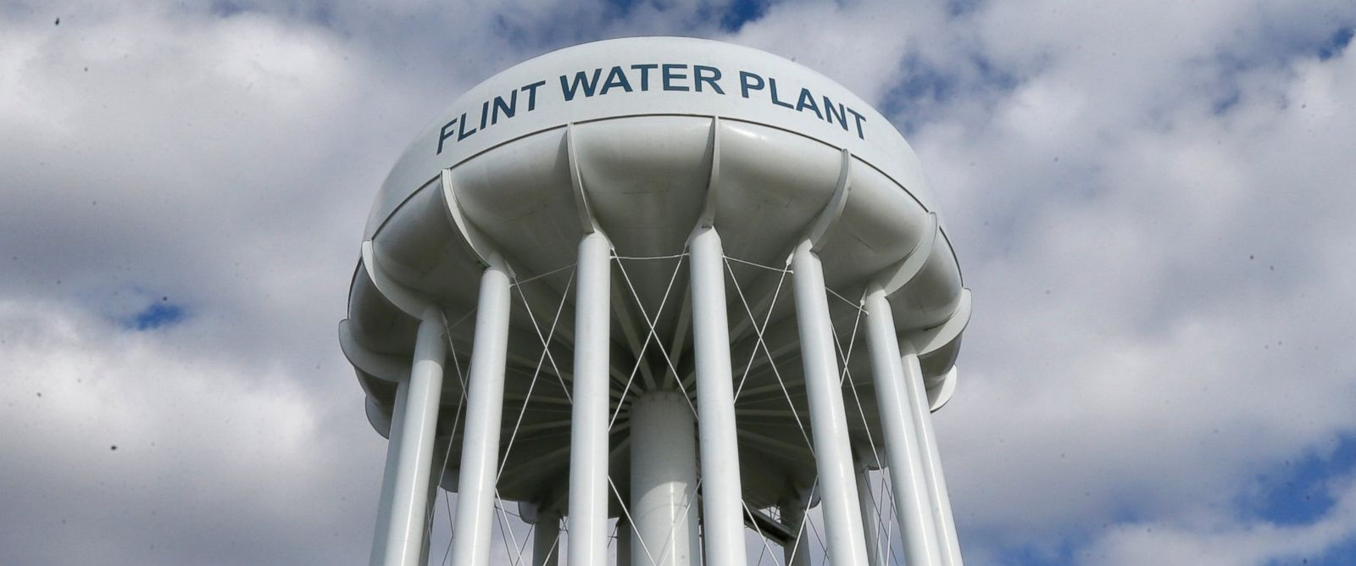
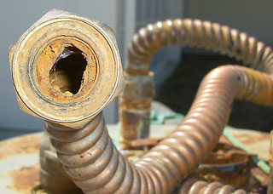
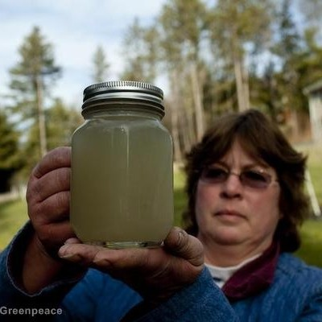
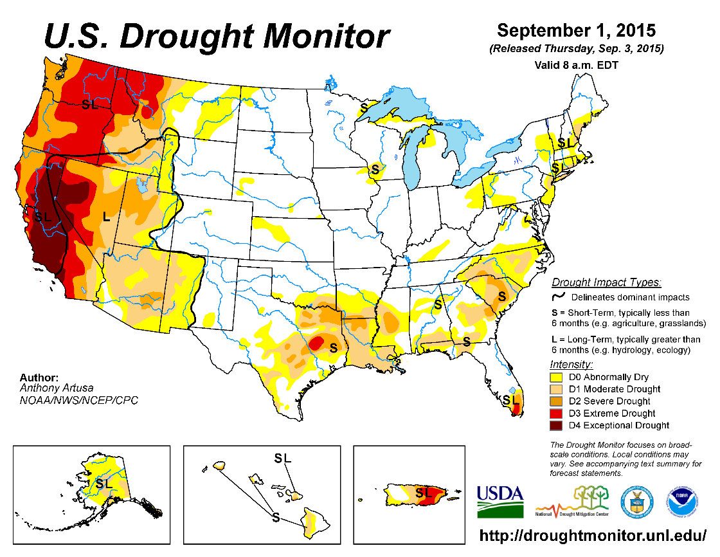
Our current needs
http://abcnews.go.com
Greenpeace.org

Slide 14
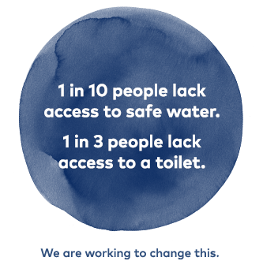
Global context
http://water.org/water-crisis/water-sanitation-facts/

Slide 15
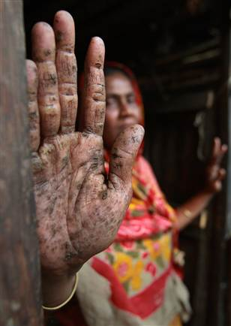
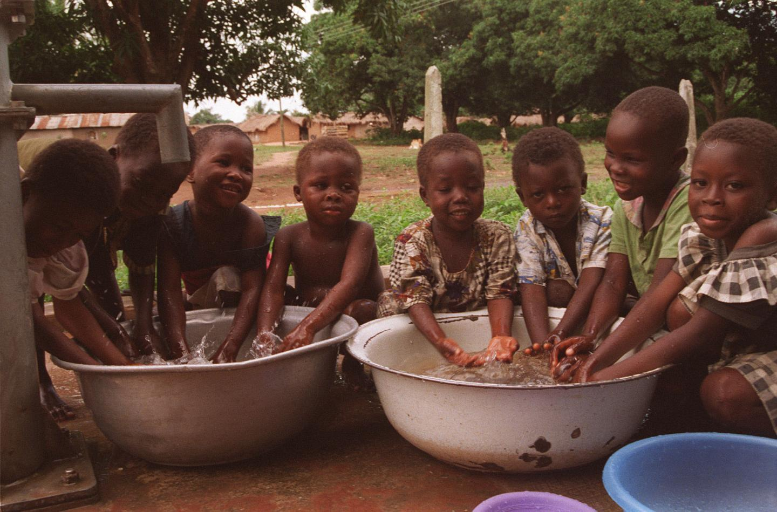
Developing world needs
Image credit: cnn.com; www.eurekalert.org
Notes:
Major points:
Poor access to water supply
Poor water resource management
Poor water productivity in the agricultural sector
884 million people in the world lack access to safe water supplies.
More than 840,000 people die each year from water-related disease.
Almost 2 in 3 people who need safe drinking water survive on less than $2 a day.
In many developing countries, millions of women spend several hours a day collecting water from distant, often polluted sources.
Every minute a child dies of a water-related disease.
Diarrhea caused by inadequate drinking water, sanitation, and hand hygiene kills an estimated 842,000 people every year globally, or approximately 2,300 people per day.
More than 1/2 of all primary schools in developing countries don't have adequate water facilities and nearly 2/3 lack adequate sanitation.
Clean water is one aspect of improving sustainable food production in order to reduce poverty and hunger.
More than 80% of sewage in developing countries is discharged untreated, polluting rivers, lakes and coastal areas.
By 2025, 1.8 billion people will be living in countries or regions with absolute water scarcity, and two-thirds of the world's population could be living under water stressed conditions.
Every $1 spent on water and sanitation generates $8 as a result of saved time, increased productivity and reduced health care costs.

Slide 16
Green Engineering and Water
As water demand increases and supplies become stressed, green engineering principles can be applied to find solutions
Ignoring the principles can lead to unintended consequences

Slide 17
Green Engineering Principles and water
Principle 8: Meet need, minimize excess (avoid one-size fits all solutions)
Principle 2: Prevention instead of treatment
Principle 11: Design for commercial “afterlife”
Principle 10: Integrate material & energy flows

Slide 18
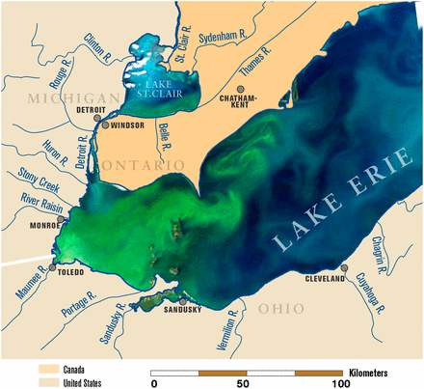
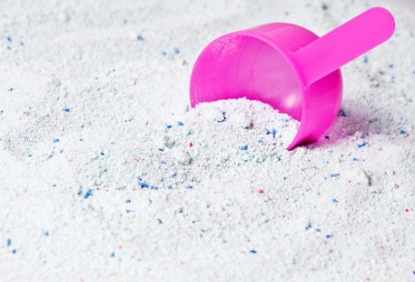
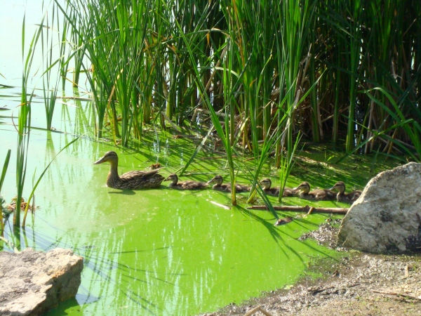
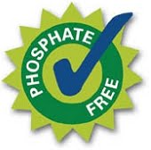
Principle 8: Meet need, minimize excess
Ignoring the principles:
Eutrophication from phosphate in water systems
Michalak , A. PNAS 2013
Boore L. National Geographic. Dec 19, 2014.
Notes:
Phosphates were added to detergents at high amounts to overcome the hardness in water. If they were not consumed then they would wash into surface water and lead to high PO4 levels and eutrophication.
Michalak, Anna M., et al. "Record-setting algal bloom in Lake Erie caused by agricultural and meteorological trends consistent with expected future conditions." Proceedings of the National Academy of Sciences 110.16 (2013): 6448-6452.
https://pubs.usgs.gov/wri/wri994007/pdf/wri99-4007.pdf:
Eutrophication became an issue in the United States during the late 1960’s when increasing inputs of phosphorus to the environment from phosphate detergent use and the agricultural application of fertilizer and manure caused an increasing incidence of cultural eutrophication among water bodies in the United States. A combination of phosphate detergent bans and controls on phosphorus in wastewater-treatment-plant effluent was used to combat this problem.
http://voices.nationalgeographic.com/2014/12/19/big-data-arrives-on-a-small-lake-in-vermont/

Slide 19
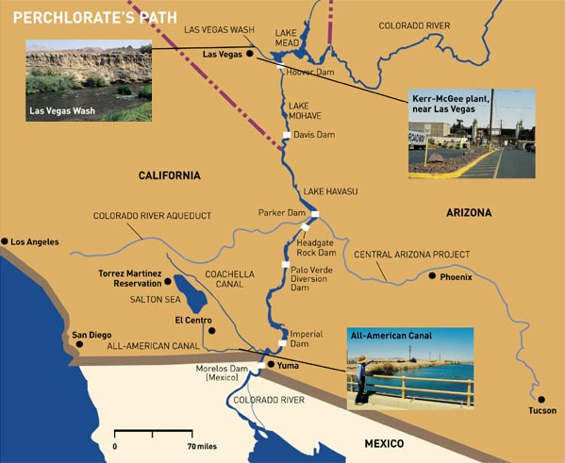
Principle 2: Prevention instead of treatment
Perchlorates in the Colorado River
Notes:
In 1997, the EPA first discovered perchlorate contamination in Nevada's water, hundreds of miles downstream from the Las Vegas area. At that time, as much as 1,000 pounds per day of perchlorate was entering Lake Mead and the Colorado River through contaminated groundwater. Lake Mead provides drinking water to residents of Southern Nevada. The contamination originated from two perchlorate-manufacturing facilities that had operated in the area up until the late 1990s. Cleanup activities are ongoing, and have reduced the perchlorate amount from 1,000 pounds per day to about 100. Cleanup activities are also underway at the only other known perchlorate site in Nevada, the former Rocketdyne Nevada Test Facility in Northern Nevada.
The highest levels of perchlorate contamination in EPA's Pacific Southwest region have been found in Henderson at the Kerr McGee Chemical Company (KMCC) in Henderson, Nevada, where prior owners/operators made perchlorate beginning in the early 1950s. Kerr McGee acquired the property in 1967 and continued perchlorate production until 1998. The contamination seeps from ground water into the Las Vegas Wash, Lake Mead and ultimately the Colorado River, affecting the drinking water supply of 15 to 20 million people in communities and tribal nations in Arizona, southern California and southern Nevada.
https://archive.epa.gov/region9/toxic/web/html/per_nv.html
Perchlorate can disrupt thyroid function by interfering with the uptake of iodine. Particularly vulnerable to effects of perchlorate exposure are developing fetuses and newborns, whose nervous systems are at risk, and people with hypothyroidism--their thyroids don't produce enough hormones for normal body functions. -- http://pubs.acs.org/cen/coverstory/8133/8133perchlorates.html
PERCHLORATE SALTS are used to provide oxygen so solid rocket fuel can burn. They are used in rockets and Minuteman missiles. These salts are also found in roadside flares and airbag inflators and are used in the manufacture of matches. And perchlorates are highly soluble in water
Perchlorates are persistent and it is estimated it will take more than 20 years to clean up the contamination

Slide 20
Combined Sewer Overflow
Notes:
Issues with infrastructure
https://www3.epa.gov/caddis/ssr_urb_ww2.html

Slide 21
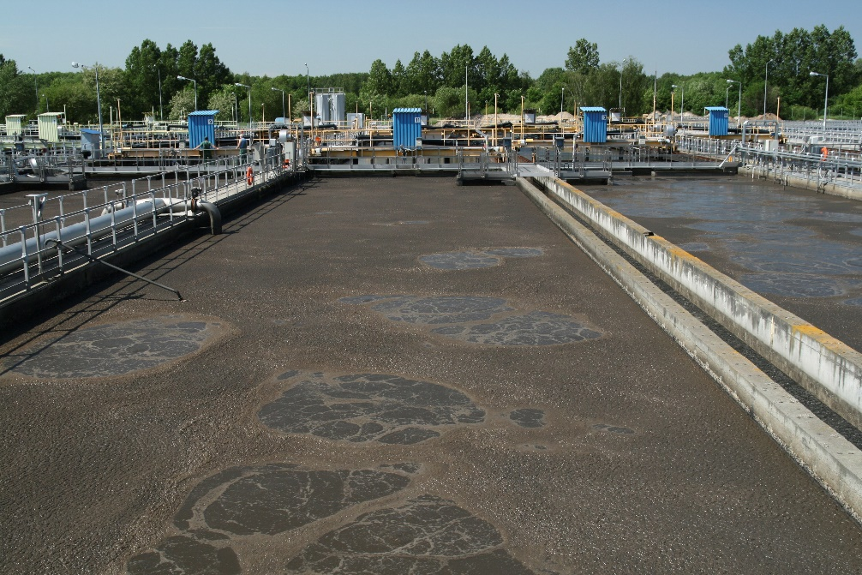
Principle 11: Design for commercial “afterlife”
Sewage farms in Paris on Seine River (1890’s)
Sedlak, D. Water 4.0. 2014
Notes:
Sewage contains nutrients

Slide 22
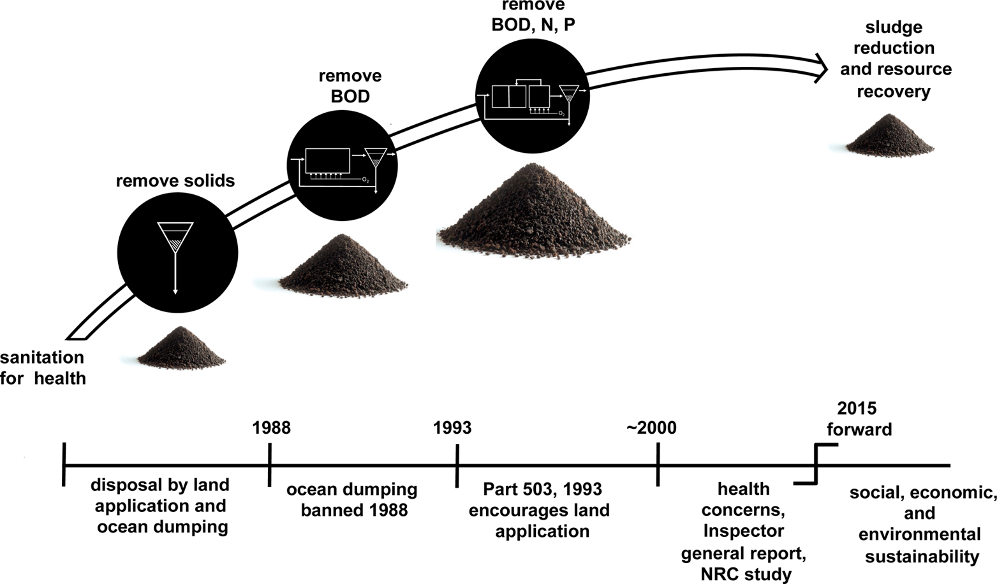
Sewage sludge over time
Peccia and Westerhoff..ES&T 2015
Notes:
Peccia, Jordan, and Paul Westerhoff. "We should expect more out of our sewage sludge." Environmental science & technology 49.14 (2015): 8271-8276.

Slide 23
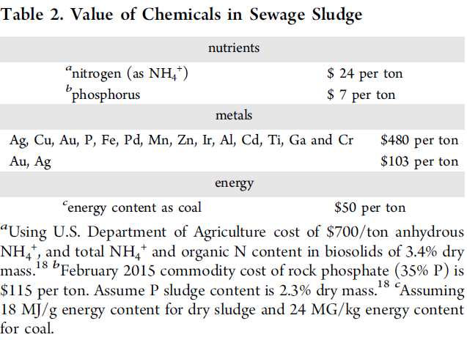
Value recovery from sludge
Peccia and Westerhoff..ES&T 2015
Notes:
Peccia, Jordan, and Paul Westerhoff. "We should expect more out of our sewage sludge." Environmental science & technology 49.14 (2015): 8271-8276.

Slide 24
Principle 10: Integrate material & energy flows
Anaerobic digetsion
Notes:
https://www.americanbiogascouncil.org/pdf/briefing15may12_nacwa.pdf

Slide 25
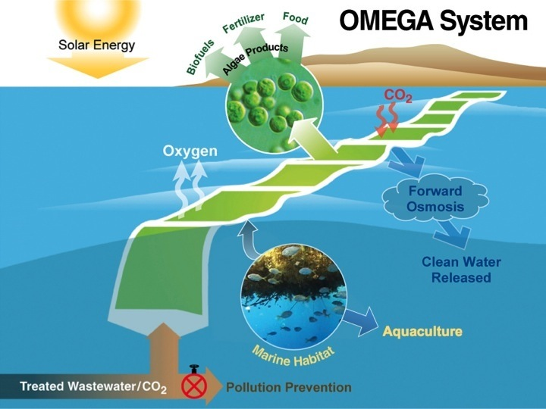
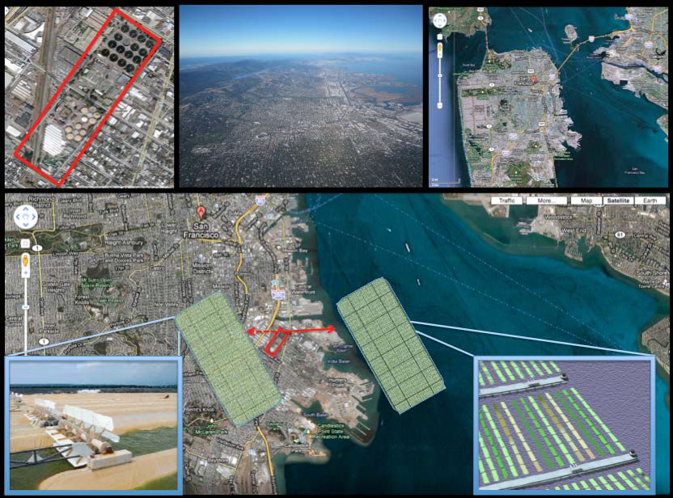
Principle 10: Integrate material & energy flows
NASA Omega
Trent 2012: NASA OMEGA Final Project Report

Slide 26
Problems with our water infrastructure
Treatment
Disinfection by-products
New contaminants
Delivery
Corroding infrastructure
Developed vs. developing countries
Supply
Drought and flooding

Slide 27
Water Reuse
Example: Aqus Greywater system
Notes:
Greywater is the wastewater from, sinks, dishwashers, showers, hand basins, baths, and washing machines, and contains fats, oils, harmful chemicals, bleaches and germs that affect human health. Untreated greywater can have impacts on water quality and public health through high bacterial loads, nutrient discharge, biological oxygen demand and salinity impacts. Untreated greywater can turn septic if left untreated, in less than 24 hours.
http://www.epa.sa.gov.au/environmental_info/water_quality/programs/grey_and_black_water_discharge/grey_water

Slide 28
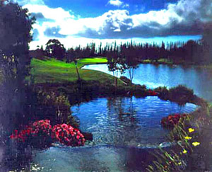
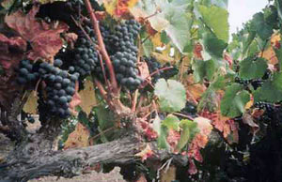
Grey Water Application
Notes:
The Experience at Koele Golf Course, on the Island of Lanai, has used recycled water for irrigation since 1994. The pond shown is recycled water, as is all the water used to irrigate this world-class golf course in the state of Hawaii.
Recycled water has been used for a number of years to irrigate vineyards at California wineries, and this use is growing. Recently, Gallo Wineries and the City of Santa Rosa completed facilities for the irrigation of 350 acres of vineyards with recycled water from the Santa Rosa Subregional Water Reclamation System
https://www3.epa.gov/region9/water/recycling/

Slide 29
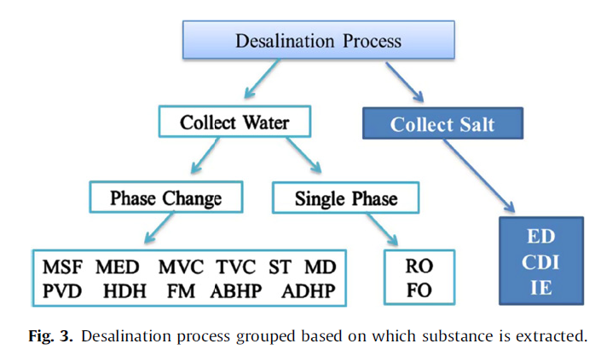
Treatment: Desalination
Chennan, L. Renew Sustain E Rev. 2013
Notes:
Li, Chennan, Yogi Goswami, and Elias Stefanakos. "Solar assisted sea water desalination: A review." Renewable and Sustainable Energy Reviews 19 (2013): 136-163.

Slide 30
Why desalination?
Werber, J. Nat. Rev. Mat. 1. 2016
Notes:
Werber, Jay R., Chinedum O. Osuji, and Menachem Elimelech. "Materials for next-generation desalination and water purification membranes." Nature Reviews Materials 1 (2016): 16018.

Slide 31
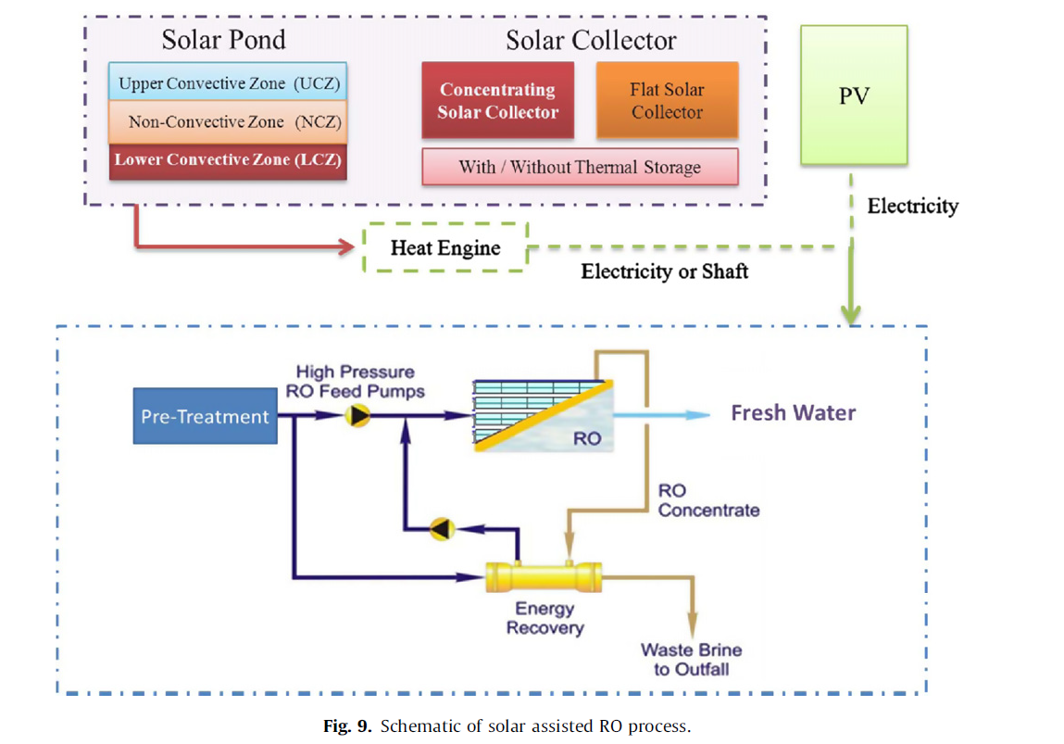
Energy requirements?

Slide 32
Summary
Water is an essential resource
Ignoring sustainability has caused many historical water problems
Following green engineering has helped to develop solutions
Water stress will require new solutions for growing problems
The principles of green engineering may help to make sure these solutions are sustainable

