Slide 1
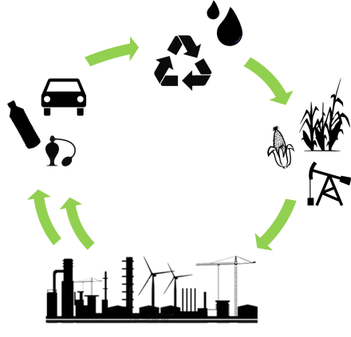
The Engineering Grand Challenges and Green Engineering
February 1, 2017
Notes:
Welcome to the course! Please feel free to use the following slides. The figures have mostly been taken from public sites and published articles with citations included (the full citation is typically provided in the notes section). Please feel free to contact me if you have questions. In the notes section of each slide are the major talking points that I use for each slide. Modify as you see fit but they are there so that you can see the progression between the slides. I would also love to hear from you with regards to updates/additions that you think are particularly helpful.

Slide 2
The Grand Challenges for Engineering
Notes:
Developed by the National Academy of Engineering
Recognized as global challenges that span multiple disciplines
Many are naturally aligned with designing a sustainable future (energy, resources, health, security) but others can be done and can enable a better quality future quality of life.
How do we tackle these challenges sustainably?

Slide 3
Sustainability
“The development which meets the needs of current generations without compromising the ability of future generations to meet their own needs”
-- Brundtland Commission Report (1987)
Notes:
First we need to define sustainability:
Typically ask the students to come up with their own definition before provide this one from the Brundtland report (WORLD COMMISSION ON ENVRIONMENT AND DEVELOPMENT)

Slide 4
Sustainability: Working Definition
the design of human and industrial systems to
ensure that mankind’s use of natural resources
and cycles do not lead to diminished quality of life due either to losses in future economic
opportunities or to adverse impacts on social
conditions, human health, and the environment
Mihelcic, et al. ES&T 2013
Notes:
A more specific definition that can help to frame the course in the context of the grand challenges
Point out connections to people, prosperity, and planet
Source: J.R. Mihelcic, J.C. Crittenden, M.J. Small, D.R. Shonnard, D.R. Hokanson, Q. Zhang, H. Chen, S.A. Sorby, V.U. James, J.W. Sutherland, J.L. Schnoor, “Sustsainability Science and Engineering: The Emergence of a New Metadiscipline” Env. Sci. Tech. 2003, 37, 5314-5324.

Slide 5
The Triple Bottom Line
Planet
Sustainability
People
Prosperity
Notes:
At the intersection of these lies a sustainable future
This framework was defined through accounting to make sure that solutions not only provided an economic incentive but also took into account ethical considerations with regard to social and environmental outcomes.
Next: Let’s take a look at each of these three factors, how they are changing, and how they are interconnected

Slide 6
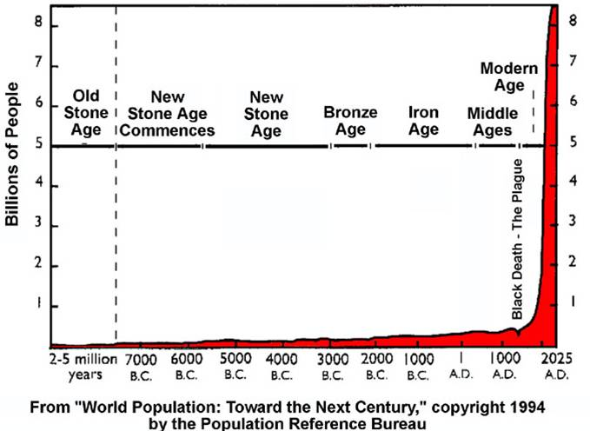
World Population Growth Through History
Notes:
World population is growing exponentially and expected to reach upwards of 9-10 billion people (2017: 7.5 billion people)

Slide 7
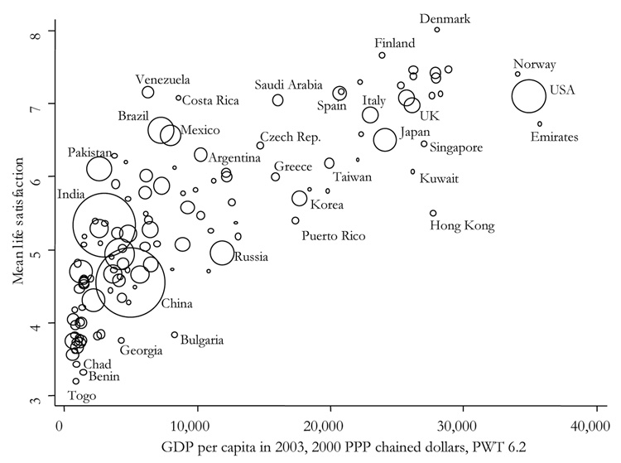
People and prosperity
Deaton, A. J Econ Perspectives. 2008
Notes:
As the number of people increase, those people need to have resources in order to survive and thrive.
This figure links life satisfaction with the gross domestic product per capita
The data is taken from surveys about life satisfaction and health
The size of the bubble corresponds to the country’s population
Is there a threshold level of wealth that corresponds to sufficient life satisfaction – next plot on log scale
Source: Deaton, Angus. “Income, Health and Wellbeing Around the World: Evidence from the Gallup World Poll.” The journal of economic perspectives : a journal of the American Economic Association 22.2 (2008): 53–72. PMC. Web. 27 Dec. 2016.

Slide 8
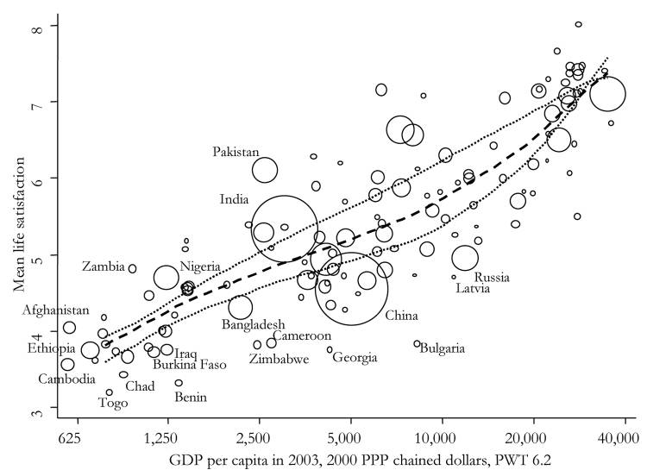
People and prosperity (log scale)
Deaton, A. J Econ Perspectives. 2008
Notes:
Looking at the same data on a log scale shows even more closely, the linkage between GDP and life satisfaction.
Unanswerable questions: what is enough?
As developing countries try to improve their life satisfaction, they must increase their GDP

Slide 9
People and Prosperity
Tilman and Clark. Nature. 2014
Notes:
One measure of health is how many and what type of calories that a population has access to.
As GDP increases, diets are changing. Namely, one eats more protein and takes in more calories.
In order to produce more food and protein rich foods, this has a toll on the environment
Source: Tilman, David, and Michael Clark. "Global diets link environmental sustainability and human health." Nature 515.7528 (2014): 518-522.:
Caption: Dependence of per capita daily dietary demand for: a, meat protein; b, refined sugars+refined animal fats+oils+alcohol; and c, calories on per capita gross domestic product (GDP measured in 1990 International Dollars). Each point is an annual datum for 1961 to 2009 for India, China, and six economic groups containing 98 other nations (Extended Data Table 4). Fitted curves were used to forecast 2050 income-dependent demand.

Slide 10
People and Planet
Tilman and Clark. Nature. 2014
Notes:
Traditional sources of protein consume a lot of resources that lead to high greenhouse gas emissions (CO2, methane, etc)
This is just one example of how people and planet is linked but we must also think about other aspects
Figure caption:
Caption: The data are based on an analysis of 555 food production systems: a, per kilocalorie; b, per United States Department of Agriculture (USDA)-defined serving; c, per gram of protein. The mean and s.e.m. are shown for each case. Extended Data Tables 1, 2, 3 list data sources, items included in each of the 22 food types and show the mean, s.e.m. and number of data points for each bar, respectively. NA, not applicable.
Source: Tilman, David, and Michael Clark. "Global diets link environmental sustainability and human health." Nature 515.7528 (2014): 518-522.

Slide 11
What else do we need?
Energy
Food
Water
Land?
Transportation?
Air?
Environment?
Medicines?
Health?
epa.gov
Notes:
Ask: what else do you need to live and how would that effect this equation?
Food, Energy, and Water are connected, but what else do we need?
Not only do we need to think about the impact of individual items, we need to think about their systematic/ life cycle impact

Slide 12
Green Engineering
Design, commercialization, and use of processes and products that are feasible and economical while minimizing:
Risk to human health and the environment
Generation of pollution at the source
US EPA, OPPT, Chemical Engineering Branch, Green Engineering Program
Notes:
In considering ways to address the growing people, with growing needs, we can use the tools of green engineering
What is the definition of green engineering

Slide 13
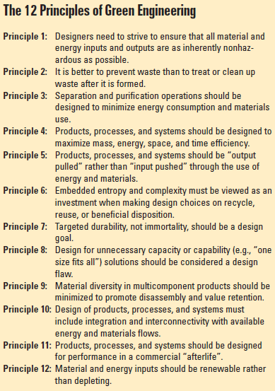
Green engineering
Anastas and Zimmerman. ES&T 2003
Notes:
Originally published in 2003, the principles of green engineering provide general design guidelines to try to minimize impact
Anastas, Paul T., and Julie B. Zimmerman. "Peer reviewed: design through the 12 principles of green engineering." Environmental science & technology 37.5 (2003): 94A-101A.

Slide 14
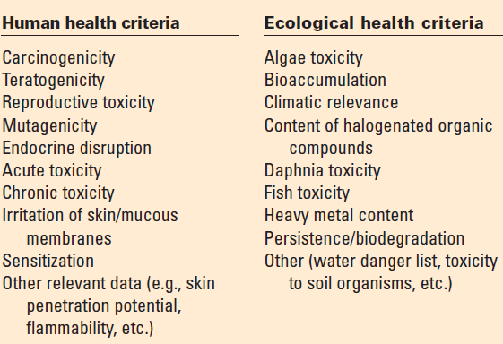
Cradle-to-cradle design
Parameters for McDonough Braungart Design Chemistry’s materials assessment protocol
Notes:
In order to determine if a solution is sustainable we need to consider certain metrics.
Other frameworks also seek to design human systems to eliminate conflicts between economic growth and environmental health.
For example the cradle to cradle design framework considers numerous environmental enpoints which also align with the grand challenges
Source: McDonough, William, et al. "Peer reviewed: Applying the principles of green engineering to cradle-to-cradle design." (2003): 434A-441A.

Slide 15
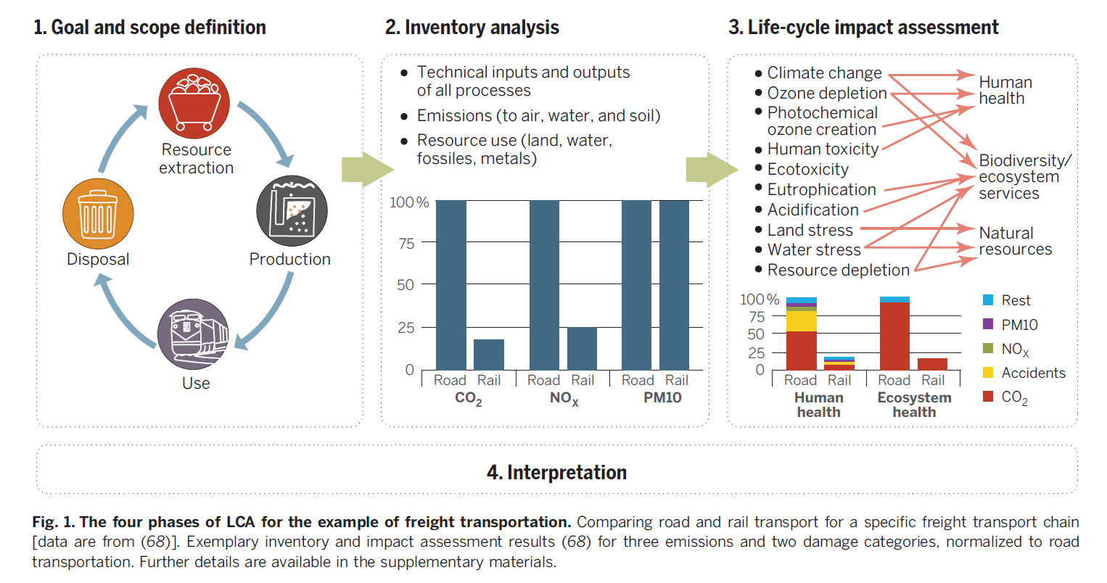
Life Cycle Assessment
Hellweg and Canals. Science 2014
Notes:
In order to quantify the impacts, a systems perspective must be used to apply the 12 principles. LCA is useful for determining better alternatives and finding gaps and places to innovate.
Hellweg, Stefanie, and Llorenç Milà i Canals. "Emerging approaches, challenges and opportunities in life cycle assessment." Science 344.6188 (2014): 1109-1113.

Slide 16
Case studies
Energy
Water
Pharmaceuticals
Notes:
In this class we will explore how the principles of green engineering apply to some of the grand challenges. We will see how each principle applies in various case studies having to do with energy, water, and pharmaceuticals.

Slide 17
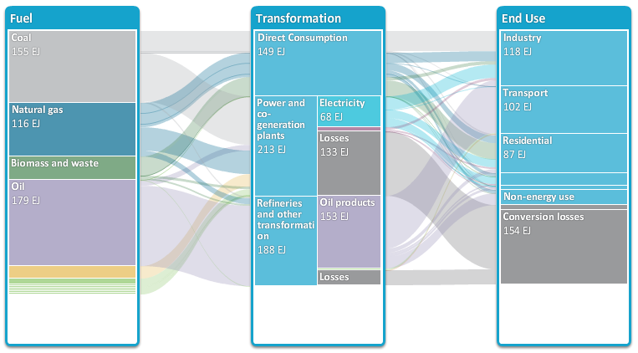
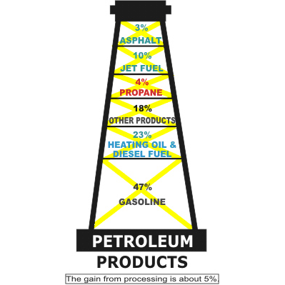
Energy
Principle 4: Maximize mass, energy, space, time efficiency
Principle 12: Renewable rather than depleting
Principle 7: Targeted durability
Principle 6: Conserve complexity
Source: IEA Energy Technology Perspectives
Notes:
Specifically, we will look at innovations in the energy sector for both traditional and alternative energy technologies, and what

Slide 18
Water
Principle 8: Meet need, minimize excess (avoid one-size fits all solutions)
Principle 2: Prevention instead of treatment
Principle 11: Design for commercial “afterlife”
Principle 10: Integrate material & energy flows
Notes:
We will also explore the history of water, a vital resource, and see how the principles apply to providing and utilizing water.

Slide 19
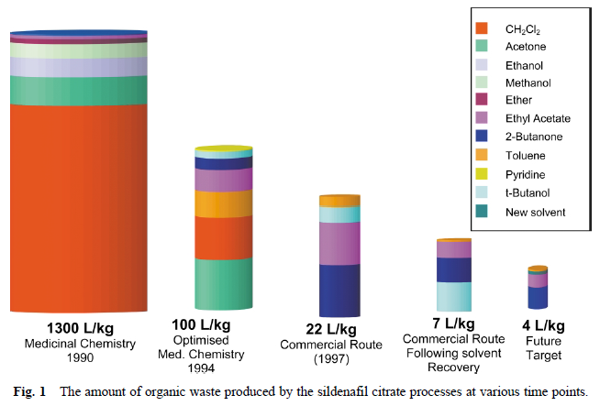
Pharmaceuticals
Principle 3: Design for separation
Principle 9: Minimize material diversity
Principle 1: Inherent rather than circumstantial
Principle 5: “Output-pulled” rather than “input-pushed”
Notes:
In the pharma industry, one of the most inherently wasteful industries we will also explore how green engineering decreases waste production. We will focus on the application of green solvents and how this emerging field can/has made an impact.

Slide 20
Syllabus and course format
Week | Topic | Deliverables
1 | Administration
2 | Introduction
3 | Energy
4 | Water – Chose Groups and Tentative Topics
5 | Brainstorming and Project Topics
6 | Pharmaceuticals | Project Outline
7 | Discussion/Guest lecture
8 | Team meetings | Project Update 1
9 | Discussion/Guest lecture
10 | Team meetings | Project Update 2
11 | Discussion/Guest lecture
12 | Team meetings | Project Update 3
13 | Team meetings
14 | Final Presentations | Final Report

