Slide 1
INVESTMENT CLUB
October 28th, 2016

Slide 2
Agenda
Market Update
Amazon vs Netflix
Interview Question
Announcements

Slide 3
Market Update 10/28
Kat Stevens and Kevin Albagli

Slide 4
Market Overview
DOW: 18237(-.115%)
S&P 500: 2139(-.696%)
Nasdaq: 5231(-1.36%)
Russell 2000:1194
(-2.85%)
10 Year: 1.850%(+.11%)
Oil: $49.47 (-$1.20)
Gold: $1273(+.474%)
WSJ dollar index: 88.86
(+.373%)

Slide 5
Economic Releases
PMI Manufacturing flash: 53.2 (51.4 September)
New Home Sales: 593k (575k August)
Jobless Claims: 258k (261k prior week)
GDP report 3rd quarter: 2.9% yoy (1.4% Q2)

Slide 6
In The News
FOMC meeting Nov 1-2
Austria issues 70 year bond (1.53% yield)
Note: US 30 yr. 2.60%
Opec meeting Nov 30th,
U.S Presidential Election in under two weeks

Slide 7
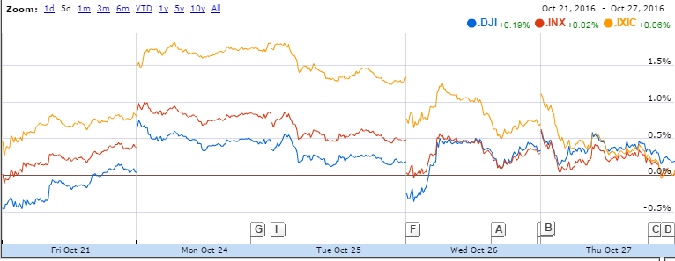
Benchmarks’ Reaction

Slide 8
Big Things in Earnings
Tesla: Finally broke positive after 12 straight quarters of negative profits
Under Armour: Beat earnings estimates, but share price dropped 13% after expected growth for 2017 significantly dropped
Apple: Decline in revenue and profit, slumped after hours, affected S&P 500 and Nasdaq (market-capitalization weighted)

Slide 9
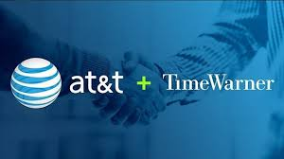
AT&T and Time Warner Get Cozy
AT&T buying Time Warner for $85.4 billion
Slowing wireless subscriber growth→ increasing value per user instead of users
Bought DirecTV last year, Time Warner provides content (CNN, TNT, HBO)
Hurdles: 1) Political: Trump vowed to block the deal, Clinton is under pressure to be more aggressive
2) DoJ: AT&T has content and distribution, but Comcast acquired NBCUniversal in 2011 in a similar deal
3) FCC: Could direct a deal to the Administrative Law Judge, almost no deals survive the ALJ process

Slide 10
AMAZON VS NETFLIX
Battle of the Stocks III - Return of the Stocks

Slide 11
Battle of the Stocks: Amazon.com Inc (AMZN)
Buy: 6 Shares @$781.90
Anna Evinski and Kameliya Yordanova

Slide 12
Company Breakdown
3 Pillars:
Amazon marketplace
Amazon Prime
Amazon Web Services (AWS)

Slide 13
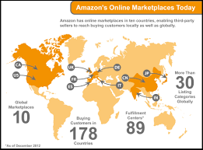
Amazon marketplace
E-commerce platform allowing sellers to sell new and used items next to Amazon.com’s regular items
Allows Amazon expand customer base without investing more inventory, but Amazon guarantees the products sold on its site
Marketplace uses Amazon’s software infrastructure to charge buyer’s credit card but not send any personal information to seller
Available over 60 countries
3rd party sellers 40% ($40 bill) Amazon’s annual sales

Slide 14
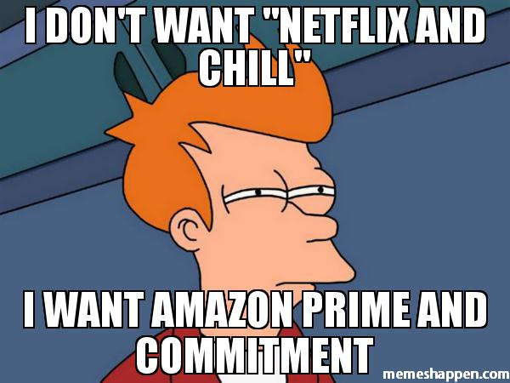
Amazon Prime
Customers get free 2-day delivery on specific items
Prime items has grown from 1 million to 30 million since Prime’s founding
Prime Video: exclusive content from Amazon, Amazon video won 6 Emmys
Although there will always be “computers are too complicated” individuals, with memberships like Prime, creates customer loyalty to a “club”
Additionally, the digital age is the future
“Need fresh strawberries for the dinner party in an hour? The preparer could order them without stepping out of the house” -informationweek.com

Slide 15
Amazon Web Services (AWS)
AWS offers cloud services, where anyone can store data, photos, you name it
Most profitable Amazon business $861 million operating income (55% year-over-year growth)
Currently laying foundation for the future of cloud so in years to come, other companies won’t be able to compare to Amazon
After Netflix’s extreme hardware failure in 2008, the company turned to Amazon’s cloud services to house data (everything from Netflix’s video player to their billing and payments are housed in Amazon’s cloud)
“Starting at the end of this summer [2016], Netflix will fully reside in Amazon's data centers in the cloud, as well as some ISP facilities, and the Internet exchange points that facilitate speedy Internet traffic” -informationweek.com

Slide 16
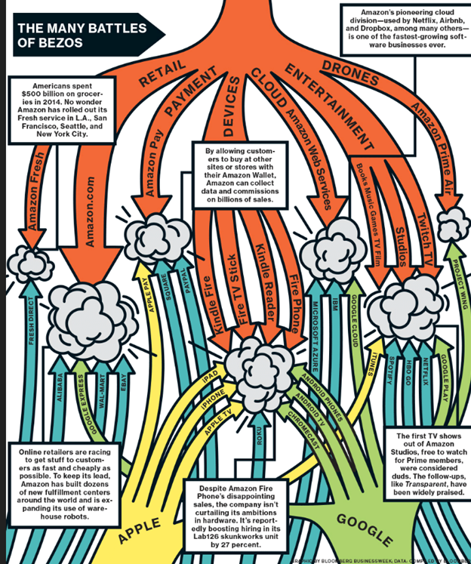

Slide 17
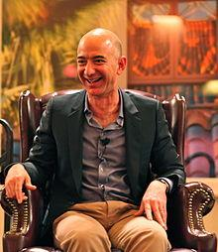
CEO
Jeff Bezos founder, Chairman & CEO
Net worth $71 billion, founded Amazon in 1994, Bezos one of Google’s first investors
Corporate office headquarters in Seattle, WA
Amazon now grown to world’s largest online shopping retailer
Other than Amazon Marketplace, AWS cloud unit, and Amazon Prime, Bezos looking to add fourth unit to business, perhaps expanding video streaming capabilities

Slide 18
Amazon Third Quarter Earnings and Forward Guidance
EPS (earnings per share): $0.52 vs. analyst estimate $0.78 per share
Revenue: $32.7 billion vs. analyst estimate $32.69 billion
AWS (revenue): $3.23 billion vs. analyst estimate $3.13 billion
Net Income: $252 million, lower than past 3 quarters
Q4FY2016 Guidance: Net sales expected to be between $42-$45.5 billion (17-27% growth)

Slide 19
Financial Statistics
Beta (measure systematic risk aka volatility compared to mkt. as whole, beta >1 means more volatile stock): 1.60
Market Capitalization (company’s shares outstanding x current mkt. price one share): 387.96B
Current Price (of stock): $781.90
PE (current share price/earnings per-share): 194.57
Price to Book (mkt. value aka stock price to book value): 28.80
Target Estimate: 920.02

Slide 20
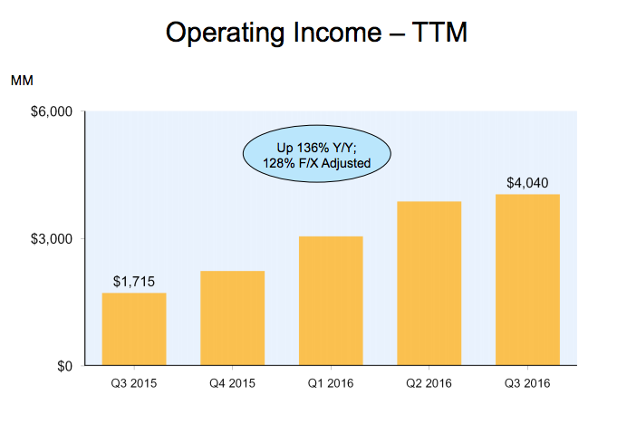
Operating income is main metric we use to evaluate company’s profit realized from business operations after deducting operating expenses

Slide 21
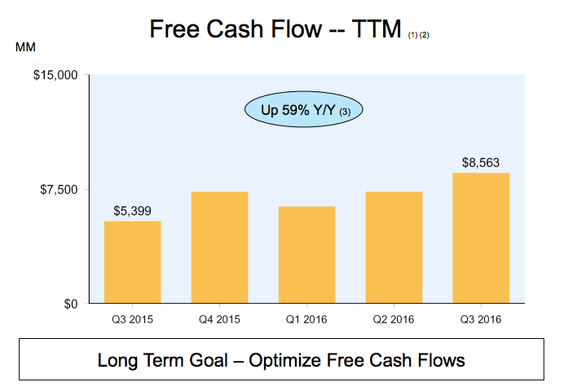
Free Cash Flow: measures a company’s financial performance, meaning operating cash flow minus capital expenditures

Slide 22
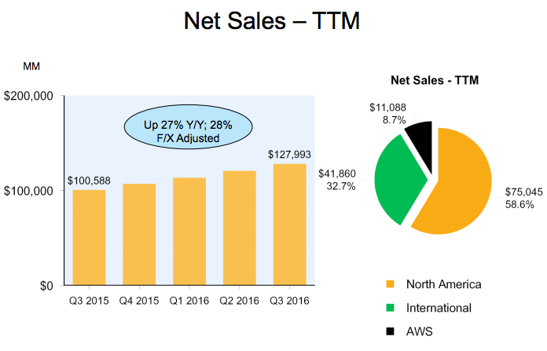

Slide 23
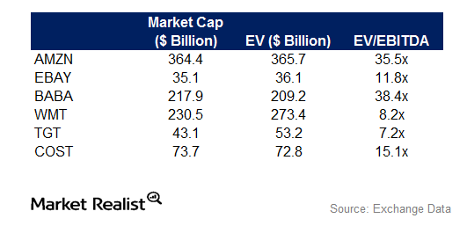
EV(enterprise value)/EBITDA(earnings before investment, taxes, depreciation, amortization) good measure for operating income, which is arguably the most important way to realize company’s profit, higher is better

Slide 24
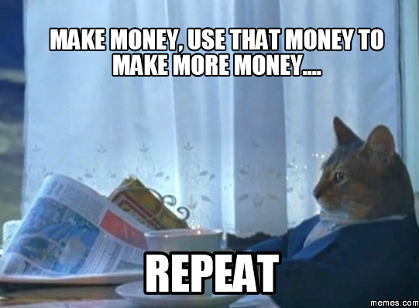
Great Company, Why Don’t They Make Any Money?
Jeff Bezos has one goal: make Amazon a worldwide conglomerate (Bezos has been able to achieve ½ goals he outlined back in 1997)
Sell products at cost or below continuing on path of revenue growth and starting on way to profitability
High revenue growth everyone expects earnings report and EPS to be great but every report they fall short (last time stock dropped 15%
Willing to do what’s necessary to accomplish their goal--lay off employees to expand cloud

Slide 25
Stock Split
Amazon grows organically (no buyback), increased stock price (not because of buyback)
Stock split: company increases number of shares outstanding.
Value of each individual share falls to keep the company's overall value constant
Amazon's has yet to announce plans for stock split, although likely this will happen in the near future (it has done it in the past)
Advantages:
1) Allow for more retail investors to participate
2) Help facilitate Amazon's addition to the Dow Jones Industrial Average (fulfills all criteria except for price)
3) Potentially increase demand for stock, increasing shares (ex: Apple 2014 - shares have risen ~15%)

Slide 26
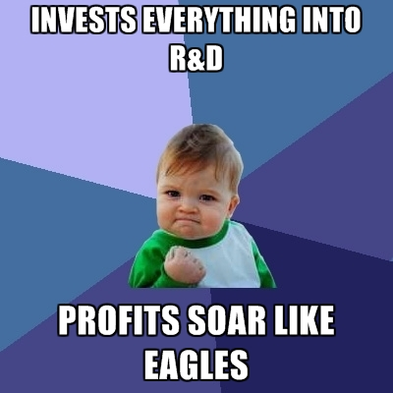
Research & Development
June 30, 2016: 3.88B (eBay: 2.88M, Alibaba 610.37M)
“RCE Residual Cash Earnings measure calculated as cash generated by business less a charge that reflects expected return of the shareholders and lenders for the use of the company’s capital” -Fortuna Advisors
Basically RCE great for tech bc/ captures growth profitability and asset efficiency
Amazon’s RCE improvement over last three year period was in 98% for tech companies, outshining almost every tech company at 300% more growth per dollar of reinvestment
Not only are growing constantly but making great decisions in what they’re growing in

Slide 27
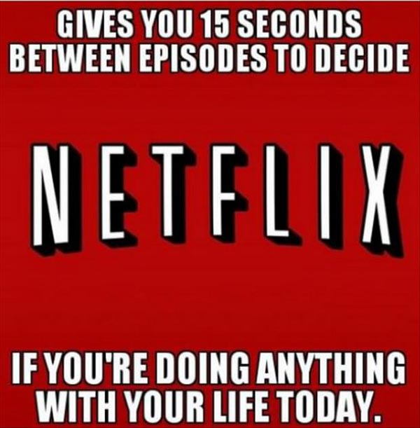
Netflix
Netflix model: continue to be subscription based company business has its limits, original content and use that to grow, buys out content from domestic companies generate their own content
True that every quarter they surprise
Example: Apple fears can’t be innovative anymore, eventually sell iPhones to everyone around the world, no more market
Netflix Time Warner Cable and AT&T, how are you going to compare?
Amazon=productivity=future

Slide 28
Buy 36 Shares @ $128.47
Heman Matharu & Michael Frohwein

Slide 29
Company Background
Main segments are global video streaming, and domestic DVD renting in the US
Revenues are derived from a monthly membership fee ($8, $10, or $12)
Streaming library includes licensed video and Netflix's original programming
Netflix is releasing an estimated 126 original content in 2016; more than any other company
Available worldwide (except for Mainland China, Crimea, North Korea and Syria)

Slide 30
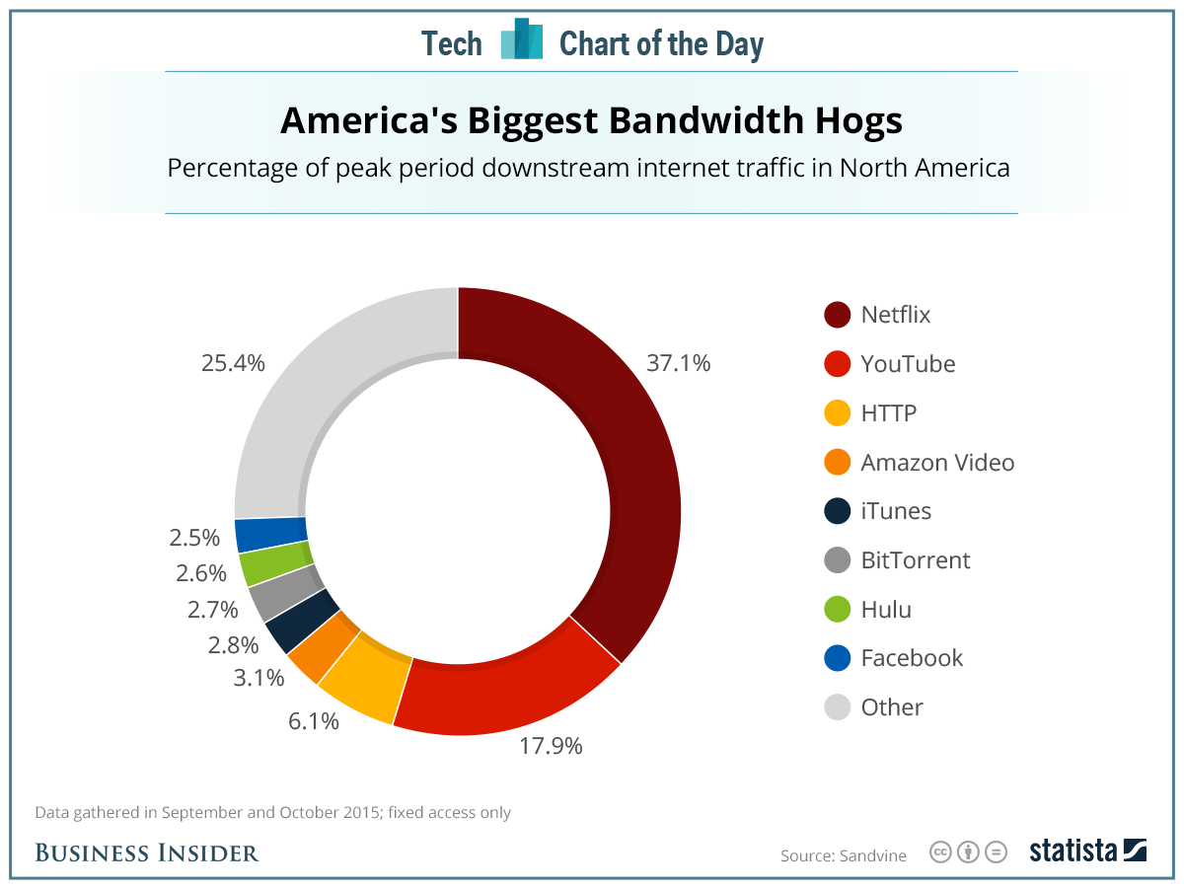

Slide 31
Company Background
$54 billion market cap; P/E of 343.34
Current market value of $128.47
2.29 billion in revenue and 52 million in net income for Q3
47.5 Million paid members (expected to grow by 1.2 million in Q4)
30% increase in revenue Y/Y
Projected 80% increase in net income in 2016

Slide 32
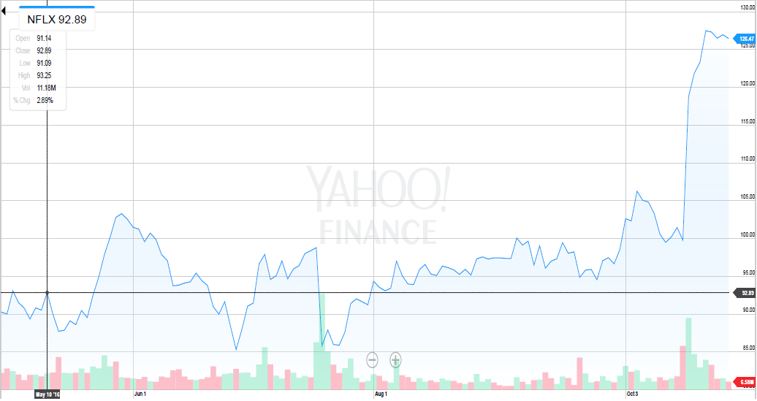
Stock Price (3 months)

Slide 33
Investment Thesis
Netflix is seeing rapid growth in its international streaming business; 50% year to year
It is increasing its investment in original production, which has already shown to be very successful
The company isn't susceptible to a potential recession - people will still spend money to watch videos

Slide 34
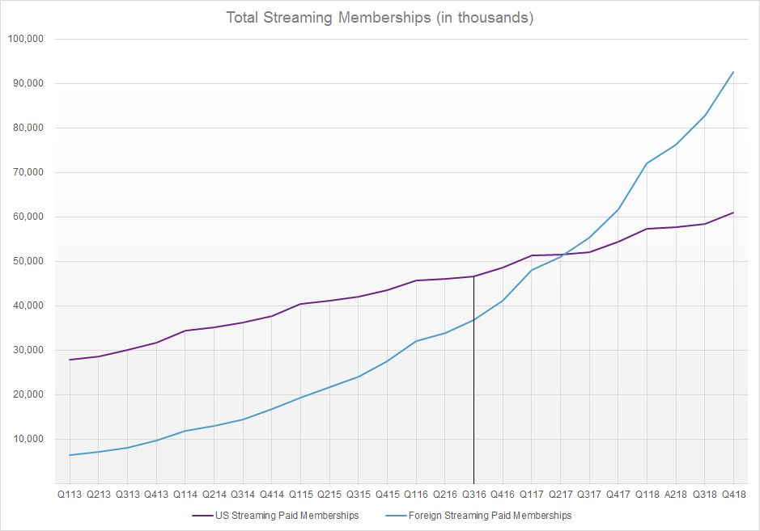

Slide 35
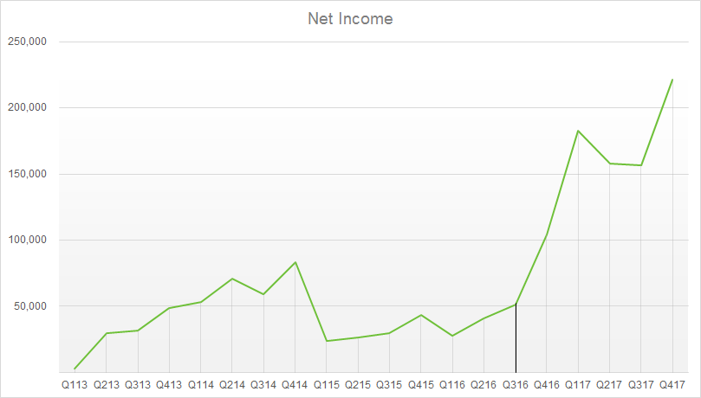
(In Thousands)

Slide 36
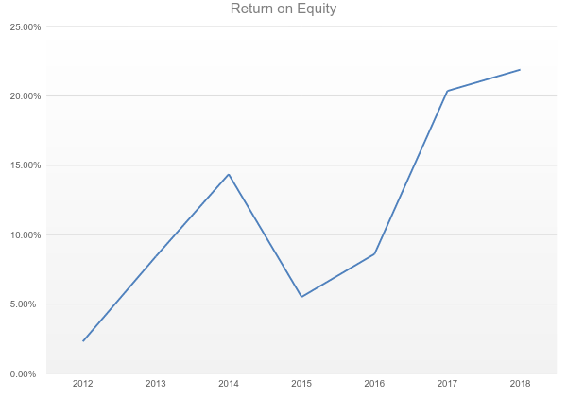

Slide 37
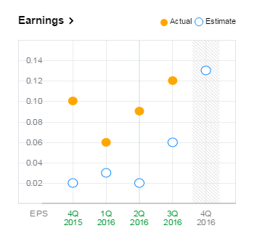
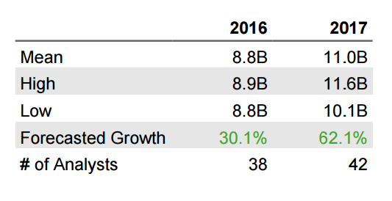
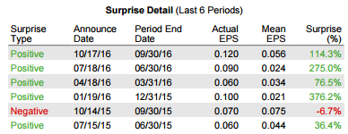

Slide 38
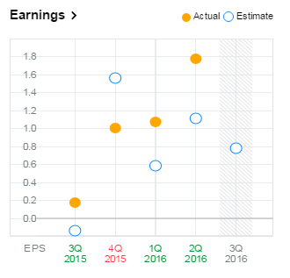
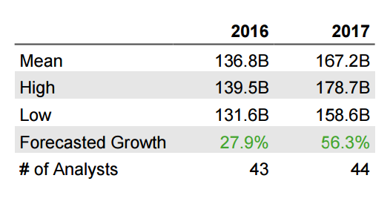
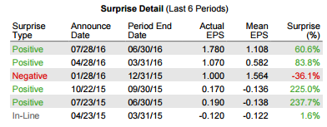

Slide 39
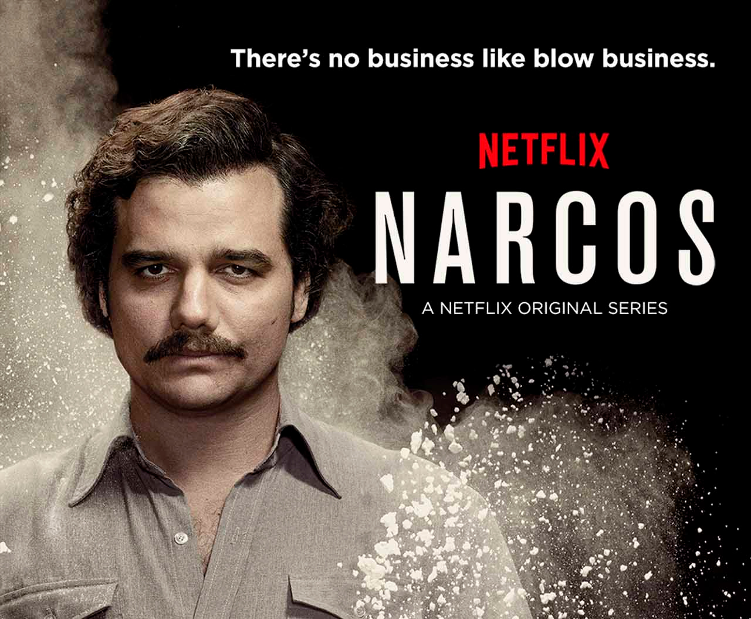
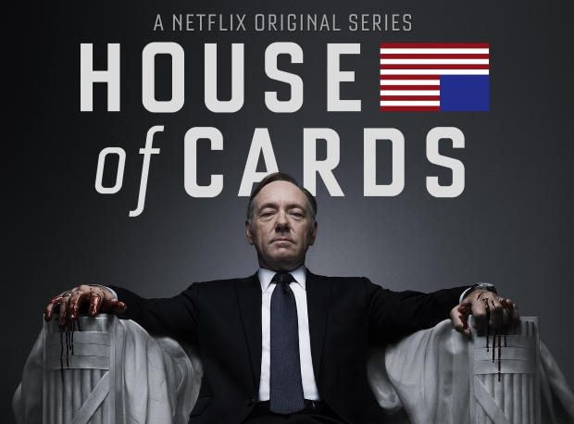
Netflix Original Shows
Has won 14 emmys from 75 nominations from shows such as:
House of Cards
Orange is the New Black
Stranger Things
Jessica Jones
Luke Cage
Daredevil
Making a Murder
Bo Jack Horseman
Narcos
Arrested Development

Slide 40
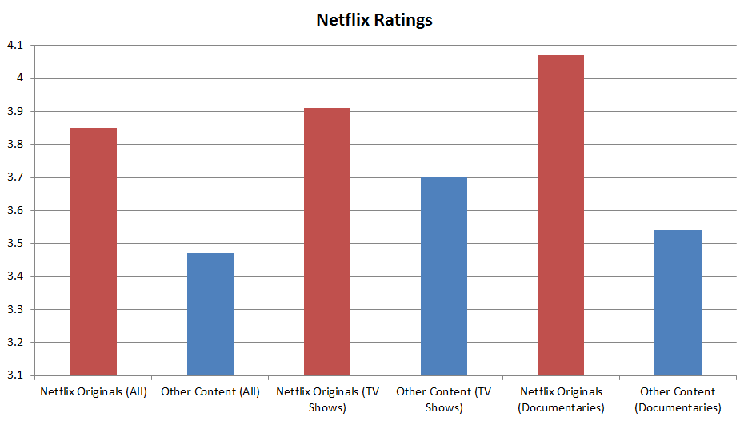

Slide 41
Why Amazon isn't as great
Missed earning estimates for the last quarter by 33%; lowered Q4 revenue guidance too
Projected to struggle during holiday season and beyond due to high costs of its retail business and related investments
More susceptible to economy because large portion of revenue comes from consumer spending

Slide 42
INTERVIEW QUESTION

