Slide 1
Investment Club
September 23rd, 2016

Slide 2
Agenda
Market Update
Indices
Stock Pitch
The Different Sectors in Finance
Interview Question/Prep
Upcoming Events

Slide 3
Market Update
Colin Evanko and Mac Erb

Slide 4
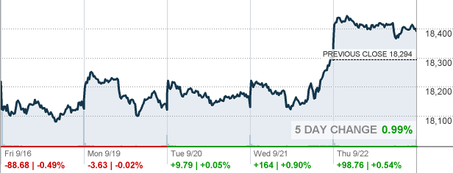
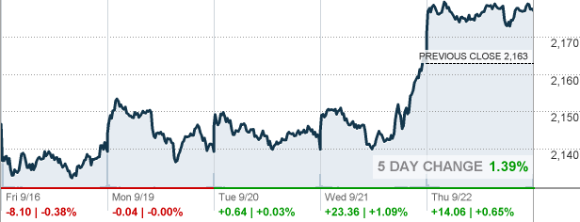
Markets
Dow Jones: Closed at 18,392.46
Increased .93% over the past 4 days
S&P 500: Closed at 2,177.18
Increased 1.4% over the past 4 days
Dow: 5 Day Index
S&P: 5 Day Index

Slide 5
Company Updates
Wells Fargo & Co.
CEO John Stumpf attends hearing with Senate Banking Committee about alleged illegal sales practices which led to a $185 million dollar fine and entrance into an enforcement action.
Employees given incentives to sell additional products to bank customers
Employees enrolled customers in products/credit cards without permission
Bayer and Monsanto Merger
Bayer made a $66 billion dollar deal to acquire Monsanto
Deal won’t be able to be finalized for at least a few months.
Hanjin
Ships 3% of containers globally per year
Filed bankruptcy and ships not allowed into ports
14 billion dollars stuck on ships not able to dock
South Korea is not looking to bail out Hanjin, Hanjin will likely have to sell all 37 ships and return all 61 chartered vessels

Slide 6
Fed Meeting Wednesday
Federal Funds Rate (Interest Rate) to remain in the same range
Current American interest rate = 0.500%
Current Range 0.250 - 0.500
As a Result of Decision
Stocks rise as a result of predicted growth
Value of dollar weakened
Government-bond yields slipped

Slide 7
Global Aspects - Japan
Bank of Japan Meeting on Wednesday
BOJ is trying to stimulate inflation and growth (that's not going well)
Analysts predict BOJ will cut rates as far as 0.7%
Bond buying program larger than United States but ⅓ size economy
Yield Curve Control Efforts
BOJ has a target of around zero percent for the 10-year government bond yield
Yield Curve: The relationship between yields across different maturities on fixed-rate debt from the same issuer (government bonds)
Flattening out rates between the short and long term
Notes:
http://www.bloomberg.com/news/articles/2016-09-21/quicktake-q-a-what-s-a-yield-curve-and-why-s-boj-targeting-it
YAAAAAASSSSSS

Slide 8
Currencies
Japan
The yen is up 20% from the US dollar in 2016
Yen increased by 1% in comparison to US dollar monday
Stronger Yen makes products more expensive world wide (could damage Japan Economy)
China
Chinese Yuan = 0.15 US dollars

Slide 9
Indices
Colin Gallagher

Slide 10
Standard & Poor’s 500 (S&P 500)
Regarded as most accurate gauge of Large Cap U.S. Stocks
Index of 500 Stocks
Weight: Market Value
Passive investment opportunities in the S&P include Vanguard S&P 500 ETF, the SPDR S&P 500 ETF or iShares S&P 500 Index ETF
Notes:
http://www.investopedia.com/terms/s/sp500.asp
http://www.cnbc.com/2016/08/22/the-sp-500s-new-sector-could-be-a-really-big-deal.html

Slide 11
Dow Jones Industrial Average (DJIA)
Initiated in 1882
Price weighted average of 30 stocks on the NYSE
Includes companies such as General Electric Company, the Walt Disney Company, Exxon Mobil Corporation and Microsoft Corporation
Notes:
http://www.investopedia.com/terms/d/djia.asp

Slide 12
NASDAQ Composite
Market cap weighted index of approximately 3,000 stocks
Includes all Nasdaq-listed stocks that are not derivatives, preferred shares, funds, exchange-traded funds (ETFs) or debenture securities
Not limited to U.S. based companies

Slide 13
Nikkei 225
Price-weighted index comprised of Japan's top 225 blue-chip companies traded on the Tokyo Stock Exchange
Big Names: Canon Inc. (CAJ), Panasonic Corp. (PCRFY), Pioneer Corp., Sharp Corp., Sony Corp. (SNE), Nissan Motor Co. (NSANY), Toyota Motor Corp. (TM), Mitsubishi Motor Corp., Mazda Motor Corp. (MZDAY) and Honda Motor Co. (HMC).

Slide 14
FTSE
Comprised of blue-chip stocks that are listed on the LSE
Companies that will make up the FTSE 100, are determined on a quarterly basis, usually the Wednesday following the first Friday in the months of March, June, September and December
Weighted by Market Capitalization
Updated every 15 seconds

Slide 15
Shanghai Composite (SHCOMP)
Market composite made up of all the A-shares and B-shares that trade on the Shanghai Stock Exchange
SSE Composite will closely resemble the overall economy of China
Notes:
http://www.investopedia.com/terms/a/a-shares.asp

Slide 16
Stock Pitch
Tom Foerster and Kevin Albagli

Slide 17
Vanguard Small Value ETF (VBR)
Buy 720 shares at Market Price

Slide 18
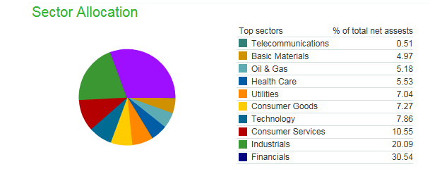
What is VBR?
Tracks the CRSP US Small Cap Value index
Minimum market cap of $15 million
Median market cap of $3.2 bn
A more aggressive investment than many other holdings
Very few value holdings in our portfolio

Slide 19
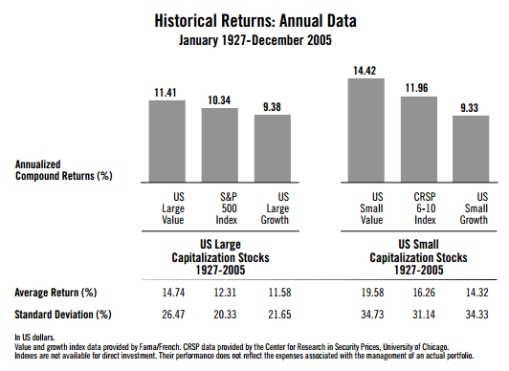
Why small cap?
Historically small cap stocks are more volatile than large-cap
Portfolio has almost no exposure to small cap
Yielding 70 basis points above the US 10 year treasury

Slide 20
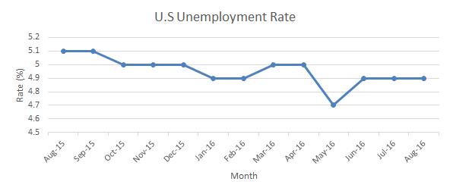
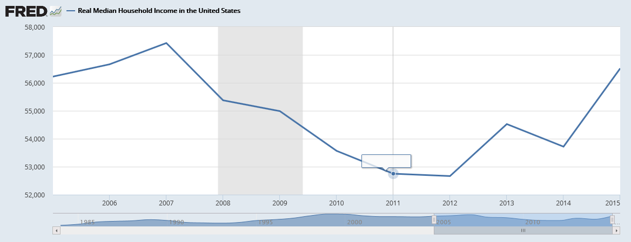
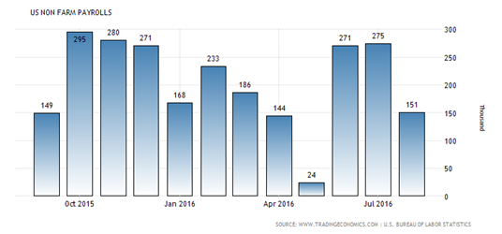
Economic Growth (Labor market)

Slide 21
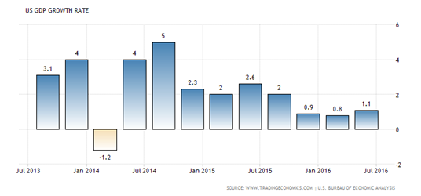
Room To Grow (GDP & Inflation)
12-month PCE inflation
 | 16-Feb | 16-Mar | 16-Apr | 16-May | 16-Jun | 16-Jul
PCE | 0.9 | 0.8 | 1 | 1 | 0.9 | 0.8
PCE ex F&E | 1.7 | 1.6 | 1.6 | 1.6 | 1.6 | 1.6
Trimmed mean | 1.7 | 1.7 | 1.7 | 1.7 | 1.7 | 1.6

Slide 22
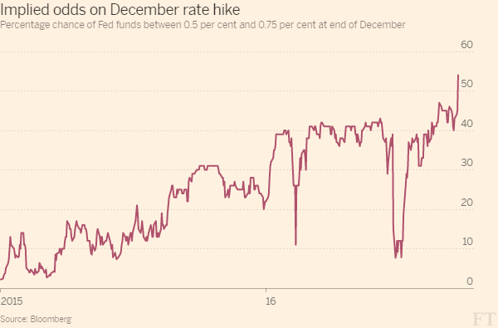
Fed Outlook
Against this backdrop, the Committee decided to maintain the target range for the federal funds rate at 1/4 to 1/2 percent. The Committee judges that the case for an increase in the federal funds rate has strengthened but decided, for the time being, to wait for further evidence of continued progress toward its objectives. The stance of monetary policy remains accommodative, thereby supporting further improvement in labor market conditions and a return to 2 percent inflation. (FOMC meeting statement)

Slide 23
Potential cons
As they are more volatile than larger cap stocks, small cap stocks have the potential for larger losses
More sensitive to adverse financial conditions
Fees of .08% detract from gains

Slide 24
Sectors in Finance
Jason Shavel

Slide 25
Look at the drawing happening on the board

Slide 26
Interview Question
Othman Guennoun

Slide 27
Why choose this firm?
Why Morgan Stanley? Barclays? Etc.

Slide 28
Steps to address this question
Expect this question in every interview
Prepare for it:
Check company website for recent initiatives, programs, partnerships
Find a link or connection
Discuss the link or connection with passion
Finish off by asking specific questions about the firm

Slide 29
Upcoming Events

Slide 30
Finance Trek - October 11th
(Application Deadline: Sept 25th - Career Spot)
Finance Night - October 18th
(Register on the Career Services website - $20 refundable deposit)

