Slide 1
Investment Club
November 4th, 2016

Slide 2
Agenda:
Market Update
Interview Question
Amazon vs Netflix Stock Pitch
Announcements

Slide 3
Market Update
Mac Erb & Colin Evanko

Slide 4
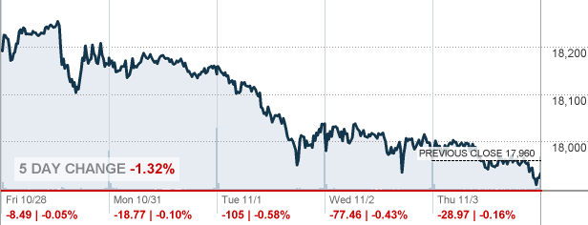
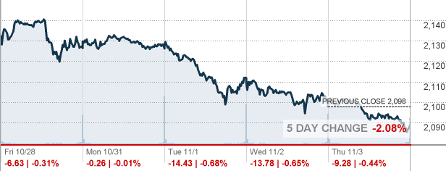
Market Overview
Dow Jones: Closed at 17,930.67
Decreased by 1.4% over the past 4 days
Dow: 5 Day Index
S&P 500: Closed at 2,088
Decreased by 1.9% over the past 4 days
S&P 500: 5 Day Index

Slide 5
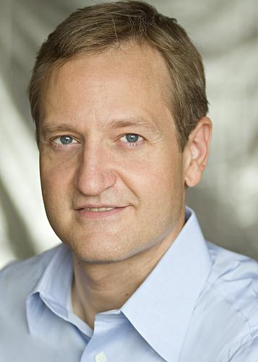
Lafayette Endowment
Fell more than 60 Million dollars since 2014
Worst drop since 2009
740.3 million→ Down from 803.7 million
Loss of 5.4 Percent from 2015
Bohrer Is current Lafayette Endowment Manager
Every Year Lafayette withdraws roughly 5 percent of total endowment to run the school

Slide 6
This Week’s Happenings
General Electric Co. & Baker Hughes Inc. Merger
Roughly $30 billion to combine the oil-and-gas businesses
Hopeful bet by GE on improving industry
Publicly traded shares and majority ownership and control of entity by GE
Fed Meeting Wednesday
Left federal-funds rate at same range of 0.25-0.50
Inflation has not reached the Fed’s predicted 2% mark
New assessment points to rate increase in December with projected economic growth
Major Company Earnings Reports:
Facebook: Adjusted earnings of $1.09 per share on revenue of $7.01 billion
GoPro: Losses of $84 million or -$0.60 per share, sales dropped 40% this year.
Starbucks: Adjusted earnings of $0.56 per share on revenue of $5.71 billion

Slide 7
November 8th Predicted Impact
Equity Strategists from Barclays predict market will drop 11 to 13 percent if Trump is Elected
Trump represents risk with uncertainty in policies
2-3 percent drop if Clinton is elected.
Clinton has familiar policies but still looks to impose regulations and increase taxes
Lower stock prices and a Decline in market value actually increases chances of the FED not raising rates in December

Slide 8
Currencies
WSJ Dollar Index US Dollar down .3% to 87.6
British Pound Increases 1.3% to 1.263 on the dollar

Slide 9
AMAZON VS NETFLIX
Battle of the Stocks III - Return of the Stocks

Slide 10
Battle of the Stocks: Amazon.com Inc (AMZN)
Buy: 14 Shares @ $760.00 (total: $10,640)
Anna Evinski and Kameliya Yordanova

Slide 11
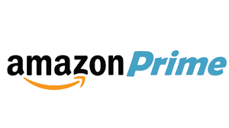
Company Breakdown
3 Pillars:
Amazon marketplace
Amazon Prime
Amazon Web Services (AWS)

Slide 12
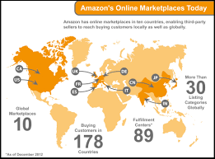
Amazon marketplace
E-commerce platform allowing sellers to sell new and used items next to Amazon.com’s regular items
Allows Amazon expand customer base without investing more inventory, but Amazon guarantees the products sold on its site
Marketplace uses Amazon’s software infrastructure to charge buyer’s credit card but not send any personal information to seller
Available over 60 countries
3rd party sellers 40% ($40 bill) Amazon’s annual sales

Slide 13
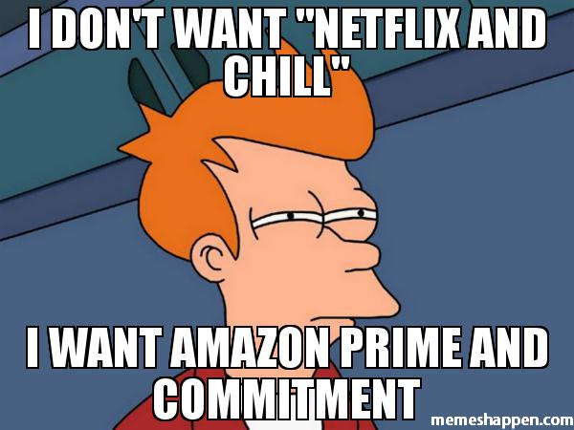
Amazon Prime
Customers get free 2-day delivery on specific items
Prime items has grown from 1 million to 30 million since Prime’s founding
Prime Video: exclusive content from Amazon, Amazon video won 6 Emmys
Although there will always be “computers are too complicated” individuals, with memberships like Prime, creates customer loyalty to a “club”
Additionally, the digital age is the future
“Need fresh strawberries for the dinner party in an hour? The preparer could order them without stepping out of the house” -informationweek.com

Slide 14
Amazon Web Services (AWS)
AWS offers cloud services, where anyone can store data, photos, you name it
Most profitable Amazon business $861 million operating income (55% year-over-year growth)
Currently laying foundation for the future of cloud so in years to come, other companies won’t be able to compare to Amazon
After Netflix’s extreme hardware failure in 2008, the company turned to Amazon’s cloud services to house data (everything from Netflix’s video player to their billing and payments are housed in Amazon’s cloud)
“Starting at the end of this summer [2016], Netflix will fully reside in Amazon's data centers in the cloud, as well as some ISP facilities, and the Internet exchange points that facilitate speedy Internet traffic” -informationweek.com

Slide 15
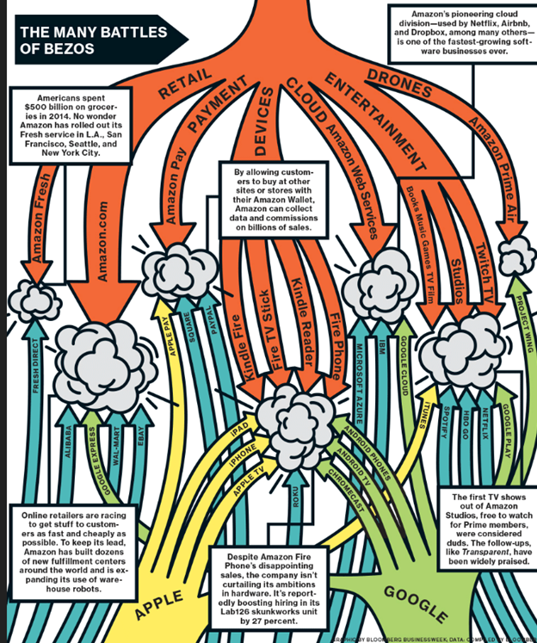

Slide 16
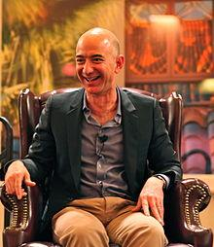
CEO
Jeff Bezos founder, Chairman & CEO
Net worth $71 billion, founded Amazon in 1994, Bezos one of Google’s first investors
Corporate office headquarters in Seattle, WA
Amazon now grown to world’s largest online shopping retailer
Other than Amazon Marketplace, AWS cloud unit, and Amazon Prime, Bezos looking to add fourth unit to business, perhaps expanding video streaming capabilities

Slide 17
Amazon Third Quarter Earnings and Forward Guidance
EPS (earnings per share): $0.52 vs. analyst estimate $0.78 per share
Revenue: $32.7 billion vs. analyst estimate $32.69 billion
AWS (revenue): $3.23 billion vs. analyst estimate $3.13 billion
Net Income: $252 million, lower than past 3 quarters
Q4FY2016 Guidance: Net sales expected to be between $42-$45.5 billion (17-27% growth)

Slide 18
Financial Statistics
Beta (measure systematic risk aka volatility compared to mkt. as whole, beta >1 means more volatile stock): 1.54
Market Capitalization (company’s shares outstanding x current mkt. price one share): 364.4B
Current Price (of stock): $760.00
PE (current share price/earnings per-share): 174.26
Price to Book (mkt. value aka stock price to book value): 20.31
Target Estimate: 921.63

Slide 19
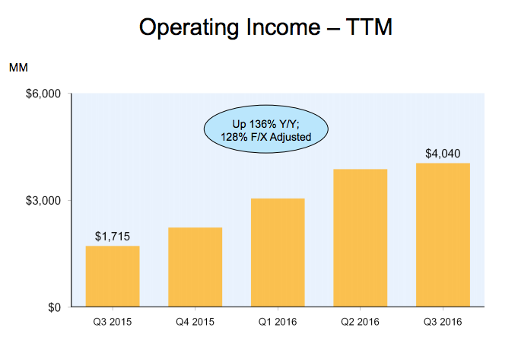
Operating income: main metric we use to evaluate company’s profit realized from business operations after deducting operating expenses

Slide 20
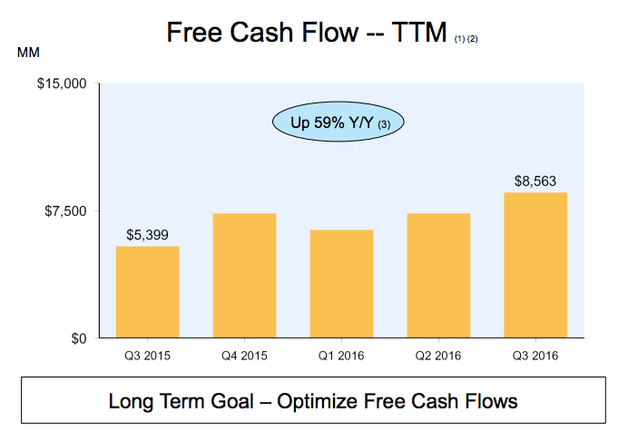
Free Cash Flow: measures a company’s financial performance, meaning operating cash flow minus capital expenditures

Slide 21
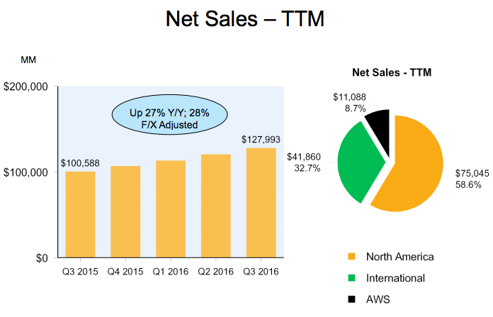

Slide 22
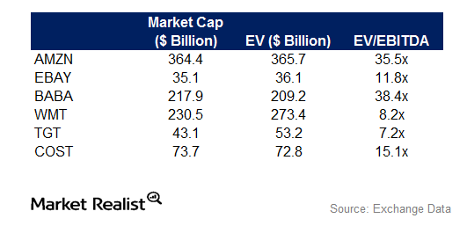
EV(enterprise value)/EBITDA(earnings before investment, taxes, depreciation, amortization) good measure for operating income, which is arguably the most important way to realize company’s profit, higher is better

Slide 23
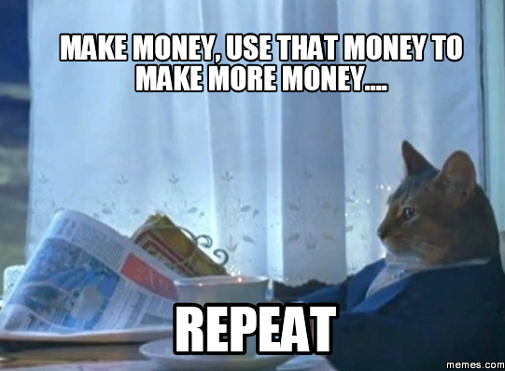
Great Company, Why Don’t They Make Any Money?
Jeff Bezos has one goal: make Amazon a worldwide conglomerate (Bezos has been able to achieve ½ goals he outlined back in 1997)
Sell products at cost or below continuing on path of revenue growth and starting on way to profitability
High revenue growth everyone expects earnings report and EPS to be great but every report they fall short (last time stock dropped 15%)
Willing to do what’s necessary to accomplish their goal--lay off employees to expand cloud

Slide 24
Stock Split
Amazon grows organically (no buyback), increased stock price (not because of buyback)
Stock split: company increases number of shares outstanding.
Value of each individual share falls to keep the company's overall value constant
Amazon has yet to announce plans for stock split, although likely this will happen in the near future (it has done it in the past)
Advantages:
1) Allow for more retail investors to participate
2) Help facilitate Amazon's addition to the Dow Jones Industrial Average (fulfills all criteria except for price)
3) Potentially increase demand for stock, increasing shares (ex: Apple 2014 - shares have risen ~15%)

Slide 25
Research & Development
June 30, 2016: 3.88B (eBay: 2.88M, Alibaba 610.37M)
“RCE Residual Cash Earnings measure calculated as cash generated by business less a charge that reflects expected return of the shareholders and lenders for the use of the company’s capital” -Fortuna Advisors
Basically RCE great for tech bc/ captures growth profitability and asset efficiency
Amazon’s RCE improvement over last three year period was in 98% for tech companies, outshining almost every tech company at 300% more growth per dollar of reinvestment
Not only are growing constantly but making great decisions in what they’re growing in

Slide 26
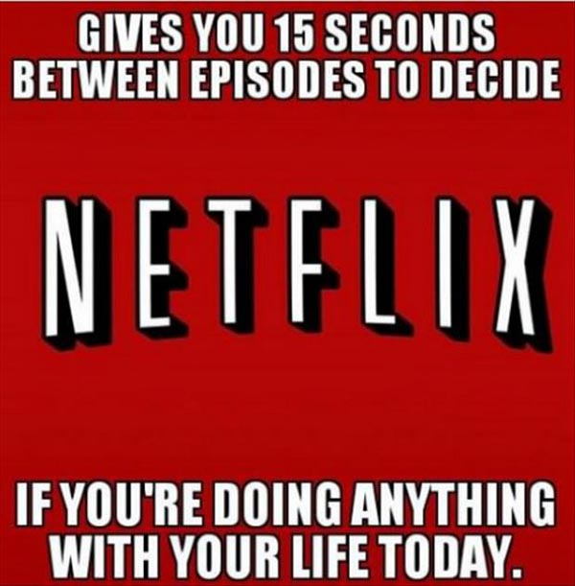
Netflix
Netflix model: continue to be subscription based company business has its limits, original content and use that to grow, buys out content from domestic companies generate their own content
True that every quarter they surprise
Example: Apple fears can’t be innovative anymore, eventually sell iPhones to everyone around the world, no more market
Netflix Time Warner Cable and AT&T, how are you going to compare?
Amazon=productivity=future

Slide 27
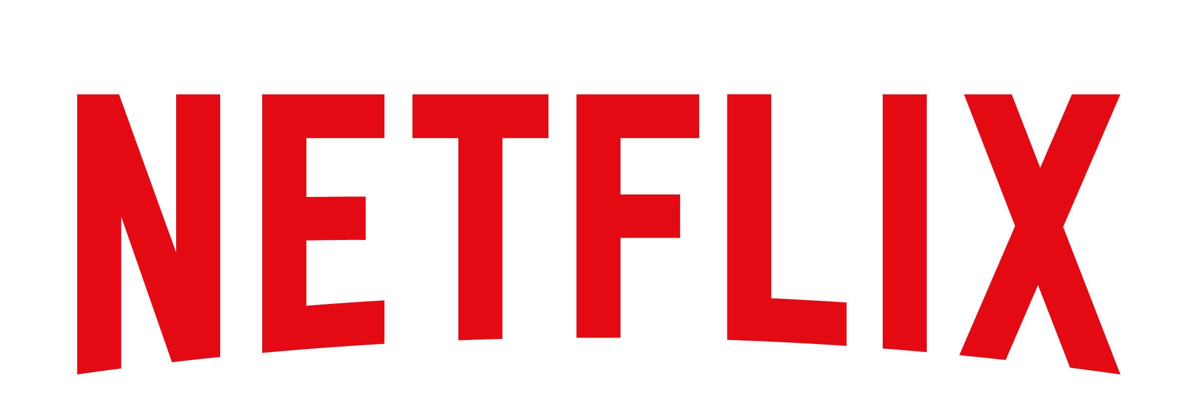
Buy 40 Shares @ $122.32
Heman Matharu & Michael Frohwein

Slide 28
Company Background
Main segments are global video streaming, and domestic DVD renting in the US
Revenues are derived from a monthly membership fee ($8, $10, or $12)
Streaming library includes licensed video and Netflix's original programming
Netflix is releasing an estimated 126 original content in 2016; more than any other company
Available worldwide (except for Mainland China, Crimea, North Korea and Syria)

Slide 29
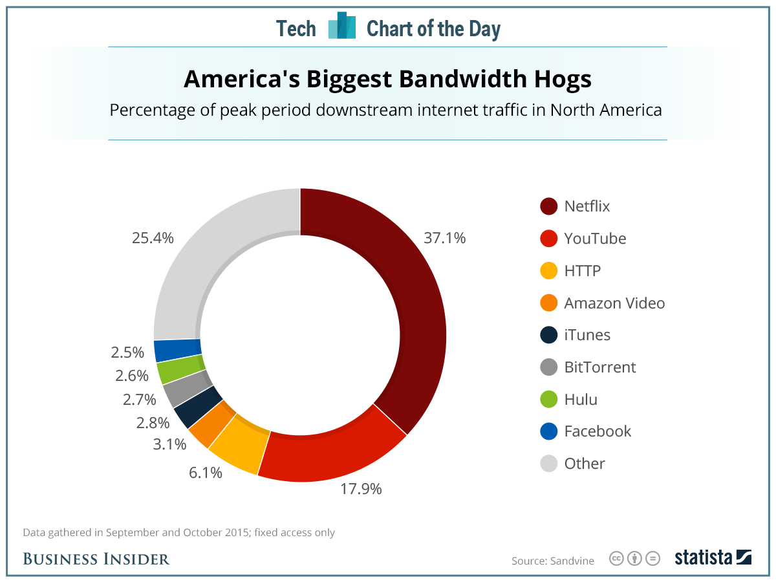

Slide 30
Company Background
$54 billion market cap
2.29 billion in revenue and 52 million in net income for Q3
47.5 Million paid members (expected to grow by 1.2 million in Q4)
30% increase in revenue Y/Y
Projected 80% increase in net income in 2016

Slide 31
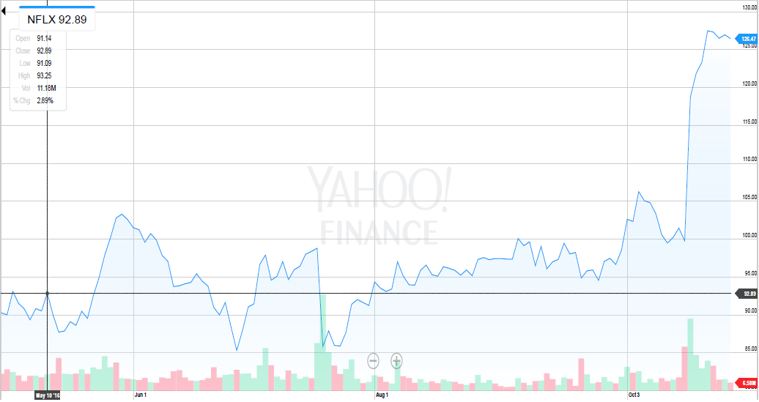
Stock Price (3 months)

Slide 32
Investment Thesis
Netflix is seeing rapid growth in its international streaming business
It is increasing its investment in original production, which has already shown to be very successful
The company isn't susceptible to a potential recession - people will still spend money to watch videos

Slide 33
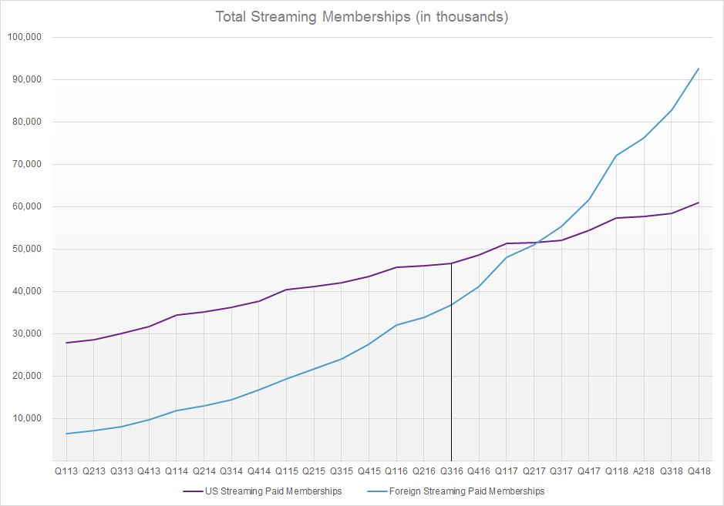
Growth
50% Y/Y Foreign Subscriber Growth
10% Y/Y US Subscriber Growth

Slide 34
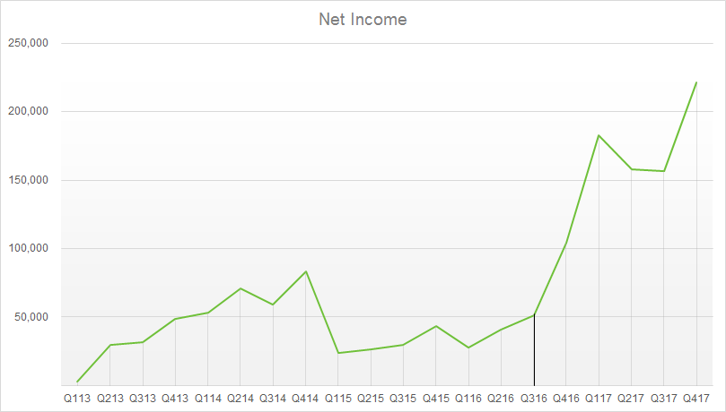
(In Thousands)

Slide 35
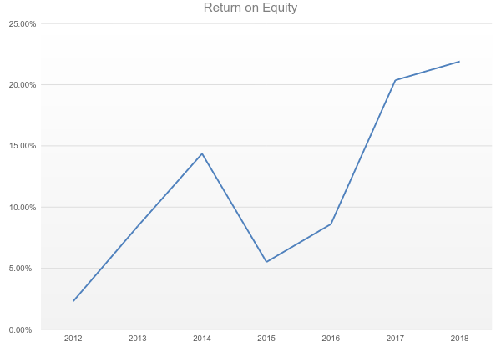

Slide 36
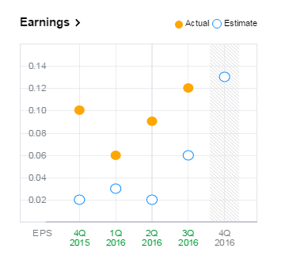
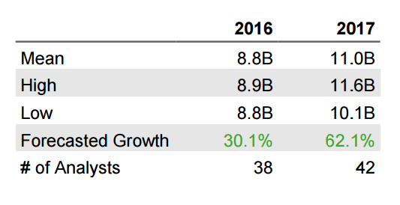
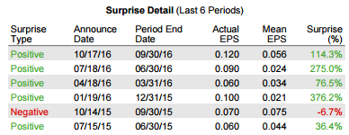

Slide 37
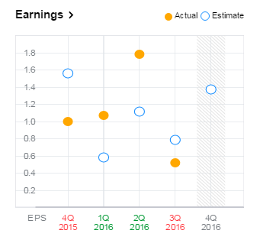
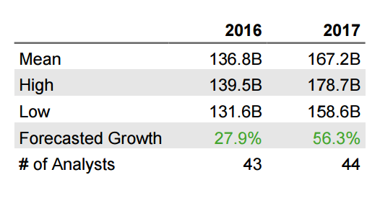
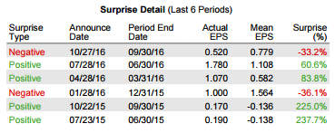

Slide 38
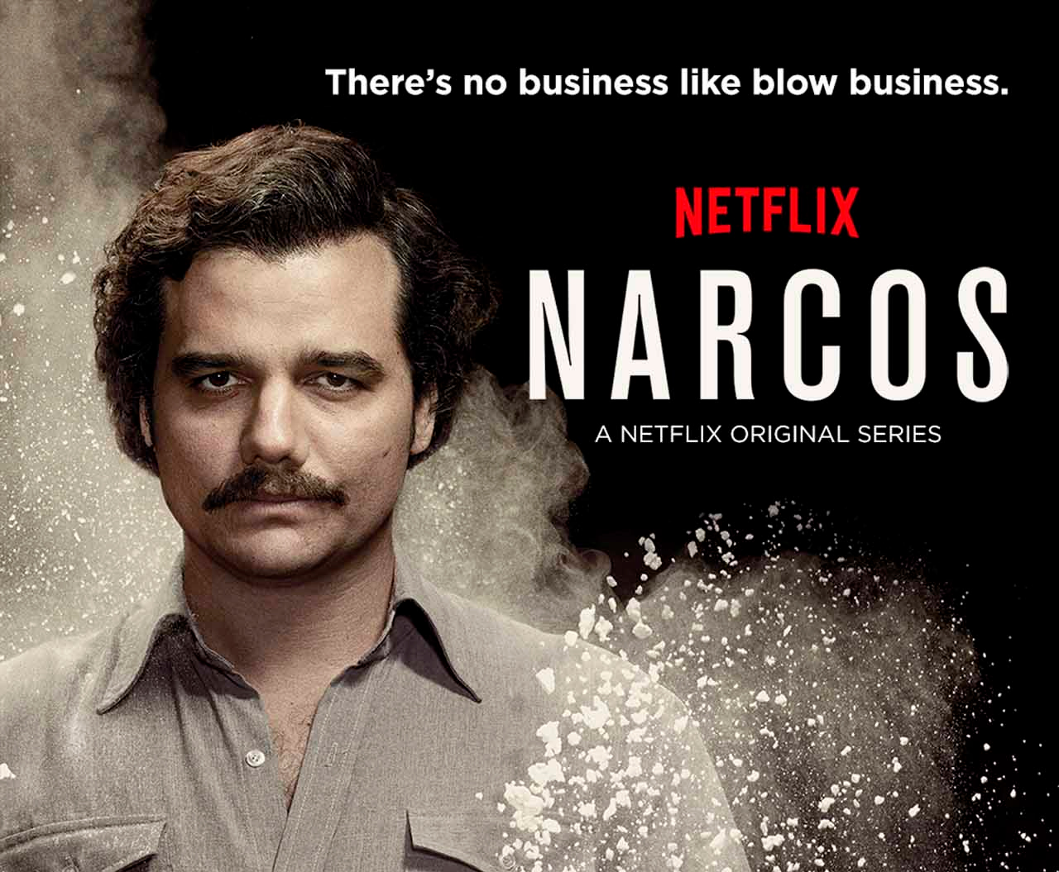
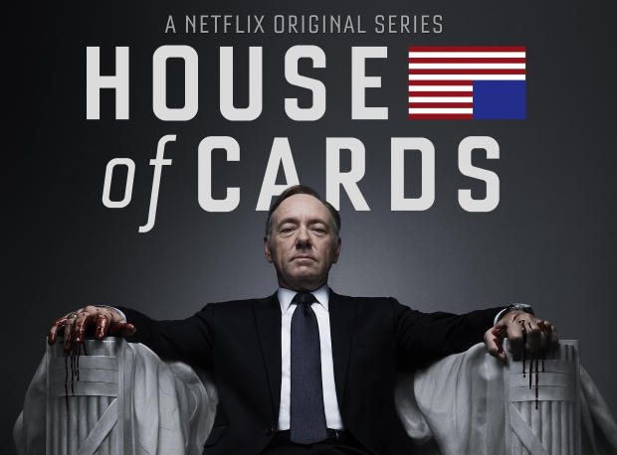
Netflix Original Shows
House of Cards
Narcos
Arrested Development
Stranger Things
Orange is the New Black
Luke Cage
Daredevil
Making a Murder
Bo Jack Horseman
Etc.

Slide 39
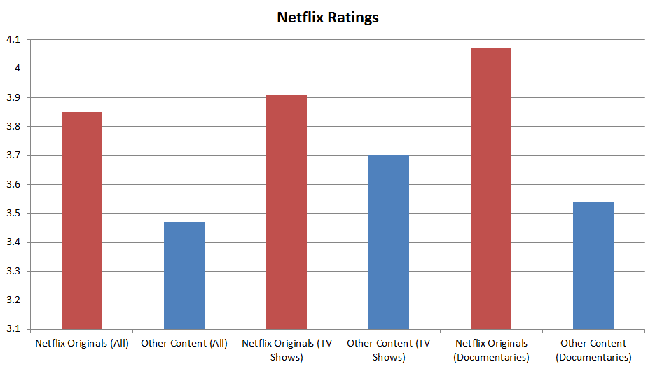

Slide 40
Why Amazon isn't as great
Missed earning estimates for the last quarter by 33%; lowered Q4 revenue guidance too
Projected to struggle during holiday season and beyond due to high costs of its retail business and related investments
More susceptible to economy because large portion of revenue comes from consumer spending

