Slide 1
INVESTMENT CLUB
February 3rd, 2016

Slide 2
AGENDA
Market Update
Volatility
UnderArmour. What Happened?
Portfolio Update

Slide 3
2 Month
Market Update
(12/09 - 02/02)
By: Jesse and Sydney

Slide 4
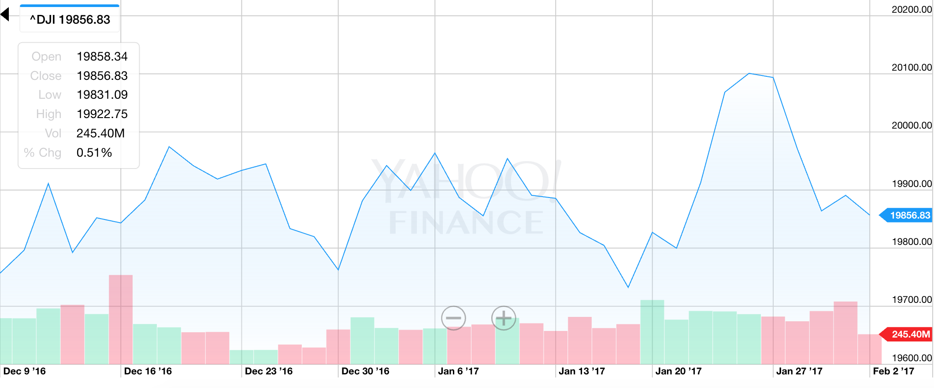
DOW HITS 20,000!!!
On 1/25/17, the DJIA hit 20,000 for the first time ever
Second wind post-election (closed below 18,000 on 11/4)
Dubbed the “Trump Bump”: investors hoping for tax cuts, deregulation, and an increase in infrastructure spending

Slide 5
Interest Rates
Back in December, benchmark IRs were raised for the second time ever since the financial crisis (0.5% → 0.75%)
  Still very low historically
Yellen and Co. still not ready to raise rates
  Large proposed changes by the new administration can cause changes in economic growth
“All in all, things are looking good,” Patrick T. Harker, President of the Federal Reserve Bank of Philadelphia, said in mid-January. “We’re starting 2017 off on a good food.”

Slide 6
Holiday Sales
4% increase from 2015 to 2016
  Strengthening economy encouraged consumers to spend
By the last day of 2016, the CCI was at a 15-year high
Total sales: $658.3B, 2.5B more than the NRF’s projections
Online sales increased 12% YOY
Department store sales decreased 7% YOY

Slide 7
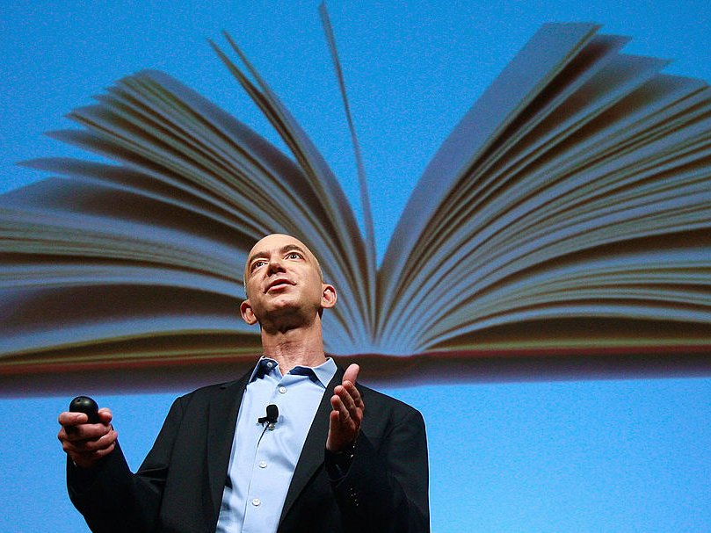
Amazon
Massive holiday season- shipped over 1B items worldwide
Estimated to have driven close to half of U.S. online sales growth
Down 4% one minute after market close due
Earnings report
  EPS: $1.54/share vs. $1.35/share estimate
  Revenue: $43.7B vs. $44.68B estimate (up 22% YOY)
  Amazon Web Services Revenue: $3.5B (up 47% YOY)

Slide 8
Snap Inc.
Snapchat’s parent company, Snap Inc., officially filed papers to move forward with their ~$3B IPO
Looking at a valuation around $25B
“We have incurred operating losses in the past, expect to incur operating losses in the future, and may never achieve,” the filing said.
Two co-founders will control “all stockholder decisions”
Net revenue: $404.48M in 2016, up from $58.66M in 2015
Net loss: $514.64M in 2016, wider than $372.89M in 2015

Slide 9
M&A
$270 billion in M&A in January
Up from $207.1 billion last year
Foreign Investment is down
  Went from $48 billion to $13.2 billion
Political uncertainty is causing much of this with Brexit in the U.K. and the future of regulations and taxes in the U.S
Specifically want to know about anti-trust policy and currency repatriation
Corporate bond issuances also hit $174.03 billion, largest January ever

Slide 10
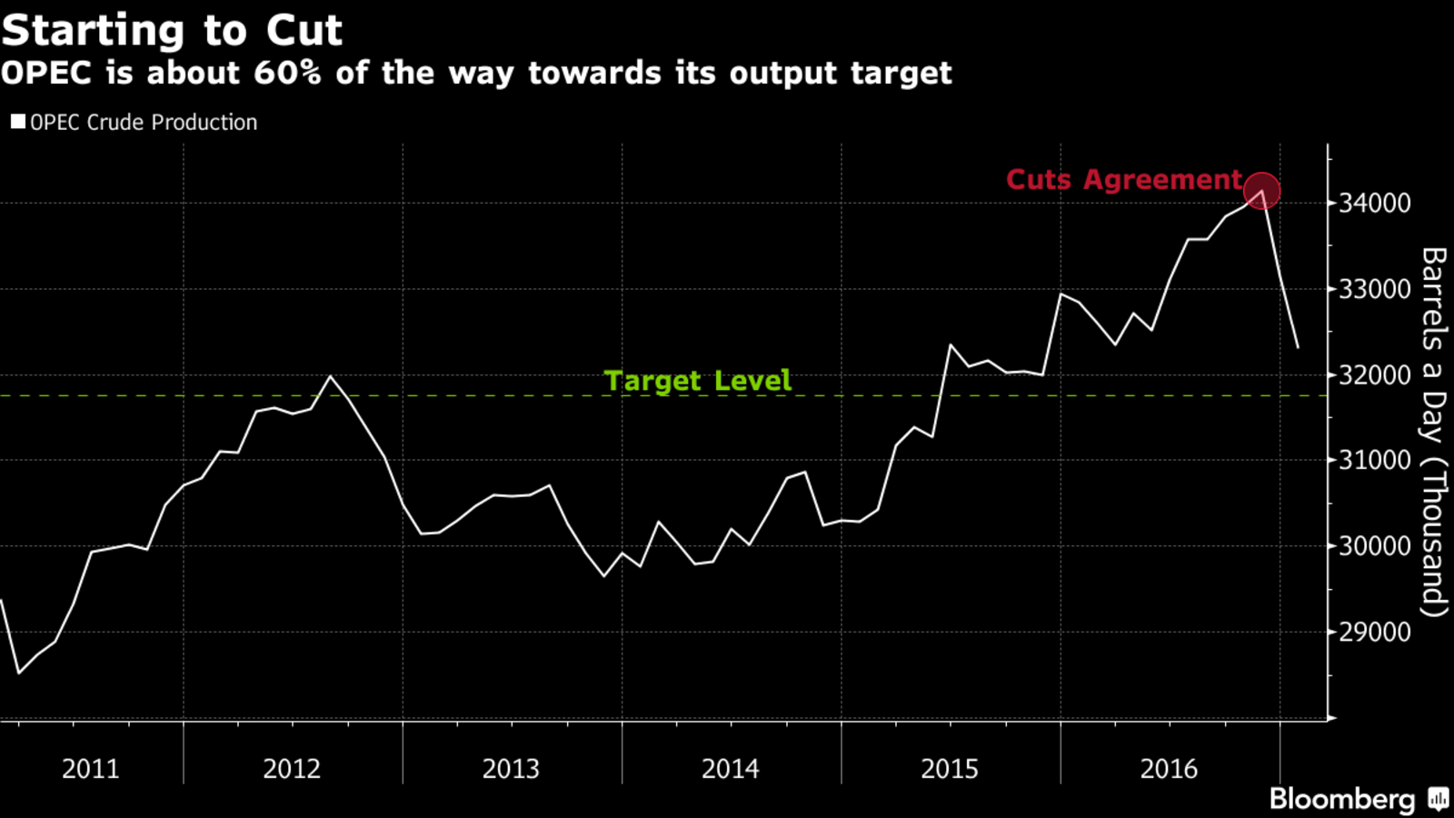
OPEC
Successfully cut 840,000 barrels a day last month
Brings them down to 32.3 million BPD
60% of the way to their output target
83% of promised cuts were implemented
Offset by increases by Iran, Nigeria, and Libya

Slide 11
Currencies
The dollar went up at the end of the year and then came back down to about where it was last time
Trump has accused China of currency manipulation in the past, and want to bring back what he views as jobs lost to trade
He also wants to increase spending, decrease tax, lower regulation, and bring back money being stored abroad
This will cause conflicting pressure on the dollar in the future

Slide 12
Brexit
Commons voted to go through with Brexit
  Says they will hopefully allow EU citizens to stay
Prime Minister set a deadline of March 31 for invoking Article 50
Preparing for the negotiation process
  Currently still negotiating on immigration and trade
Still has tо clear the House of Lords
Keep watching to see what the European Union does
  Hard stance to prevent future exits
  Could go easy because this is in everyone’s best interest

Slide 13
Volatility with Friends
Dave Perron

Slide 14
What is Volatility
-Volatility is a statistical measure of the dispersion of returns for a given security or market index
-refers to the amount of uncertainty or risk about the size of changes in a security's value
-A higher volatility means that a security's value can potentially be spread out over a larger range of values
-Higher volatility stocks come with more risk and more reward
-In options, volatility is a variable in option pricing formulas

Slide 15
Beta
-the volatility of a stock relative to the market
-tells you how much a stock is expected to move based off of how a benchmark index moves (usually S&P 500)
-a beta of 1.1 means that historically, when a benchmark index moves up 100%, the stock moves up 110%, whereas a beta of .9 means a stock would historically move up 90% when the market moves up 100%
-keep in mind this is the same for when the market heads south

Slide 16
What I want to talk about
VIX is the ticker symbol for the CBOE (Chicago Board Options Exchange) volatility index
-shows the market expectations of 30 day volatility
-made up of wide variety of implied volatilities of S&P 500 options
-implied volatility- expected volatility of stock over the life of the option
-Options with higher implied volatility----> higher premium
-Index seen as main gauge of investor fear in the market

Slide 17
The Cool Part
-in times of market stress or uncertainty, the VIX jumps up
-in times of market stability and certainty, the VIX falls
-Recently, the VIX has been at its lowest level since 2014, and below all but 1% of its readings in history
-From the Friday before the presidential election through the 29th, the so-called fear gauge has had its sharpest 12-week drop ever
-It is at unusually low levels

Slide 18
Calm Before the Storm?
-According to Factset, S&P 500 companies are trading at 21 times the past 12 months of earnings compared to their 10 year average of around 16 times
-CEO of Moet Hennessy Louis Vuitton- “For every 10 years, we have eight good years and two not good years”
-noted that eight years have passed since the financial crisis
-President Trump could also have an impact on financial markets, whether it is actually policy he implements or just things he says
-Markets very surprisingly are not pricing in uncertainty, and have performed well even given current valuations

Slide 19
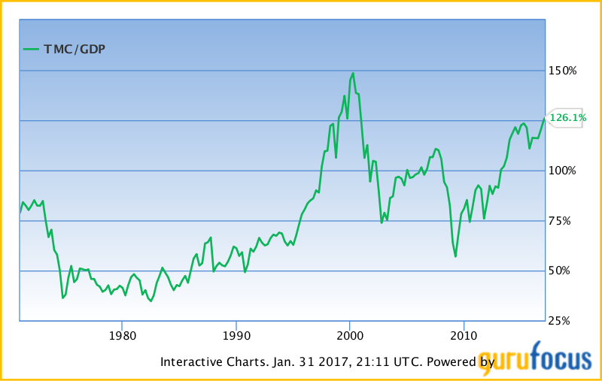
Market Cap to GDP (Buffett Value Indicator)
- "it is probably the best single measure of where valuations stand at any given moment."-Buffett
-seen as long term valuation indicator
-typically it is at unusually high levels before a major crash, as we can see from the graph
-so with valuations high, volatility at unusually low levels
and this widely used metric showing the market is
extremely overvalued, is this the calm before the storm?
-The next few months should be very telling

Slide 20
Under Armour Update
Marie Bucklin and Anna Evinski

Slide 21
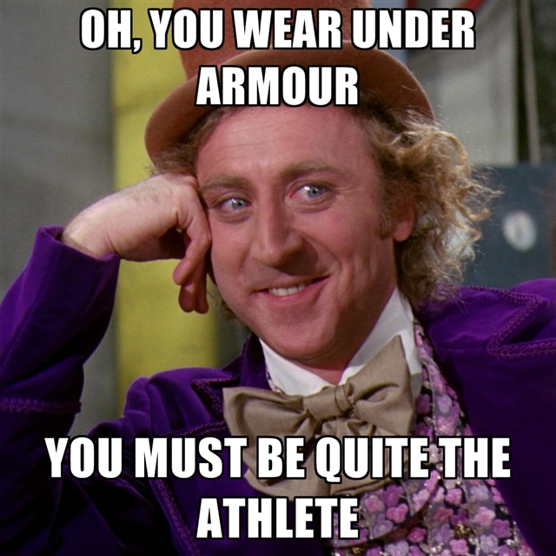
Why we bought Under Armour?
Thought growth would be exponential
Had just introduced Steph Curry as sponsor and boasted Tom Brady, Dwayne Johnson, Bryce Harper
Kept beating analyst estimates
Was predicted to be 3rd largest sportswear brand in world 2030
“Under Armour is a pure growth… evidenced by its share price and P/E ratio. The company appears to be investing in key areas that will bolster the brand in years to come” -Investopedia
“Despite company’s stability, size and growth, investors should steer clear of investing in Nike for 2016. Nike is a mature company, and its stock is hitting all-time highs” -Investopedia

Slide 22
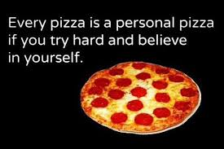
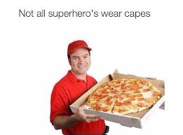
Stock Prices
Bought: $47.04/share
  (160 shares) total $7,525.75
Now: $20.65/share
Lost: $4,229.75 (56.2%)...that’s a lot of pizza…
  Slowing growth, declines in quarterly profit
  Shares of Under Armour fell 27% premarket to $21.19 (Jan 31st)
  2017: UA expects revenue to rise 11% to 12% to $5.4 billion, below $6.06 billion analysts have predicted
  Change from class A to class C. Went up 9% on 11/28/16. This ruling was effective on 12/7

Slide 23
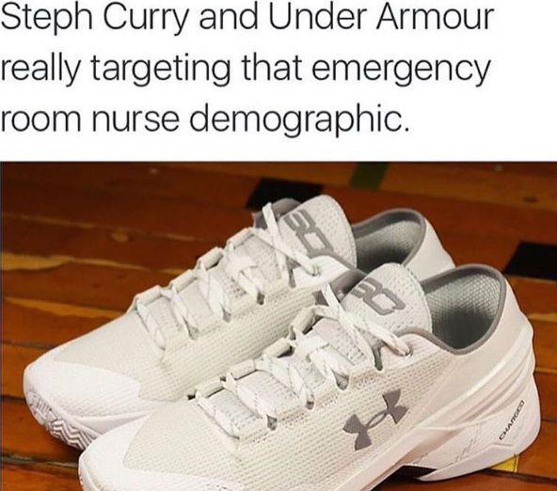
Theories for falling stock prices
Club’s initial theory: Because of athlete sponsor list
  Not the case because it doesn’t make sense… Curry is still Curry and Brady is in the Super Bowl.
  “Stephen Curry and the Golden State Warriors have the best record in the NBA. Tom Brady will attempt to win his fifth Super Bowl with the New England Patriots on Sunday” -CNN Money
Not addressing the style needs of the people
Missed earnings projections
Adidas came back in style
UA was never really a coveted brand

Slide 24
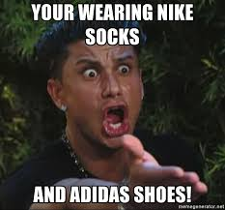
Nike & Adidas...major players
Nike April 22nd: 59.43/share
  Nike now: $52.80/share
Adidas April 22nd: 107.15/share
  Adidas now: $146.95/share
WHY??
  Nike was worst performing dow stock last year, but has since radically improved
    “Nike has once again topped estimates and found a way to get more gear sold while improving operations, posting even larger earnings gains on those increased sales. For the second half of Nike's fiscal year 2017, the company's new strategy to decrease its number of styles but expand its offerings in each could help to reduce inventory and margin challenges” -The Motley Fool
  Adidas--boost from Olympics, back in style

Slide 25
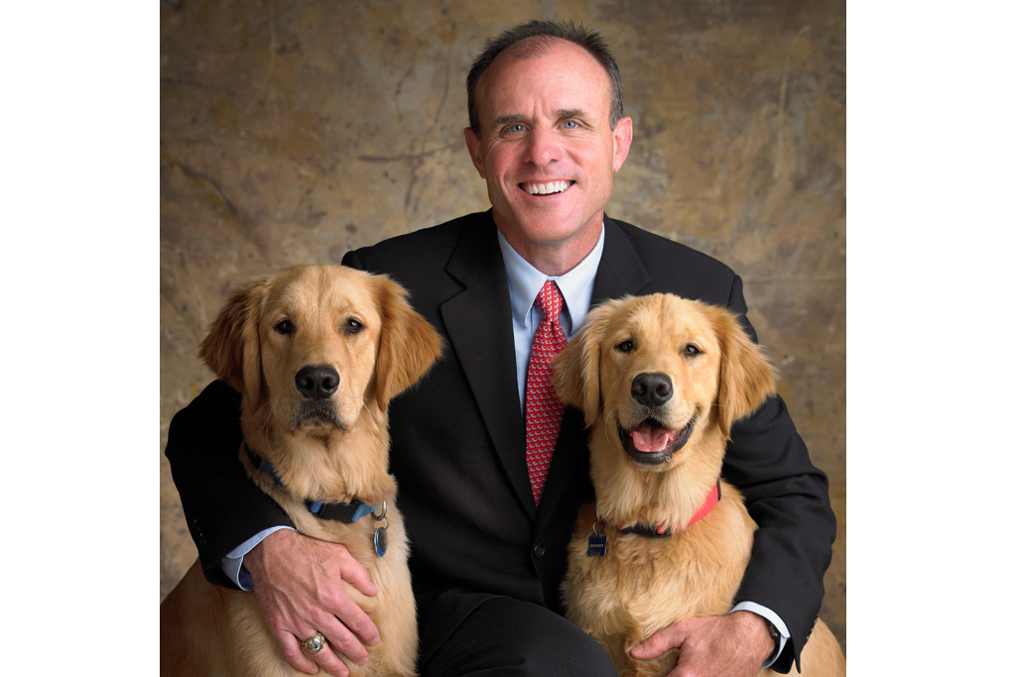
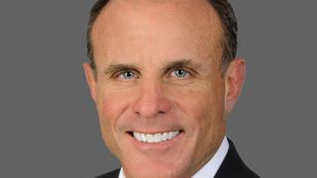
Internal Company Issues
CFO Chip Molloy stepping down for “personal reasons”
  After only 13 months with company
  David Bergman, senior vice president of corporate finance, will serve as acting CFO
Stock plummeted 30% last year
2/2/17 Under investigatigation by purchasers of Under Armour because of possible violations with Sections 10b and 20a of the 1934 Securities and Exchange Commission Act

Slide 26
Why are the stocks tanking?
Dropped over 24% on 1/31 when the 4th quarter report came out
  “Roughly $2.7 billion or 1/5 of Under Armour's market capitalization disappeared on January 31, 2017 after Under Armour said its quarterly revenue growth dropped more than 20% for the first time in 26 quarters ” -- a lovely WSJ article
  “The apparel company missed on both revenue and earnings per share against analyst expectations. Earnings for the fourth quarter came in at $0.23 a share against analyst expectations of $0.25. Revenue also whiffed at $1.31 billion, lower than projections of $1.41 billion.” -BI article
The company also lowered its guidance for 2017, bringing estimates for operating income down to $320 million and a smaller gross margin
Question -- Is the recent large stock price drop the market adjusting or people reacting to the poor report?

Slide 27
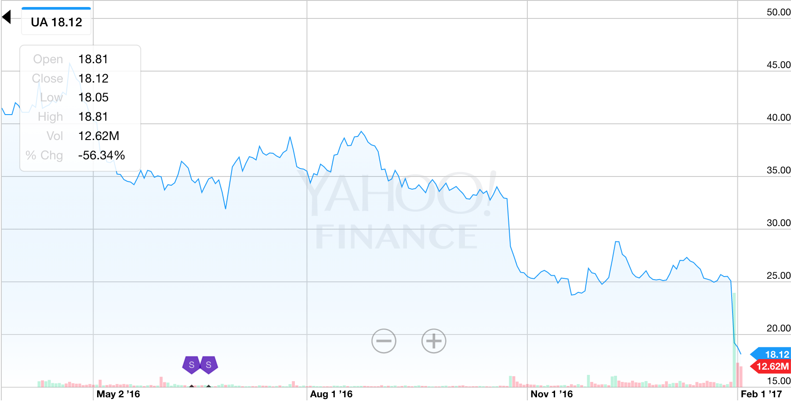

Slide 28
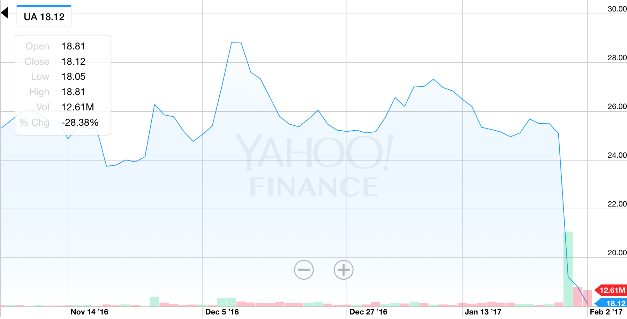

Slide 29

Conclusions--
CEO Kevin Plank says it is because of changing athletic wear climate in North America, where most of Under Armour’s sales are
We should tread lightly
  Adidas doing so well and Nike recovering from last year

Slide 30
Portfolio Update
Colin Evanko & Mac Erb

Slide 31
Our Portfolio vs. S&P 500
 | December 8th, 2016 | February 2, 2017 | %Change
S&P 500 | 2,246.19 | 2,280.5 | 1.015%
Our Portfolio (Equity/ETFs) | $593,542.86 | $603,766.01 | 1.72%
Our Portfolio (Cash) | $0 | $0 | 0%
Our Portfolio (Total) | $593,542.86 | $603,766.01 | 1.72%

Slide 32
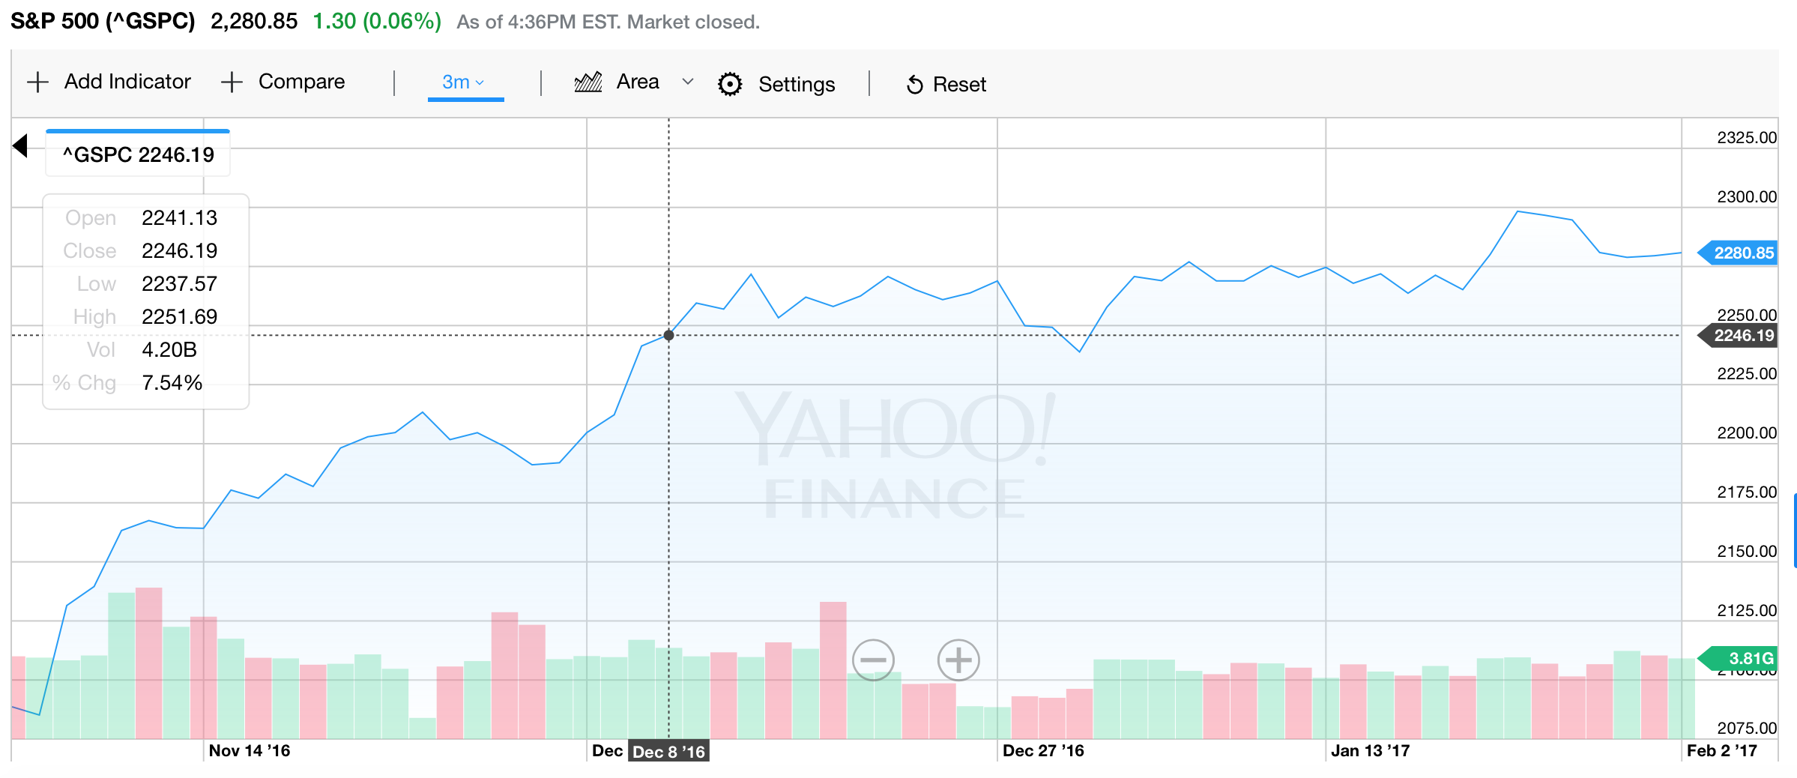
S&P 500

Slide 33
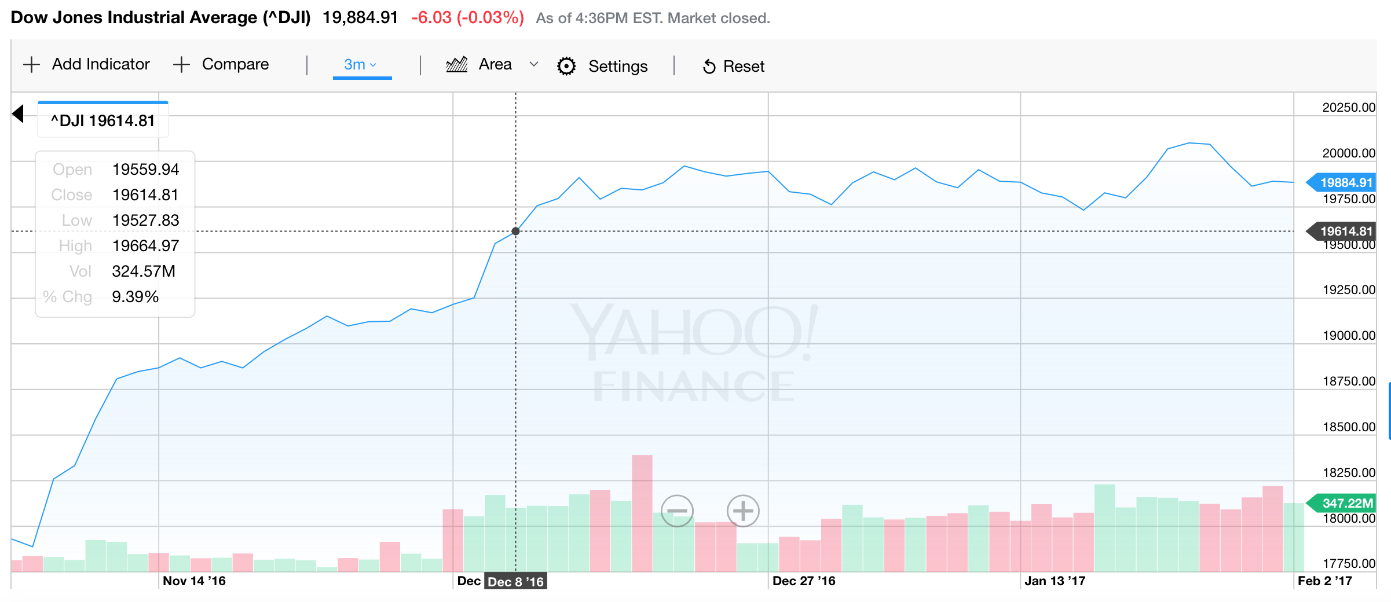
Dow Jones

Slide 34
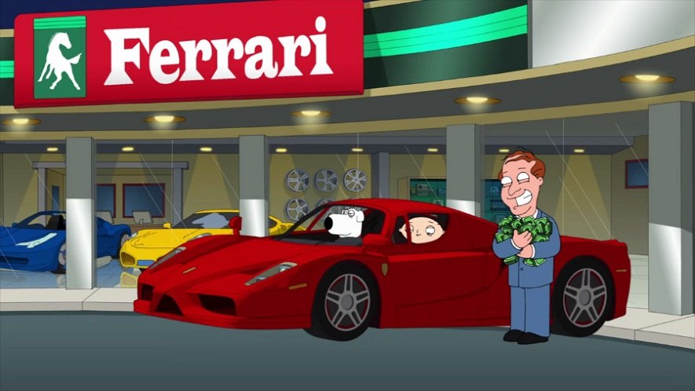
Winners
Amazon 1.8% Equity
  9.15% Return over past two months
Amgen Inc. 2.64% Equity
  8.82% Return over past two months
Apple 2.12% Equity
  8.75% Return over past two months
Ferrari 1.07% Equity
  13.79% Return over past two months
KRATOS DEF & SEC SOL 2.35% Equity
  11.08% Return over past two months
Southern Copper Corp 3.44% Equity
  12.2% Return over past two months

Slide 35
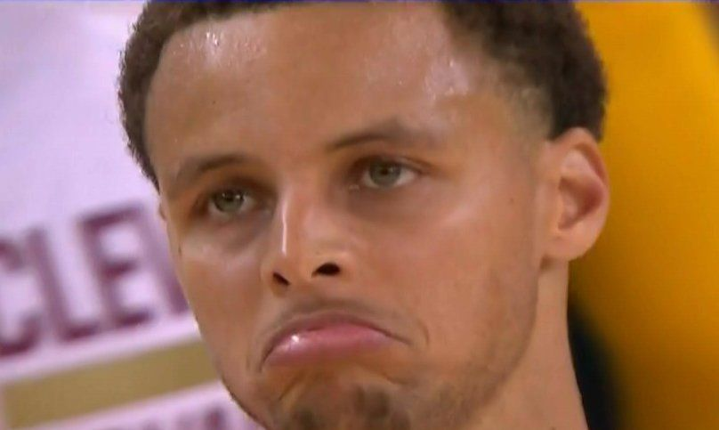
Losers
Dollar Tree (3.2% Equity)
  -11.19% Return over past two months
Long Island Iced Tea (0.4% Equity)
  -18.1% Return over past two months
Qualcomm (0.61% Equity)
  -23.4% Return over past two months
Under Armour (0.55% Equity)
  -37.46% Return over past two months

