Slide 1
Welcome to the Lafayette Investment Club
Sep 9 2011

Slide 2
Agenda
Intro
Why Investment Club?
Investment Basics
Career Services
(Gold)

Slide 3
Officer Introduction
Blago Baychev (me) – President
Miao Wang – VP
Jessica Lee – Secretary
Annalaura Kraft – Treasurer
Kirtika C., Colin S., Greg R.– Analysts
Ayla, Marina – Public Relations
Kumera Bekele – Webmaster
Prof. Michael Kelly – Advisor

Slide 4
Info
General Meetings – Every(other) Friday at 12:15pm in Simon L3
Facebook Events – main communication method
Next Meeting – Next Friday, Sep 16

Slide 5
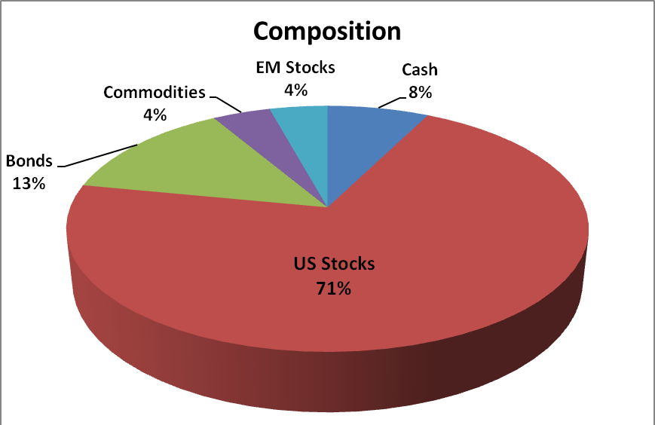
Portfolio
Assets Under Management: ~ $335,000 (real!)

Slide 6
Why Investment Club?
Gives you a chance to make real life investment decisions such as buy/sell stocks
Meet new interesting people who have the same passion for finance and investing as you do
Educate you on financial statements such as the balance sheet, income statement, and cash flow statement.
Learn different types of securities and ways you can minimize the risk of your own portfolio(options, stop loss orders)
“we give you the tools to succeed” - Miao

Slide 7
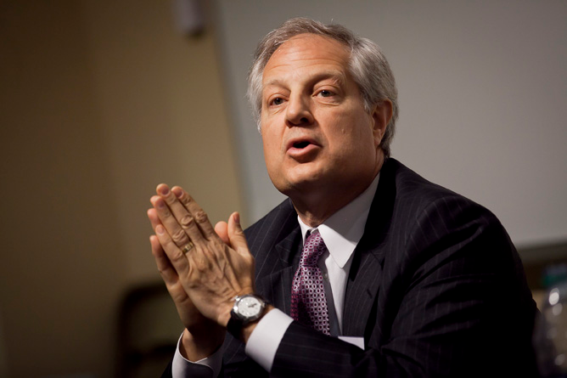
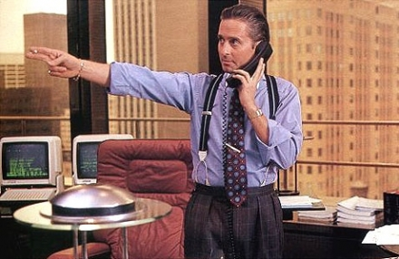
Events
Finance Night
Wall Street 2 Movie Trip
Market Madness Competition
Wall Street Panel
Hedge Fund Trip

Slide 8
Help us Help You
The investment club is a great resume booster
Something to talk about during job/internship interviews in careers in the field of finance
Past members of the club are always reaching out to current members and the Investment club is a good tool for networking

Slide 9
Alumni
We have club alumni as well as current members who work on Wall St.

Slide 10
Gourmet PPPIZZAAAAAAA!!!!!
FREEEEEEEEEEEE!!!!!!

Slide 11
Investment Basics
S&P 500 (5 year snapshot)
What is the S&P 500?
The Standard and Poor’s 500 Index is a market capitalization weighted index of 500 stocks. The index is designed to measure performance of the broad DOMESTIC economy through changes in the aggregate market value of 500 stocks representing all major industries.

Slide 12
Other important indicators
DJIA: 11295.81
Nasdaq: 2529.14
10 year Treasury: 1.98 %
EUR/USD : 1.3875
Gold: 1,866.10
Oil:
DJIA (Dow Jones Industrial Average): price weighted average of 30 blue chip stocks that are generally the leaders in their industry
Resources (more on sites.lafayette.edu/investmentclub)
www.investopedia.com (sign up for “Term of the Day”)
www.yahoo.finance.com
www.finance.google.com
www.wsj.com
www.finance.google.com

Slide 13
Career Services
www.careerservices.lafayette.edu

Slide 14
Thank you!
See you NEXT FRIDAY, SEP 19 !!!

