Slide 1
The Lafayette Investment Club
WELCOME to
09/17/10

Slide 2
Intro
Board members:
Blago President
Patrick VP
Miao Treasurer
Karim Secretary
Ayla and Marina PR
Khine Webmaster
Advisor: Prof. Michael Kelly

Slide 3
Agenda
What do we do?
Events
News highlights
Club Member Careers
What are the benefits?

Slide 4
What do we do?
Pick stocks
Present
Vote

Slide 5
Portfolio
Club AUM: $330, 000
Diversified portfolio
Energy, TMT, Healthcare, Consumers, etc.
Largest Holdings: Cash, GE, IBM, JNJ, AKAM

Slide 6
$30 000
waiting for your ideas!

Slide 7
What else?
Education
Networking
Career

Slide 8
Events & Activities
Finance Night, Oct 14th
sign up with CS before 4th Oct
Movie Night
(After Sept 24th)
Wall Street 2
Including Tickets&Transpotation
Sign Up on Facebook

Slide 9
More……
WALL STREET Visitors
Talks, networking, internship oppurtunities, exposure to the real world
SPOT Party
Help needed: A Party Planner from our new members….
$750 budget just for PARTY

Slide 10
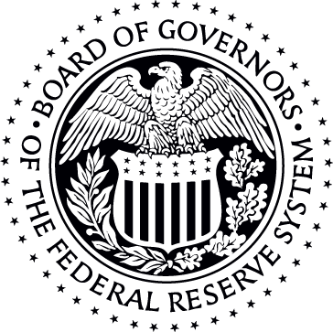
US Economy
News Recap
Housing prices
US GDP rose by 2.4% in Q2
Unemployment rate rises to 9.6%
Deflation fears

Slide 11
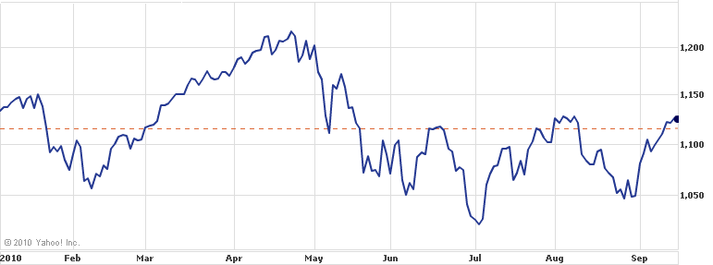
S&P 500

Slide 12
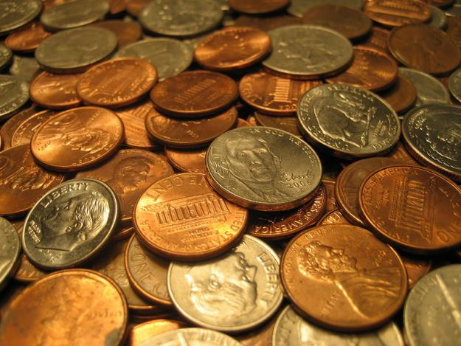
Banking Sector
Goldman lawsuits
Financial Overhaul

Slide 13
Club Alumni Careers
Dan Stefan '10 - Bloomberg Eduardo Diaz '10 - Morgan Stanley Brandon Gold '10 - Harvard Law School Felix Foster '10 – Citigroup Sergey Georgievich '09 - Citigroup Dengzao Pan '09 - Citigroup + Morgan Stanley Michael Feniger '09 - Merrill Lynch John Mumo '07 - Citigroup
Great Networking Resources !

Slide 14
What are our current board members doing?
Blago - Summer @ Morgan Stanley Karim - Summer @ Deutsche Bank Marina – Summer @ Allianz
Patrick – Summer @ Lafayette EXCEL Research
Khine Lin – Summer @ Bell Lab + EXCEL
Miao+Ayla – Summer @ China (Too cool for any of those above)

Slide 15
Why it is important to have Investment Club on your resume
Practical interaction
Real life Story:
Miao → was not in Investment Club → Out
Blago → Highly involved in Investment Club → In

Slide 16
Some great FT & Internship Opportunities on Career Vault
Credit Suisse
Morgan Stanley
Citi
SEI
Northwestern
More coming up soon,
We can help u!

Slide 17
Why you should be an active member of the Investment Club?
Looks good on the resume!
Improve your presentation skills
Prepare yourself for careers in finance
Gain a better understanding of certain concepts in finance
Meet successful people
Free Pizza & Soda ☺

Slide 18
MEETING NEXT FRIDAY !!!
Portfolio Analysis
Selling losing positions
Thank you for coming!

