Slide 1
AUTOCART
This interactive slideshow is to showcase a concept that our ES 101 team has been working on. When in its final stage this tablet will be mounted to the front of shopping carts allowing for items to be tracked as they are deposited in the cart. Once all items have been gathered the user will be able to pay directly on the cart avoiding the inconvenience of long checkout lines.
TAP SCREEN TO BEGIN

Slide 2
Welcome
Tap screen to avoid long check out lines

Slide 3
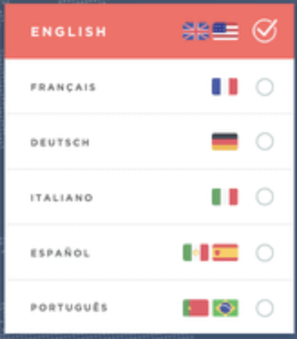
Select your language:

Slide 4
Scan your items now
Back
Checkout
Scan by inserting items in the cart with the label upright, facing one of the scanners.

Slide 5
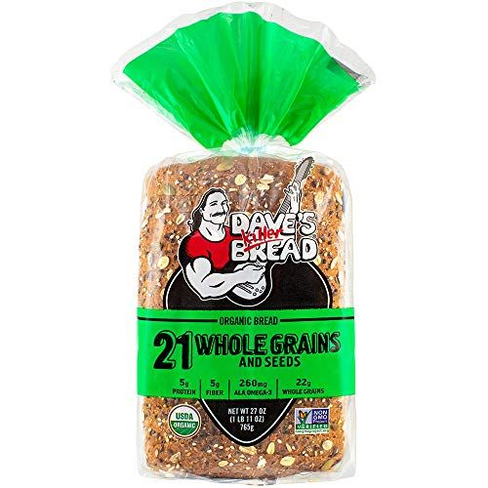
Is this the correct Item?
YES
NO
Dave’s Killer Bread: Wholegrain (1)

Slide 6
Scan your items now
Checkout
Scan by inserting items in the cart with the label upright, facing one of the scanners.

Slide 7
How would you like to Pay?
Back
CASH
CARD

Slide 8
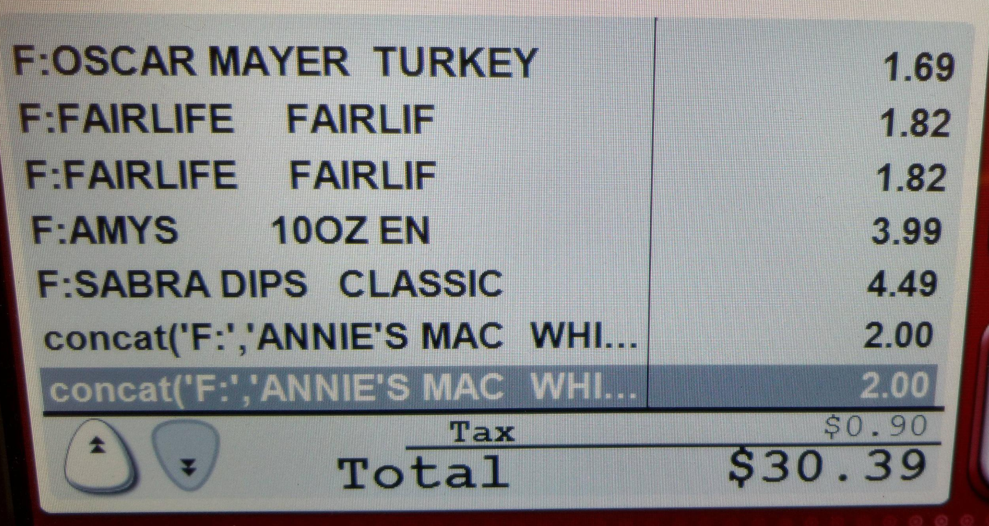
Paying with cash
Are items in cart correct?
Back
Review Receipt
YES
NO

Slide 9
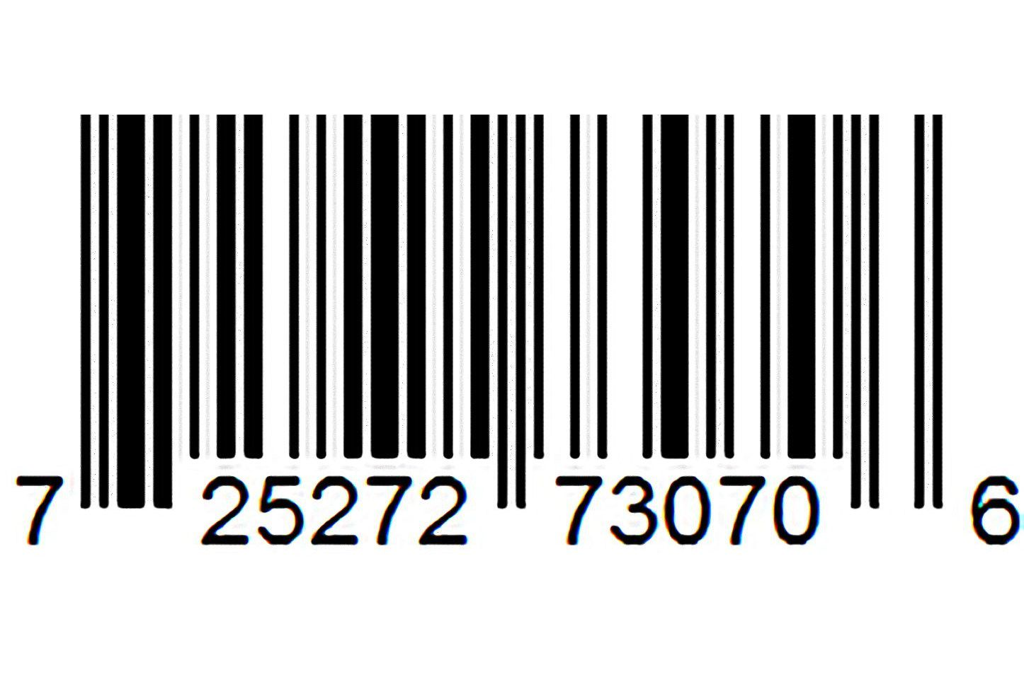
Paying with cash
Back
*Bring barcode to cashier to pay*

Slide 10
Paying with card
Are items in cart correct?
Back
Review Receipt
YES
NO

Slide 11
See a Cashier

Slide 12
Scan, Swipe or Tap Card Now
Back

Slide 13
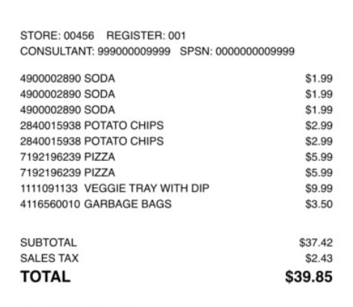
Would you like a copy of your receipt?
Enter Email below for copy of receipt sent to you:
example@gmail.com
Skip
Enter

Slide 14
Thank You for Shopping

