Slide 1
Analyzing the Feasibility of a New Footbridge at Karl Stirner Arts Trail
Steve Cohen, Adam Kong, Matt Malloy, and Kendall Sangster
Notes:
kendall
Add info about other groups/ differences

Slide 2
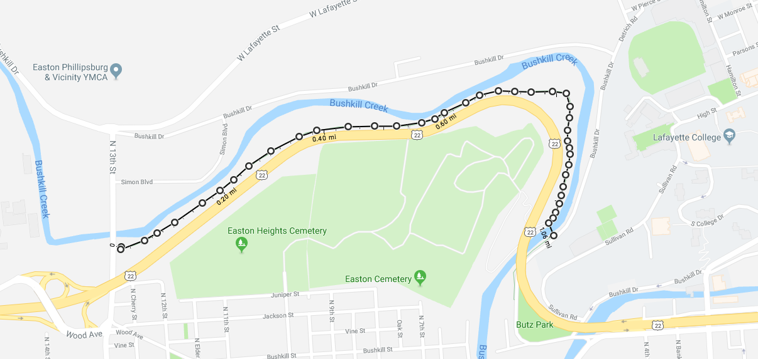
PROBLEM
Lafayette Public Safety
*
*
Notes:
Steve
About a mile apart

Slide 3
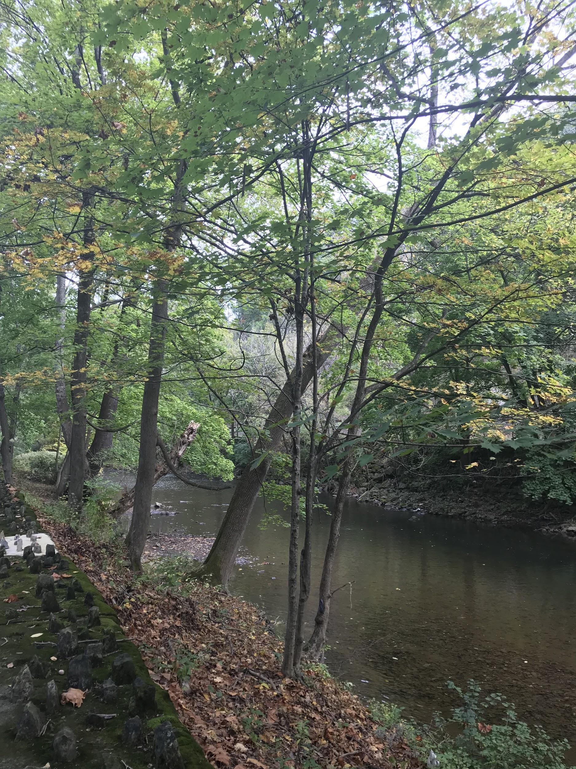
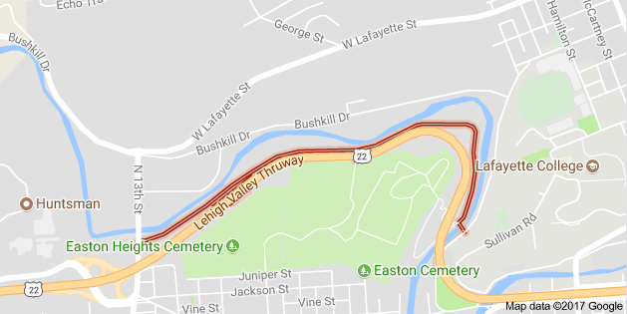
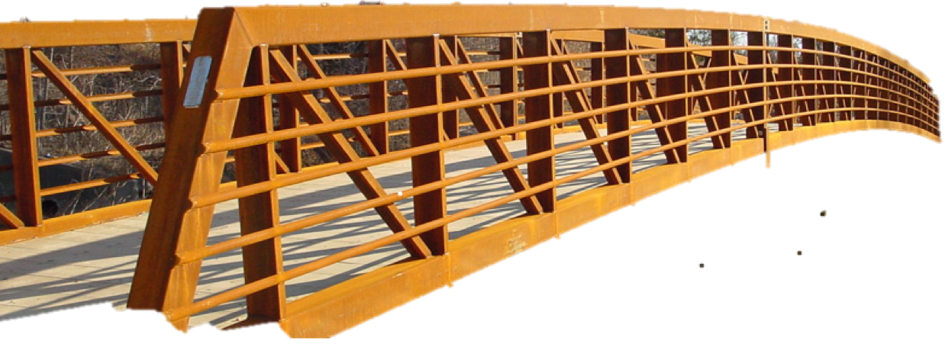
SOLUTION
Notes:
Adam
Solution: to add another bridge
This bridge would add another access point to the trail and ties in the back of campus with Easton
This would be an ideal time to do this since the area is currently being redeveloped

Slide 4
What We Need to Know
Who wants the “Lafayette Bridge”?
Who are the decision makers in this process?
What policy challenges can affect the “Lafayette Bridge”?
Notes:
Matt

Slide 5
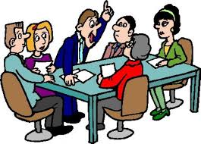
Policy Actors
Karl Stirner Arts Trail (KSAT) Board of Governance
Lafayette College Faculty Advisors
Arts Advisory Council
Notes:
Matt
(i took the below out to simplify it but feel free to add it back in)
Lafayette College
State and Federal Government
E&S Permit from the Northampton County Conservation
District Chapter 106 PADEP Floodplain Management Permit

Slide 6
Social Benefits
Notes:
KENDALL
Rec: biggest thing we focused on here was how bridge could contribute to the further connectivity of the trail and surrounding areas, making it more usable and accessible. In a range of literature, we’ve read that having parks that were perceived as being safer and more accessible were used significantly more and even shown to positively affect how the public perceived their own personal health and well-being.
history/culture: focus was how bridge could contribute to the rich art culture in easton, and possibly showcase easton’s history in its design (maybe insert following slide about design inspirations, if later, then connect back)
Comm.: what we mean here is how bridge could influence the relationships within the community, largely between easton & lafayette, could bring town members into campus and allow students and comm. Members to mingle on the trail. In a study….read that town members that were on campus more frequently more positively perceived the college, saw it as an asset, & town-gown relationship was more productive and beneficial to both parties.

Slide 7
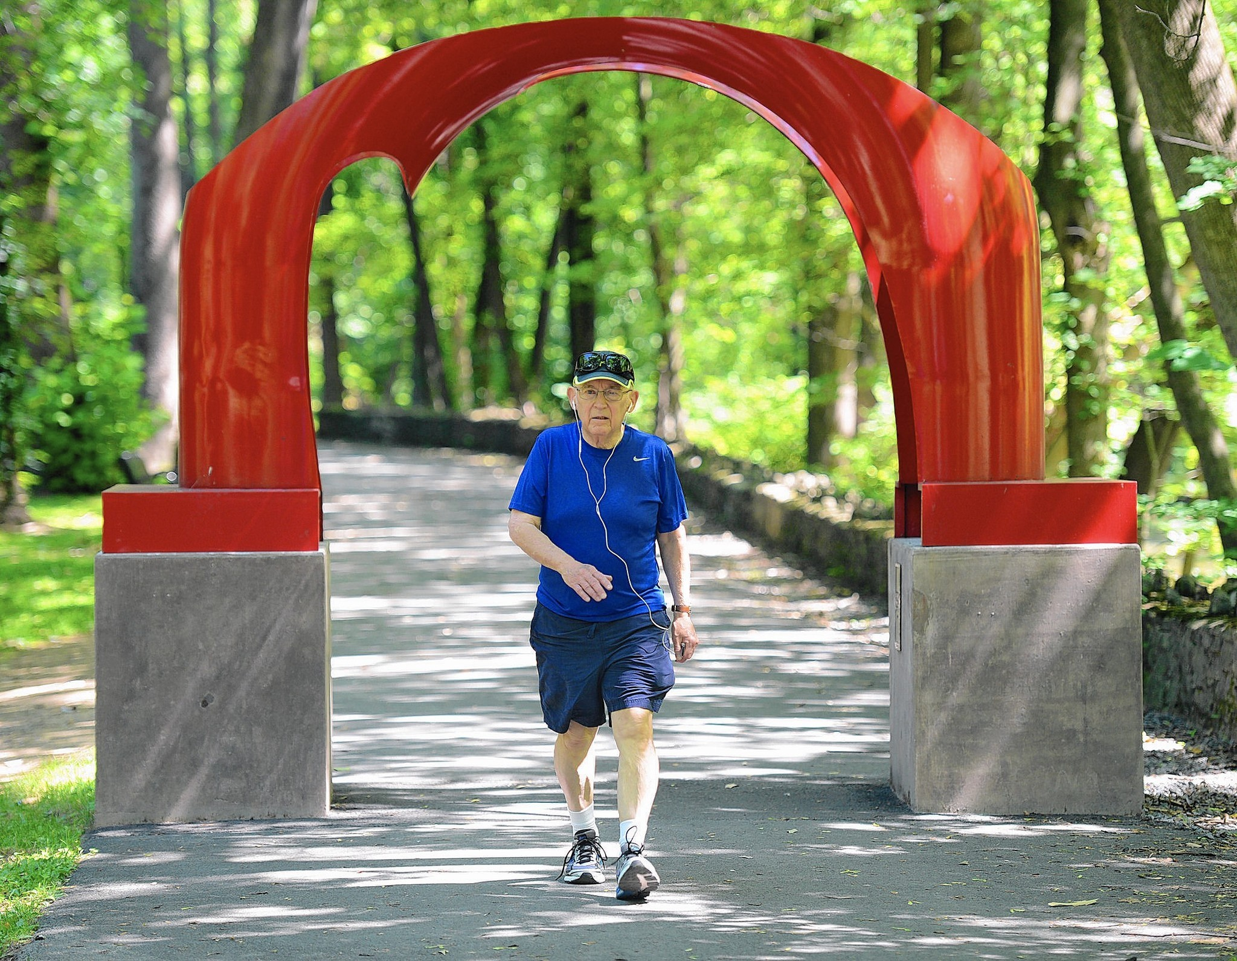
Recreation & Public Health
Notes:
Kendall

Slide 8
Better Parks =
Healthier community

Slide 9
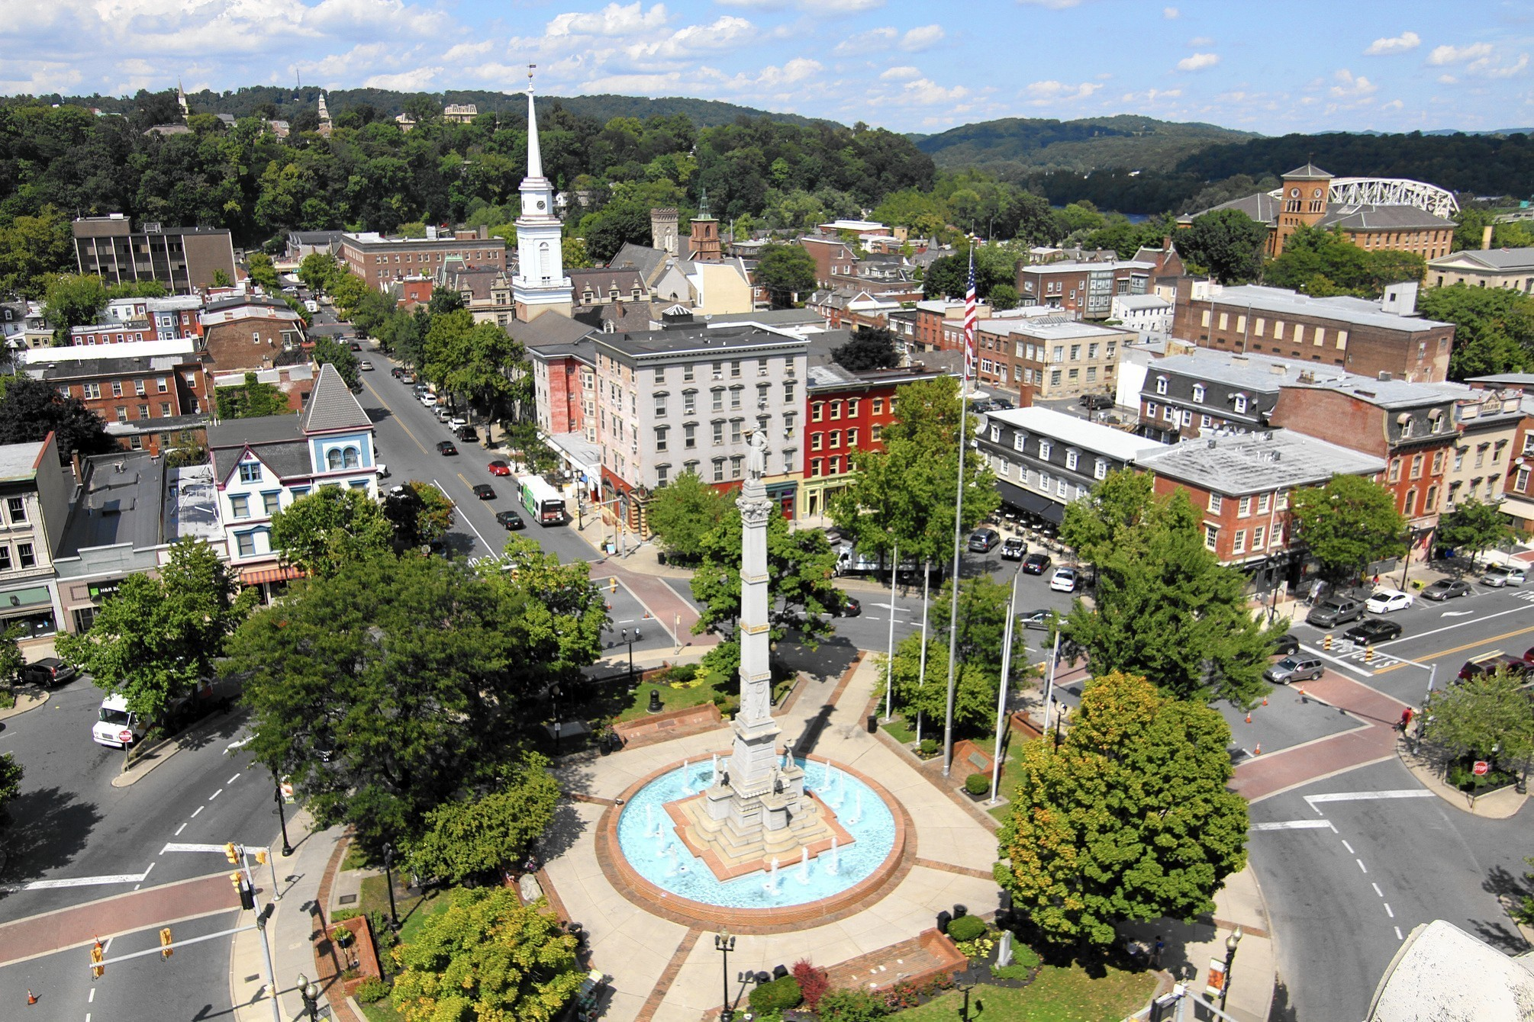
Contributing to Easton's Art Culture
Notes:
Kendall

Slide 10
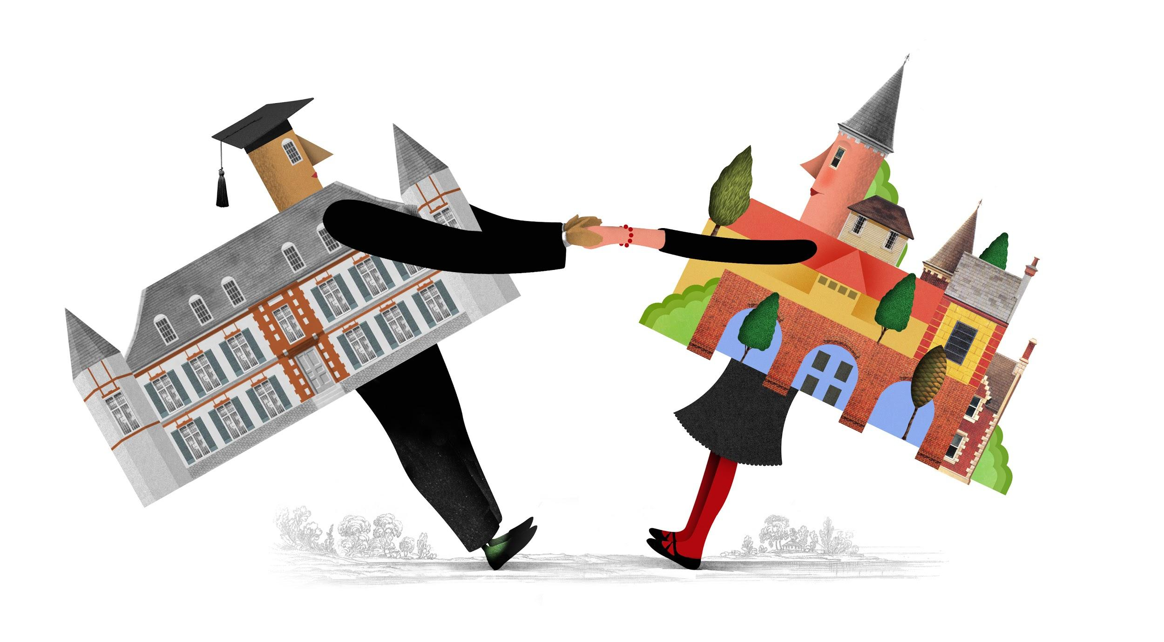
Community Relationships
Notes:
Kendall

Slide 11
Economic Considerations
Notes:
In order for us to understand the overall context surrounding this project, it was important for us to complete an economic analysis so that we are able to assess the value this bridge can provide. By considering the benefit this bridge, subsequent steps such as funding, construction, and maintenance will be completed more efficiently

Slide 12
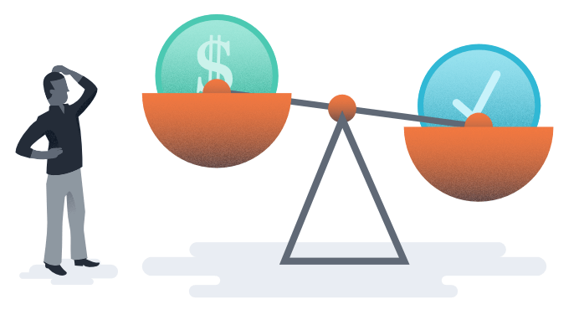
Benefit
Costs
Connecting Lafayette and the Easton Community
Social capital
Increased student patronage of Easton Business
Beautifying Easton
Materials
Labor
Maintenance
Consultation
Geotechnical Analysis
Notes:
While this bridge will entail various costs, we want to emphasize that this project will enhance the connectivity within Easton and the Lafayette Campus. In our research, we learned that as walkability in an area increases, so does social capital. What that is is the idea that there is a relationship between people and economically valuable entities. Essentially, as student use the trail more and easton community members come up to college hill, the area will ultimately grow economically.

Slide 13
Visualizing the Bridge
Notes:
Adam
Lastly, we wanted to provide some design ideas to consider for the bridge that we think will make this bridge effective in bringing more people to the arts trail as well and strengthening community relations.

Slide 14
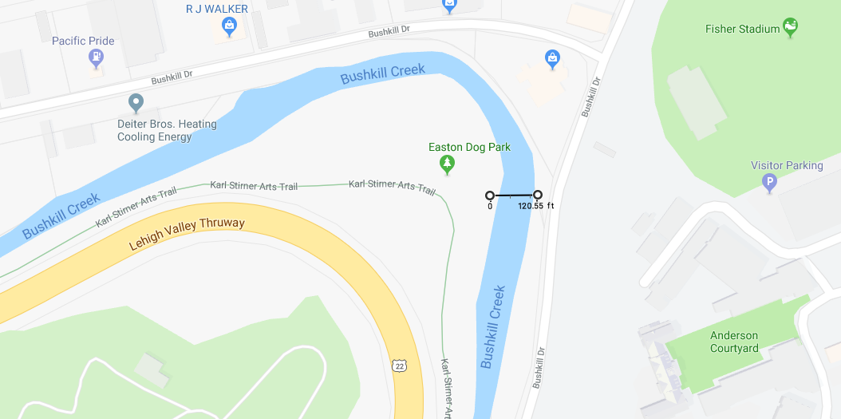
The Space
Lafayette Public Safety
Notes:
Adam
Might wonder what bridge could actually look like
120 ft bridge approx
As Kendall previously mentioned, this proposed bridge will add another access point to arts trail via bushkill dr. Specifically, the bridge will adjacent to the dog park and the IAS dealership.
Right next to the new Bushkill campus, and would be the closest access point to lafayette
The span of the bridge would be approximately 120 ft

Slide 15
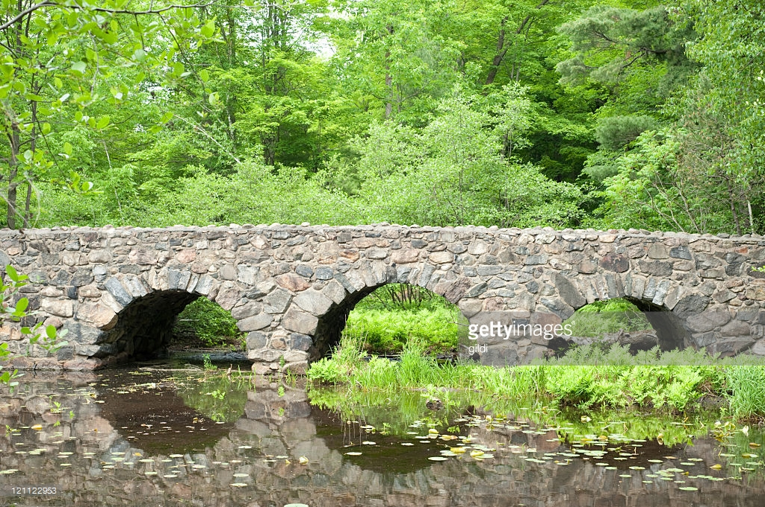
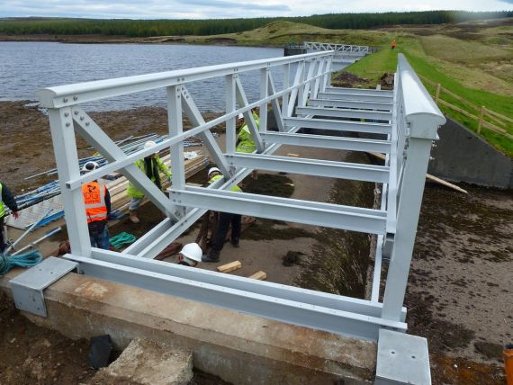
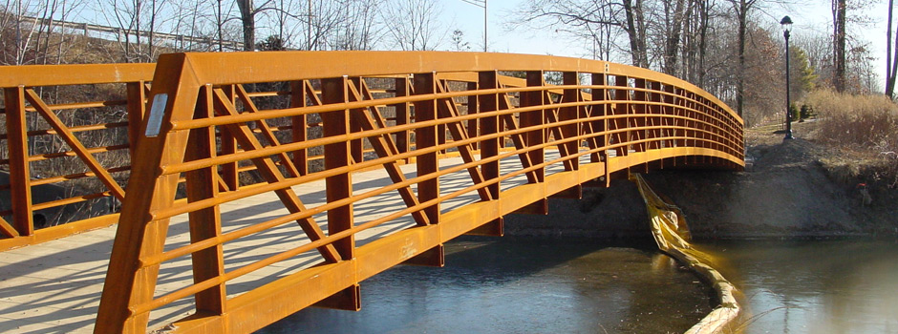
Materials
← Stone
Glass-Reinforced Plastic →
← Weathering Steel
Notes:
Ways that we can incorporate these design concepts is through the material used to construct the bridge. Through research of various materials, we have found several materials that would be ideal for this type of bridge.
Stone
Long lasting, low maintenance
Strong
May be limiting for design possibilities (more traditional look)
Glass Reinforced Plastic (composite)
Light weight, easy installation, good for remote locations, can be colored,
Could be Weak in high temperatures
This is a more expensive material than steel (most out of these 3)
Self-oxidizing steel (Weathering Steel)
Commonly used in bridge construction
Extremely durable, low maintenance
Least expensive start to finish

Slide 16
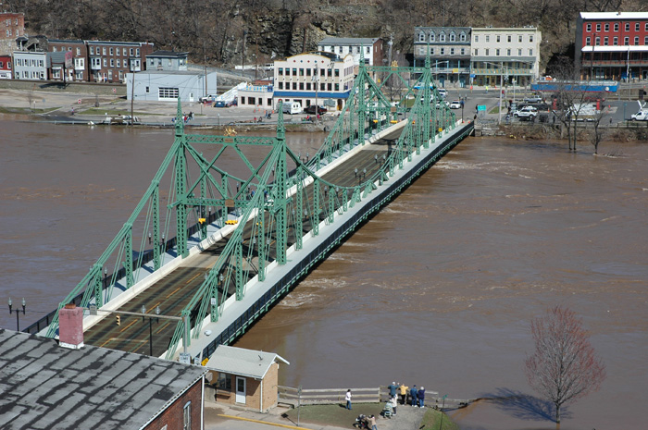
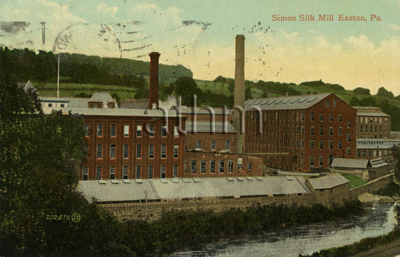
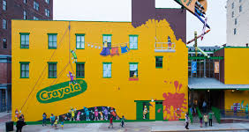
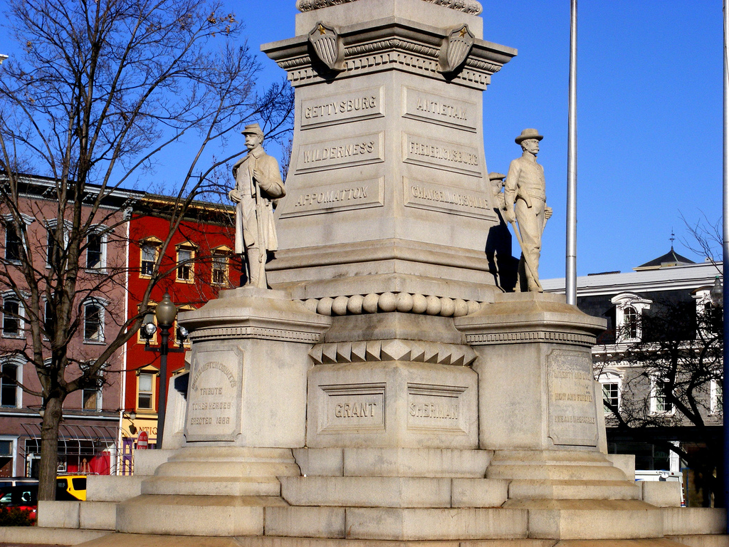
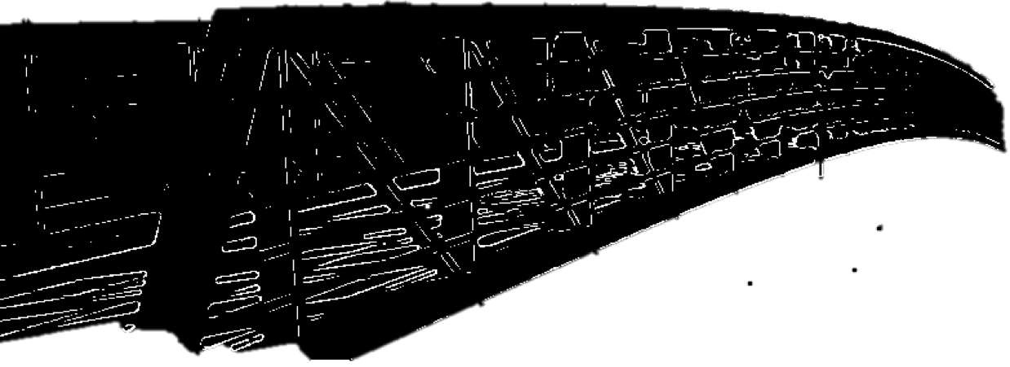
What Might This Bridge Look Like?
?????
??
Notes:
matt
Our proposed bridge is meant for more than just the functionality of a bridge, but to also improve the Lafayette/Easton community relationship as well as bolstering Easton’s art culture.
In order for this bridge to do those things, it will have to be designed in a way to interest community members to walk on it
The bridge would include design concepts that can educate users about things such as
Easton’s history,
STEM field education,
Inspirations could come from Easton’s flooding history, the two rivers, silk mill, crayola factory, etc.
(also id be careful not the mention “the flood” in Easton...there was that one flood in the picture but Easton has had many floods and that has shaped a lot of what Easton is now..so if that could influence the design just mention the general flooding history)

Slide 17
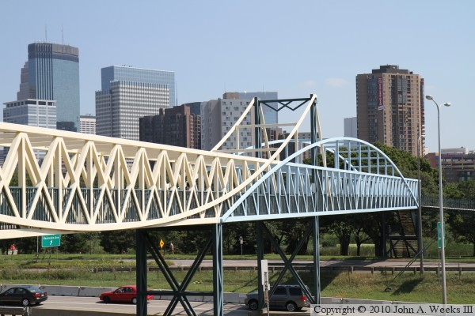
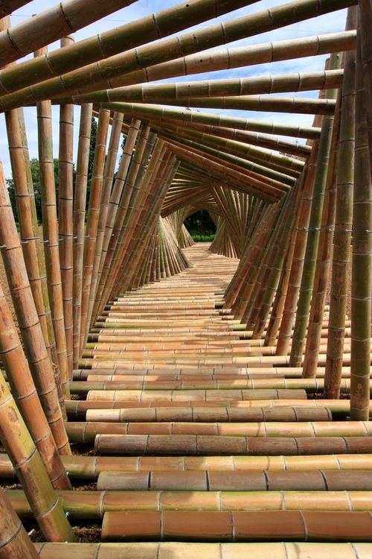
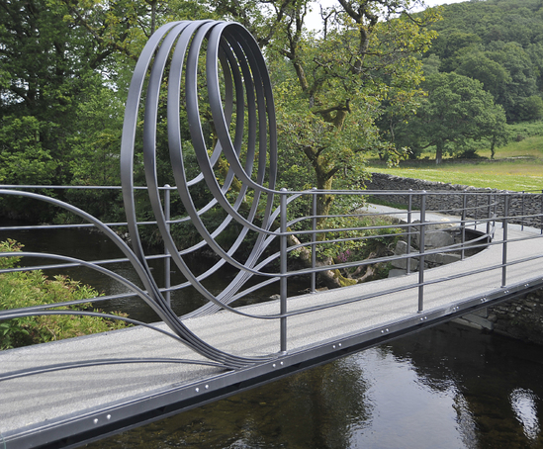
Inspirations
Irene Hixon Whitney Bridge: Minneapolis, Minnesota
Lake District National Park, UK
Kyoto, Japan
Notes:
Kendall
Its an experience, it’s a destination

Slide 18
Next Steps
Involve local artists
Gather community input
Develop design & choose materials
Acquire funding
Permit Applications
Finding manufacturer & builder
Notes:
Steve
Moving forward, we hope that this feasibility study will not only help provide information regarding its overall context, but encourage people working on this in the future to consider the ways in which it can be developed efficiently. If we were to continue working on this we think that incorporating easton’s local artists can ensure that the bridge possesses a meaningful artistic component. With their information, along with community input, we would be able to develop a design that can be proposed to the college and interested alumni. Then of course we would then begin to consider permitting, construction services, etc. However, we will cross that bridge when we get there.

Slide 19
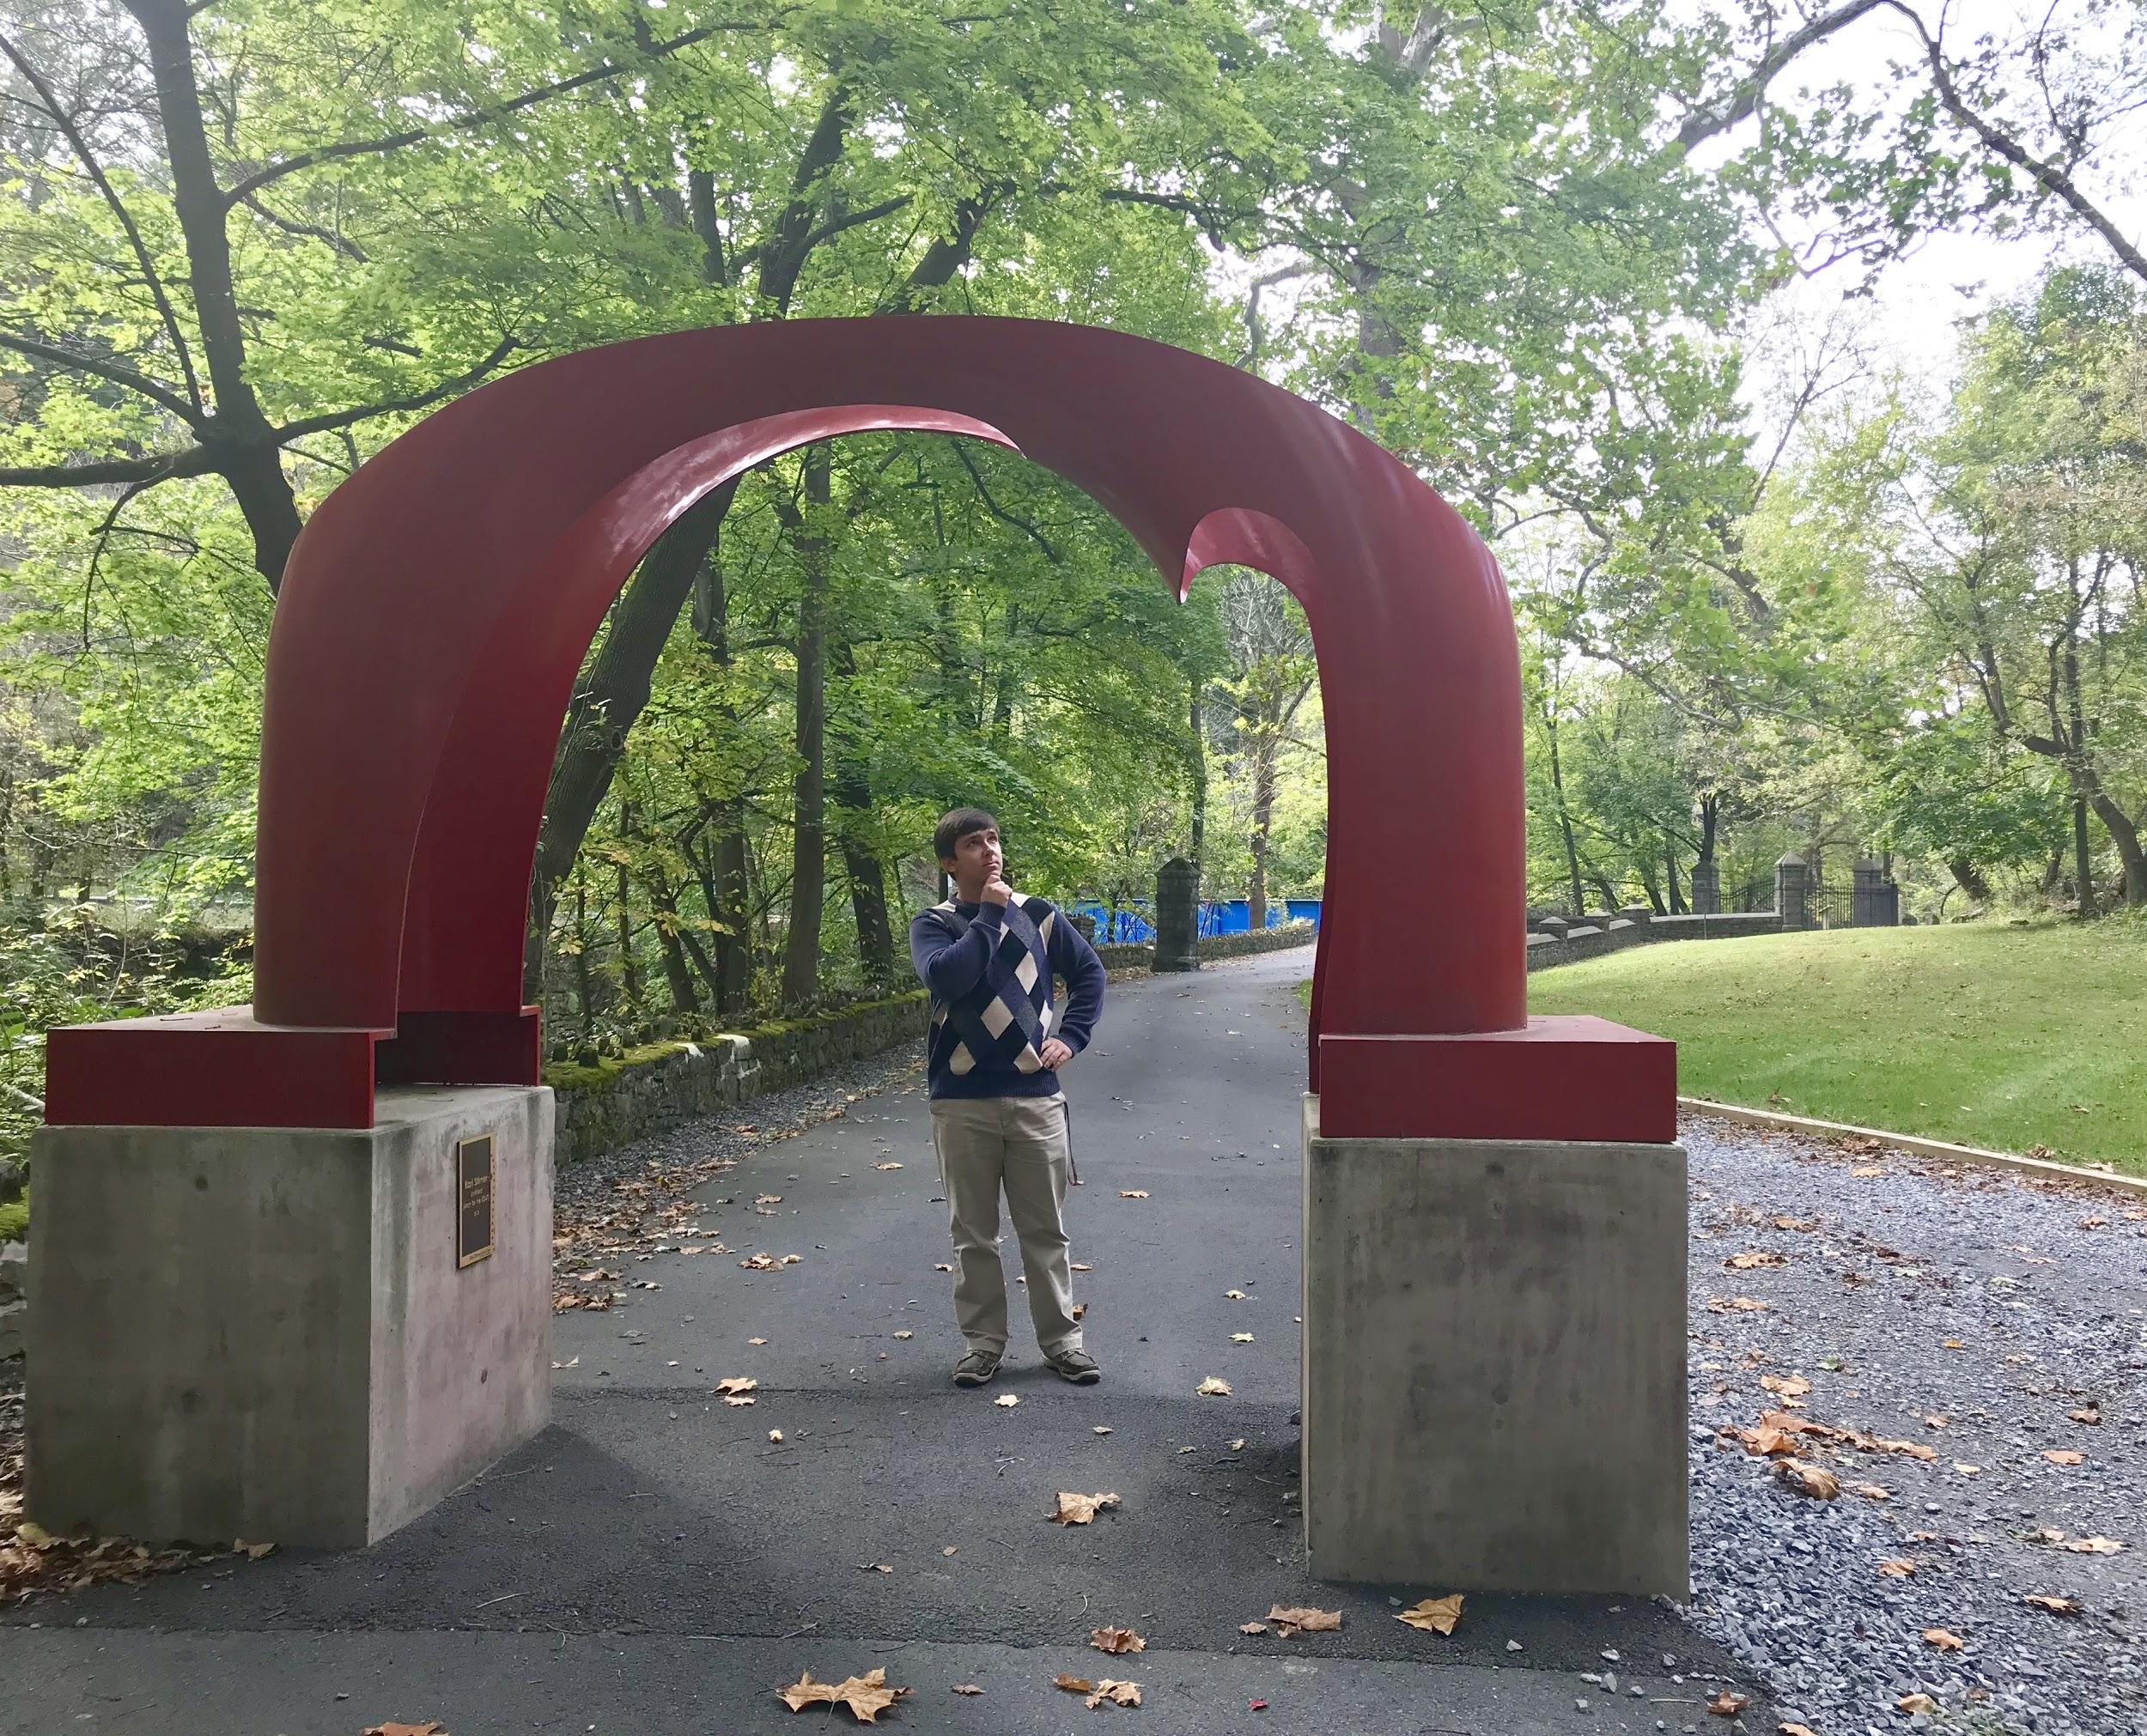
Questions?
Notes:
Steve

