Slide 1
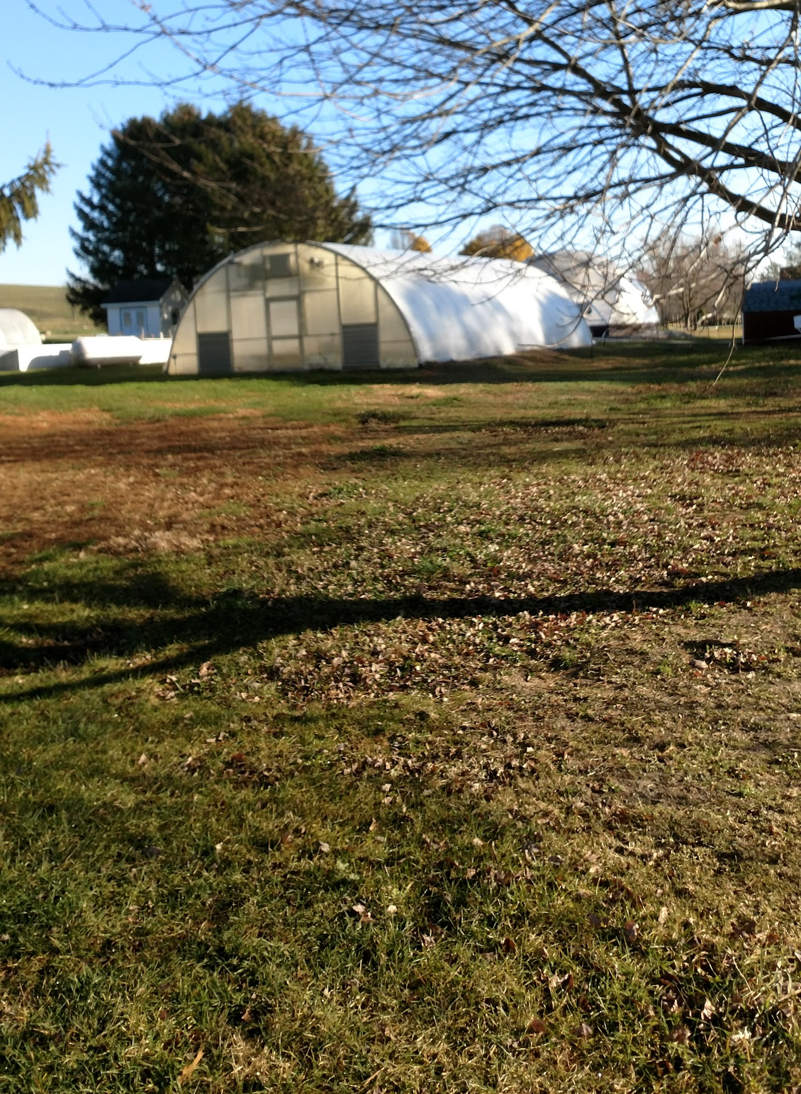
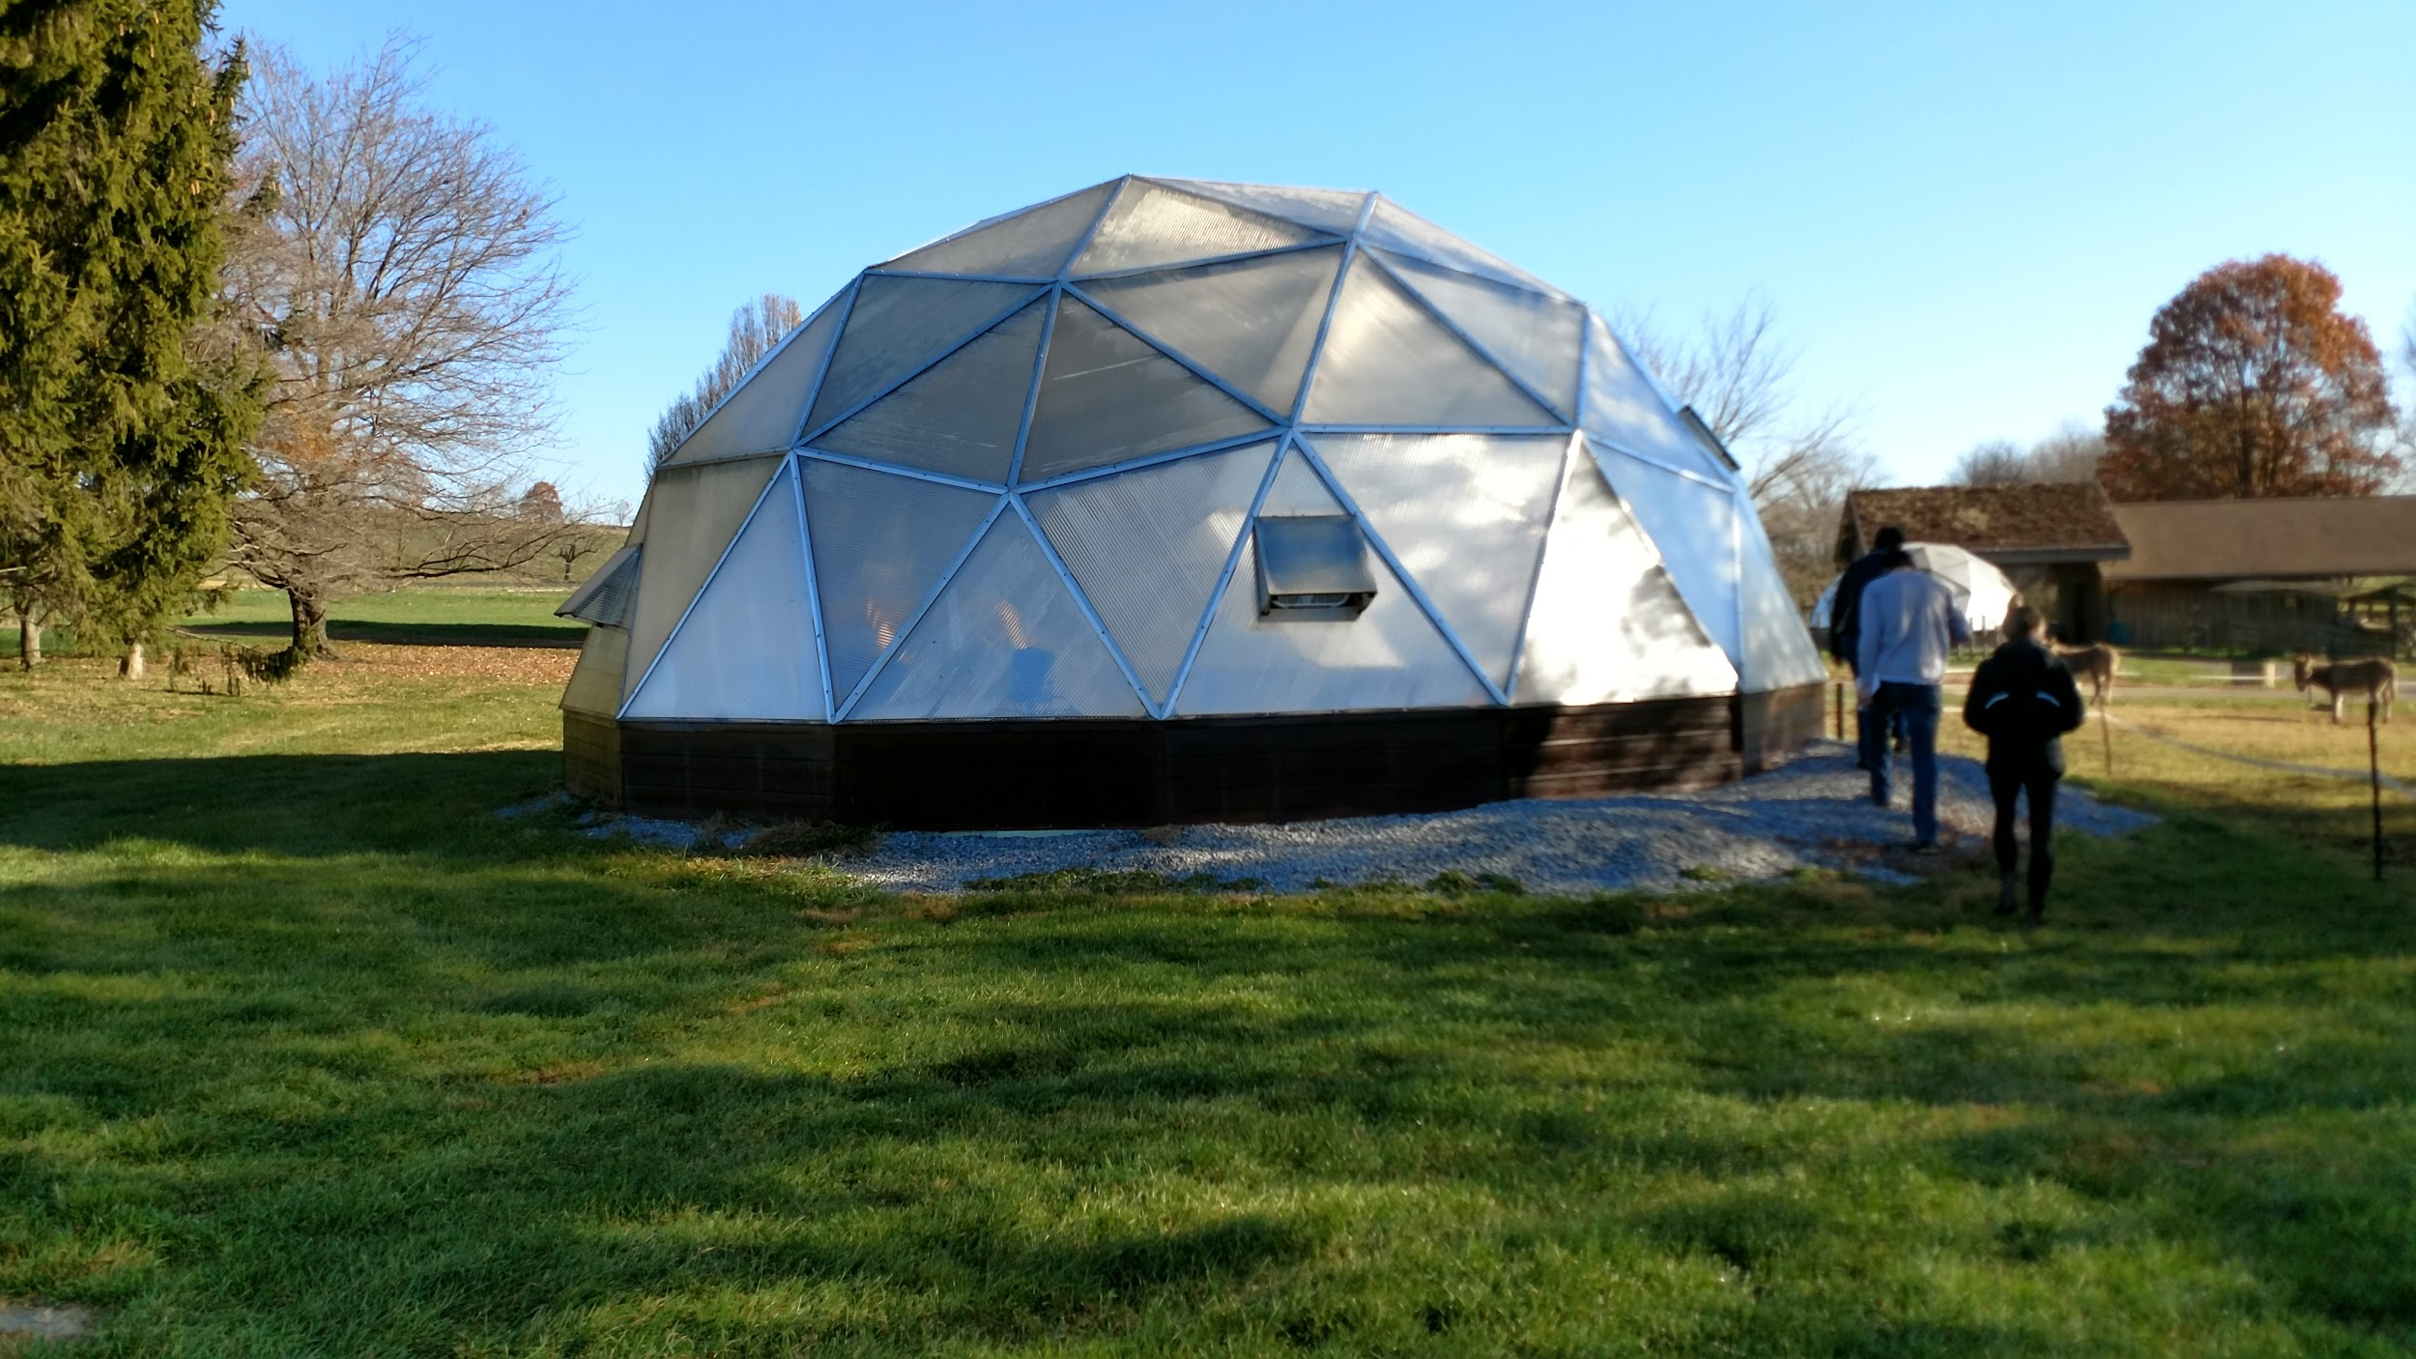
Greenhouse Dreamhouse 2016
Issaiah Coldren, Ezra Keough, Collin Owen, Kelly Reager

Slide 2
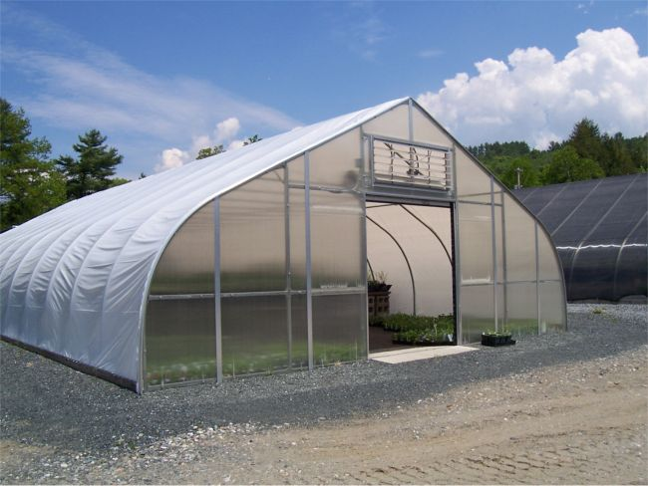
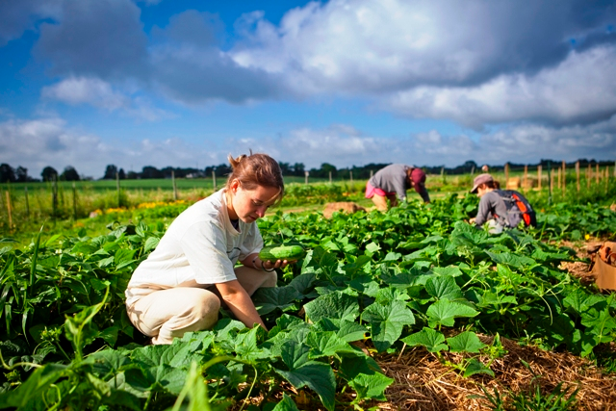
Background
Capstone Project 2015
Conclusion: gothic greenhouse
Our Project
Research Question
Project goals
Rental Greenhouse

Slide 3
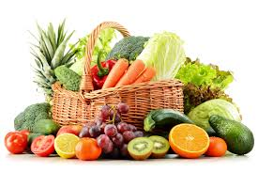
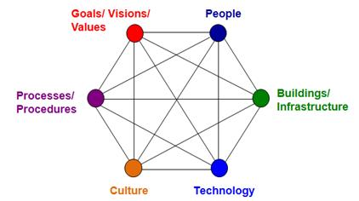
Social Context
Social Identity and the Garden:
Small Undergraduate Liberal Arts College with a Developing Sustainability Program
Size Comparison
Lafayette College
2,533
Purdue University
30,043

Slide 4
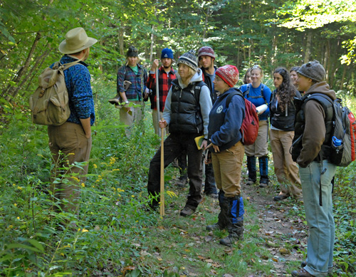
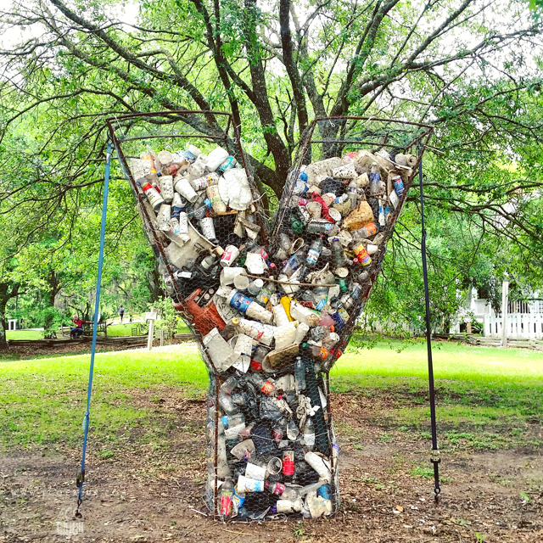
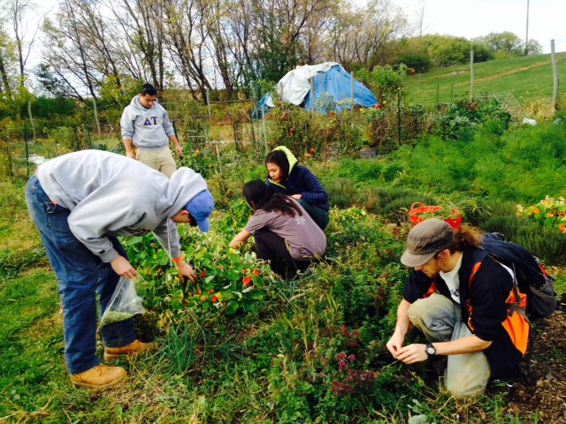
How the Carbon Neutral Greenhouse contributes to society at Lafayette
As part of two systems:
Lafayette’s formal education
As an example of progress for our developing sustainability program

Slide 5
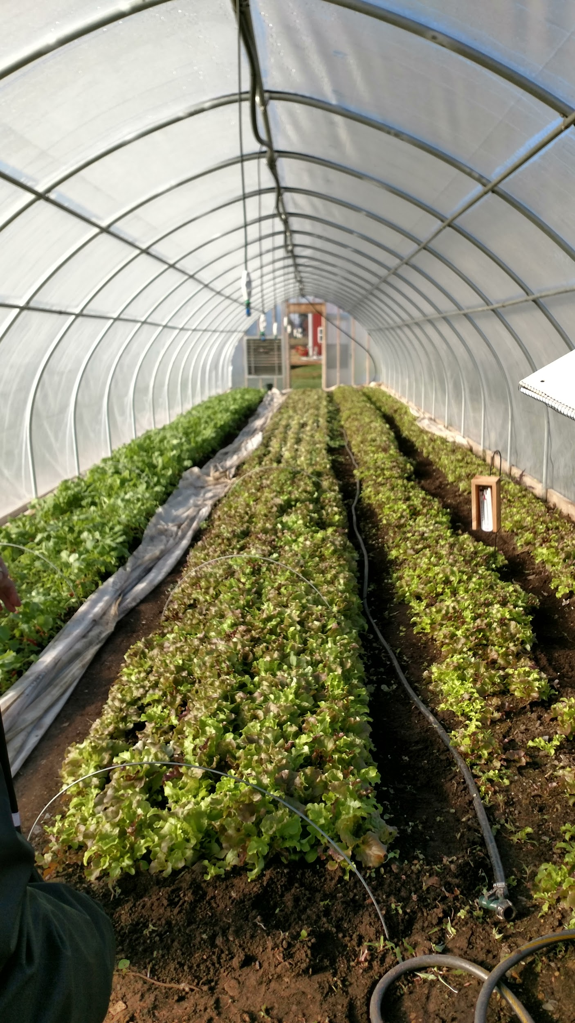
Technical Analysis
General results
Energy use is primarily due to heating, not electricity
Heating needs vary by plant species
Heating is highly dependent on temperature difference across film and surface area of a given film
Specific results
→ Need to identify three variables:
Defining Temperature of Environment
Defining Internal Temperature
Defining Maximum Area needed for seed-starting
→ A solution with worst-case-scenario assumptions
Notes:
General Conclusions from Technical Research on energy supply for greenhouses
Energy use is primarily from heating, not electricity: Amount of energy consumed by electricity is negligible.
Heating needs vary by plant species: Some seeds need no more than a hoop-house, but many significantly higher temperatures to get started
Heating is highly dependent on temperature difference across film and surface area of a given film: Heat Loss primarily a function of the flux of energy across the film between the inside and outside of the greenhouse
Specific Conclusions from Technical Research
→ Need to identify three variables:
Defining Temperature of Environment (dependent on time of year when seedlings are being grown)
Defining Internal Temperature (dependent on seedlings being grown)
Defining Maximum Area needed for Seed-starting (dependent on current needs and predicted garden growth)
→ A solution with worst-case-scenario assumptions

Slide 6
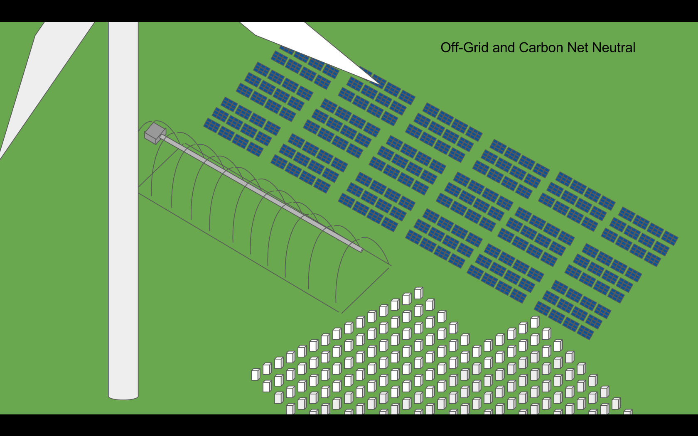
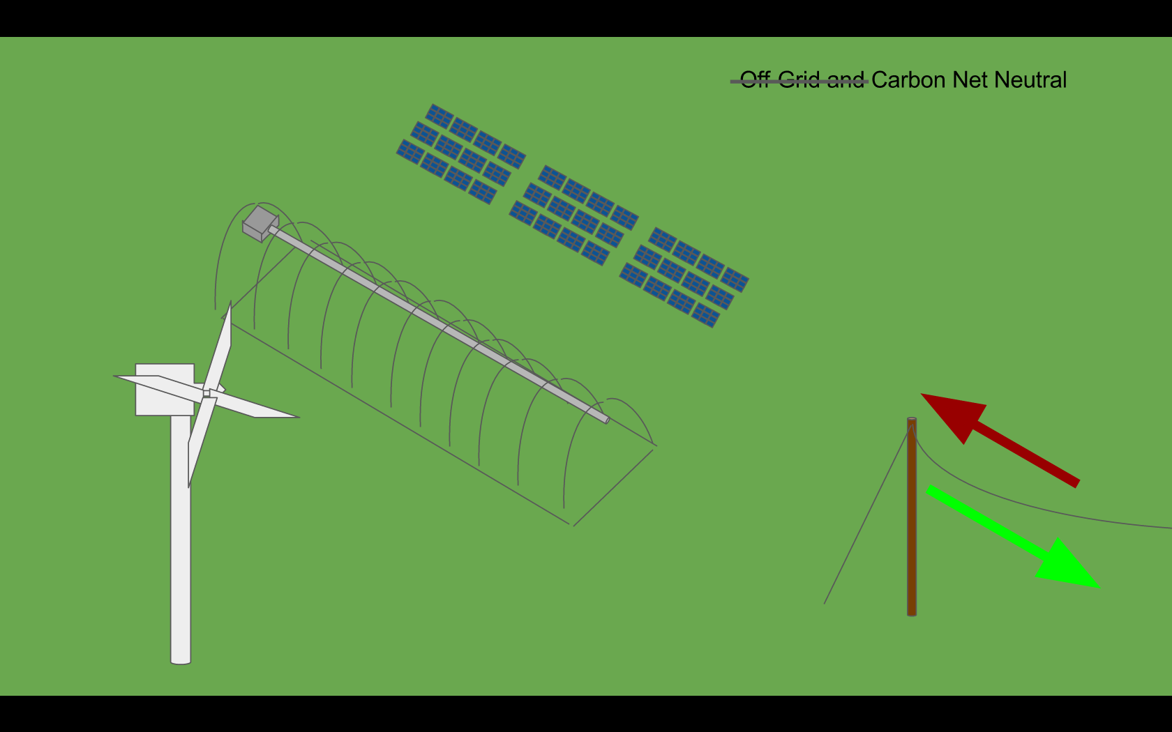
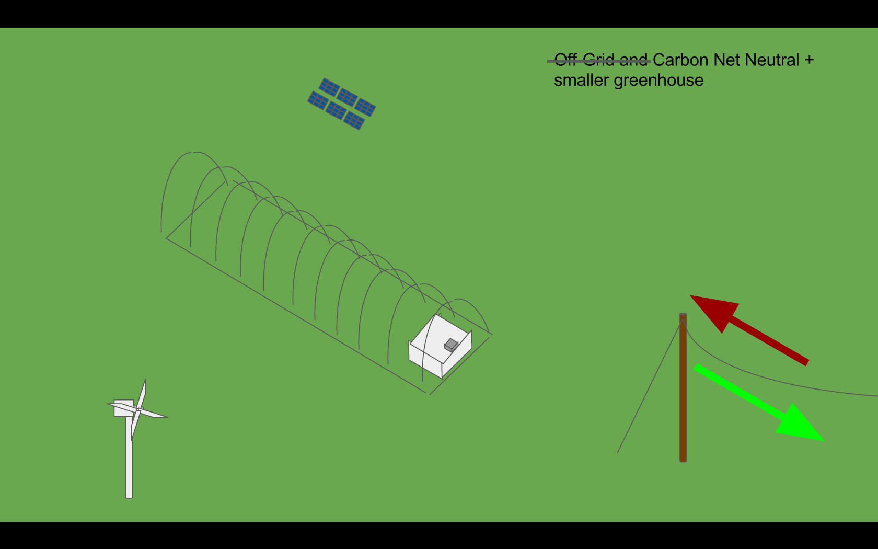
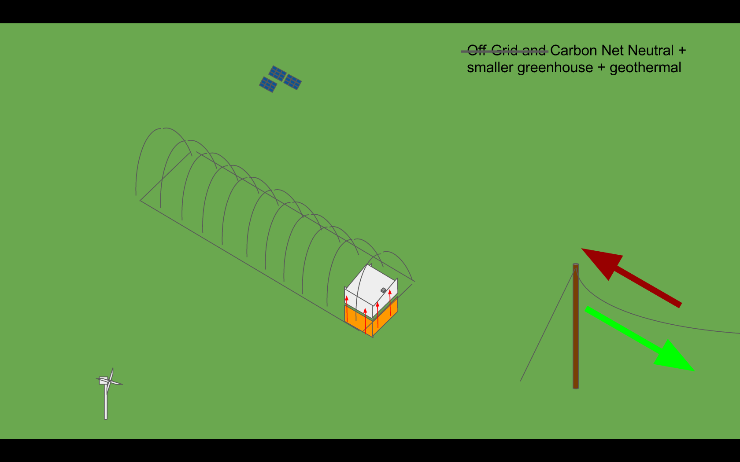
Net-Metered and Carbon Neutral
100mmBtu/yr
10x smaller demand
Layered Greenhouse, Carbon-neutral
Layered greenhouse, carbon-neutral, geothermal
40% Heat Reduction
+15˚F
Decreased Surface Area
Notes:
General Conclusions from Technical Research on energy supply for greenhouses
Energy use is primarily from heating, not electricity: Amount of energy consumed by electricity is negligible.
Heating needs vary by plant species: Some seeds need no more than a hoop-house, but many significantly higher temperatures to get started
Heating is highly dependent on temperature difference across film and surface area of a given film: Heat Loss primarily a function of the flux of energy across the film between the inside and outside of the greenhouse
Specific Conclusions from Technical Research
→ Need to identify three variables:
Defining Temperature of Environment (dependent on time of year when seedlings are being grown)
Defining Internal Temperature (dependent on seedlings being grown)
Defining Maximum Area needed for Seed-starting (dependent on current needs and predicted garden growth)
→ A solution with worst-case-scenario assumptions
Off-grid energy supply must be designed around short-term energy usage whereas on-grid energy supply is based on annual energy use
Short-term energy usage must be designed around dramatic spikes thanks to periods of low energy production and high energy use
Eliot Coleman notes the idea of using cold frames inside hoophouses. We suggest using an entire addt’l greenhouses inside.
Geothermal is supposed to be up to a 40% reduction in PA.
Need to mention buying clean energy as an option

Slide 7
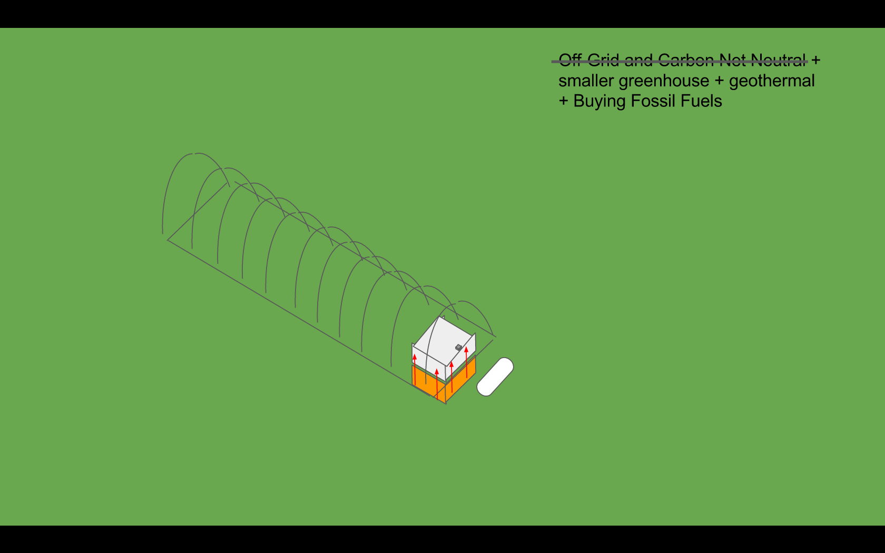
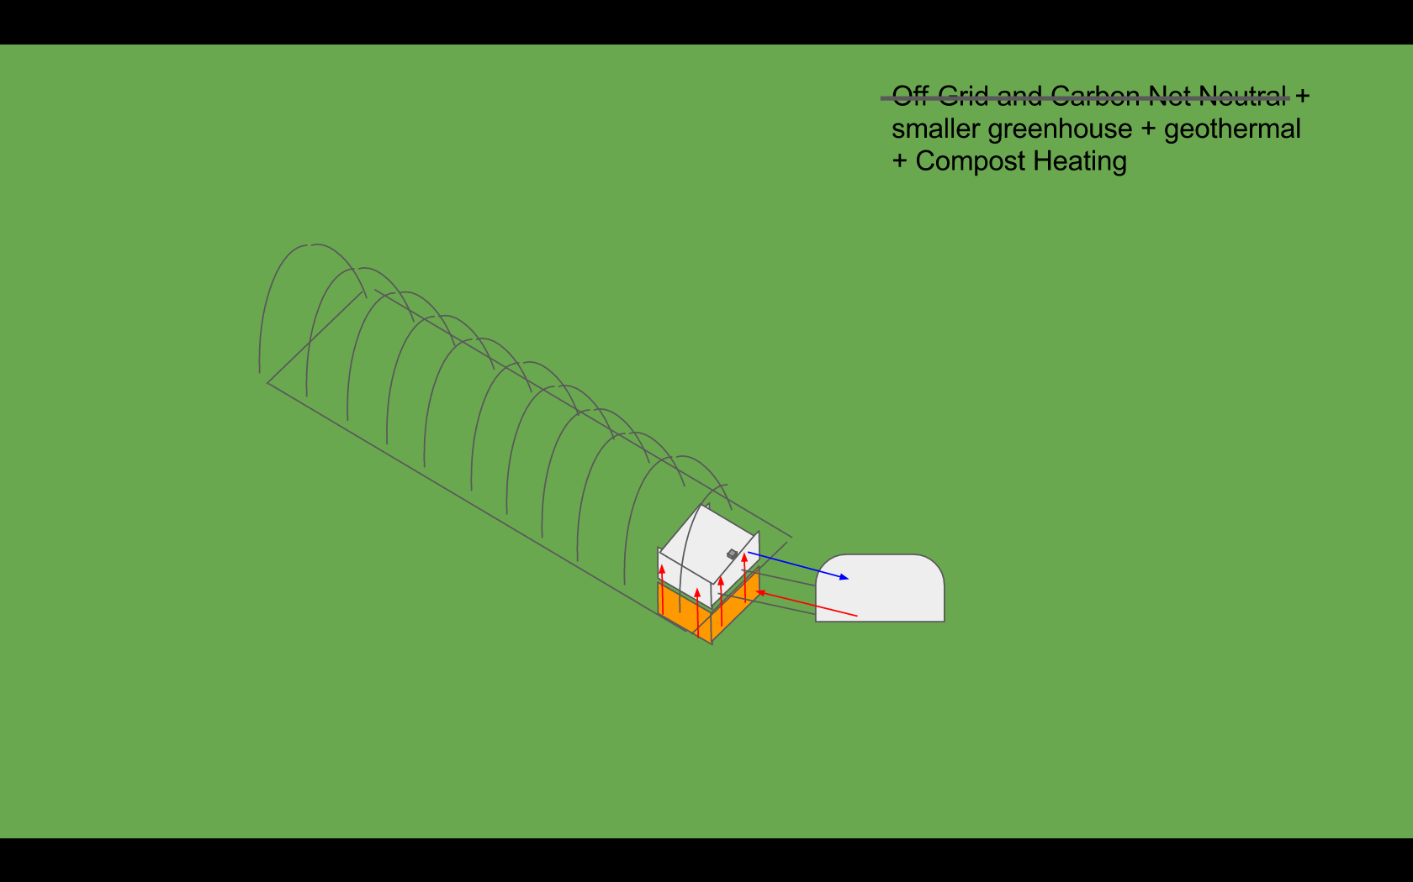
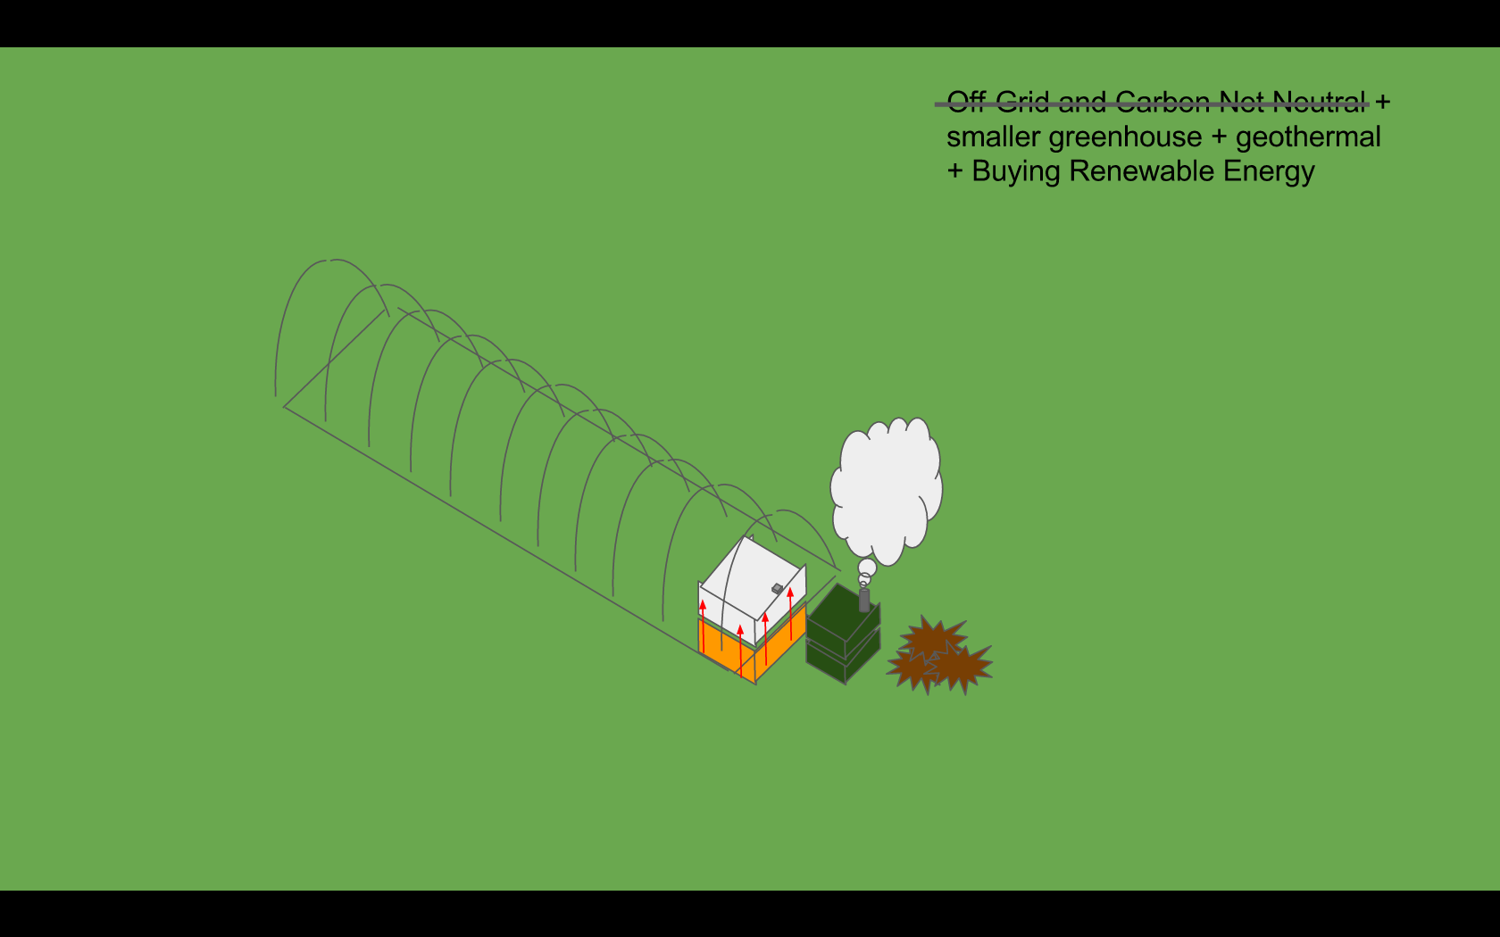
traditional natural gas heating
experimental compost heater
wood-burner
experimental water-heat storage
Notes:
Need to mention buying clean energy as an option

Slide 8
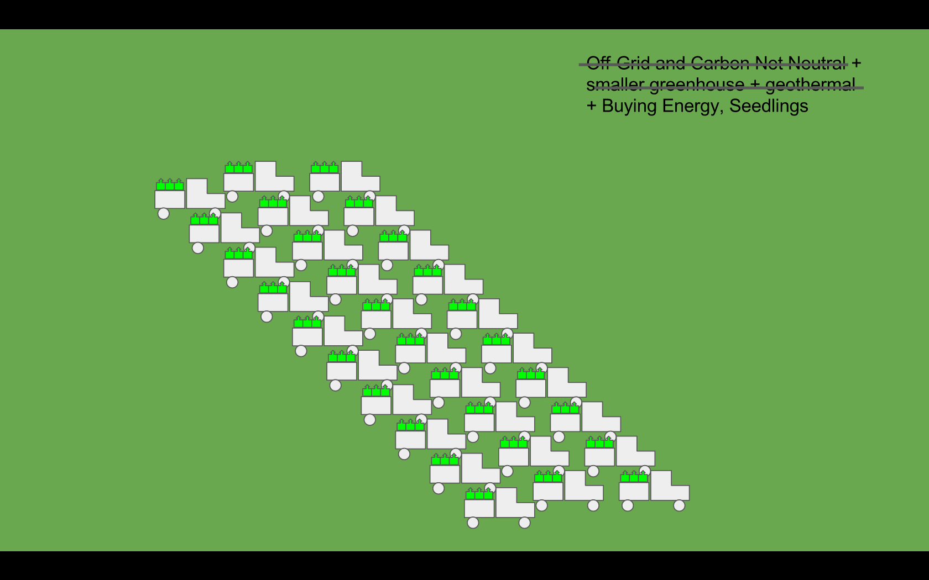
Economic Analysis
From a financial standpoint, why do we need a heated greenhouse?
Rental Greenhouse Opportunity Cost
Connecting Lafayette with the Community
Make LaFarm a more productive cornerstone of Lafayette College
Notes:
As Issaiah mentioned earlier, the LaFarm manager, Sarah Edmonds drives 40 mins to a rental Greenhouse in Emmaus PA. She makes this drive twice a week during the growing season which a major opportunity cost in which she could make more productive use of her time
If we implemented a greenhouse onto LaFarm we could take advantage of seed starting which would allow us to grow crops during adverse weather conditions giving us a head start and the ability to grow more crops leading to an increase in sales to Bon Appetit and donations to Easton
Additionally we could connect with members of Forks Township and Easton by renting out parts of the Greenhouse
How the opportunity cost unfolds:
→ Primarily: underutilization of the skills of a salaried Lafayette College employee (maybe $1,000 of her salary goes to driving rather than doing actual gardening).
→ Secondarily: added costs of gas and rental space

Slide 9
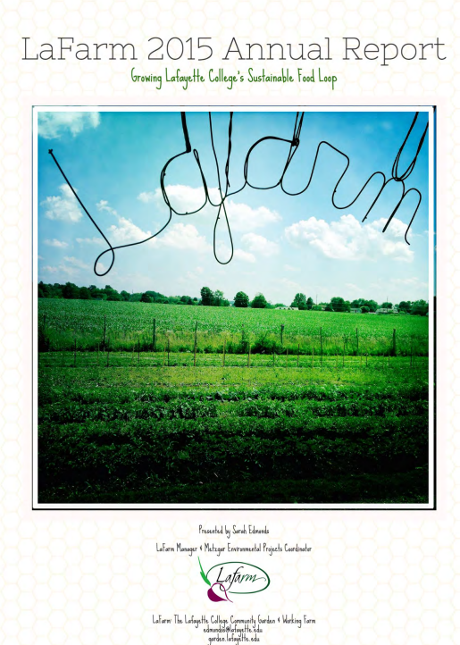
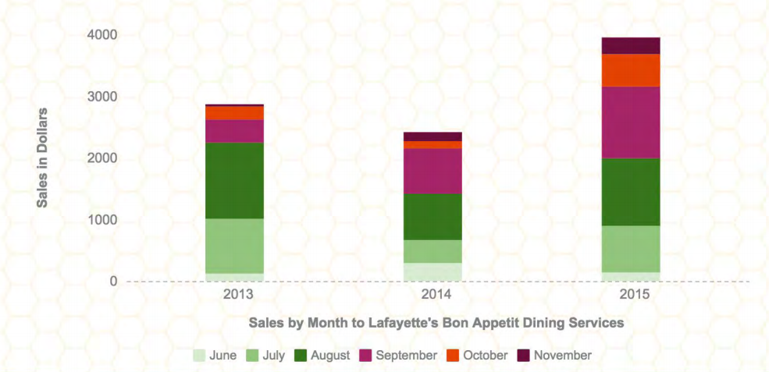
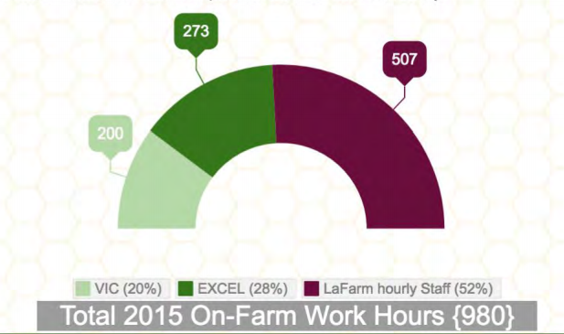
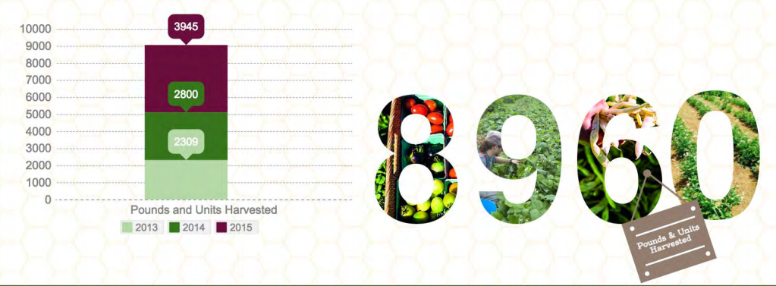
Notes:
This Greenhouse will improve upon the success that LaFarm has built up for the past 3 years
For a better understanding of this project we have researched the history and context of LaFarm by viewing the annual reports which are available online
These graphs and charts are from the report and they show…
Tell us why it matters.
The greenhouse has a high initial cost and increased hours of work associated but pays back over time with increased sales of produce.

Slide 10
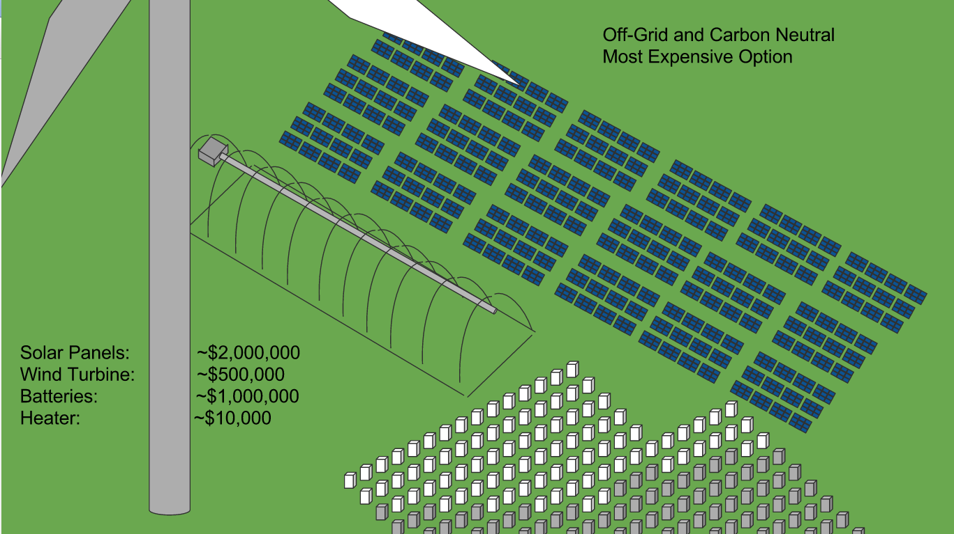
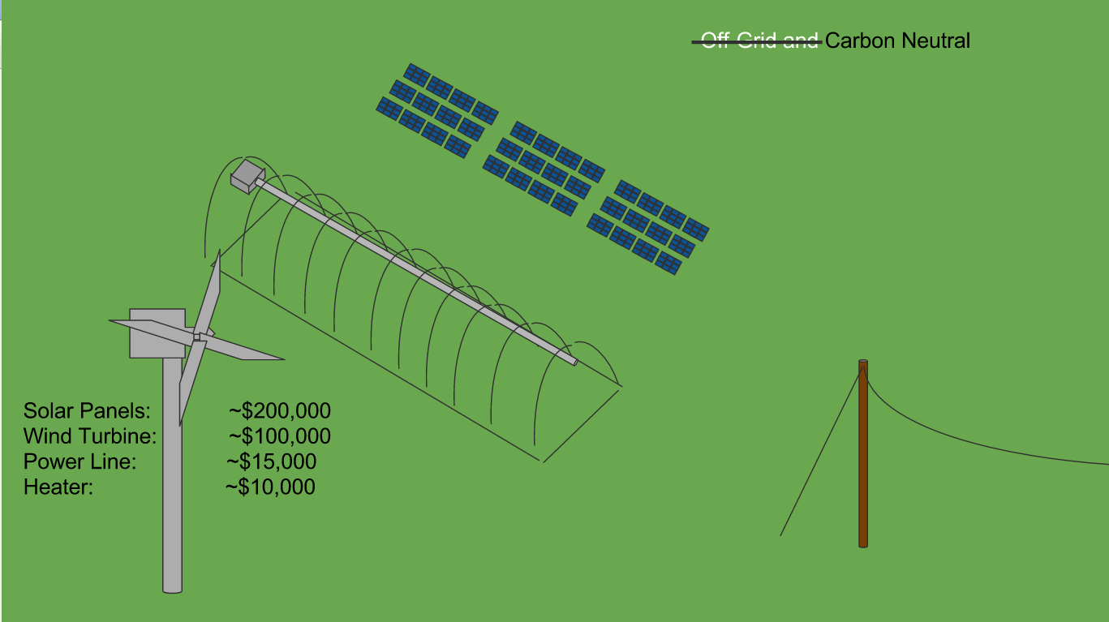
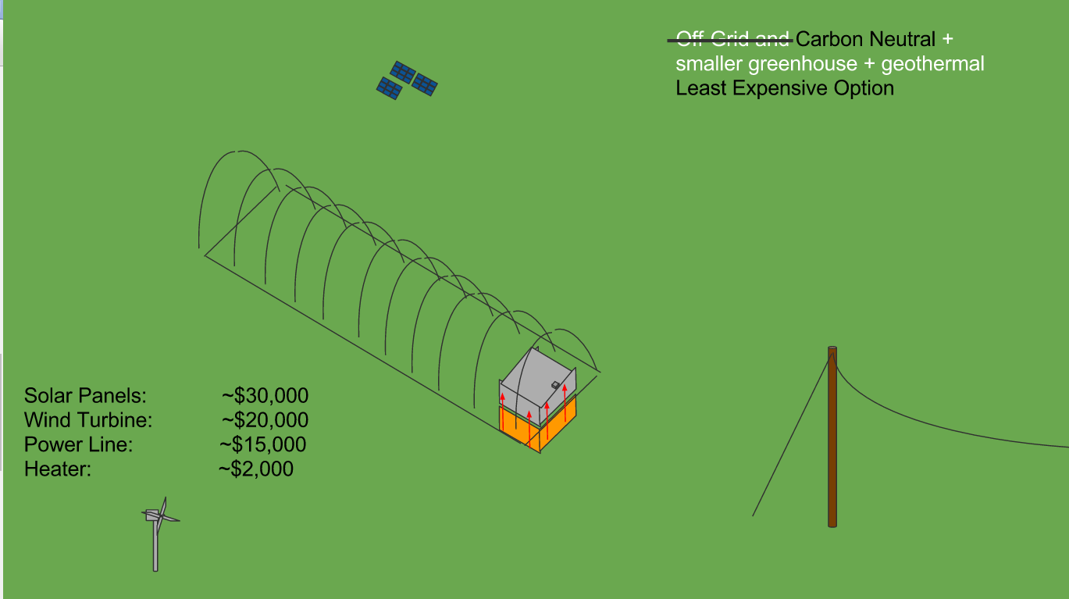
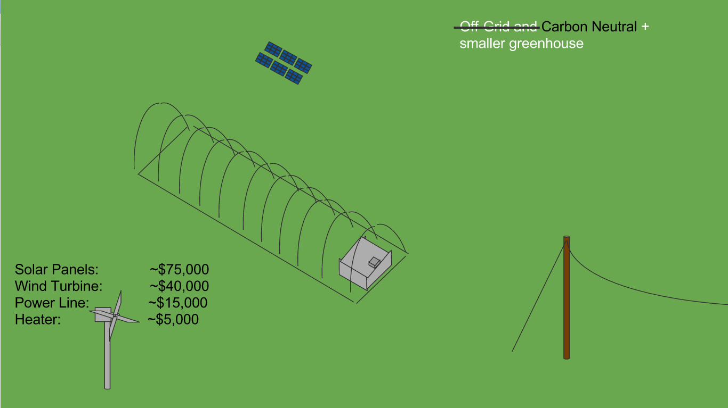
Total~$3,500,000
Total~$325,000
Total~$67,000
Total~$135,000
Notes:
Explain Costs which is best and how we advanced through each option
How will we get the funding for this project? - Lafayette Administration, Local Donors/Alumni, Federal Loans/Grants

Slide 11
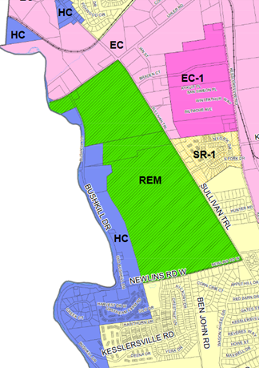
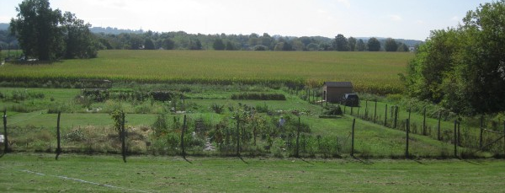
Political Analysis
Pennsylvania/Forks Township
(can we even build a greenhouse on this site?)
Zoning regulations
REM
Usage regulations
Environmental Performance Standards
Site Location

Slide 12
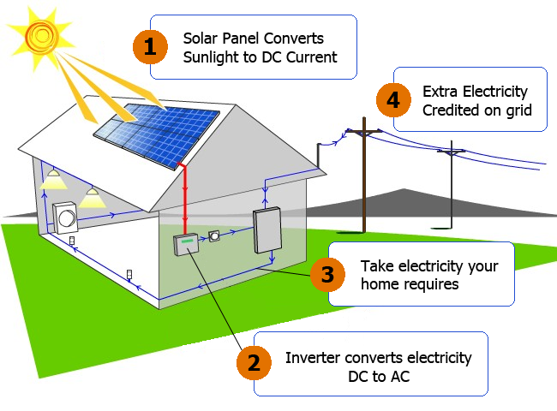
Net-Metering VS. Off the Grid
LaFarm’s personal preference
Multi-step process to reach off the grid
Regulations varies by state
Not all electricity suppliers provide net-metering

Slide 13
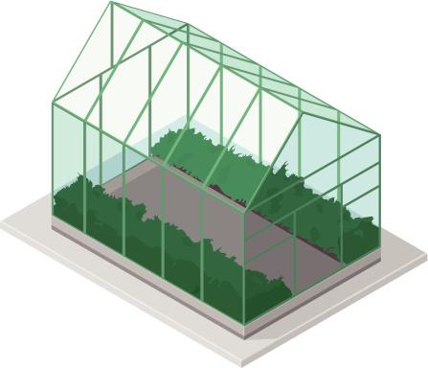
Federally Funded Program
Eligibility
Organizations vs. individuals
How To Apply:
Online registration
Potential Grants:
Organic Agriculture Research and Extension Initiative

Slide 14
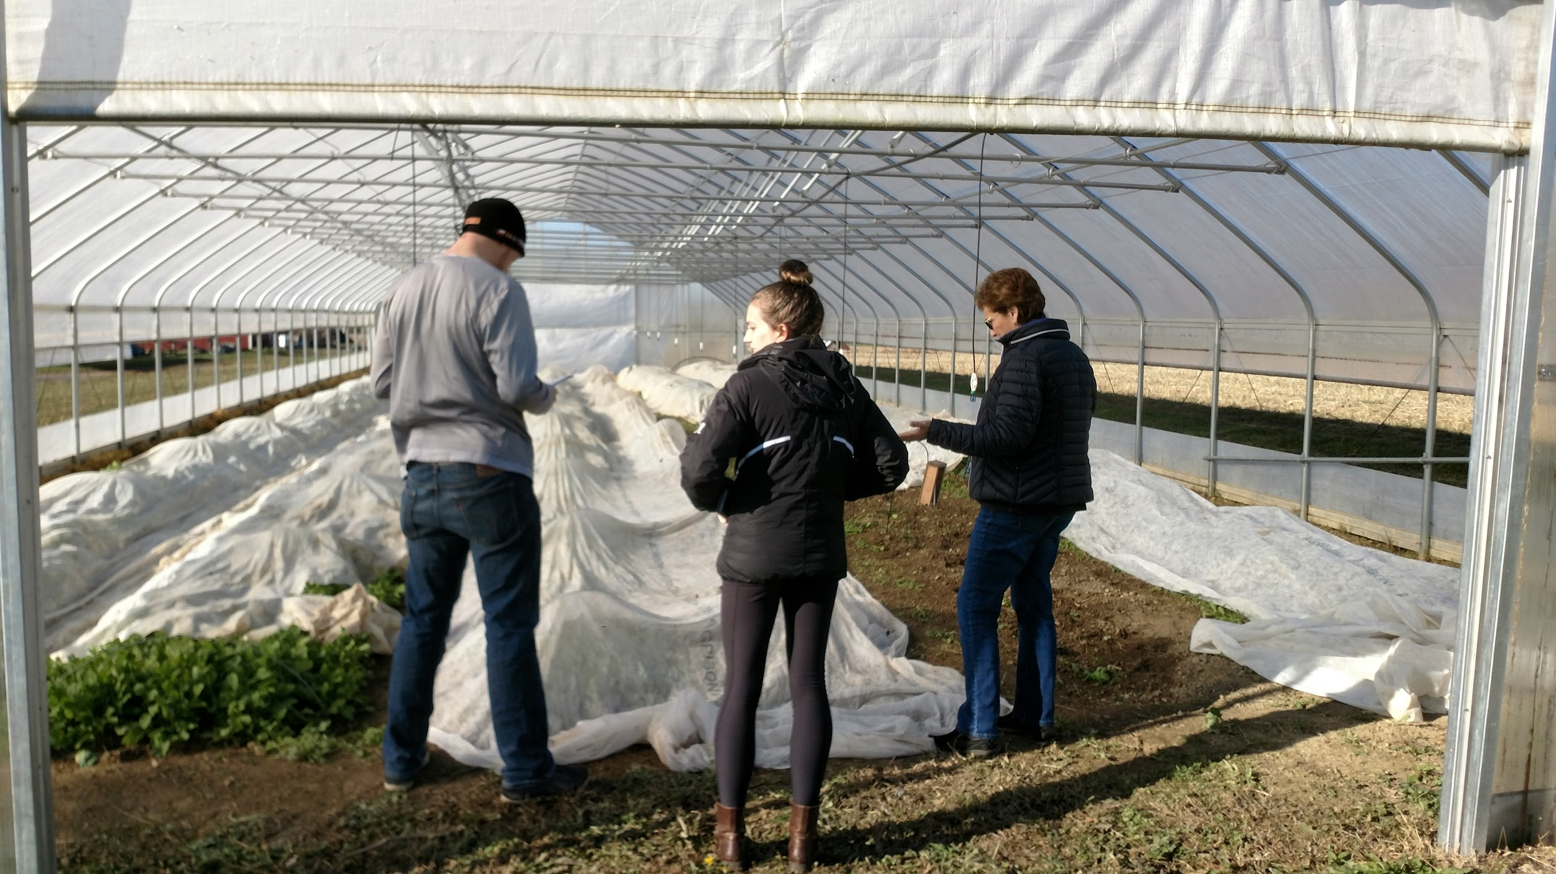
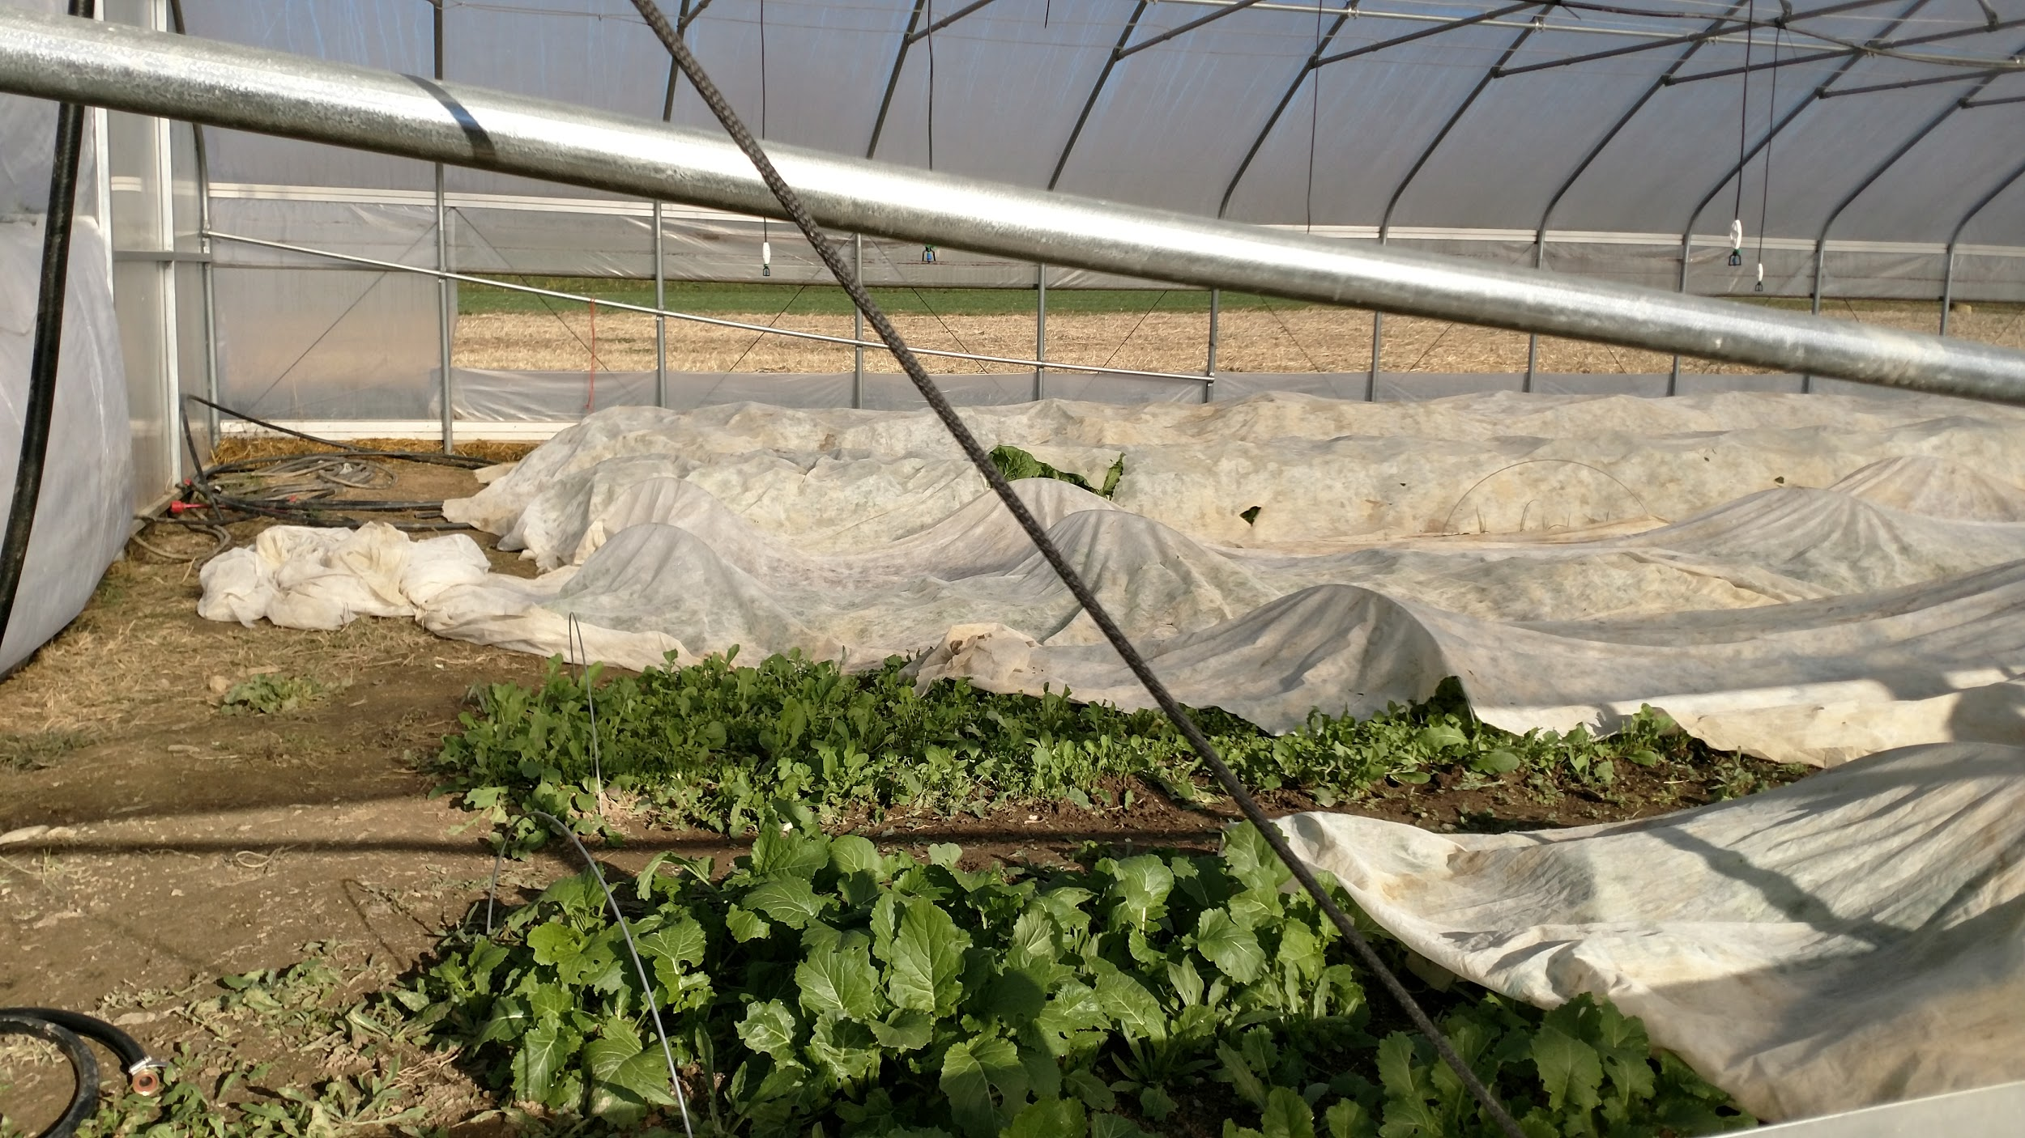
Recommendations
Stepped Solution
Next Main Focus - Water
Independent Studies, Research, & Interdisciplinary Projects

Slide 15
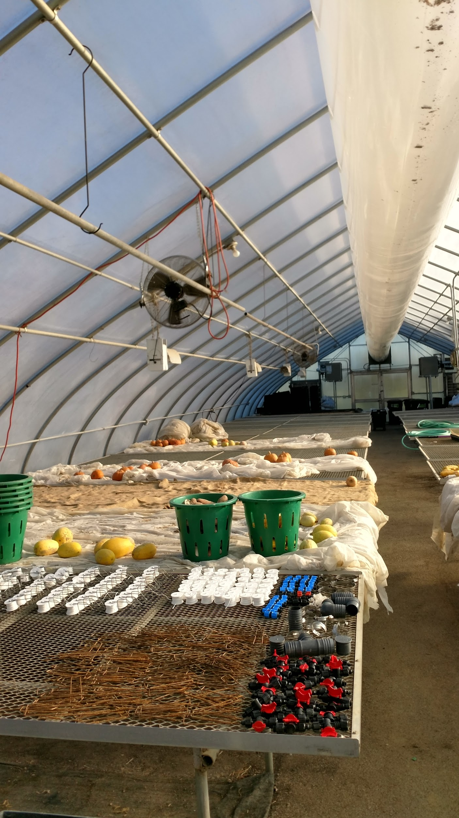
Conclusion
Rodale Institute
Stepping Stones
$5,000 Student Government granted hoop-house budget must be spent by end of Spring Semester

Slide 16
Thank You!
Questions?

