Slide 1

Lafayette College Project Management
Elliot Les and Tianmin(Kevin) Kong

Slide 2

Agenda
Scope of Work
Project Planning
Milestones
Succession Planning
Takeaways
Notes:
Kevin

Slide 3
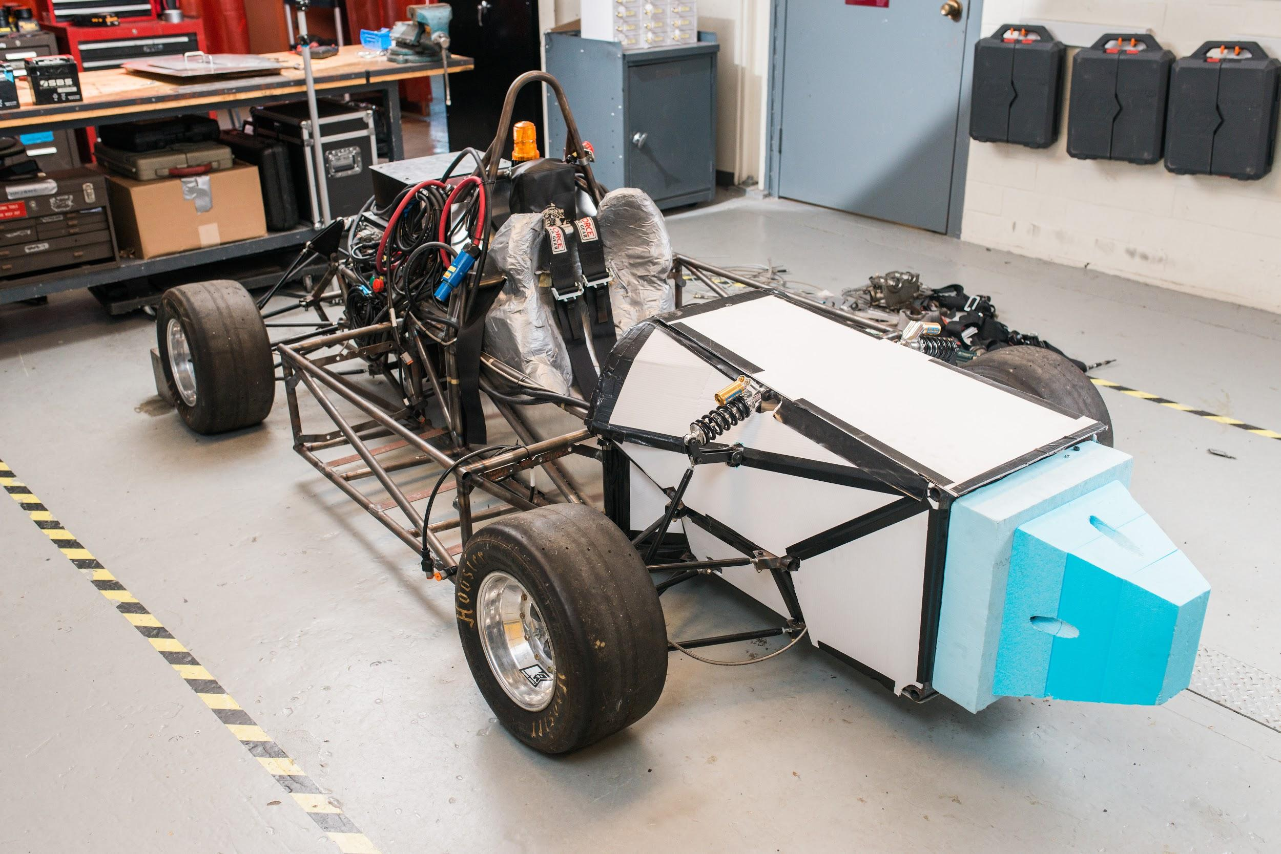
Scope of Work
Notes:
Elliot/Kevin
Two teams, senior design class.
Goal is to enter the competition

Slide 4
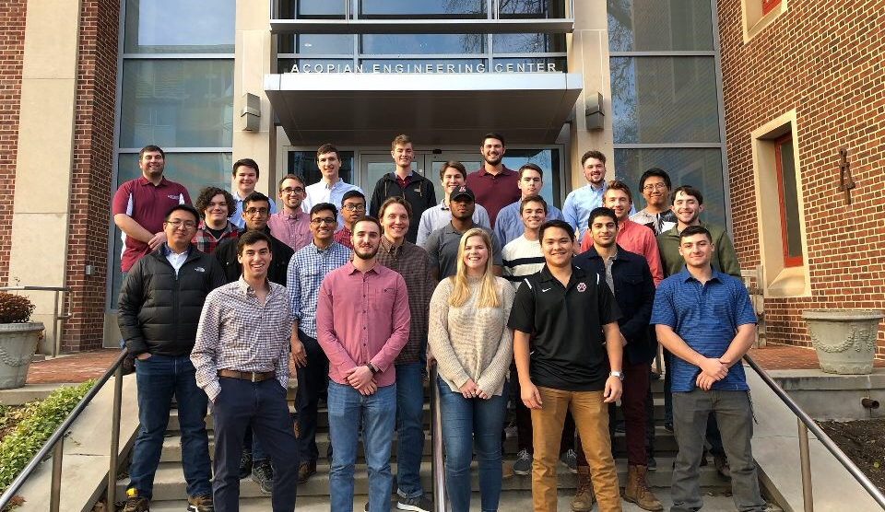
Team Structure
Notes:
Elliot/Kevin

Slide 5
Project Planning
Notes:
Elliot

Slide 6
Division Of Labor
Aero, Body, Chassis, and Ergonomics
Leadership, Management, and Rules
Suspension, Steering, Brakes, and Wheels
Powertrain, Packaging, and Batteries
(Electrical Sub-Components)
Notes:
Elliot

Slide 7
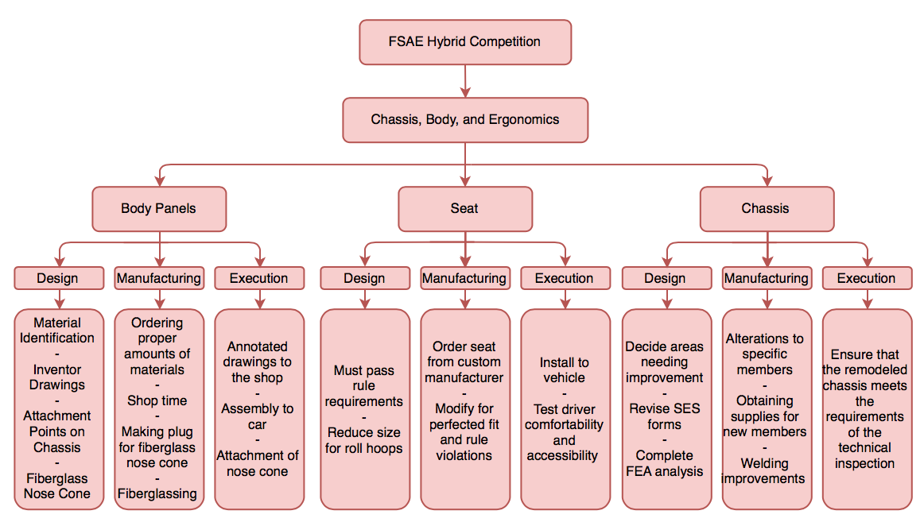
Work Breakdown Structure
Program
Project
Tasks
Sub-Tasks
Work Package
Notes:
Kevin
Used same style of the work breakdown structure for both ME and ECE teams.

Slide 8
Change Management Process
Discovery
Change Request
Change Analysis
Change Approval
Execution
A plan is currently in place and an issue is discovered.
Change is proposed in a weekly meeting or the team chat to the project managers or team leaders. A reason for change and recommendation are required.
The issue at hand along with the recommendation are discussed amongst the whole team. Discussion of the impact on the current plan, budget, and schedule is required.
A new plan is developed and finalized. The schedule and budget is adjusted to accommodate the change. The change must be fully cleared with team leaders, project managers, and faculty advisors.
The change is implemented and carefully observed throughout its completion.
Notes:
Elliot

Slide 9
Milestones
Independent Operation of Electrical Subsystems
Dynamometer fully operational with successful GLV and safety loop operation. TSI (high voltage relay) complete.
Vehicle Teardown and Redesign Completion
All problems with existing design identified.
Electrical Components Installed
Fully operational accumulators with appropriate wiring.
January 2018
March 2018
December 2017
February 2018
April 2018
Wheel Package Upgrades
Complete redesign of uprights, hubs, brake discs and callipers.
Rolling Chassis
All mechanical subsystems complete and operational.
Notes:
Elliot/Kevin

Slide 10
Succession Planning
Detailed Photographs
Parts Lists
Google Drive Folders
Open Shop
Invitations to weekly meetings
Recommendations
Reflection
Underclassmen
Involvement
Documentation and Organization
Final Report
Notes:
Elliot

Slide 11

Takeaways
Collaboration between engineering departments
Planning vs. Execution
Inherited Legacy from previous projects
Notes:
Kevin

Slide 12
Questions?

