Slide 1
ECE 491 - Team Alpha Final Design Proposal Presentation
Alexander Labell, Devin Arnold, Samuel Ehgartner, Corin Nosow, Austin Pelayo, Michala Dennis, Andrew Borek & Jack Horowitz

Slide 2
Team Organization
All members split into three design sub-teams:
Mechanical Design: Devin Arnold & Samuel Ehgartner
Electrical Design: Andrew Borek, Corin Nosow & Jack Horowitz
Embedded Control & User Interface: Michala Dennis, Austin Pelayo & Alex Labell
With the added administrative responsibilities:
Team Leader: Jack Horowitz
Quality Assurance Manager: Austin Pelayo
Treasurer: Devin Arnold
Organization Manager: Michala Dennis
Website Manager: Corin Nosow

Slide 3
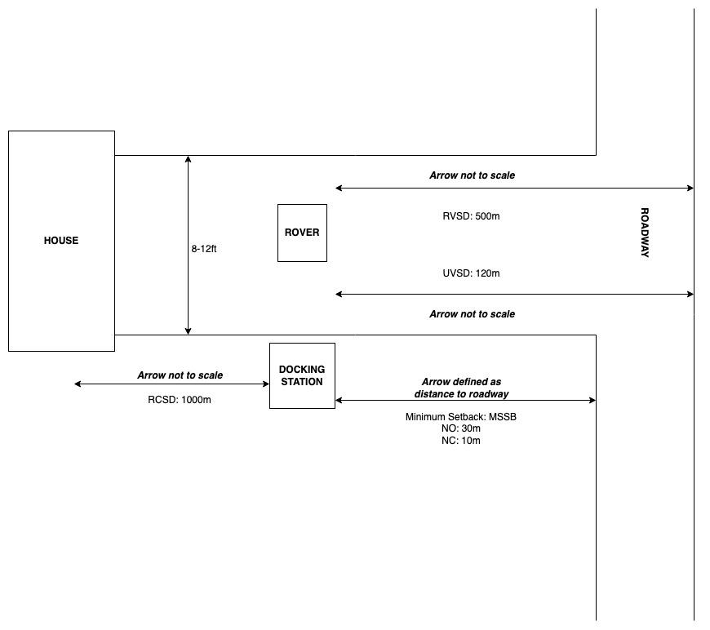
Defined Operation Environment

Slide 4
Mechanical Overview
The MARGE system will be divided into two parts, each of which are responsible for their own tasks
The Docking Station
Charging the MARGE Rover
Sensing the presence of incoming vehicles
Providing navigational aid
Sending commands to the Rover
Communicating with Remote Controllers
The Rover
Traveling between the Docking Station and the midpoint of the roadway
Act as a responsive or passive indicator to cars entering the roadway

Slide 5
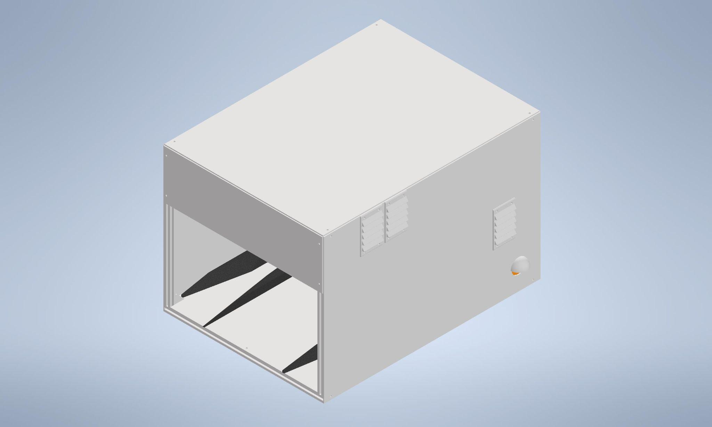
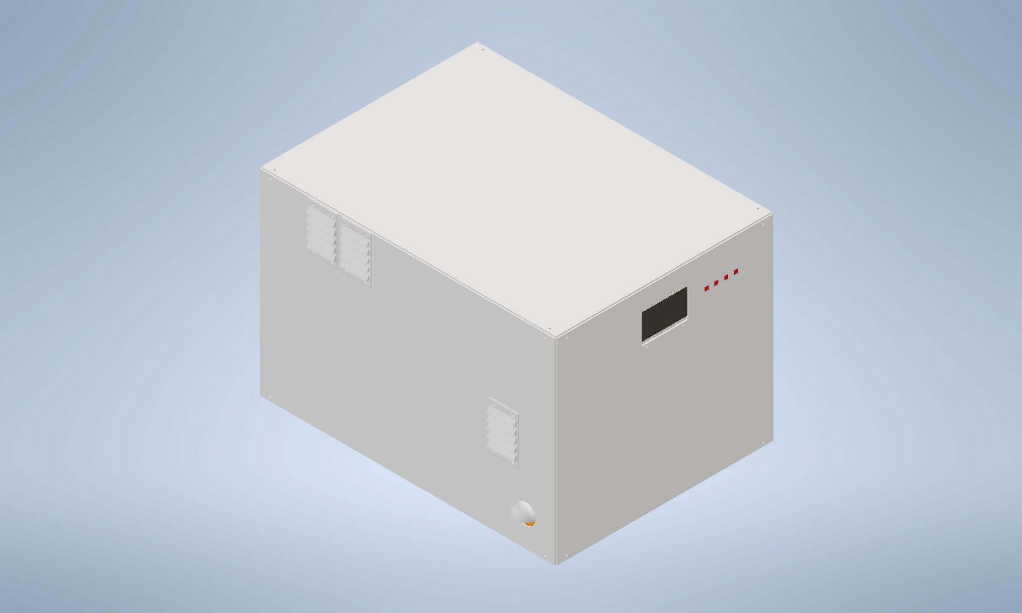
The Docking Station
Main team member responsible: Sam
Structural Design:
Total Dimensions: 22” wide / 30” long / 20” tall
Constructed from aluminum T-Slot framing and polypropylene plastic body panels
Powered by 100W photovoltaic panel that will be placed near the Docking Station
Ventilation points included to avoid overheating
User interface access point located on the rear of the structure
Total Weight specification: ~70 lbs
Docking Station Front View
Docking Station Rear View

Slide 6
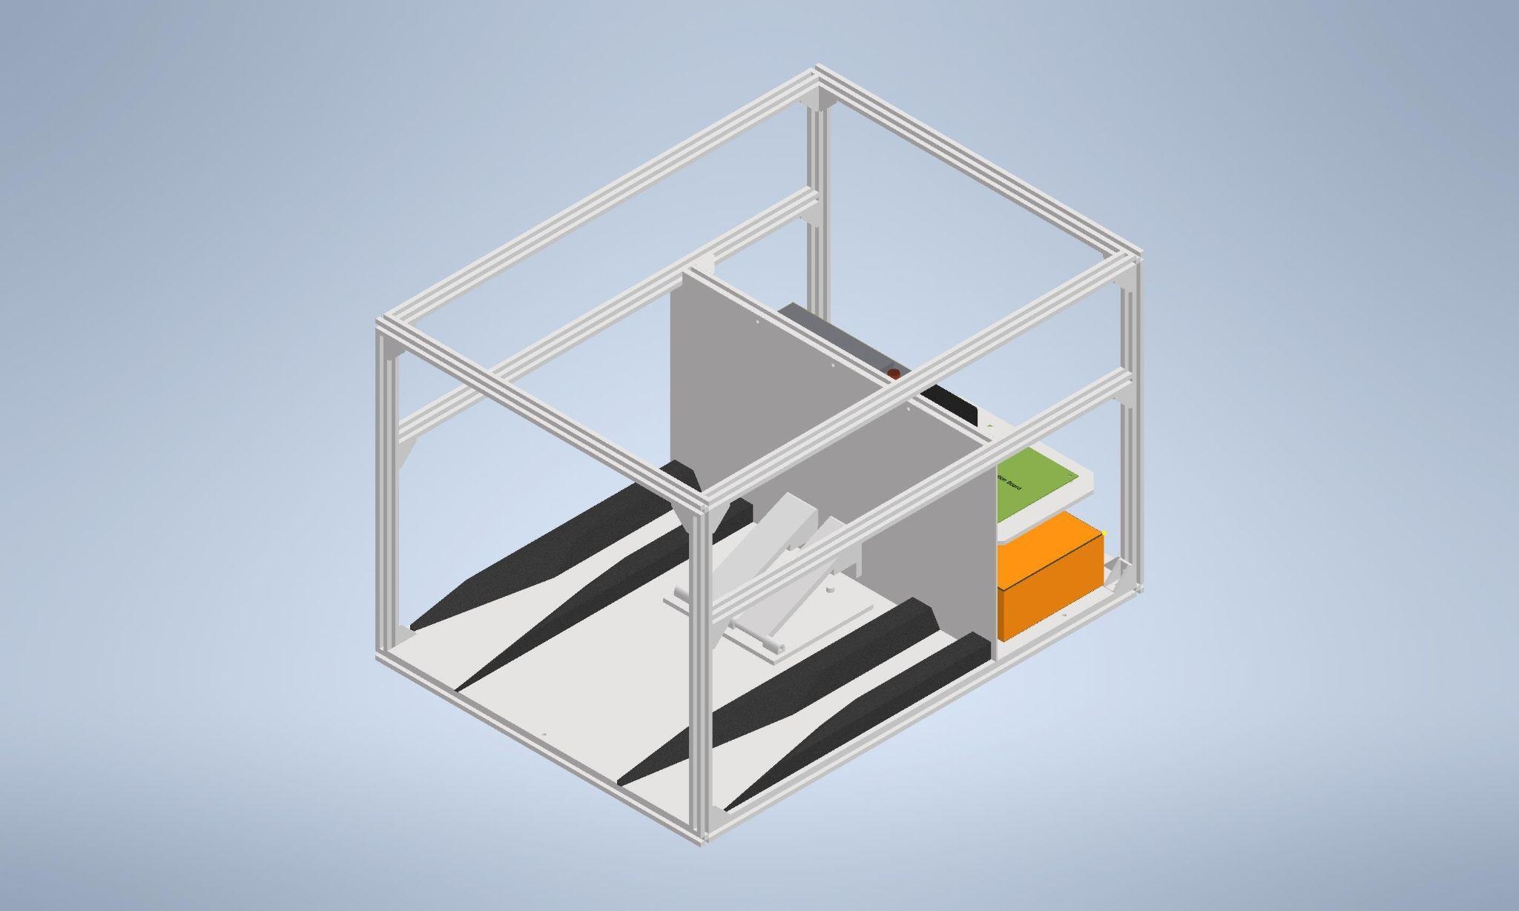
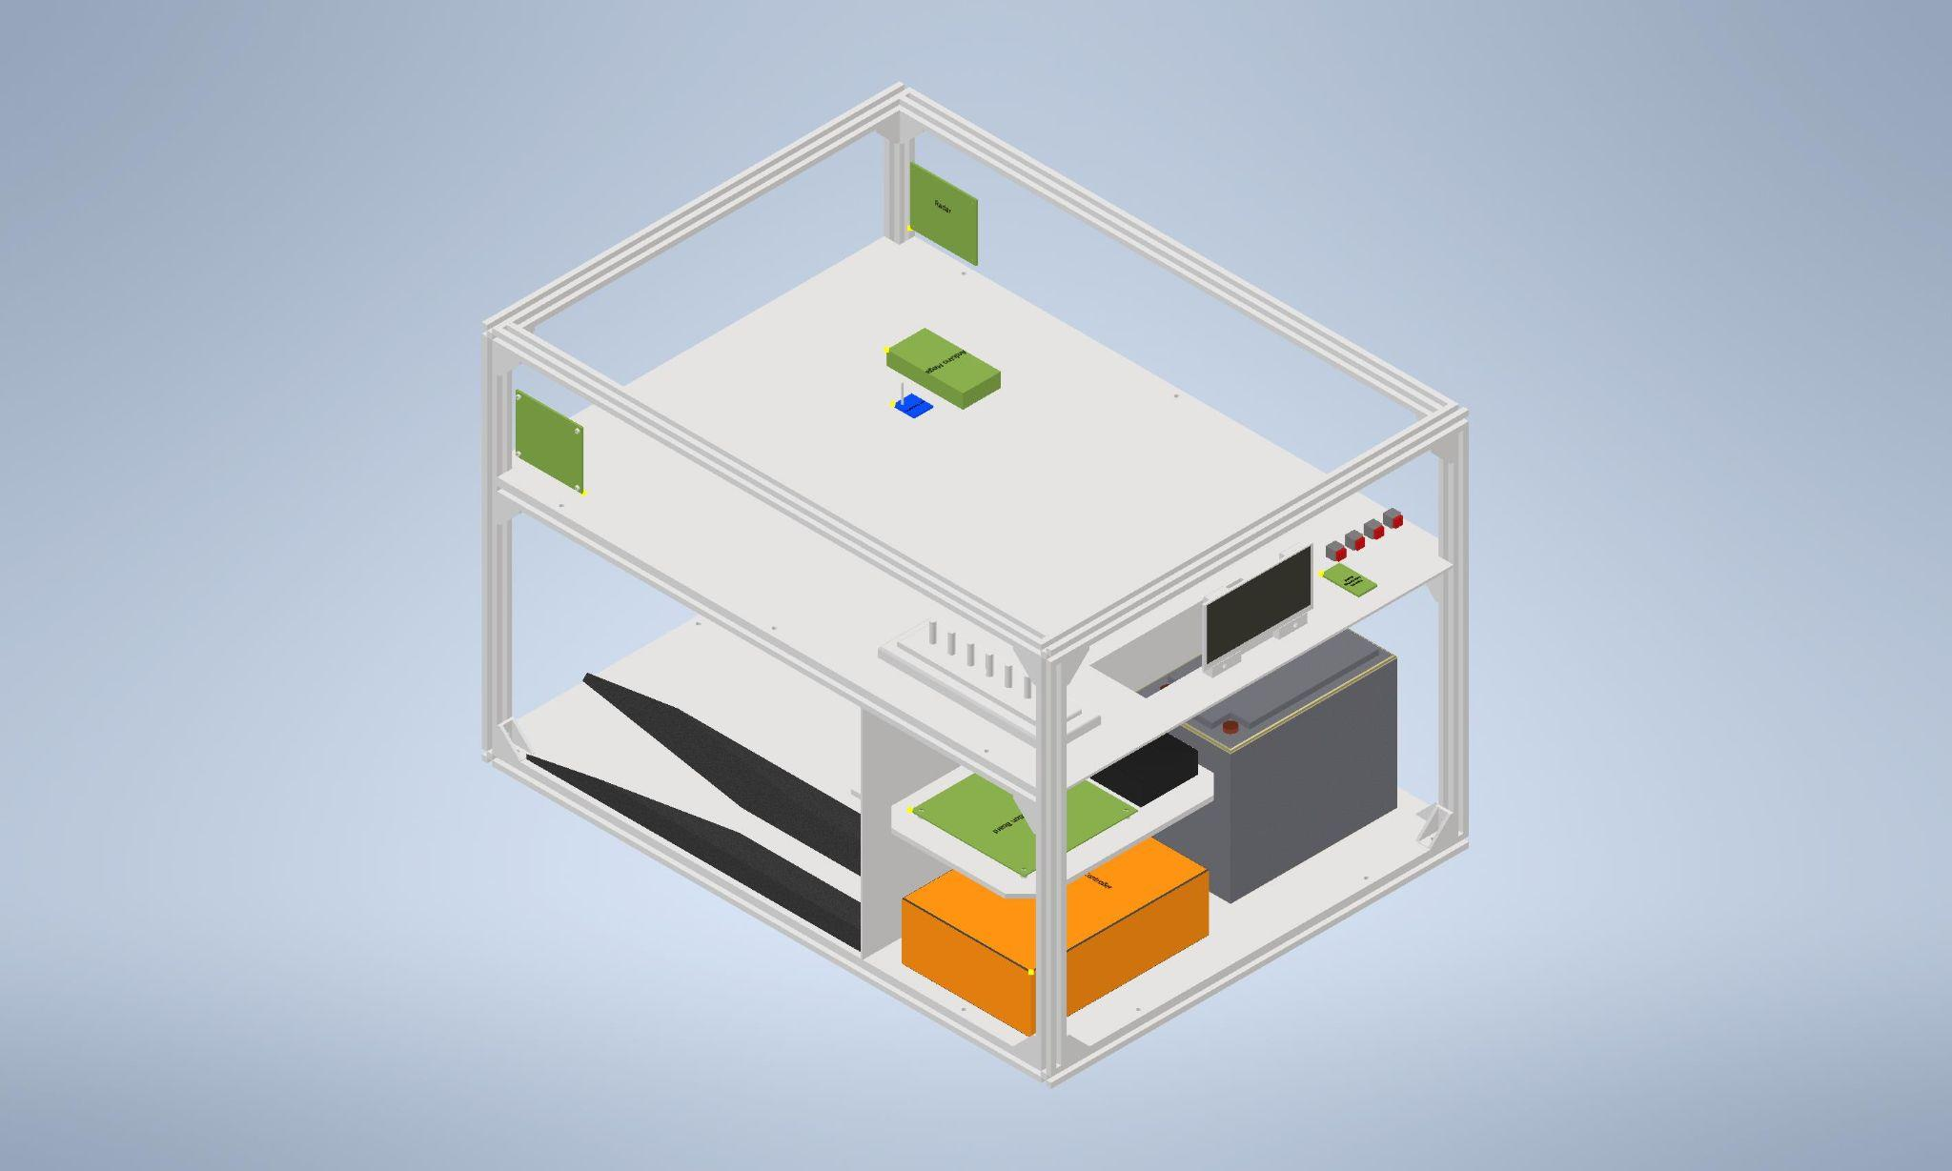
Internal Design of Docking Station
Main team member responsible: Sam
Station will be divided into three compartments
Garage, Energy Storage, and Computation
Garage will include:
The Mechanical Guidance System (MGS)
Charging Contacts for the Rover
ArUco Tag and illuminator for navigation
Energy Storage will include:
Battery
Power Distribution Board and Solar Charge Controller
Battery Charge Controller
Computational will include:
Arduino Mega, LoRa transceivers, radar sensing
User interface screen and buttons
Docking Station Front View (INTERNAL)
Docking Station Rear View (INTERNAL)

Slide 7
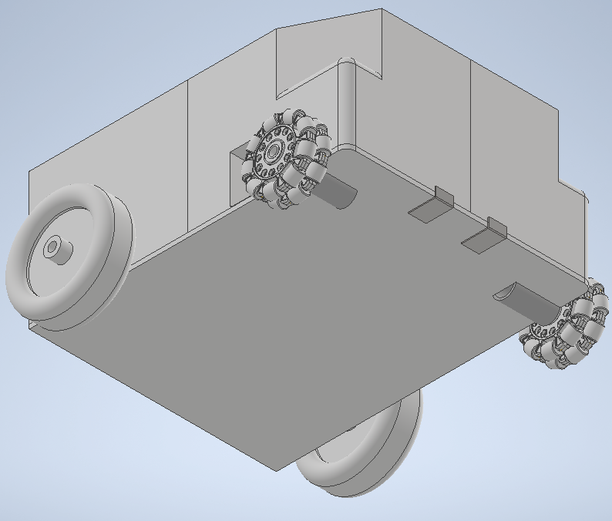
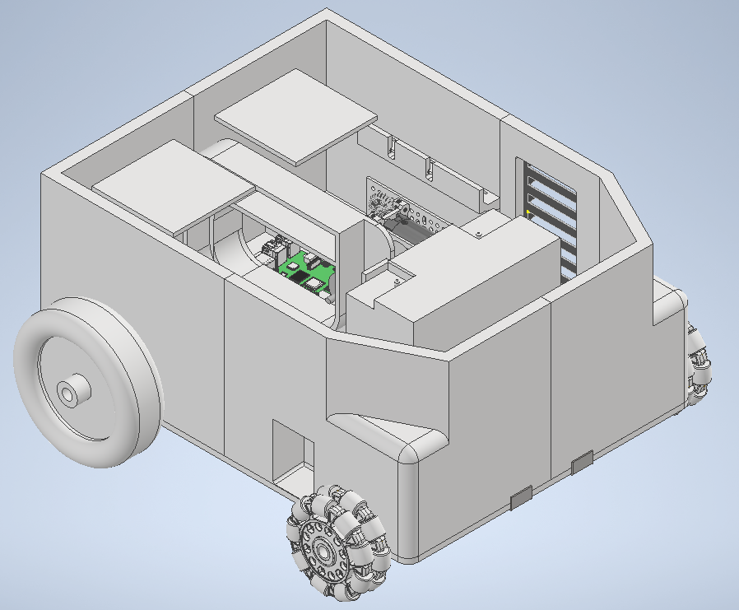
The MARGE Rover
Main team member responsible: Devin
Structural Design
Total Dimensions: 14” width / 18” length / 8” tall
Constructed from 3d printed PLA plastic and polypropylene panels
Rover locomotion will be driven by two 12V motors, turning two 6” wheels at the rear of the vehicle
Two 4” omnidirectional wheels will be at the front
Ventilation will be included to keep internal temperatures low
Chamfered front end for alignment
Rover Underside View
Rover Front View (Roof Removed)

Slide 8
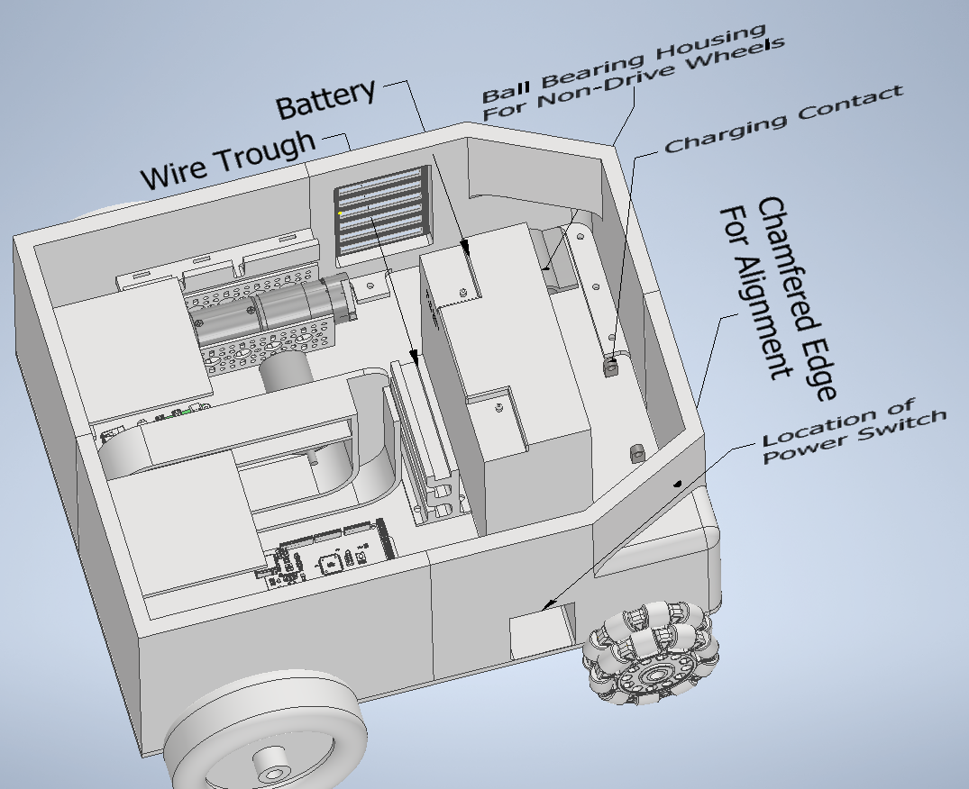
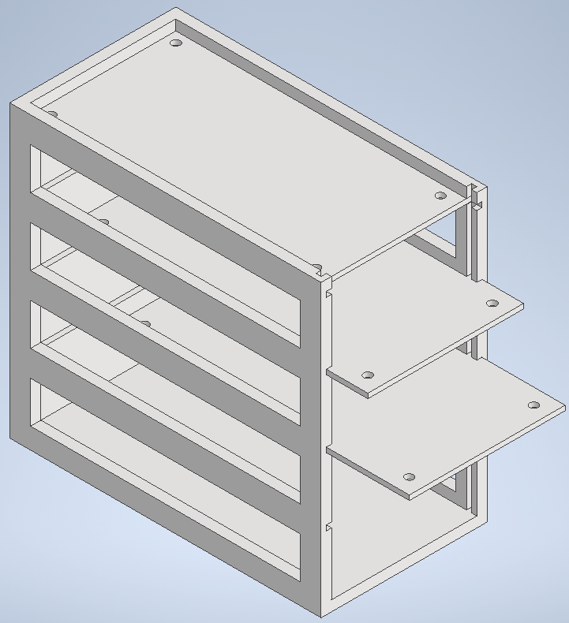
Internal Design of MARGE Rover
Main team member responsible: Devin
The Rover will include its own 12.8V, 10 amp-hour battery
To pair with the charging mechanism in the garage of the Docking Station, the Rover will have metal contacts on the bottom of the chassis
A main power switch will be stowed on the side of the body
Available space is a major limiting factor for the Rover
A shelving system will be used to more efficiently store processing components such as:
Rover Power Distribution Board, Arduino Mega, Raspberry Pi, Lora Comm Transceiver
Rover Internal View
Rover Shelving System

Slide 9
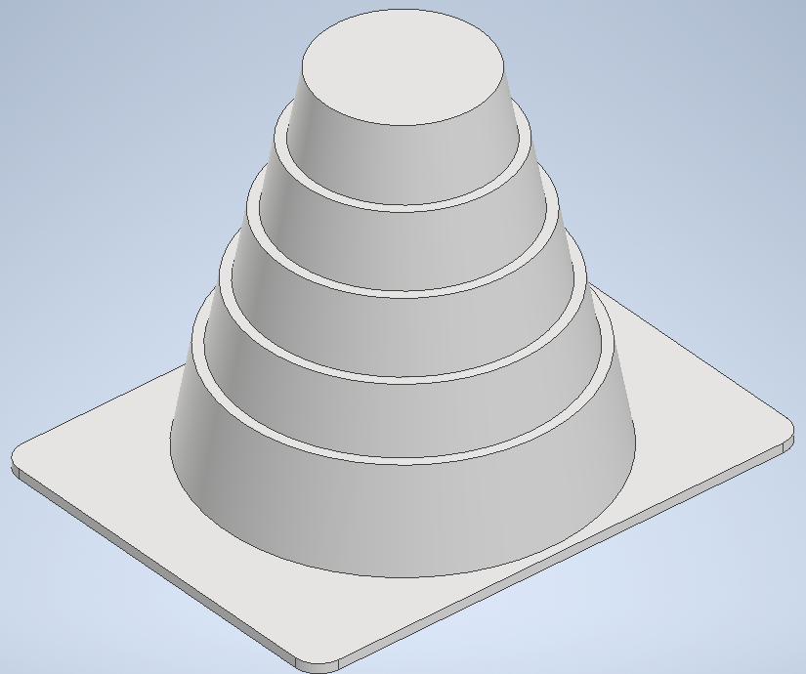
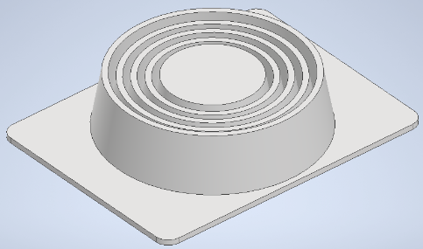
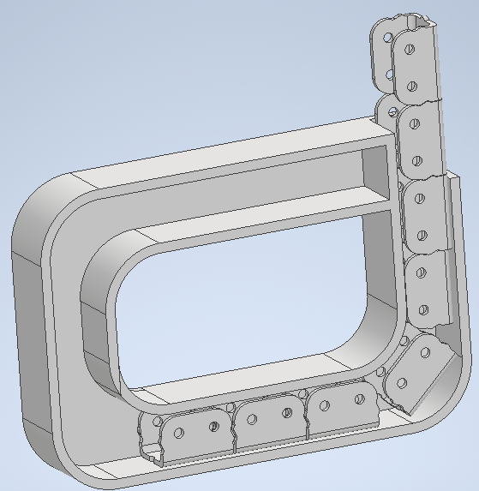
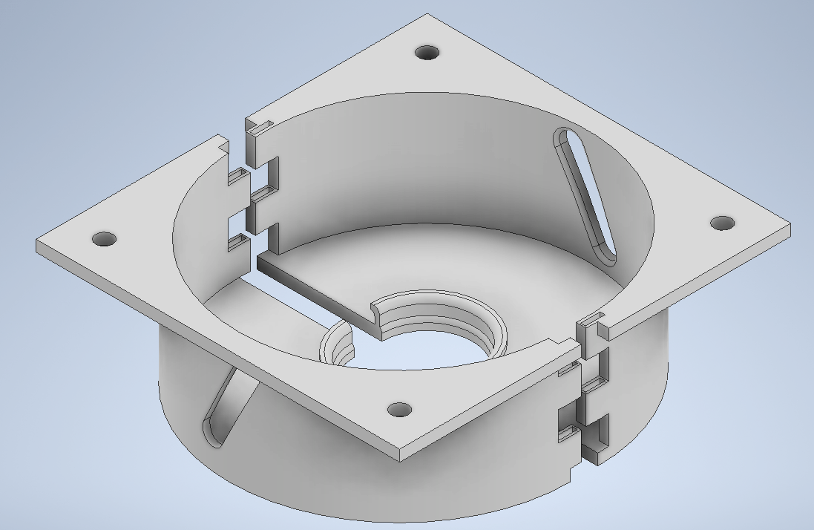
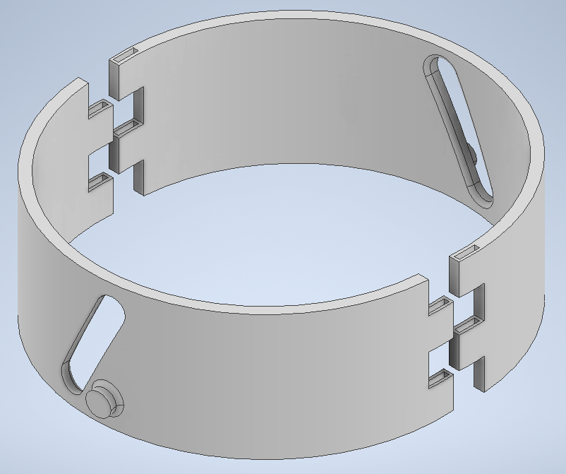
MARGE Rover Visual Indication
Main team member responsible: Devin
The roof of the Rover will incorporate an actuating cone assembly
A chain driven by a secondary motor will drive a chain vertically and extend a cone from the top of the Rover
Deployable Cone Base Segment
Deployable Cone Intermediary Segment
Vertical Chain Storage Housing

Slide 10
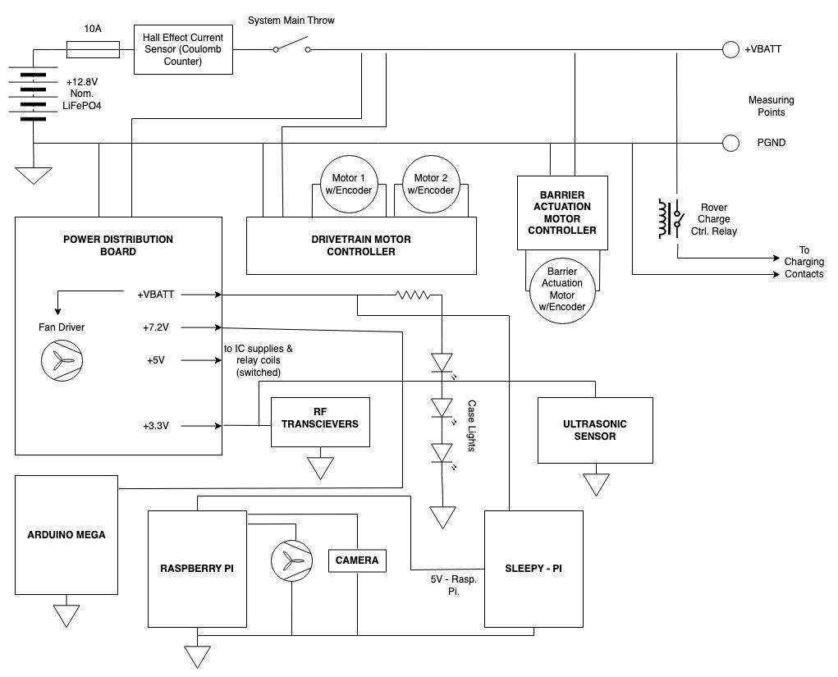
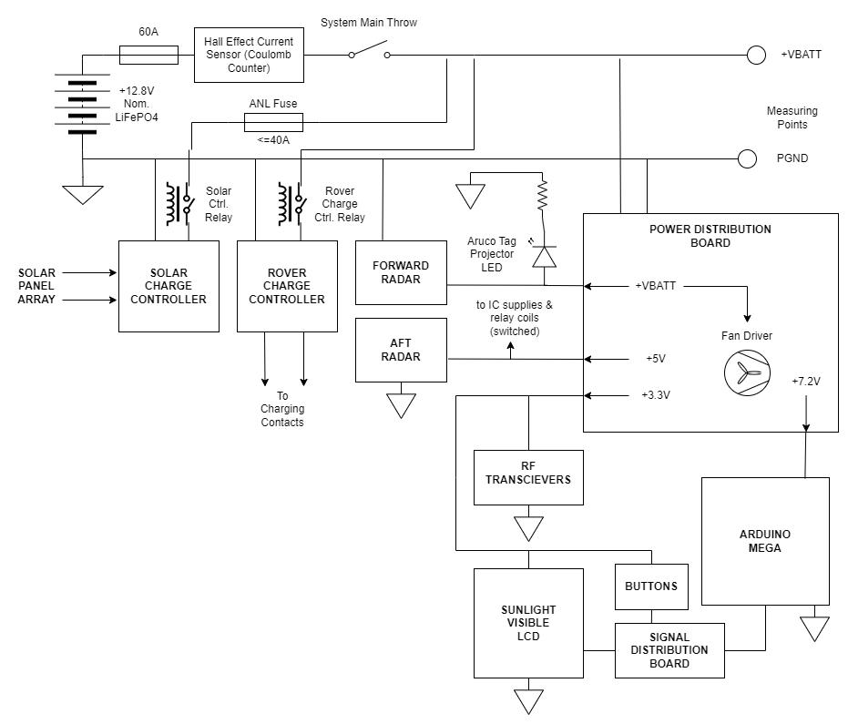
Top Level Rover/Docking Station Electrical Design

Slide 11
Vehicle Sensing
Main team member responsible: Jack
Detect authorized & unauthorized vehicles
Reduce nuisance and false reads as much as possible
Solutions Chosen:
Dual 24GHz Doppler & Doppler FMCW radars, facing forward and aft
Radio transceiver pair for vehicle to MARGE authentication
Motivations for choosing radar:
Suitability for vehicle presence detection applications
Superior performance in adverse weather conditions

Slide 12
Navigation
Main team member responsible: Alex
The navigation system was identified early on in the project as one of the more challenging parameters of the project.
Requires complete autonomy from user intervention.
Our Solution:
Aruco tag located on Docking Station.
Raspberry Pi, camera module & ultrasonic sensor located on Rover.
Localization from camera’s view of aruco tag used to navigate to Docking Station.
Ultrasonic sensor used to finalize approach from within ‘garage’ of Docking Station.

Slide 13
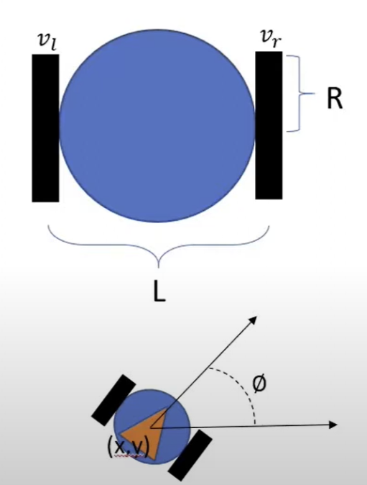
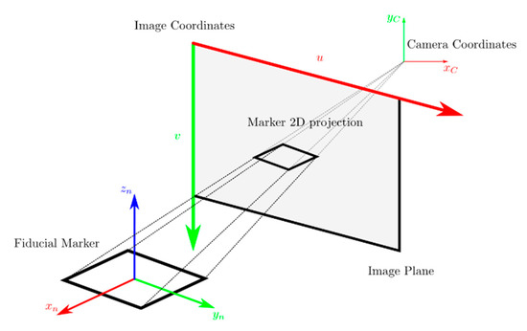
Navigation Continued…
Navigation protocol controls motor driver circuit, motor encoder odometry used as feedback
Drivetrain employs a differential drive schema

Slide 14
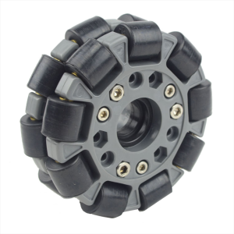
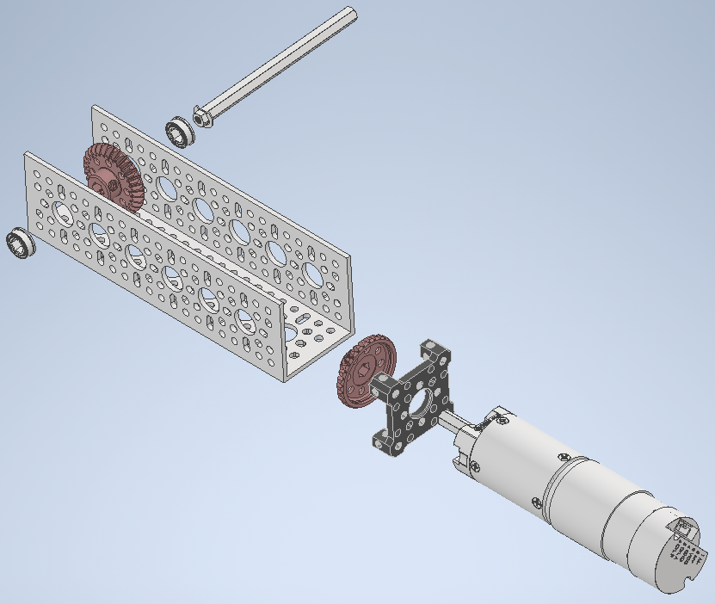
Motor Assembly & Locomotion Platform
Main team members responsible: Devin & Sam
A pair of brushed, two-phase DC motors provide drive to the rear wheels.
A pair of omni-directional wheels at the front allow for passive steering capability from differential drive control.
Prevents excessive tire scrubbing with road surface.

Slide 15
Drivetrain Motor Controller
Main team member responsible: Jack Inter-team collaborators: Sam Fowler
Designed as an inter-team effort with Team Beta
Features:
2x exclusively NMOS H-bridges
Half-bridge gate drivers with built-in PWM deadzoning
Opto-coupled PWM inputs
Overcurrent, overvoltage and reverse polarity protection

Slide 16
Visual Signal & Actuation Controller
Main team members responsible: Devin & Drew
A visual signal cone will be deployed to indicate restricted access to an oncoming driver
Driven by brushed, two-phase DC motor and motor driver

Slide 17
Microprocessor Control
Team responsible: Embedded Control & User Interface Team
Both Docking Station and Rover feature an Arduino Mega
Rover will have a Raspberry Pi & Sleepy Pi for navigation
Each component of the system (rover, base station, remotes) will feature an arduino nano for communication.

Slide 18
Remote Controllers
Main team member responsible: Austin
Two controllers are part of the MARGE system:
MARGE System Remote controller
Used to change system modes, and override for custom control
Can connect from as far as 1km
Rechargeable via USB-C
MARGE Vehicle Authentication Beacon
Used within a vehicle to authenticate with MARGE system
Akin to a garage door opener
Both controllers are of the same design, with slight variations for the different applications

Slide 19
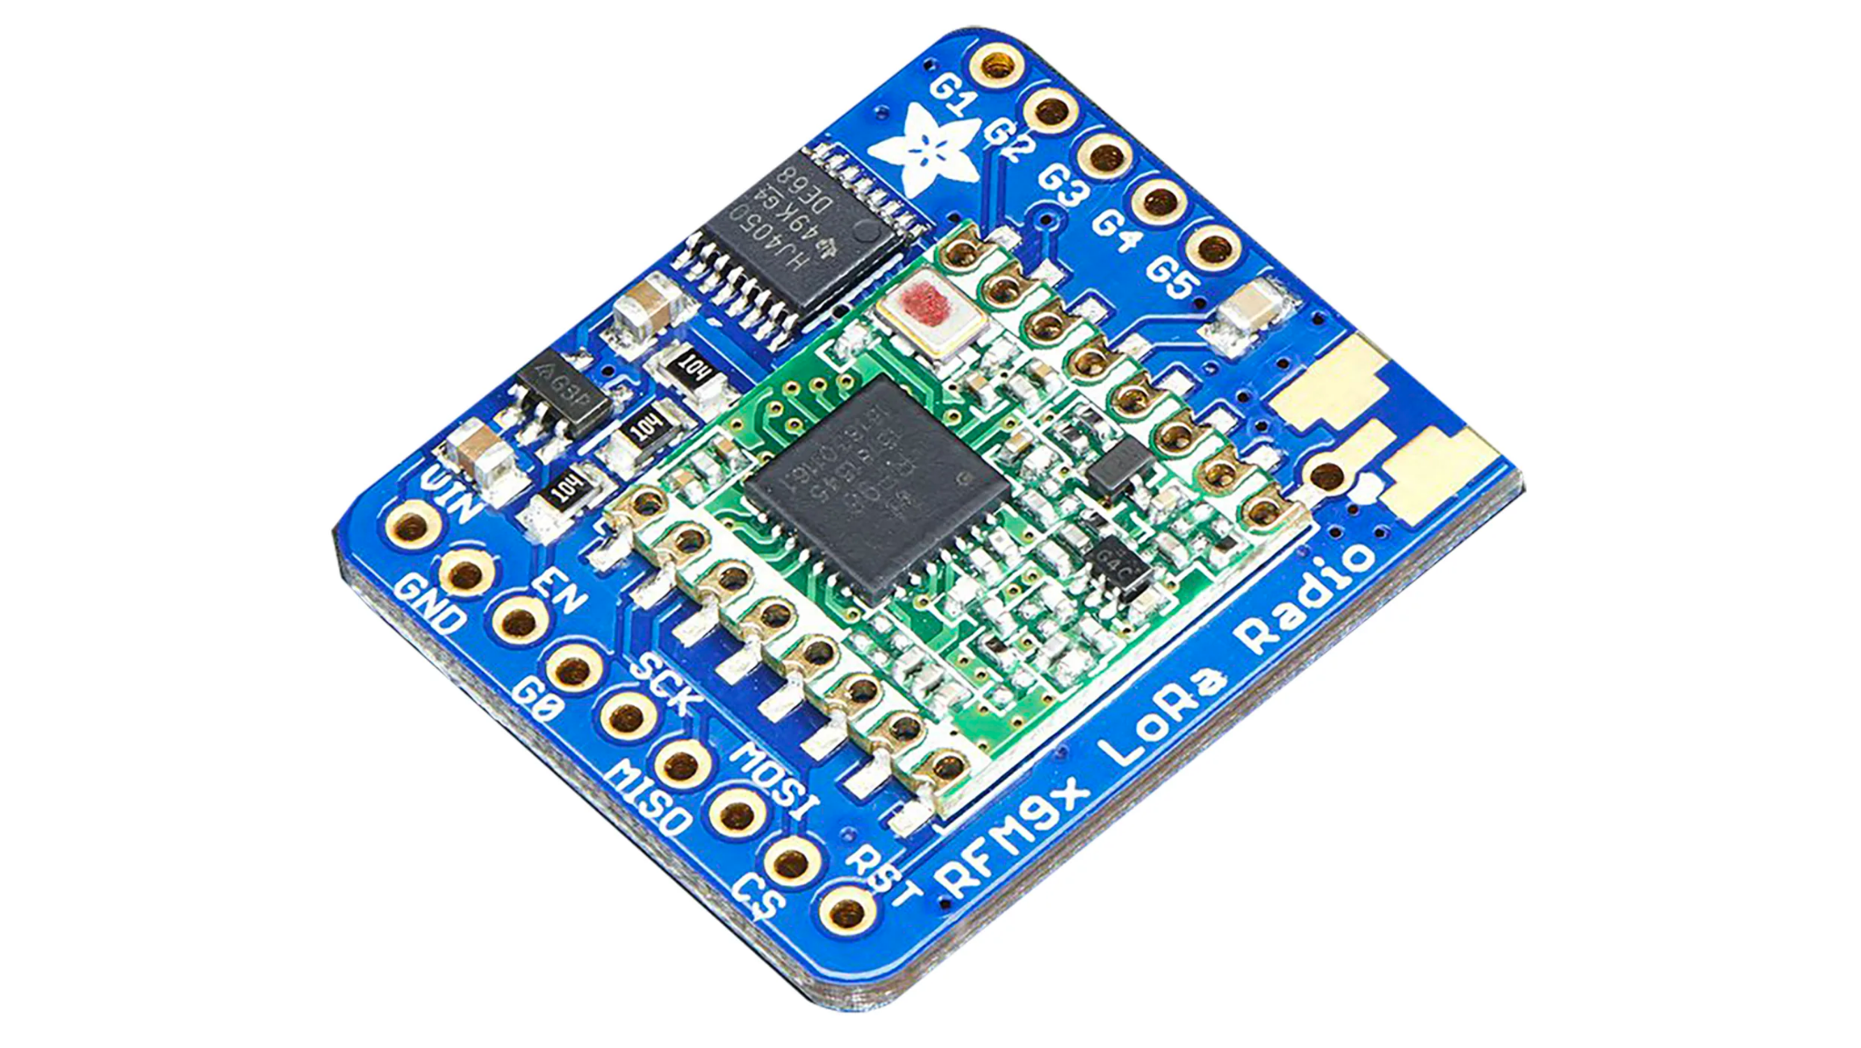
Wireless Communication
Main team member responsible: Austin
Communication between system components required for operation
LoRa RFM96W Radio Transceiver present on Docking Station, Rover and all remote controllers
Will be connected to custom signal distribution board, standardized for each system

Slide 20
System Finite State Machine
Main team member responsible: Michala
The MARGE system and its various components, though separated, act together as a unified system - controlled by the central FSM
This Includes a
Remote FSM
Rover FSM
GUI Control - Docking Station

Slide 21
Power Generation & Distribution: Docking Station/Rover
Main team member responsible: Jack
Both the Docking Station and Rover have dedicated accumulator systems
Docking Station is charged by 100W monocrystalline solar panel
Charge controllers:
MPPT Solar Charge Controller
CC/CV LiFePO4 Battery Charge Controller
Power Distribution:
Many sensors, microprocessors and other loads on both devices
Docking Station and Rover both have team-built power regulation boards

