Slide 1
Solar Tracking Final Design
Zheping Yin

Slide 2
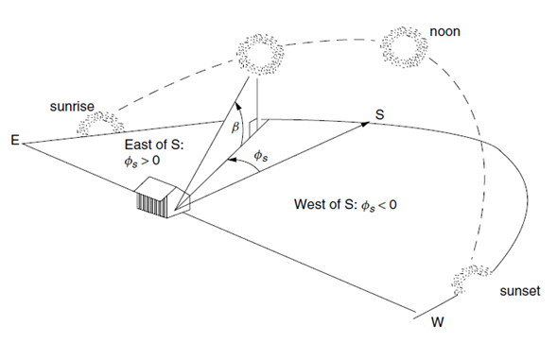
Main Goal
Have higher total gain than stationary
Have higher total gain than 1 axis tracking
Have a total loss less than 10% compared to perfect 2-axis tracking

Slide 3
Change in Mechanical Design since 2022.12
According to Henry, altitude angle movement range is now 33 degrees to 88 degrees.

Slide 4
Tracking “Algorithm” (Too lame to be called an algorithm)
Case is assumed to be facing south when in use.
Predicted Azimuth and Altitude angle will be calculated based on date, time, longitude, and latitude.
Vertical tracking will start once the predicted altitude angle is greater than 33 degrees.
User will have the option to performance automatic adjustment using the photoresistors mounted on the edges of the solar panel.
Automatic adjustment will be activated if the difference between the actual solar angles and current solar panel angles are greater than 15 degrees.

Slide 5
Mechanical Requirements
For azimuth angle, southeast is +, southwest is -
Facts:
The maximum noon solar altitude angle in Easton is 75 degrees (Achieved)
The minimum noon solar altitude angle in Easton is 28 degrees (Not Achieved)
The required azimuth range is from -120 degrees to 120 degrees (Achieved)

Slide 6
Ideal Performance Analysis
Altitude angle of 1-axis tracking and stationary is calculated according the solar declination.
Azimuth angle of stationary is the angle at noon.
Total Insolation Gain for Different Tracking Methods
Date\Tracking Type | Our Tracking | 2-Axis Track | 1-Axis Track | Stationary | Max Altitude Angle
14-Jan | 13.00% | 16.00% | 15.00% | 0.00% | 28.56
14-Mar | 29.00% | 30.00% | 24.00% | 0.00% | 46.64
14-Jul | 36.00% | 37.00% | 16.00% | 0.00% | 71.67
14-Oct | 22.00% | 24.00% | 20.00% | 0.00% | 40.77

Slide 7
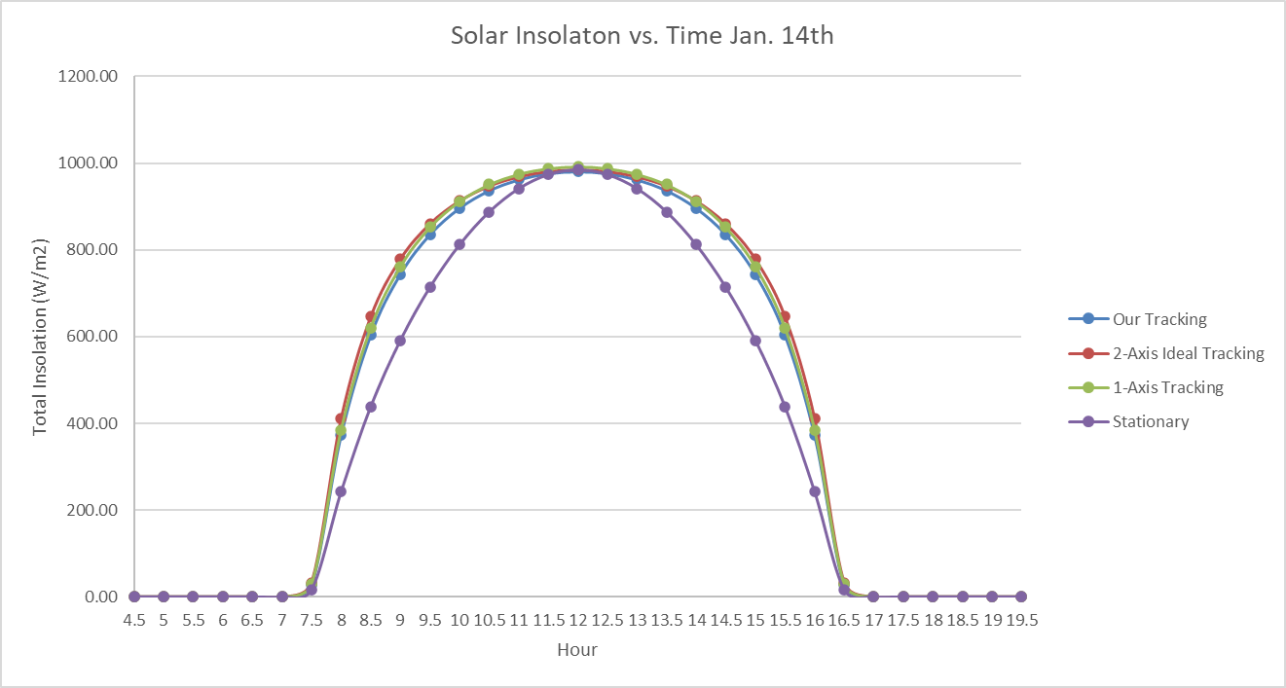
Ideal Performance Analysis

Slide 8
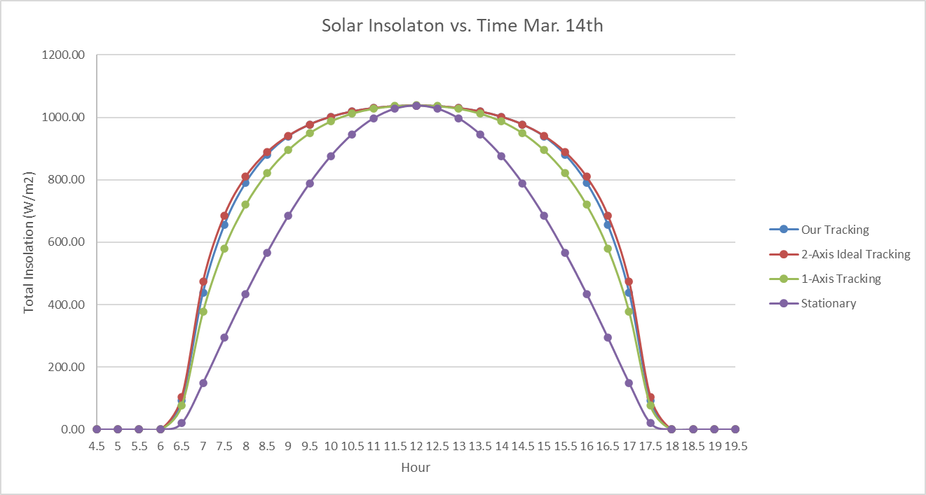
Ideal Performance Analysis

Slide 9
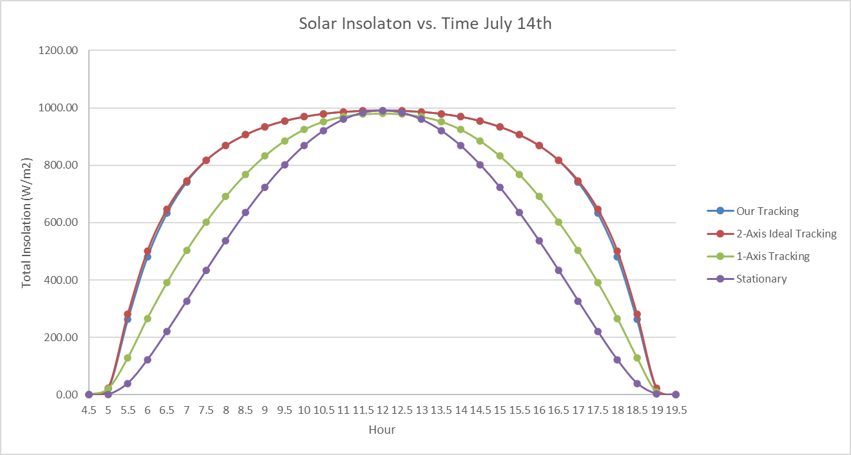
Ideal Performance Analysis

Slide 10
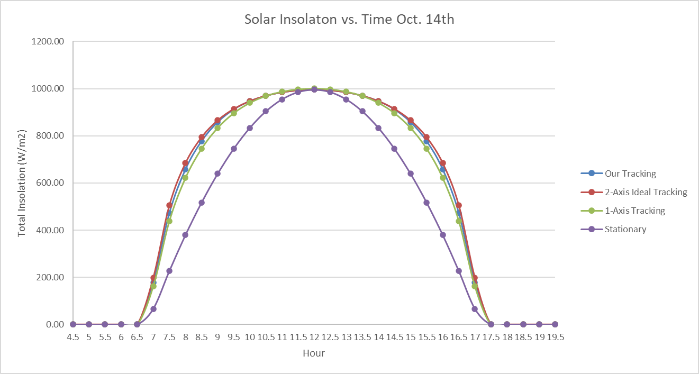
Ideal Performance Analysis

Slide 11
Power loss
Loss due to inaccurate tracking
If the predicted azimuth and altitude angle are both 15 degrees away from the actual azimuth and altitude angle, the power loss will be 3%
Total loss should be from 4% to 6% compared to 2-axis ideal tracking

Slide 12
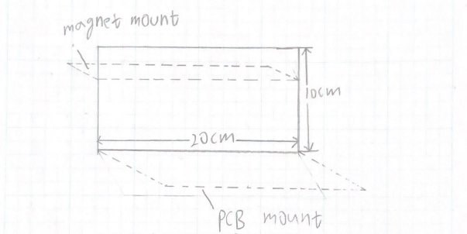
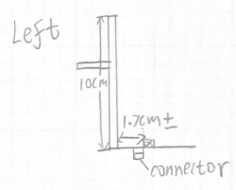
Sensor Mount Design

Slide 13
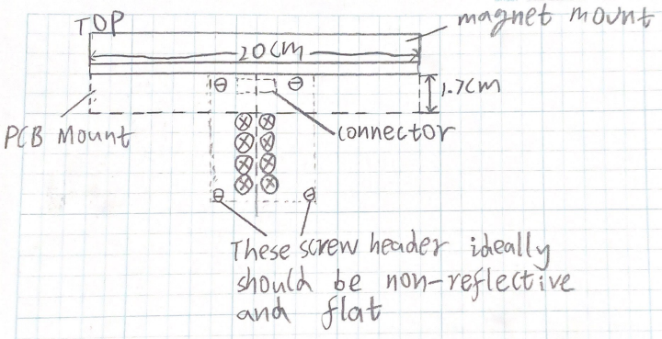
Sensor Mount Design

Slide 14
Magnet
Not purchased yet
Possible category:
Magnet Tape
Sticky bar magnet (hyperlink attached)
Heavy duty round magnet
Concern:
Too strong magnet may break the mount
Possible solution:
Add a triangle structure below the flat mount

Slide 15
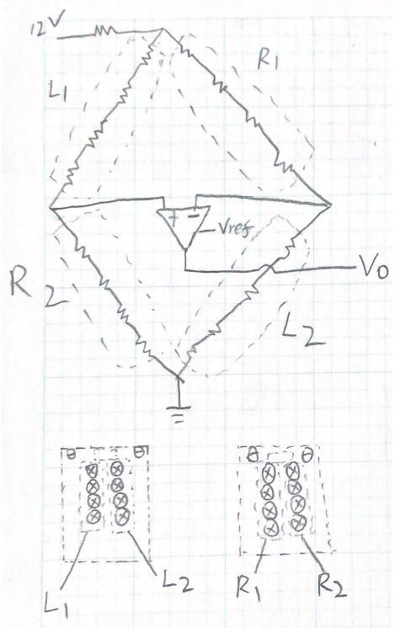
PCB Mount

Slide 16
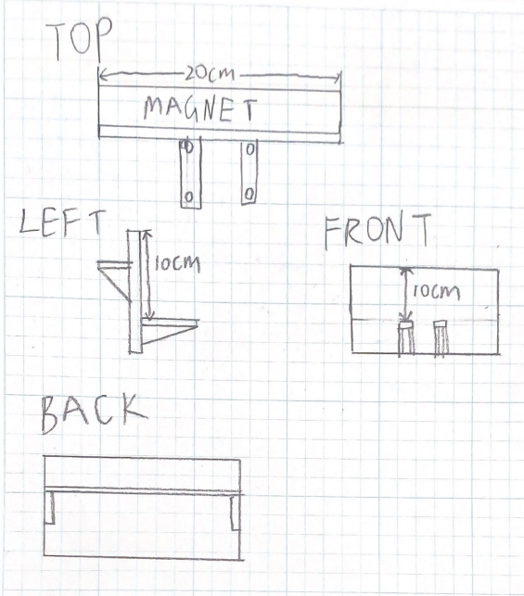
Possible Magnet Mount and PCB Mount Design

Slide 17
If an error of 30 degrees occur in both angle
Front
Top

Slide 18
Circuit design
5v
Vtotal
The extra resistor will be 150 ohm
I do not think gain is necessary
Vref=1.5V
Limits:
Vout is between 0-5 volts
Maximum power on each photoresistor is 90mW
Issue:
Inconsistent resistance at low brightness

Slide 19
Inconsistency of photoresistor
Issue:
When the photoresistors face the sun directly on a bright sunny day, the resistance is 90 ohms +/- 30 (I remember, but no one provided me the data)
Under shadow, the resistance is 300+/- 30
When the photoresistors face the sun directly on a cloudy day, the resistance is 220+/-50
Solution:
Don’t perform automatic adjustments on a cloudy day.
The voltage reading across the extra resistor will do this.

Slide 20
Analysis
5v
Vtotal
If all resistors are at 90 ohms, power across each resistor is 4mW is Vtotal is 5V, there is no concern of burning the resistors
Brightness under shadow is the same regardless of the weather

Slide 21
Worst case voltage difference under sunny day
Vtotal
5v
R1=R2=270*4
L1=L2=120*4
Vout=2.5-2.2=0.3 or 2.5+2.2=4.7
If photoresistors take too much voltage
R1=R2=330*4
L1=L2=120*4
Vout=2.5-2.4=0.1 or 2.5+2.4=4.9

Slide 22
Worst case voltage difference under cloudy day
5v
Vtotal
R1=R2=270*4
L1=L2=270*4
Vout=2.5V

Slide 23
Very Detailed Parts of Work
Draw the KiCad circuit (Not me)
Specify dimensions of PCB mount and magnet mount (Not me)
Waterproof design (Not me)
I do not think this is possible with our current manufacture accuracy
Choose the magnet, send purchase order, and test if the current design is sturdy enough (Not me)
Determine how to arrange the photoresistor on the PCB board (Not me)
Ensure the two closest photoresistors are 1.7cm away from the sensor mount “wall” (Not me)
Make the 3D model and print the sensor mount (Not me)
Solder the circuit board (Not me)
Test the circuit (Not me)
Test the sensor mount with the circuit on the quad (Me and someone else)
Test the entire design with solar tracking code (Me)

Slide 24
Work that is left undone til the last moment?!
Good Luck!
NOT ME

