Slide 1

Preliminary Outline
Remotely Accessible Portable Solar Charging Evaluation System
ECE Class of 2023

Slide 2
Table of Contents
Motivation
Design Objectives
Design Metrics
Design Constraints
Relevant Codes and Standards
Concepts applied from other classes
7. Concepts we need to learn
8. Runtime comparison between Solar Generator and Honda Generator
9. Preliminary Operation Manual
10. GUI
11. Preliminary Safety Analysis
12. Estimated Cost
13. Preliminary figures and Designs
14. Preliminary test procedures
15. Solar Kit Study

Slide 3

1. Motivation
Portable solar battery charging system with wireless access for battery performance and external conditions measuring
Create an enhanced alternative to the Honda EU2200i portable generator
Our system should be electrically output same or better the power output of a Honda EU2200i portable generator
It would also be better for the environment as it would not burn fossil fuel.
Fig. 1. Honda EU2200i Portable AC Generator
Roger, Haki & Anna McKay

Slide 4
2. Design Objectives pt.1
provide a standard AC 110V 60Hz output voltage compatible to a standard residential wall outlet with load capability meeting or exceeding the nominal 20 amps
use an inverter to power convert from 12V DC to 110V AC output
include a panel solar tracking feature that can be set at a fixed angle, or run in a user defined path mode, or a solar feedback tracking mode
acquire environmental, directional, and electrical performance data from the charging system and positioning system by wireless transmission of this data to a remote computer, tablet, and/or phone
configure to be portable and accommodate various but reasonable terrain
Roger & Haki

Slide 5
2. Design Objectives pt.2
configure for research into optimising the charging system under different environmental conditions for recreational application
must include following sensors:
Environmental – Temperature, Pressure, Humidity, Wind
Voltage and Current – Charge controller input voltage, Charge controller input current, Charge controller output current, Battery voltage, Inverter input current, Design Specific Electronics currents.
Battery temperature.
Panel orientation – relevant rotation and pitch angle
Relative solar measurements – photoresistor, etc.
Others as negotiated.
Roger & Haki

Slide 6
3. Design Constraints
charged by 12V battery system
provides standard AC 110V 60Hz output voltage
load capability meeting or exceeding the nominal 20 amps
supplies rec applications that work on a 20A AC outlet
units should not exceed 100 lbs total
enclosures of the batteries and inverter should be non-conducting
the charging system must be fully functional without a remote device
all electronics must be locally powered by 12V battery system
system’s data transmission must be wireless
Roger & Haki

Slide 7
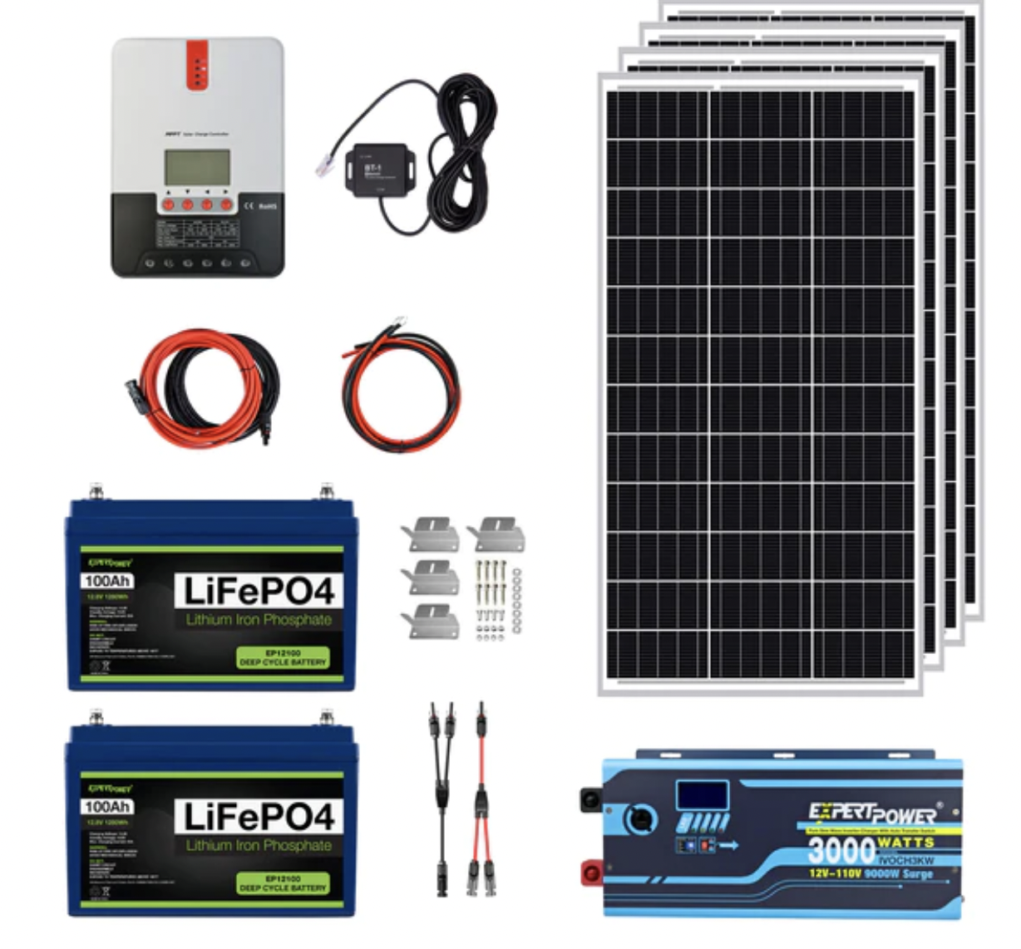
4. Design Metrics
Weight: < 100lbs (for each unit)
Solar Panels: ~12 lbs each
Battery: ~27 lbs
Charged Controller: ~4 lbs
Inverter: ~55 lbs
Minimise size
Solar panels: ~40 x 20 in
Battery: ~13 x 7 in
Charged Controller: ~9 x 7 in
Inverter: ~19 x 8 in
Minimise cost
Solar Kit: ~$2,000
Maximise portability
Fig. 2. ExpertPower 2.5KWH 400W Solar Kit
Roger & Haki

Slide 8


5. Relevant Codes and Standards
DC/AC Conversion
Charged controller and inverter circuit
Using a pure sine wave DC/AC inverter
Solar Panel Standards
International Electrotechnical Commission (IEC)
Battery Standards
Battery Council International (BCI) number
http://www.exidebatteries.com/bci.cfm
Consider storage standards
Warranty
Roger & Haki

Slide 9
6. Concepts applied from other classes
Soldering
DC-to-DC step-down conversion (circuit design)
Power distribution
Low power design for sensing and transmission circuits
Writing skills for project proposals, users’ manual, etc.
Group work from various lab classes
GUI creation
Microcontroller programming
Anna McKay & Zheping

Slide 10
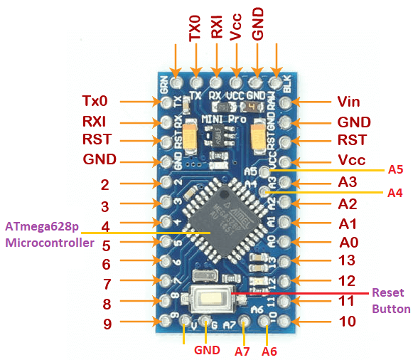
7. Concepts we need to learn
Safety procedures and precautions associated with high power systems
PCB (Printed Circuit Board) Design
Arduino
Wifi
Arduino Dashboard
Interfacing between Arduinos
SPI
I2C
GPIO
Sensor interfacing
ADC
Arduino GFX Library
Adafruit touchscreen Library
Component procurement
3D modelling/printing
2D modelling for communications with machine shop
Solar panel axis movement
Fig. 3. Arduino Board
Roger & Haki

Slide 11
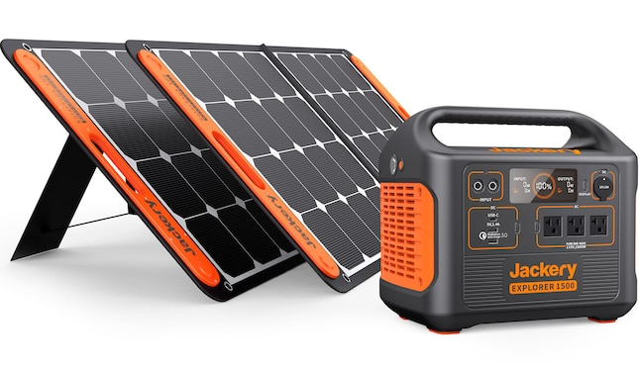
8. Runtime comparison between Solar generator and Honda generator:
The preliminary proposal should include runtime comparison studies of the solar charging solution versus the Honda generator based on load and agreed upon reasonable operating assumptions.
Honda Generator Specifications:
3.2 hours of runtime at 15 amps(rated load)
8.1 hours at 25% rated load
While we have not decided on a kit yet, most kits we’ve researched come with a single, or multiple, 100aH batteries.
Ideally we would select the solar kit with two 100 aH batteries as this gives us flexibility in terms of placing objects in the final product while fulfilling the output specifications as well.
Will Oaks & Will Anderson

Slide 12
9. Preliminary operation manual
The Operation Manual would include instructions for set-up and use of the solar panel system. It would also include general technical specifications that a customer would need to know like the limitations of the design and capacity of the battery.
The set-up instructions would have both a quick start guide and a more detailed explanation for people with various levels of experience with products similar to a standard generator.
Along with technical specifications and a set-up guide, it would also include some relatively simple fixes for common problems caused by long term use or more vulnerable parts of the design that are unavoidable. It would also have resources listed for more technical support.
Anna McKay

Slide 13
10. GUI pt.1
The user interface would include metrics on the home page about the solar panel and battery performance as well as data from environmental sensors.
It would be information that is practical to the average user so as not to complicate use for less technically inclined customers, with a focus on safety and use.
Metrics on what energy the system itself is consuming would be available only in an advanced metrics page as most users would be uninterested in this information.
The UI also contains another page for WiFi setup, a button to enable autonomous mode, and another button to set the arduinos to sleep mode.
The UI would be graphically appealing to average users without being overly complicated. It would be intuitive with the most important metrics and controls on the home page and less important information and options in subsections of the menu.
A touch screen will be used to display the GUI for better user experience.
Anna McKay

Slide 14
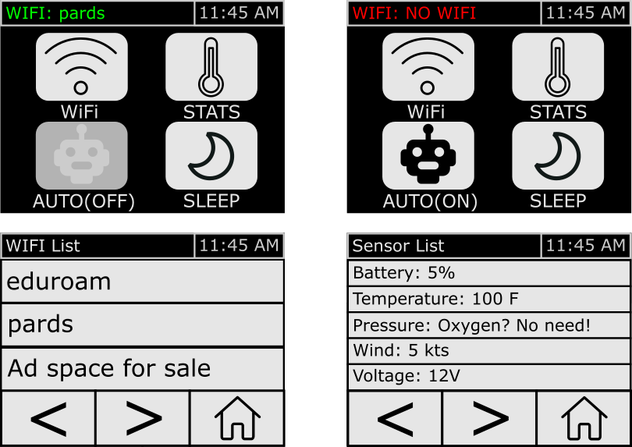
10. GUI pt.2
Zheping
Fig. 4. GUI mockups

Slide 15

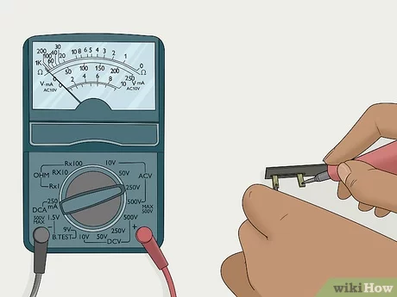
11. Preliminary Safety Measurements
The largest danger comes from the high power nature of this system. An accidental short can pose a significant hazard. Measures should be taken to both learn what can cause and prevent an accidental short.
Wear goggles when soldering or when there is a hazard of sparks
Check voltage against ground before working on any component
Report damage to groups
Clear floors, Clean workspace
No food and drink by workspace
Label components
Anna McKay, Roger & Henry

Slide 16

12. Estimated cost:
Initial list of TOTAL components
~$4,000
Largest single cost item is the solar kits
$2,100 approximate based on average prices
Other items include Arduinos, sensors, and other incidentals, which has the potential to run over $1,500
Henry

Slide 17
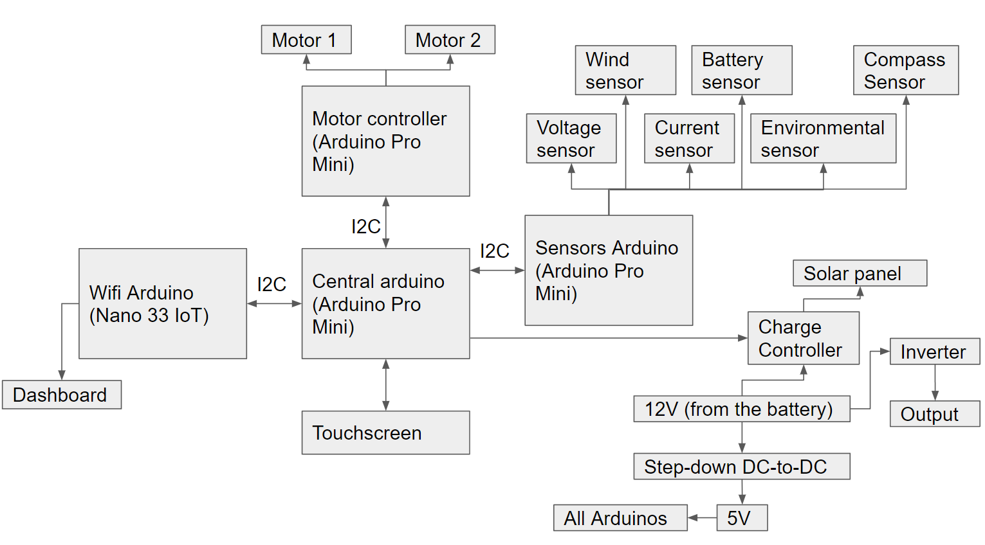
13. Preliminary figures and design
Fig. 5. Overall system structure
Boris & Haki

Slide 18
14. Preliminary test procedures:
test the design by using it as anticipated to make sure it can perform as expected
tests of various components; this will include unit tests of the code, tests of various parts of the wire harness, and safety checks along the way to ensure that continuing the building process will not endanger anyone working on it or any possible users
power consumption test of the microcontrollers will also be performed to ensure a long battery life
Anna McKay & Zheping

Slide 19
15. Solar Kit Study (Example 1)
ExpertPower Solar Kit (2.5KWh, 400W)
Max power (per unit) = 100W
VMP = 20.6V
IMP = 4.85A
Comes with 2 100Ah batteries
Each battery 27 pounds
Solar Panels Rated 5.56 amps and 18 volts
Fig. 6. ExpertPower 2.5KWH 400W Solar Kit
Will Oakes

Slide 20
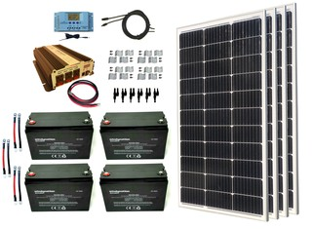
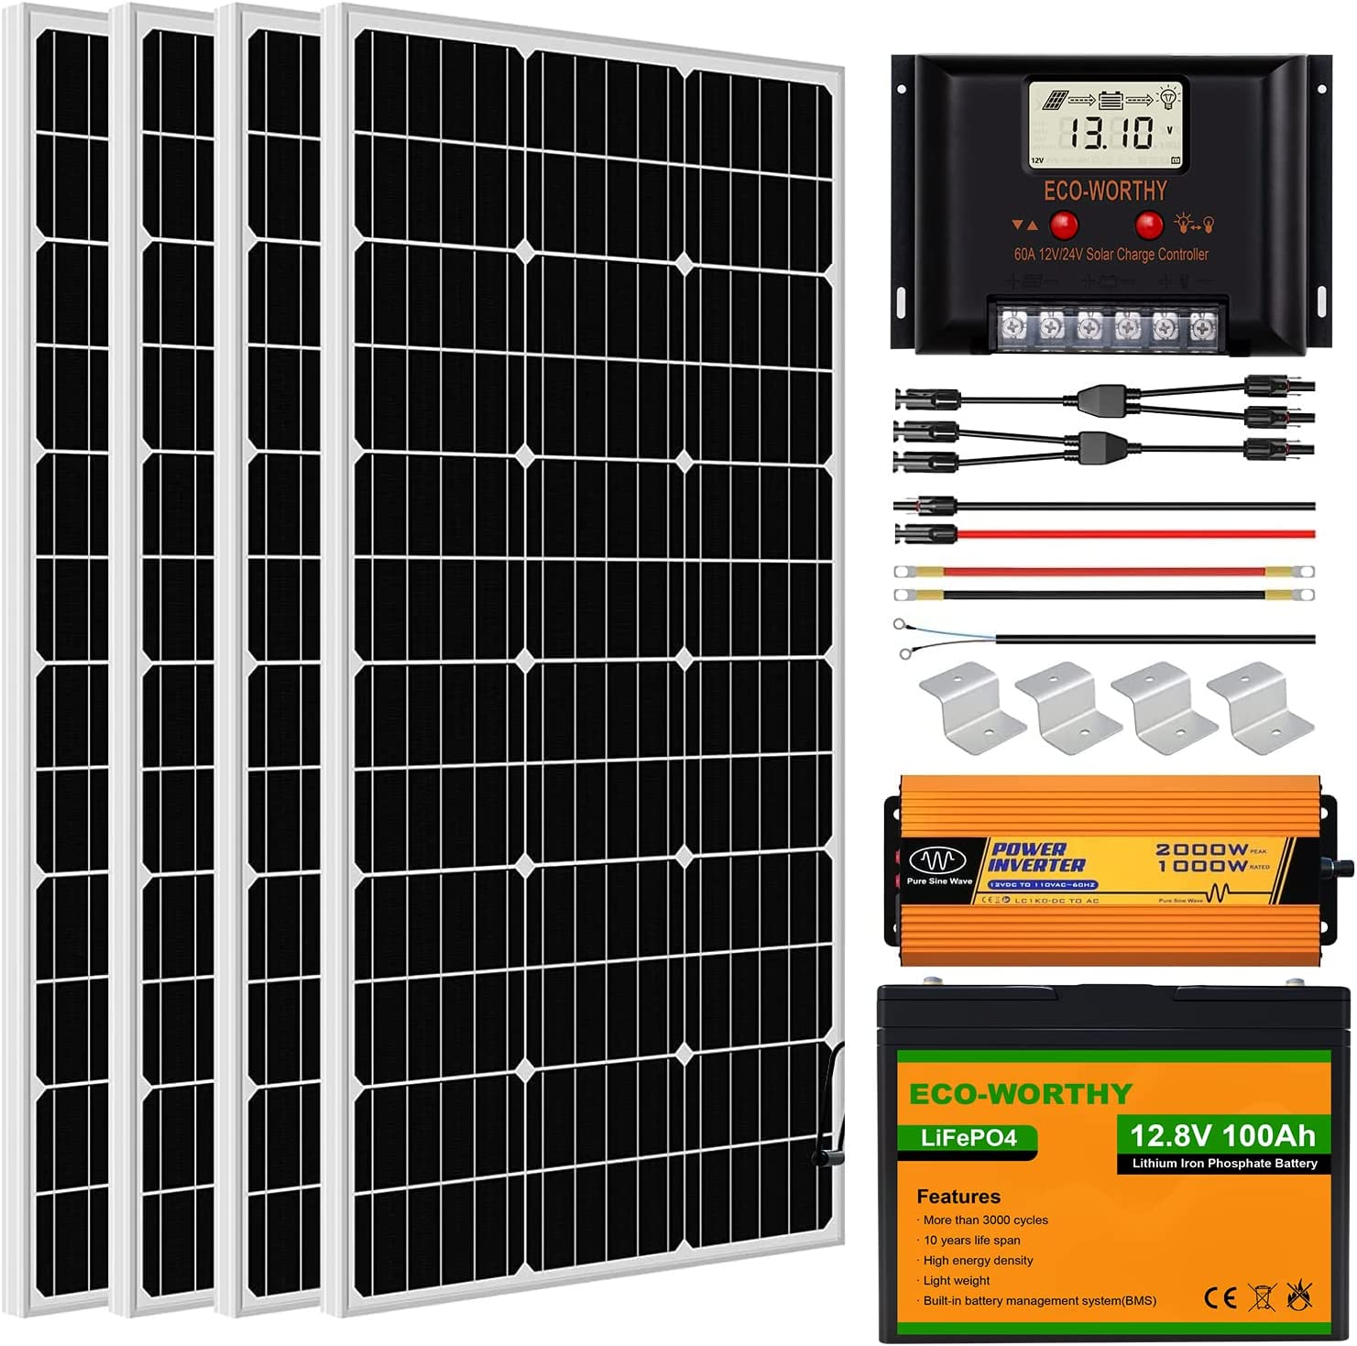
15. Solar Kit Study (Example 2 & 3)
Windy Nation - Similar kit option
Comes with 4 100Ah batteries
4 100W solar panels
Documentation kind of hard to find for this one
Eco Worthy Kit - Also similar
Rated power: 100W
Open-Circuit Voltage (Voc): 21.6V
Short circuit current (Isc): 6.13A
Working current (Iop): 5.78A
Output Tolerance: ±3%
Temperature range: -40℃to +80℃
Size: 39.8*20.1*1.4 inch
Weight:18.96 pounds
12V 100AH Lithium Battery
Will Oakes

Slide 21
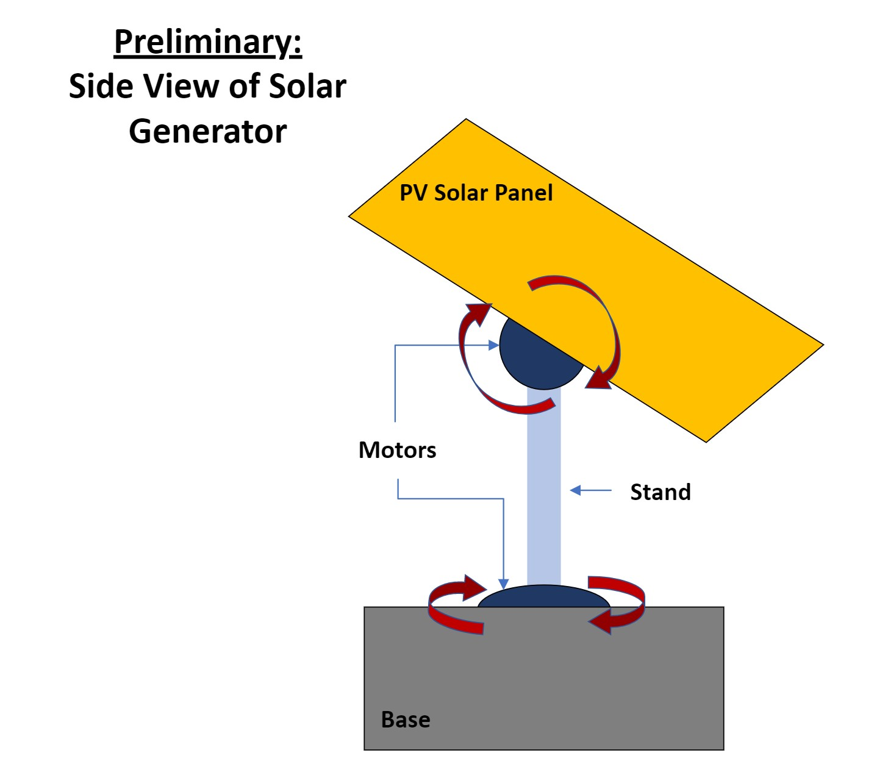
16. Diagrams pt1
Fig. 7. Side view of solar generator

Slide 22
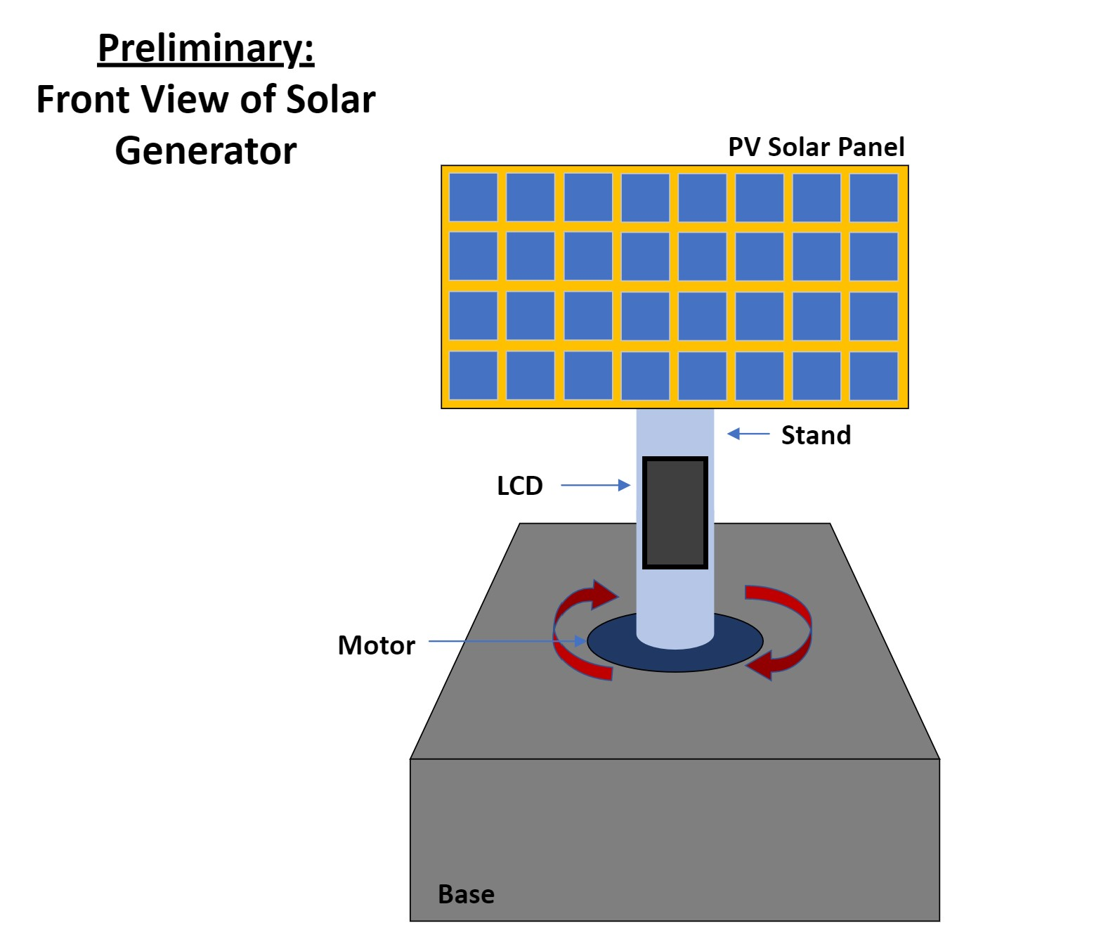
16. Diagrams pt2
Fig. 8. Front view of solar generator

Slide 23
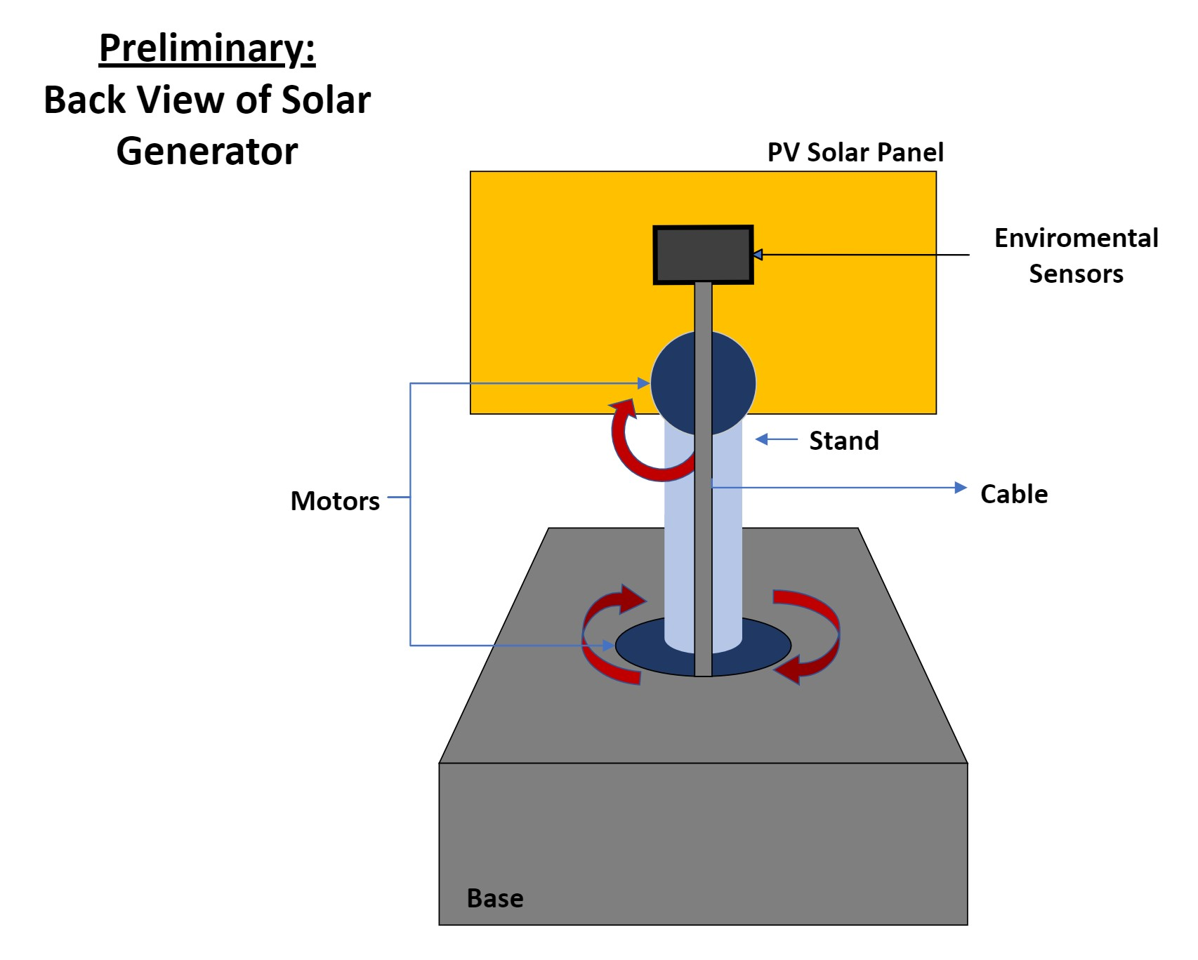
16. Diagrams pt3
Fig. 9. Back view of solar generator

Slide 24
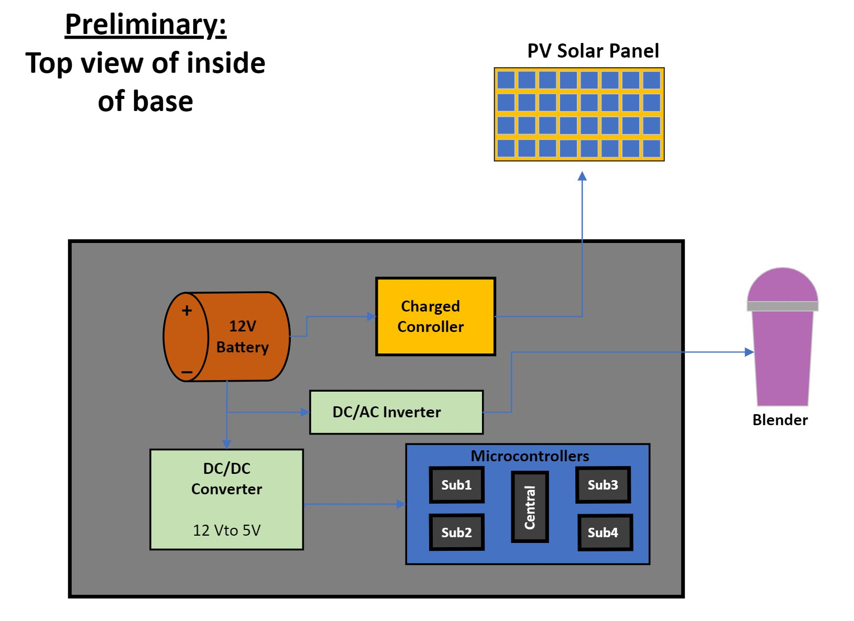
15. Diagrams pt4
Fig. 10. Top view of the inside of generator’s base

Slide 25
Any Questions?

