Slide 1
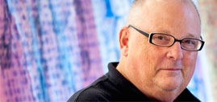
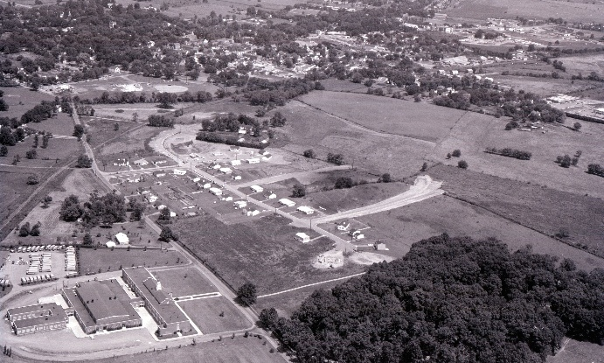
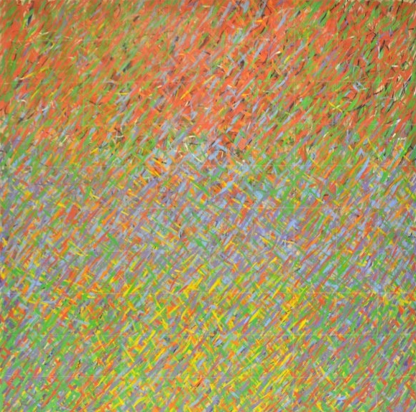
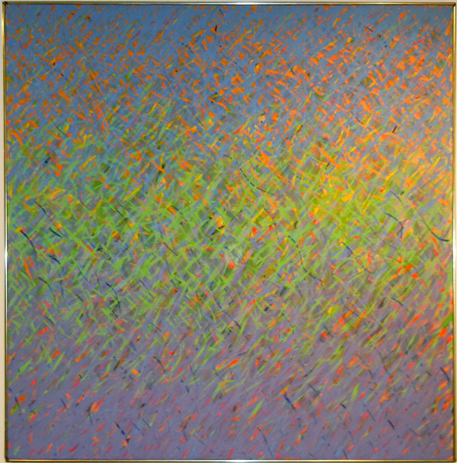
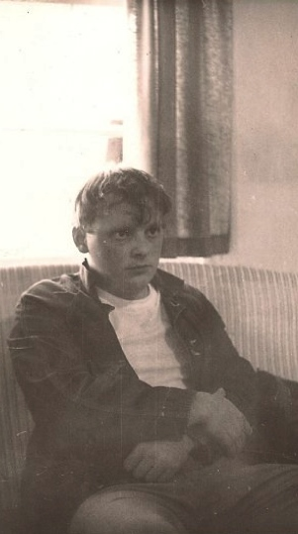
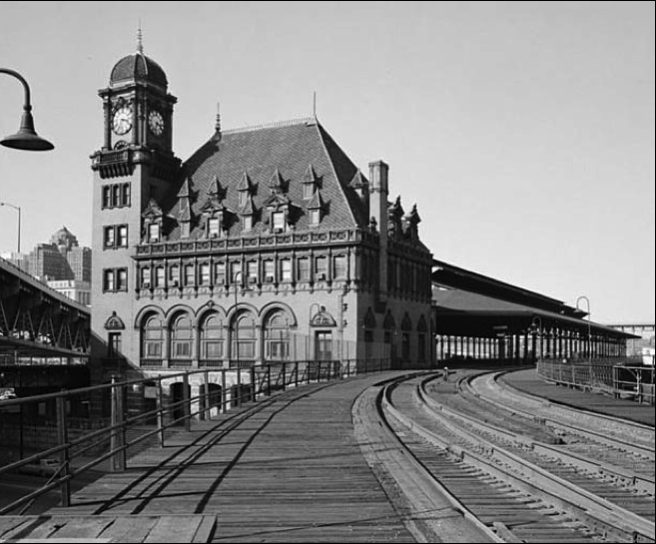
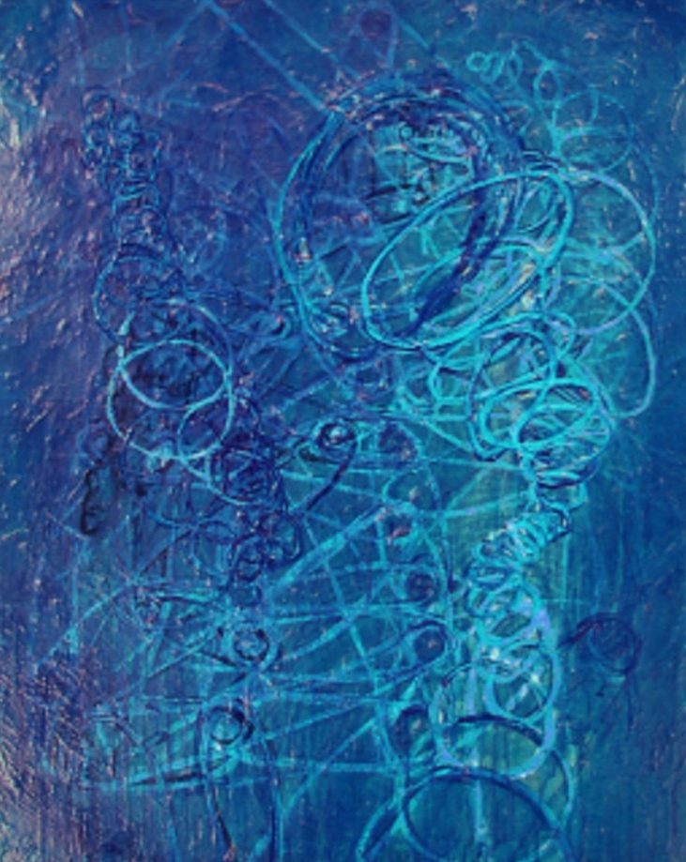
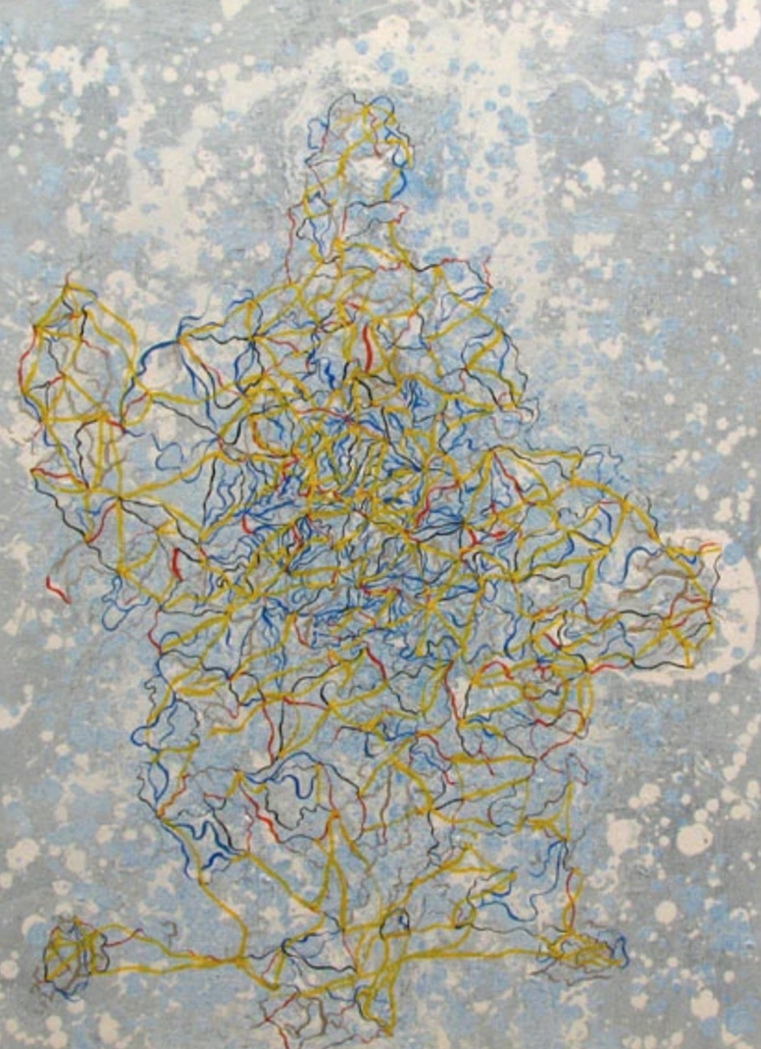
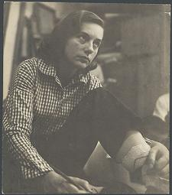
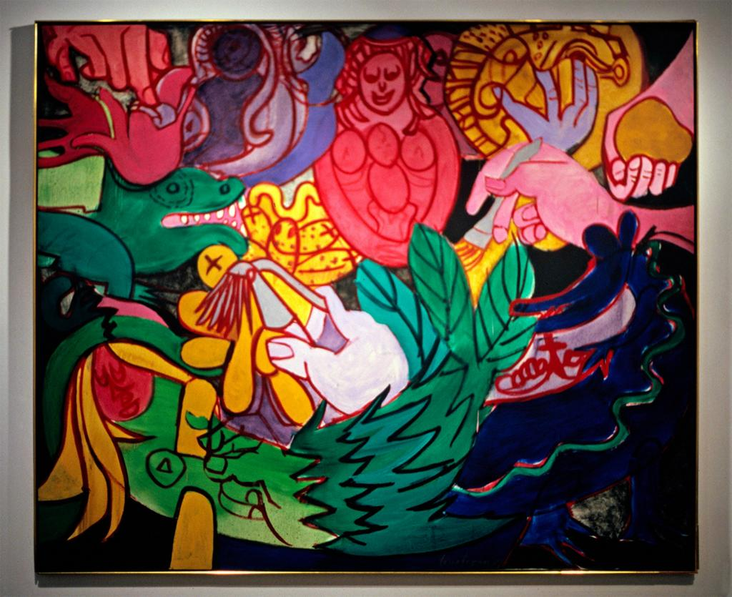
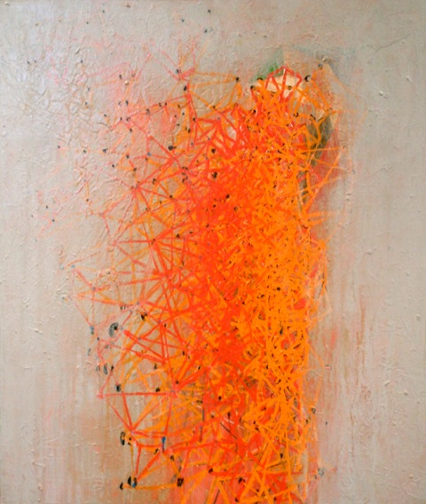
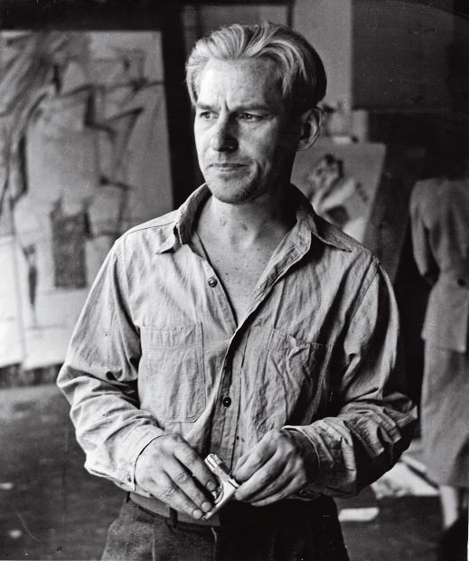
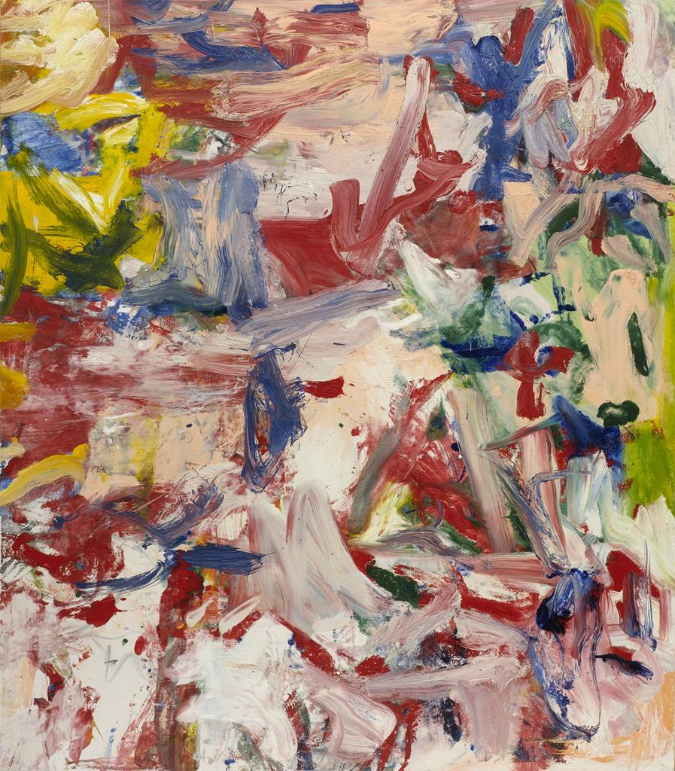
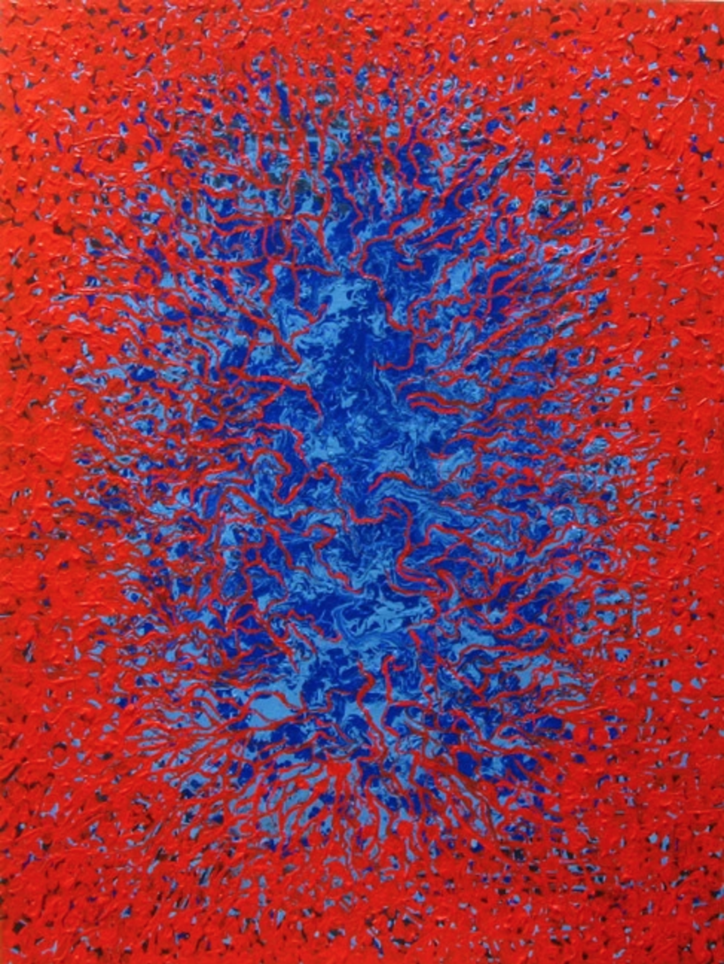
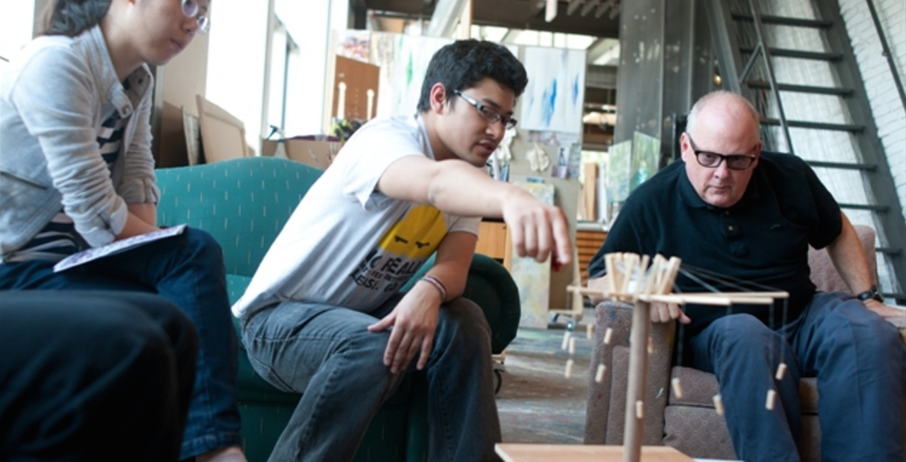
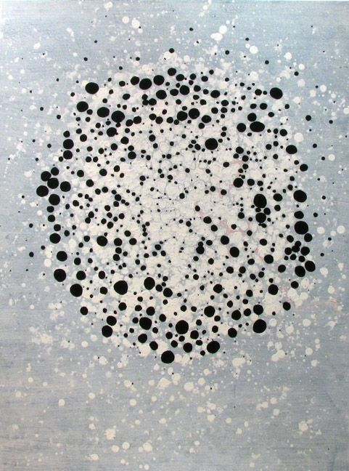
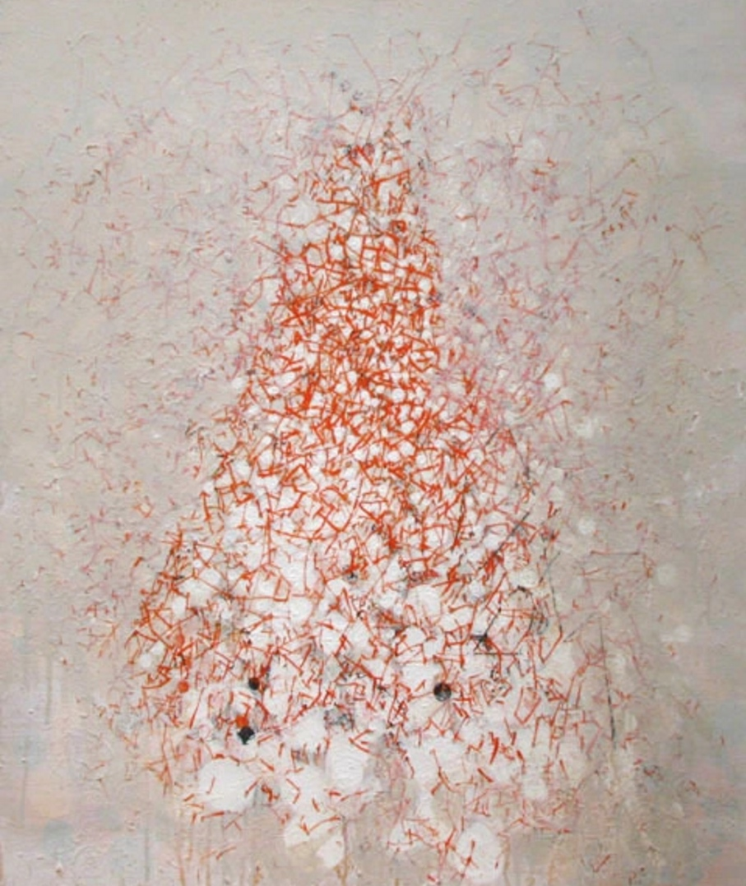
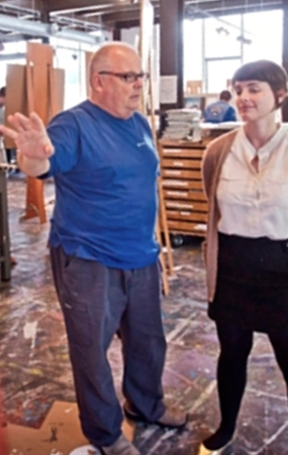
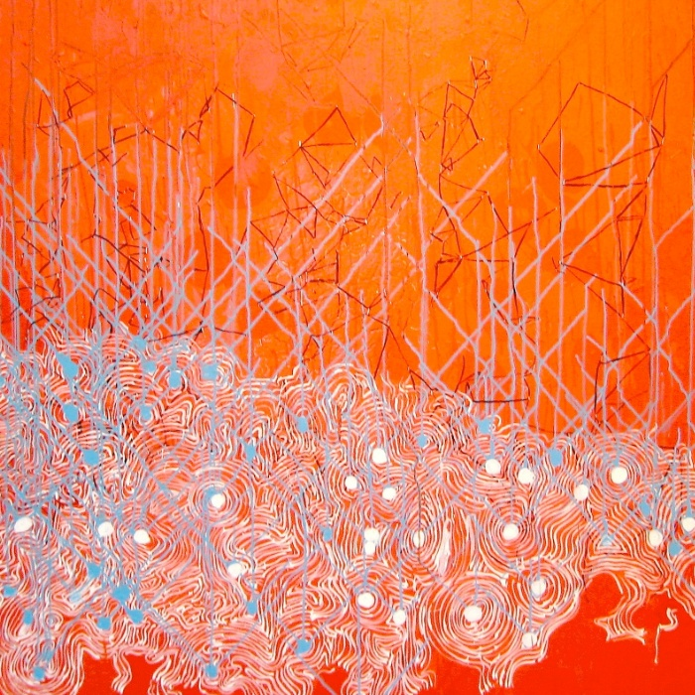
Ed Kerns: The Mystery Man
“I became pretty aware that I wasn’t choosing to be an artist but that it kind of chose me”
1960 aerial view of Virginian farmland
Beginnings
Professor Edward Kerns was born in Richmond, Virginia in 1945. With an ancestry heavily entwined with the ins and outs of the Civil War that ended up killing most of his male ancestors, Kerns grew up in a southern, aristocratic, household filled with women who, perhaps fortunately for him, were well read and observers of the arts: “I grew up in a house of books and art and music and it was not unusual to attend operas and plays so I didn’t have a typical childhood…. I became pretty aware that I wasn’t choosing to be an artist but that it kind of chose me...At the ripe age of 15, I was taking the train to Washington, Baltimore and to New York and to all those museums and I was doing this on my own.” Luckily, he had supportive parents who, although appalled at first that he didn’t want to be a lawyer or doctor as was custom in his family, allowed him to follow his passion: “It was time for me to go to college and I went to the University of Virginia and I was going to do what my family had always done, become a physician. I was a biology major and I had done it because I had this deep old family sense of responsibility…while I was there I realized I wasn’t that person. I was something else. And I remember going to tell my dad ‘I can’t do this I'm going to be a painter.’ And I was ready for the wrath, none came my way, and he said ‘that sounds lovely son. Why don’t you do that?’ I couldn’t believe it! I was completely crippled by the surprise. I had been ready to fight with him.” And with this support, Kerns quit school as a biology major and started his formal art education at BCU.
Train station, Richmond, Virginia, 1960s
Ed Kerns, NYC, c. 1970
Mentorship
At the Maryland Institute College of Art, Kerns met Grace Hartigan of whom he described as “a real alley cat, Hoboken, Irish, Catholic woman who was self-made and a brilliant painter”. Through a chain of serendipitous events, he ended up at the prestigious LeRoy E. Hoffberger School of Painting led, at the time, by Hartigan. Twelve people each year were accepted. “She was the introduction into what it really meant to be an artist.” They quickly hit it off and he eventually ended up filling up the role of chauffeur, a function that served him very well. “Over the next few years I drove her around in a big old Lincoln town car and we would go to places together and I would just be there as a fly on the wall and she would say ‘we need to go to long island I need to see Bill (de Kooning) I need to go see Philip Guston “ and whatever. But they liked me cause I was smart and they would include me…” After grad school, Kerns got an incredible offer to teach art at the University of Kansas but was quickly dissuaded when Hartigan tore the letter up and forced him to go to NY where he eventually earned his fame. “She says, ‘you're not going to Kansas boy! You must go to NY and if you don’t go to NY I will never speak to you again!...you should go paint. you should go do this.’” While in NY, and while still working for Hartigan, de Kooning sparked an interest in Kerns and made him his personal assitant. “He said to me, ‘you drive for Grace, why don’t you drive for me, and maybe build some stretchers and blah blah blah,’ and pretty soon I’m in his life. I’m a studio-canvas-stretcher, jack-of-all-trades, whatever is needed, grocery shopping, coffee making son of a bitch. I’m just all over the place…I got to watch him paint and go places with him and meet all kinds of interesting contemporary figures that came through the studio. I met Richard Feynman, Edward Albee, Barbara Guest... But the main lesson was about what it took to make art.” Kerns quickly build his reputation in the art world and had his first exhibit show b the time the 70’s rolled around. “ I had my first show in new York in 57th street. I was 26. That is unheard of. DeKooning didn’t have his first show until he was 44 years old. So this is virtually unheard of.”
Grace Hartigan, 1977
Grace Hartigan, c. 1970
Willem de Kooning, 1977
Willem de Kooning, c. 1970
Present
As a professor at Lafayette College, Ed Kerns naturally fills the role of mentor for many of his students. But unlike the traditional mentor who passes down his skill to his mentee, Kerns chooses to be a resource book of sorts by sharing his experiences for reference: “Some fields are driven by a kind of mentoring as I was with Grace Hartigan to become a really good painter, and that might play out here occasionally, but more often than not it’s an opening up to a much broader human view of human capacity as what we can do....it’s the handoff of value, and why we have values. It’s not the hand off of techniques.” Kerns makes sure that it’s all about the students and prefers to underemphasize his success in order to let them flourish: “Another thing I’ve learned is you have to be extraordinarily modest. Yourself. You cannot, unless it’s self-effacement or jokingly, reveal what you think is the best of your career…. If somebody’s really interested they’ll let you know and you can tell them what you know. But always in the context of, you know, this is not about fame. It’s about knowing things. That’s what we do as human beings. We want to know things; we pine to know things.”
Besides teaching and mentoring, Kurns continues to produce art today but at a much more relaxed pace. He describes art as his calling but he also acknowledges that it takes a lot. And so he prefers the freedom that teaching and his success gives him. He produces art as he wants to, when he wants to. Luckily for us, it doesn’t seem like he will be stopping anytime soon.
By, Stacy Nganga and Mirielle Vasselli

