Slide 1
Course Registration
Sophomore Fall 2016

Slide 2
First Year – 8 courses
ES 101 – Introduction to Engineering
FYS – First Year Seminar
MATH 161 – Calculus I
MATH 162 – Calculus II
CHEM 121 – General Chemistry
CHEM 122 – General Chemistry II
PHYS 131 – Newtonian Dynamics
CCS¹

Slide 3
The Common Course of Study
First-Year Seminar
Distribution Requirements:
one course in the Humanities (H)
one course in Natural Science with lab (NS)
one course in Social Sciences (SS)
two additional courses in two different divisions outside the student's home division
Quantitative Reasoning Requirement (Q)
Writing Requirement (W):
First-Year Seminar
three additional W-designated courses, minimum of one course in the major and one outside major
Global and Multiculturalism (GM)
two courses with domestic and global contexts
Values Requirement (V)
Elementary Proficiency in a second language
one year of study of a language
First Priority for CCS in Spring 2016

Slide 4
Second Year – 10 courses
ES elective²
MATH 263 – Calculus III
MATH 264 – Differential Equations
CHEM 221 – Organic Chemistry I
Chemistry elective³
CHE 211 – Material and Energy Balances
CHE 222 – Thermodynamics
CCS
CCS
Free elective

Slide 5
Staying at Lafayette?
MATH 263 – Calculus III
CHEM 221 – Organic Chemistry I
CHE 211 – Material and Energy Balances
ES elective²
CCS
MATH 264 – Differential Equations
Chemistry elective³
CHE 222 – Thermodynamics
CCS
Free elective
FALL
SPRING

Slide 6
Studying Abroad in Spring?
MATH 263 – Calculus III
CHEM 221 – Organic Chemistry I
CHE 211 – Material and Energy Balances
CHE 222 – Thermodynamics
CCS
MATH 264 – Differential Equations
ES elective²
Chemistry elective³
CCS
Free elective
FALL
SPRING

Slide 7
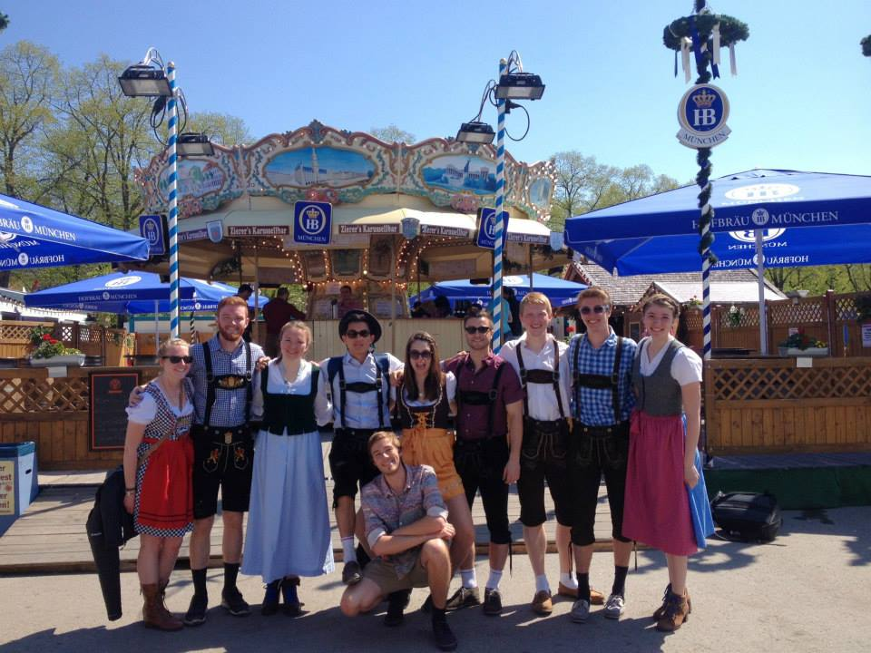
Classes in Germany!!
Renewable Energy
CHE 370
Chemical Engineering Elective
Bioprocess Engineering
CHE 337
Chemical Engineering Elective
Circuits
ES 241
Engineering Elective
German Culture and Politics
INDS 225
GM 2

Slide 8
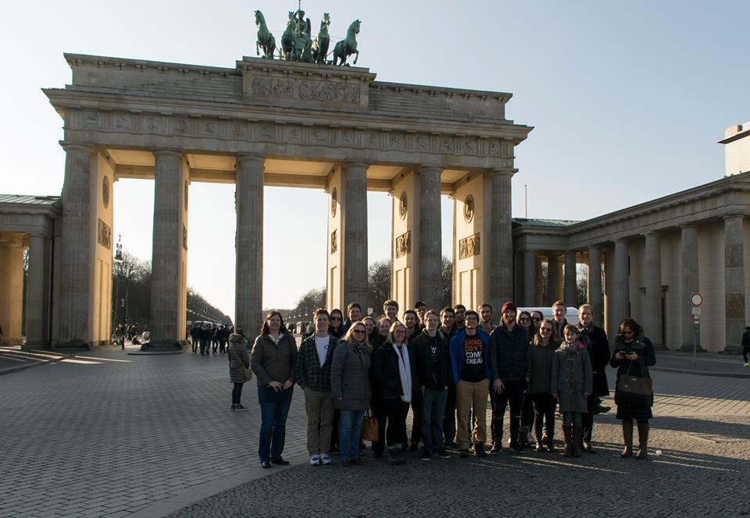
Other Classes
Differential Equations
Linear Algebra
Social Inequalities
German
Junior/ Senior Year: Analytical Chemistry or Inorganic Chemistry

Slide 9
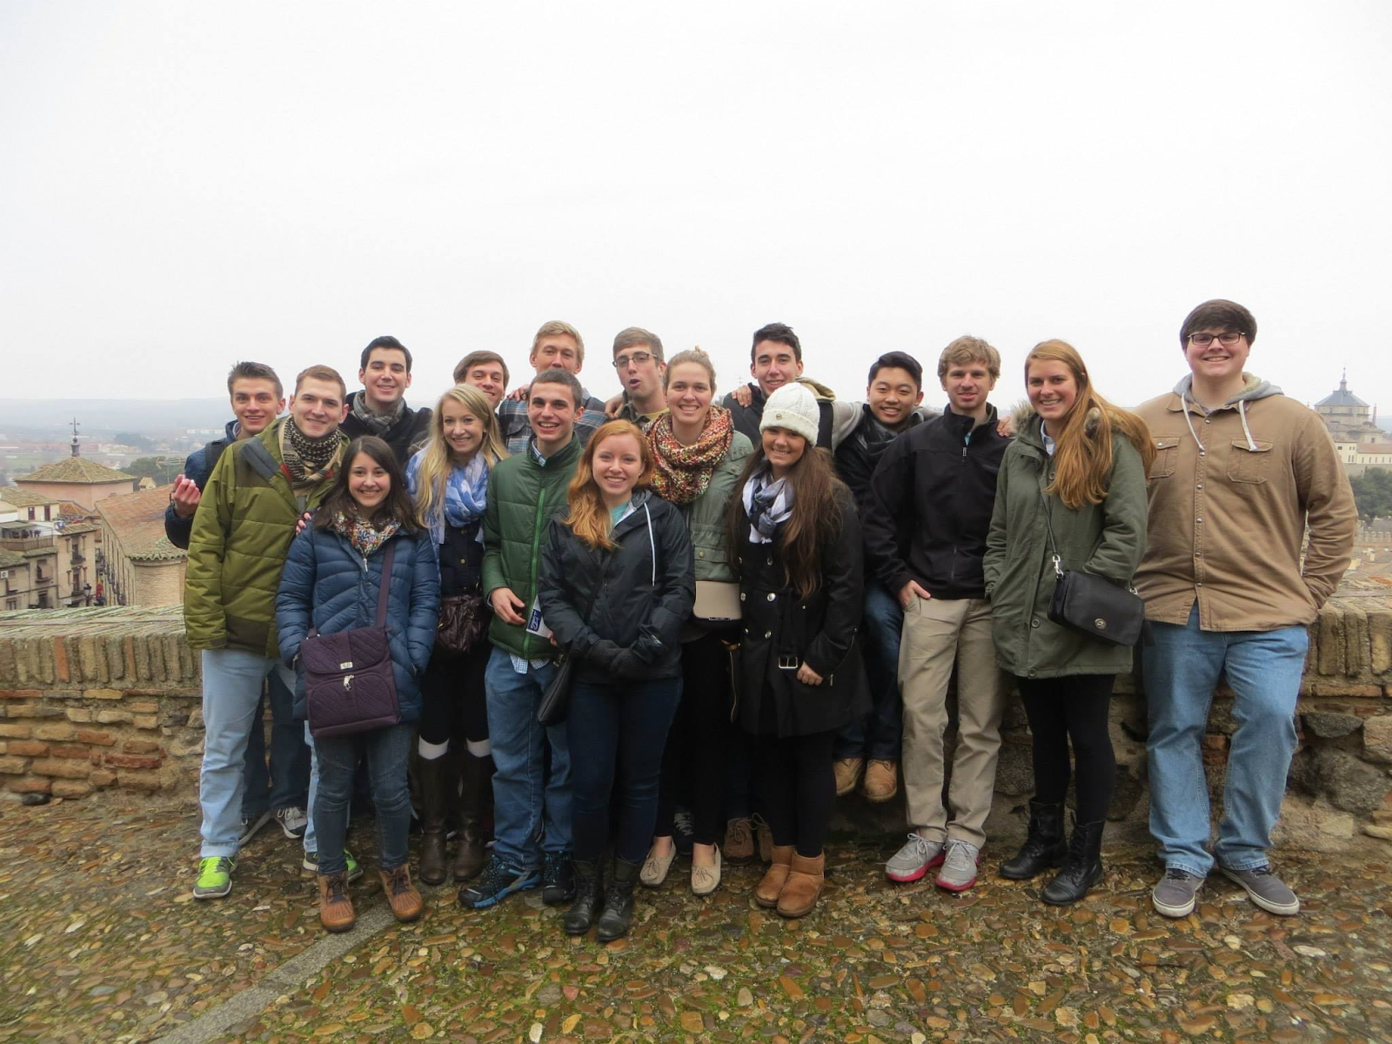
Classes in Spain
Sustainability of Water Systems
EGRS 222
Values, Writing
International Terrorism
GOV 299
Social Science Elective
0.75 Credits
Organic Chemistry II
CHEM 222
Chemistry Elective
Art History

Slide 10
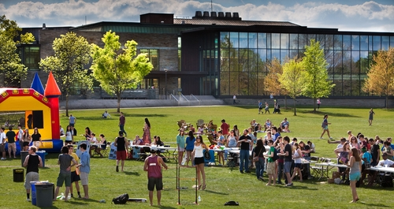
Staying at Lafayette

Slide 11
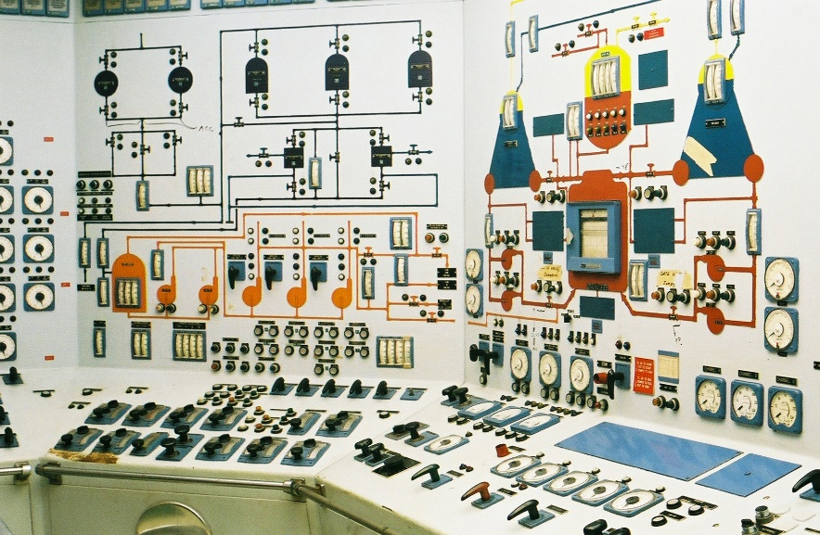
Opportunity to take Interesting Courses
Alternative Energy
Drug Delivery
Process Controls
Completed common course sophomore year!

Slide 12
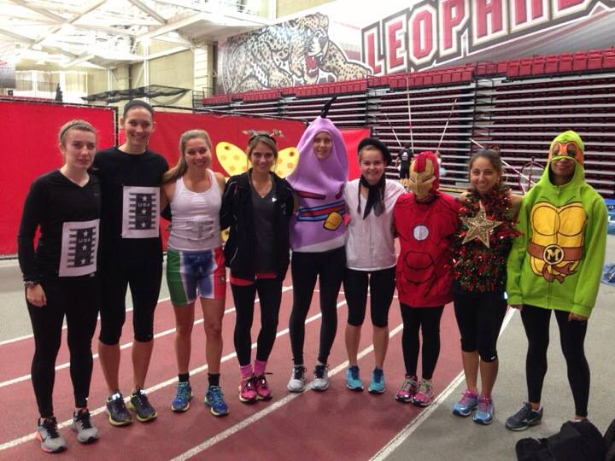
Participation in Athletics

Slide 13
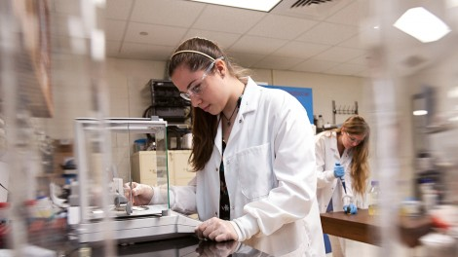
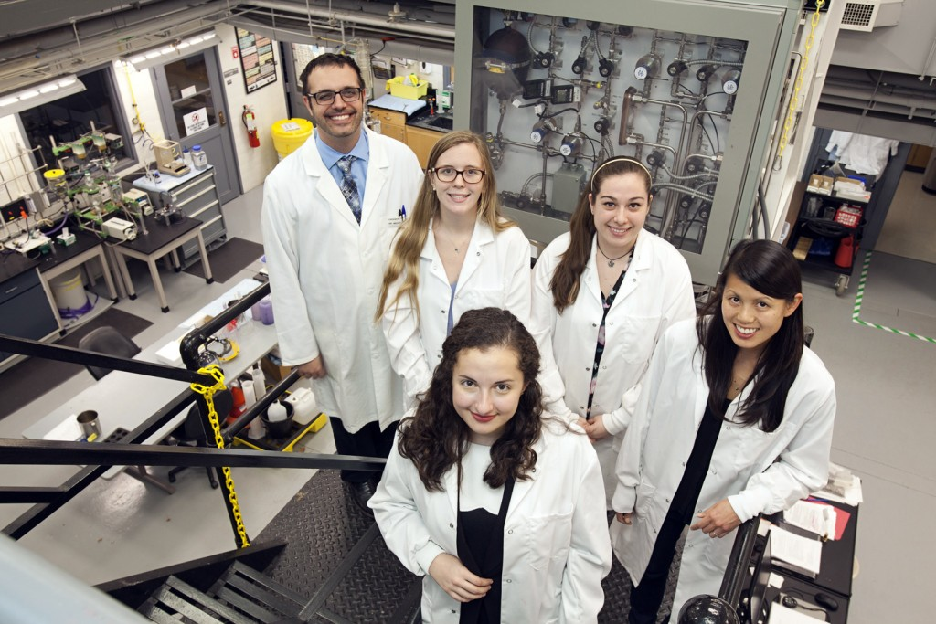
Other Extracurricular Activities
AICHE
LETS
SWE
WA (writing associate)
Excel Scholar research

Slide 14
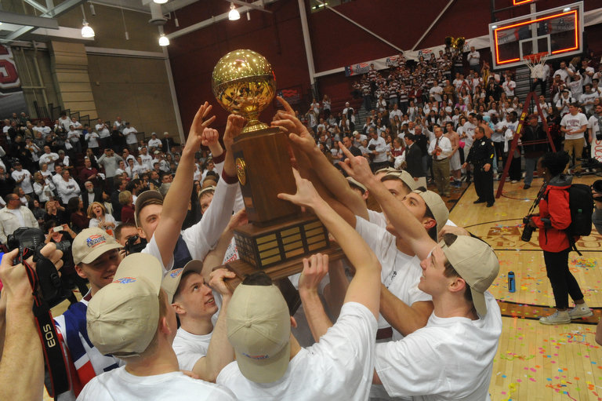
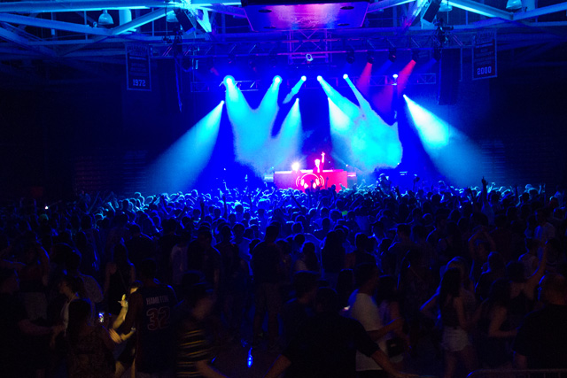
Other Experiences
Basketball Patriot League Champs 2015
Spring Concert
Holi Festival
Football season!

Slide 15
Next Steps
Sign-up for an advising appointment with your advisor
Be prepared!
Create a sample schedule with back-ups to CCS courses
Course Registration
Wednesday, April 13 @ 7:00am

Slide 16
Questions?

