Slide 1
AIChE Spring 2018 General Body Meeting
February 5, 2018
Notes:
Hayden

Slide 2
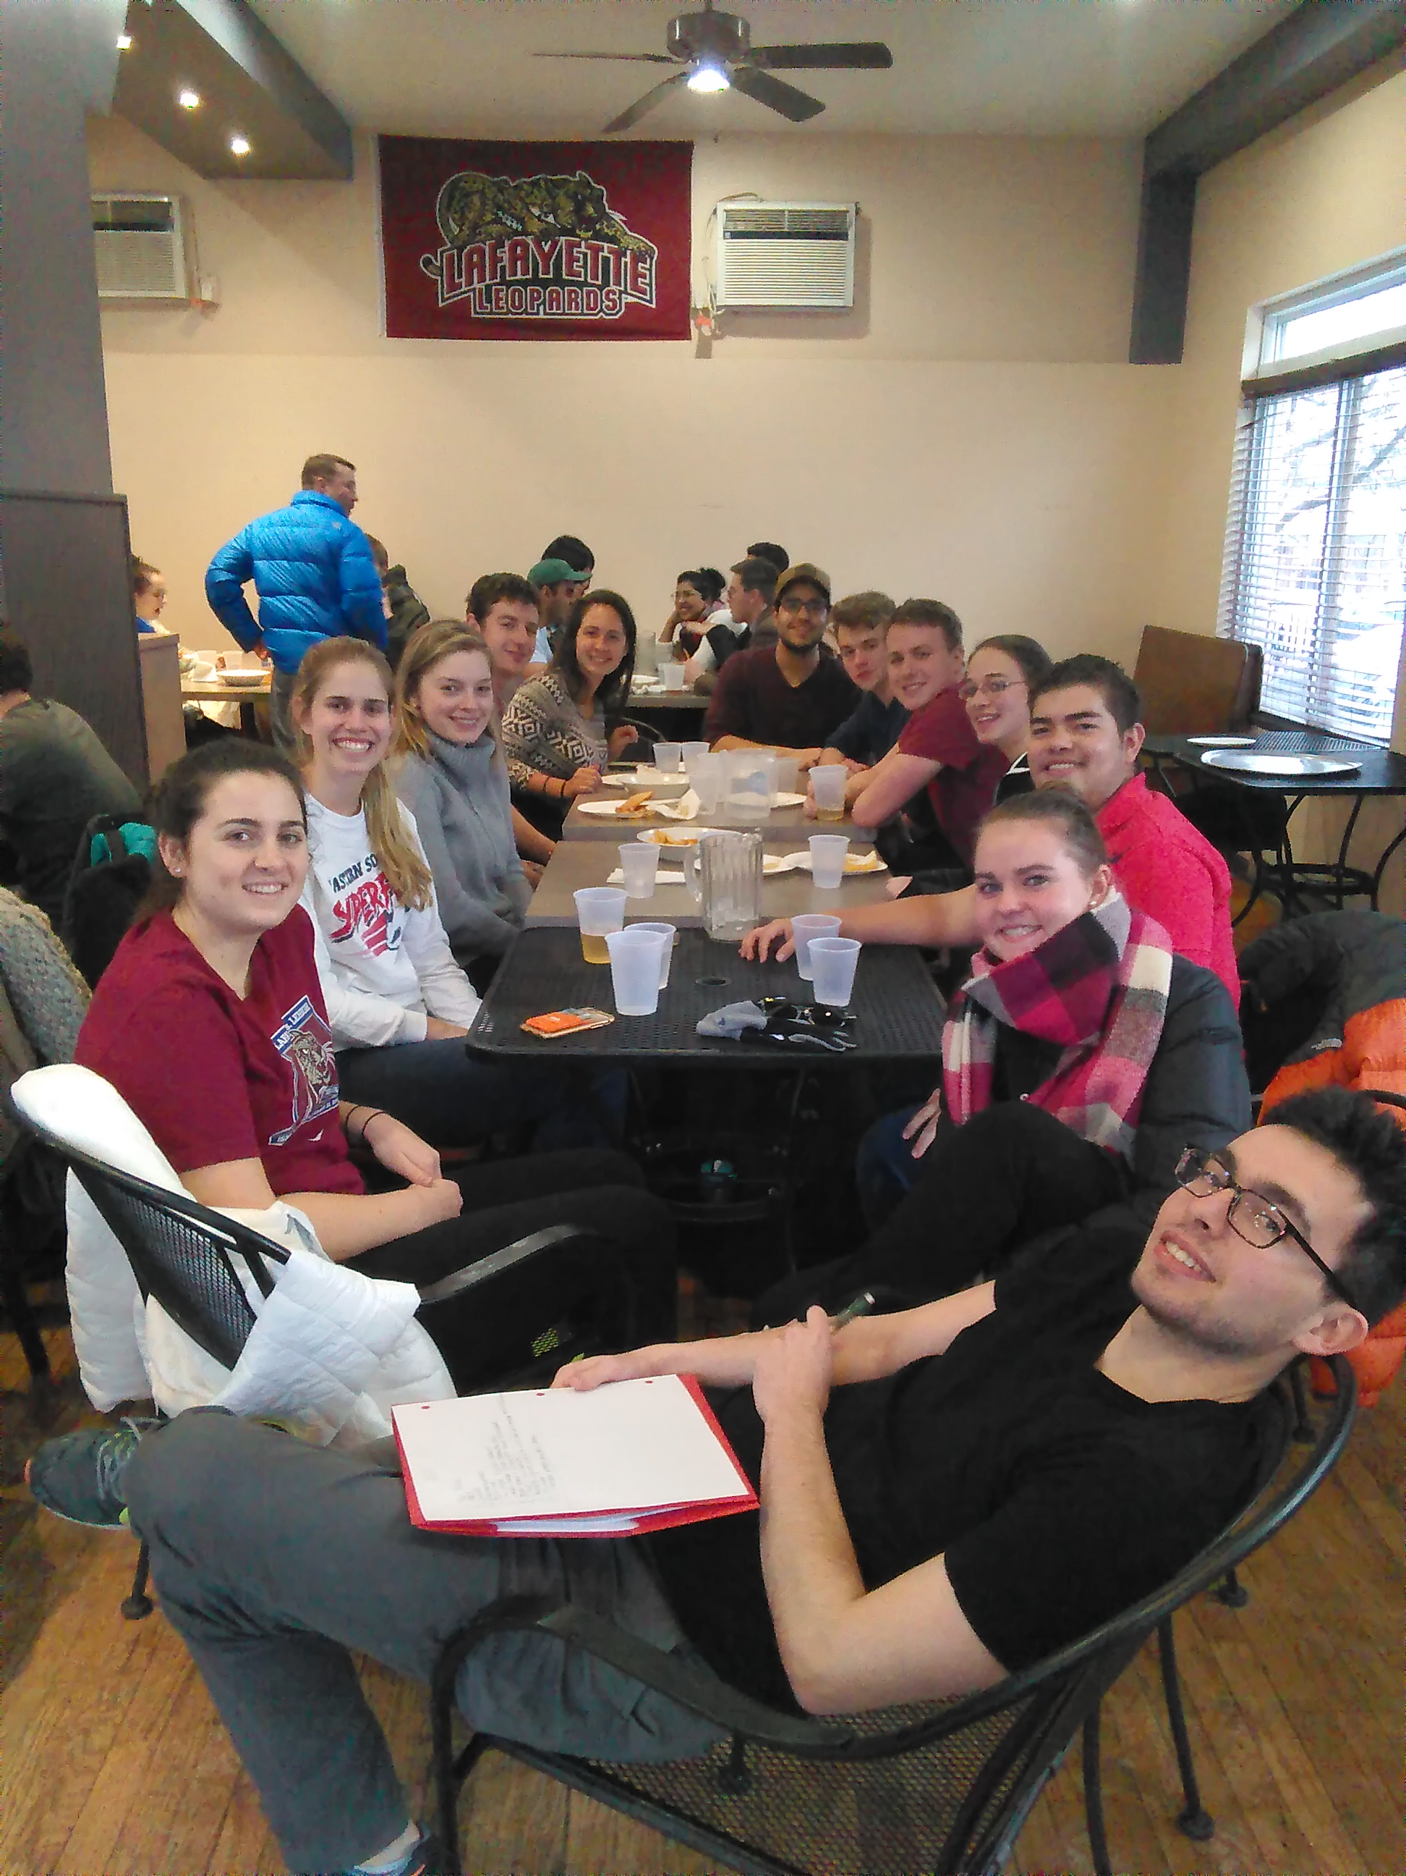
Save the Date!
Pub Night!
Friday, 2/16
4:30-6:30
Campus Pizza
National Engineers Week
Monday, 2/19 - Friday, 2/23
Field Trip
Air Products Plant tour? (April)
Notes:
Sean

Slide 3
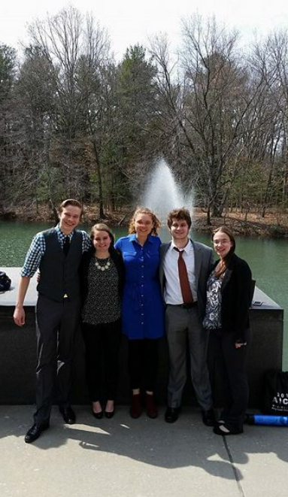
Save the Date!
AIChE Regional Student Conference
April 6-7
Princeton University
Literacy Day
3/3 10am-2pm
Notes:
Sean

Slide 4
Watch your Email
Brownbags
Service Opportunities
Bonding Events
Any Suggestions?
Let us know!

Slide 5
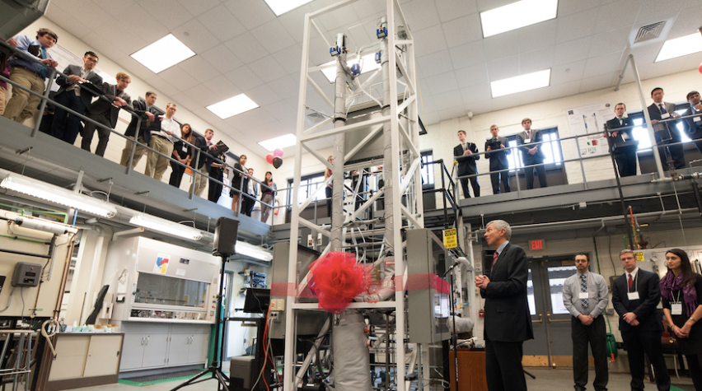
ChBE Symposium
Mission Statement:
1) To expose underclassmen students to the chemical engineering professional community of which they will become a part after graduation.
2) To provide a platform to enhance the communication, connectivity, and participation among the Lafayette Chemical Engineering Department: faculty, students, and alumni.
Notes:
Michael

Slide 6
ChBE Symposium
When: March 23, 2018
Where: Kirby Hall of Civil Rights
What: Presentations, Group Panels, Breakout Sessions, Lab Tours, Poster Session
Notes:
Sara

Slide 7
ChBE Symposium Volunteering
Folders
Set up/Clean up
Registration
Photographers?
Greeters
Notes:
Danielle

Slide 8
National AIChE involvement
Become an Official Member....it’s FREE!
Online Courses
Job and Internship Board
Online library/Reference Resources
You will have to do this anyway senior year!!!
Notes:
Danielle

Slide 9
Helpful Websites
Lafayette AIChE Sites Page
http://sites.lafayette.edu/aiche/
Lafayette AIChE Facebook Page
https://www.facebook.com/lafayette.aiche
AIChE Mid Atlantic Conference Page
https://princetonaiche.wordpress.com/registration/
National AIChE Website
http://www.aiche.org/
http://www.aiche.org/community/membership
Notes:
Michael

Slide 10
Questions?

Slide 11
Contact Us!
PRESIDENTS
Colleen Lavelle lavellec@lafayette.edu
Sara Mikovic - mikovics@lafayette.edu
VICE PRESIDENTS
Trent Eastman eastmant@lafayette.edu
Ali Bord borda@lafayette.edu
SOPHOMORE REPRESENTATIVE
Sarah Park parks@lafayette.edu
FACULTY ADVISOR
Professor Senra - senram@lafayette.edu
DEPARTMENT HEAD
Professor L. Anderson - andersol@lafayette.edu

