Slide 1

Utilizing polymerization-induced phase separation to improve dental restorative materials
Caroline R. Szczepanski¹ and Jeffrey W. Stansbury^{1,2}
March 1, 2013
Lafayette College
¹Department of Chemical & Biological Engineering, University of Colorado, Boulder,CO, USA
²Biomaterial Research Center, School of Dental Medicine, University of Colorado, Aurora, CO, USA

Slide 2
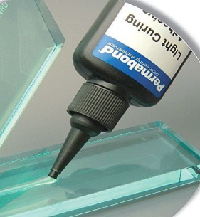

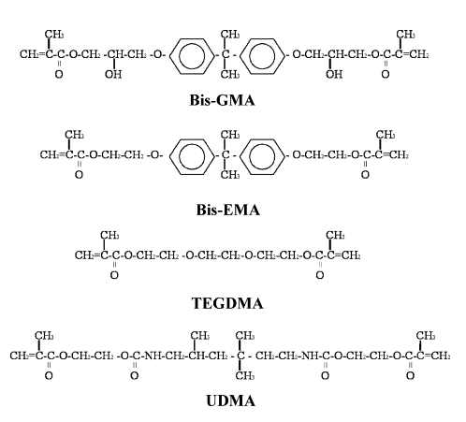
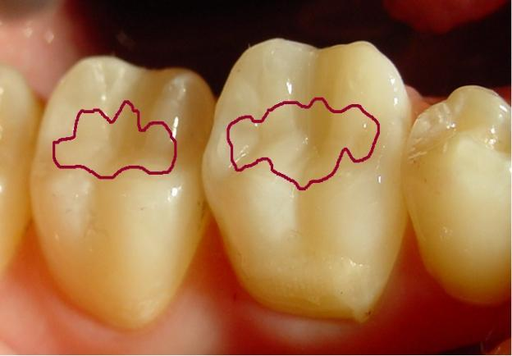
Photo-curable Polymer Networks
Photo-curable Polymer Networks
  Volumetric Shrinkage
  Polymerization Stress
  Internal defects
  Interfacial defects
Spatial control
Temporal control
Low temperature
Biologically compatible
http://www.hielscher.com/ultrasonics/industries.htm
http://img.directindustry.com/images_di/photo-g/uv-curable-adhesive-54994.jpg
Ferracane, J. Dental Materials 2005.

Slide 3
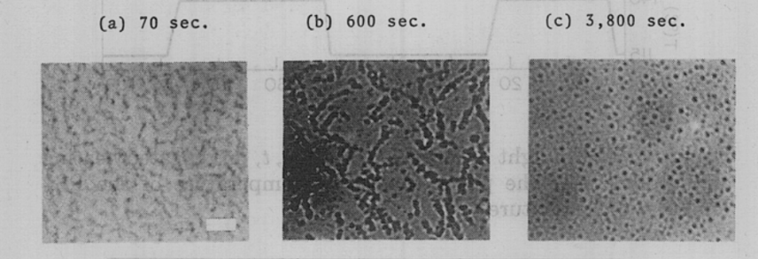
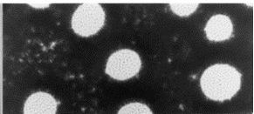
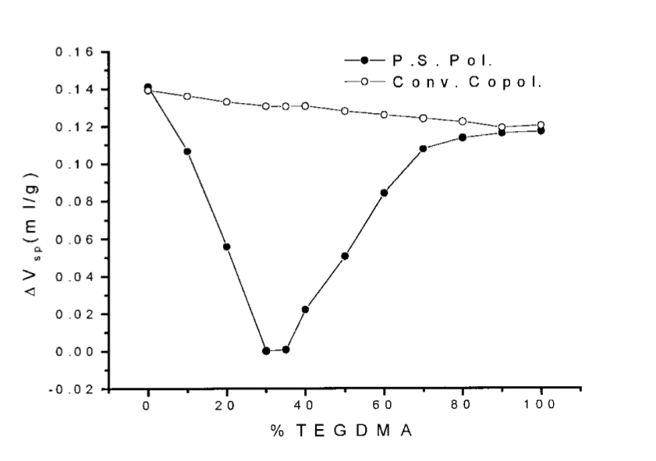
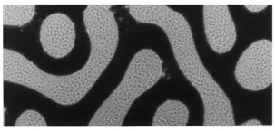
Polymerization Induced Phase Separation (PIPS)
Thermally induced phase separation in a poly-styrene / poly-vinyl methyl ether solution. Decomposed at 115°C. Scale bar represents 10μm.
Nishi T, Wang TT, Kwei TK. Macromolecules 1975.
Low-temperature (32°C) cure of a 1:1 propylene glycol: maleic anhydride resin modified with polyester (9% left, 11% right). Methyl ethyl ketone peroxide initiated. Cure time > 5h.
Conventional co-polymer (TEGDMA/MMA)
Phase separating co-polymer (TEGDMA/[PMMA+MMA])
Li W, Lee LJ. Polymer 2000.
Δ Specific Volume (ml/g)
  Potential to make materials with reduced volumetric shrinkage
Wt% Phase 1 - TEGDMA
R. Velazquez, I. Ceja, J. Guzman, V.M. Castano. Journal of Applied Polymer Science, 2004.
Notes:
Emphasize why these are inappropriate!
High Temp
Long Polymerization times
Types of monomers used!

Slide 4
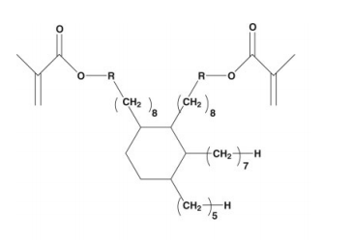
Polymerization Induced Phase Separation (PIPS)
  Limitations
  Curing mechanisms
  Monomer formulations
  Reaction Time
  Limited Information on the physical mechanism of shrinkage reduction
Dimethacrylate monomers based on dimer acid structure have shown polymerization induced phase separation (PIPS) behavior in photo-initiated monomeric systems.
Trujillo-Lemon M., Ge J, et al. Journal of Polymer Science Part A: Polymer Chemistry 2006.

Slide 5
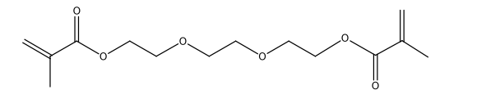
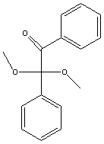
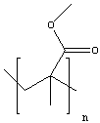
Specific Aim 4
Our Approach to PIPS
Modify bulk homo-polymer matrix:
Using a UV-photo initiatior
  λ~365nm
TEGDMA
2,2-dimethoxy-2-phenylacetophenone (DMPA)
With the addition of non-reactive pre-polymers:
  Varying loading (wt%) and side-group length
Advantages
Biologically compatible monomers
Purely photo-initiated materials
Fast reaction times
PEMA
PMMA
PBMA
PBMA | PEMA | PMMA
M_{W}~337,000 Da | M_{W}~515,000 Da | M_{W}~120,000 Da
T_{g}~22.4(±2.5) ºC | T_{g}~72.5(±1.1) ºC | T_{g}~117(±6.0) ºC
ρ=1.07 g/mL | ρ=1.11 g/mL | ρ=1.19 g/mL

Slide 6
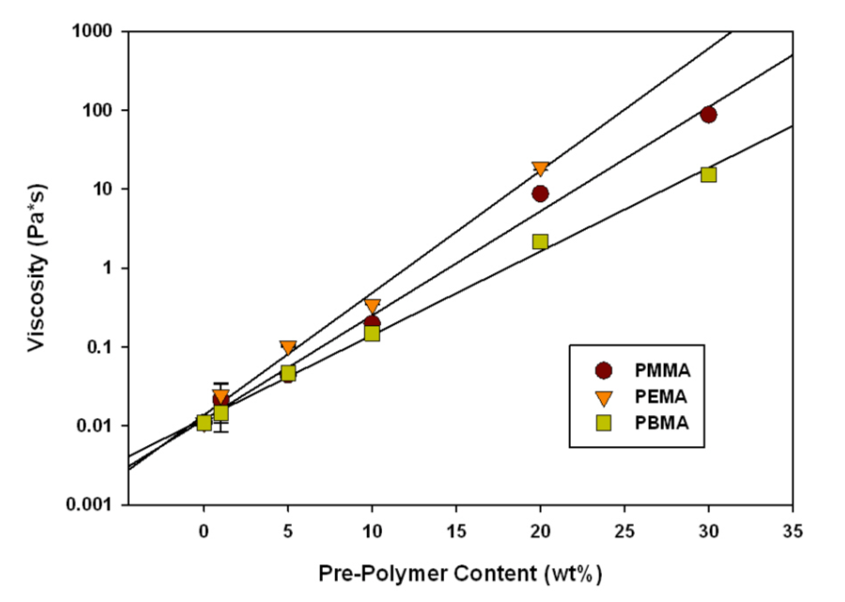
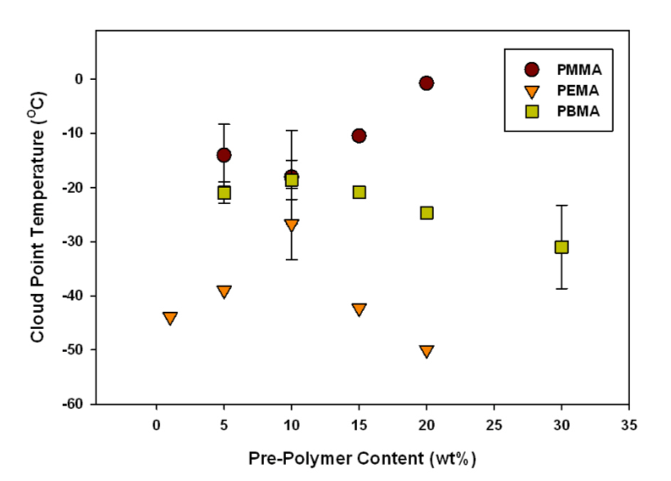
Monomer Formulation and Stability
Physical
Multiple formulations appropriate for ambient cure polymerizations.
Thermal
PBMA | PEMA | PMMA
M_{W}~337,000 Da | M_{W}~515,000 Da | M_{W}~120,000 Da
T_{g}~22.4(±2.5) ºC | T_{g}~72.5(±1.1) ºC | T_{g}~117(±6.0) ºC
ρ=1.07 g/mL | ρ=1.11 g/mL | ρ=1.19 g/mL

Slide 7
Kinetics of Polymerization
1. Initiation

Slide 8
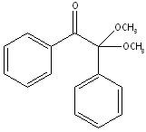



Photo-initiatior Cleavage Mechanism
Type I Cleavage
+
Relatively stable radical
+
CH₃
Very high reactivity, diffusive, raises efficiency of the reaction.

Slide 9
Kinetics of Polymerization
1. Initiation
2. Propagation
3. Chain Transfer
4. Termination

Slide 10
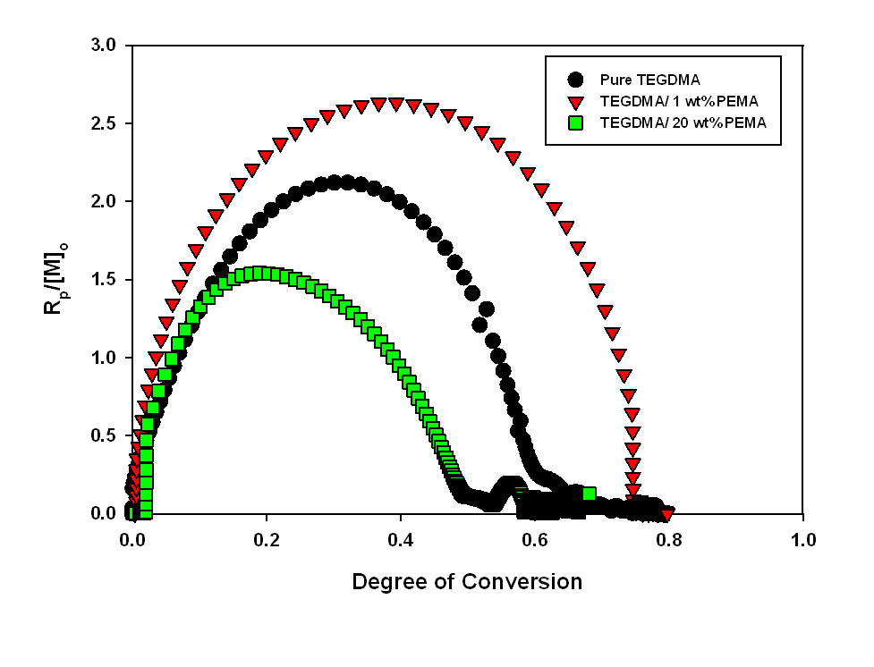
Kinetics of Polymerization
I_{o}=5mW/cm²
λ=365nm

Slide 11
Kinetic and Thermodynamic Interplay
Reactive monomer
Non-Reactive pre-polymer
Entropy Decrease
Early Gelation
Late Gelation
Pre-Gel
Post-Gel
Notes:
Change slow and fast????
Phase separation is a balance between the thermodynamic miscibility, and the kinetic development which effects how those incompatible phases can move.
RHS -
LHS – Gelation precedes phase separation. Macromolecular diffusion can not occur after cross-linking.

Slide 12
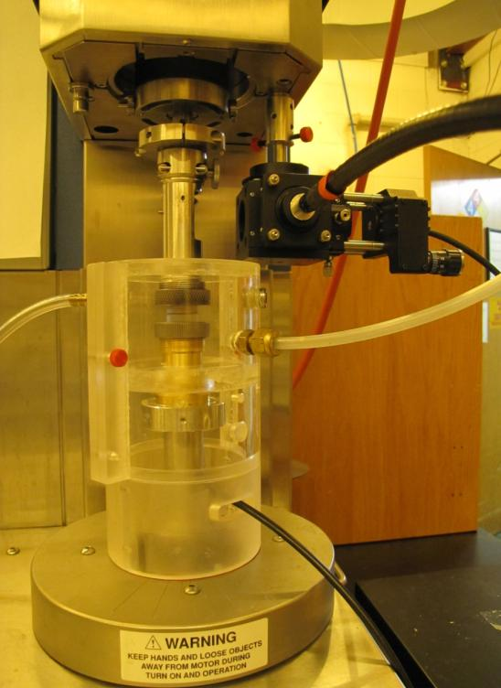
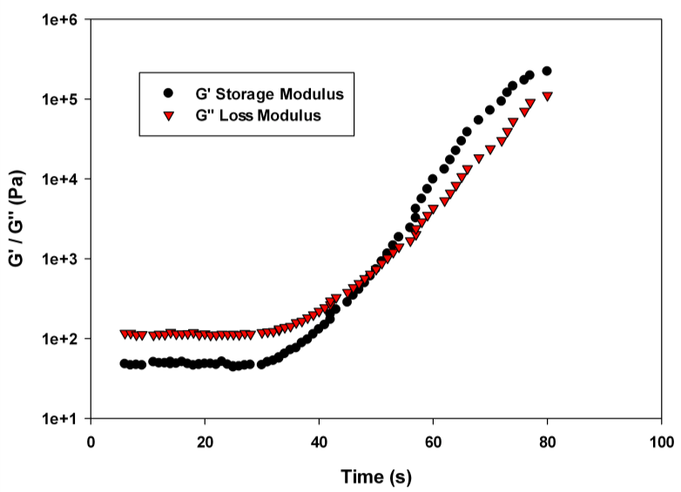
Photo-Rheometry
I_{o}=300μW/cm²
λ=365nm
Cold Mirror
Sample between quartz plates
Nitrogen Purge Chamber
Rheological development of a TEGDMA / 15 wt% PEMA network in real-time. I_{o}=300μW/cm². Irradiation begins at t=30s.
Image: Carmem Pfeifer
G’/G’’ cross over point as a function of conversion
G’/G’’ crossover ~ Gelation

Slide 13
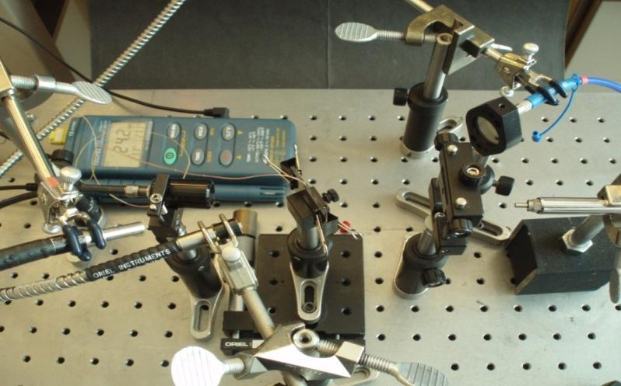
Optical Property Development
365nm light source
I_{o}=300μW/cm²
λ_{cure}=365nm
To UV-vis detector
Near-IR source
To IR-detector
Sample between glass slides
400-800nm light source
Onset of turbidity ~ onset of phase separation
Material
TEGDMA | 1.46 (±1e-4)
PMMA | 1.49 (±7e-4)
PEMA | 1.49 (±2e-4)
PBMA | 1.48 (±4e-4)

Slide 14
Optical Property Development
TEGDMA Rich Phase
TEGDMA/pre-polymer Phase
t_{o}
PIPS onset
Moderate Conversion
Higher Conversion
Final Conversion
polyTEGDMA
Refractive Index
Prepolymer
TEGDMA

Slide 15
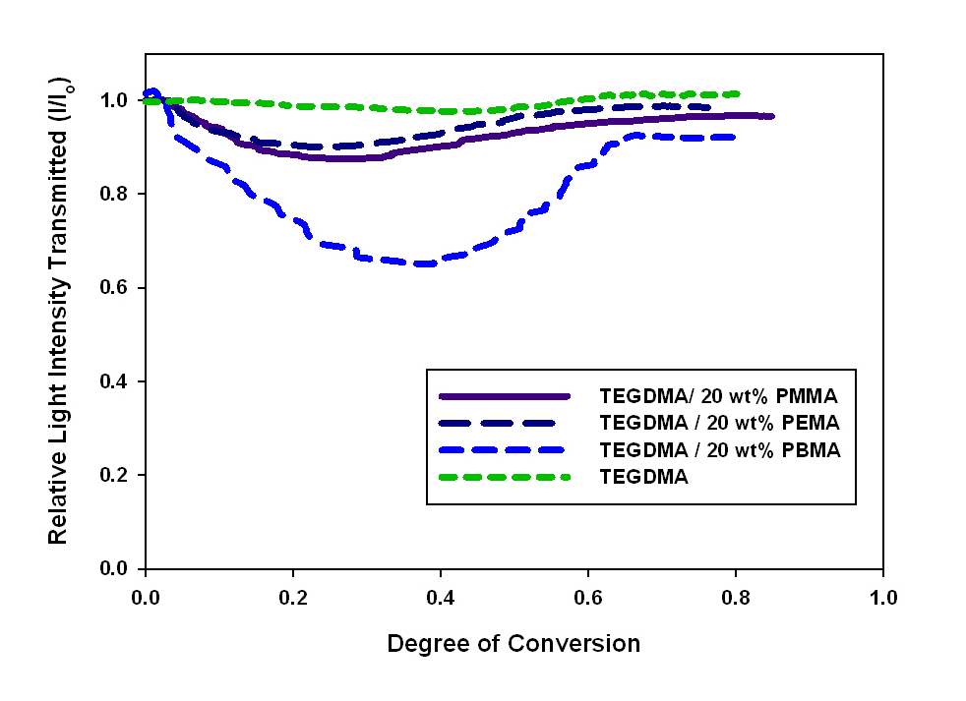
Optics of Polymerization
Specific Aim 1
I_{o}=300μW/cm²
PIPS Onset
TEGDMA rich phase ‘catch-up’
Gelation

Slide 16
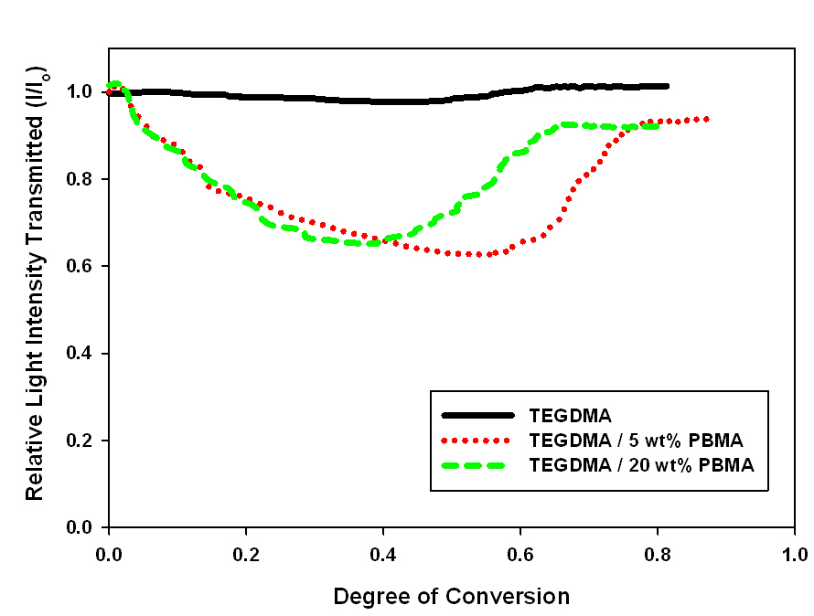
Optical Property Development – Same Material, Different Loading
I_{o}=300μW/cm²
Similar phase compositions?

Slide 17
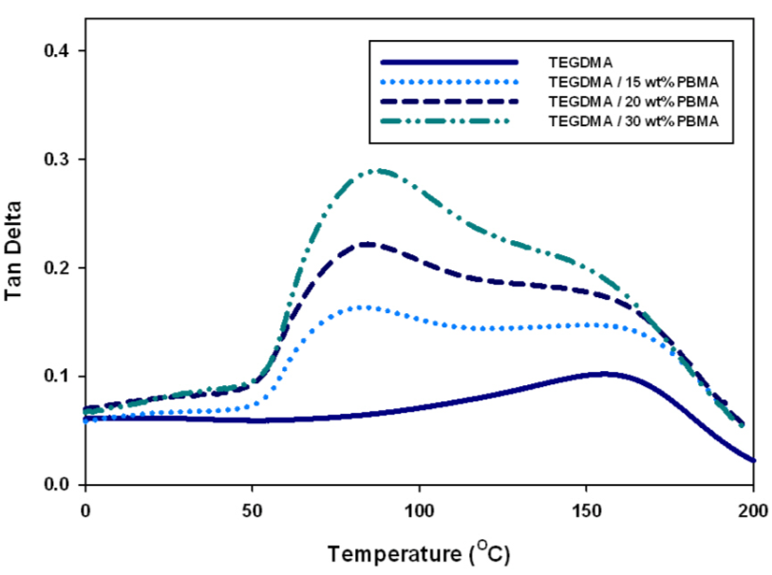
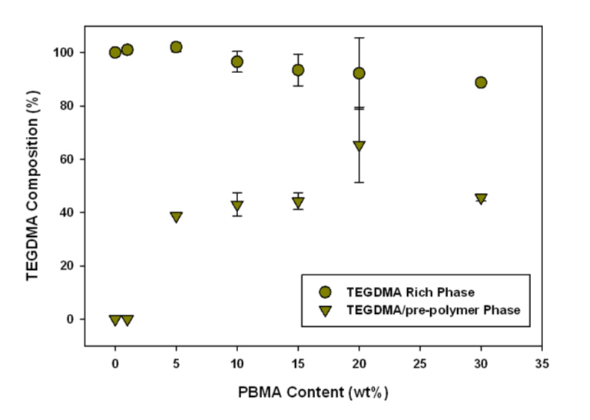
Post-Cure Phase Composition
T_{g} pure PBMA
Samples analyzed post-cure
Sample conversion > 90%
Temperature sweep
-50°C - 200°C
3°C /min
Strain: 0.01%
T_{g} poly-TEGDMA
Validate optical bench results using post-cure dynamic mechanical analysis.

Slide 18
Where to next?
  Limitations
  Curing mechanisms
  Monomer formulations
  Reaction Time
  Limited Information on the physical mechanism of shrinkage reduction
Szczepanski CR, Pfeifer CS and JW Stansbury. Polymer, 2012; 53: 4694-4701.

Slide 19
Proposed Shrinkage Reduction Mechanism with PIPS
Polymer Modulus
Phase 1 Polymerization Rate
Phase 2 Polymerization Rate
Differing Polymerizations:
Gelation, vitrification, stress and shrinkage development – non-equivalent.
Monomer Modulus
Mechanism:
Development of first phase causes interfacial and internal stresses (normal). May lead to cavitation within the material.
Later development of second phase will lead to distortion, displacement, and changes in density of the first phase.
Notes:
Emphasize that this picture is the SIMPLEST representation.
Entanglements or covalent bonds with other network.
LPA – traditionally in the form of non-reactive pre-polymer. This way – we can take a pre-polymer with fixed properties – and see how that can affect the development of homo-polymer network.
Segway into velazquez work

Slide 20
Polymerization Stress
Measure displacement of cantilever beam as sample polymerizes between glass rods.
Beam deflection ~ polymerization stress
Use near-IR fiber optics to simultaneously measure conversion.

Slide 21
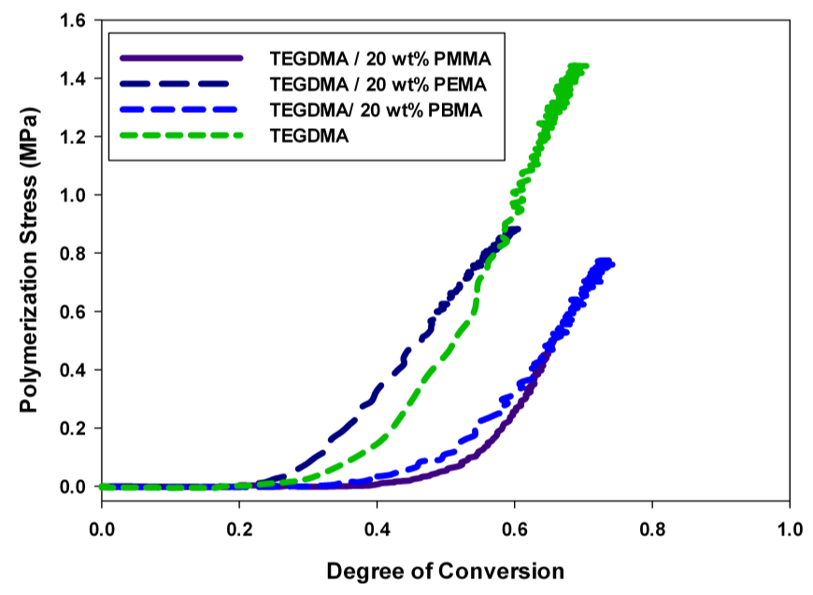
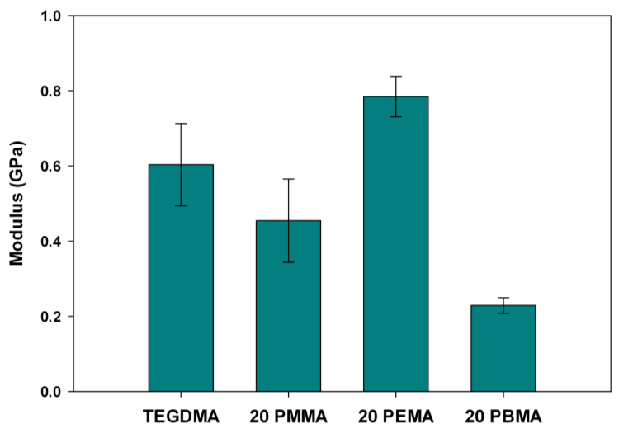
Stress Development with PIPS
Polymerization Stress
I_{o}=300μW/cm²
~40% reduction in polymerization stress
Reduction goes beyond the impact of volumetric displacement by prepolymer
Still achieve equivalent or higher final degree of conversion
Modulus
Potentially maintain an equivalent or enhanced modulus post-cure compared to TEGDMA-control
Modulus normalized by final conversion

Slide 22
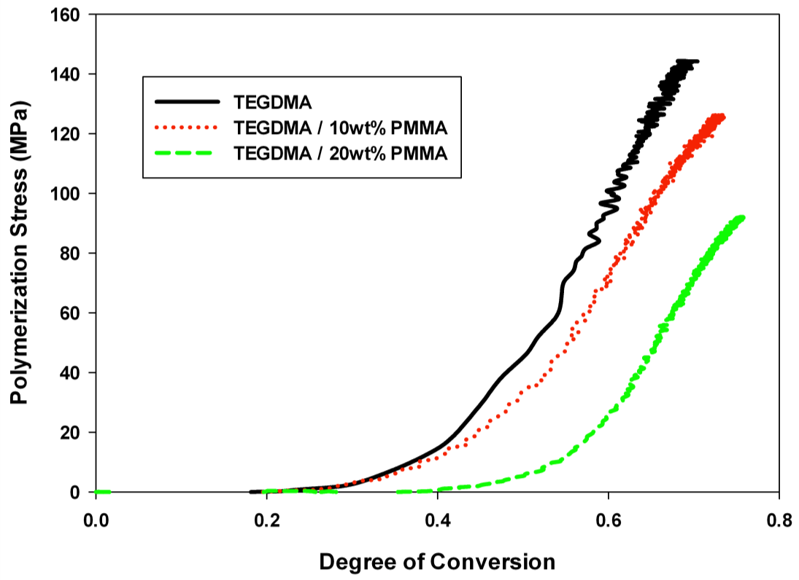
Stress Development with PIPS
I_{o}=300μW/cm²
~10% reduction
~40% reduction
Phase structure?
Loading material?

Slide 23
Mechanisms of Phase Separation
Spinodal Decomposition
Nucleation and Growth
Highly un-stable state
Co-continuous phase structure
Potential for coarsening with time
Meta-stable state
Spherical domain structure
Dispersed phase grows with time
Li W, Lee L. Polymer 2000; 41:697-710.

Slide 24
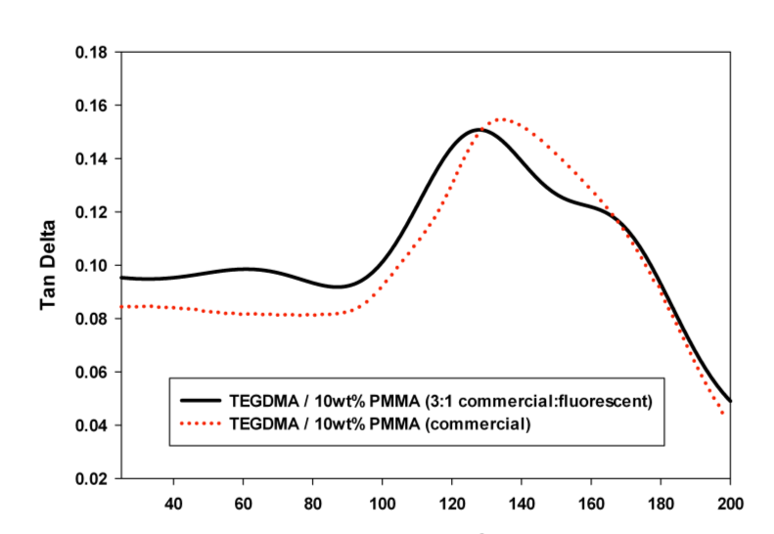

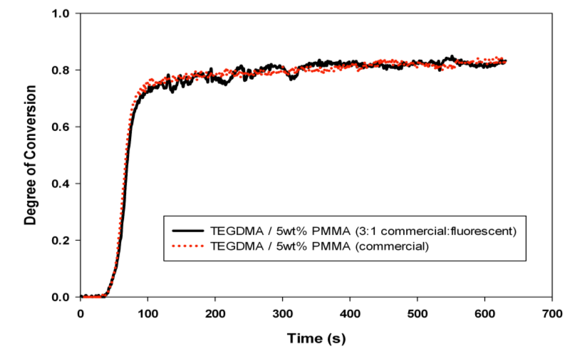
Confocal Microscopy to determine phase structure
Introduce a fluorescently-tagged prepolymer into the monomer matrix.
Regions that are pre-polymer rich will show up brighter under confocal microscopy.
A
Commercial PMMA (Aldrich) | Synthesized Poly-fluor PMMA
M_{w}~ 120,000 | M_{w}~ 51,998
No fluorescent tags. | 0.02 wt% poly-fluor 570 in initial reaction mixture
150μm
Confocal image of pure poly-TEGDMA polymer. DC=77%.

Slide 25
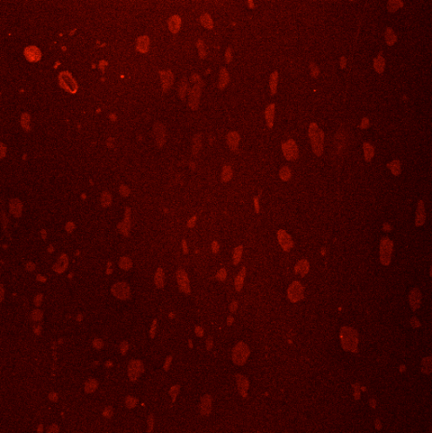
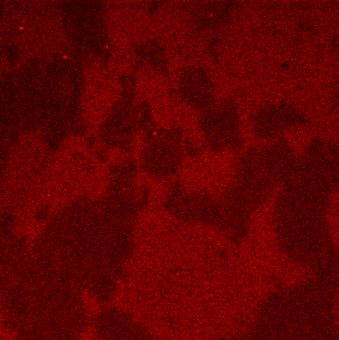
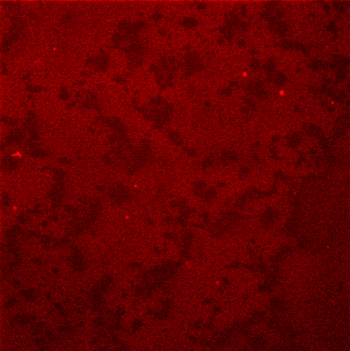
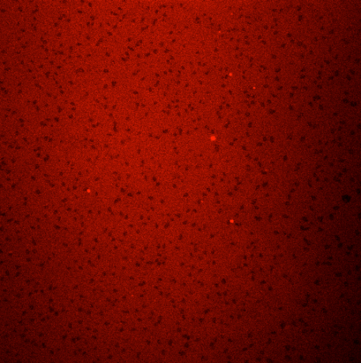
Mechanisms of Phase Separation
A
B
Confocal microscopy images of materials, post-cure, having undergone PIPS. All materials were cured under the following conditions: I_{o}=5mW/cm², λ=365nm.
TEGDMA / 1wt% PMMA (3:1), DC=82%.
TEGDMA / 5wt% PMMA (3:1), DC=85%.
TEGDMA/10wt% PMMA (3:1), DC=75%.
TEGDMA/20wt% PMMA (9:1), DC=92%
150μm
50μm
C
D
Nikon A1R Confocal Microscope. Images taken using 20x (NA 0.75) objective. Ex(nm): 587, Em(nm): 610.
50μm
150μm
Notes:
Mention :
Investigated effect of light intensity in the materials.
Investigating (currently) the partial cure samples, how does this happen in real time?

Slide 26
Kinetic and Thermodynamic Interplay
Reactive monomer
Non-Reactive pre-polymer
Entropy Decrease
Early Gelation
Late Gelation
Pre-Gel
Post-Gel
Notes:
Change slow and fast????
Phase separation is a balance between the thermodynamic miscibility, and the kinetic development which effects how those incompatible phases can move.
RHS -
LHS – Gelation precedes phase separation. Macromolecular diffusion can not occur after cross-linking.

Slide 27
Molecular Weight Studies
Introduce prepolymers of varying molecular weight into TEGDMA matrix.
Vary light intensity of the reaction, and thus the time allowed for diffusion of incompatible species to understand balance between kinetics and thermodynamics more accurately.
 | PMMA 1K | PMMA 11K | PMMA 120K
M_{W} (Da) | 1,500 | 11,885 | 120,000
T_{g} | 45°C | 74°C | 117°C

Slide 28
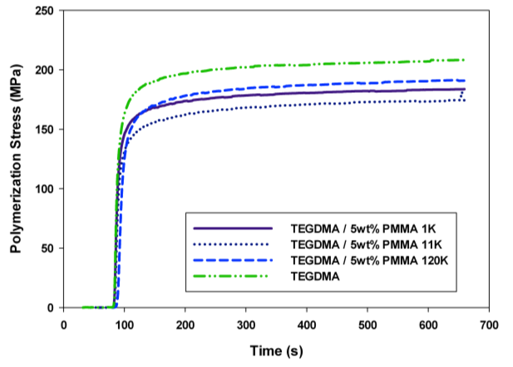
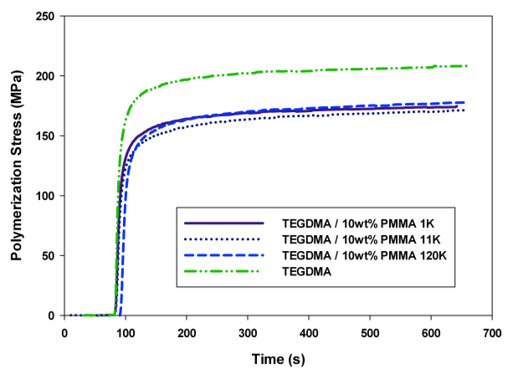
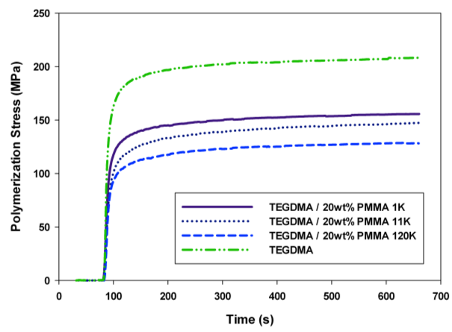
Molecular Weight Studies - Stress development
I_{o}=5mW/cm²
5 wt% loading
10 wt% loading
20 wt% loading
Only at high prepolymer loadings does MW of prepolymer impact stress.
Viscosity of monomer formulations.

Slide 29
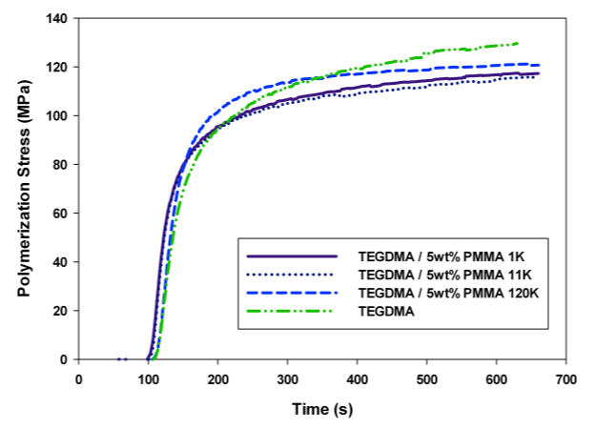
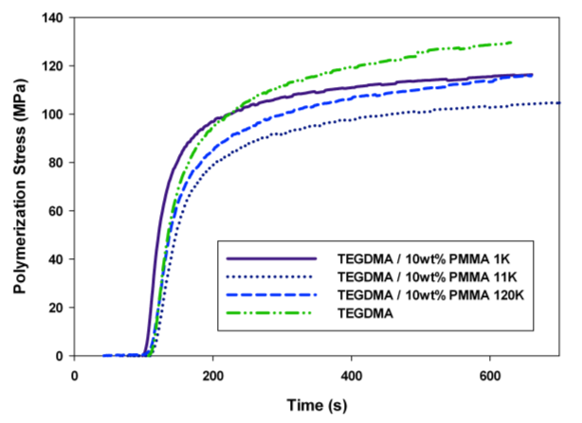
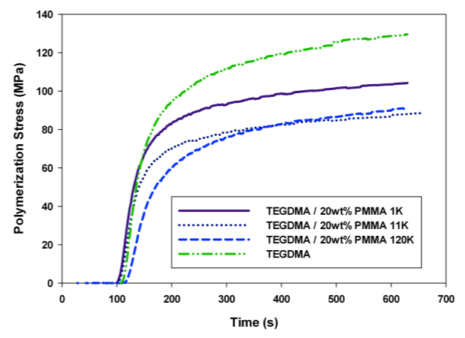
Molecular Weight Studies - Stress development
I_{o}=300μW/cm²
5 wt% loading
10 wt% loading
20 wt% loading
Increasing time for diffusion of incompatible phases allows more effective stress reduction via PIPS.

Slide 30
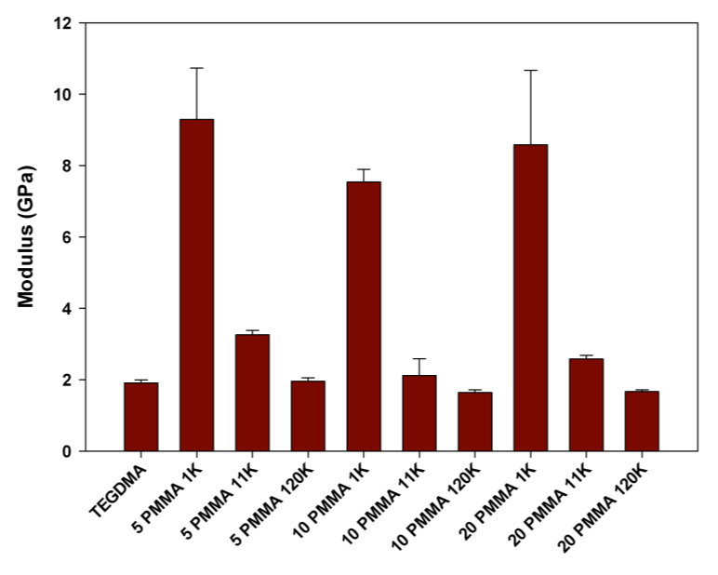
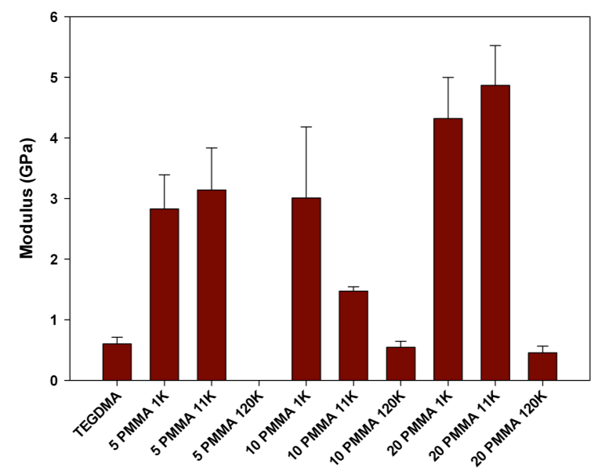
Molecular Weight Studies – Final Modulus
Increasing time for diffusion of incompatible phases also allows for increase of final modulus.
Mechanism still unknown.
I_{o}=5mW/cm²
I_{o}=300μW/cm²
T_{g} relative to reaction exotherm?

Slide 31
Conclusions
Demonstrated PIPS in a purely photo-initiated, ambient cure polymerization.
Found that PIPS leads to additional polymerization stress reduction beyond what is expected from volumetric displacement.
Future work:
  Understand how physical properties of the prepolymers, specifically T_{g} also impact PIPS process.
  Extend to systems of co-polymers appropriate for dental resin formulations

Slide 32
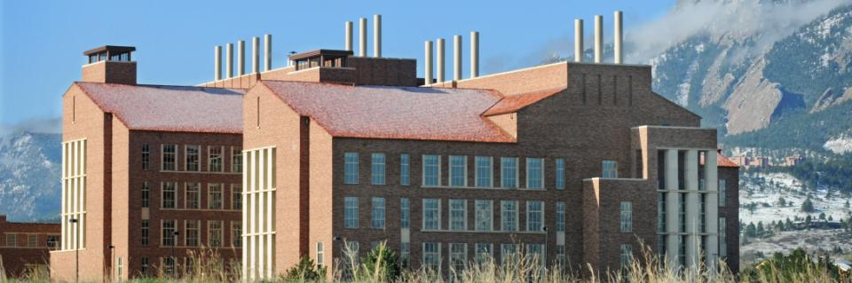
Acknowledgements
Stansbury Research Group (Aurora and Boulder)
Bowman Research Group
NIH/NIDCR 5R01DE014227
http://www.colorado.edu/chbe/

