Slide 1
Lafayette Investment Club
Nov 4, 2011

Slide 2
Agenda
Club News
Financial News
Short Selling
Sell some KMR

Slide 3
Club News

Slide 4
Portfolio
$351,719 (down 1.5% vs last week)
S&P 500 1,261 (down 1.8%)
WARNING: Vestas Windsystems – down 15% on manufacturing worries. (down 50% since we bought it)

Slide 5
Occupy Wall Street
Occupy Wall Street (OWS) is an ongoing series of demonstrations in New York City based in Zuccotti Park in the Wall Street financial district.
Protest against social and economic inequality, corporate greed andcorruption

Slide 6
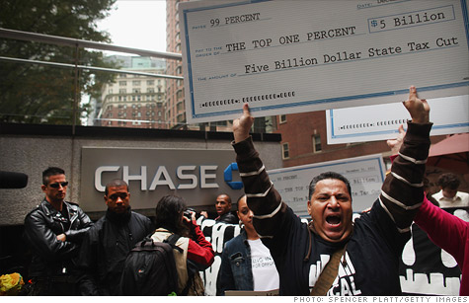

Slide 7
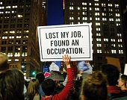
Implication +/-
Economics is really bad and unemployment is really Severe.
On the other hand, this
May just be a joke of a bunch of uneducated
People.

Slide 8
Look at this
This guy tells everyone on wall street that we should all go to China because they have a annual GDP grow rate of 10%
I am sure he will have fun if he comes to China….

Slide 9
Short Selling

Slide 10
What is Short Selling?
Trading technique used to profit from downward moves in stock price
Sell shares you don’t own, hoping that the price will fall, allowing you to buy them back and return them for less money

Slide 11
Why Sell Short?
Speculate
Bet that stock price will fall
Hedge
Protect your portfolio

Slide 12
Speculative Example
UBS is trading around $12 a share
You think it will drop to $6
You borrow 100 shares, sell them for $12
Supposing UBS drops to $6, you cover your short by buying shares back
Profit = ($12 - $6)*100 shares= $600

Slide 13
Hedging Example
You want to protect a $100,000 diversified portfolio of stocks
You open a short position on an equity index like the S&P that protects you close to 1-for-1
If your portfolio falls 3%, you have lost $3,000
But you make $3,000 on your short

Slide 14
Risks
Gamble
Losses can be infinite
Using borrowed money
“The Squeeze”
Timing

Slide 15
SELL KMR
By: Rau and Simon

Slide 16
What is an MLP?
An investment that combines the tax benefits of a limited partnership (LP) with the liquidity of common stock.
Has a partnership structure
issues investment units that trade on an exchange like common stock.
combine the tax advantages of a partnership with the liquidity of a publicly traded stock
In order to qualify, a firm must earn 90% of its income through activities or interest and dividend payments relating to natural resources, commodities or real estate.

Slide 17
Tax Advantages of an MLP
Don’t pay a corporate income tax
the tax liability of the entity is passed on to its unitholders(shareholders)
Once a year, each investor receives a K-1 statement detailing his or her share of the partnership's net income, which is then taxed at the investor's individual tax rate.
This is a strong incentive to become an MLP because it means a cost advantage over their incorporated peers.(peers pay corporate income tax)
eliminates the “double taxation” generally applied to corporations (whereby the corporation pays taxes on its income and the corporation's shareholders also pay taxes on the corporation's dividends).
Being a MLP lowers its cost of capital(makes it easier to build new pipelines and other necessities)

Slide 18
About KMR
Kinder Morgan Management, LLC operates as an energy transportation and storage company in North America.
As of December 31, 2009, it owned and operated approximately 28,000 miles of pipelines and 180 terminals.
The company was founded in 2001 and is based in Houston, Texas.

Slide 19
KMR, KMI, KMP, EL PASO WTF?
Kinder Morgan Partners is separated into KMP,KMR, and KMI
In February, Kinder Morgan completed its public offering, which actually is a re-IPO after its common stock was originally bought up by private equity firms in 2007. SYMBOL: KMI not to be mistaken with KMR.
Kinder Morgan Energy Partners LP (KMP)
KMR is Kinder Morgan Management LLC - shares are legally equal with KMP shares. KMP receives distributions in cash. KMR receives distributions in the form of KMR shares. (Equivalent of built in reinvestment plan)
EL PASO - Kinder Morgan recently acquired El Paso Corporation (EP) creating the largest midstream and the fourth largest energy company in North America.

Slide 20
KMR In our Portfolio
5.16% of our portfolio
-third largest holding(behind IBM and CAT)
Currently own 273 shares
Trading at $66.48(currently around 52-week High)
18k position

Slide 21
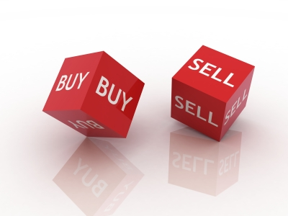
Sell?
RECCOMENDATION : SELL (ENTIRE POSITION)
Why?
Our opinion is to avoid the affiliated Kinder Morgan Partnership equities.
Capital Gains? Taxes?
The Kinder Morgan General Partner legal structure provides incentives to benefit the General Partner.
Our advice is to avoid Kinder Morgan Management LLC, El Paso Corp., and El Paso Pipeline Partners, L.P., and Kinder Morgan Energy Partners LP.
If you believe in Kinder Morgan buy KMI

Slide 22
Why KMI?
The management team has proven to be first class in returning consistent recognized returns.
The company can attract top employee talent at all levels of the enterprise.
Kinder Morgan has access to capital markets for further growth initiatives.
In October The KMI board of directors declared a dividend of $0.30 per share ($1.20 annualized), payable on Nov. 15, 2011.
4.2% dividend
Also owns 20% equity interest in NGPL PipeCo LLC

Slide 23
Why is it Attractive? (KMI)
Trading at a EV/EBITDA Multiple of 13.
270 Million in cash on the balance sheet.
High dividend
Great peg ratio: 1.43
EL PASO DEAL – When the deal goes through stock will pop. (80% chance according to BofA analysts)

Slide 24
WHAT WE SHOULD DO?!

Slide 25
Option 1
Sell (The entire KMR position)
Allocate half of the positions cash back into KMI.
And take the other 9k and reinvest into another high growth potential stock.
Plenty of gems out there (I.E. NLY)

Slide 26
Option 2
Sell (The entire KMR position)
Take 18k in profits
-substantially increase our cash holdings(from (22,000 to 40,000)
Have cash on hand to reinvest in another equity when the timing is right(buy low, sell high)

