Slide 1
Lafayette Investment Club
11/11/11

Slide 2
Agenda
Club News
Europe Update
Foreign Exchange
Buy Family Dollar

Slide 3
Club News
DeSales University Trip – Entrepreneurship Conference
Thursday, Nov 17 – 6:00-8:30pm
Kevin Rhodes '82
Sign up with Career Services

Slide 4
Portfolio
AUM $352,680 – roughly flat
S&P 500 – 1,265 – up ~1%
Cisco – positive surprise - up ~7% in 2 days
Vestas – up 8% today

Slide 5
Europe
http://finance.yahoo.com/video/marketnews-19148628/italy-s-senate-approves-debt-reduction-measures-27227933.html

Slide 6
Europe
50% voluntary haircut on Greek Debt
Referrendum to public withdrawn
Possible exit from Eurozone down the line
Papandreas steps down – new govt to be formed

Slide 7
Europe
Italian Spreads at crossed 7% mark
End of Berlusconi era
Austerity package - passed

Slide 8
FOREX: Currency Exchange, Risk in Foreign Markets, and ETF’s
Greg Allis

Slide 9
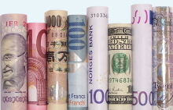
Foreign Exchange Market
A market for trading different currencies
Facilitates international trade
Controlled by exchange rates
Exchange rates change based on
Transaction demand for a currency
Speculative demand
Biggest currency traders: Deutsche Bank, Barclays, UBS, Citi, JP Morgan

Slide 10
Currency Trading
USD/EUR €0.7344 mean $1 will buy you €0.7344, or €1 costs you $1.3616
USD/EUR usually ranges from €0.65 - €0.85
Most Traded Currencies by Market Share
 | Currency | ISO Code | Daily Share
1) | United States Dollar | $ USD | 89.4%
2) | Euro | € EUR | 39.1%
3) | Japanese Yen | ¥ JPY | 19.0%
4) | Pound sterling | £ GBP | 12.9%
5) | Australian dollar | $ AUD | 7.6%
 | OTHER |  | 32.0%
 | Total* |  | 200.0%
*The total is 200% because in a Currency Pair, currencies are traded two ways
Exchange Rates from 11/10/11

Slide 11
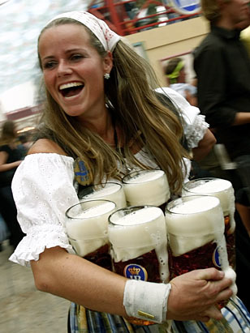
Changes in Exchange Rates
Day | USD/EUR Rate | Cost of a €3 German Beer in USD
1 | €0.7500 | $4.00
2 | €0.8000 | $3.75
3 | €0.7000 | $4.29

Slide 12
Exposure to Risk in Foreign Markets
Investing in foreign markets is complicated
You must both the performance of the company and the currency that it trades in
Even if the share price increases, it is possible to lose on an investment
Trade | Company | Shares | Price (€) | EUR Value (€) | EUR/USD ($) | USD Value ($)
Buy | XYZ | 1,000 | 50 | 50,000 | 1.35 | 67,500
Sell | XYZ | 1,000 | 52 | 52,000 | 1.27 | 66,040

Slide 13
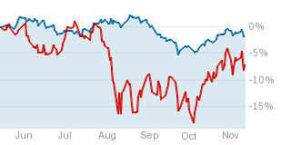
Forex ETF’s
Mirrors the level of a currency
FXB : CurrencyShares British Pound Sterling Trust
Measures the level of the GBP vs. the USD

Slide 14
Hedges and Instruments
Forward: contract that will lock in a particular rate until the transaction is made
Option: an instrument that affords the right to engage in a transaction at a later date at a set price
Short: By shorting the currency that your foreign stock trades in, losses (and gains) are mitigated
Swap: a transaction in which two currencies are traded under the agreement that they will be returned after a certain period of time

Slide 15
Buy Family Dollar Stores Inc. (FDO)
By: Rau and Simon

Slide 16
About FDO
Family Dollar Stores operates a chain of about 6,800 general merchandise discount stores across 44 states
provides low-income consumers a variety of apparel, food, cleaning supplies, beauty and health products, toys, pet products, and seasonal goods
Prices generally range from less than $1 to $10
targets low to lower-middle income households

Slide 17
FDO
Last trade: 57.94
P/E: 18.57
PEG: 1.07
EV/EBITDA: 8.61

Slide 18
Competitor Ratios
Dollar General STOCK PRICE - 38.96
P/E -20.61
PEG – 1.01
EV/EBITDA – 9.74
Dollar Tree STOCK PRICE - 77.87
P/E – 21.60
PEG – 1.10
EV/ EBITDA - 10.65

Slide 19
Recent News
4Q
sales increased 5.6% on top of a 6.1% increase last year
Due to increases in customer traffic and average customer ticket
earnings per diluted share increased 19.1% to $3.12 per share

Slide 20
Year End results
Net sales for the year increased 8.7% to $8.5 billion, and comp store(stores open for 1 year or more) sales increased 5.5%
SG&A expense increased 7.2% due to…
Investments to drive revenue growth(opened 94 new stores)
Expanding operating hours
Store renovations
FDO showing strong core expense control in their efforts to optimize infrastructure improvements and efforts to drive greater efficiency.
generated $528 million of operating cash flow
Increased dividend per share by about 16%(returning excess capital to shareholders)
Bought back $670 million shares of common stock in an effort to optimize the balance sheet

Slide 21
Plans to drive revenue and earnings growth
after increasing the pace of new store openings last year by 50%, FDO intends to increase new store growth again this year by more than 50%
Intend to grow store square footage of 5% to 7% by fiscal 2013.
plan to open 450 to 500 new stores, including the companies first stores in California
plan to renovate, relocate or expand more than 1,000 stores

Slide 22
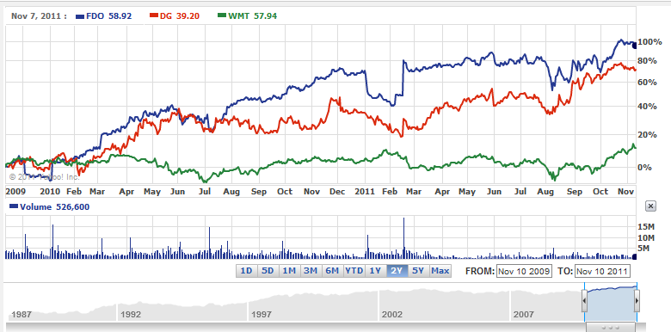
How has it traded against comps?

Slide 23
Risks
Current economic conditions and other economic factors could impact business adversely(slowdown in U.S. economy)
-effects consumers disposable income
profitability is vulnerable to cost increases, inflation and energy prices
Rising unemployment rates and stagnant wage growth could cause low-income consumers to cut back on discretionary category purchases, including higher-margin seasonal goods, gifts, and apparel.
The cost of goods (COG’s) inflationary commodity costs are also a risk worth noting. Margins forcast may be impacted due to this, but increased market share preformance has been solid.

Slide 24
Why Buy?
Aggressive store renovation programs to improve merchandise assortments and enhance the physical appearance of older stores should boost store traffic over the next few years.
Family Dollar has a significant opportunity to capitalize on falling retail real estate costs. More than half of its stores have leases that expire within the next three years, and we believe the firm will be able to negotiate more favorable rent terms or relocate stores to higher-traffic areas.
Improved employee retention rate and better work flow management should help reduce labor costs and lower inventory shrinkage, which will probably boost the firm's profitability.

Slide 25
Buy
50 shares
$58 * 50 = $2900
Small position
Further diversify into consumer markets

