Slide 1
Lafayette Investment Club
Sep 23 2011

Slide 2
Meeting Agenda
Club News
Financial News
How to analyze a stock (Fundamental / Tech)
Renewable Energy Sector (why / how to play)

Slide 3
Finance Night
Oct 13 6:30-8:30 Princeton Club
Deposit $20 before 5pm on Monday, October 3rd
3 Prep Sessions:
TUESDAY, OCTOBER 4th, 12:15-1:00PM
WEDNESDAY, OCTOBER 5th, 4:30-5:15PM
THURSDAY, OCTOBER 6th, 12:15PM – 1:00PM

Slide 4
Coming Up
Sebastian Crapanzano, MD Risk Management
Morgan Stanley
Jim Glascott, MD Investment Banking
Barclays
Bloomberg Assessment Test – Finance Skills
No Preparation Required

Slide 5
The ECON Club
Will be showing:
Catch Me If You Can
Tuesday, September 27:
8:00PM
In Hugel 100
(runtime: 144 minutes)

Slide 6
Portfolio
AUM $321,374 (-5% vs. last week) – down $18,000
S&P500 1,135 (-6.5% vs. last week)
Main losers:
Financials (BofA -13.5%, Goldman -11%, MFC -10.5%)
Energy - CVX -10.3%

Slide 7
*** NEWS ***

Slide 8
Indicators
FHFA housing price index up 0.8% in July
Housing Starts (P:601K, C: 571K)
Consumer Sentiment - (P:55.7, C:57.8)
Capacity Utilization 77.4%
Next Week
Case Shiller home price index
Consumer Confidence (c: 47 vs. May 70)
3rd Estimate of 2Q GDP
Notes:
http://biz.yahoo.com/c/e.html
Capacity Utilization – 85% consistent with no slack in the economy – i.e. output at long run maximum stable output
P = prior
Consumer expectations, in a reflection of the weak jobs market and recent trouble in the financial markets, are at the lowest point since the Iranian hostage and oil crisis more than 30 years ago. The assessment of the six-month outlook, which is the leading component of the consumer sentiment index, slipped four tenths at the mid-month reading to 47.0. As recently as May, this component was approaching a respectable 70.
Case Shiller shows health of the housing market
Indicative of likelihood of increase in spending

Slide 9
National
Fed Operation twist – buy long sell short
Housing market in the dump -2.5%
UBS gone Rogue?
RIM doesn’t seem to see bottom yet
Notes:
1) Buying long term and selling short term flattens the yield curve without expanding the fed’s balance sheet thus. It also aids the housing market better because their interest rates are set based on longer term treasuries. The fed also decided to roll over its agency securities holdings as opposed to reinvesting them in treasuries thus further aiding the housing market even more directly.
3) Economists expect home prices to drop 2.5% this year and rise only 1.1% annually through 2015. With prices down nearly 32% from their 2005 peak, economists are essentially forecasting a lost decade for the housing market with long-term repercussions for consumers and the broader economy. Yesterday morning, the Commerce Department released figures showing builders began work on a seasonally adjusted 571K homes last month, a 5% decline from July and less than half the 1.2M that's consistent with healthy housing markets.
4) UBS (UBS) said its loss from unauthorized trading is now at $2.3B, up from an earlier estimate of $2B, but continued to dismiss calls for CEO Oswald Gruebel's resignation. UBS said the rogue trader hid his loss with fake hedging positions, but sources say some inside the bank knew enough to question the trader's actions early on but failed to report on the trades.
5) Research in Motion (RIMM -18.8%) plunges premarket after missing FQ2 forecasts on both the top and bottom line. Shipments for the Playbook tablet totaled just 200K, less than half street consensus of 490K. "We had cut our Playbook numbers, and they still came in below that," says Canaccord's Mike Walkley. Guidance for FQ3 was largely in line with estimates as the company is confident a "major" software update and promotions will generate better sales later this year.
6) After a week of volatility following the dismissal of CEO Carol Bartz, Yahoo (YHOO) has drawn the attention of strategic investors and buyout shops, including Silver Lake - which has already approached the Web giant with an offer, working with Andreessen Horowitz. A number of Asian assets may complicate any transaction; Yahoo has hired Allen & Co.

Slide 10
Global
Moody’s downgrades BofA, WF
Italy added to S&P black list
Japan ready to battle persistently strong Yen
China - Markets may finally be cooling
Central Banks load up on Gold
Notes:
1) In its latest World Economic Outlook report, the IMF downgraded its growth forecasts across the globe, particularly in the U.S. (from 2.5% to 1.5% in 2012) and the EU (from 1.7% to 1.1%). It also warned of "severe repercussions" to the global economy unless the eurozone strengthens its banking system and the U.S. straightens out its finances
2) S&P cut Italy's credit rating to A from A+, with outlook negative, citing the political situation as limiting the nation's ability to respond effectively to its debt crisis. S&P said the negative outlook "reflects our view of additional downside risks to public finances related to the trajectory of Italy's real and nominal GDP growth.“
3) Japan released an interim plan to deal with the strong yen, saying it will move to shore up its economy through such measures as a corporate tax cut and support for small and medium-sized businesses. The government didn't close the door on the possibility of direct currency intervention, saying it remains ready to take "decisive" action as needed.
4a) New-home prices rose in fewer Chinese cities in August - a possible sign of a much-awaited cooling. Prices rose in 23 out of 70 cities in August, vs. 39 in July. Year-on-year, prices were higher in all 70 cities tracked by the index
4b) Deposits at China's Big Four banks have dropped by 420B yuan ($66B) since the end of Aug. as customers move money into private-lending markets, where they enjoy rates up to 10x the benchmark. China's tighter lending policies aimed at curbing inflation are forcing smaller businesses to borrow on secondary market
5) European central banks have become net buyers of gold for the first time in more than two decades, while central banks globally are set to buy more gold this year than they have since the Bretton Woods system collapsed forty years ago. The shift towards gold has helped push the price of the metal up more than 25% this year. Gold futures +0.5% to $1,824 (2:45 ET).

Slide 11
How to analyze a stock?

Slide 12
How to analyze a stock step by step
Company and Industry Overview (10K)
What is the company’s main source of revenue.
Know about the industry. (Housing? No, thanks)
Market Capitalization
Market capitalization defines a company’s total value (share price multiplied by number of shares)
Larger: Safer. Smaller: more potential.

Slide 13
How to analyze a stock step by step
Valuation Ratios
Price to earning/Sales: it can be a double-edge.
Trading Volume
Two low: subject to price manipulation, really bad
Cash Flow
Statement of cash flow: Operating, Investing and Financing.
Tells what the company is doing with all the cash. (profitability, sustainability, etc)

Slide 14
How to analyze a stock step by step
Balance sheet, Income Statement and financial ratios
- Assets/debt: sustainability
- Current asset/Current liability: liquidity
- Historical sales & earning growth: potential
- profit margin- income/gross revenue:
profitability & efficiency
News
Comparison
Across the industry
Main competitors

Slide 15
Basics of Technical Analysis

Slide 16
Definitiion
A method of evaluating securities by analyzing statistics generated by market activity, such as past prices and volume.
No intrinsic value

Slide 17
Candlestick

Slide 18
“The trend is your friend”
The general price direction of the market for the particular security
A series of peaks and troughs
Upward (bullish), downward (bearish), sideways trend

Slide 20
Support/Resistance
Price levels in which historically buying/selling pressure has been dominant
Easily identifiable – a series of peaks/troughs at the same price
The more times these levels get tested the more reliable they become

Slide 21
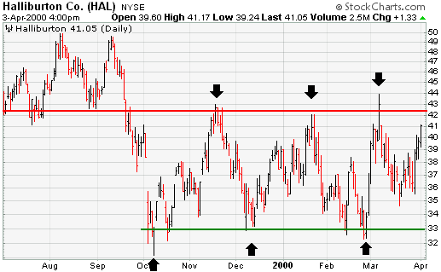

Slide 22
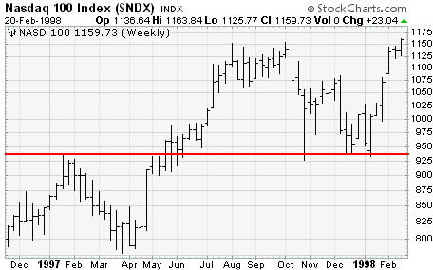
Role Reversal

Slide 23
Moving Average Convergence/Divergence
Simply two smoothed moving averages
Slow line and fast line
Generate buy and sell signals when crossovers occur

Slide 24
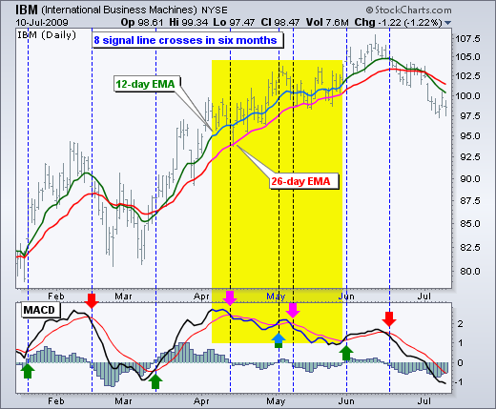

Slide 25
Renewable Energy
(Greg A’s Slides)

Slide 26
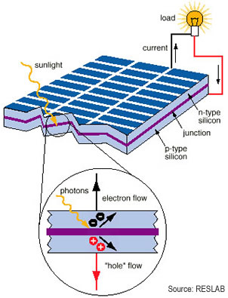
Solar Energy
Photovoltaic (PV) Effect: solar cells absorb sun’s radiation and convert to usable electricity
Electric output is a function of the number of and quality of PV cells and the angle of contact
Cells operate above 80% efficiency for around 20 years

Slide 27
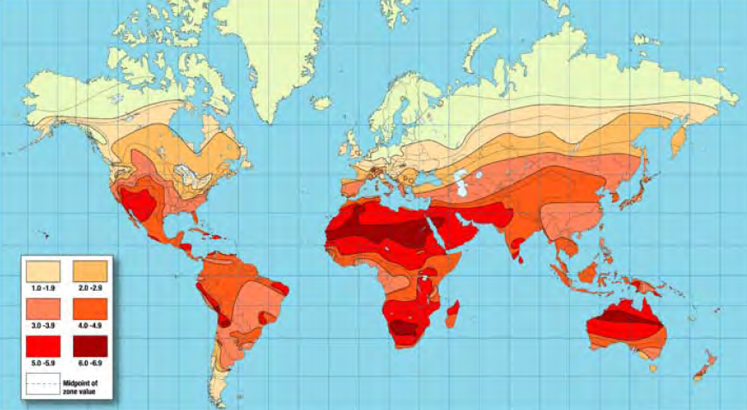
Radiation Hotspots

Slide 28
Best Solar Energy Environments
Germany – Very successful feed-in tariffs and strong supporters of the green energy movement
Spain – Solar production increased five-fold from 2007 to 2008 through feed-in tariffs
Japan – Aggressive federal movement towards solar energy and research to improve efficiency
U.S. – Great solar potential in Southwest, but solar energy makes up a small portion of the total consumption
China – Largest solar energy producer and solar panel producer in the world
*Source: Discovery News http://news.discovery.com/tech/ten-places-harness-solar.html

Slide 29
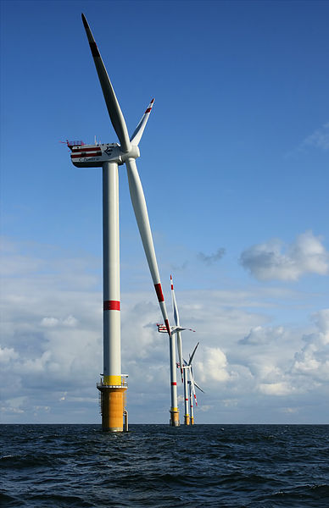
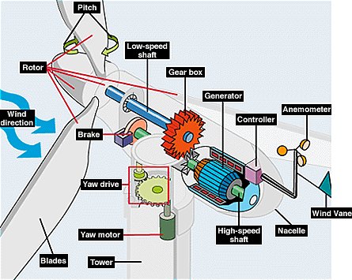
Wind Turbines
Convert kinetic energy from wind to mechanical energy and electricity
Range from 100 kW to 3 MW

Slide 30
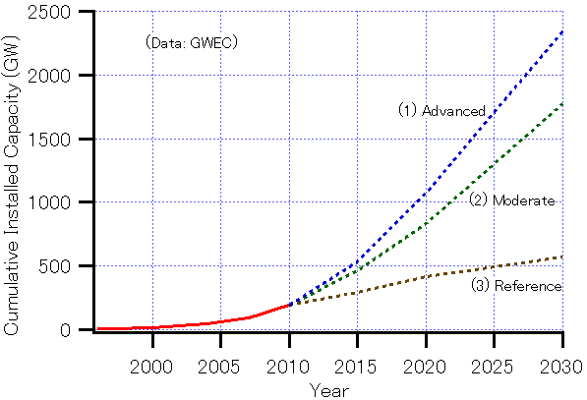
Global Wind Energy Production
Source: GWEC, Global Wind Report Annual Market Update 2010

Slide 31
Gov’t Role in Renewable Energy
Gov’t funding is essential for the operation and development of the industry
Covers part of large upfront cost
In U.S., policies vary state-to-state
Includes grants, tax credits, and subsidies

Slide 32
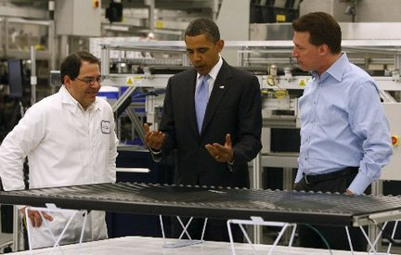
Solyndra Bankruptcy
On 3/9/09, they were awarded a $535M loan guarantee that was previously denied
Due to pricing pressure, built up inventory, and the construction of their second fabrication plant ($700M), they shut down their first plant
On 8/31/11, they filed for bankruptcy and laid off their remaining 1,100 employees
The gov’t should not be picking “winners and losers”

Slide 33
Where/How to Invest in Clean Energy &Risks of Clean Energy

Slide 34
Alternate Energy Stocks
First Solar Inc. (NASDAQ: FSLR)
-solar
Tesla Motors Inc. (NASDAQ: TSLA)
-electrical(vehicles)
FuelCell Energy Inc. (NASDAQ: FCEL)
-electrical
Renixx –Renewable Energy Industrial Index

Slide 35
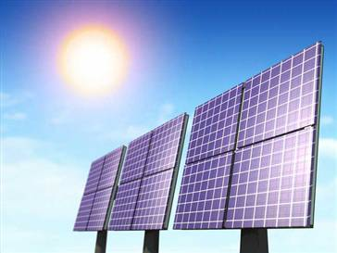
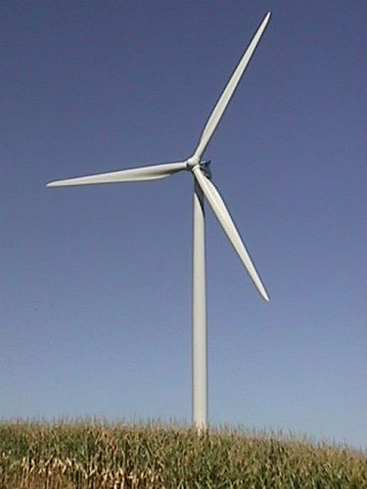
Green ETF’s
A green ETF is ultimately a basket of alternative energy stocks or stocks of green companies
Bought and sold on the stock market
Not subject to the same fees as an alternate investment fund(lower expense ratio)
Buying ETF’s is less risky than individual stocks

Slide 36
Alternate Energy ETF’s
Market Vectors Global Alternative Energy ETF (NYSE: GEX)
PowerShares Clean Energy ETF (NYSE:PBW)
Market Vectors Solar Energy ETF (NYSE: KWT).
Funds
iShares S&P Global Clean Energy Index Fund (ICLN)
New Alternatives Fund(NALFX)

Slide 37
Risks of Clean Energy
Rapidly developing technologies
Industries prospects rely on Government help(subsidies)
Alternative-energy stocks tend to fall in and out of favor depending on the price of crude
So many clean energy companies emerging its hard to pick which one will stand the test of time
(Investor emotional Involvement for the wrong reasons)

