Slide 1
Lafayette Investment Club
Oct 21, 2011

Slide 2
Agenda
Club News
China Mobile
Frontier Communications
Pharmaceuticals vs. Biotech

Slide 3
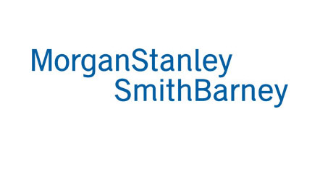
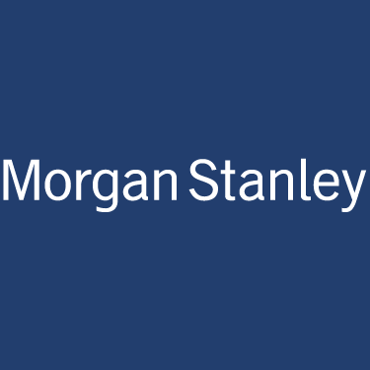
Club News
Financial Planning, MSSB
Mon, Oct 24th (Hugel 100)
Morgan Stanley – Fri, Oct 28th – 12pm
Sebastian Crapanzano, MD, Risk Management
Barclays – Tue, Nov 1st
Jim Glascott, MD, Investment Banking

Slide 4
Portfolio
$339,108 up 1.5% since September
S&P500 up .9%
DJI up .4%

Slide 5
Earnings
IBM misses Rev, raises outlook Down 5%
GS misses Rev and EPS Up 8%
BAC beats Rev and EPS Up 9.7%
MSFT beats Rev Down .5%
JNJ beats EPS, misses Rev Down .95%

Slide 6
Upcoming Earnings
Today: GE, VZ
Next week: CAT, DNR, CLX, MFC, CSCO

Slide 7
CHL -ADR
Miao Wang

Slide 8
What does China Mobile do?
Provides a range of mobile telecommunications services across Mainland China and Hong Kong.
600+ Million subscribers
Main Competitors: China Unicom, China Telecom (about 100 to 200 Million subscribers each)

Slide 9
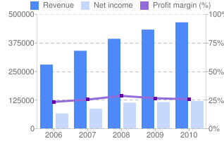
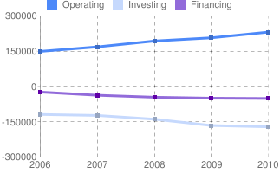
Financials
Sustained Growth
Highly profitable: 25% Profit Margin compared to 1.88% of China Unicom and 10% of China Telecom
Highly liquid: Current ratio of 1.3 compared to 0.2 of China Unicom and 0.4 of China Telecom

Slide 10
Valuations-looks undervalued
Quote: $48.16; 52 week 43.51 - 53.51
EV/EBITDA: $4.67
Target a price of $57 with industry medium EV/EBITDA of 5.75
Cross checked with DCF Valuation using a 7.9% cost of capital (WACC) and a 3% terminal growth rate - $61
Cross checked with P/E ratio
Trailing P/E 10.3 vs. 12.57 industry vs. 19.7 Telecom
vs. 83 China Unicom ( Ridiculous… )

Slide 11
Why CHL? Investment Thesis
Growth Potential in the number of mobile users in China:
Rural Area remain untagged.
Project 1billion + users (NOT subscribers) by 2012
Position itself to capture the shift from landlines to Mobile (Unicom & Telecom was focusing on landlines)
Position itself to capture the growth potential in Smart phones
Only 15% smart phone users among all mobile users
Has been actively discussing and working with Apple and BB
Apple just announce that all future iphones will support China Mobile 4G network

Slide 12
Catalyst
Leader/a step faster than competitions in introducing new products and technology
First one introduce 4G (Unicom still on 3G haha)
Has been working closely with media company to creative original products and applications
Undervalued – Why no one is buying it?
Uncertainties in foreign markets Risk aversion
Slower growth in emerging markets early this year
Fraud in China ( Trust me, this is not a FRAUD!!!)

Slide 13
Risk
Competition from China Unicom – Attractive price packages; really cheap
Growth potential in China
Government Regulation – economic Freedom

Slide 14
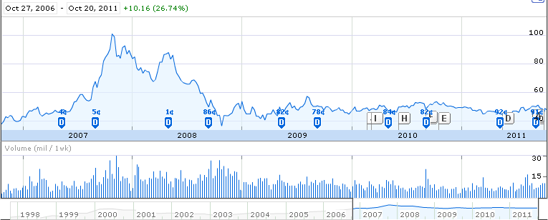
CHL

Slide 15
Decision
Buy Now
Or Never

Slide 16
Frontier Communications
Colin Serling

Slide 17
Frontier Communications
Frontier Communications: Phone and Internet service provider
Reasons to BUY MORE:
Price: 6.07
52 week range: 5.33 - 9.84
Pays a 12.5% dividend
68.37% Gross margin compared to 56.91% industry
Only $6B in market cap compared to $570B industry… candidate for Merger?

Slide 18
Reason to Sell
Reasons to Sell:
We own 48 shares at 6.07= .09% of portfolio
Current Ratio of .78
Just took out $575 million to refinance debt
Recent Pending lawsuit “"HSI surcharge" under the "state taxes and other charges" section of your customers' broadband bills, telling them it was either a required or an authorized governmental fee

Slide 19
Suit continued…
HSI surcharge added $1 to $1.50 to the monthly bills. As of June 30, Frontier had 1,715,119 high-speed Internet subscribers.
So that would give the company an extra $1,715,119 to $2,572,678.5 a month in additional revenue. or $20.6 million to $30.9 million annually.

Slide 20
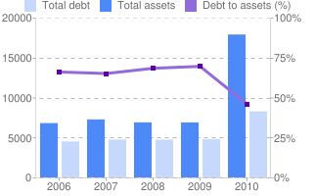
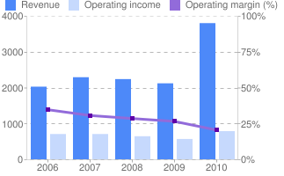
SELL
-Overall Pretty Flat
-Pending Law suit
-No positive catalysts or new technology
-Competitive Market
-Increasing Debt
-Sketchy increase in total assets (hmm…)
-So small (48 shares) Insignificant

Slide 21
Hold or Sell?

Slide 22
Portfolio Notables
GE (5%) reports today October 21st
FULL EARNINGS ANALYSIS Next MEETING!
Kinder Morgan Inc agreed to by El Paso Corp for $21.1 billion creating the largest natural-gas pipeline network in the US. CEO is betting need for pipelines will continue to grow. (up $4 bucks since announcement)

Slide 23
Pharmaceuticals Vs. Biotechnology

Slide 24
Why?
~$30,000 of our portfolio
~9%

Slide 25
Biotechnology
Biggest 5
Amgen: Immune disease, Oncology
Genentech: Oncology, Immunology, Tissue Growth and Repair, Neuroscience, and Infectious Disease
Genzyme: Lysosomal storage Disease, Renal Disease, Orthopedics, Transplant and Immune DIsease, Oncology, Genetics and diagnostics.
UCB: Central Nervous System, Inflammatory (allergy), oncology (Not based in US)
Gilead: HIV, Hepatitis, Pulmonary

Slide 26
Pharmaceuticals
Biggest 6
Pfizer: Lipitor (Laf Grad)
Novartis (Swiss)
Merck & Co.: 36 drugs
Bayer (Germany)
GlaxoSmithKline (UK): Pharmaceticals, biologics, vaccines, and consumer healthcare
Johnson and Johnson

Slide 27
Difference Between Pharm and Biotech
Pharm: "Throwing Spaghetti to the wall and see what stick"
Drug Refinement
More Capital
Vertical Integrate ==> all parts of the process
Biotech: More Centered on one idea.
Drug Discoveries
Less Capital
Genetic engineering technology in research ==> based around monoclonal antibodies, which mimick certain proteins or other molecules to target a specific cell area.
Biotech ==> Big Pharm

Slide 28
Patient Protection and Affordable Care Act

Slide 29
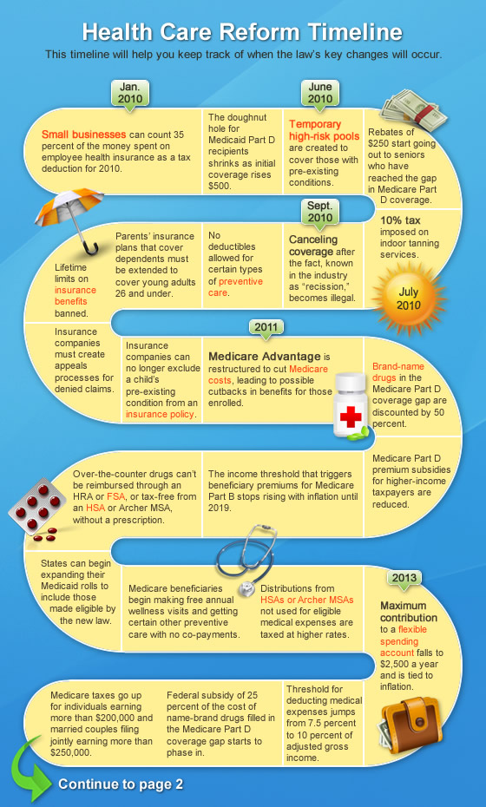
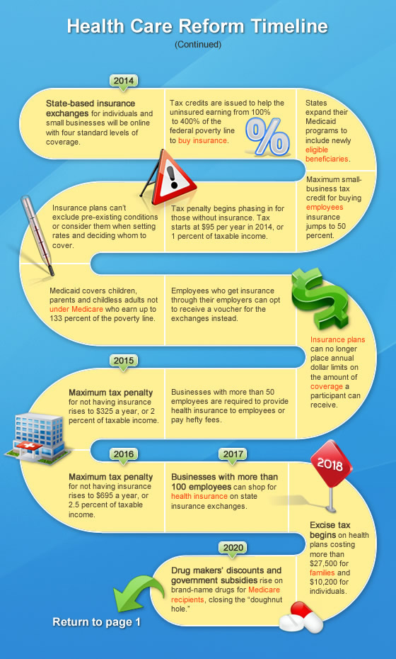

Slide 30
New Reforms
Canceling coverage after the fact, known in the industry as "recession" becomes illegal
Life Time Limits on insurance benefits banned
Brand-name drugs in the Medicare part D coverage gap are discounted by 50 percent. Then 25 percent then 0 percent
Over the counter drugs can't be reimbursed through an HRA or FSA
Insurance Plans can no longer place annual dollar limits on the amount of coverage a participant can recieve.
Cant deny people from insurance for pre diagnosed condition
Insurance (or some form of it) for everyone.

Slide 31
What me may see
Increase reliance on generic drugs (pharm)
Increase IT in healthcare (My personal favorite)
e- prescribing
More people on insurance
Less profits or more profits for insurance companies?
Innovation

