Slide 1
Lafayette Investment Club
Sep 16 2011

Slide 2
Agenda
Club News
Club Portfolio
Financial News
Buy/Sell

Slide 3
Club News
Next meeting next Friday Sep 23
Finance Night on Oct 13th - Deadline Oct 3rd
Tuesday, October 4th at 12:15 Wednesday, October 5th at 4:30 Thursday, October 6th at 12:15
$20 REFUNDABLE DEPOSIT

Slide 4
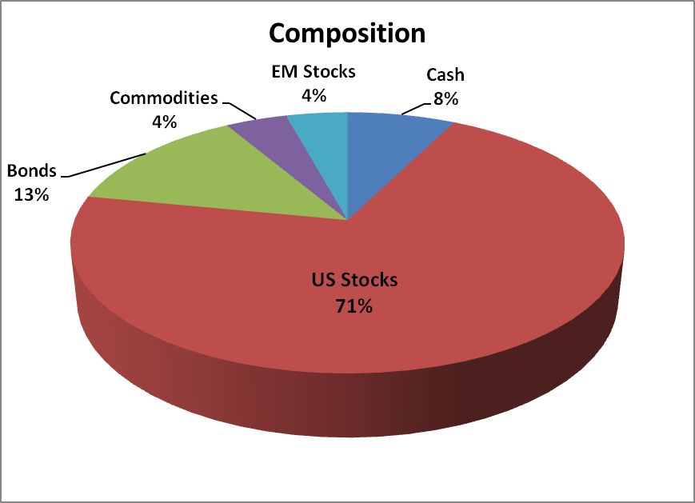
Portfolio
Current value $338,985

Slide 5
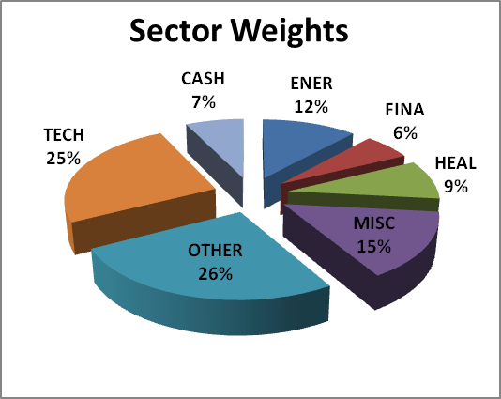
Portfolio

Slide 6
Top 10 Holdings
INTERNATIONAL BUSINESS MACHINES | IBM | $21,261.25 | 6.28%
CATERPILLAR INC COM | CAT | $17,320.00 | 5.12%
KINDER MORGAN MANAGEMENT | KMR | $16,234.13 | 4.80%
T ROWE PRICE INTL EMERGING MRKTS | PREMX | $13,451.37 | 3.97%
VANGUARD LONG TERM FD | VBLTX | $13,140.04 | 3.88%
GENERAL ELECTRIC | GE | $12,864.00 | 3.80%
EXXON MOBIL | XOM | $12,581.70 | 3.72%
JOHNSON & JOHNSON | JNJ | $11,270.00 | 3.33%
ISHARES BARCLAYS 1-3 YR TRS BD | SHY | $9,988.70 | 2.95%
CLOROX COMPANY | CLX | $9,481.98 | 2.80%

Slide 7
Bottom 10 Holdings
DOMINION RESOURCES | D | $4,303.02 | 1.27%
BANK OF NEW YORK | BK | $3,983.72 | 1.18%
JAKKS PACIFIC INC | JAKK | $3,966.00 | 1.17%
GOLDMAN SACHS | GS | $3,239.10 | 0.96%
POWERSHARES DB SOFT COMMODITIES FUND | DBA | $3,238.00 | 0.96%
VESTAS WINDSYSTEMS | VWDRY | $3,100.00 | 0.92%
ISHARES MSCI EAFE INDEX FUND | EFA | $2,544.00 | 0.75%
BANK OF AMERICA CORP | BAC | $1,685.90 | 0.50%
HEWLETT PACKARD | HPQ | $1,163.50 | 0.34%
FRONTIER COMMUNICATIONS | FTR | $337.44 | 0.10%

Slide 8
Financial News

Slide 9
Economic Releases
S&P up 0.88% for the week (-3.86 YTD)
Jobless Claims – P-414K; C-412K, Actual – 428K
CPI (M/M) – P- 0.4%; C-0.2%; Actual- 0.5%
Upcoming Economic Releases
FOMC two day meeting – 20 – 21
Housing Starts/ Housing Price Index
Jobless Claims

Slide 10
News - Global
Correlations driven above 90% due to renewed fears of global economic crisis
Euro Bond plan – But Merkel still says no
China – we won’t hold our finger in the damn! + slowdown in inflation
Stagflation in the UK?
IEA sees weaker oil demand – why is brent still at $114 then?

Slide 11
News - US
President Obama outlines $447B program to reduce unemployment
BoA set to slash 30K jobs
US growth forecasts marked down to 1.7% from 2.8% this year
Treasury twist – treasury to cooperate with the fed
Delays in processing foreclosures possibly underestimated the overhang

Slide 12
LOTS OF UNCERTAINTY BUT IT IS NOT THE END !! (HOPEFULLY)

Slide 13
Buy/Sell General Electric (GE)

Slide 14
GE
Key Statistics
Price- 16.21
P/E – 12.75
52-week range (14.72-21.65)
Beta- 1.66
Market cap- 171.821B
3.8% Dividend

Slide 15
GE Overview
GE is a global infrastructure, finance and media company
Produces :
aircraft engines, locomotives and other transportation equipment, kitchen and laundry appliances, lighting, electric distribution and control equipment, generators and turbines, and medical imaging equipment.
GE is also one of the US's pre-eminent financial services providers

Slide 16
Overview Continued
GE serves customers in more than 100 countries
GE has taken down $1B in orders for gas turbines in North America this year already, highlighting the push to use cleaner-burning natural gas for power generation
Looking to increase its global growth by tapping Russia and emerging markets such as Brazil

Slide 17
Sets Sights on Russia
GE announced that its forming two new joint ventures(JV) in Russia in the energy and healthcare fields
These joint ventures will boost orders of energy-efficient heavy-duty gas-fired power generation turbines as well as thousands of high-tech medical diagnostic units in Russia
GE estimates that this could boost $10-$15 Billion dollars in sales from this JV
Reaffirms GE’s global leadership in the Energy and Healthcare sectors

Slide 18
GE Focused on Emerging Markets
Entering into the Brazilian solar energy market
GE is entering into a partnership with current Brazilian solar energy producer MPX, to double the companies output of solar energy in the near future
By expanding to emerging markets such as Brazil, GE will be able to continue its future expansion in the solar energy arena at a higher rate than they could in the US

Slide 19
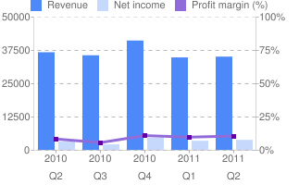
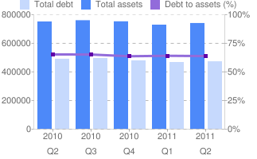
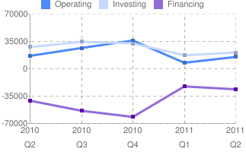
Financial Statements

Slide 20
Risks
By involving itself in the finance industry, GE has exposed itself to many of the same problems that banks have (especially with its exposure to consumer loans) *GE Capital is only 3.2% of its revenue*
In addition, it's one of the more expensive blue chips out there given its (lack of) revenue and income growth. *currently cheap with upside potential*

Slide 21
BUY/HOLD

