Slide 1
Lafayette Investment Club
4/22/2011

Slide 2
Agenda
Club News
Financial News
AMSC – what to do?
Officer Elections

Slide 3
Club News
Entrepreneurship Talk – Prof. Hutchinson
Monday, 7pm, Kirby 104
Last Meeting – Next Friday @ Noon
Social at Lambros’ New Place (next to Cosmic Cup)

Slide 4
Financial News
S&P Downgrade
Dollar?
Treasuries?

Slide 6
AMSC
Greg “Papi” Rau
Colin “Big Meetch” Serling

Slide 7
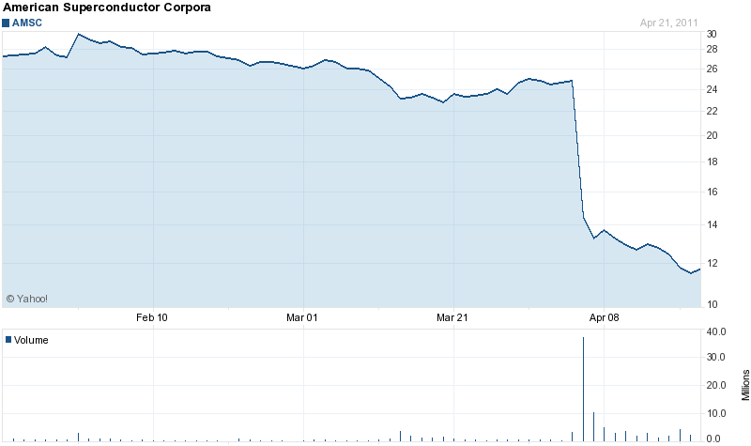
3 month AMSC chart

Slide 8
Overview
3 Areas of Focus:
Wind Energy (Turbine design, components, grid connections)
Power Systems (Grid components
motors)
High Temperature Superconductor (HTS) wires

Slide 9
As talked about last time…
On April 5, 2011, AMSC announced that Sinovel refused to accept shipments and refused to pay for shipments made during the 2010 fiscal year.
Expected 2010 4Q earnings substantially below previous projections. The following day, shares of AMSC plummeted by more than 42 percent.

Slide 10
Some Numbers
Current 11.61
52 week range: 11.50 - 38.88
P/E 13.62
Beta 1.55
EPS: 0.86

Slide 11
Recent News
Involved in a class action lawsuit
Charged with violating federal securities laws for lacking adequate internal and financial controls
Sinovel was not paying AMSC for certain contracted shipments
AMSC was improperly recognizing revenue on certain contracted shipments to Sinovel
As a result, AMSC's revenues were OVERSTATED

Slide 12
Potential Future (Press Release April 21st)
American Superconductor Wire Serves in Superconductor Electrical Substation in China
“This is a holistic project that demonstrates how superconductors will be applied in substations throughout China in the years ahead. As China’s electricity needs continue to increase, these solutions will be essential to maintain a high level of efficiency and reliability for our homes and businesses.”

Slide 13
Closing Thoughts
Good
leader in a viable industry - renewable energy
Young industry a lot of room for growth
New superconductors in electrical substation(s) in China
Bad
If Sinovel discontinues business and moves elsewhere, can AMSC replace 70% of its future revenue
Pending Lawsuits and low stock price making it difficult for future acquisitions

Slide 14
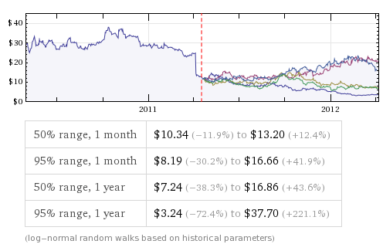
Volatility

Slide 15
Recommendation
Stop-Loss: $9.5
Limit: $16
“Bracket Order”
Don’t like the percentage of revenue coming from Sinovel even if they were to return and make the statement they will continue future business (uncertain now and risky later)
Summer months = no trading

Slide 16
Officer Elections
President
Vice President
Secretary
Treasurer
Analyst (3)
PR (3)
Webmaster

