Slide 1
Lafayette Investment Club
April 15 2011

Slide 2
Agenda
Club News
Portfolio
Financial News
Sell Recommendation: AMSC

Slide 3
Club News
Hedge Fund Trip
E-MAIL NANETTE COOLEY (cooleyn@lafayette.edu) TODAY!
Hosted by Alex Hyman P'14, Cofounder Thursday, April 21, 12:00pm - 5:00pm
Movie “Inside Job” – FREE FOOD! by the Econ Club
Monday, April 18th, Hugel 100, 7:00pm - 9:00pm

Slide 4
OFFICER ELECTIONS
Next Friday, April 20
Analysts (2-3)
PR (3)
Webmaster
Secretary
Treasurer
President and VP

Slide 5
Portfolio
January $368,344.58
April $370,293.23
YTD Portfolio Return .53% vs. S&P500 2.16%
WHY?

Slide 6
Portfolio

Slide 7
Portfolio January to April
ENERGY and COMMODITIES 5.07%
FINANCIAL SERVICES -0.35%
HEALTHCARE and BIOTECH 2.61%
MISC 7.54%
ETFs 5.16%
TECHNOLOGY -7.36%

Slide 8
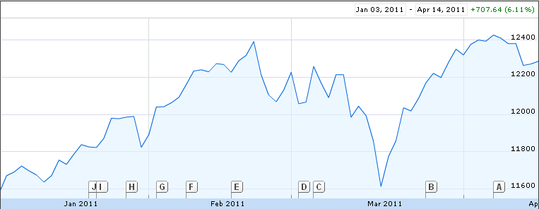
Financial News
DJIA: 12380.05, up 0.03% - 12270.99, up 0.1%

Slide 9
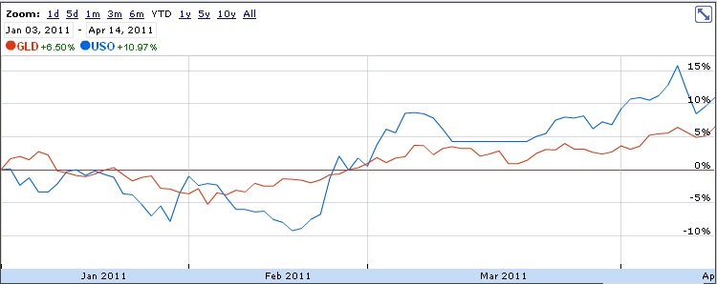
Financial News
OIL: 112.79 - 107.11, up 0.86
GOLD: 1454.90, up 2.00

Slide 10
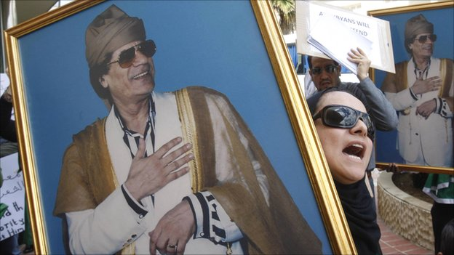
Middle East Unrest

Slide 11
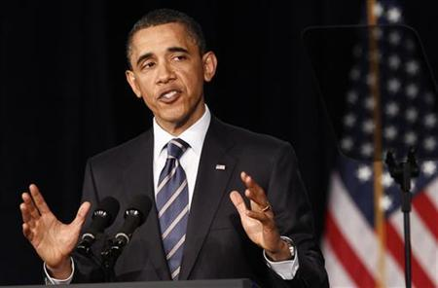
Budget Debates

Slide 12
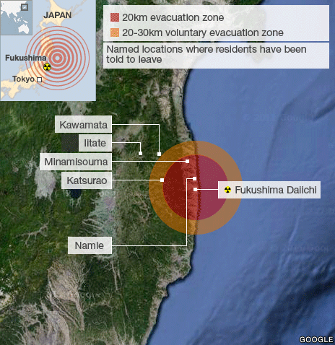
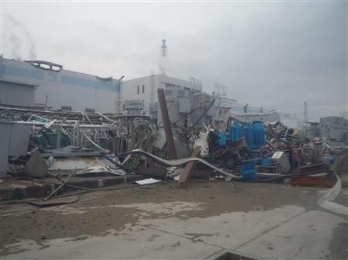
Japan

Slide 13
Sell Recommendation: AMSC
Miao and Greg

Slide 14
Overview
3 Areas of Focus:
Wind Energy (Turbine design, components, grid connections)
Power Systems (Grid components
motors)
High Temperature Superconductor (HTS) wires

Slide 15
Some Numbers
Current 13.01
52 week range: 12.54-38.88
P/E 15.16
Beta 1.58
EPS: 0.86

Slide 16
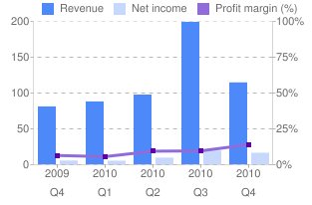
Financials
Income Statement (Annually )
Income Statement (Quarterly)
Only up to March 2010…
Up to Dec 2010

Slide 17
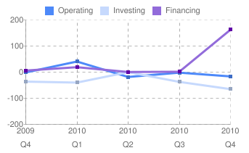
More financials
Balance Sheet
Quarterly Cash Flow

Slide 18
What was going on?
Quarterly Cash Flow
Balance Sheet (Quarterly)

Slide 19
Something good about AMSC
Overlap with other AMSC business
Government Support: $4.8M from the Department of Energy for further development of superconducting electrical cables.
Bright future of the business (long run): Energy Consumption

Slide 20
Recent Movement
April 6th

Slide 21
Recent News
Chinese Industrial company Sinovel, which accounts for over 70% of AMSC’s revenues, declined to receive American Superconductors components due to inventory backup
“If Sinovel cancelled purchase orders or development contracts, or discontinued future purchases from us, we would likely be unable to replace the related revenues. This would have a serious negative impact on our operating results and financial position.”
-10-k for 2009

Slide 22
Other Negative News
In March, AMSC said it would buy The Switch Engineering Oy for $266 million -- $79 million of which would be paid in stock.
With the recent drop in AMSC's stock value it would require more shares to complete the deal which makes this acquisition less likely

Slide 23
Should we sell it?
As a result of the recent withdrawal of Sinovels business, AMSC will likely be running in the red light for at least one year, possible more
We recommend to Sell AMSC

