Slide 1
Lafayette Investment Club
4/1/2011

Slide 2
Agenda
Club News
Market Madness 2: Game Stats
Winners and Prizes
Winning strategies (take notes!)

Slide 3
Club News
April 6th, Oechsle 7 PM Wall St. Panel
WRITE A QUESTION YOU WANT TO ASK!
April 21st Thursday – 12-4pm - Hedge Fund Trip:
Hyman Beck & Co Florham Park, NJ
- Sign Up! (link of Facebook)

Slide 4
Market Madness 2010 Facts:
February 15th – April 15th - 2 months
S&P 500 +10.67%
Best: +135% (J. Ballreich ’10) Worst: -45%
Outperform: 33 (30%) Underperform: 77 (70%)
Players: 110

Slide 5
Market Madness 2011 Facts:
February 21st – April 1st – 1.25 months
S&P 500 -1.28%
Outperform: 64 (74%) Underperform: 23 (26%)
Players: 87
Best: +123% Worst: -116%

Slide 6
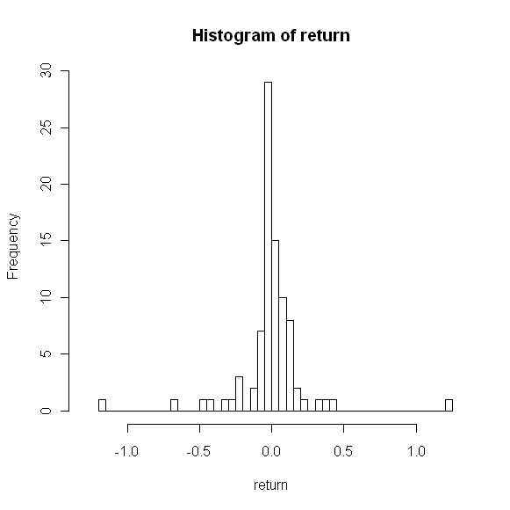
Returns

Slide 8
Lafayette Prop Trading
UNDERPERFORM!
2010 team: +5.13% vs. 10.6% (S&P 500)
OUTPERFORM!
2011 team: +0.36%
vs. -1.28% (S&P 500)

Slide 9
WINNERS!
1st Place: $250
2nd Place: $100
3rd Place: $50

