Slide 1
Lafayette Investment Club
February 4, 2011

Slide 2
Agenda
Club News
Financial News
Asset Allocation – Bonds
Railroads - Union Pacific
(Voting/Trading)

Slide 3
Club News
SPRING 2011 Events:
Market Madness – trading competition Feb 21 – April 1
Wall St Speaker Panel – 5 Wall St Alumni, April 6th
Plus – Speakers, Spot Party, Investment Nachos, etc.

Slide 4
Portfolio
Since Dec - UP 6.11% vs. 5.79% for DOW JONES
Cash ~ $26 000
Current Value = $372 553 (up from $350 000)

Slide 5
Where is the money?

Slide 6
Leaders
EQS 30% $695
MFC 25% $1355
GE 24% $3400
BAC 21% $700
XOM 17% $2082

Slide 7
Laggards
AMSC -14% ($919)
AKAM -9% ($1212)
EWZ -6.2% ($360)
VBLTX -3.9% ($426)

Slide 8
Financial Overview

Slide 9
State of the Economy
Strong Growth in consumer Spending
But Income growth still very slow
Credit Follows Gained Traction
But Credit condition is still tight for small businesses
Some firms seem to start hiring
But employment is still stubbornly high(about 9.4%)

Slide 10
Markets
Commodities Price keep increasing.
Treasury yield curve more and more steep.
Stock price keep going up generally since last Nov.
Dow : 7.55 % increase
S&P 500: 9.02%
NASDAQ: 8.41%

Slide 11
Fixed Income Assets

Slide 12
Types of Fixed Income
Corporate Bonds
Treasuries
Sovereign Debt
Municipal Bonds
CDs

Slide 13
Corporate Bonds
Debt issued by Corporations
May be investment grade (comparatively low risk)
May be high-yield (aka "junk"), much higher risk

Slide 14
Treasuries
T-Bills come in maturities of 28 days , 91 days , 182 days, and 364 days
Very low risk, US government bonds
Also very low yield
Treasury Notes mature in 1-10 years
Treasury bonds mature in 20-30 years
TIPS vary the rate to compensate for inflation

Slide 15
Sovereign Debt
Widely varying in risk
Can be difficult to obtain assets from "bankrupt" sovereign

Slide 16
Municipal Bonds
Issued by states, counties, and municipalities
Tax-sheltered
Some problems may be looming for municipal bonds

Slide 17
Certificate of Deposit
Low-risk instrument, locks investor in to product for duration
Offered by many banks

Slide 18
Risk summary
Credit risk
Interest rate risk

Slide 19
Ways to acquire bonds
Purchase bonds
Purchase ETF
Mutual fund

Slide 20
Some risks
Interest rate risk
Credit risk

Slide 21
Union Pacific

Slide 22
Why Railway
Revenue Tied to consumer demand for good & Product
Very good earning reports
Gradual improvement since early 2010
Future economic growth -> Sustained Momentum

Slide 23
Why Union Pacific
Location – Mid + West (Chicago Area)
Obama’s Railroad Expansion Plan – Invest 8 billion to high-speed rail(most of them are located in the west connecting Chicago)
Date of Operation: 1862 to present
Whatever Blago is gonna say

Slide 24
UNP

Slide 25
UNP

Slide 26
CSX

Slide 27
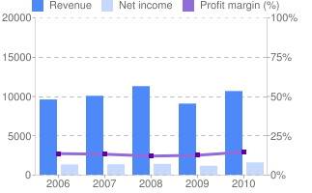
CSX (Income)

Slide 28
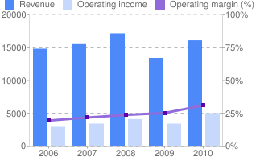
UNP (Income)

Slide 29
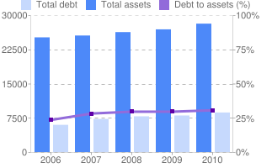
UNP vs. CSX (Balance)

Slide 30
COAL
44% of all tonnage in US
21% of railroad revenues
Coal Production in 2009:
Western U.S. 575,053,186
Top 50 Mines 654,173,287
~ 88% for UNION PACIFIC and Burlington

Slide 31
COAL

Slide 32
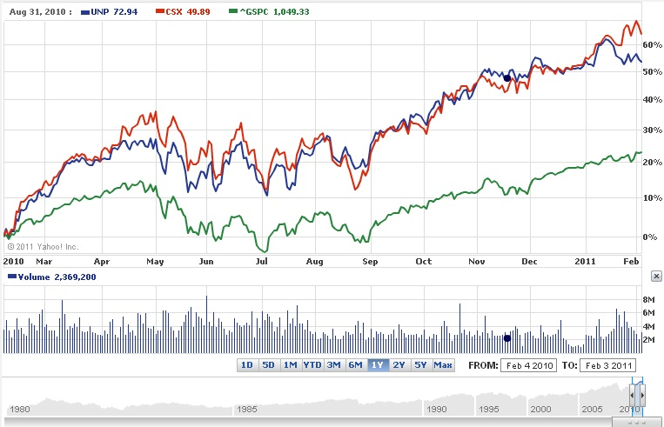
Performance

Slide 33
Buy UNP
Buy 80 UNP @ $95 ~ 2% of the portfolio

