Slide 1
Lafayette Investment Club
2/11/11

Slide 2
Agenda
Club News
Portfolio
Financial News
Education - Commodities
Stock Opinion - Equus Total Return (EQS)

Slide 3
Club News
SPRING 2011 Events:
Next Meeting – Feb 18
Greg Ip – journalist, US Econ
Thu Feb 17, 4:15pm @ Simon L3
Market Madness – trading contest Feb 21 – April 1
Wall St Speaker Panel – April 6
Officer Elections – end of semester

Slide 4
Trading Webinars
Wed 16th Feb 8.00am-9.00am - Introduction to Trading
Wed 23rd Feb 8.00am-9.00am - Intermediate Trend Trading & Live Trades

Slide 5
Portfolio
Current value ~ $370,815
Down .4% vs. S&P up .76%
DANGER: Technology stocks (CSCO)
26% of portfolio in TECH STOCKS

Slide 6
Markets
Dow 12,229.29
S&P 500 1321.87
Oil $87.22
Gold 1,366.80
USD/EUR 0.7387

Slide 7
Mixed Signals from the job report
Unemployment rate falls to 9%
Payrolls increased by 36,000, not 200,000

Slide 9
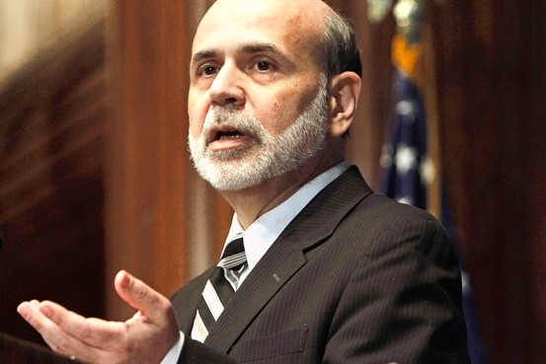
Inflation fears
Emerging markets
Bernanke
Bond Market

Slide 10
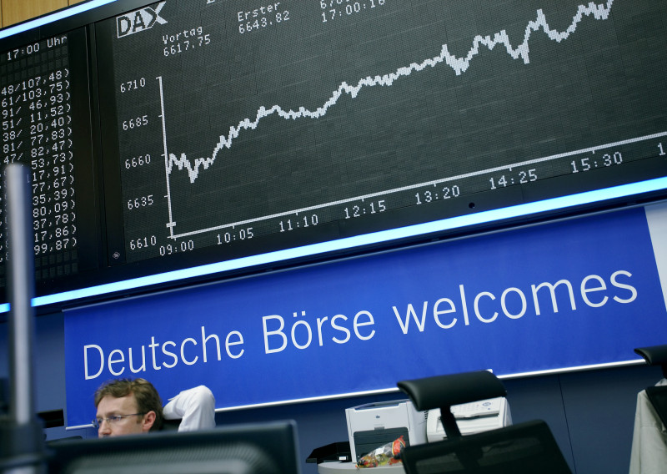
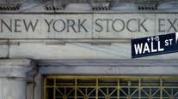
NYSE Euronext and Deutsche Börse in advanced merger talks

Slide 11
Superbowl

Slide 12
Commodities
Education

Slide 13
Definition
A kind of thing produced for use or sale, an article of commerce, an object of trade; in pl. goods, merchandise, wares, produce. Now esp. food or raw materials, as objects of trade.
- Oxford English Dictionary

Slide 14
Examples
Soybeans
Wheat
Gold
Silver
Oil

Slide 15
Advantages/Disadvantages (different from other securities)
Recongnized hedge against inflation
Provide increased diversification for portfolio
No fixed income stream
Volatile

Slide 16
Gain or loss?
Inflation
Financial panics
Increased industrial demand
Increased consumer demand
Deflation
Depression when governments don’t turn on the printing presses

Slide 17
How to earn returns on commodities?
Futures contracts
Physical purchase
ETFs
Mutual Funds
Anything else?

Slide 18
Monetary Base In Billions of Dollars
Source: FRED Data

Slide 19
Main Content Page Layout
Add a subtitle here
This text is a placeholder.
Here is the second level.
You may change this text
Here is the third level

Slide 20
Three Picture Page Layout
A second line of text may go here.
A description of the first picture. You may change this text.
A second place holder is available here. Add as much text as you would like.
A description of the second picture. You may change this text.
A second place holder is available here. Add as much text as you would like.
A description of the third picture. You may change this text.
A second place holder is available here. Add as much text as you would like.

Slide 21
EQS

Slide 22
What is EQS (Equus Total Return)
Equus Total Return, Inc. operates as a closed-end business development company
Provides funds/make investment to growing small companies.

Slide 23
Financials
Current Price: 2.75
EPS: -3.85
Beta: 0.06
Net Income : -6.41 Million(2010 Q3), -12.26 (Q2)

Slide 24
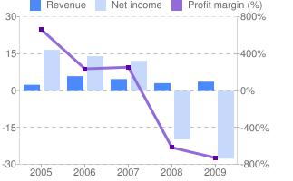
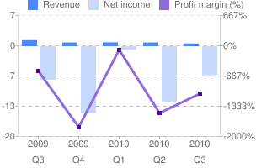
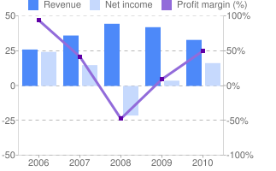
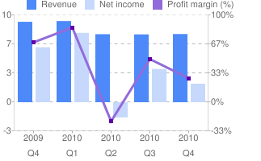
Income
Bad years + Bad Quarters
EQS
GLAD

Slide 25
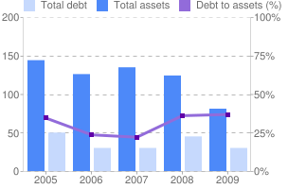
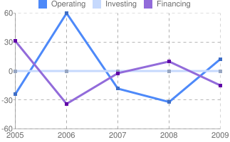
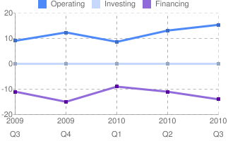
Balance Sheet + Cash Flow

Slide 26
Recent News
Equus Sells Three Related Investments for Ten Million in Cash
The operating results of each of these companies had declined, and collectability of the notes was therefore called into question
Bad Investments – sold in huge discount, big loss.
Maybe they have some liquidity problem

Slide 27
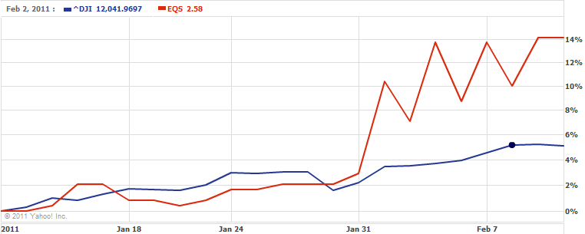
EQS Rocks… or does it?

Slide 28
RSI-Colin
RSI: 83.33
RSI measures the momentum of the price movements.
Overvalued!

Slide 29
WHAT DOES THIS SUGGEST?
SELL!!!!!!
(close entire position)

