Slide 1
Lafayette Investment Club
04/09/10

Slide 2
Club News
Next Meetings:
April 16th – Elections
President
Vice President
Treasurer
Secretary
Webmasters and PRs
MARKET MADNESS WINNERS
1st: $100, 2nd: $50, 3rd: $20
April 23rd - Joe Bonadayo, Charles Schwab

Slide 3
Today in investment club
Current Events
Portfolio Risk Management
Buy/Hold Presentation on LOW (Brandon and Dan)
Sell Presentation on LOW (Miao and Patrick)
MARKET MADNESS overview

Slide 4
Current Events
Payroll unemployment ↑ by 162,000 – Census!
30 year mortgage rate at 5.21%
Consumer borrowing declined by $11.5 bln
Oil prices ↓ by 96 cents
Banks borrowing from Fed on a decline

Slide 5
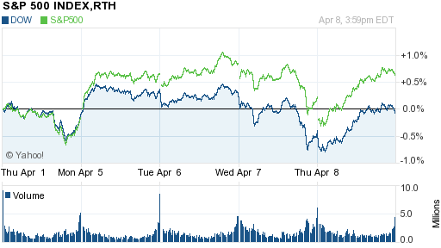
DJIA and S&P500

Slide 6
What is risk?
Uncertainty – more than one outcome is possible
Probability – expected value of a situation
Financial risk
- the variability or volatility of returns
- includes both lower and higher than expected returns

Slide 7
Important features of risk
People are risk-averse (big % of their wealth)
People have to be rewarded in order to take risks
Taking risk can bring pleasure (small % of wealth) – called “gambling”.
PEOPLE ARE BAD AT PERCEIVING RISK!

Slide 8
Measures of investment risk (MPT)
Alpha: Measures risk relative to the market or benchmark index
Beta: Measures volatility or systemic risk compared to the market or the benchmark index
R-Squared: Measures the percentage of an investment's movement that are attributable to movements in its benchmark index
Standard Deviation: Measures how much return on an investment is deviating from the expected normal or average returns
Sharpe Ratio: An indicator of whether an investment's return is due to smart investing decisions or a result of excess risk.

Slide 9
What IS BETA?
A measure of the volatility, or systemic risk, of a security or a portfolio in comparison to the market as a whole.

Slide 10
properties of beta
MARKET: β = 1
If β<1 – less risk, less volatility, less reward/loss
If β>1 – more risk, more volatility, more reward/loss
WORKS LINEARY -> β_{p} = ∑w*β_{a}

Slide 11
How risky is our portfolio?
Weighted average of all Betas = 0.82
This explains why we were doing better than the market during the downturn
What do we want to do during this upturn?
Increase Beta ☺

Slide 12
Riskiness of assets
Cash β=0
Bond funds β~0
BAC β=2.37 !!!
HP β=1.04
GILD (Health care) β=.38
Treasury bonds fund β= -.04

Slide 13
Portfolio RISK
β=.82 -> Invest $20000 -> β=.95
in β=1.2

Slide 14
LOWES COMPANY
Around $7650 (2.32% of portfolio)
β=1.02
HOLD/SELL?

Slide 15
Company Fundamentals
Actual EPS is 28% higher than predicted
Current Ratio : 1.323
The ratio is mainly used to give an idea of the company's ability to pay back its short-term liabilities
Lowe's Companies Inc.'s Corporate Governance Quotient as of 1-Apr-10 is better than 53.9% of S&P 500 companies and 85.9% of Retailing companies.
Valuates the strengths, deficiencies, and risks of a company's corporate governance practices and board

Slide 16
Company Fundamentals
Current Price: 25.59 50-Day Moving Average:24.26 200-Day Moving Average:22.56
Golden Cross - A crossover involving a security's short-term moving average breaking above its long-term moving average or resistance level
Indicates a bull market on the horizon and is reinforced by high trading volumes. Additionally, the long-term moving average becomes the new support level in the rising market.
Technicians might see this cross as a sign that the market has turned in favor of the stock.

Slide 17
Comparison
HD:
Plumbing, Electrical and Kitchen: 30.6% of net sales
Hardware and Seasonal:28.7% of net sales
Building Materials, Lumber and Millwork: 22.1% of net sales
Paint and Flooring: 18.6% of net sales
LOW
Plumbing/Electrical/Kitchen: 32% of net sales
Hardware/Seasonal: 15% of net sales
Building Materials/Lumber/Millwork: 20% of net sales
Paint/Flooring: 14% of net sales
Home Care: 18% of net sales
Lawn and Landscape Products: 5% of net sales
Nursery: 4% of net sales
Home Environment: 3% of net sales
Outdoor Power Equipment: 4% of net sales
Windows and Walls: 2% of net sales

Slide 18
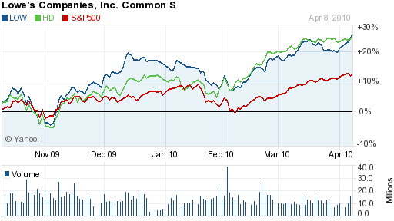
LOW vs. HD

Slide 19
Comparison
In 2009, Home Depot dominated in terms of sales revenue ($66.2 billion vs. $47.2 billion). Lowe's has outpaced the market leader along key metrics of same stores sales growth and operating margin growth.
International Markets: Home Depot has 268 stores outside of the US (mostly in Canada and Mexico) which is six more stores than it had in 2008. On the other hand, at the end of 2009, Lowe's had a total of 16 stores outside the United States, all of which are in Canada. Lowe’s opened a store in Mexico during Q1 2010.
One key driver of the difference in operating performance is Lowe's store environment, which is often noted to be more more customer friendly than Home Depot's. Consumers wanting less of a "warehouse style" home improvement retailer often choose Lowe's over Home Depot. This is especially true for the lucrative, growing DIFM customer base.

Slide 20
Key Difference
One key driver of the difference in operating performance is Lowe's store environment, which is often noted to be more more customer friendly than Home Depot's. Consumers wanting less of a "warehouse style" home improvement retailer often choose Lowe's over Home Depot. This is especially true for the lucrative, growing DIFM customer base.

Slide 21
Decision
Hold current holding of 300 shares

Slide 22
Company Fundamentals
Operating cash flow: 4.05B
Levered Free Cash Flow: 1.88B
Operating Margin: 6.83%
Profit Margin: 3.78%
Market Cap: 36.94B
Diluted EPS: $1.21

Slide 23
Competitor (HD)
Profit Margin: 4.02%
Operating Margin: 7.48%
Return on equity: 14.10%
Diluted EPS: $1.57

Slide 24
Housing Market
Fed’s decision to pull back supports
Distressed properties
Financing can still be hard to get
Expiration of tax credits
Notes:
You'll need at least 10% down or 10% equity in your home and a credit score of 720 or higher; your mortgage, insurance, and property taxes shouldn't exceed 31% of your gross income; and no more than 41% can go to paying debts of any kind.

Slide 25
Suggestion
SELL LOW – 300 shares

