Slide 1
Lafayette Investment Club
03/26/10

Slide 2
Club News
Events:
Tonight @ 7, Hugel 103 - John Morris, hedge-fund manager
Saturday, Kirby 104 – Financing Africa Conference
Tuesday, March 30, Simon L3, 4pm – Martha Heinze, JPMorganChase – Careers on Wall Street
Next Meetings:
April 9th - ?
April 16th – Market Madness Winners!
April 23rd - Elections
Wall Street 2 – postponed until Sep 23rd ☹☹☹

Slide 3
Today in investment club
MARKET MADNESS
Portfolio Overview
Buy Presentation on AMGN (by Brandon Commodaro)
Hold/Sell Presentation on JAKK (Miao and Eduardo)

Slide 4
Portfolio overview
TOTAL VALUE $328,528.07
CASH $40,824.16
TECH $70,600.25
ENER $31,583.13
HEALTH CARE $30,496.50
FINANCIALS $52,037.54
MISC $41,454.06
OTHER (bonds and international funds) $61,532.44

Slide 5
Portfolio overview

Slide 6
Portfolio overview

Slide 7
SECTOR OVERVIEW
MISC HEALTH CARE

Slide 8
Company: Amgen | Presenters: Brandon Commodaro
Ticker: AMGN | Sector: Biotech/ Healthcare
Date: 3/26/2010 | Buy/ Sell: Buy

Slide 9
News
New Healthcare Bill has passed
What does this mean for Biotech companies?

Slide 10
What is in the Bill?
States that if you have insurance at the time of the bill becoming law and change, you will be required to take a similar plan. If that is not available, you will be required to take the government option!
All non-US citizens, illegal or not, will be provided with free healthcare services
Taxpayers will subsidize all union retiree and community organizer health plans
No company can sue the government for price-fixing. No "judicial review" is permitted against the government monopoly

Slide 11
Step by Step
The healthcare bill will be initiated in steps
2010
Children age 26 and younger will be able to remain covered under their parents health insurance plans (this is increased from past age limits which were anywhere from age 22-25)
Adults with pre-existing conditions will be eligible for coverage into high risk health insurance pools until future health care exchanges are up and running.
Health insurance companies will be prohibited from levying annual limits and lifetime limits on coverage.
2011
Seniors enrolled in Medicare Advantage or the Prescription Drug Plan will receive a 50% discount on brand name drugs immediately with additional prescription drug discounts to follow
2014
All US citizens will be forced to have health insurance coverage considered acceptable by the US Government or else pay a fine
Businesses with 50 or more employees will face a fine of either $2,000 or $3,000 per employee for not offering health insurance coverage.

Slide 12
The Facilitators
Basically…
The Government will facilitate an environment where previously ineligible applicants will now be eligible for insurance
The Government will facilitate an environment where companies will be forced to supply health care to employees
The Government will enforce policy in 2014 by fining

Slide 13
Company Profile
Amgen Inc. (Amgen) is an independent biotechnology medicines company. The Company discovers, develops, manufactures and markets medicines for grievous illnesses. It focuses on human therapeutics and concentrates on medicines based on advances in cellular and molecular biology.

Slide 14
Product Pipeline
Prolia/ Denosumab - PENDING FDA APPROVAL
Used to treat Osteoporosis ($$)
Possibly help prevent cancer from spreading to the bone ($$$)
“Denosumab demonstrated superiority over the standard of care in treating bone complications in breast cancer” – Investor Relations
Amgen will market Prolia for PMO and oncology in the United States and Canada without a partner

Slide 15
Numbers
Current Stock Price | $59.07 (Close of 3/24/10)
P/E | 13.10
EPS | 4.51
PEG | 1.32
Dividend | N/A
52 WEEK HIGH/ LOW | 44.96 - 64.76

Slide 16
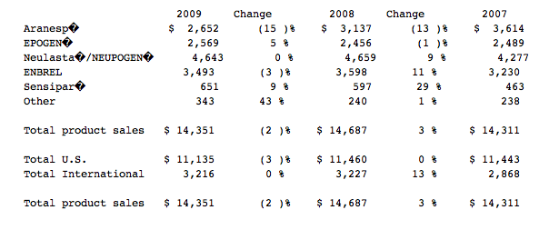
Earnings
“Amgen, Inc. reaffirmed fiscal 2010 guidance and expects revenues of $15.1-$15.5 billion and earnings per share (EPS) of $5.05-$5.25. According to Reuters Estimates, analysts on an average are expecting the Company to report revenue of $15.3 billion and EPS of $5.11 for fiscal 2010. ” - Reuters

Slide 17
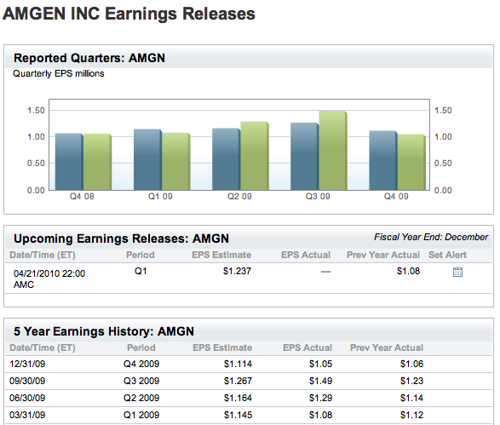

Slide 18
Earnings Trends

Slide 19
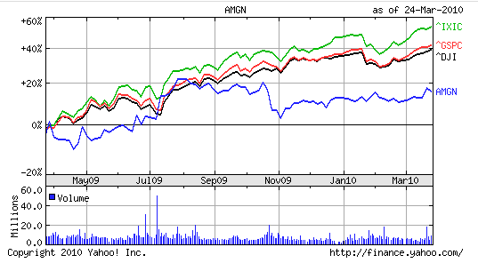
Poised For A Comeback

Slide 20
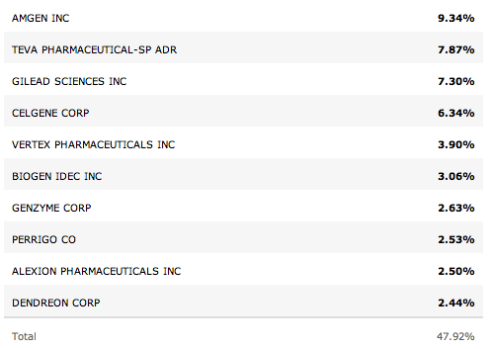
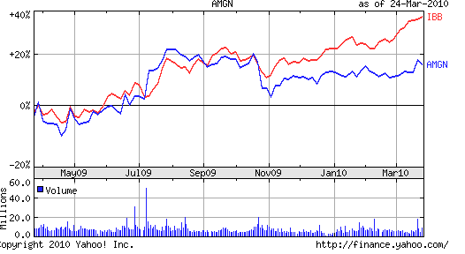
IBB Holdings
→→→

Slide 21
Counterargument
Points to take into consideration
Stock price has leveled
Health Care Bill will go into final effect in 2014
Competitor Novartis (NVS) shows strong fundamentals

Slide 22
Proposal
Double shares in AMGN (buy 100 @ 59.96)
Great product pipeline
No direct competitor – more invested into Biotech as opposed to healthcare and vaccines
Strong Fundamental outlook
Closely follows positive market trend

Slide 23
JAKKS Pacific
Miao Wang
03/26/09

Slide 24
What does JAKK do
JAKK is a multi-brand company that designs and markets a broad range of toys and games
-Action Figures
-Water Toys
-Vehicles Toys
-Stationery
-Construction toys
-TV games
-etc (a lot more)

Slide 25
Boys

Slide 26
Girls

Slide 27
Bad things
Big loss of -385.51 million in 2009 compare to a gain of 76.1 million in 2008
Net sales is significantly lower in every quarter of 2009 than that of 2008

Slide 28
Fourth Quarter of 2009
Net Sale: 198.8m vs. 269.3m in 2008
Net income: -1.9m vs. 16.9m in 2008
Operational Efficiency???

Slide 29
Good things
One of the top five toy companies in the states
Diversity of Products
Sells products in China
Consumer goods(not necessities) vs. Economy recovery
Presented at Needham Game Day Conference (Yesterday)
Increasing trend since Jan of 2010

Slide 30
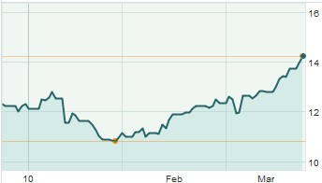

Slide 32
Statistics
Latest Trade: 13.82
52wk Range: 10.55 - 16.26
Market Cap: 389.26M
Beta: 0.72
EPS: -14.02

Slide 33
What shall we do?
Keep it
Sell it

