Slide 1
Lafayette Investment Club
02/19/10

Slide 2
Today in investment club
Current Events
Buy Presentation on AMSC (by Jeromie Ballreich)
Short Selling
MARKET MADNESS
TV Show: Wall Street Warriors

Slide 3
Current Events
Initial claims for state unemployment benefits ↑
Producer Price Index ↑ due to energy prices
U.S Mortgage rates below 5%
Philly Business Activity Index rose to 17.2%
Fed raises emergency loan rate 0.75% from 0.5%
Strong earning reports for HP

Slide 4
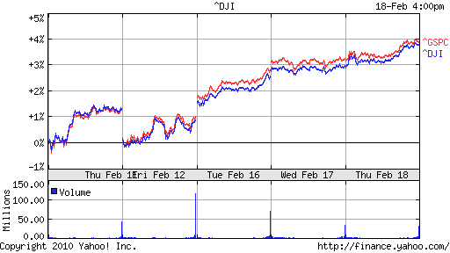
DJIA and S&P500

Slide 5
Buy Recommendation: American Superconductor (AMSC)
Jeromie Ballreich
Lafayette Investment Club
February 19, 2010

Slide 6
Overview (part 1)
Ticker Symbol: AMSC
52 week range: 11.66-43.95
Market Cap: $1.4 Billion
Recent Financial Results (quarterly)
Revenue: $80.7 million (95% increase)
GAAP: $5.2 MM, EPS: .11
Margins: 37.5 compared to 23.2
No Debt, $100+ MM in Cash

Slide 7
Overview (part 2)
3 Areas of Focus:
Wind Energy (Turbine design, components, grid connections)
Power Systems (Grid components
motors)
Superconductors (wires)

Slide 8
Investment Thesis
AMSC pursues a “Qualcomm” business model with Wind Energy
Provides turbine designs in return for royalty and agreement to use AMSC components
Benefit is scalability, high margins, and low capital

Slide 9
Thesis (cont.)
AMSC Licensees includes many Chinese industrials such as Sinovel (#1 Wind company in China, Top #5 in World)
As licensees begin turbine production, AMSC generates high margin $$$
Wind energy=Jobs, Energy security

Slide 10
Thesis (cont.)
More licensees to increase/begin production next 2 years, with more licensees expected
EXTRA Benefit: Overlap with other AMSC business

Slide 11
Thesis
Sweet Spot in opportunity
R&D ` Commercialization
Use of DCF valuation “breaks down” Too many unknowns, tend to be conservative
$80 million range for next year sales (analysts)
Raising estimates/outlook

Slide 12
Thesis
EPS $.65 (2010) and $1.20 (2011)=floor for stock
New wind contracts, grid news (LS Cable), partnerships can drive stock price
Execution can get analysts “excited” about superconductor prospects

Slide 13
RISKS
Most revenue comes from Sinovel
China exposure
Macroeconomic risks
Failure to execute
Technology edge

Slide 14
Buy
250 shares
75 shares
none

Slide 15
Short Selling
Involves selling shares you do not presently own
Typically borrowed
Strategy used to profit from downward price movement

Slide 16
Example
Suppose XYZ is trading at $100/share
You think it will drop to $50
You borrow 100 shares of XYZ, sell them at $100
XYZ drops to $50, you buy shares back and return them
Profit = $100*100-$50*100=$5,000

Slide 17
Caveats
You must maintain minimum “margin”
If your account goes under this, broker can take action
Must pay dividend if short position opened while dividend paid

