Slide 1
Friday September 6^{th,} 2013 1st Meeting of Fall Semester
Lafayette College Investment Club

Slide 2
Meeting Agenda
Maureen Boehmer of Career Services will give an introduction to her role and opportunities there are in the fall.
Finance Night, Alumni Meetings, Etc.
Introduction To Club – Welcoming New Members
Fall Agenda
Market Update by our Market Analyst Ryan McCormick
What is going on in Markets

Slide 3
WELCOME NEW MEMBERS
Interesting Facts about the Investment Club
We are the only club on campus that is self sustaining and receives no aid or funding from the school.
We currently have over 400MM dollars invested in the markets. (Yes real money)
Being the oldest club on campus started over 40 years ago

Slide 4
Market Update
9/6/13

Slide 5
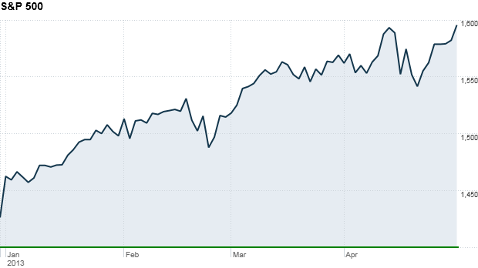
Summer – Two Stories
Economic Recovery Remains Slow
Unemployment Rate around 7.4%
Long-term unemployed elevated
Conversely, Stock Market reached record high

Slide 6
Reasoning
Federal Reserve engaged in QE program, buying long-term Treasuries and MBS
Lower long-term interest rates and encourage growth (housing market).
Lowers opportunity cost for investors
Investment in markets caused prices to appreciate

Slide 7
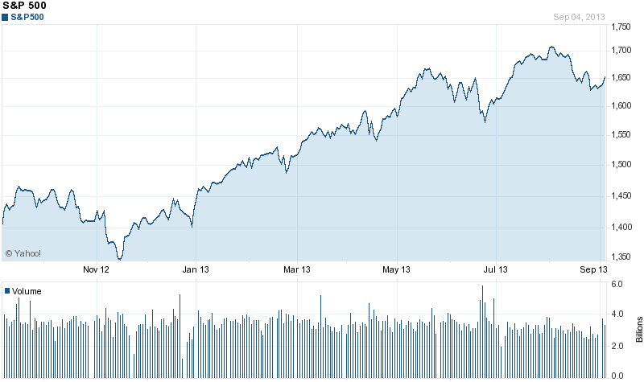
QE Tapering
In June, Fed chairman Bernake threatened to taper asset purchase program
Sent volatility throughout markets

Slide 8
Moving Forward
Anticipated tapering after September meeting
Bond rates will move higher; could cause an increase in yield.
Investors will look to re-position portfolios
N/A to Investment Club – valued portfolio

Slide 9
Other News
Verizon bought Vodafone’s U.S. wireless business for a reported $130 billion
Gives Verizon power in increasingly competitive market
Deliver improved wireless network coverage

Slide 10
Continued
Samsung unveiled “Smartwatch” product
Includes Wi-Fi and connects to all Android devices
Can measure your health data through watch
Apple stock decreased on the news
Demonstrates ultra-competitive market

Slide 11
New Members
Get involved by doing market update
Great way to learn about Economy/Finance
Easy to get started through WSJ
Contact Info: mccormir@lafayette.edu

