Slide 1
Lafayette Electric Vehicle 2015
ECE 492: Senior Design II
Morning Critical Design Review
March 11, 2015
Hugel 100

Slide 2
Roadmap
Meet the Morning Teams
Introduction: Motivation
Interface Control
System Assemblies Layout/Interfaces (Car)
System Assemblies Layout/Interfaces (Rack)
Interconnects
Panel Drawings and Hubs
Grounded Low Voltage (GLV)
Safety Loop
GLV Power
VCI
TSI
5. GLV BOM and Budget

Slide 3
Roadmap Cont.
Tractive System Voltage (TSV)
Overview
Safety
Mechanical
PacMan System
Charging
AMS
BoB
Acceptance Testing
Maintenance
6. Out of Scope: LFEV-2016
7. Conclusion

Slide 4
Roadmap
Meet the Morning Teams
Introduction: Motivation
Interface Control
System Assemblies Layout/Interfaces (Car)
System Assemblies Layout/Interfaces (Rack)
Interconnects
Panel Drawings and Hubs
Grounded Low Voltage (GLV)
Safety Loop
GLV Power
VCI
TSI
5. GLV BOM and Budget

Slide 5
Meet the Morning Teams
Grounded Low Voltage (GLV)
Dan Zakzewski
Alo Posillico
Nick DiNino
Jordan Frank
Zach Helwig
Tractive System Voltage (TSV)
William Stathis
Duhang “Hansen” Liang
Katherine Nellis
Jaejoon Yang
Jordan Blake
Mechanical Engineering Team
Ben Prevoznak
Kailan Ottaway
A. Freddie Hess

Slide 6
Roadmap
Meet the Morning Teams
Introduction: Motivation
Interface Control
System Assemblies Layout/Interfaces (Car)
System Assemblies Layout/Interfaces (Rack)
Interconnects
Panel Drawings and Hubs
Grounded Low Voltage (GLV)
Safety Loop
GLV Power
VCI
TSI
5. GLV BOM and Budget

Slide 7
Introduction: Motivation
Formula Hybrid Competition Vehicle
Electric Car
Capable of Vehicle Integration
Four Team Integration
Integrate with Mechanical Engineering Department
Provide next year’s team with a well-structured Formula Hybrid Vehicle ready for integration

Slide 8
Roadmap
Meet the Morning Teams
Introduction: Motivation
Interface Control
System Assemblies Layout/Interfaces (Car)
System Assemblies Layout/Interfaces (Rack)
Interconnects
Panel Drawings and Hubs
Grounded Low Voltage (GLV)
Safety Loop
GLV Power
VCI
TSI
5. GLV BOM and Budget

Slide 9
Interface Control
An Interface Control Document was created to accurately and completely define all (electrical, mechanical, semantic) aspects of top-level interfaces to allow different designers to coordinate with each other successfully.
Next, we will discuss these top-level interfaces.

Slide 10
Roadmap
Meet the Morning Teams
Introduction: Motivation
Interface Control
System Assemblies Layout/Interfaces (Car)
System Assemblies Layout/Interfaces (Rack)
Interconnects
Panel Drawings and Hubs
Grounded Low Voltage (GLV)
Safety Loop
GLV Power
VCI
TSI
5. GLV BOM and Budget

Slide 11
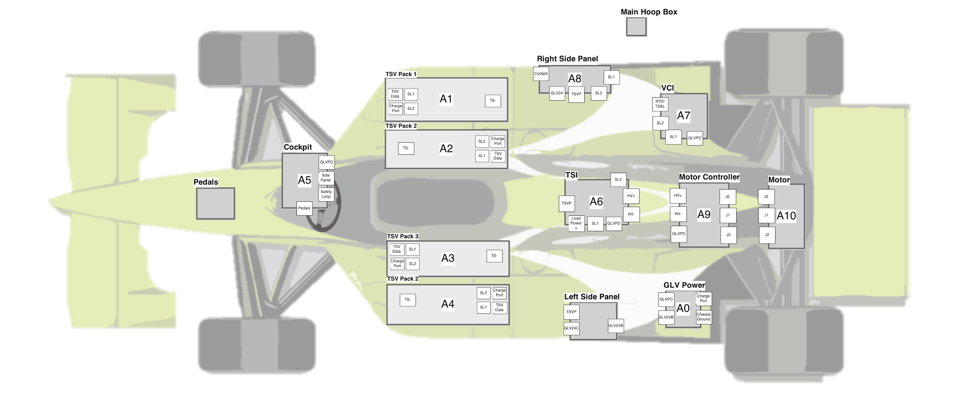
System Assemblies Layout - Top View
High Voltage Supply
Driver Interface Panel
Side Panel Interfaces
Low Voltage Power Source

Slide 12
System Assemblies Layout - Top View
Tractive System Interface
Vehicle Computer Interface
Motor Controller

Slide 13
Layout Selection
SAE Requirements:
Side Panels
Cockpit Panel
Warning Devices
Mechanical:
TSV best placed adjacent to the driver
Motor located near rear axle
Cabling
Orientation of TSV System Packs
TSI, Motor Controller, and Motor all adjacent
Interfacing
VCI accessible by pit station crew

Slide 14
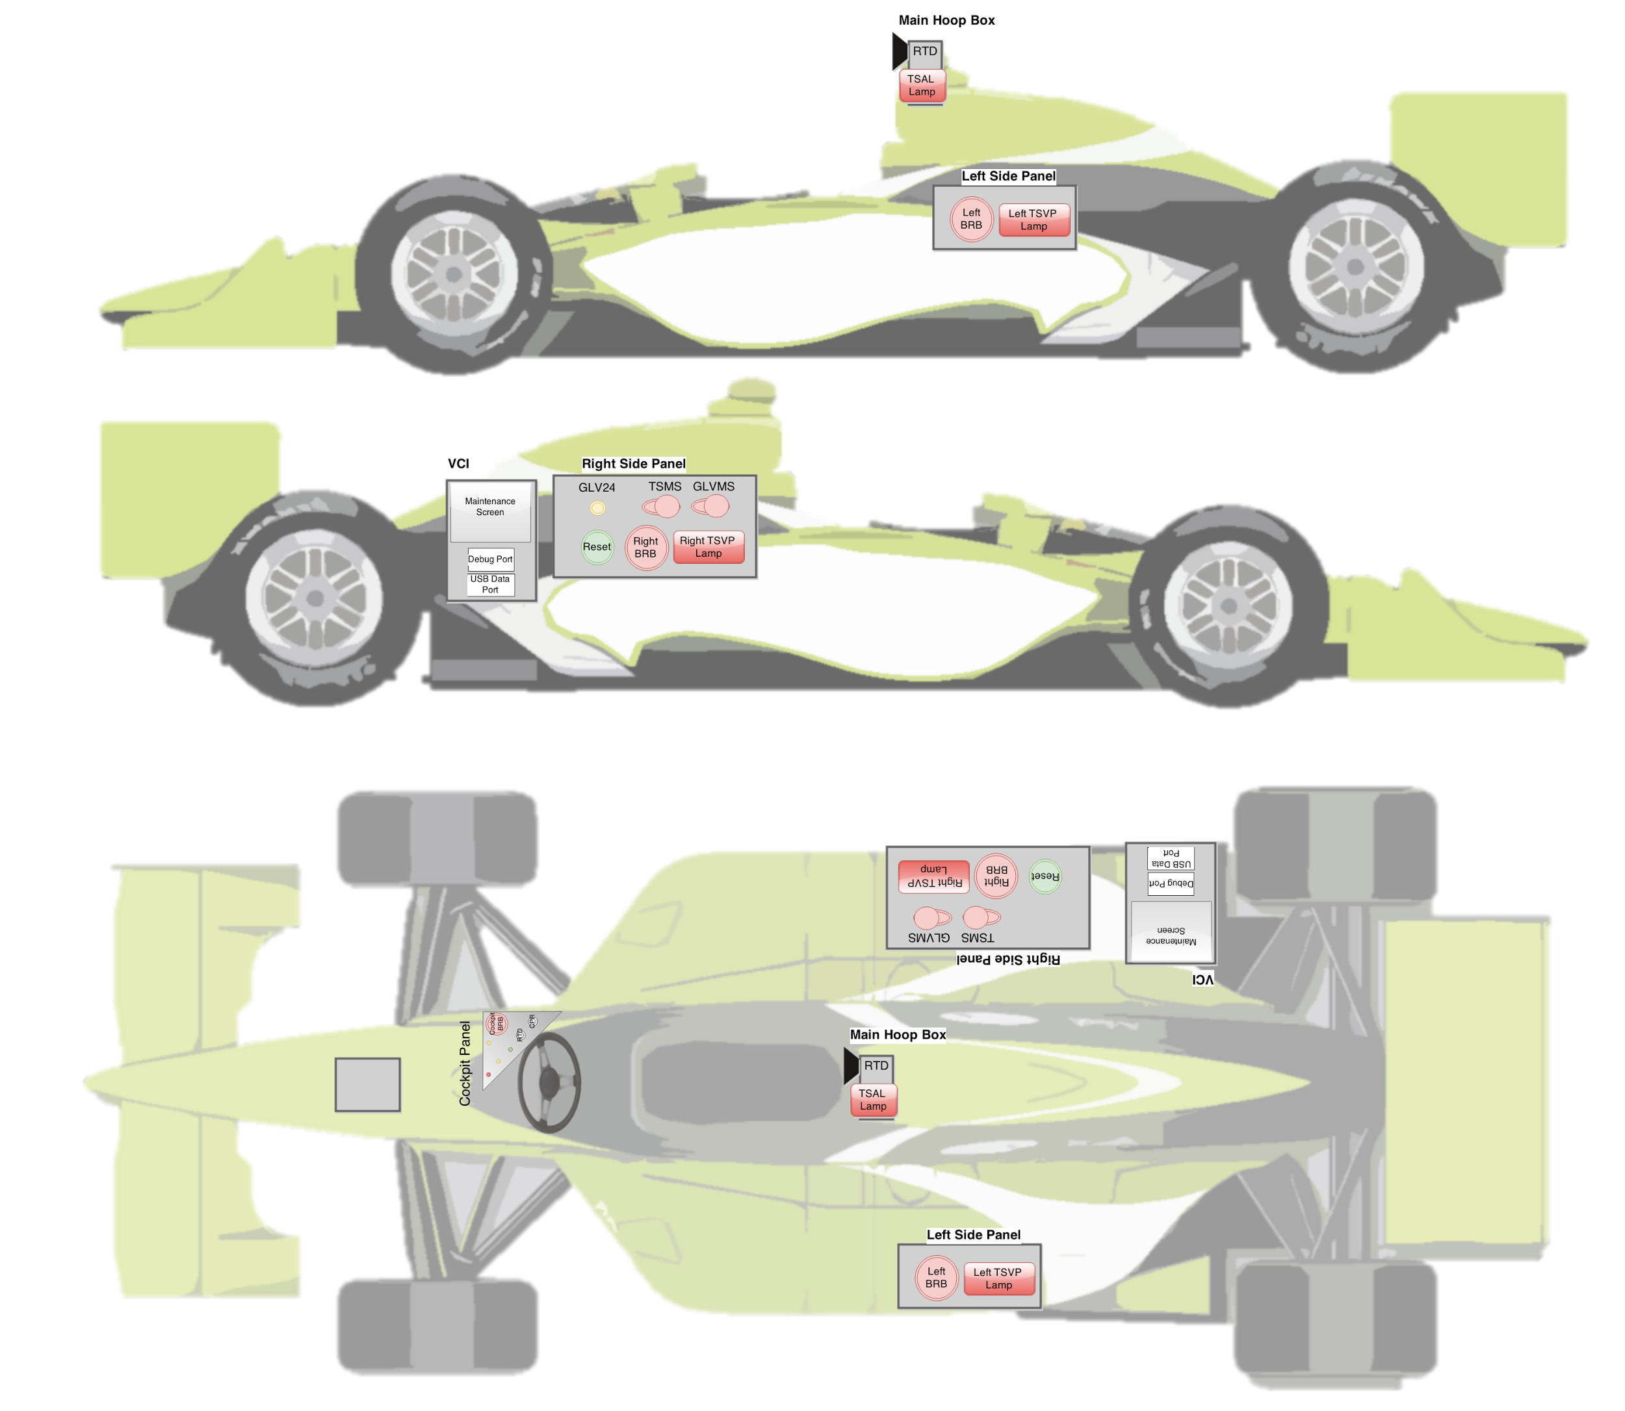
Physical Interfaces Layout - Side View

Slide 15
Physical Interfaces Layout - Top View

Slide 16
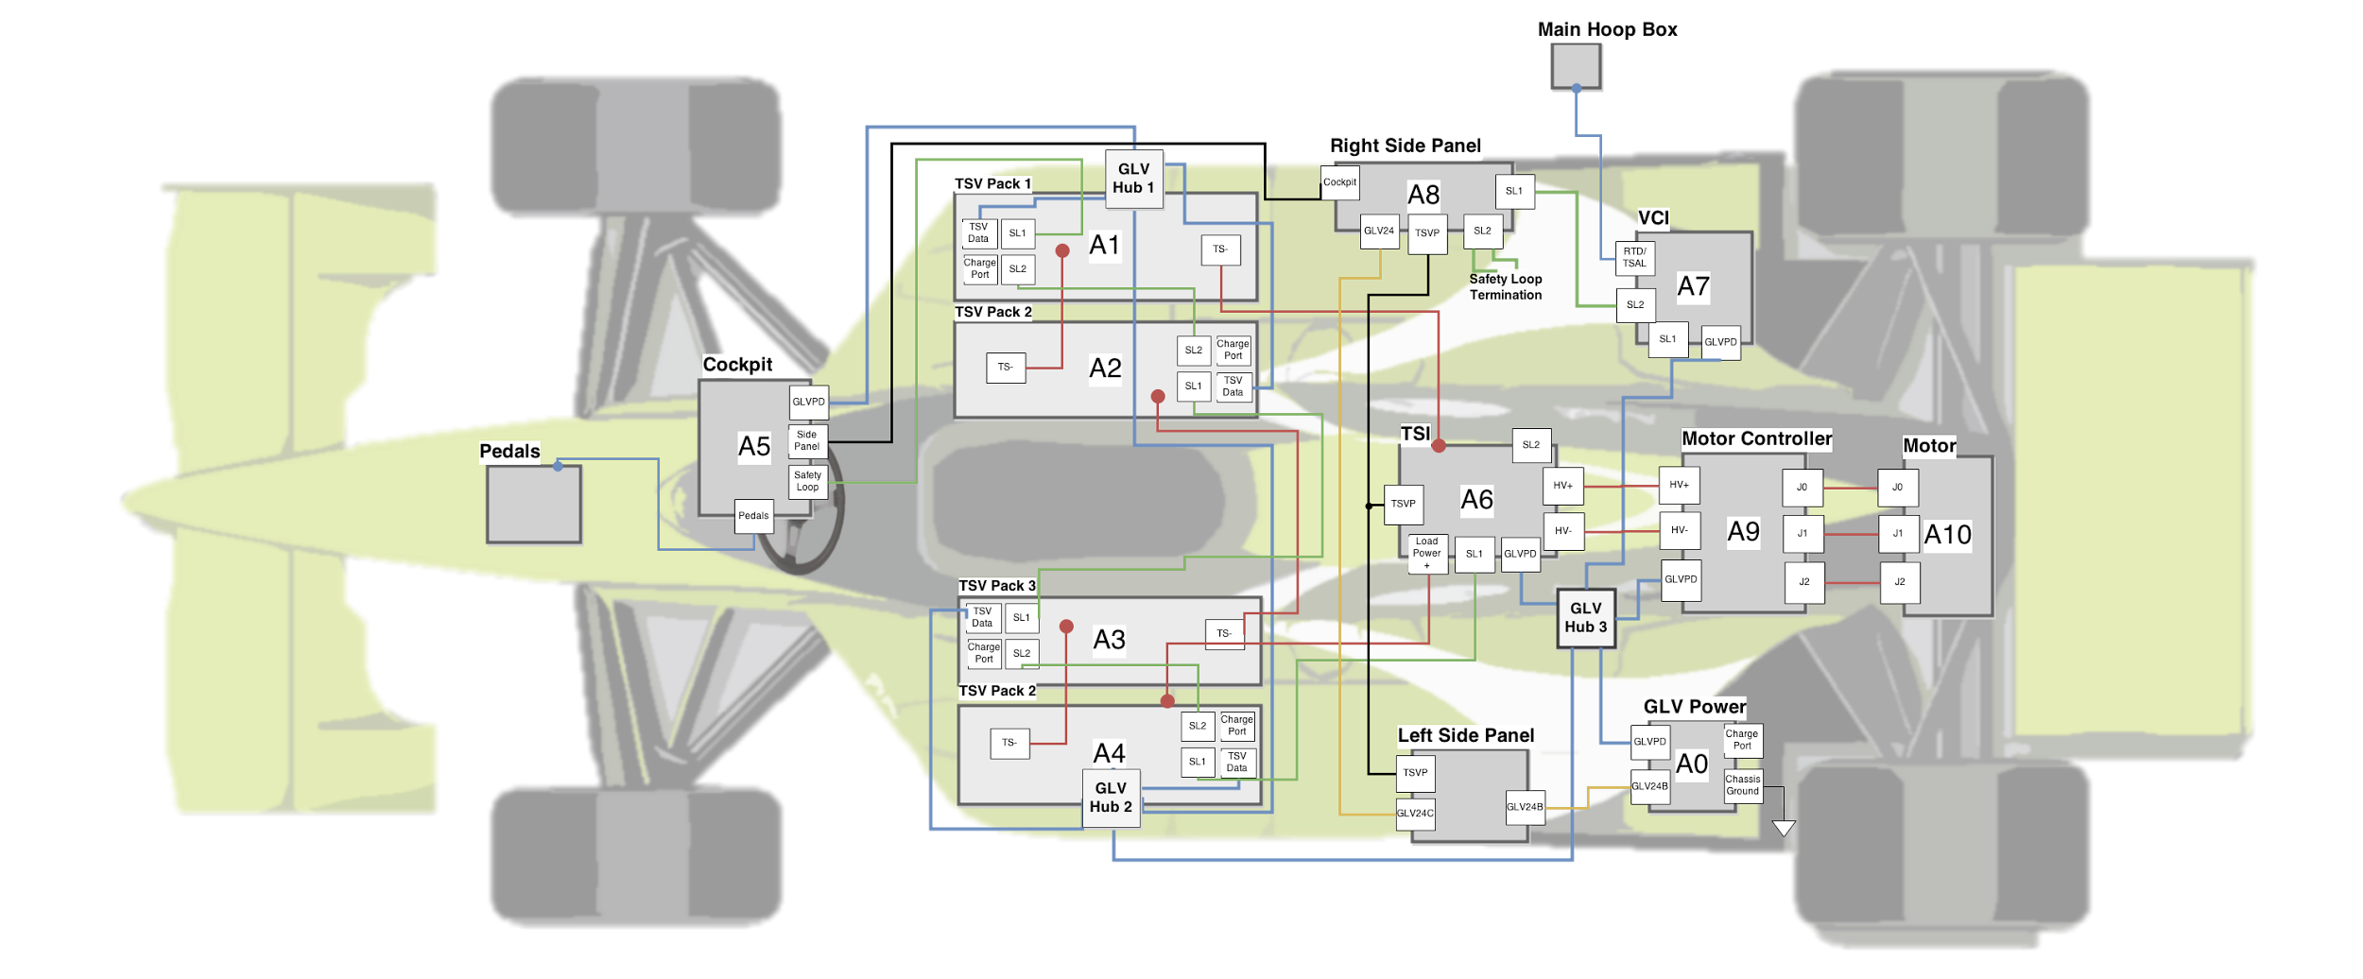
System Assemblies Layout - Top View

Slide 18
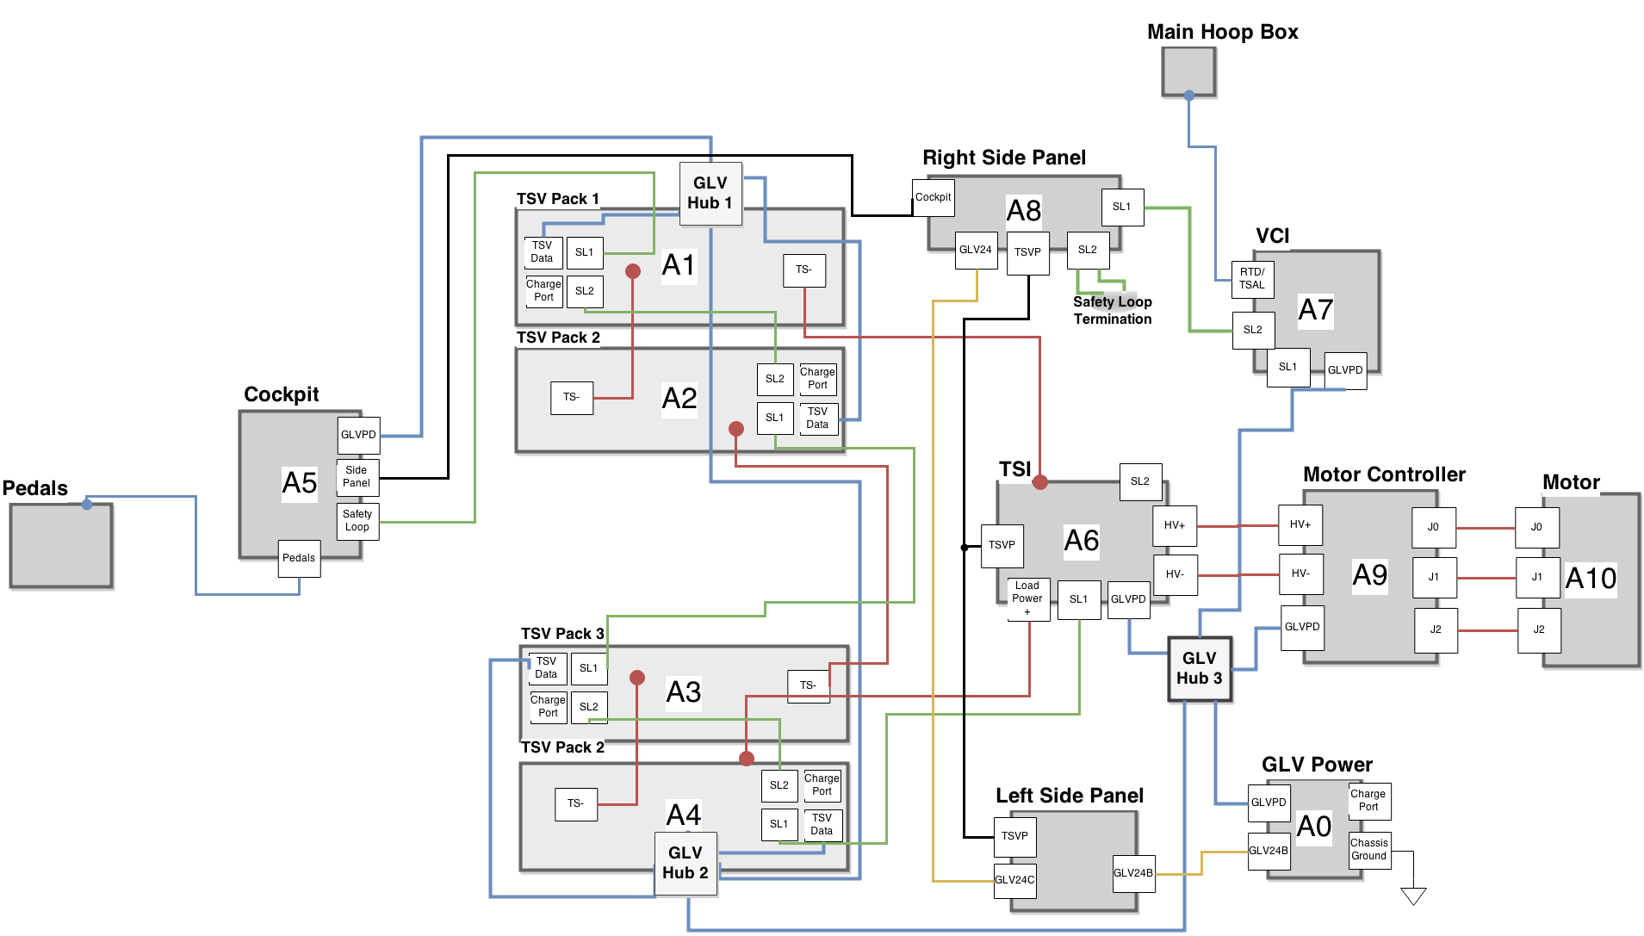
Vehicle Layout

Slide 19
Roadmap
Meet the Morning Teams
Introduction: Motivation
Interface Control
System Assemblies Layout/Interfaces (Car)
System Assemblies Layout/Interfaces (Rack)
Interconnects
Panel Drawings and Hubs
Grounded Low Voltage (GLV)
Safety Loop
GLV Power
VCI
TSI
5. GLV BOM and Budget

Slide 20
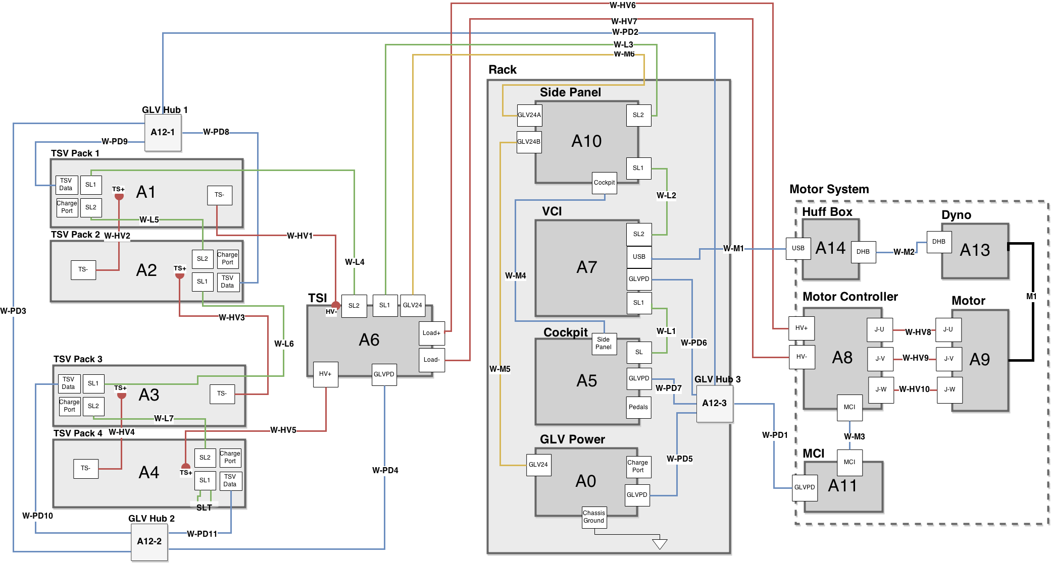
End-of-Term Integration Layout

Slide 21
End of Term Integration Layout
Most Boxes Car Integratable
VCI
Cockpit Box
GLV Power Box
TSI
TSV Packs
Cable Design
Same length as used in vehicle integration where possible (longer elsewhere)
Easy to test as parts are integrated into the system

Slide 22
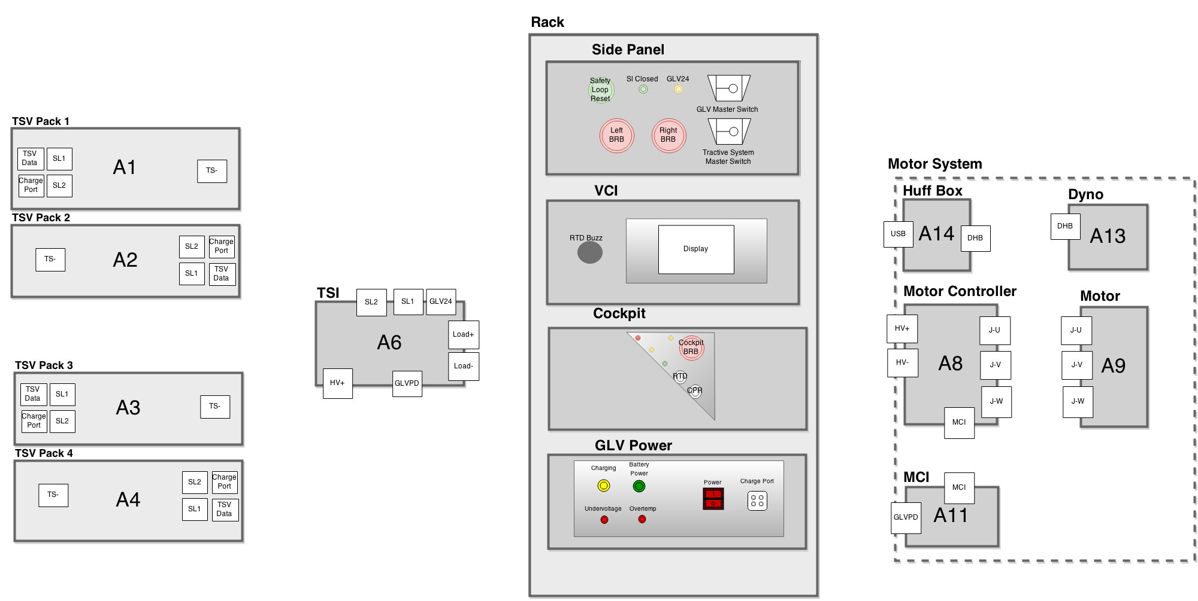
Semester Integration Physical Interfaces

Slide 23
Physical Interfaces
Side Panel
Contains Master Switches
Safety Loop Interface
Power Indicators

Slide 24
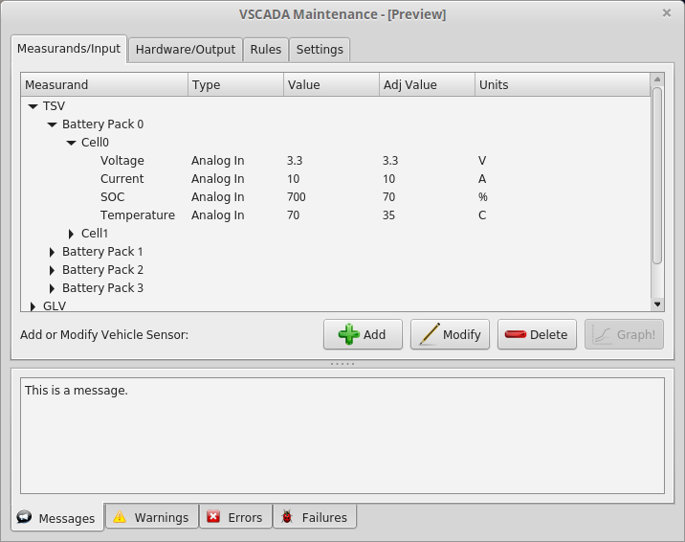
Physical Interfaces
VCI Display
9 Inch Touchscreen
Direct VSCADA Maintenance
System Parameter Control

Slide 25
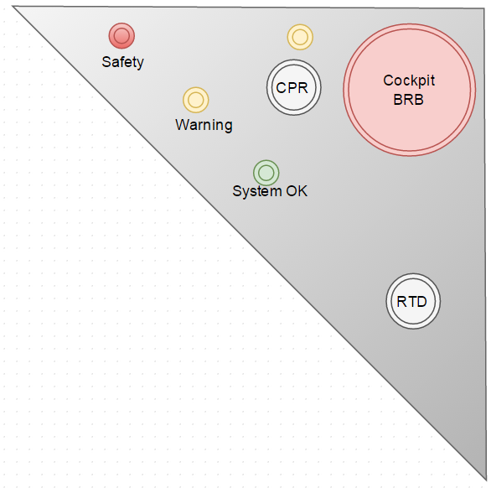
Physical Interfaces
Cockpit Panel
Driver Interface
E-Stop (BRB) and Reset (CPR)
Indicators
Key Start Switch

Slide 26
Physical Interfaces
GLV Power Panel
Low Voltage Battery Indicators
GLV Power Switch

Slide 27
Roadmap
Meet the Morning Teams
Introduction: Motivation
Interface Control
System Assemblies Layout/Interfaces (Car)
System Assemblies Layout/Interfaces (Rack)
Interconnects
Panel Drawings and Hubs
Grounded Low Voltage (GLV)
Safety Loop
GLV Power
VCI
TSI
5. GLV BOM and Budget

Slide 28
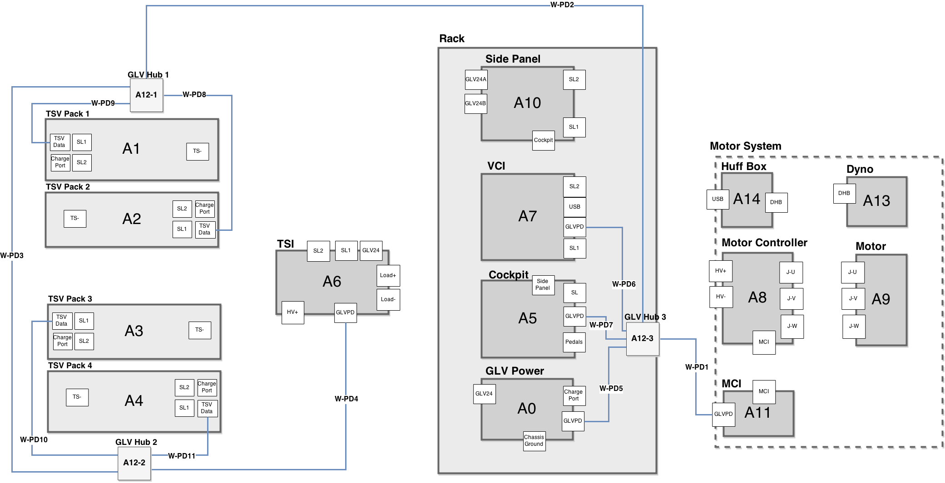
GLV Power and Data Distribution

Slide 29
GLV Power and Data Distribution
12 Volt Power Supply
Needed for VSCADA Computer
Easily Regulated to 5V
CAN Data Line
Industry Standard in Automotive Systems
Already Implemented inside the Motor Controller
CAN Consequences
Single long bus line
Nodes connected via short (<1.0 m) stubs
GLV Hub Boxes

Slide 30
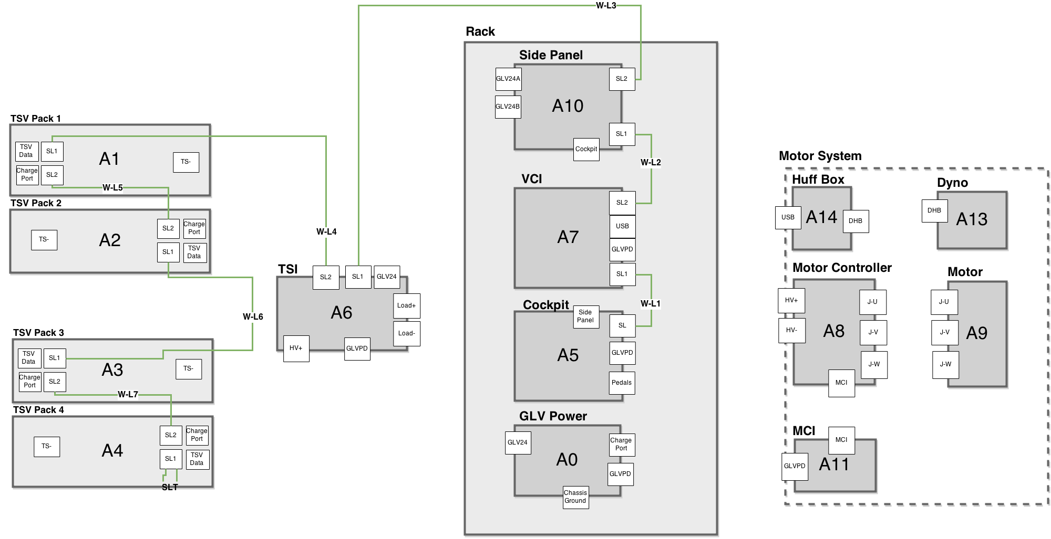
Safety Loop Connections

Slide 31
Safety Loop Connections
SAE Requirement
Control of the Tractive System Accumulator Isolation Relays (AIRs)
Two Ports Per System
Easily add additional systems
No required order of systems

Slide 32
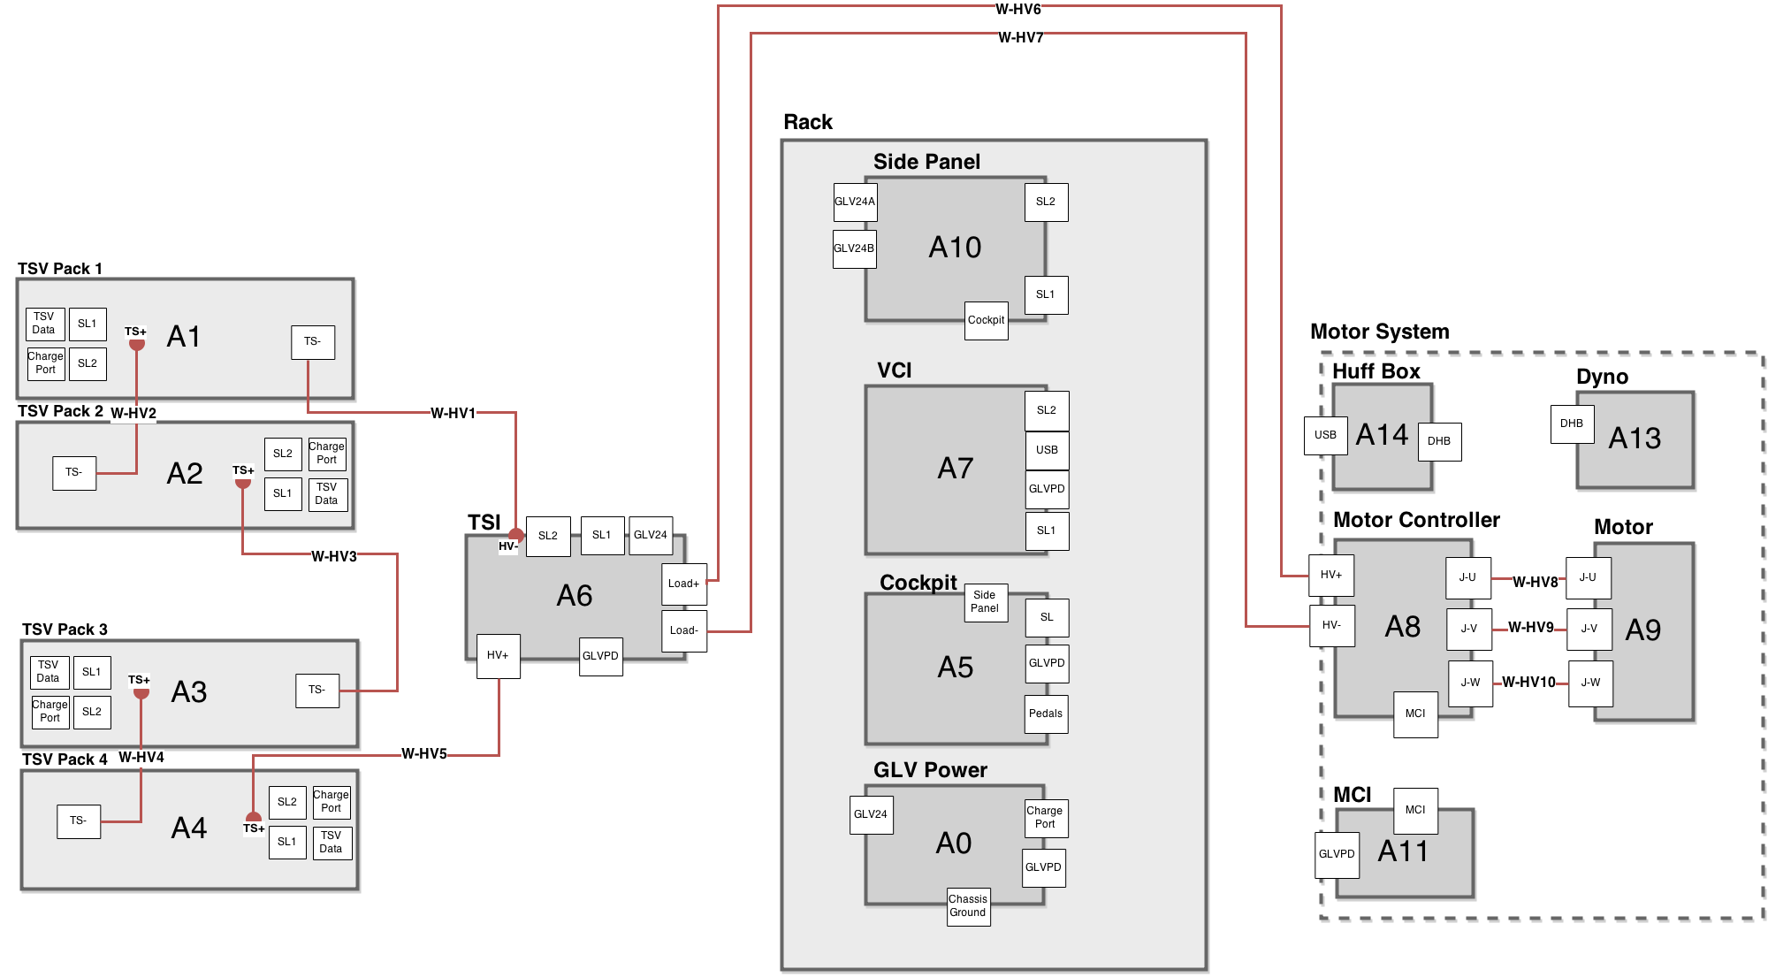
Tractive System High Voltage Path

Slide 33
Tractive System High Voltage Path
Internally Hardwired Connections
Less Cables
Less Interconnects
Powerlock Connectors
SAE Requirements:
Easily Removable
Lockable

Slide 34
Tractive System High Voltage Path
Powerlock Connectors
Bolt Terminals
Pre-existing

Slide 35
Semester Integration Layout

Slide 36
Roadmap
Meet the Morning Teams
Introduction: Motivation
Interface Control
System Assemblies Layout/Interfaces (Car)
System Assemblies Layout/Interfaces (Rack)
Interconnects
Panel Drawings and Hubs
Grounded Low Voltage (GLV)
Safety Loop
GLV Power
VCI
TSI
5. GLV BOM and Budget

Slide 37
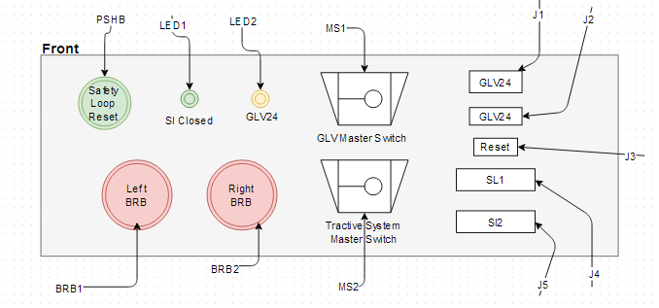
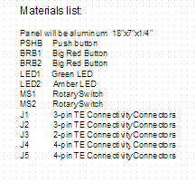
Side Controls Panel
Designed for testing purposes

Slide 38
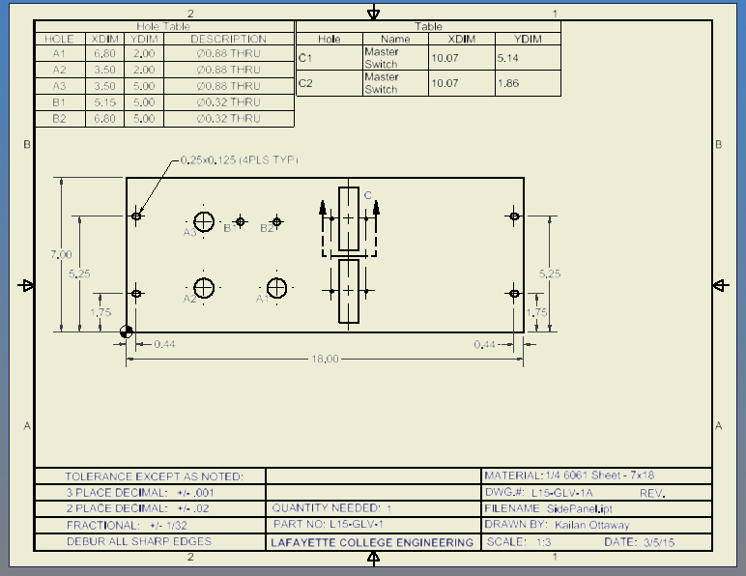
Side Controls Panel Drawing

Slide 39
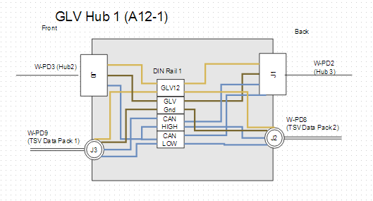
GLV Hub 1
Connects to GLV Hub 2 and 3
Dangly that connects to TSV Pack 1 data port
Dangly that connects to TSV Pack 2 data port
Notes:
Works for the car
Mention why we are using the dangly stubs VS longer wires with connectors

Slide 40
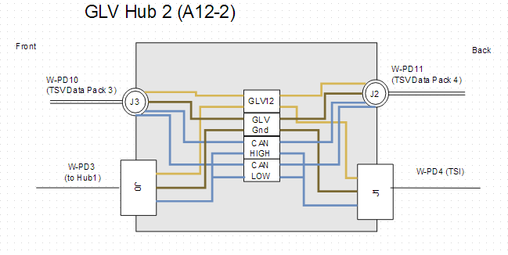
GLV Hub 2
Connects to GLV Hub 1
Connects to TSI
Dangly that connects to TSV Pack 3 data port
Dangly that connects to TSV Pack 4 data port

Slide 41
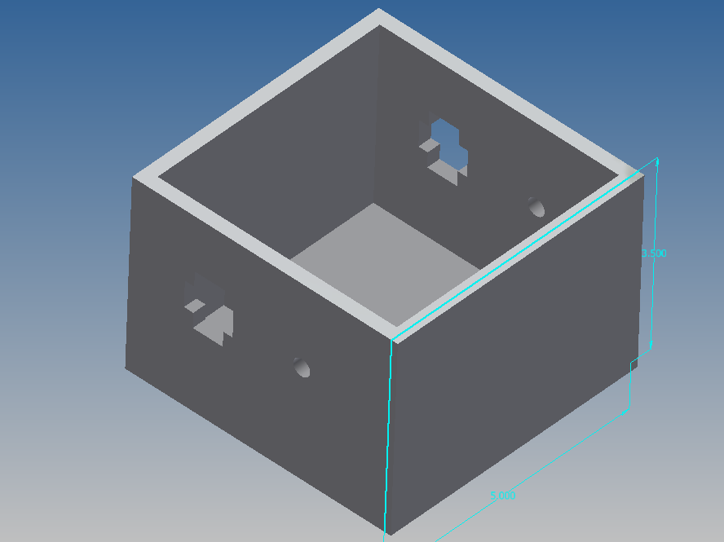
GLV Hub 1 & 2

Slide 42
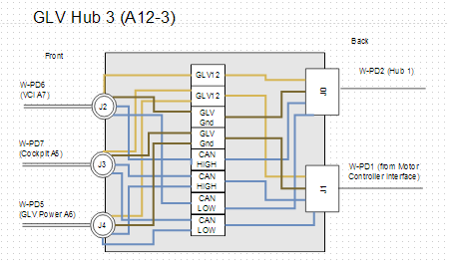
GLV Hub 3
Connects to GLV Hub 1
Connects to Motor Controller Interface
Dangly that connects to the VCI
Dangly that connects to the Cockpit
Dangly that connects to GLV Power

Slide 43
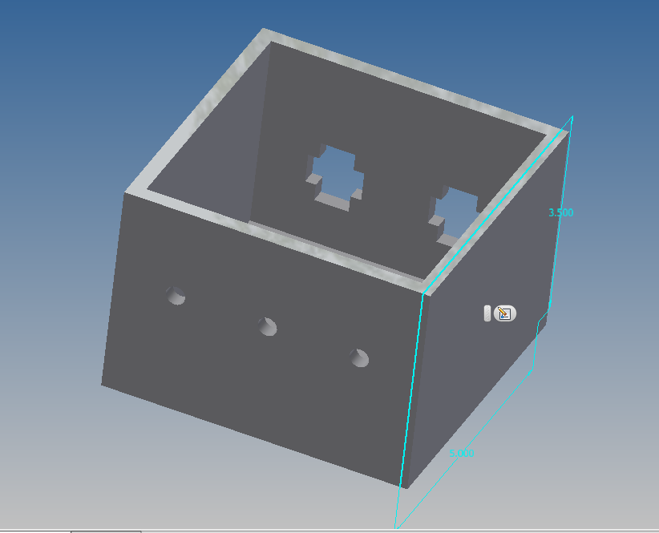
GLV Hub 3

Slide 44
Roadmap
Meet the Morning Teams
Introduction: Motivation
Interface Control
System Assemblies Layout/Interfaces (Car)
System Assemblies Layout/Interfaces (Rack)
Interconnects
Panel Drawings and Hubs
Grounded Low Voltage (GLV)
Safety Loop
GLV Power
VCI
TSI
5. GLV BOM and Budget

Slide 45
Grounded Low Voltage
GLV system is responsible for supplying power to all non-tractive devices on the vehicle, interfacing other subsystems together, and operating the safety circuit in accordance to the EV requirements.

Slide 46
Roadmap
Meet the Morning Teams
Introduction: Motivation
Interface Control
System Assemblies Layout/Interfaces (Car)
System Assemblies Layout/Interfaces (Rack)
Interconnects
Panel Drawings and Hubs
Grounded Low Voltage (GLV)
Safety Loop
GLV Power
VCI
TSI
5. GLV BOM and Budget

Slide 47
Cockpit and the Safety Loop

Slide 48
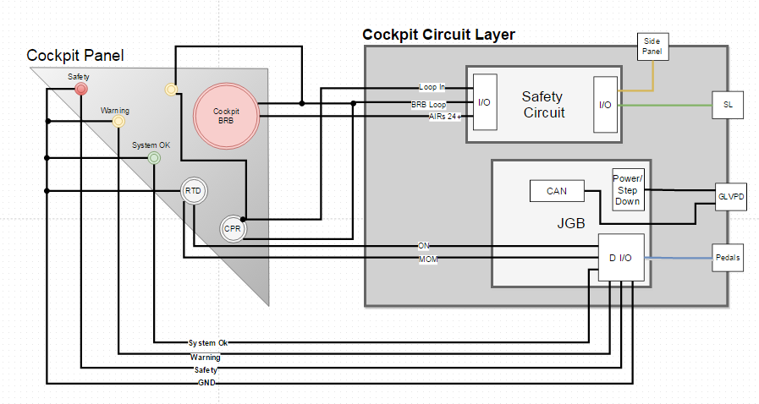
Cockpit Panel and Internals

Slide 49
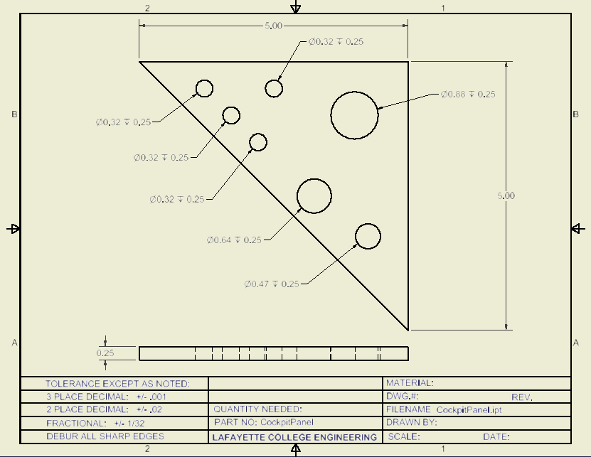
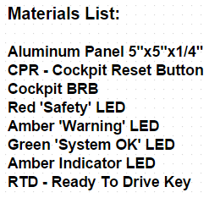
Cockpit Panel Drawing

Slide 50
Safety Loop and Safety Circuit
Keeps high level voltage system in a safe state
Monitors status of the system and provides multiple shutdown options to both driver and surrounding personnel
Interacts with each electrical subsystem

Slide 51
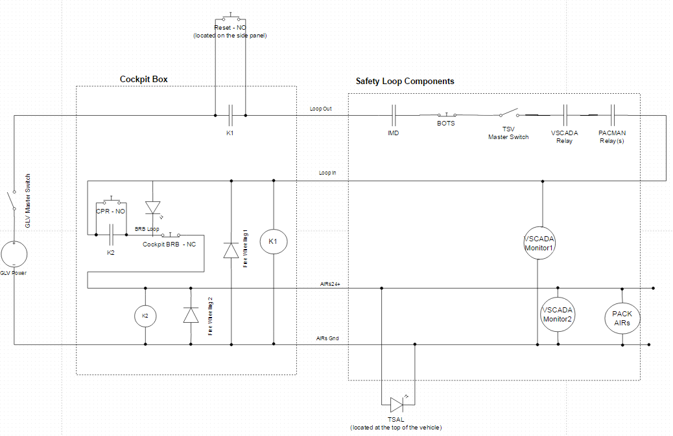

Slide 52
Shutdown Priority Table
Controlled Systems
 | GLV Supply to: Instrumentation, Data Acquisition, Computers, Telemetry, Etc. | AIRs (TS Voltage)
TSMS |  | OFF
Cockpit BRB |  | OFF
AMS |  | OFF
IMD |  | OFF
Brake Over-Travel |  | OFF
Side-Mounted BRBs | OFF | OFF
GLVMS | OFF | OFF
Shutdown Sources

Slide 53
Safety Loop Summary
Safety Loop accounts for failures/faults in the 4-wire safety loop
Any failure in the safety loop will be appropriately reacted to within the time constraints provided by the Formula Hybrid Rules
Appropriate steps must be taken in order to make the car ready-to-drive in each scenario
The Test Plan for the Safety Loop does not have a threshold for any test; whether it be button/switch functionality or the shutdown circuit itself. The loop will function to the specifications provided.

Slide 54
Roadmap
Meet the Morning Teams
Introduction: Motivation
Interface Control
System Assemblies Layout/Interfaces (Car)
System Assemblies Layout/Interfaces (Rack)
Interconnects
Panel Drawings and Hubs
Grounded Low Voltage (GLV)
Safety Loop
GLV Power
VCI
TSI
5. GLV BOM and Budget

Slide 55
GLV Power

Slide 56
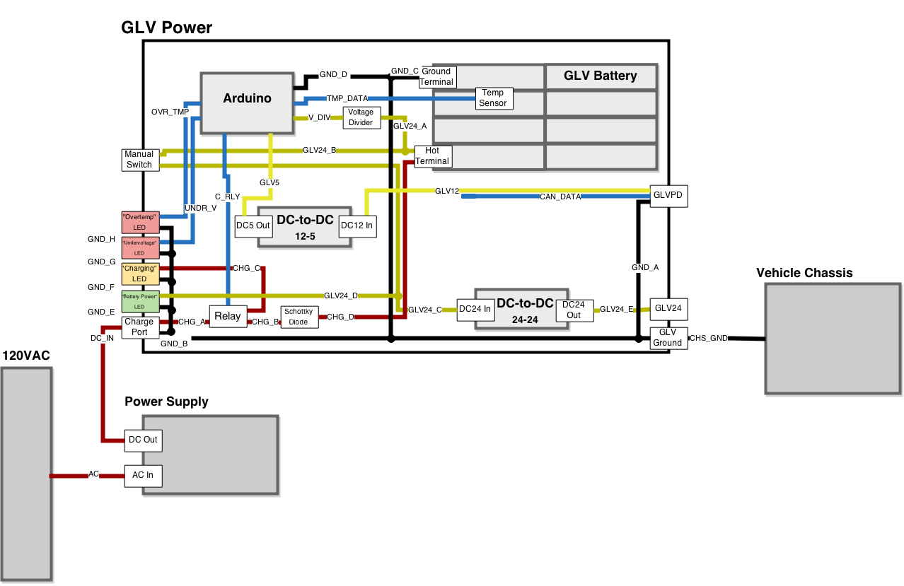
GLV Power Box and Dependents

Slide 57
GLV Power Box

Slide 58
GLV Power Box - End Goal (JGB)

Slide 59
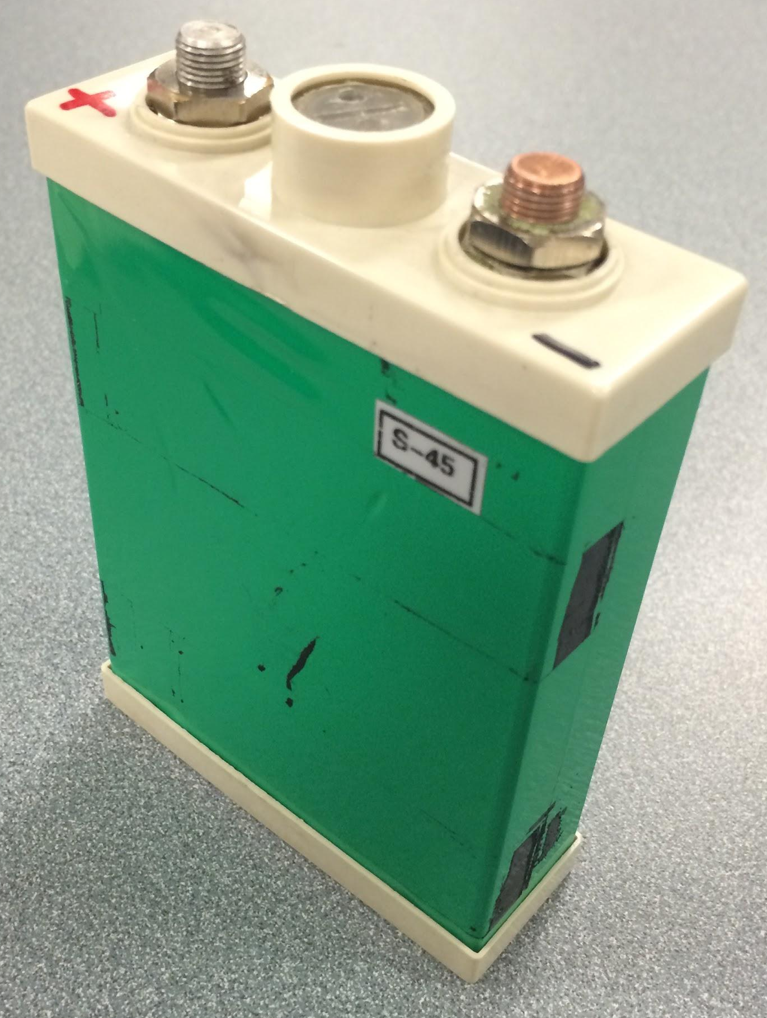
GLV Battery Cell
3.3V LiFePO4 10Ah

Slide 60
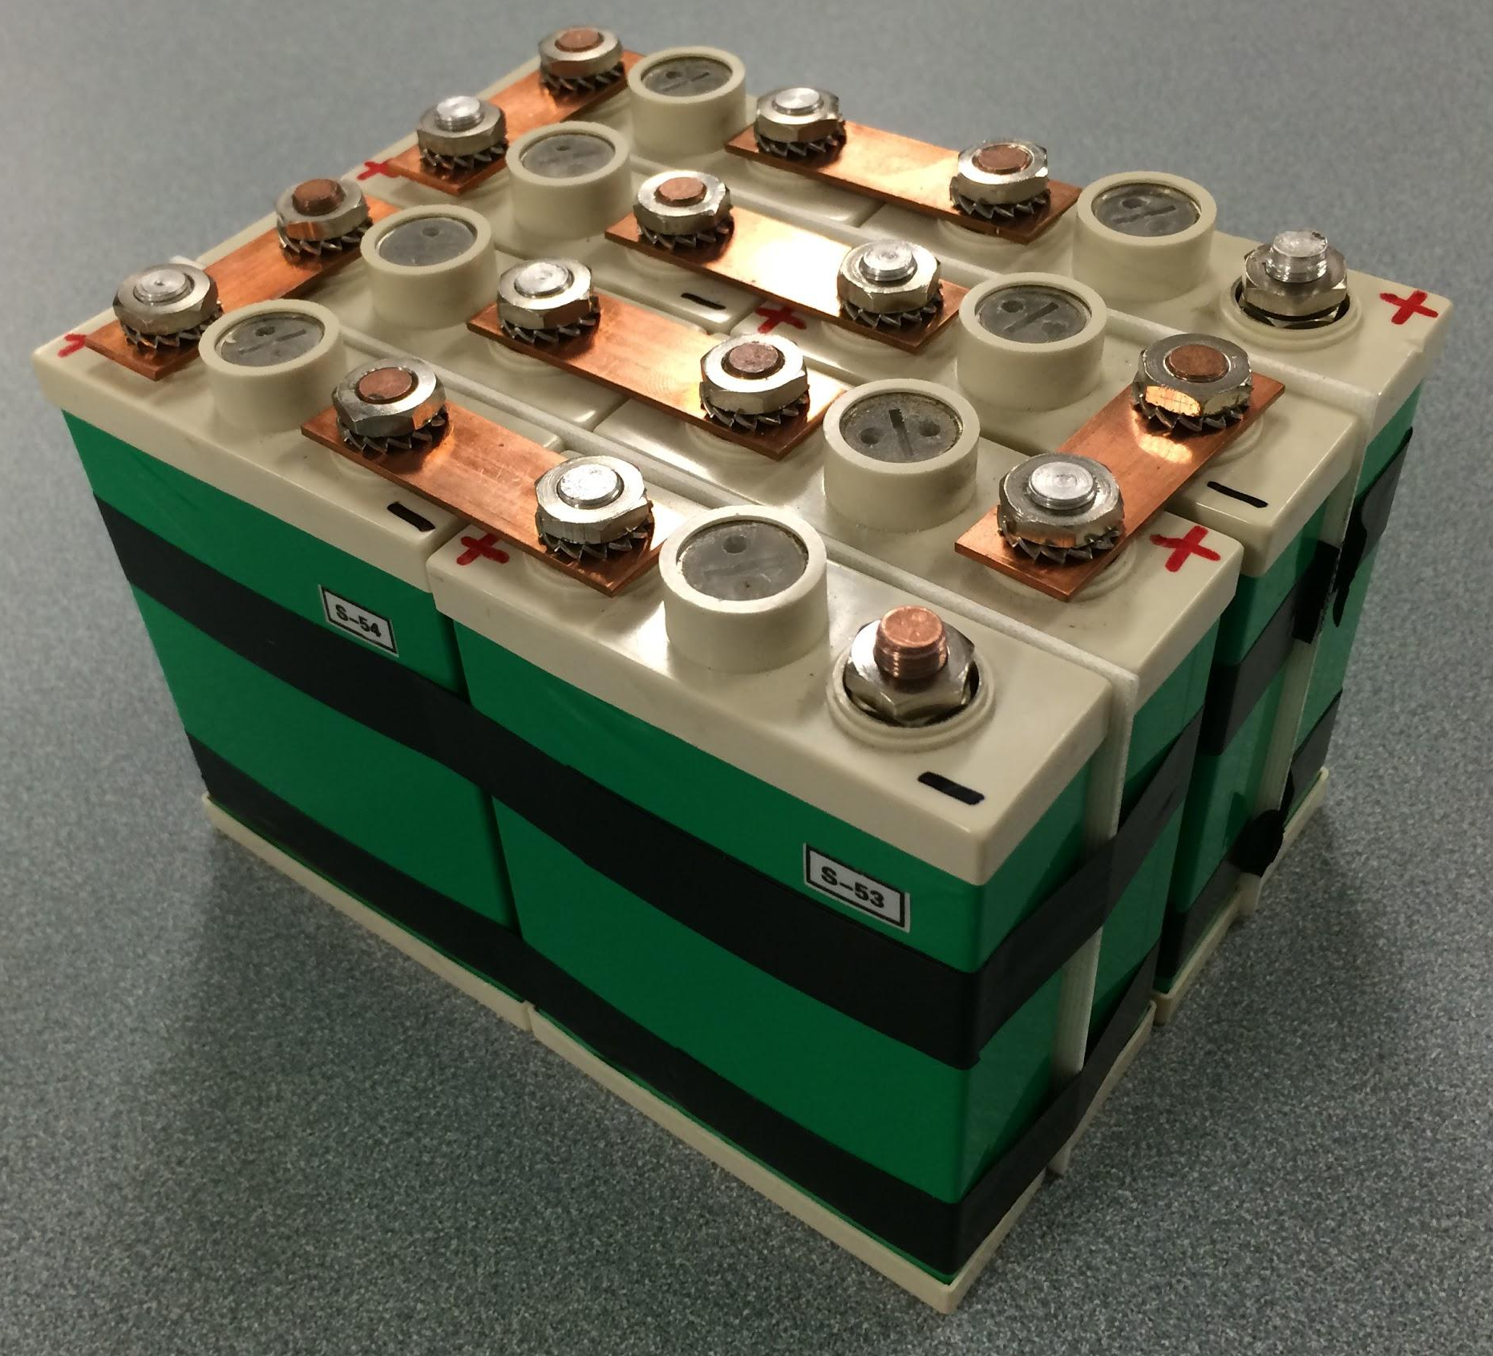
GLV Battery
Eight cells
24V
10Ah

Slide 61
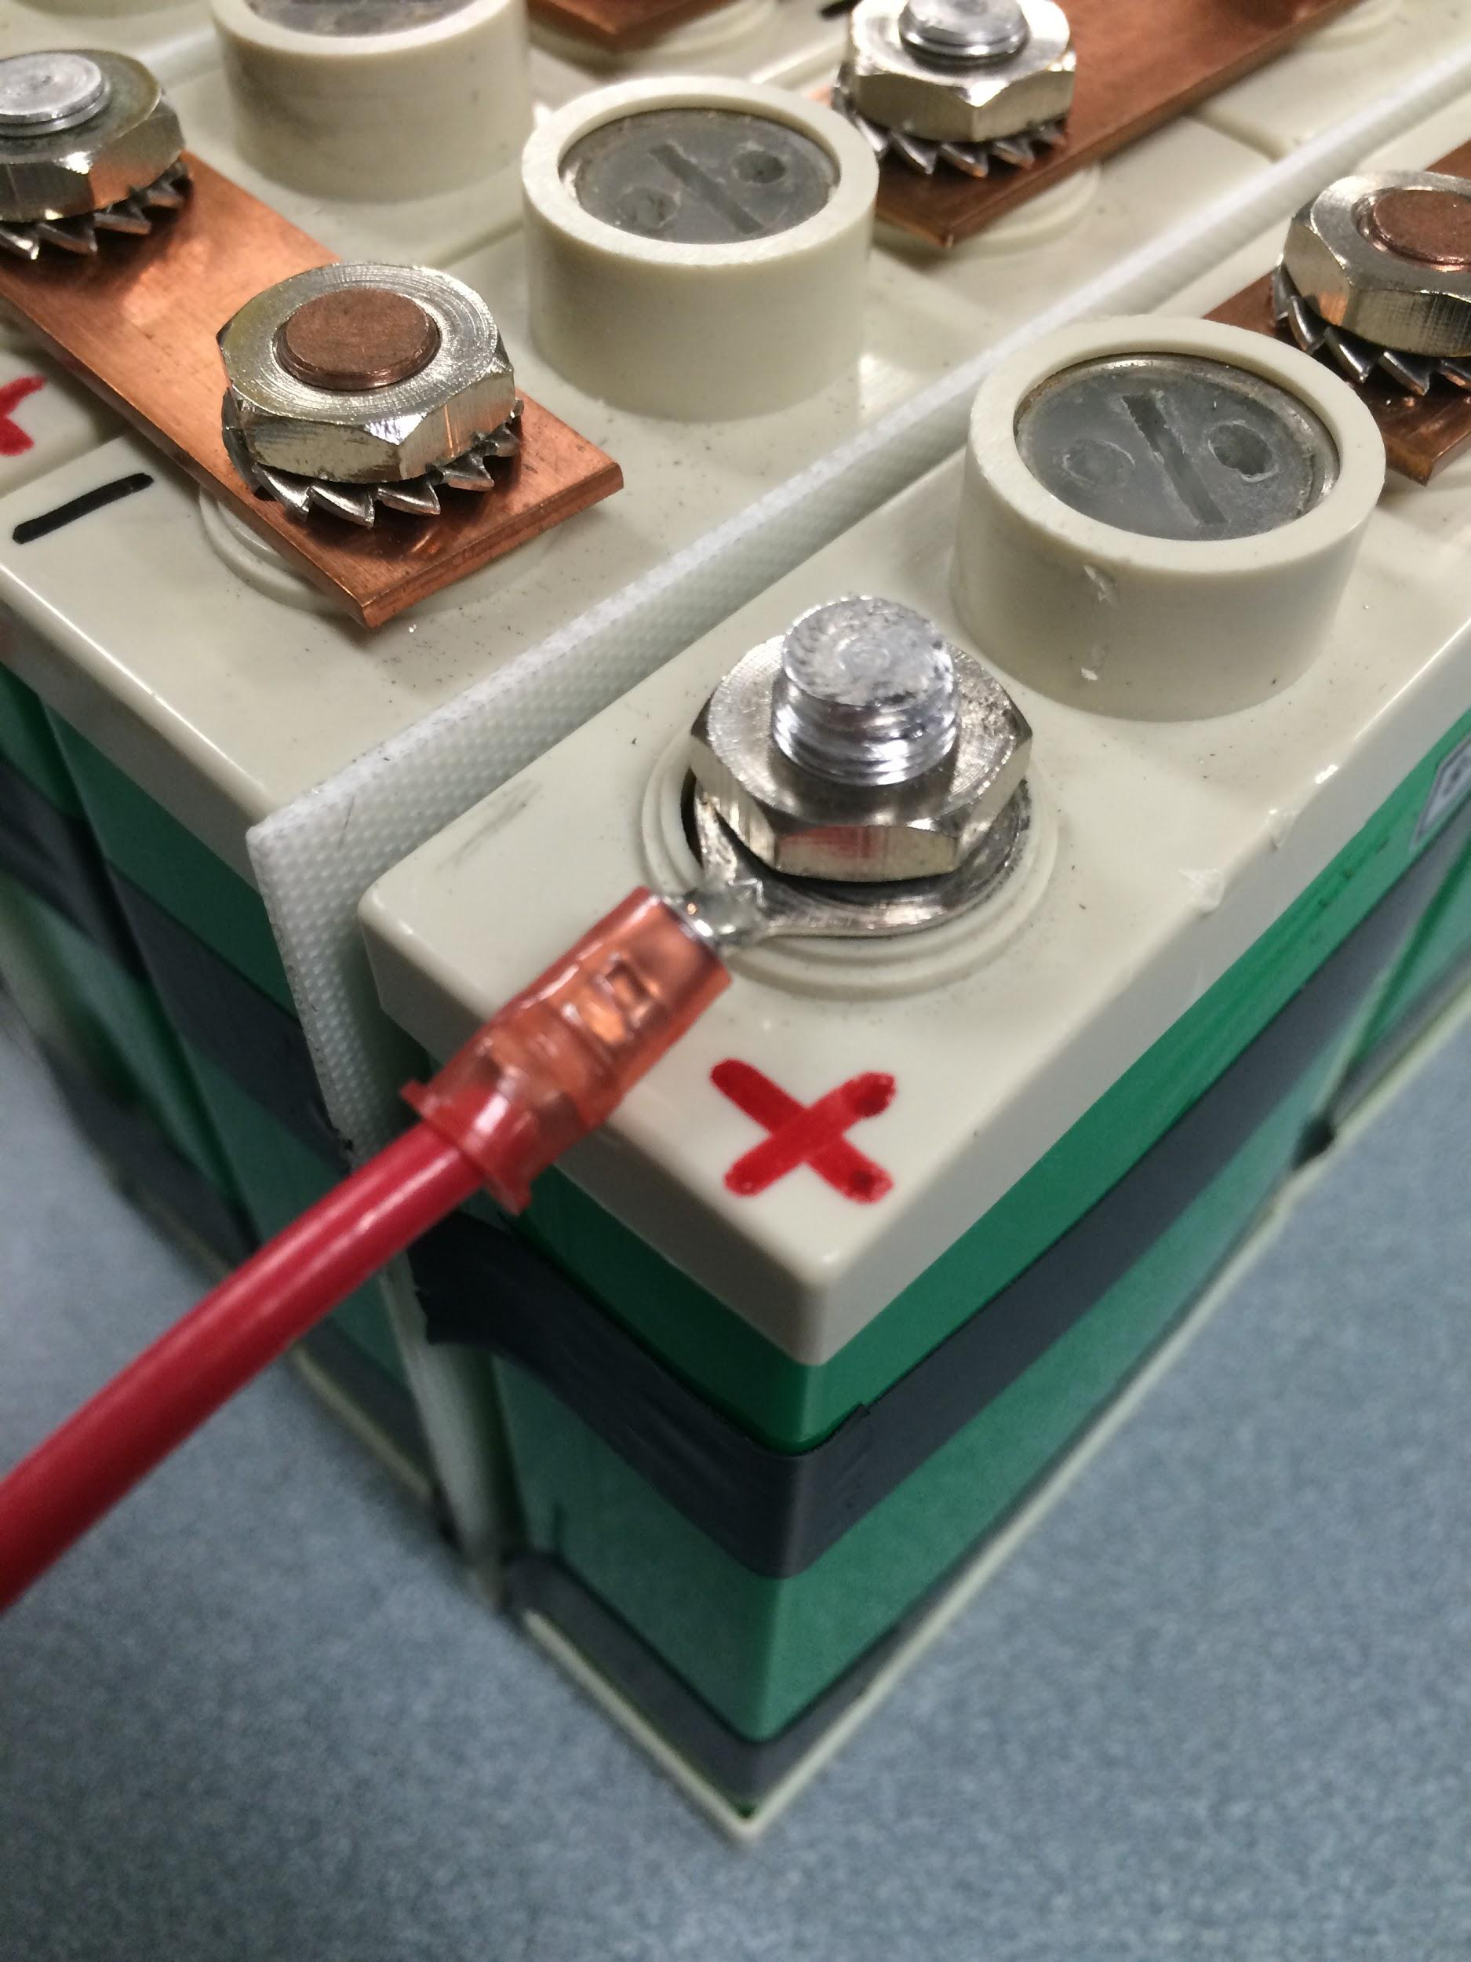
GLV Battery Connection
Crimped Terminal (Open Barrel)

Slide 62
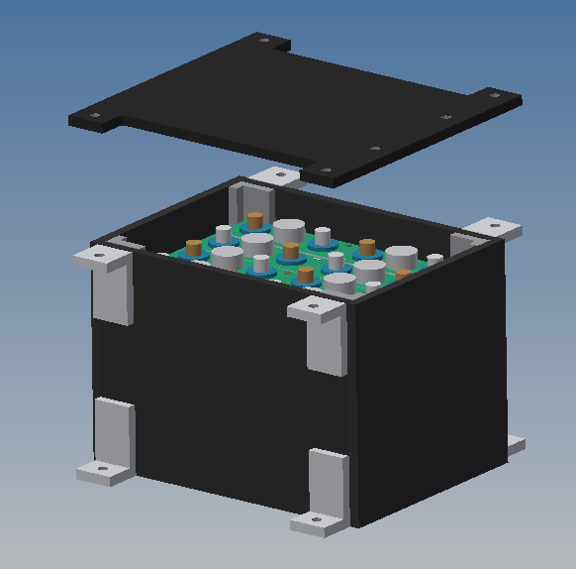
Battery Mounting
EV3.7.1- All GLV batteries must be attached securely to the frame.

Slide 63
GLV Battery Capacity Calculation
R006-1 The GLV system shall contain a rechargeable battery of sufficient capacity to run the car GLV systems for at least three hours.
Utilizes the measured power consumption of the VSCADA computer and a reasonable ceiling estimation for the screen.
GLV Relays (2.04W x 2) = 4.08W + 1W (for microcontrollers, relays)
AIRS (2.04W x 2) = 8.16W + ~100mW (CAN transceivers)
VSCADA 2.64W computer + 2W screen
Total 17.88W / 24V = 0.745A x 1.5 = 1.1175Ah 1hr
2.235Ah 2hr
3.3525Ah 3hr
4.47Ah 4hr
5.5875Ah 5hr

Slide 64
GLV Battery Capacity Calculation
R006-1 The GLV system shall contain a rechargeable battery of sufficient capacity to run the car GLV systems for at least three hours.
Utilizes the peak power consumption of the VSCADA computer and a higher ceiling estimation for the screen.
GLV Relays (2.04W x 2) = 4.08W + 1W (for microcontrollers, relays)
AIRS (2.04W x 2) = 8.16W + ~100mW (CAN transceivers)
VSCADA 5.28W computer + 4W screen
Total 25.52W / 24V = 1.06A x 1.5 = 1.595Ah 1hr
3.19Ah 2hr
4.785Ah 3hr
6.38Ah 4hr
9.57Ah 5hr

Slide 65
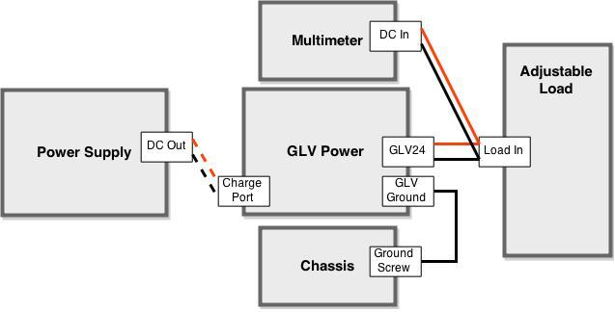
GLV Power and Battery Duration Test
R006-0 The GLV system shall provide DC supply voltage with sufficient current to supply all the power needs of the GLV systems and other non-tractive systems.
R006-1 The GLV system shall contain a rechargeable battery of sufficient capacity to run the car GLV systems for at least three hours.
Simplified Procedure:
Fully charge the battery.
Attach the Power Box to the adjustable load and set the current to simulate appropriate power consumption.
Record voltage at timing intervals.
Voltage must remain above designated value (21V) for three hours.

Slide 66
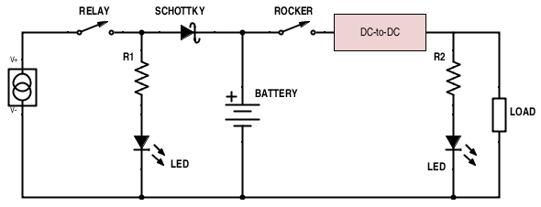
Charging Circuit

Slide 67
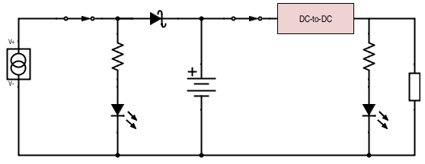
Charging Circuit - Charging
R006-2ii The charging system shall be capable of powering the GLV system indefinitely as it simultaneously charges the GLV battery in a plug and forget functionality.
+ < 0.46V -
(0.46V @ 15A)
24V <1.06A
~0.745A
+ 2V -
30V
27K
~5A
27K
32.5V
5.7A
“Charging” LED On
24V
28.5V max
“Battery Power” LED On

Slide 68
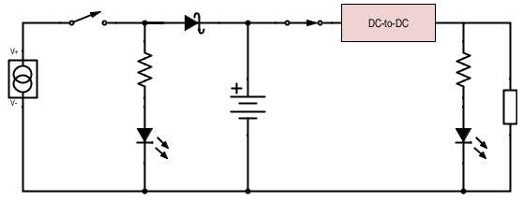
Charging Circuit - Discharging
24V <1.06A
~0.745A
~0.745A
27K
~24V
“Battery Power” LED On
“Charging” LED Off

Slide 69
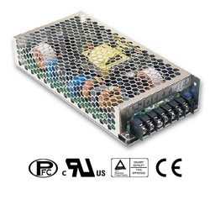
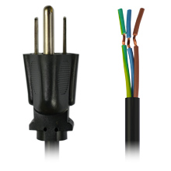
GLV Power - Charger
R006-2i The GLV system shall be rechargeable by means of a UL listed charging device that plugs into the 120 VAC mains.
www.trcelectronics.com
www.powergatellc.com

Slide 70
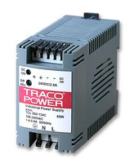
Battery Protection
R006-2iii It shall be possible to charge a fully discharged GLV battery without disassembly or special actions.
R006-2v The GLV battery shall be protected from full discharge, overcharge, overcurrent, and overvoltage.
Full Discharge:
The 24-24 DC-to-DC Converter has an under voltage shutdown of 15.7 VDC.
The solid-state relay controlling the charge circuit will be the normally closed type.
Overcharge:
Discussed on previous slides.
Overcurrent:
The 24-24 DC-to-DC Converter has a current limitation of 110% its typical, which is 2.5A for this device.
2.5A x 1.1 = 2.75A… Well above the expected range and below battery capabilities.
Overvoltage:
The 24-24 DC-to-DC Converter has an overvoltage protection trigger point of <42V.
uk.farnell.com

Slide 71
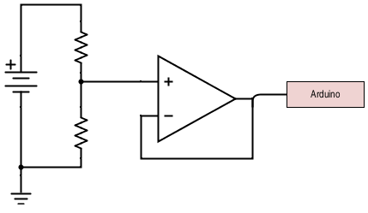
Voltage Sensing
R006- The GLV battery shall be protected from overcharge.
GLV voltage shall be measured by VSCADA.
< 28V
112K
< 5V
28K

Slide 72
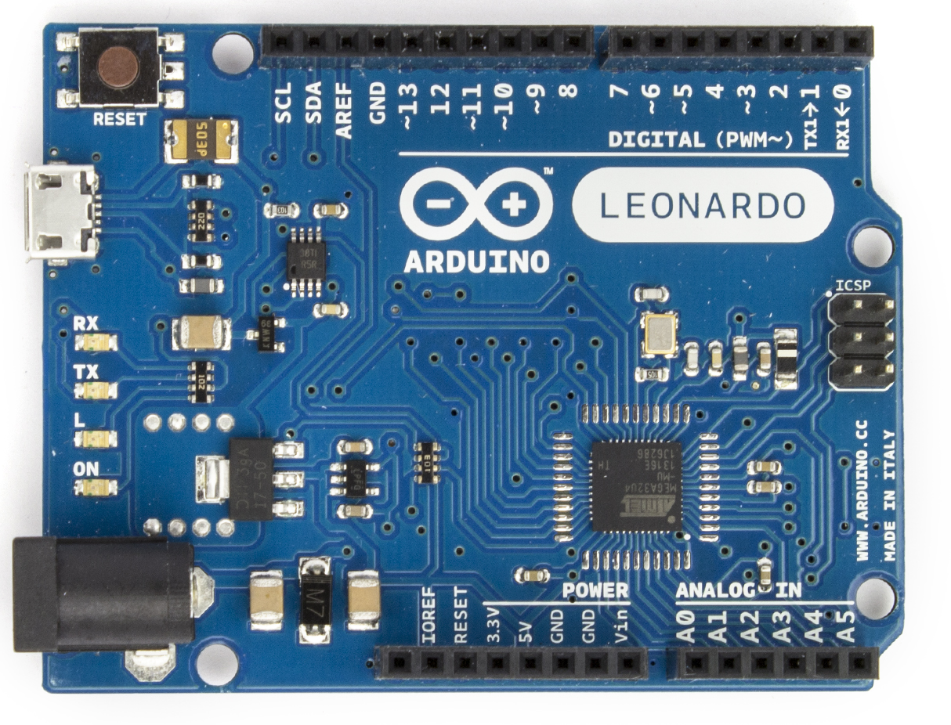
GLV Power Software
R006- GLV voltage, current, temperature, and SOC shall be measured by VSCADA.
GLV Power Arduino
Maintainability:
Code will be written in C which is not going extinct in the near future.
Files will be uploaded to the website containing the source code and Arduino ID.
www.arduino.cc

Slide 73
Roadmap
Meet the Morning Teams
Introduction: Motivation
Interface Control
System Assemblies Layout/Interfaces (Car)
System Assemblies Layout/Interfaces (Rack)
Interconnects
Panel Drawings and Hubs
Grounded Low Voltage (GLV)
Safety Loop
GLV Power
VCI
TSI
5. GLV BOM and Budget

Slide 74
Vehicle Computer Interface

Slide 75
VCI
Contains:
VSCADA Computer
Maintenance Panel Display
Safety Loop Control and Monitors
TSAL Circuit
RTD Sound Control

Slide 76
VCI
Contains:
VSCADA Computer
Maintenance Panel Display
Safety Loop Control and Monitors
TSAL Circuit
RTD Sound Control

Slide 77
VCI
TSAL
555 Timer in astable configuration
Active whenever the AIRs is open
Set for a frequency of 3.2 Hz
Physical TSAL Lamp not included
Tested using DDM
Expected output:
12V
50% duty cycle
0.3125 second period

Slide 78
VCI
Safety Loop Monitoring
Interfaced to the CAN Controller board
Safety Loop Monitor
AIRs State Monitor
Safety Loop Control
Controlled by VSCADA digital I/O
Gives Safety Loop control to system software

Slide 79
Roadmap
Meet the Morning Teams
Introduction: Motivation
Interface Control
System Assemblies Layout/Interfaces (Car)
System Assemblies Layout/Interfaces (Rack)
Interconnects
Panel Drawings and Hubs
Grounded Low Voltage (GLV)
Safety Loop
GLV Power
VCI
TSI
5. GLV BOM and Budget

Slide 80
Tractive System Interface (TSI)

Slide 81
TSI - Overview
High Voltage Relay Control
Precharge Protection
Tractive System Voltage Present Light (TSVP)
Insulation Monitoring Device (IMD)
GLV PD 24 to 12 stepdown
TSMP

Slide 82
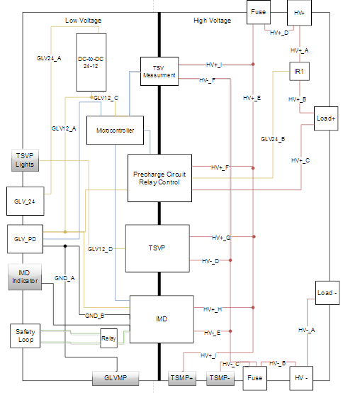
TSI

Slide 83
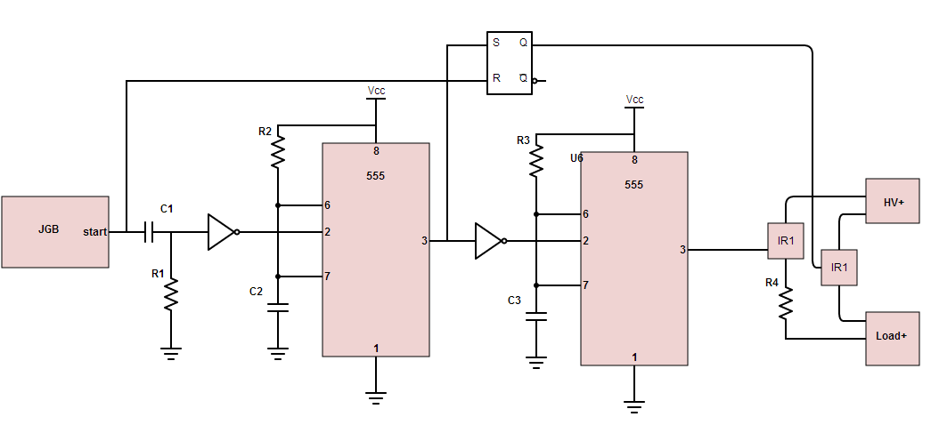
TSI - Pre-Charge/Relay Control
Precharge circuit prevents inrush current and damage to relay contacts
This configuration will take about 4 seconds for the motor controller to reach 96V

Slide 84
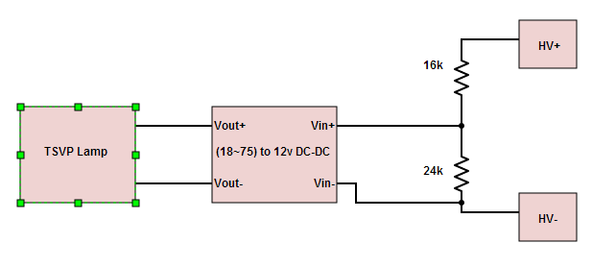
TSI - TSVP
Must be powered by TSV and grounded to GLV ground
Use a DC DC converter to satisfy this requirement and maintain isolation

Slide 85
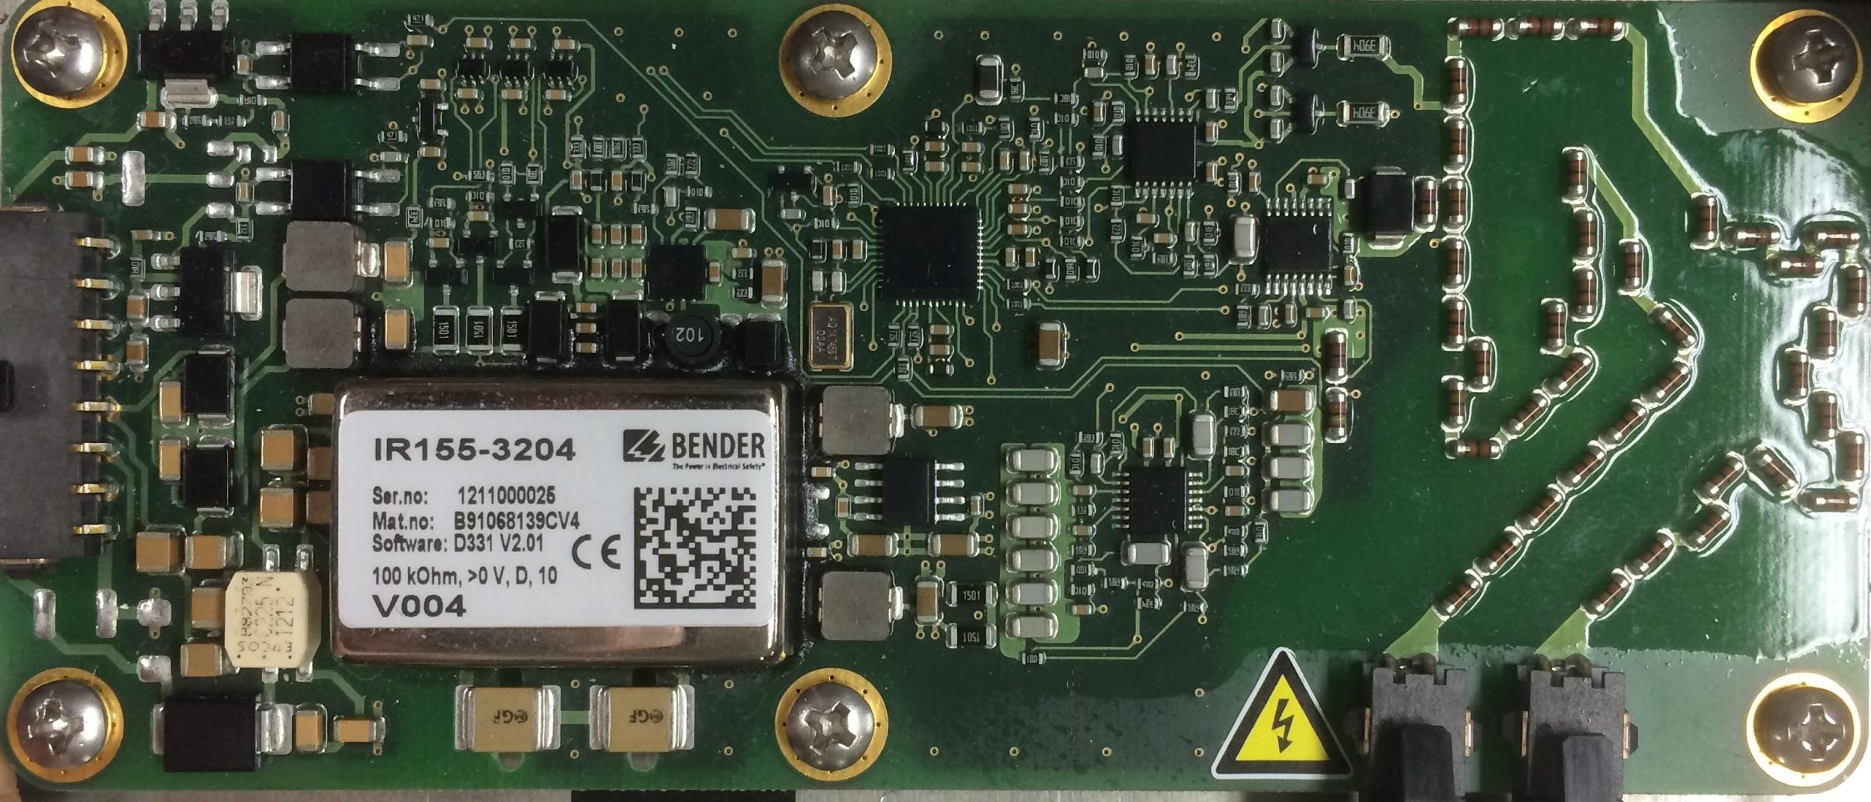
TSI - IMD
Pin 8 - Status Output High
Feeds directly to a relay on Safety Loop
Pin 8 output change opens Safety Loop (High → Low)

Slide 86
TSI - Other Components
GLV Power
24V to 12V DC-DC converter steps down the voltage from GLV24 to power the GLVPD at 12 Volts
TSMP
TSMP+ is a direct contact to the HV+ terminal
TSMP- is a direct contact to the HV- terminal
GLV GMP provides a reference to GLV ground

Slide 87
TSI - QA Configuration
Connect high voltage terminals to a high voltage power source
Connect the high voltage load terminals to the motor controller
Connect the GLV24 terminal to a low voltage power supply

Slide 88
TSI - QA Test Plan
TSVP Test
Apply 30 volts to high voltage power supply and check the TSVP output with a multimeter
Pre-charge/Relay Test
Put start signal high and measure time it takes relays to close
IMD Test
Using a multimeter, check for connection across the relay after shorting the ground

Slide 89
Roadmap
Meet the Morning Teams
Introduction: Motivation
Interface Control
System Assemblies Layout/Interfaces (Car)
System Assemblies Layout/Interfaces (Rack)
Interconnects
Panel Drawings and Hubs
Grounded Low Voltage (GLV)
Safety Loop
GLV Power
VCI
TSI
5. GLV BOM and Budget

Slide 90
GLV Bill of Materials
Description | Vendor Part Name | Quantity | Unit Price | Total Price
Te-Connectivity 2 pin/1 row parallel | 1-480699-0 | 4 | $0.28 | $1.12
Te-Connectivity 2 pin/1 row free | 1-480698-0 | 4 | $0.28 | $1.12
Te-Connectivity 3 pin/1 row parallel | 1-480701-0 | 6 | $0.28 | $1.68
Te-Connectivity 3 pin/1 row free | 1-480700-0 | 6 | $0.27 | $1.62
Te-Connectivity 8 pin/2 row parallel | 794954-8 | 4 | $0.25 | $1
Te-Connectivity 8 pin/2 row parallel | 794953-8 | 4 | $0.25 | $1
Te-Connectivity pin | 350561-3 | 10 | $0.14 | $1.38
Te-Connectivity socket | 350570-3 | 10 | $0.13 | $1.32
24V DIN Rail DC/DC Converter | TCL 060-124 DC | 1 | $80.62 | $80.62
DIN Rail DC/DC Converter | STMGFS152405-N2 | 1 | $69.05 | $69.05
36vdc PFC Power Supply | HRP-200-36 | 1 | $64.80 | $64.80
DIN Rail | 277-2064-ND | 1 | $9.82 | $9.82
DIN Rail Terminal Blocks | APC1281-ND | 50 | $1.33 | $66.63
SWITCH PUSH SPST-NO | CWI282-ND | 1 | $4.12 | $4.12
SWITCH KEYLOCK SP3T | KO129B606-ND | 1 | $9.80 | $9.80
DIODE SCHOTTKY 45V 7A | SB15H45-E3/73GITB-ND | 5 | $0.81 | $4.05
LED RED 1/4" HOLE 5V | L10021-ND | 5 | $2.17 | $10.85
Relay 5A 5V | Z2774-ND | 10 | $1.18 | $11.78
 |  |  | Grand Total | $341.76

Slide 91
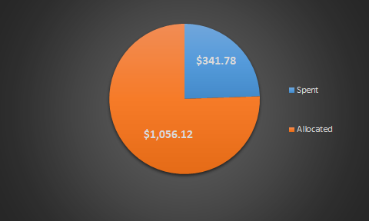
GLV Budget
Total Allocated Funds - $1397.90

Slide 92
Roadmap Cont.
Tractive System Voltage (TSV)
Overview
Safety
Mechanical
PacMan System
Charging
AMS
BoB
Acceptance Testing
Maintenance
6. Out of Scope: LFEV-2016
7. Conclusion

Slide 93
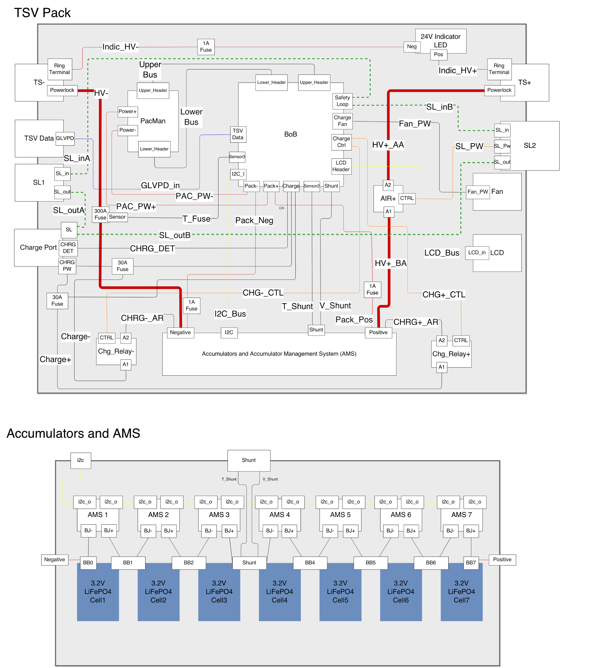
Tractive System Voltage

Slide 94
Main subsystems
Accumulator Managment System (AMS)
Breakout Board (BoB)
Pack Manager (PacMan)
7 3.2V 60A-hr LiFePO4 Cells

Slide 95
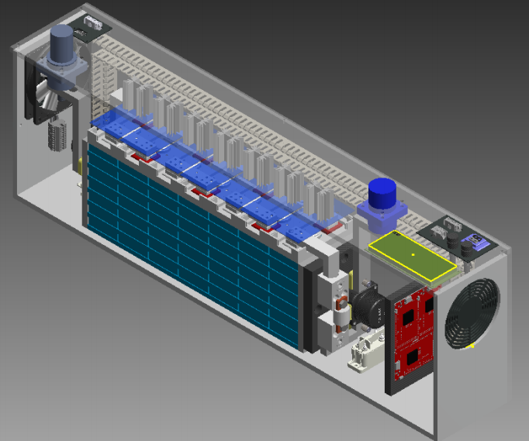

Slide 96
Roadmap Cont.
Tractive System Voltage (TSV)
Overview
Safety
Mechanical
PacMan System
Charging
AMS
BoB
Acceptance Testing
Maintenance
6. Out of Scope: LFEV-2016
7. Conclusion

Slide 97
TSV - Safety
Fusing
2 fuses for BoB
1 fuse for voltage present LED
1 large fuse for pack main current path
2 fuses for charge relay
Voltage present LED
turns on when voltage > 20V DC present at poles
can sustain voltage up to 96V
works even when a cell fails with all other packs connected
Safety protocols

Slide 98
Pack Safety Loop
One port at each end of the pack
Each contains safety loop and SL 24V/GND
SL 24V/GND used to power AIR
Safety path:

Slide 99
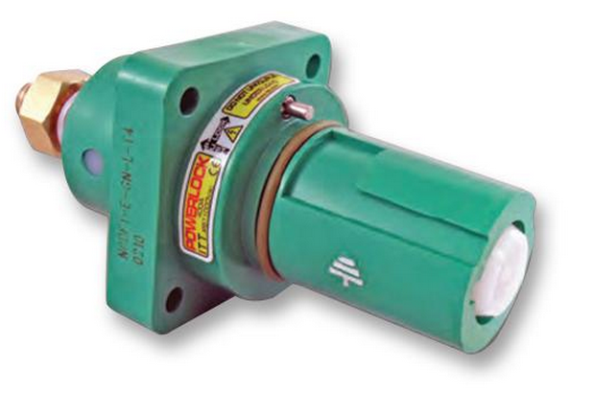
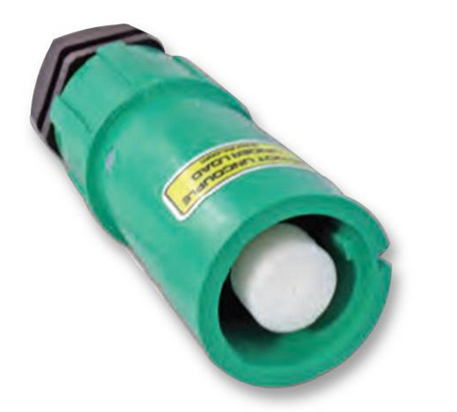
High Voltage Interfaces
4 “Danglies” one per pack
400A rated Newark 44W4352
Source Hangs off of pack with cable to + terminal
4 Panel mount female connectors
400A rated Newark 44W4361
Connected to - terminal bus bar
http://www.newark.com/itt-cannon/nls-3-gy-s120-m40a/line-source-line-3-grey-400a/dp/44W4352
http://www.newark.com/itt-cannon/npdft-3-gy-l-t4/panel-drain-line-3-grey-400a/dp/44W4361

Slide 100
Roadmap Cont.
Tractive System Voltage (TSV)
Overview
Safety
Mechanical
PacMan System
Charging
AMS
BoB
Acceptance Testing
Maintenance
6. Out of Scope: LFEV-2016
7. Conclusion

Slide 101
Mechanical Objectives
acceleration requirements
splash proof
internal wall
vibration
galvanic isolation

Slide 102
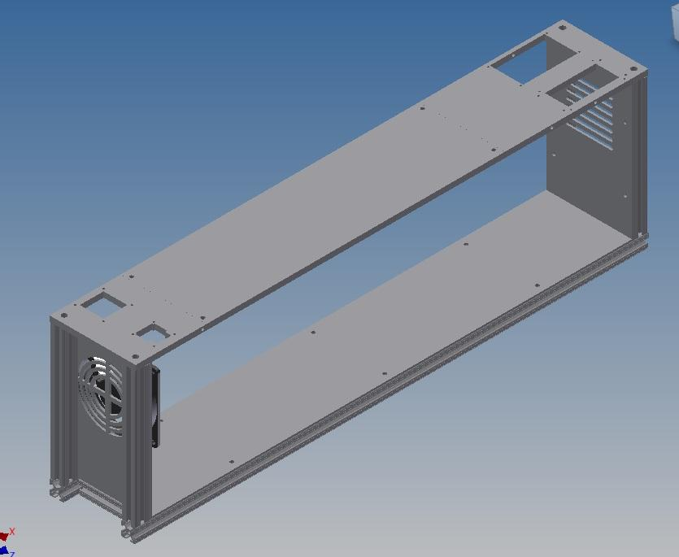
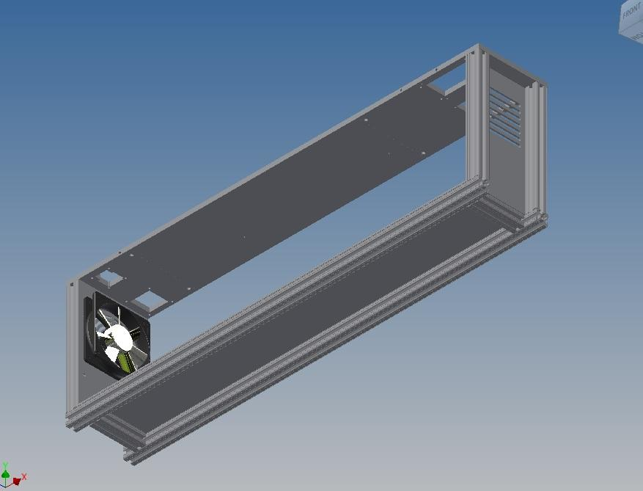
Mechanical- Frame/External Casing
Rigid 8020 Aluminum External Frame

Slide 103
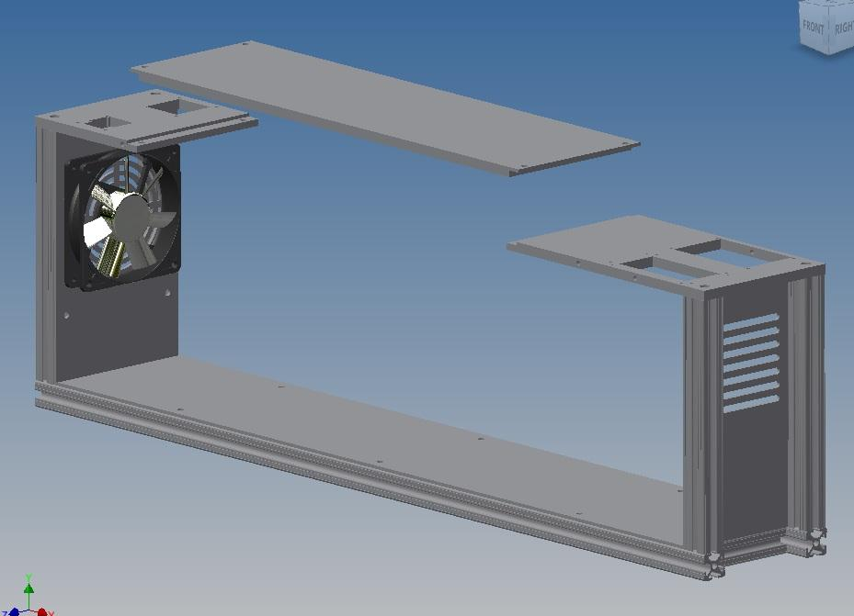
Mechanical- Frame/External Casing
-Removable Top For Quick Battery/BMS Access

Slide 104
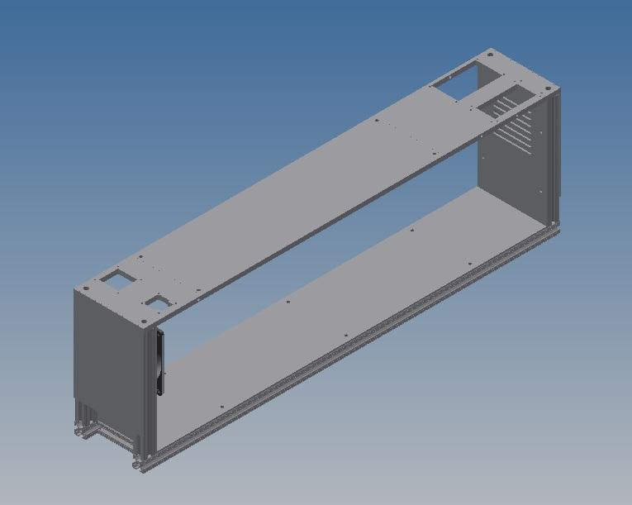
Mechanical- Frame/External Casing
-Splash Resistant Ventilation

Slide 105
Cell Restraint

Slide 106
Top Bars

Slide 107
Side Bars

Slide 108
End Plates

Slide 109
Integration with Container

Slide 110
BMS Restraint

Slide 111
BMS Removal

Slide 112
Added Components

Slide 113
Free Terminal

Slide 114
Mechanical - Conductor Bars
Carries large current
Low resistance

Slide 115
Mechanical - Current Measuring Shunt
Special conductor used to measure current
118μΩ at STP

Slide 116
Roadmap Cont.
Tractive System Voltage (TSV)
Overview
Safety
Mechanical
PacMan System
Charging
AMS
BoB
Acceptance Testing
Maintenance
6. Out of Scope: LFEV-2016
7. Conclusion

Slide 117
PacMan System
Receives and processes data from AMS
Receives and processes pack sensor data
Opens BoB safety loop
CAN communication with VSCADA and LCD
Implement charge and forget charging

Slide 118
PacMan Computer
https://www.embeddedarm.com/products/board-pictures.php?product=TS-7400-V2
Technologic Systems TS-7400-V2

Slide 119
PacMan Computer Hardware Specs
1.2W Typical power usage
6.67 Weeks for each pack
10mW sleep mode
15.35 years for each pack
I2C bus for AMS and LCD communication
CAN bus for VSCADA interface
4 ADC inputs for pack sensors
39 DIO ports for logic functions

Slide 120
PacMan Computer - Connections
5-28V DC Power
https://www.embeddedarm.com/products/board-pictures.php?product=TS-7400-V2

Slide 121
PacMan Computer - Connections
I2C Data
GND
I2C CLK
CPU 3.3V
Reg 5V
Reboot
GND
GND
Upper Header Pins
https://www.embeddedarm.com/products/board-pictures.php?product=TS-7400-V2

Slide 122
PacMan Computer - Connections
DIO_00
CPU 3.3V
DIO_01
DIO_02
DIO_03
DIO_04
DIO_05
DIO_02
DIO_07
DIO_04
DIO_09
GND
CAN_Rx0
CAN_Rx1
CAN_Tx0
CAN_Tx1
Reg 5V
ADC0
ADC1
ADC2
ADC3
Lower Header Pins
GND
https://www.embeddedarm.com/products/board-pictures.php?product=TS-7400-V2

Slide 123
PacMan Software
Debian 'Wheezy' Linux (Kernel 2.6.36)
Updates from 2014 team’s code
Correct State of Charge algorithm
Reboot should not invalidate state of charge
Temperature adjustment for current-measuring shunt
CAN communication with VSCADA

Slide 124
PacMan Safety Loop Control
Safety loop opened in 3 different ways
Charger plugged
Watchdog timeout
CPU DIO02 pin for software control
Watchdog fed by CPU DIO03 pin

Slide 125
VSCADA CAN Interface
No longer RS-485, new isolated chip
All 4 packs on the same main CAN line
When address prompted, will return all relevant data to VSCADA
CAN H
GLV 12V
CAN L
GLV GND
CAN
http://www.mouser.com/ProductDetail/TE-Connectivity-AMP/1-480705-0/?qs=OSEowtgdlxJxrUuPTLeZpA%3D%3D

Slide 126
Roadmap Cont.
Tractive System Voltage (TSV)
Overview
Safety
Mechanical
PacMan System
Charging
AMS
BoB
Acceptance Testing
Maintenance
6. Out of Scope: LFEV-2016
7. Conclusion

Slide 127
Charger-GENESYS 750W Half-Rack
http://www.testoon.com/images_produit/009789-full.jpg
http://sites.lafayette.edu/ece492-sp14/files/2014/02/LFEV-ESCM-2014-UsersManual.pdf

Slide 128
Charging
Anderson PowerPole connector used
Charge Detect
Charge Detect goes to BoB ends at PacMan
Charge +/-
Charge +/- go to charge relays
Safety Loop
Open when charging plug is plugged in
Closed when dummy plug is in charge port

Slide 129
Pack State Diagram

Slide 130
Charge Detect
Charger creates electrical connection between CHRG_DET1 and CHRG_DET2
Pulls CPU DIO06 pin high through optoisolator

Slide 131
Cooling
When bypassing cells, they get HOT
When charger is plugged, fan switches on
Fan powered by charger to not deplete batteries
Reducing heat sink to half height
Thermal resistance now 3.7 ℃/W @ 200 LFM
With 10.2W power, 37.74 ℃ rise
http://www.mouser.com/ProductDetail/ebm-papst/4414F/?qs=sGAEpiMZZMt8mcbdCMUjUxEnE1a%2fhD2SdPrUzYqJg8M%3d
http://www.digikey.com/product-detail/en/657-20ABP/345-1035-ND/340333?WT.z_cid=ref_octopart_dkc_buynow&site=us

Slide 132
Charge Relays
We will be using a normally closed charge relay
This fixes previous error where pack was unchargeable when depleted
Charging is finished when all AMS bypass
CPU DIO00 pin signals CHRG_TRIG to optoisolator for charge relays to open when charging is finished
Using relay - OMRON MGN1C-DC24
SPDT - can wire to be NO or NC
24V DC 30A

Slide 133
Roadmap Cont.
Tractive System Voltage (TSV)
Overview
Safety
Mechanical
PacMan System
Charging
AMS
BoB
Acceptance Testing
Maintenance
6. Out of Scope: LFEV-2016
7. Conclusion

Slide 134
Accumulators and AMS

Slide 135
Accumulator Management System Board
Boards monitor attributes of each assigned cell
Voltage levels
Current levels
Ability to bypass cell during charging
Reports back to PacMan through I²C
Board Reset
Software
Remote/Manual
Notes:
→ Each board is assigned an unique address upon configuration.

Slide 136
AMS Command List

Slide 137
AMS Software Bug
Bugs documented by LFEV-2013
No constraint to force PacMan to wait until the AMS board has processed a request
Results: incorrect data readings on the first response
2. Concurrency issues in memory: read/write collisions
Results: possible retrieval of unwanted data
LFEV-2015 Goals
Manipulate clocks so that no additional requests could be sent by PacMan until original request is processed.
Implement constraints so that data cannot be read and written at the same time
Notes:
→ Bug patched by LFEV-2014: they discard the first read and any reads that are all zeros
slave can hold the clock line

Slide 138
AMS Software Reset
Initialization: PacMan will attempt to communicate with each board
Failed attempt → reset of that board
Error & Reset will display on Pack LCD

Slide 139
AMS Remote Reset
LFEV 2014’s Design → LFEV 2015 utilizing it
Asserted by manual reset button through PacMan BoB
Notes:
Last Year’s Design: Asserting 3.3 V on RST_POS of J3/J2 of the AMS board will reset it.
This Year: including manual reset button to assert this through

Slide 140
Roadmap Cont.
Tractive System Voltage (TSV)
Overview
Safety
Mechanical
PacMan System
Charging
AMS
BoB
Acceptance Testing
Maintenance
6. Out of Scope: LFEV-2016
7. Conclusion

Slide 141
PacMan Breakout Board
Acts as connector between TS-7400-V2 and the AMS boards and proper sensor relays
Contains circuitry used for current, temperature, and pack voltage measurements
Includes isolation chips to provide galvanic isolation between low and high voltage circuits

Slide 142
PacMan BoB Manual Reset
MB2000 series switch pushbutton (NKK Switches)
RESET_POS
RESET_NEG
J22
6N135 high-speed optocoupler (Vishay Semiconductors)
U16
Notes:
PUSHBUTTON
meets requirements: splashproof & waterproof
UL standards

Slide 143
PacMan BoB Layout Errata

Slide 144
Roadmap Cont.
Tractive System Voltage (TSV)
Overview
Safety
Mechanical
PacMan System
Charging
AMS
BoB
Acceptance Testing
Maintenance
6. Out of Scope: LFEV-2016
7. Conclusion

Slide 145
Acceptance Testing
Overview
Designed around requirements
Minimizing time and charge cycles needed
Repeatable for individual packs
Focus
Safety
Plug-and-forget charging
Accuracy of measurands
New SoC algorithm

Slide 146
Acceptance Testing Cont.
Test configuration A

Slide 147
Acceptance Testing Cont.
Test configuration B

Slide 148
Acceptance Testing Cont.
T000: Pack Display and Safety Qualification
Prerequisite for all other tests
Configuration A
No active load
Measurement accuracy verification
Safety checks (isolation, sensor readings)
Controls/reset tests

Slide 149
Acceptance Testing Cont.
T001: Low Current Discharge Test
Discharge cycle
Configuration A
Safety features tested (safety loop, low-voltage protection, temp/voltage sensors)
Un-balances cells for subsequent tests
Measurement accuracy verification
SoC tested

Slide 150
Acceptance Testing Cont.
T002: Charge Cycle Test
Complete charge cycle
Configuration B
Charges at two different rates to test SoC
Safety loop tested
Measurement accuracy verification
Cell-balancing tested
Plug-and-forget feature tested

Slide 151
Acceptance Testing Cont.
T003: High/low Current Discharge Test
Discharge cycle
Configuration A
Discharge at 3 different rates (high/low/paused)
Max current performance tested
Measurement accuracy verification
Safety features tested
SoC tested
Simulates real-life use case

Slide 152
Roadmap Cont.
Tractive System Voltage (TSV)
Overview
Safety
Mechanical
PacMan System
Charging
AMS
BoB
Acceptance Testing
Maintenance
6. Out of Scope: LFEV-2016
7. Conclusion

Slide 153
Maintainability
Hardware
MTTR = 1 day for most parts when spare parts on hand
MTTR < 8 days for most parts when no spare parts available
Full analysis in maintainability plan

Slide 154
Maintainability Cont.
Software
PacMan software and AMS firmware
Source control
Backup/restore
Instructions for programming
Compatibility with VSCADA

Slide 155
TSV BOM & Budget

Slide 156
AMS

Slide 157
PacMan & BOB

Slide 158
Pack Electrical Parts (page 1)

Slide 159
Pack Electrical Parts (page 2)

Slide 160
Budget
Initially allocated money:
Dyno - $148
SCADA - $715
GLV - $1397.90
TSV - $2739.10

Slide 161
Budget
Money Spent so far
Dyno - $362
TSV - $1026.03
SCADA - $304.26
GLV - $10.24

Slide 162
Budget
Current status of money:

Slide 163
Roadmap Cont.
Tractive System Voltage (TSV)
Overview
Safety
Mechanical
PacMan System
Charging
AMS
BoB
Acceptance Testing
Maintenance
6. Out of Scope: LFEV-2016
7. Conclusion

Slide 164
Out of Scope: LFEV-2016
GLV
Implement AIR failure sensors

Slide 165
Out of Scope: LFEV-2016 Cont.
TSV
Implement AIR failure sensors
Low voltage indicator light
Building 4 complete packs

Slide 166
Roadmap
Tractive System Voltage (TSV)
Overview
Safety
Mechanical
PacMan System
Charging
AMS
BoB
Acceptance Testing
Maintenance
6. Out of Scope: LFEV-2016
7. Conclusion

Slide 167
Lafayette Electric Vehicle 2015
ECE 492: Senior Design II
Afternoon Critical Design Review
March 11, 2015
Hugel 100

Slide 168
Roadmap
Meet the Afternoon Teams
Interface Control Review
Vehicle Supervisory Control and Data Acquisition (VSCADA)
Daemon
Interfacing
User Applications
Data Storage
Dynamometer (DYNO)
Decomposition and Definition
Integration and Recomposition

Slide 169
Roadmap
Meet the Afternoon Teams
Interface Control Review
Vehicle Supervisory Control and Data Acquisition (VSCADA)
Daemon
Interfacing
User Applications
Data Storage
Dynamometer (DYNO)
Decomposition and Definition
Integration and Recomposition

Slide 170
Meet the Afternoon Teams
Vehicle Supervisory Control and Data Acquisition (VSCADA)
Yiming Chen
Bikram Shrestha
Rameel Sethi
John Gehrig
Sam Cesario
Adam Cornwell
Dynamometer (DYNO)
Steve Mazich
Brendan Malone
John Bloore
Nate Hand
Alex Hytha

Slide 171
Roadmap
Meet the Afternoon Teams
Interface Control Review
Vehicle Supervisory Control and Data Acquisition (VSCADA)
Daemon
Interfacing
User Applications
Data Storage
Dynamometer (DYNO)
Decomposition and Definition
Integration and Recomposition

Slide 172
Interface Control
An Interface Control Document was created to accurately and completely define all (electrical, mechanical, semantic) aspects of top-level interfaces to allow different designers to coordinate with each other successfully.
Next, we will discuss these top-level interfaces.

Slide 173
System Assemblies Layout - Top View

Slide 174
Physical Interfaces Layout - Side View

Slide 175
Physical Interfaces Layout - Top View

Slide 176
System Assemblies Layout

Slide 177
Notes:
Close to physical layout on car -Sam

Slide 178
Notes:
Look in Lab -Sam

Slide 179
Notes:
GLV Connections, Hubs are JGB’s?? -Sam

Slide 180
Notes:
High Voltage for DYNO -DYNO

Slide 181
Notes:
More DYNO connections -DYNO

Slide 182
Notes:
Full System ICD -Sam

Slide 183
Roadmap
Meet the Afternoon Teams
Interface Control Review
Vehicle Supervisory Control and Data Acquisition (VSCADA)
Daemon
Interfacing
User Applications
Data Storage
Dynamometer (DYNO)
Decomposition and Definition
Integration and Recomposition

Slide 184
VCI

Slide 185
Embedded Computer: VAB-820

Slide 186
VSCADA
Notes:
Block Diagram inside the Cockpit - Yiming

Slide 187
Roadmap
Meet the Afternoon Teams
Interface Control Review
Vehicle Supervisory Control and Data Acquisition (VSCADA)
Daemon
Interfacing
User Applications
Data Storage
Dynamometer (DYNO)
Decomposition and Definition
Integration and Recomposition

Slide 188
Logging/Daemons - Main Program
VSCADA uses systemd to initially launch the main program
systemd has most major linux distributions support
The main program will run in the background as the server with PID registered
The main program will start by doing system startup procedures

Slide 189
Logging/Daemons - Startup
VSCADA uses systemd to initially launch the main program
systemd has most major linux distributions support
The main program will run in the background as the server with PID registered
The main program will start by doing system startup procedures

Slide 190
System Startup

Slide 191
System States and Exceptions
Startup Stage
When system boots up and will goto one of the following stages
Good to Go Stage
No error or warning and is ready to be driven
Driving Stage
The car is drving
Vehicle Boot Up Error Stage
VSCADA is functional but other subsystems are not
VSCADA Boot Up Error Stage
VSCADA is not functional
Failed Stage
VSCADA failed to boot up
You are not allowed to drive if in these error stages

Slide 192
System States and Exceptions
Sensor Errors:
Logic:
Errors are configurable and specific
If happens before driving, then the car is disabled from driving;
else take actions according to sensor configuration
Possible Errors:
OverHeating
UnderCharged
System Errors:
Snytax error
Failed Stage
VehicleStartupConfigLoadException
Other Boot Up Error Stage
DatabaseLoadException
VSCADA Boot Up Error Stage
RRDFileNotFoundException
VSCADA Boot Up Error Stage
VehicleStartupTimeoutException
Other Boot Up Error Stage
SensorCheckingTimeoutException
Other Boot Up Error Stage
SystemFailureError
Failed Stage
OtherCommunicationException
Vehicle Boot Up Error Stage
OtherSystemException
VSCADA Boot Up Error Stage

Slide 193
Logging/Daemons - Logging
Have 5 levels, in their respective order:
Debug: detailed information, mainly used for debugging
Info: general information, should contain important data
Warning: Need user’s attention
Error: Need user to check the source of the error
Critical: Opps.
Logs are stored in syslog of Linux
syslog handles storage, update, filter, etc.
Python and other library support for syslog
Can be viewed by clients over the TCP protocol
Levels can be set by configuration. Info level by default

Slide 194
Roadmap
Meet the Afternoon Teams
Interface Control Review
Vehicle Supervisory Control and Data Acquisition (VSCADA)
Daemon
Interfacing
User Applications
Data Storage
Dynamometer (DYNO)
Decomposition and Definition
Integration and Recomposition

Slide 195
Interfaces
TSV Communication
Send/Receive Packets of data from the four PACMAN via CAN
will follow API
GLV Communication
JGB act as a hub for groups of sensors via CAN
DYNO Communication
Control Throttle via JGB board
Motor Controller CAN
Dynamometer - USB interface to read RPM and torque, set valve

Slide 196
CAN Interface
SocketCAN -Linux Drivers
Python-CAN

Slide 197
TSV Pack LevelCAN Frame
BYTE 0
BYTE 1
BYTE 2
BYTE 3
BYTE 4
BYTE 5
BYTE 6
BYTE 7
Byte 0 - 1,Pack#(1-4)
Byte 1 - Voltage (High)
Byte 2 - Voltage (Low)
Byte 3 - Current (High)
Byte 4 - Current (Low)
Byte 5 - SOC (High)
Byte 6 - SOC (Low)
Byte 7 - Fuse Temp

Slide 198
TSV(1) AMS Level CAN Frame
BYTE 0
BYTE 1
BYTE 2
BYTE 3
BYTE 4
BYTE 5
BYTE 6
BYTE 7
Byte 0 - x1,Pack#(1-4)
Byte 1 - AMS#(1-7)
Byte 2 - Voltage (High)
Byte 3 - Voltage (Low)
Byte 4 - Current (High)
Byte 5 - Current (Low)
Byte 6 - Temperature (High)
Byte 7 - Temperature (Low)

Slide 199
GLV(2) Cockpit CAN Frame
BYTE 0
BYTE 1
BYTE 2
BYTE 3
BYTE 4
BYTE 5
BYTE 6
BYTE 7
Byte 0 - x21 (Cockpit)
Byte 1 - Ambient_temp (High)
Byte 2 - Ambient_temp (Low)
Byte 3 - Failure_LED (High)
Byte 4 - Failure_LED (High)
Byte 5 - Warning_LED(High)
Byte 6 - Ok_LED (High)
Byte 7 - Ok_LED (Low)

Slide 200
GLV(2) TSI CAN Frame
BYTE 0
BYTE 1
BYTE 2
BYTE 3
BYTE 4
BYTE 5
BYTE 6
BYTE 7
Byte 0 - x22 (TSI)
Byte 1 - Temperature (High)
Byte 2 - Temperature (Low)
Byte 3 - x00
Byte 4 - x00
Byte 5 - x00
Byte 6 - x00
Byte 7 - x00

Slide 201
GLV(3) GLV_Power CAN Frame
BYTE 0
BYTE 1
BYTE 2
BYTE 3
BYTE 4
BYTE 5
BYTE 6
BYTE 7
Byte 0 - x13
Byte 1 - Voltage (High)
Byte 2 - Voltage (Low)
Byte 3 - Current (High)
Byte 4 - Current (Low)
Byte 5 - Temperature (High)
Byte 6 - Temperature (Low)
Byte 7 - SOC

Slide 202
Motor Controller CAN Frames (1 / 2)
BYTE 0
BYTE 1
BYTE 2
BYTE 3
BYTE 4
BYTE 5
BYTE 6
BYTE 7
Byte 0 - RPM (High)
Byte 1 - RPM (Low)
Byte 2 - Motor Temp
Byte 3 - Controller Temp
Byte 4 - RMS Current (High)
Byte 5 - RMS Current (Low)
Byte 6 - Capacitor V (High)
Byte 7 - Capacitor V (Low)

Slide 203
Motor Controller CAN Frames (2 / 2)
BYTE 0
BYTE 1
BYTE 2
BYTE 3
BYTE 4
BYTE 5
BYTE 6
BYTE 7
Byte 0 - Stator Freq (High)
Byte 1 - Stator Freq (Low)
Byte 2 - Controller Fault P
Byte 3 - Controller Fault S
Byte 4 - Throttle Input
Byte 5 - Brake Input
Byte 6 - System Bits
Byte 7 - (UNUSED)

Slide 204
CAN Microcontroller Board (JGB)
Automotive AVR
CAN Bus
LIN
UART (RS-232)
Board Inputs/Outputs
Internal Temperature
5 ADC Channels
3 PWM Channels
1 DAC Channel
6 GPIO/SPI
2 Differential ADC
USB - UART

Slide 205
Microcontroller Firmware Design
UART
Send/Receive Test/Debugging Information
CAN
SCADA Communication
TIMER
PWM, Sensor Timing
WATCHDOG TIMER
Crash Prevention
I/O
System Control Interface

Slide 206
Microcontroller Prototype Hardware
WORKING:
ADC
D2A
PWM
GPIO
NOT WORKING:
CAN
UART

Slide 207
Microcontroller CAN Frames
BYTE 0
BYTE 1
BYTE 2
BYTE 3
BYTE 4
BYTE 5
BYTE 6
BYTE 7
Byte 0 -
Byte 1 -
Byte 2 -
Byte 3 -
Byte 4 -
Byte 5 -
Byte 6 -
Byte 7 -

Slide 209
Microcontroller Code/Toolchain
{INSERT CODE HERE/TOOLCHAIN IMAGES}

Slide 210
Client - Server Architecture
SERVER
(IP)
CLIENT
(WIRELESS)
CLIENT
(LOCAL)
TCP
TCP
Request - Response Model
Client Initiates Request
Server Responds to Request
JSON Object Passing
Unix-Style Commands
Modular, Flexible, Expandable

Slide 211
Server Command Architecture
Server Command Syntax:
CMD NAME
FLAGS
OPTIONS
ARGUMENTS
CMD NAME -
Unique command name, identifies specific server task to carry out.
FLAGS -
Enables or disables specific command functionality or output.
OPTIONS -
Utilized to pass data from the client to server.
ARGUMENTS -
End objects affected by the server command.
Syntax Notes:
All command Options, Flags, Arguments space separated.
Flags begin with the “-” character.
Options are followed by a string containing no spaces.

Slide 212
Server - Client Demonstration
{INSERT VM/Host Images Here}

Slide 213
Server - Client Code Review
{INSERT PYTHON TCP SERVER CODE HERE}

Slide 214
Roadmap
Meet the Afternoon Teams
Interface Control Review
Vehicle Supervisory Control and Data Acquisition (VSCADA)
Daemon
Interfacing
User Applications
Data Storage
Dynamometer (DYNO)
Decomposition and Definition
Integration and Recomposition

Slide 215
Front-End User Application
VSCADA Maintenance Application
Contains all required user functionality in one program
Runs on remote PC (pit station PC) and vehicle embedded computer with touchscreen
Demo mode can be selected in the maintenance application
Password is used to protect maintenance mode from unauthorized access

Slide 216
Maintenance App - Measurands/Input

Slide 217
Maintenance App - Add/Edit Sensor Window

Slide 218
Maintenance App - Measurand Graph Window

Slide 219
Maintenance App - Hardware/Output

Slide 220
Maintenance App - Rules

Slide 221
Maintenance App - Settings

Slide 222
Roadmap
Meet the Afternoon Teams
Interface Control Review
Vehicle Supervisory Control and Data Acquisition (VSCADA)
Daemon
Interfacing
User Applications
Data Storage
Dynamometer (DYNO)
Decomposition and Definition
Integration and Recomposition

Slide 223
Round Robin Database (RRD)
High performance data logging and graphing system for time series data
Uses circular buffer to store data
Data size does not expand with time.
Overwrite the data once it reach the starting point
Framework for storing measurement averages, min,max and derivative
Graphical presentation for both stored and archived data.

Slide 224
RRD Creation
Size of the database can be determined at creation time.
Specify the step time (rate at which the database update the data)
Specify the step time for archives too. For different archives, different time step can be applied.

Slide 225
Round Robin Archives (RRA)
Average
Minimum
Maximum
Last
Data Source

Slide 226
RRD for this project
Monitor the time series data.
Take care of time and space complexity.
Very simple in structure.
Manipulate the stored data and archived the data.
Graphing tools.

Slide 227
Database and Configuration
Database for sensor list and most of the configurations
Text files for logic related (startup procedures, logic switches, etc)

Slide 228
Database
SQL is used for the followings:
Table 1: restoring sensor information
sensor hierarchy
CAN id
sampling rate
rrd file reference
This means, all data is going to be stored in RRD, but a reference is kept in SQL as a cleaner solution
Table 2: type of sensor
analog in, analog out, digital in, digital out
need to know this for sending out data on CAN

Slide 229
Database
Table 3: warning/error threshold
High and low values for warnings, errors and failures
Reaching these values will trigger some certain actions, which is referred in the next table
Table 4: warning/error actions
Each of the actions here is generic and configurable
Table 5: calibration
have slop and offsets

Slide 230
SQL DB: ‘Sensor_Table’
Name | id_CAN | id_Sensor | Type | Sample_Rate
Overwrite_Period | Units | Factor | Offset | RRD_DB

Slide 231
SQL DB: ‘Sensor_Type’
id | Description | Type | Direction

Slide 232
SQL DB: ‘Sensor_Levels’
id | Warning_Low | Warning_High | Error_Low | Error_High | Fail_Low | Fail_High

Slide 233
SQL DB: ‘Sensor_Actions’
id | Action_Name | Priority_Level | Effector_Name | Effector_State

Slide 234
id | Name | id_CAN | id_Sensor | Type | Sample_Rate | Overwrite_Period | Units | Factor | Offset | RRD_DB
1 | TSV/Pack1/Voltage | 0 | 1 | Analog | 20 | 24 | V | 1 | 0 | /data/TSV/pack1/voltage.rrd
2 | TSV/Pack1/Current | 1 | 2 | Analog | 21 | 25 | A | 1 | 0 | /data/TSV/pack1/current.rrd
3 | TSV/Pack1/SOC | 2 | 3 | Analog | 22 | 26 | % | 1 | 0 | /data/TSV/pack1/SOC.rrd
4 | TSV/Pack1/Fuse_Temperature | 3 | 4 | Analog | 23 | 27 | °C | 1 | 0 | /data/TSV/pack1/fuse_temperature.rrd
5 | TSV/Pack1/AMS1/Temperature | 4 | 5 | Analog | 24 | 28 | °C | 1 | 0 | /data/TSV/pack1/AMS1/temperature.rrd
6 | TSV/Pack1/AMS1/Voltage | 5 | 6 | Analog | 25 | 29 | V | 1 | 0 | /data/TSV/pack1/AMS1/voltage.rrd
7 | TSV/Pack1/AMS1/Current | 6 | 7 | Analog | 26 | 30 | A | 1 | 0 | /data/TSV/pack1/AMS1/current.rrd
8 | TSV/Pack1/AMS2/Temperature | 7 | 8 | Analog | 27 | 31 | °C | 1 | 0 | /data/TSV/pack1/AMS2/temperature.rrd
9 | TSV/Pack1/AMS2/Voltage | 8 | 9 | Analog | 28 | 32 | V | 1 | 0 | /data/TSV/pack1/AMS2/voltage.rrd
10 | TSV/Pack1/AMS2/Current | 9 | 10 | Analog | 29 | 33 | A | 1 | 0 | /data/TSV/pack1/AMS2/current.rrd
11 | TSV/Pack1/AMS3/Temperature | 10 | 11 | Analog | 30 | 34 | °C | 1 | 0 | /data/TSV/pack1/AMS3/temperature.rrd
12 | TSV/Pack1/AMS3/Voltage | 11 | 12 | Analog | 31 | 35 | V | 1 | 0 | /data/TSV/pack1/AMS3/voltage.rrd
13 | TSV/Pack1/AMS3/Current | 12 | 13 | Analog | 32 | 36 | A | 1 | 0 | /data/TSV/pack1/AMS3/current.rrd
14 | TSV/Pack1/AMS4/Temperature | 13 | 14 | Analog | 33 | 37 | °C | 1 | 0 | /data/TSV/pack1/AMS4/temperature.rrd
15 | TSV/Pack1/AMS4/Voltage | 14 | 15 | Analog | 34 | 38 | V | 1 | 0 | /data/TSV/pack1/AMS4/voltage.rrd
16 | TSV/Pack1/AMS4/Current | 15 | 16 | Analog | 35 | 39 | A | 1 | 0 | /data/TSV/pack1/AMS4/current.rrd
17 | TSV/Pack1/AMS5/Temperature | 16 | 17 | Analog | 36 | 40 | °C | 1 | 0 | /data/TSV/pack1/AMS5/temperature.rrd
18 | TSV/Pack1/AMS5/Voltage | 17 | 18 | Analog | 37 | 41 | V | 1 | 0 | /data/TSV/pack1/AMS5/voltage.rrd
19 | TSV/Pack1/AMS5/Current | 18 | 19 | Analog | 38 | 42 | A | 1 | 0 | /data/TSV/pack1/AMS5/current.rrd
20 | TSV/Pack1/AMS6/Temperature | 19 | 20 | Analog | 39 | 43 | °C | 1 | 0 | /data/TSV/pack1/AMS6/temperature.rrd
21 | TSV/Pack1/AMS6/Voltage | 20 | 21 | Analog | 40 | 44 | V | 1 | 0 | /data/TSV/pack1/AMS6/voltage.rrd
22 | TSV/Pack1/AMS6/Current | 21 | 22 | Analog | 41 | 45 | A | 1 | 0 | /data/TSV/pack1/AMS6/current.rrd
23 | TSV/Pack1/AMS7/Temperature | 22 | 23 | Analog | 42 | 46 | °C | 1 | 0 | /data/TSV/pack1/AMS7/temperature.rrd
24 | TSV/Pack1/AMS7/Voltage | 23 | 24 | Analog | 43 | 47 | V | 1 | 0 | /data/TSV/pack1/AMS7/voltage.rrd
25 | TSV/Pack1/AMS7/Current | 24 | 25 | Analog | 44 | 48 | A | 1 | 0 | /data/TSV/pack1/AMS7/current.rrd
26 | TSV/Pack2/Voltage | 25 | 26 | Analog | 45 | 49 | V | 1 | 0 | /data/TSV/pack2/voltage.rrd
27 | TSV/Pack2/Current | 26 | 27 | Analog | 46 | 50 | A | 1 | 0 | /data/TSV/pack2/current.rrd
28 | TSV/Pack2/SOC | 27 | 28 | Analog | 47 | 51 | % | 1 | 0 | /data/TSV/pack2/SOC.rrd
29 | TSV/Pack2/Fuse_Temperature | 28 | 29 | Analog | 48 | 52 | °C | 1 | 0 | /data/TSV/pack2/fuse_temperature.rrd
30 | TSV/Pack2/AMS1/Temperature | 29 | 30 | Analog | 49 | 53 | °C | 1 | 0 | /data/TSV/pack2/AMS1/temperature.rrd
31 | TSV/Pack2/AMS1/Voltage | 30 | 31 | Analog | 50 | 54 | V | 1 | 0 | /data/TSV/pack2/AMS1/voltage.rrd
32 | TSV/Pack2/AMS1/Current | 31 | 32 | Analog | 51 | 55 | A | 1 | 0 | /data/TSV/pack2/AMS1/current.rrd
33 | TSV/Pack2/AMS2/Temperature | 32 | 33 | Analog | 52 | 56 | °C | 1 | 0 | /data/TSV/pack2/AMS2/temperature.rrd
34 | TSV/Pack2/AMS2/Voltage | 33 | 34 | Analog | 53 | 57 | V | 1 | 0 | /data/TSV/pack2/AMS2/voltage.rrd
35 | TSV/Pack2/AMS2/Current | 34 | 35 | Analog | 54 | 58 | A | 1 | 0 | /data/TSV/pack2/AMS2/current.rrd
36 | TSV/Pack2/AMS3/Temperature | 35 | 36 | Analog | 55 | 59 | °C | 1 | 0 | /data/TSV/pack2/AMS3/temperature.rrd
37 | TSV/Pack2/AMS3/Voltage | 36 | 37 | Analog | 56 | 60 | V | 1 | 0 | /data/TSV/pack2/AMS3/voltage.rrd
38 | TSV/Pack2/AMS3/Current | 37 | 38 | Analog | 57 | 61 | A | 1 | 0 | /data/TSV/pack2/AMS3/current.rrd
39 | TSV/Pack2/AMS4/Temperature | 38 | 39 | Analog | 58 | 62 | °C | 1 | 0 | /data/TSV/pack2/AMS4/temperature.rrd
40 | TSV/Pack2/AMS4/Voltage | 39 | 40 | Analog | 59 | 63 | V | 1 | 0 | /data/TSV/pack2/AMS4/voltage.rrd
41 | TSV/Pack2/AMS4/Current | 40 | 41 | Analog | 60 | 64 | A | 1 | 0 | /data/TSV/pack2/AMS4/current.rrd
42 | TSV/Pack2/AMS5/Temperature | 41 | 42 | Analog | 61 | 65 | °C | 1 | 0 | /data/TSV/pack2/AMS5/temperature.rrd
43 | TSV/Pack2/AMS5/Voltage | 42 | 43 | Analog | 62 | 66 | V | 1 | 0 | /data/TSV/pack2/AMS5/voltage.rrd
44 | TSV/Pack2/AMS5/Current | 43 | 44 | Analog | 63 | 67 | A | 1 | 0 | /data/TSV/pack2/AMS5/current.rrd
45 | TSV/Pack2/AMS6/Temperature | 44 | 45 | Analog | 64 | 68 | °C | 1 | 0 | /data/TSV/pack2/AMS6/temperature.rrd
46 | TSV/Pack2/AMS6/Voltage | 45 | 46 | Analog | 65 | 69 | V | 1 | 0 | /data/TSV/pack2/AMS6/voltage.rrd
47 | TSV/Pack2/AMS6/Current | 46 | 47 | Analog | 66 | 70 | A | 1 | 0 | /data/TSV/pack2/AMS6/current.rrd
48 | TSV/Pack2/AMS7/Temperature | 47 | 48 | Analog | 67 | 71 | °C | 1 | 0 | /data/TSV/pack2/AMS7/temperature.rrd
49 | TSV/Pack2/AMS7/Voltage | 48 | 49 | Analog | 68 | 72 | V | 1 | 0 | /data/TSV/pack2/AMS7/voltage.rrd
50 | TSV/Pack2/AMS7/Current | 49 | 50 | Analog | 69 | 73 | A | 1 | 0 | /data/TSV/pack2/AMS7/current.rrd
51 | TSV/Pack3/Voltage | 50 | 51 | Analog | 70 | 74 | V | 1 | 0 | /data/TSV/pack3/voltage.rrd
52 | TSV/Pack3/Current | 51 | 52 | Analog | 71 | 75 | A | 1 | 0 | /data/TSV/pack3/current.rrd
53 | TSV/Pack3/SOC | 52 | 53 | Analog | 72 | 76 | % | 1 | 0 | /data/TSV/pack3/SOC.rrd
54 | TSV/Pack3/Fuse_Temperature | 53 | 54 | Analog | 73 | 77 | °C | 1 | 0 | /data/TSV/pack3/fuse_temperature.rrd
55 | TSV/Pack3/AMS1/Temperature | 54 | 55 | Analog | 74 | 78 | °C | 1 | 0 | /data/TSV/pack3/AMS1/temperature.rrd
56 | TSV/Pack3/AMS1/Voltage | 55 | 56 | Analog | 75 | 79 | V | 1 | 0 | /data/TSV/pack3/AMS1/voltage.rrd
57 | TSV/Pack3/AMS1/Current | 56 | 57 | Analog | 76 | 80 | A | 1 | 0 | /data/TSV/pack3/AMS1/current.rrd
58 | TSV/Pack3/AMS2/Temperature | 57 | 58 | Analog | 77 | 81 | °C | 1 | 0 | /data/TSV/pack3/AMS2/temperature.rrd
59 | TSV/Pack3/AMS2/Voltage | 58 | 59 | Analog | 78 | 82 | V | 1 | 0 | /data/TSV/pack3/AMS2/voltage.rrd
60 | TSV/Pack3/AMS2/Current | 59 | 60 | Analog | 79 | 83 | A | 1 | 0 | /data/TSV/pack3/AMS2/current.rrd
61 | TSV/Pack3/AMS3/Temperature | 60 | 61 | Analog | 80 | 84 | °C | 1 | 0 | /data/TSV/pack3/AMS3/temperature.rrd
62 | TSV/Pack3/AMS3/Voltage | 61 | 62 | Analog | 81 | 85 | V | 1 | 0 | /data/TSV/pack3/AMS3/voltage.rrd
63 | TSV/Pack3/AMS3/Current | 62 | 63 | Analog | 82 | 86 | A | 1 | 0 | /data/TSV/pack3/AMS3/current.rrd
64 | TSV/Pack3/AMS4/Temperature | 63 | 64 | Analog | 83 | 87 | °C | 1 | 0 | /data/TSV/pack3/AMS4/temperature.rrd
65 | TSV/Pack3/AMS4/Voltage | 64 | 65 | Analog | 84 | 88 | V | 1 | 0 | /data/TSV/pack3/AMS4/voltage.rrd
66 | TSV/Pack3/AMS4/Current | 65 | 66 | Analog | 85 | 89 | A | 1 | 0 | /data/TSV/pack3/AMS4/current.rrd
67 | TSV/Pack3/AMS5/Temperature | 66 | 67 | Analog | 86 | 90 | °C | 1 | 0 | /data/TSV/pack3/AMS5/temperature.rrd
68 | TSV/Pack3/AMS5/Voltage | 67 | 68 | Analog | 87 | 91 | V | 1 | 0 | /data/TSV/pack3/AMS5/voltage.rrd
69 | TSV/Pack3/AMS5/Current | 68 | 69 | Analog | 88 | 92 | A | 1 | 0 | /data/TSV/pack3/AMS5/current.rrd
70 | TSV/Pack3/AMS6/Temperature | 69 | 70 | Analog | 89 | 93 | °C | 1 | 0 | /data/TSV/pack3/AMS6/temperature.rrd
71 | TSV/Pack3/AMS6/Voltage | 70 | 71 | Analog | 90 | 94 | V | 1 | 0 | /data/TSV/pack3/AMS6/voltage.rrd
72 | TSV/Pack3/AMS6/Current | 71 | 72 | Analog | 91 | 95 | A | 1 | 0 | /data/TSV/pack3/AMS6/current.rrd
73 | TSV/Pack3/AMS7/Temperature | 72 | 73 | Analog | 92 | 96 | °C | 1 | 0 | /data/TSV/pack3/AMS7/temperature.rrd
74 | TSV/Pack3/AMS7/Voltage | 73 | 74 | Analog | 93 | 97 | V | 1 | 0 | /data/TSV/pack3/AMS7/voltage.rrd
75 | TSV/Pack3/AMS7/Current | 74 | 75 | Analog | 94 | 98 | A | 1 | 0 | /data/TSV/pack3/AMS7/current.rrd
76 | TSV/Pack4/Voltage | 75 | 76 | Analog | 95 | 99 | V | 1 | 0 | /data/TSV/pack4/voltage.rrd
77 | TSV/Pack4/Current | 76 | 77 | Analog | 96 | 100 | A | 1 | 0 | /data/TSV/pack4/current.rrd
78 | TSV/Pack4/SOC | 77 | 78 | Analog | 97 | 101 | % | 1 | 0 | /data/TSV/pack4/SOC.rrd
79 | TSV/Pack4/fuse_Temperature | 78 | 79 | Analog | 98 | 102 | °C | 1 | 0 | /data/TSV/pack4/fuse_temperature.rrd
80 | TSV/Pack4/AMS1/Temperature | 79 | 80 | Analog | 99 | 103 | °C | 1 | 0 | /data/TSV/pack4/AMS1/temperature.rrd
81 | TSV/Pack4/AMS1/Voltage | 80 | 81 | Analog | 100 | 104 | V | 1 | 0 | /data/TSV/pack4/AMS1/voltage.rrd
82 | TSV/Pack4/AMS1/Current | 81 | 82 | Analog | 101 | 105 | A | 1 | 0 | /data/TSV/pack4/AMS1/current.rrd
83 | TSV/Pack4/AMS2/Temperature | 82 | 83 | Analog | 102 | 106 | °C | 1 | 0 | /data/TSV/pack4/AMS2/temperature.rrd
84 | TSV/Pack4/AMS2/Voltage | 83 | 84 | Analog | 103 | 107 | V | 1 | 0 | /data/TSV/pack4/AMS2/voltage.rrd
85 | TSV/Pack4/AMS2/Current | 84 | 85 | Analog | 104 | 108 | A | 1 | 0 | /data/TSV/pack4/AMS2/current.rrd
86 | TSV/Pack4/AMS3/Temperature | 85 | 86 | Analog | 105 | 109 | °C | 1 | 0 | /data/TSV/pack4/AMS3/temperature.rrd
87 | TSV/Pack4/AMS3/Voltage | 86 | 87 | Analog | 106 | 110 | V | 1 | 0 | /data/TSV/pack4/AMS3/voltage.rrd
88 | TSV/Pack4/AMS3/Current | 87 | 88 | Analog | 107 | 111 | A | 1 | 0 | /data/TSV/pack4/AMS3/current.rrd
89 | TSV/Pack4/AMS4/Temperature | 88 | 89 | Analog | 108 | 112 | °C | 1 | 0 | /data/TSV/pack4/AMS4/temperature.rrd
90 | TSV/Pack4/AMS4/Voltage | 89 | 90 | Analog | 109 | 113 | V | 1 | 0 | /data/TSV/pack4/AMS4/voltage.rrd
91 | TSV/Pack4/AMS4/Current | 90 | 91 | Analog | 110 | 114 | A | 1 | 0 | /data/TSV/pack4/AMS4/current.rrd
92 | TSV/Pack4/AMS5/Temperature | 91 | 92 | Analog | 111 | 115 | °C | 1 | 0 | /data/TSV/pack4/AMS5/temperature.rrd
93 | TSV/Pack4/AMS5/Voltage | 92 | 93 | Analog | 112 | 116 | V | 1 | 0 | /data/TSV/pack4/AMS5/voltage.rrd
94 | TSV/Pack4/AMS5/Current | 93 | 94 | Analog | 113 | 117 | A | 1 | 0 | /data/TSV/pack4/AMS5/current.rrd
95 | TSV/Pack4/AMS6/Temperature | 94 | 95 | Analog | 114 | 118 | °C | 1 | 0 | /data/TSV/pack4/AMS6/temperature.rrd
96 | TSV/Pack4/AMS6/Voltage | 95 | 96 | Analog | 115 | 119 | V | 1 | 0 | /data/TSV/pack4/AMS6/voltage.rrd
97 | TSV/Pack4/AMS6/Current | 96 | 97 | Analog | 116 | 120 | A | 1 | 0 | /data/TSV/pack4/AMS6/current.rrd
98 | TSV/Pack4/AMS7/Temperature | 97 | 98 | Analog | 117 | 121 | °C | 1 | 0 | /data/TSV/pack4/AMS7/temperature.rrd
99 | TSV/Pack4/AMS7/Voltage | 98 | 99 | Analog | 118 | 122 | V | 1 | 0 | /data/TSV/pack4/AMS7/voltage.rrd
100 | TSV/Pack4/AMS7/Current | 99 | 100 | Analog | 119 | 123 | A | 1 | 0 | /data/TSV/pack4/AMS7/current.rrd
101 | GLV/VCI/Safety_Loop_Monitor | 100 | 101 | GPIO Input | 120 | 124 | ON/OFF | 1 | 0 | /data/GLV/VCI/safety_Loop_Monitor.rrd
102 | GLV/VCI/AIR_Loop_Monitor | 101 | 102 | GPIO Input | 121 | 125 | ON/OFF | 1 | 0 | /data/GLV/VCI/AIR_Loop_Monitor.rrd
103 | GLV/VCI/Safety_Loop_Control | 102 | 103 | RELAY | 122 | 126 | ON/OFF | 1 | 0 | /data/GLV/VCI/Safety_Loop_Control.rrd
104 | GLV/Cockpitbox/Ambient_Temperature | 103 | 104 | Analog | 123 | 127 | °C | 1 | 0 | /data/GLV/cockpitbox/ambient_temperature.rrd
105 | GLV/Cockpitbox/Failure_LED | 104 | 105 | GPIO Output | 124 | 128 | ON/OFF | 1 | 0 | /data/GLV/cockpitbox/failure_LED.rrd
106 | GLV/Cockpitbox/Warn_LED | 105 | 106 | GPIO Output | 125 | 129 | ON/OFF | 1 | 0 | /data/GLV/cockpitbox/warn_LED.rrd
107 | GLV/Cockpitbox/OK_LED | 106 | 107 | GPIO Output | 126 | 130 | ON/OFF | 1 | 0 | /data/GLV/cockpitbox/ok_LED.rrd
108 | GLV/TSI/Temperature | 107 | 108 | Analog | 127 | 131 | °C | 1 | 0 | /data/GLV/TSI/temperature.rrd
109 | GLV/GLV_Power/Voltage | 108 | 109 | Analog | 128 | 132 | V | 1 | 0 | /data/GLV/GLV_power/voltage.rrd
110 | GLV/GLV_Power/Temperature | 109 | 110 | Analog | 129 | 133 | °C | 1 | 0 | /data/GLV/GLV_power/temperature.rrd
111 | GLV/GLV_Power/Current | 110 | 111 | Analog | 130 | 134 | A | 1 | 0 | /data/GLV/GLV_power/current.rrd
112 | GLV/GLV_Power/SOC | 111 | 112 | Analog | 131 | 135 | % | 1 | 0 | /data/GLV/GLV_power/SOC.rrd
113 | Dyno/Motor_RPM | 112 | 113 | Analog | 132 | 136 | RPM | 1 | 0 | /data/Dyno/motorRPM.rrd
114 | Dyno/Motor_Temperature | 113 | 114 | Analog | 133 | 137 | °C | 1 | 0 | /data/Dyno/motor_temperature.rrd
115 | Dyno/Controller_Temperature | 114 | 115 | Analog | 134 | 138 | °C | 1 | 0 | /data/Dyno/controller_temperature.rrd
116 | Dyno/RMS_Current | 115 | 116 | Analog | 135 | 139 | A | 1 | 0 | /data/Dyno/RMS_current.rrd
117 | Dyno/Capacitor_Voltage | 116 | 117 | Analog | 136 | 140 | V | 1 | 0 | /data/Dyno/capacitor_voltage.rrd
118 | Dyno/Stator_Frequency | 117 | 118 | Analog | 137 | 141 | Hz | 1 | 0 | /data/Dyno/stator_frequency.rrd
119 | Dyno/Controller_Fault_Primary | 118 | 119 | Analog | 138 | 142 | ERR CODE | 1 | 0 | /data/Dyno/controller_fault_primary.rrd
120 | Dyno/Controller_Fault_Secondary | 119 | 120 | Analog | 139 | 143 | ERR CODE | 1 | 0 | /data/Dyno/controller_fault_secondary.rrd
121 | Dyno/Throttle_In | 120 | 121 | Analog | 140 | 144 | % | 1 | 0 | /data/Dyno/throttle_in.rrd

Slide 235
Configuration
Bash style
Read during startup, and bad syntax will raise exceptions and the car will be disabled from driving
Switches can be updated and modified by maintenance app
Will be stored under same directory and database in a separate folder
Is accessible from debug port

Slide 236
Acceptance Testing
http://img.talkandroid.com/uploads/2011/08/seal-of-approval.jpg
Show that VSCADA meets all requirements as both:
part of integrated LFEV system
standalone software system
Strive for maximum amount of test automation/avoid recompiling software
Main criteria:
Exception handling
Automated hardware detection/configuration
Logging, plotting and storing of measurands
Controlling system state

Slide 237
Acceptance Testing (cont.)
Test configurations:
Config A: VSCADA powered by 12 V power source
Config B: VSCADA interfaced with GLV
Config C: VSCADA interfaced with GLV and TSV
Config D: VSCADA interfaced with GLV, TSV and DYNO

Slide 238
Acceptance Testing (cont.)
T000 - System Startup/Shutdown and GLV Data Logging
Config B
Tests:
Automatic startup without user interaction once GLV power is provided
Logging of GLV measurands
Keeping of backup in case of unexpected shutdown

Slide 239
Acceptance Testing (cont.)
T001 - Safety Checking/Exception Handling
Config D
Tests:
Lighting of Ready LED on cockpit if all subsystems are in a safe state when Ready-to-Drive buttton pressed
Lighting of warning LEDs to warn user and prevent drive mode being activated by Ready-to-Drive button if unsafe condition occurs (exception handling)
Examples are open safety loop, voltage threshold exceeded, temperature threshold exceeded, missing config file for sensors

Slide 240
Acceptance Testing (cont.)
T002 - Maintenance App Operation
Config D
Tests:
Requirement of proper user credentials to login to maintenance mode
Logging and storing of all subsystem measurands (TSV pack/cell voltages, currents, temperatures, GLV voltage, current, Dyno torque, RPM)
Allowing user to control all aspects of VSCADA such as disabling safety checks, disabling data logging, and programming individual shutdown rules

Slide 241
Acceptance Testing (cont.)
T003 - Drive Mode Operation
Config D, then repeat with Config A (simulated throttle)
Tests:
Accurate reporting of measurands while driving
Logging of exceptions should unsafe condition occur while driving
Demo operation of vehicle through software throttle if other subsystems not available

Slide 242
Acceptance Testing (cont.)
T004 - Pack Charging/Discharging
Config C
Tests:
Displaying that accumulator is charging
Displaying that accumulator is discharging

Slide 243
Acceptance Testing (cont.)
T005 - Reliability Test
Config D
Tests:
System can run through series of drive modes/simulations and maintenance configuration changes over period of 24 hours without failure

Slide 244
Acceptance Testing (cont.)
T006 - Maintainability Test
Config D
Tests:
Novice user can solve frequently occurring problem
Expert maintenance individual can solve unexpected problem
New sensors can be added to system without software recompilation
VSCADA software can be installed easily using “make/install” on different computer

Slide 245
Schedule
Week 9
Demonstration System Integration & Debugging
System parts designed in the past six weeks will be integrated into a cohesive system demonstration for CDR, and for displaying system capabilities to other groups.
CAN Communication PCB Fabrication
The General Sensor CAN Communication PCB GERBER files will be ready for fabrication and sent out for production.
Week 10
Preliminary Demonstration System
A primitive scada system will be functioning, and ready for demonstration to other groups. This system should be capable of allowing groups to test communications between themselves and the SCADA system in the future.
Week 11
SCADA Server Maintenance Mode
The main system server will be capable of performing all 'Maintenance Mode' tasks, and interfacing with all 'Maintenance Mode' client interfaces.
QA Report Submitted
Deliverable D006 (QA Report) will be submitted.

Slide 246
Schedule cont’d
Week 12
System Integration & Debugging
Any remaining components not added to the SCADA system will be added at this time. Debugging and integration into other vehicle sub-systems.
SCADA Server Demo Mode
The main system server will be capable of performing 'Demo Mode' tasks.
Week 13
Final ATR Report Submitted
Deliverable D005 (ATR Report) will be submitted.
System Integration & Debugging
Any remaining components not added to the SCADA system will be added at this time. Debugging and integration into other vehicle sub-systems.
Dynamometer Communication Library
The main system is capable of sending messages to the Huff Box over serial ports.

Slide 247
Schedule cont’d
Week 14
System Integration & Debugging
Any remaining components not added to the SCADA system will be added at this time. Debugging and integration into other vehicle sub-systems.
System Documentation
All project documentation will be finalized and completed.
Completed Maintenance Manual Submitted
A VSCADA Maintenance Manual Working Draft will be submitted.
Week 15
Final Report & Maintenance Manual Submitted
Deliverable D003 (Final Report) will be submitted.
System Errata Documentation
Any known bugs, and system errata will be documented for use by future students.

Slide 248
Budget
Item/Group | Total
SCADA
Embedden Computer System | 270
Dashboard LCD display and controller | 80
Wireless Radio | 50
Slave Sensor Micro Controller Hardware | 100
Debugger | 80
Programmer | 10
Total | 590
Budget: | 715

Slide 249
Roadmap
Meet the Afternoon Teams
Interface Control Review
Vehicle Supervisory Control and Data Acquisition (VSCADA)
Daemon
Interfacing
User Applications
Data Storage
Dynamometer (DYNO)
Decomposition and Definition
Integration and Recomposition

Slide 251
http://ops.fhwa.dot.gov/publications/seitsguide/images/image068.jpg
Notes:
our presentation follows the V-model of design;
we’ll first walk you through the high level theory, then dig into the detailed design
At the very bottom, you should understand how the system is supposed to work, and we’ll begin explaining testing

Slide 252
Roadmap
Meet the Afternoon Teams
Interface Control Review
Vehicle Supervisory Control and Data Acquisition (VSCADA)
Daemon
Interfacing
User Applications
Data Storage
Dynamometer (DYNO)
Decomposition and Definition
Integration and Recomposition

Slide 253
Concepts of Operation
Generate a torque curve
Develop a software simulation of the car
Develop a hardware simulation of the car
Determine the car gear ratio
Notes:
our goals for the project are the following: (read slide)
The hardware simulation is the most important; it allows the other systems to interact as if the car is complete

Slide 254
System Requirements
Motor/Dyno Selection
Motor Controller
Software
Data Acquisition
Throttle Control
Interfaces
VSCADA
GLV
TSV
Safety
Notes:
First, here are the actual system requirements: (read list)
motor/dyno/controller have been selected for us
data software was provided, throttle software was designed
we have to interface these systems to our components
it must all be safe

Slide 255
Motor Selection
HPEVS AC 50-27.28
Photo: HPEVS
Notes:
-8” Hydraulic Pump Motor
-Capable of producing 71 Horsepower, 120 ft-lbs of torque
-Operating Voltage: 72-108 V
-Max RPM: 6500

Slide 256
Dynamometer Selection
Huff HTH-100
Notes:
-Torque capacity: 150 ft-lbs
-Max RPM: 11,250

Slide 257
Motor Controller
Curtis 1238R-7601
Photo: evwest.com
Notes:
-Battery Voltage: 72-96 V
-Pre-programmed by HPEVS to operate with the AC 50 motor

Slide 258
Interfaces
VSCADA - Interface for data acquisition and throttle control
GLV - Interface for power and data transmission
TSV - Interface to power supply

Slide 259
Software
VSCADA - Dyno
Data Acquisition
RPM
Torque
Temp - Motor and Controller
RMS Current
Voltage
Throttle Control

Slide 260
Safety
Emergency Shutoff
Must be have an emergency stop
Must be shut down when GLV is down
Oil Temperature Shutoff
Must shut down when temperature limit is exceeded
Galvanic Isolation
Must separate high and low voltage subsystems
Motor Controller Contact Shield
Prevents accidental contact with terminals
Notes:
Must have all of the following for safety reasons

Slide 261
High-Level Design
ICD Layouts
Safety Shutoff
Throttle
HUFF - VSCADA Interface
Motor Controller
Cooling
Safety
Galvanic Isolation
Notes:
So here are the components that needed to be designed: (read list)
There is no given solution to these problems, so we’ve developed designs to solve them

Slide 262
ICD Layout
Two configurations
Dyno Testing Configuration:

Slide 263
ICD Layout
Two configurations
Integrated Design Configuration:

Slide 264
Safety Shutoff
Requirements -
Must include emergency stop
Must include temperature shutoff
Design -
Use the power supply control inputs. These control mechanical contactors.
Notes:
the system can’t be run without a safety system in place
must include an estop and temp shutoff - we’ll get to how these are integrated in the detailed design
the power supply ha

Slide 265
Huff - VSCADA interface
USB interface
Utilizes serial communication
Based on a call and response system
Used to acquire data and set values
Protocol is defined by the chip on data acquisition board

Slide 266
Motor Controller Cooling
Must regulate MC temperature
Storage ambient temperature range:-40°C to 95°C
Operating ambient temperature range:-40°C to 50°C
Internal heatsink operating temperature range:-40°C to 95°C
Utilize a Water Cooling system
Pump→ MC→ Radiator→ Pump
Mounted Cooling Housing
Effectiveness to be determined upon delivery of parts
Notes:
Linear cutback starts at 85C, Complete cutoff starts at 95C and -40C

Slide 267
Motor Controller Safety
Must prevent conductive injury from
MC ports
High Voltage
Cover all electrical hazards to prevent accidental contact
Use non-conductive plastic cover

Slide 268
Throttle
Must control the throttle input of the MC
Throttle input is 0 to +5 volts
VSCADA must be connected
Must be scriptable for testing
Use two systems:
Use a VSCADA CANbus node with an analog output for the integrated system
Use an Arduino connected over USB to control an analog output

Slide 269
Galvanic Isolation
High/Low voltage CAN must be separated
High/Low Voltage Throttle must be separated

Slide 270
Layout Review:

Slide 271
Detailed Design
Simulations
Motor
Car
Track
Safety
Independent shutoff
Insulating covers
Throttle
Independant solution
VSCADA solution
Motor Controller
Isolation
Parameters
Wiring Diagram
Cooling
Safety
Room Wiring
Testing config
Integrated config
Notes:
Here’s the meat of our design: the detailed design section
This should explain everything about how these designs function

Slide 272
Simulations - Motor
Using IEEE circuit equivalent model developed the following torque curve

Slide 274
Simulations - Car/Track
Car will be reduced down to a singular body in order to simplify the static and dynamic equations required.
The track will be simulated by an array of values that will dictate the curvature and incline of the track based on position.

Slide 275
Simulations Layout

Slide 276
Safety - Independent Shutoff
Use the input control lines
Directly linked to mechanical contactors
Interface is a 37-pin D-Sub connector
Need only the start and stop inputs
Notes:
So the safety system is interfaced with a 37 pin D-Sub connector on the back of the power supply
These pins allow external control of the start, stop, and interlock functions
They must be enabled on the power supply, but the setting is persistent across reboots]
We only need the start and stop functions. To activate them, we need a short to the +5 volt line

Slide 277
Safety - Independent Shutoff
Solution: simple rack mounted unit
Notes:
To act as an emergency stop, we decided to use a normally open locking button and the temperature switch in parallel.
The start button is not entirely necessary, but it’s easy to implement.
This system has been tested, and it works in practice

Slide 278
Safety - Insulating Covers
Plastic Cover
Non-conductive
Transition temperature higher than cutoff temp
Aluminum connecting rods
Notes:
non-conductive, transition temp of 105C (>95C which is the cutoff for MC)

Slide 279
Throttle - Independent Solution
Need to control throttle from a computer
Arduino with USB connection
No analog outputs
Low pass filter on a PWM
Scripting
Write values in a python script
http://arduino.cc/en/uploads/Main/ArduinoMega2560_R3_Fronte.jpg
https://www.python.org/static/community_logos/python-logo.png
Notes:
an arduino is the fastest solution, if not elegant.
there is no analog output, so we can use PWM with a low pass filter
we can script the input using python

Slide 280
Throttle - Independent Solution
Python script writes PWM values, which are filtered to analog voltages
Notes:
Here’s the implementation of our solution, with the filter coefficients.
It has been verified to output a stable analog value within a few percent of the serial input.
It hasn’t been tested on the motor controller yet

Slide 281
Throttle - VSCADA Solution
USB connection from VSCADA to Huff Box
Serial communication
Call and response
Protocol dictated by DAQ chip
Generate PWM signal
Relates RPM to voltage
PWM is low pass filtered

Slide 282
Motor controller - Isolation
Isolates motor controller from GLV systems
Isolate CANbus
Using TI ISO1050DUBR
Voltage step down using LM7805
Isolate throttle
Using 6N135 optocoupler
low pass filter PWM signal

Slide 283
Motor Controller - Parameters
Notes:
Important: Throttle Settings, Speed Settings

Slide 284
Motor Controller - Wiring
Testing w/ Power Supply

Slide 285
Motor Controller - Wiring
Testing w/ TSV Packs

Slide 286
Motor Controller - Wiring
Suggested in-vehicle wiring

Slide 287
Motor Controller - Cooling

Slide 288
Room Wiring - Testing Config
Notes:
This, as you can clearly see, is the wiring model for room 400.
This is all of the wires connected to the dynamometer systems.

Slide 289
Room Wiring - Integrated Config
Notes:
these are the wires in the rest of the integrated system.
The only wires that move are the motor controller power wires.

Slide 290
System Integration
Two configurations
Dyno Testing Configuration
Integrated Design Configuration
Notes:
So that’s the wiring of the two systems. the first in Dyno only, the second is the integrated system

Slide 291
Dynamometer
Dyno Testing Configuration
Utilizes Windows PC with software
Records RPM and Torque
Controls dynamometer
Integrated Design Configuration
Utilizes VSCADA computer
Records RPM and Torque
Controls dynamometer

Slide 292
System Wide
VSCADA
CAN data acquisition
Dyno data acquisition and control
Throttle
TSI
Galvanic isolation from TSV packs
TSV
Supplies power

Slide 293
Budget
Wires/Tubing: $203.92
Water cooling tubes - $15.30
Power supply cables - $188.62
Transistor/Electrical Parts - $43.22
Button switches - $15.76
Transistors - $27.46
Connectors - $108.52
Panels - $107.37
Pin Connector - $1.15
Total - $362.19

Slide 294
Roadmap
Meet the Afternoon Teams
Interface Control Review
Vehicle Supervisory Control and Data Acquisition (VSCADA)
Daemon
Interfacing
User Applications
Data Storage
Dynamometer (DYNO)
Decomposition and Definition
Integration and Recomposition

Slide 295
Unit/Device Testing
Throttle Testing
Safety Shutoff
Galvanic Isolation
Notes:
So, on to device testing
the only designs we need to test are the throttle, the safety shutoff, and the galvanic isolation

Slide 296
Throttle Testing
Independant Solution - T001-2
Using Arduino system
Sweep the throttle in increments of 100 RPM
Value must be within 5 RPM with 90% confidence
if complete:
VSCADA Solution - T002-3
Using VSCADA system
Sweep the throttle in increments of 100 RPM
Value must be within 5 RPM with 90% confidence

Slide 297
Safety Shutoff
Emergency Stop - T000-1
Press the stop, check that the system powers down
Oil Temp. Shutoff - T000-3
Heat up sensor, check that the system powers down

Slide 298
Subsystem Verification
Data Acquisition
Verification tests for:
Torque
Velocity
Current
Voltage
Temperature
Load control
Simulation Results Comparison

Slide 299
Data Acquisition
Verify sensor accuracy - T001-1
Torque - verified with first principles
Calibrate with weights on the arm
Verify calibration with different weights

Slide 300
Data Acquisition
Verify sensor accuracy - T001-2
Motor Velocity - redundant measurements
Dynamometer encoder
Motor encoder
Handheld tachometer
Verified statistically
http://www.abqindustrial.net/store/images//products/ET-2109LSR/main_small.jpg

Slide 301
Data Acquisition
Verify sensor accuracy - T001-3
Motor Current - redundant measurements
Motor controller output
Clamp sensor
Verified statistically
http://www.hiokiusa.com/images/products/m9709.gif

Slide 302
Data Acquisition
Verify sensor accuracy - T001-4
Motor Voltage - redundant measurements
Motor controller output
Power supply reading
Verified statistically
http://www.magna-power.com/products/programmable-dc-power-supplies/ts-series

Slide 303
Data Acquisition
Verify sensor accuracy - T001-5
System Temperature - redundant measurements
Motor controller output (Motor/Controller temp.)
Handheld sensor
Verified statistically
http://www.chinoamerica.com/products/sensors/mc1000/img/sensor_mc1000.jpg

Slide 304
Data Acquisition
Verify sensor accuracy - T001-6
Load Variance - check torque response
Use steady motor RPM
Vary load and check that torque varies
http://curriculum.vexrobotics.com/sites/default/files/7.7.1%20Torque%20vs.%20Speed.PNG

Slide 305
Simulation Results Comparison
Create scripts to mimic the MATLAB simulations in hardware. This will be done in automatically controlling the valve opening in the dynamometer.

Slide 306
System Verification
VSCADA Tests
Data acquisition
Throttle control
TSI Tests
Checks for galvanic isolation
TSV Pack Tests
With 4 packs
With 1 pack

Slide 307
VSCADA Tests
VSCADA data acquisition via CAN
VSCADA data acquisition from Huff Box
VSCADA throttle control
Uses data from CAN and Huff Box
Control Dynamometer valve via Huff Box

Slide 308
TSI Tests
Run the dynamometer with the TSI attached
T002-4 (assumes the TSI works properly)
If the system powers down:
It is not galvanically isolated
If the system runs:
It is properly isolated

Slide 309
TSV Tests
Run the dynamometer with TSV power
If 4 packs have been completed:
Connect the packs to the TSI
If only 1 pack has been completed:
Connect the pack in series with the power supply
Power supply will make up voltage difference

Slide 310
System Validation
Gear Ratio
Torque Curve
Final Demonstration

Slide 311
Gear Ratio
Knowing the maximum rpm and our desired maximum velocity we can solve for the gear ratio

Slide 312
Torque Curve
At minimum:
Must show velocity vs. torque at an estimated load
Goal:
Will show velocity vs. torque at several load points
Will show power consumption
Ideal:
3D graph of velocity, torque, and load

Slide 313
Budget
Initially allocated money:
Dyno - $148
SCADA - $715
GLV - $1397.90
TSV - $2739.10

Slide 314
Budget
Money Spent so far
Dyno - $362
TSV - $1026.03
SCADA - $304.26
GLV - $10.24

Slide 315
Budget
Current status of money:

