Slide 1
Lafayette Electric Vehicle 2015
ECE 492: Senior Design II
Morning Critical Design Review
March 11, 2015
Hugel 100

Slide 2
Roadmap
Meet the Morning Teams
Introduction: Motivation
Interface Control
System Assemblies Layout/Interfaces (Car)
System Assemblies Layout/Interfaces (Rack)
Interconnects
Panel Drawings and Hubs
Grounded Low Voltage (GLV)
Safety Loop
GLV Power
VCI
TSI
5. GLV BOM and Budget

Slide 3
Roadmap Cont.
Tractive System Voltage (TSV)
Overview
Safety
Mechanical
PacMan System
Charging
AMS
BoB
Acceptance Testing
Maintenance
6. Out of Scope: LFEV-2016
7. Conclusion

Slide 4
Roadmap
Meet the Morning Teams
Introduction: Motivation
Interface Control
System Assemblies Layout/Interfaces (Car)
System Assemblies Layout/Interfaces (Rack)
Interconnects
Panel Drawings and Hubs
Grounded Low Voltage (GLV)
Safety Loop
GLV Power
VCI
TSI
5. GLV BOM and Budget

Slide 5
Meet the Morning Teams
Grounded Low Voltage (GLV)
Dan Zakzewski
Alo Posillico
Nick DiNino
Jordan Frank
Zach Helwig
Tractive System Voltage (TSV)
William Stathis
Duhang “Hansen” Liang
Katherine Nellis
Jaejoon Yang
Jordan Blake
Mechanical Engineering Team
Ben Prevoznak
Kailan Ottaway
A. Freddie Hess

Slide 6
Roadmap
Meet the Morning Teams
Introduction: Motivation
Interface Control
System Assemblies Layout/Interfaces (Car)
System Assemblies Layout/Interfaces (Rack)
Interconnects
Panel Drawings and Hubs
Grounded Low Voltage (GLV)
Safety Loop
GLV Power
VCI
TSI
5. GLV BOM and Budget

Slide 7
Introduction: Motivation
Formula Hybrid Competition Vehicle
Electric Car
Capable of Vehicle Integration
Four Team Integration
Integrate with Mechanical Engineering Department
Provide next year’s team with a well-structured Formula Hybrid Vehicle ready for integration

Slide 8
Roadmap
Meet the Morning Teams
Introduction: Motivation
Interface Control
System Assemblies Layout/Interfaces (Car)
System Assemblies Layout/Interfaces (Rack)
Interconnects
Panel Drawings and Hubs
Grounded Low Voltage (GLV)
Safety Loop
GLV Power
VCI
TSI
5. GLV BOM and Budget

Slide 9
Interface Control
An Interface Control Document was created to accurately and completely define all (electrical, mechanical, semantic) aspects of top-level interfaces to allow different designers to coordinate with each other successfully.
Next, we will discuss these top-level interfaces.

Slide 10
Roadmap
Meet the Morning Teams
Introduction: Motivation
Interface Control
System Assemblies Layout/Interfaces (Car)
System Assemblies Layout/Interfaces (Rack)
Interconnects
Panel Drawings and Hubs
Grounded Low Voltage (GLV)
Safety Loop
GLV Power
VCI
TSI
5. GLV BOM and Budget

Slide 11
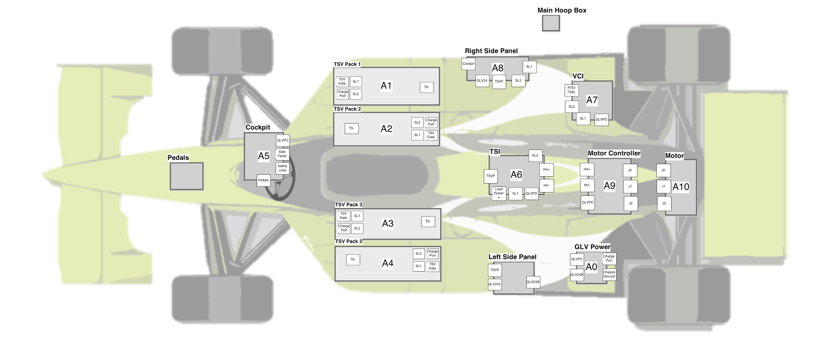
System Assemblies Layout - Top View
High Voltage Supply
Driver Interface Panel
Side Panel Interfaces
Low Voltage Power Source

Slide 12
System Assemblies Layout - Top View
Tractive System Interface
Vehicle Computer Interface
Motor Controller

Slide 13
Layout Selection
SAE Requirements:
Side Panels
Cockpit Panel
Warning Devices
Mechanical:
TSV best placed adjacent to the driver
Motor located near rear axle
Cabling
Orientation of TSV System Packs
TSI, Motor Controller, and Motor all adjacent
Interfacing
VCI accessible by pit station crew

Slide 14
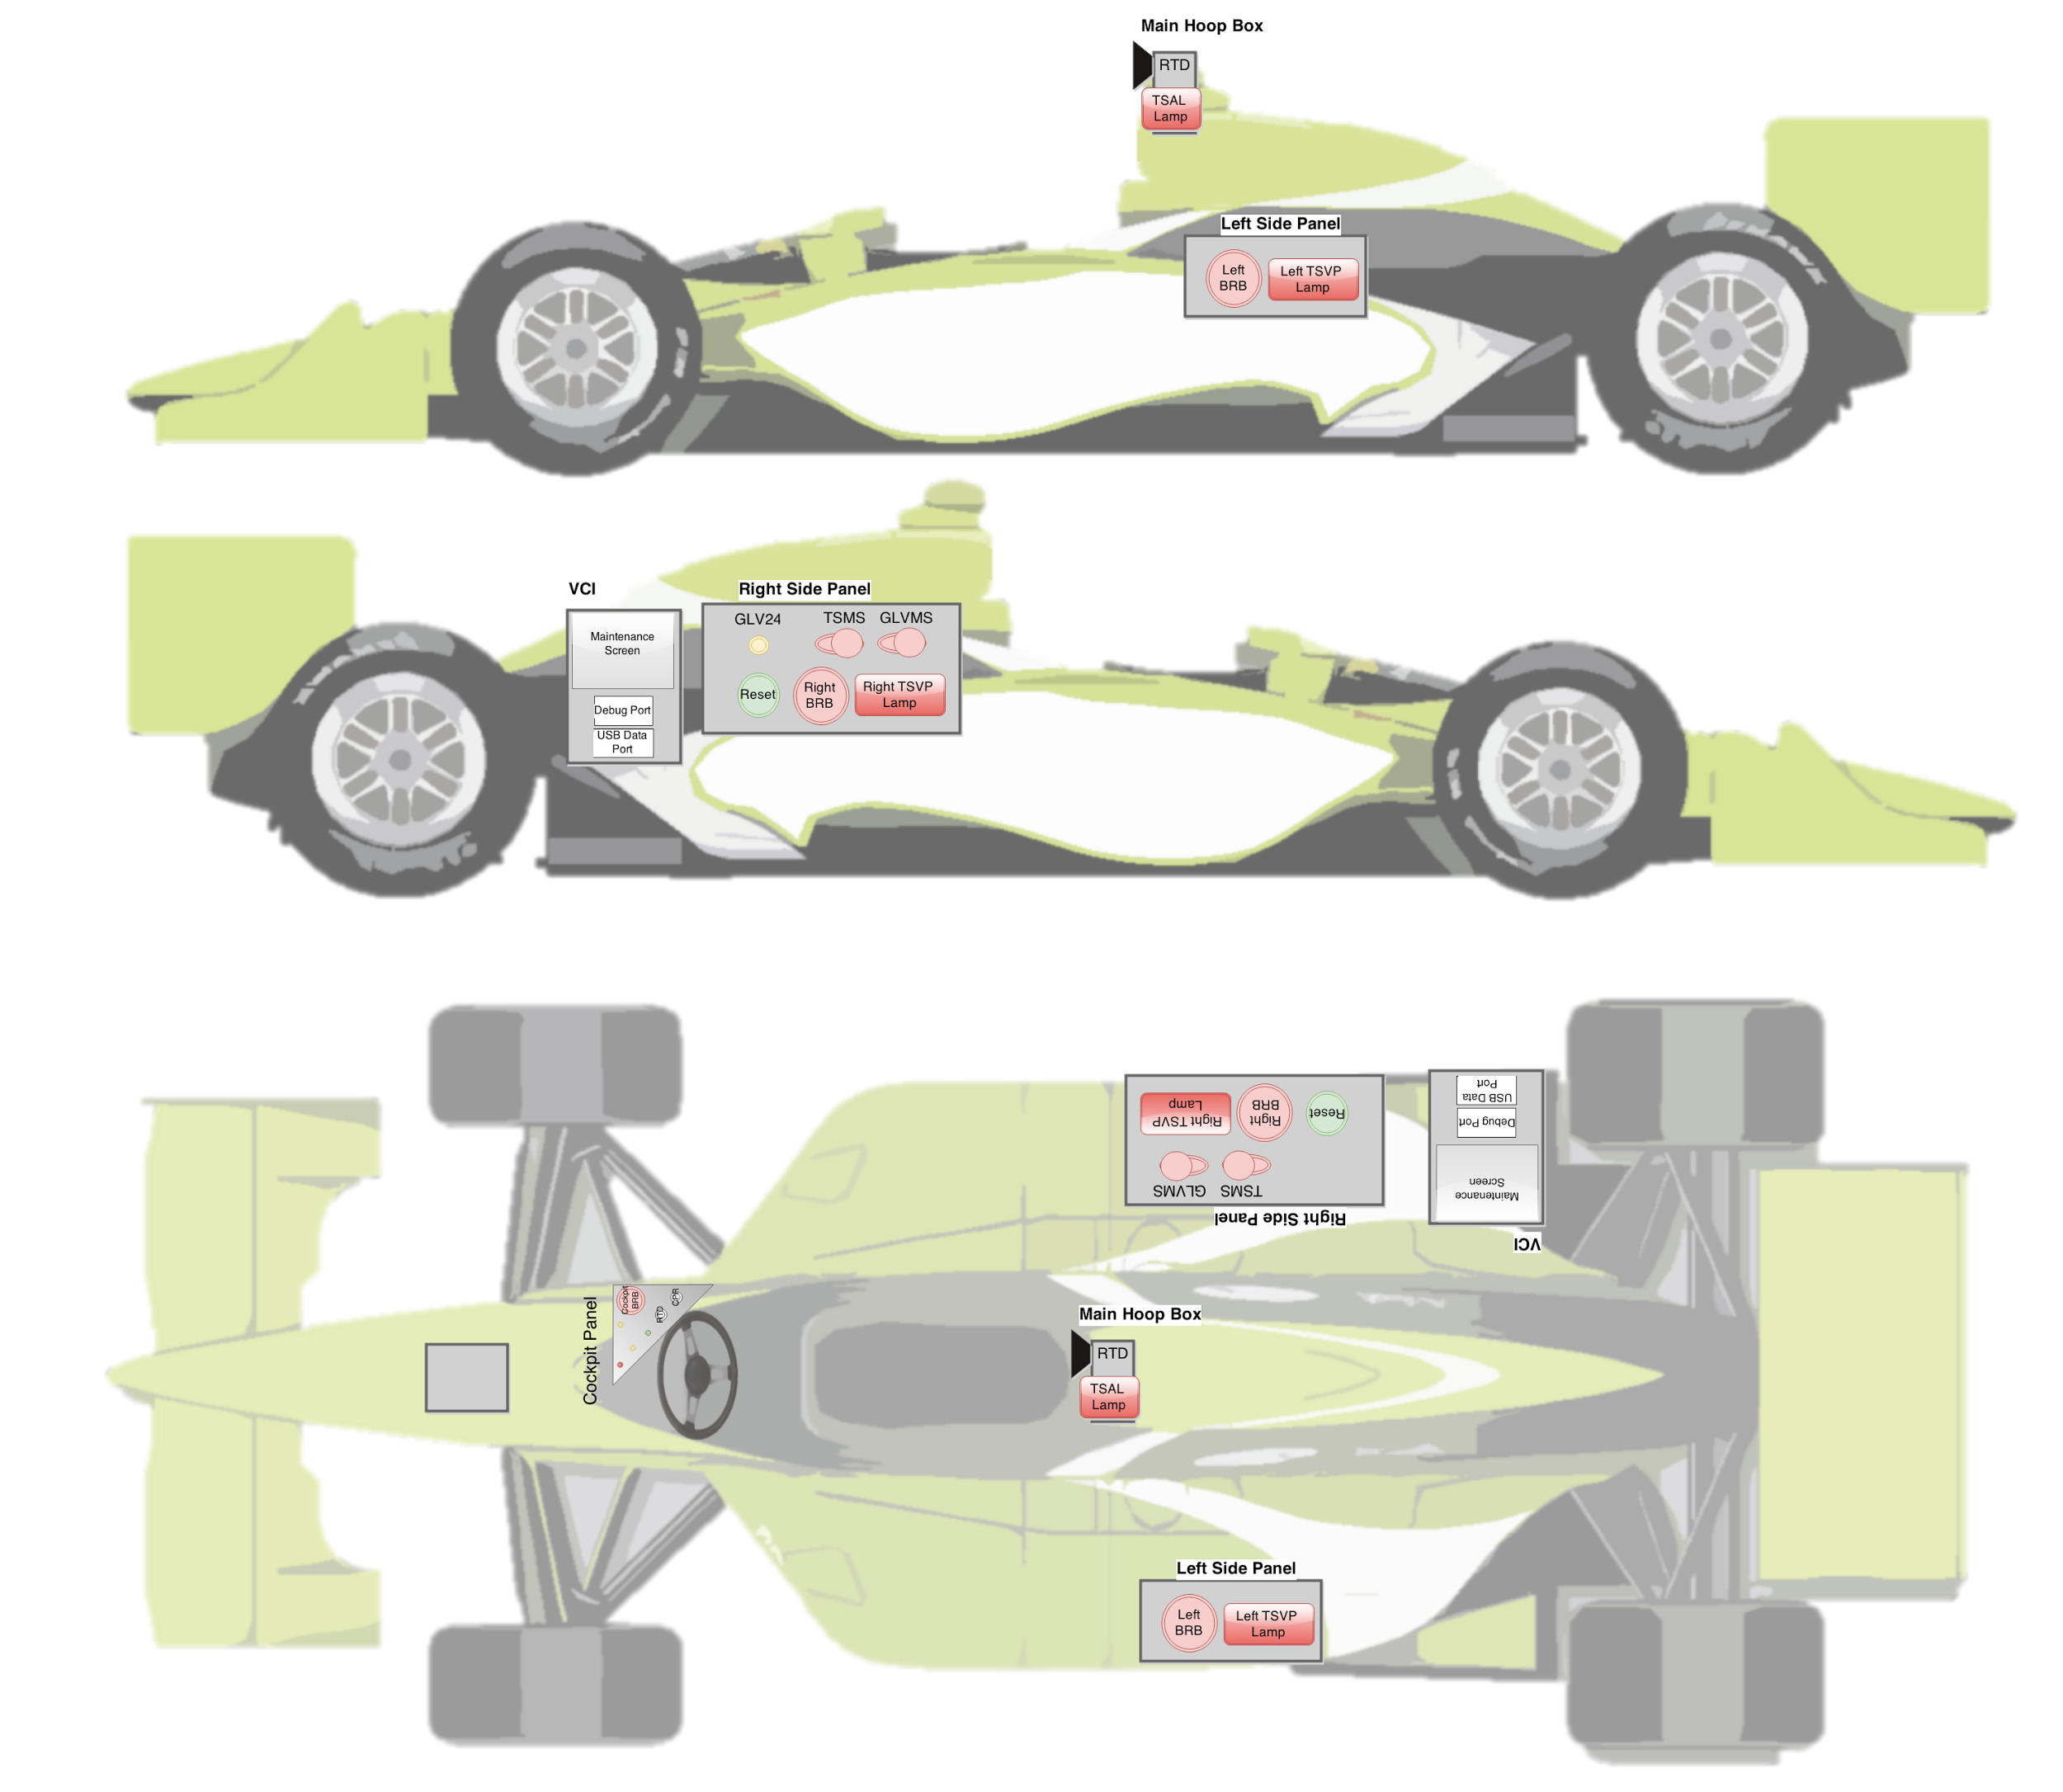
Physical Interfaces Layout - Side View

Slide 15
Physical Interfaces Layout - Top View

Slide 16
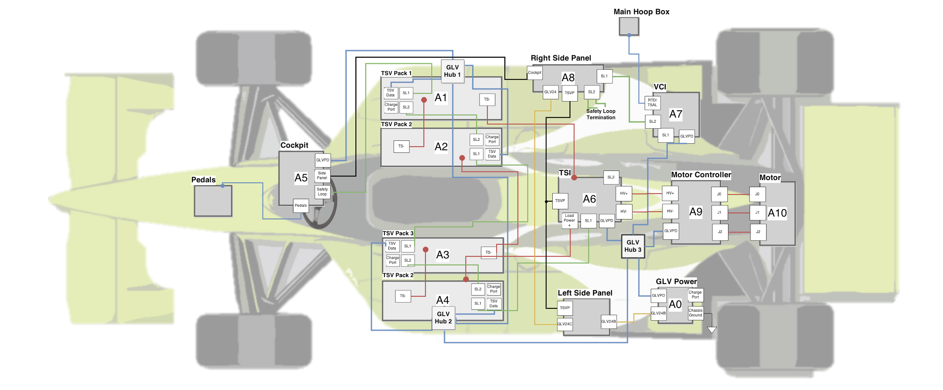
System Assemblies Layout - Top View

Slide 18
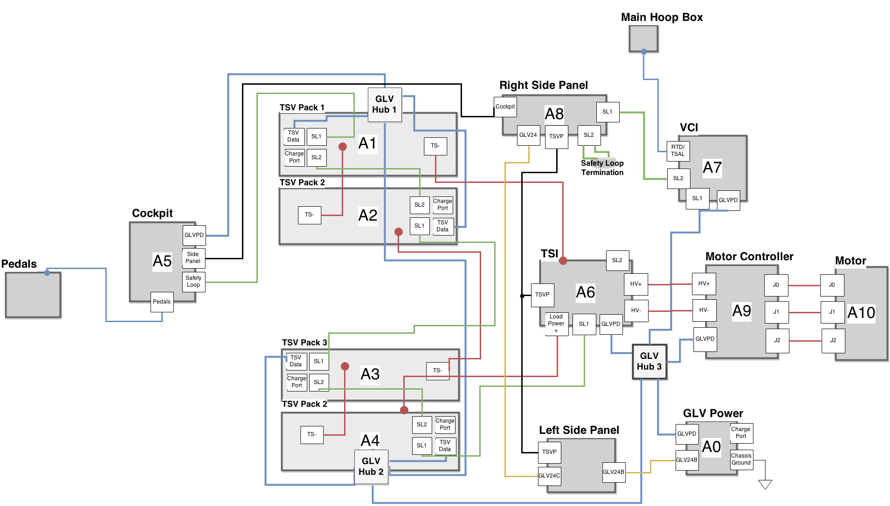
Vehicle Layout

Slide 19
Roadmap
Meet the Morning Teams
Introduction: Motivation
Interface Control
System Assemblies Layout/Interfaces (Car)
System Assemblies Layout/Interfaces (Rack)
Interconnects
Panel Drawings and Hubs
Grounded Low Voltage (GLV)
Safety Loop
GLV Power
VCI
TSI
5. GLV BOM and Budget

Slide 20
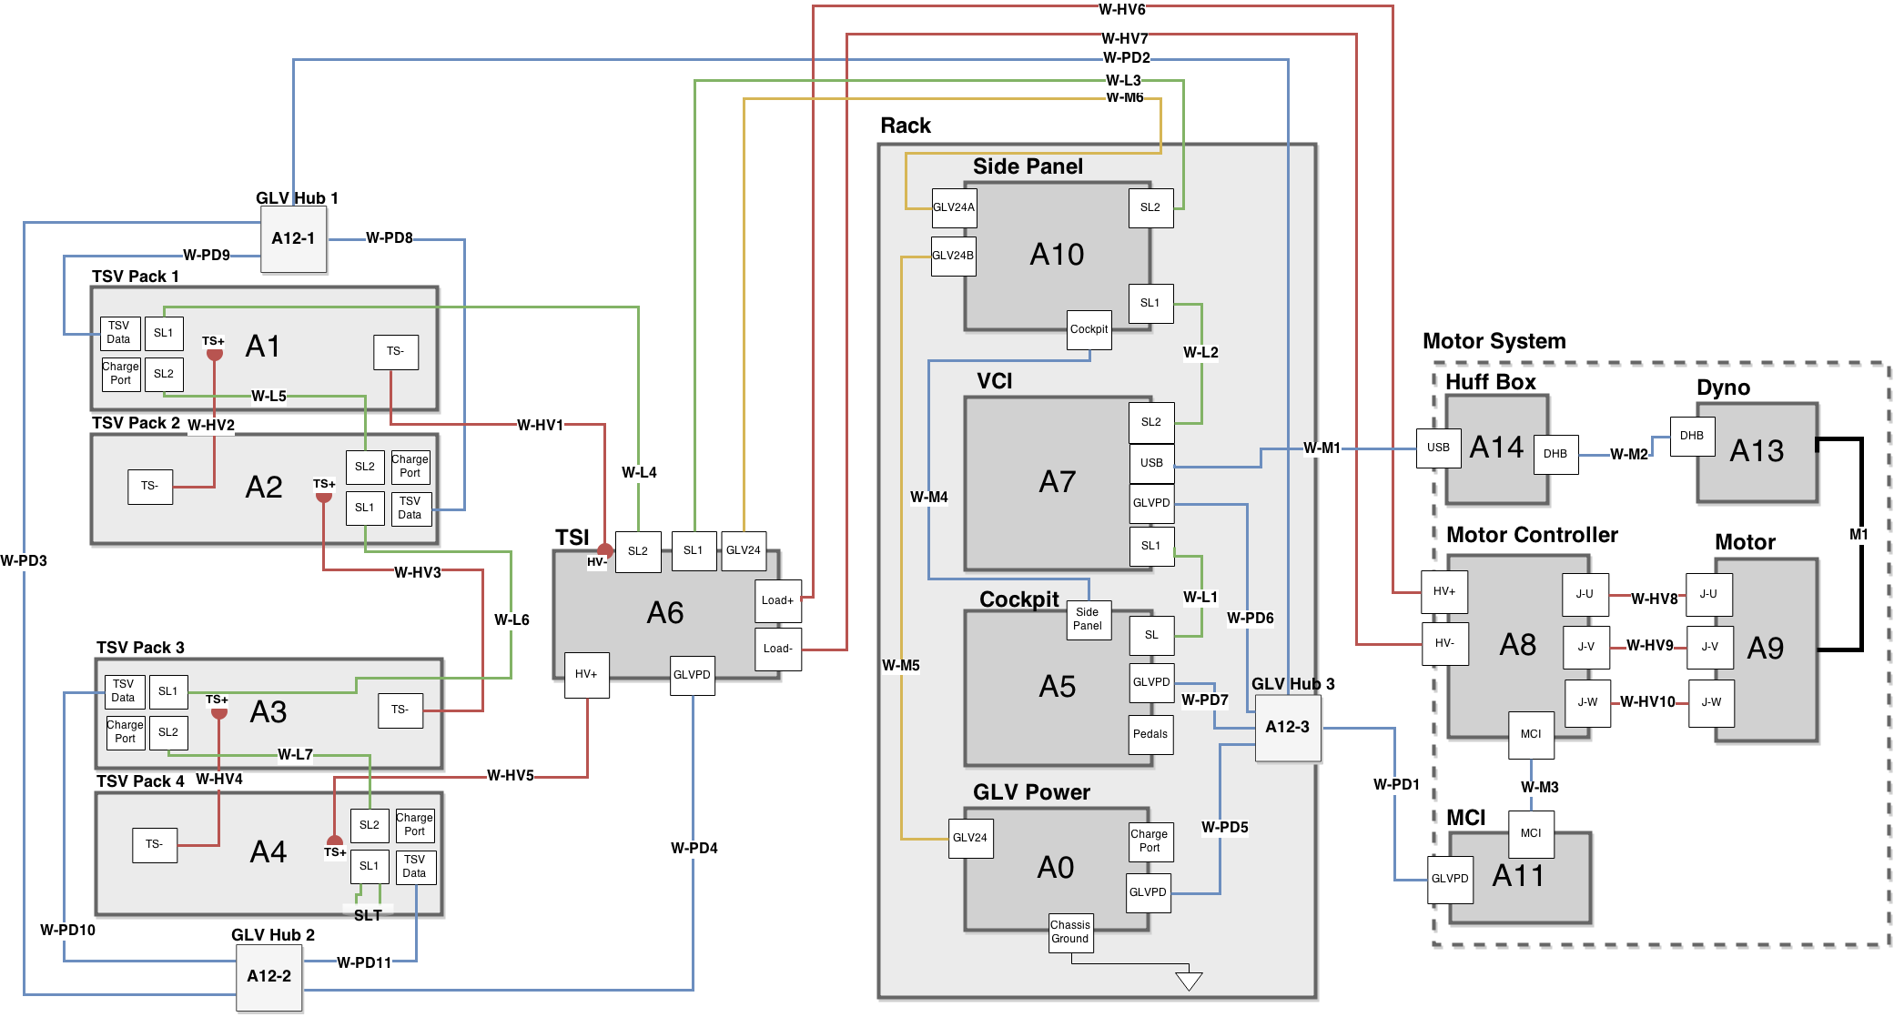
End-of-Term Integration Layout

Slide 21
End of Term Integration Layout
Most Boxes Car Integratable
VCI
Cockpit Box
GLV Power Box
TSI
TSV Packs
Cable Design
Same length as used in vehicle integration where possible (longer elsewhere)
Easy to test as parts are integrated into the system

Slide 22
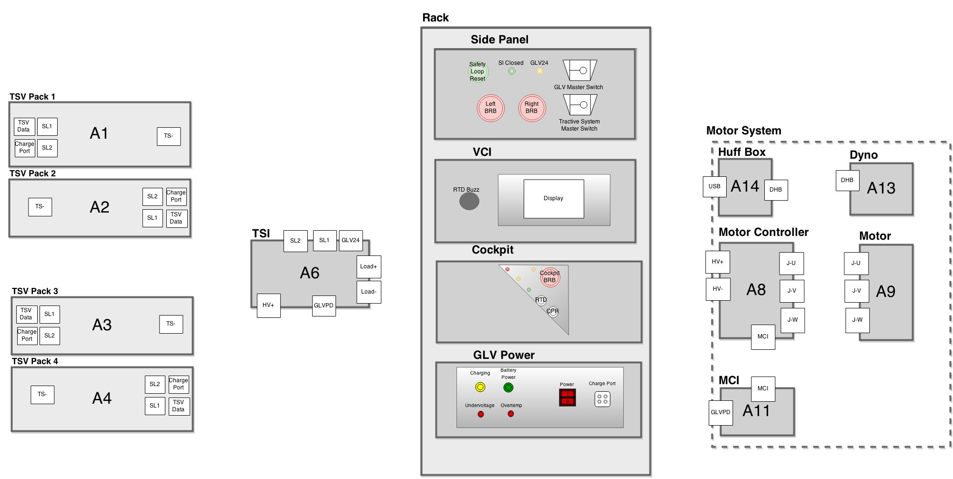
Semester Integration Physical Interfaces

Slide 23
Physical Interfaces
Side Panel
Contains Master Switches
Safety Loop Interface
Power Indicators

Slide 24
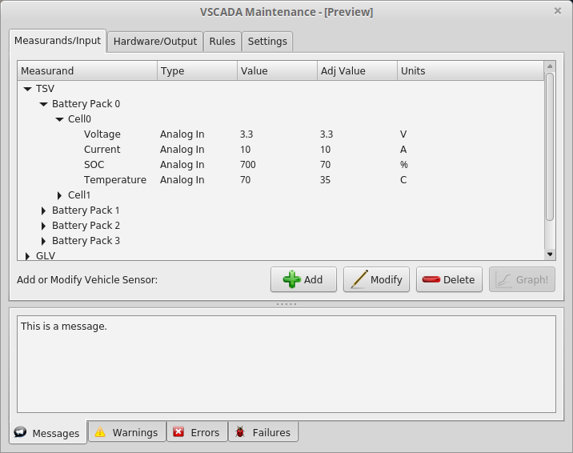
Physical Interfaces
VCI Display
9 Inch Touchscreen
Direct VSCADA Maintenance
System Parameter Control

Slide 25
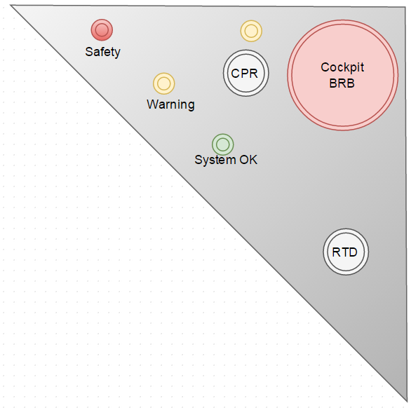
Physical Interfaces
Cockpit Panel
Driver Interface
E-Stop (BRB) and Reset (CPR)
Indicators
Key Start Switch

Slide 26
Physical Interfaces
GLV Power Panel
Low Voltage Battery Indicators
GLV Power Switch

Slide 27
Roadmap
Meet the Morning Teams
Introduction: Motivation
Interface Control
System Assemblies Layout/Interfaces (Car)
System Assemblies Layout/Interfaces (Rack)
Interconnects
Panel Drawings and Hubs
Grounded Low Voltage (GLV)
Safety Loop
GLV Power
VCI
TSI
5. GLV BOM and Budget

Slide 28
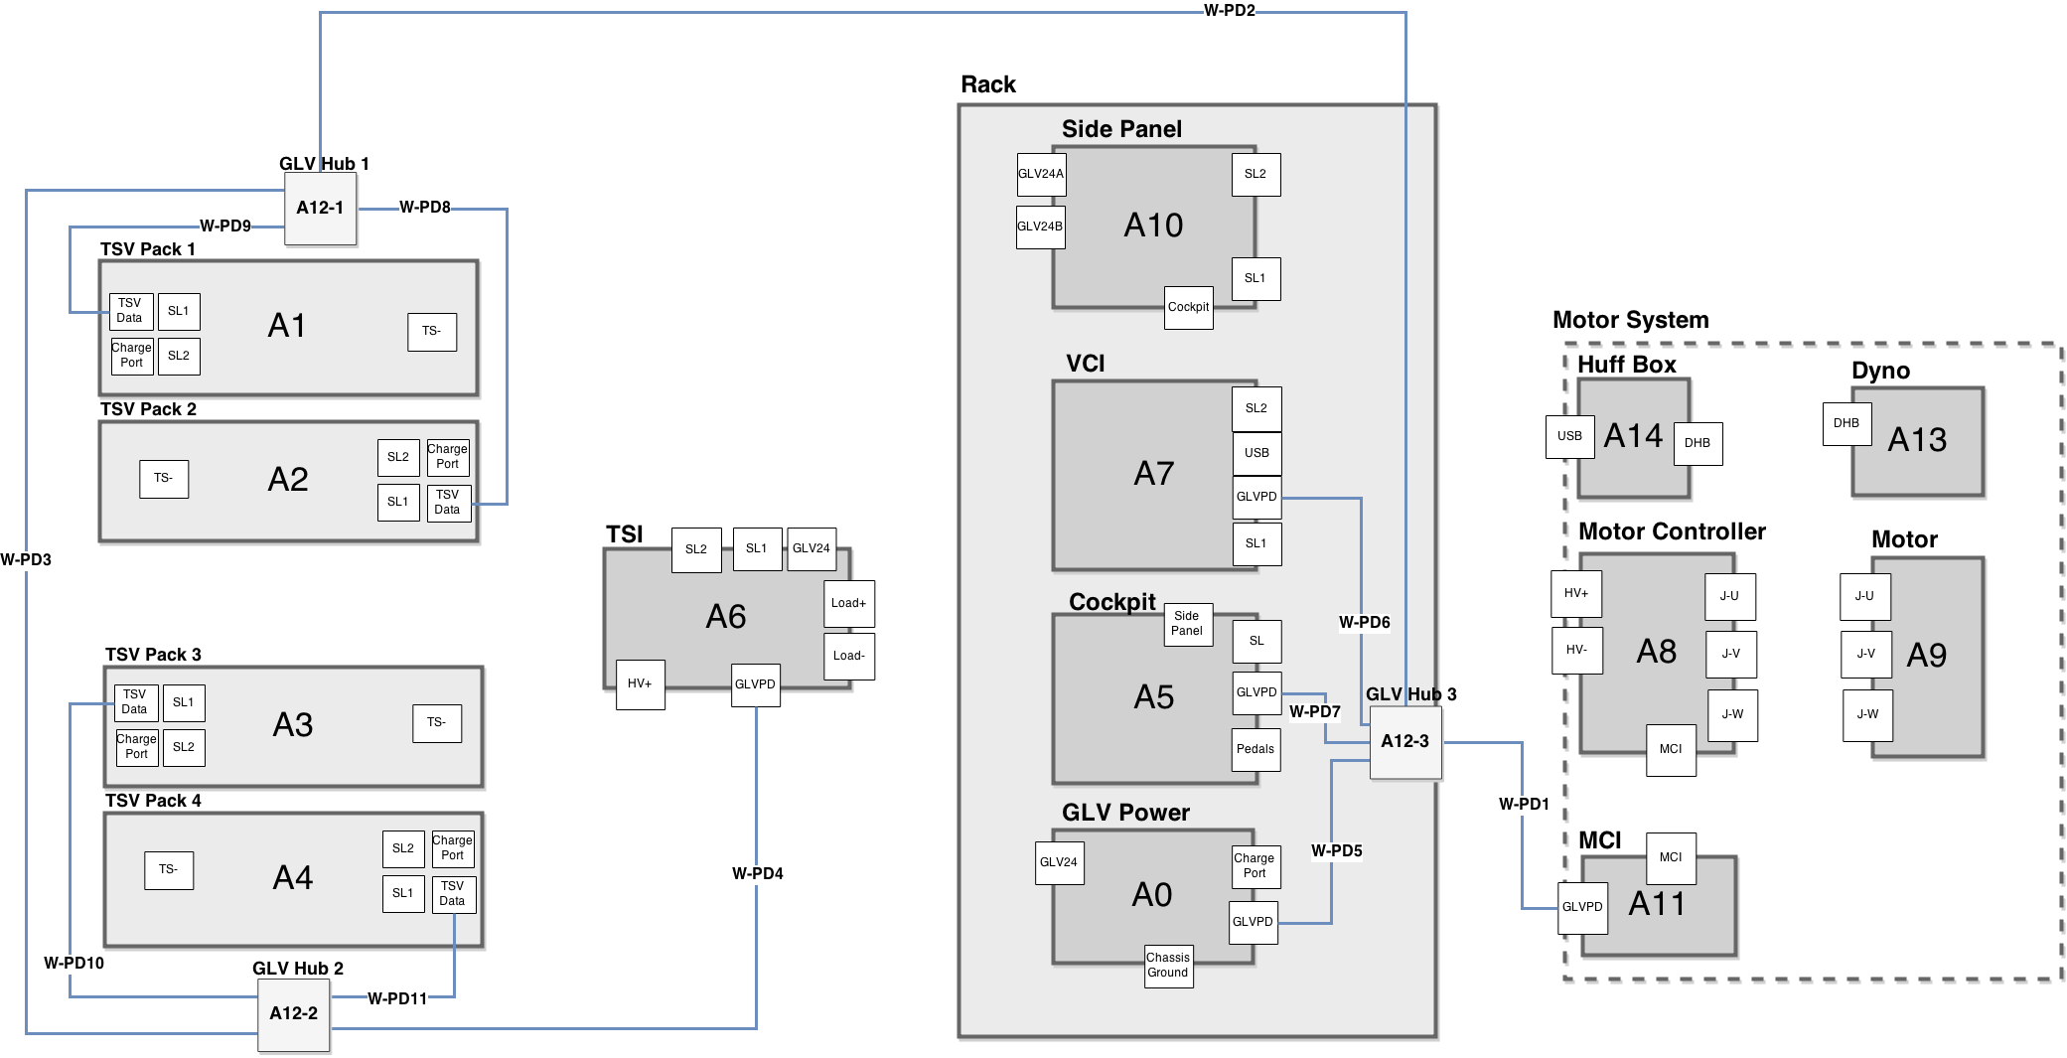
GLV Power and Data Distribution

Slide 29
GLV Power and Data Distribution
12 Volt Power Supply
Needed for VSCADA Computer
Easily Regulated to 5V
CAN Data Line
Industry Standard in Automotive Systems
Already Implemented inside the Motor Controller
CAN Consequences
Single long bus line
Nodes connected via short (<1.0 m) stubs
GLV Hub Boxes

Slide 30
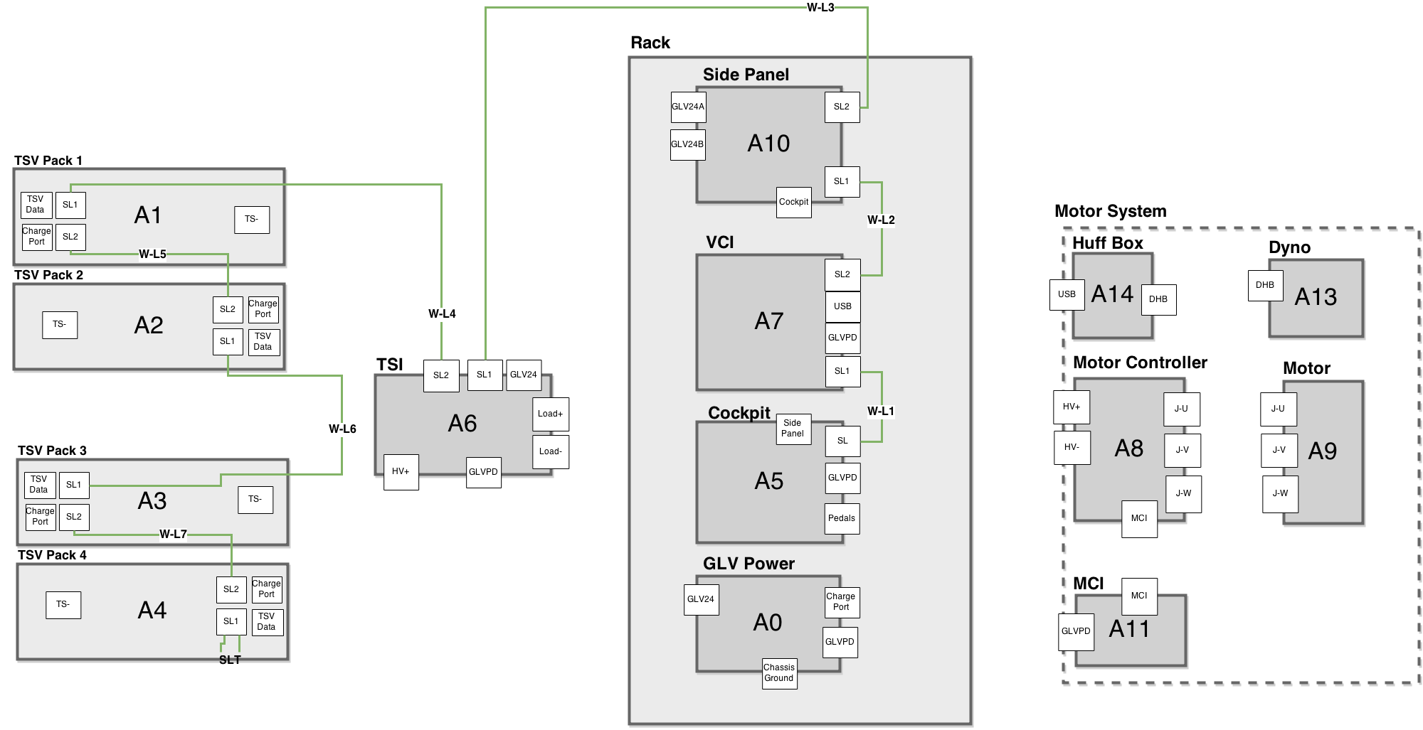
Safety Loop Connections

Slide 31
Safety Loop Connections
SAE Requirement
Control of the Tractive System Accumulator Isolation Relays (AIRs)
Two Ports Per System
Easily add additional systems
No required order of systems

Slide 32
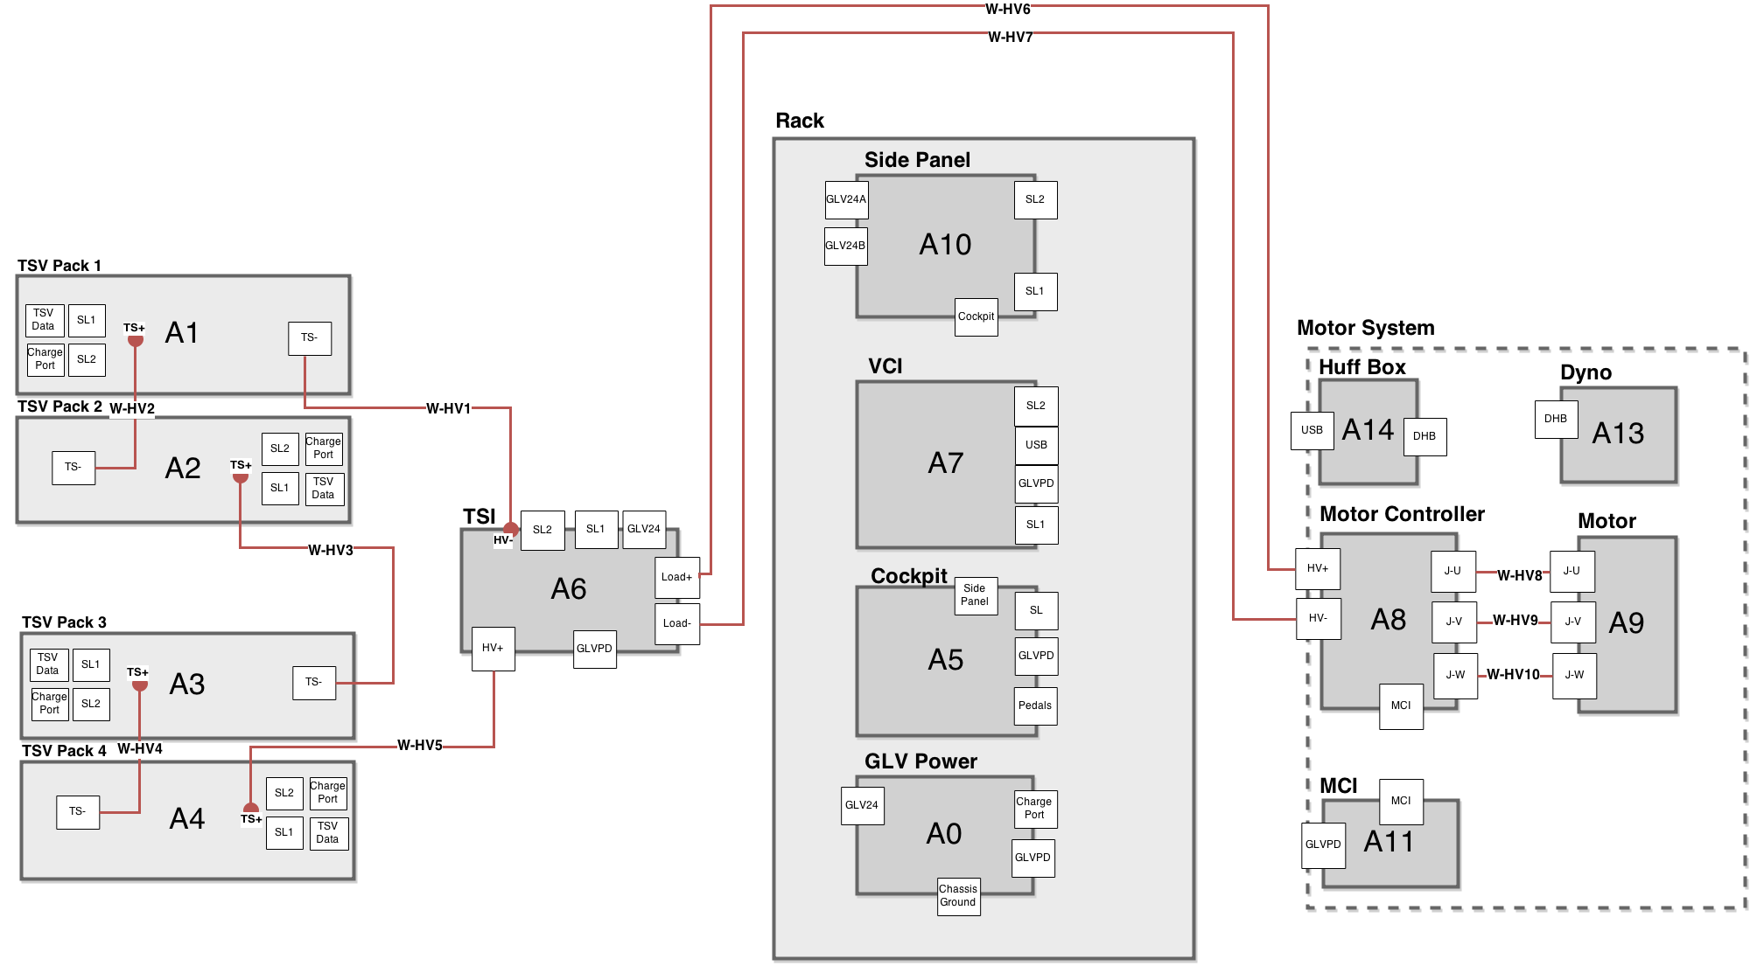
Tractive System High Voltage Path

Slide 33
Tractive System High Voltage Path
Internally Hardwired Connections
Less Cables
Less Interconnects
Powerlock Connectors
SAE Requirements:
Easily Removable
Lockable

Slide 34
Tractive System High Voltage Path
Powerlock Connectors
Bolt Terminals
Pre-existing

Slide 35
Semester Integration Layout

Slide 36
Roadmap
Meet the Morning Teams
Introduction: Motivation
Interface Control
System Assemblies Layout/Interfaces (Car)
System Assemblies Layout/Interfaces (Rack)
Interconnects
Panel Drawings and Hubs
Grounded Low Voltage (GLV)
Safety Loop
GLV Power
VCI
TSI
5. GLV BOM and Budget

Slide 37
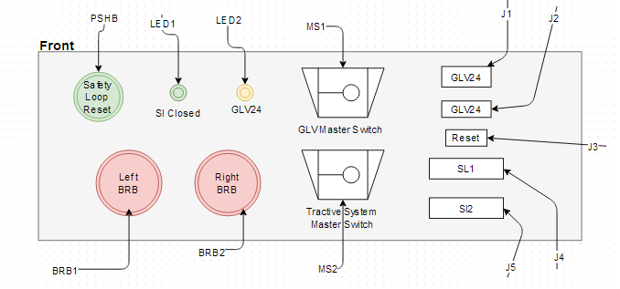
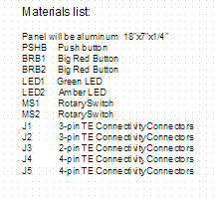
Side Controls Panel
Designed for testing purposes

Slide 38
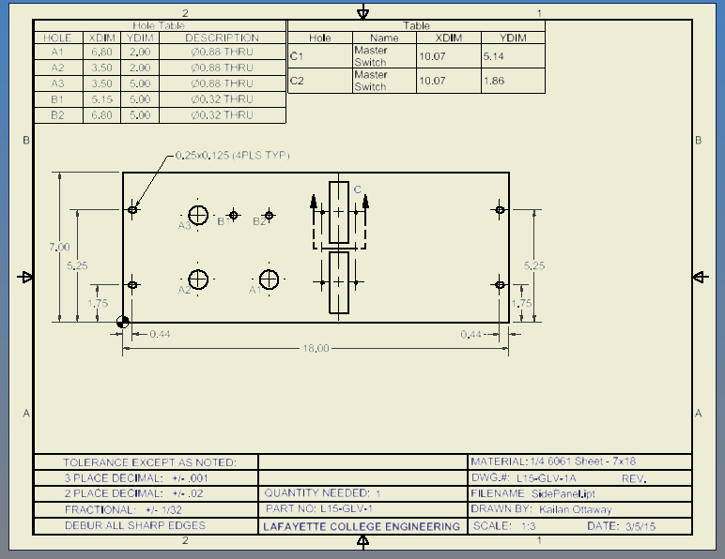
Side Controls Panel Drawing

Slide 39
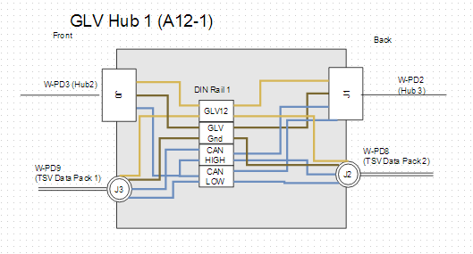
GLV Hub 1
Connects to GLV Hub 2 and 3
Dangly that connects to TSV Pack 1 data port
Dangly that connects to TSV Pack 2 data port
Notes:
Works for the car
Mention why we are using the dangly stubs VS longer wires with connectors

Slide 40
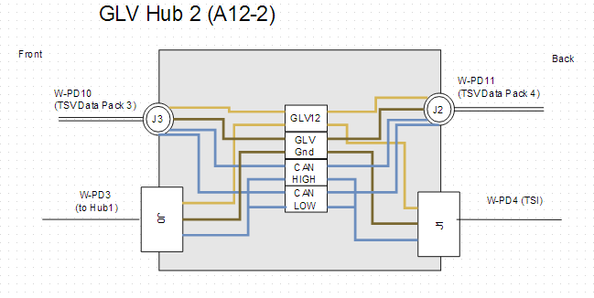
GLV Hub 2
Connects to GLV Hub 1
Connects to TSI
Dangly that connects to TSV Pack 3 data port
Dangly that connects to TSV Pack 4 data port

Slide 41
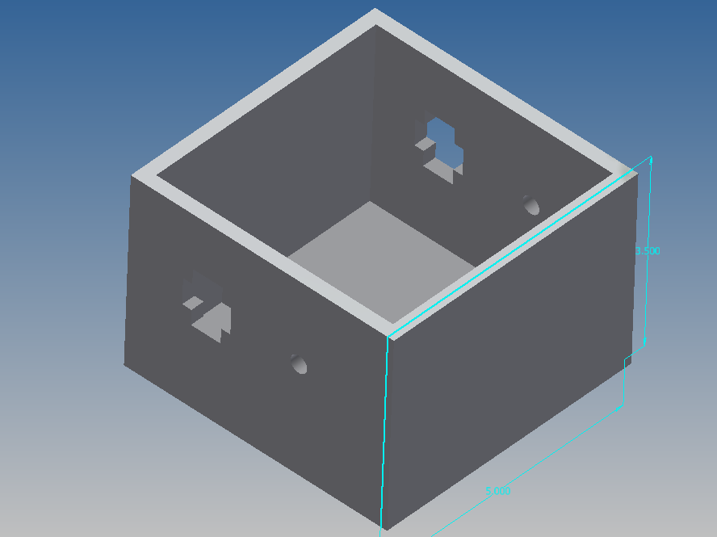
GLV Hub 1 & 2

Slide 42
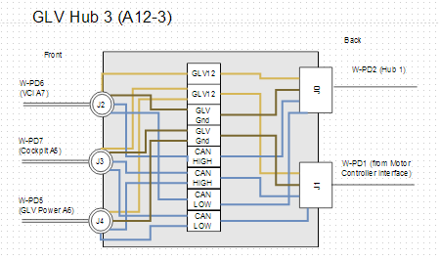
GLV Hub 3
Connects to GLV Hub 1
Connects to Motor Controller Interface
Dangly that connects to the VCI
Dangly that connects to the Cockpit
Dangly that connects to GLV Power

Slide 43
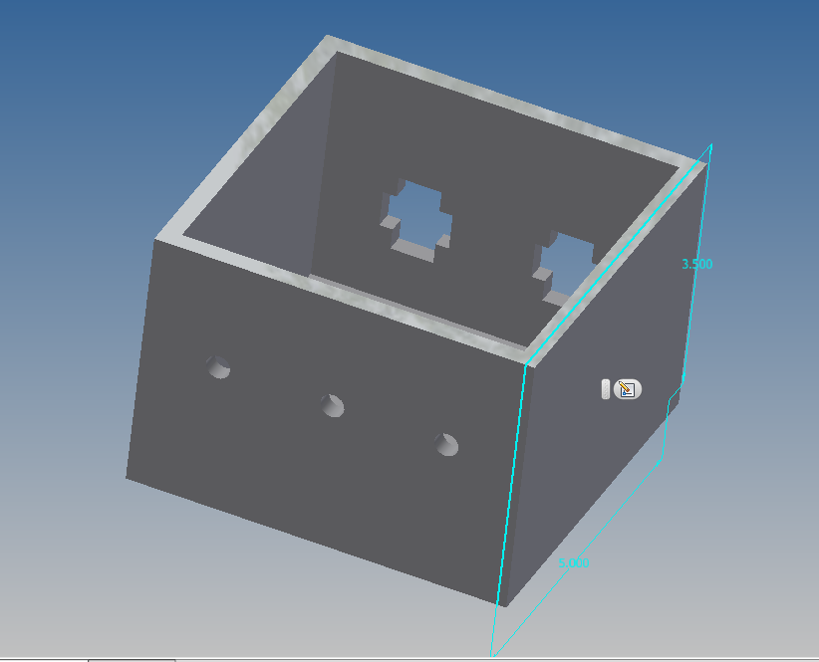
GLV Hub 3

Slide 44
Roadmap
Meet the Morning Teams
Introduction: Motivation
Interface Control
System Assemblies Layout/Interfaces (Car)
System Assemblies Layout/Interfaces (Rack)
Interconnects
Panel Drawings and Hubs
Grounded Low Voltage (GLV)
Safety Loop
GLV Power
VCI
TSI
5. GLV BOM and Budget

Slide 45
Grounded Low Voltage
GLV system is responsible for supplying power to all non-tractive devices on the vehicle, interfacing other subsystems together, and operating the safety circuit in accordance to the EV requirements.

Slide 46
Roadmap
Meet the Morning Teams
Introduction: Motivation
Interface Control
System Assemblies Layout/Interfaces (Car)
System Assemblies Layout/Interfaces (Rack)
Interconnects
Panel Drawings and Hubs
Grounded Low Voltage (GLV)
Safety Loop
GLV Power
VCI
TSI
5. GLV BOM and Budget

Slide 47
Cockpit and the Safety Loop

Slide 48
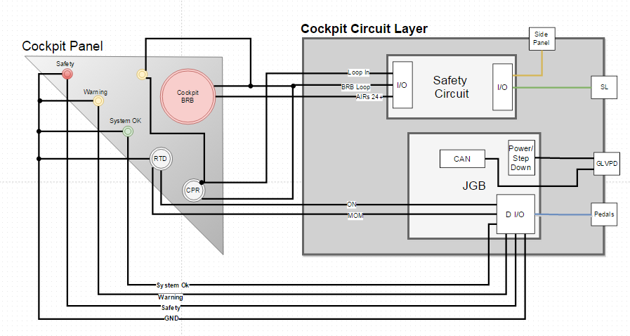
Cockpit Panel and Internals

Slide 49
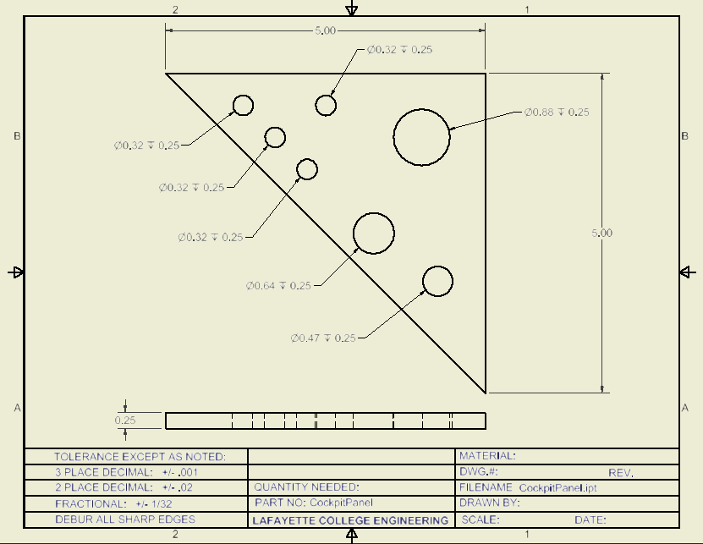
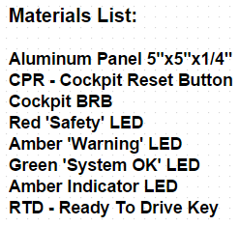
Cockpit Panel Drawing

Slide 50
Safety Loop and Safety Circuit
Keeps high level voltage system in a safe state
Monitors status of the system and provides multiple shutdown options to both driver and surrounding personnel
Interacts with each electrical subsystem

Slide 51
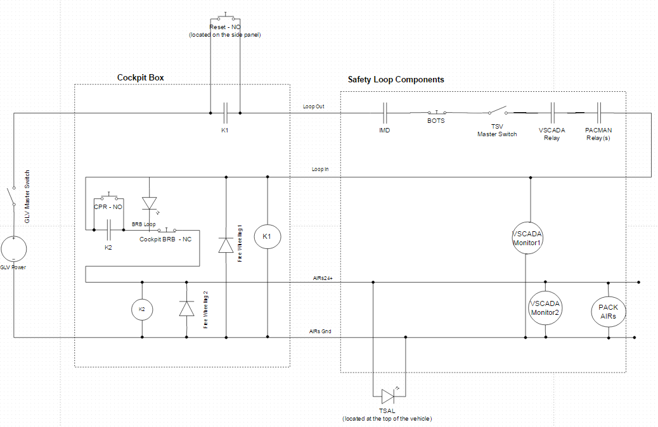

Slide 52
Shutdown Priority Table
Controlled Systems
 | GLV Supply to: Instrumentation, Data Acquisition, Computers, Telemetry, Etc. | AIRs (TS Voltage)
TSMS |  | OFF
Cockpit BRB |  | OFF
AMS |  | OFF
IMD |  | OFF
Brake Over-Travel |  | OFF
Side-Mounted BRBs | OFF | OFF
GLVMS | OFF | OFF
Shutdown Sources

Slide 53
Safety Loop Summary
Safety Loop accounts for failures/faults in the 4-wire safety loop
Any failure in the safety loop will be appropriately reacted to within the time constraints provided by the Formula Hybrid Rules
Appropriate steps must be taken in order to make the car ready-to-drive in each scenario
The Test Plan for the Safety Loop does not have a threshold for any test; whether it be button/switch functionality or the shutdown circuit itself. The loop will function to the specifications provided.

Slide 54
Roadmap
Meet the Morning Teams
Introduction: Motivation
Interface Control
System Assemblies Layout/Interfaces (Car)
System Assemblies Layout/Interfaces (Rack)
Interconnects
Panel Drawings and Hubs
Grounded Low Voltage (GLV)
Safety Loop
GLV Power
VCI
TSI
5. GLV BOM and Budget

Slide 55
GLV Power

Slide 56
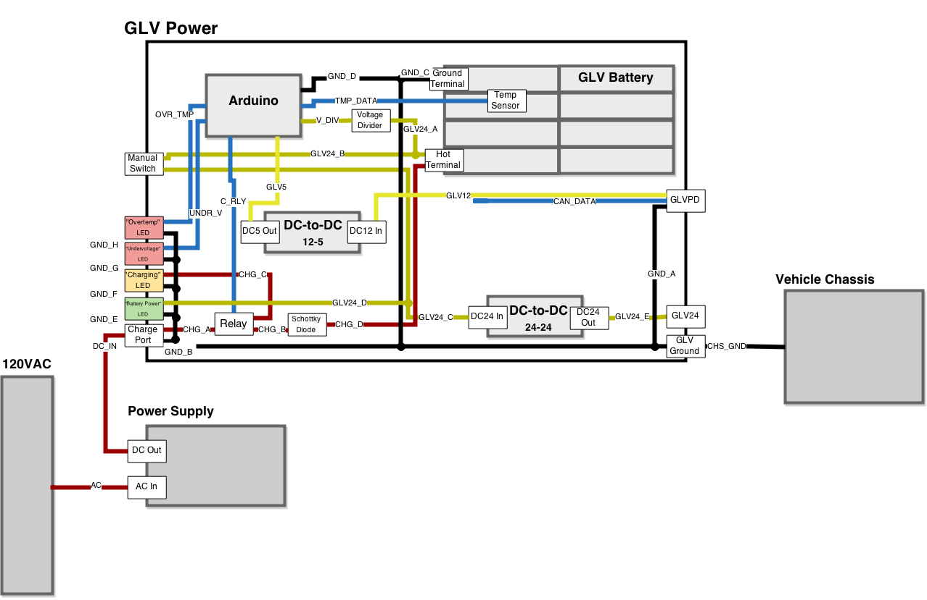
GLV Power Box and Dependents

Slide 57
GLV Power Box

Slide 58
GLV Power Box - End Goal (JGB)

Slide 59
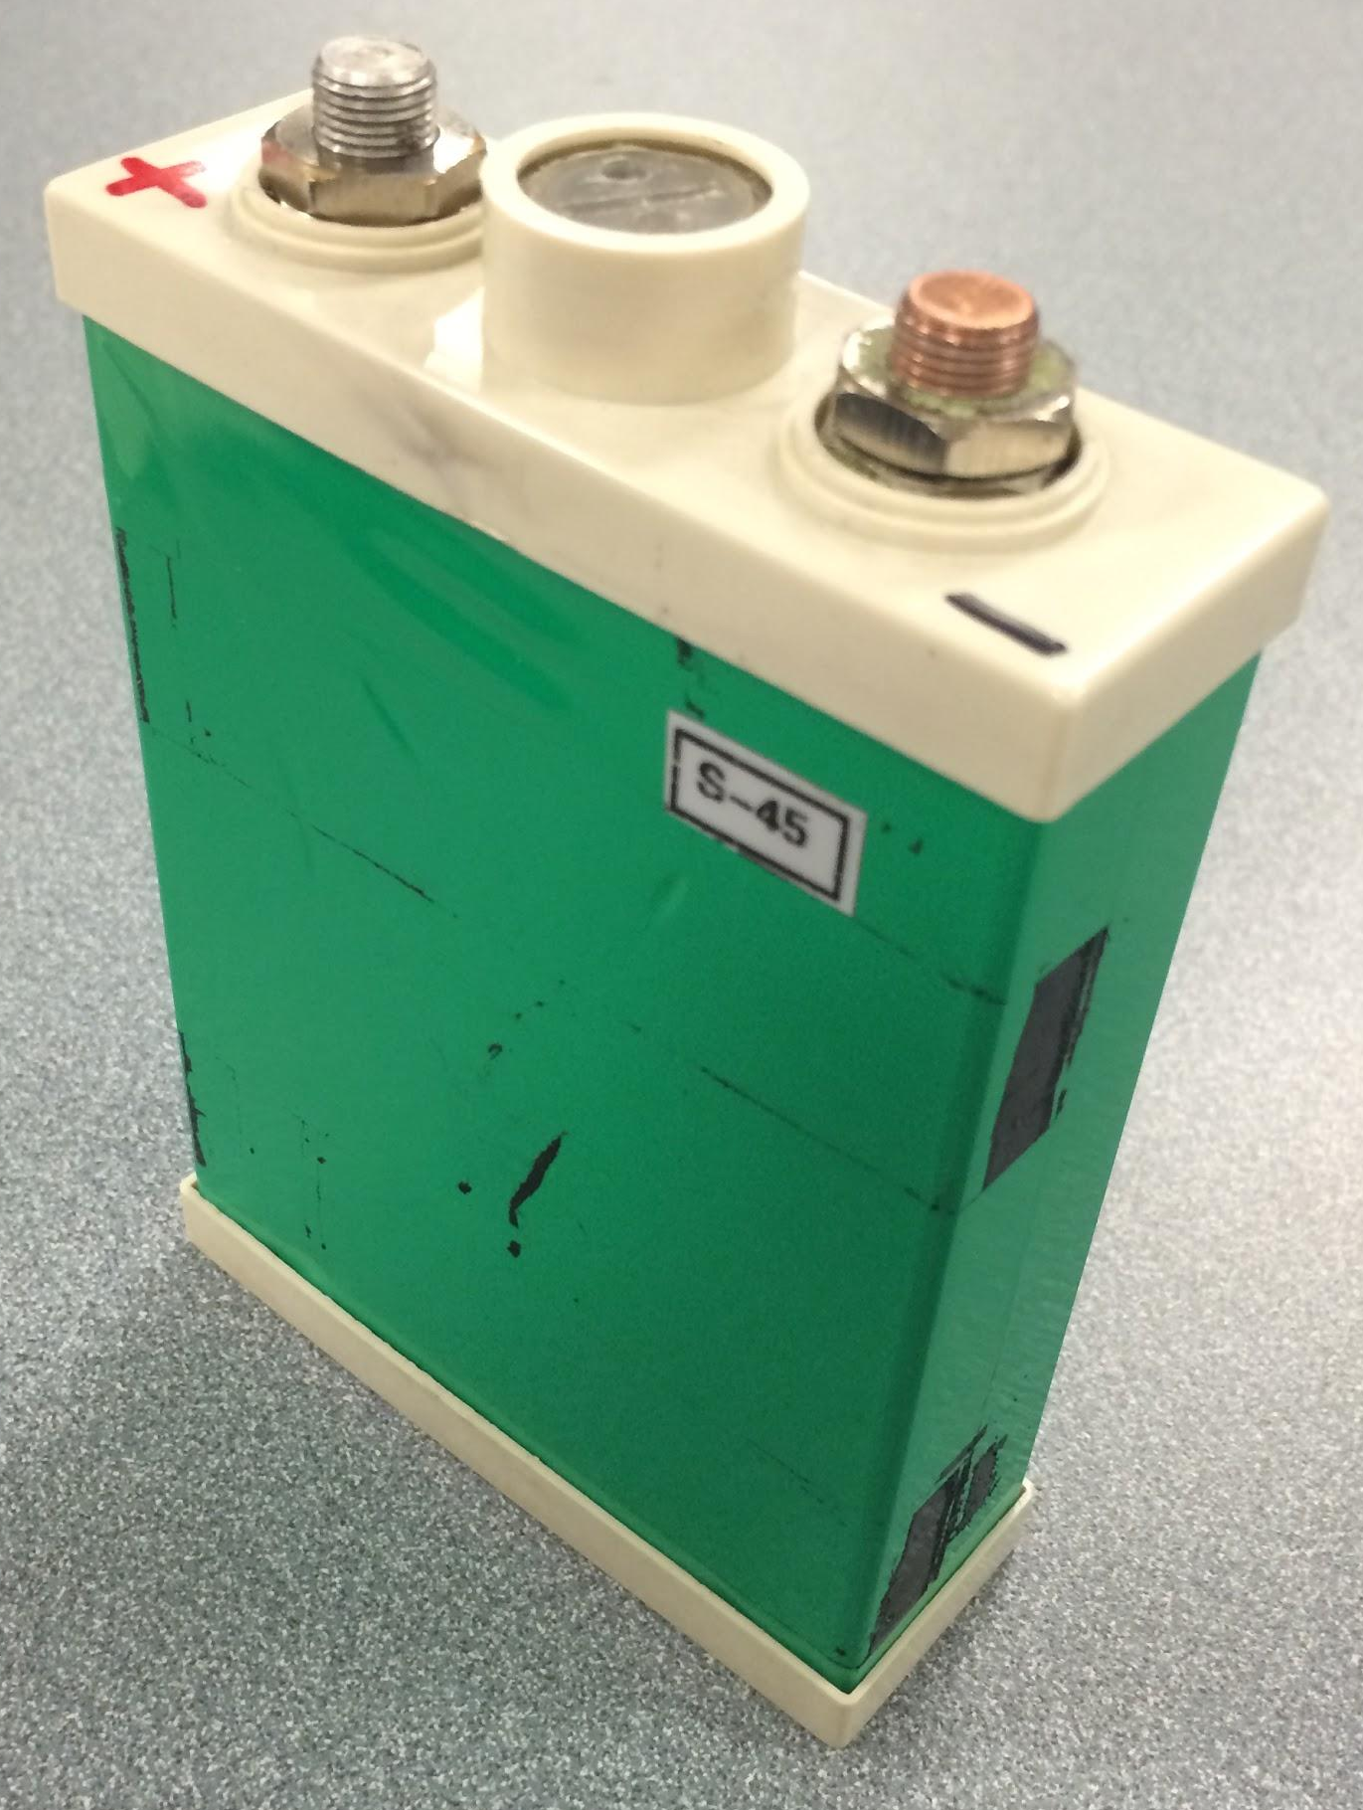
GLV Battery Cell
3.3V LiFePO4 10Ah

Slide 60
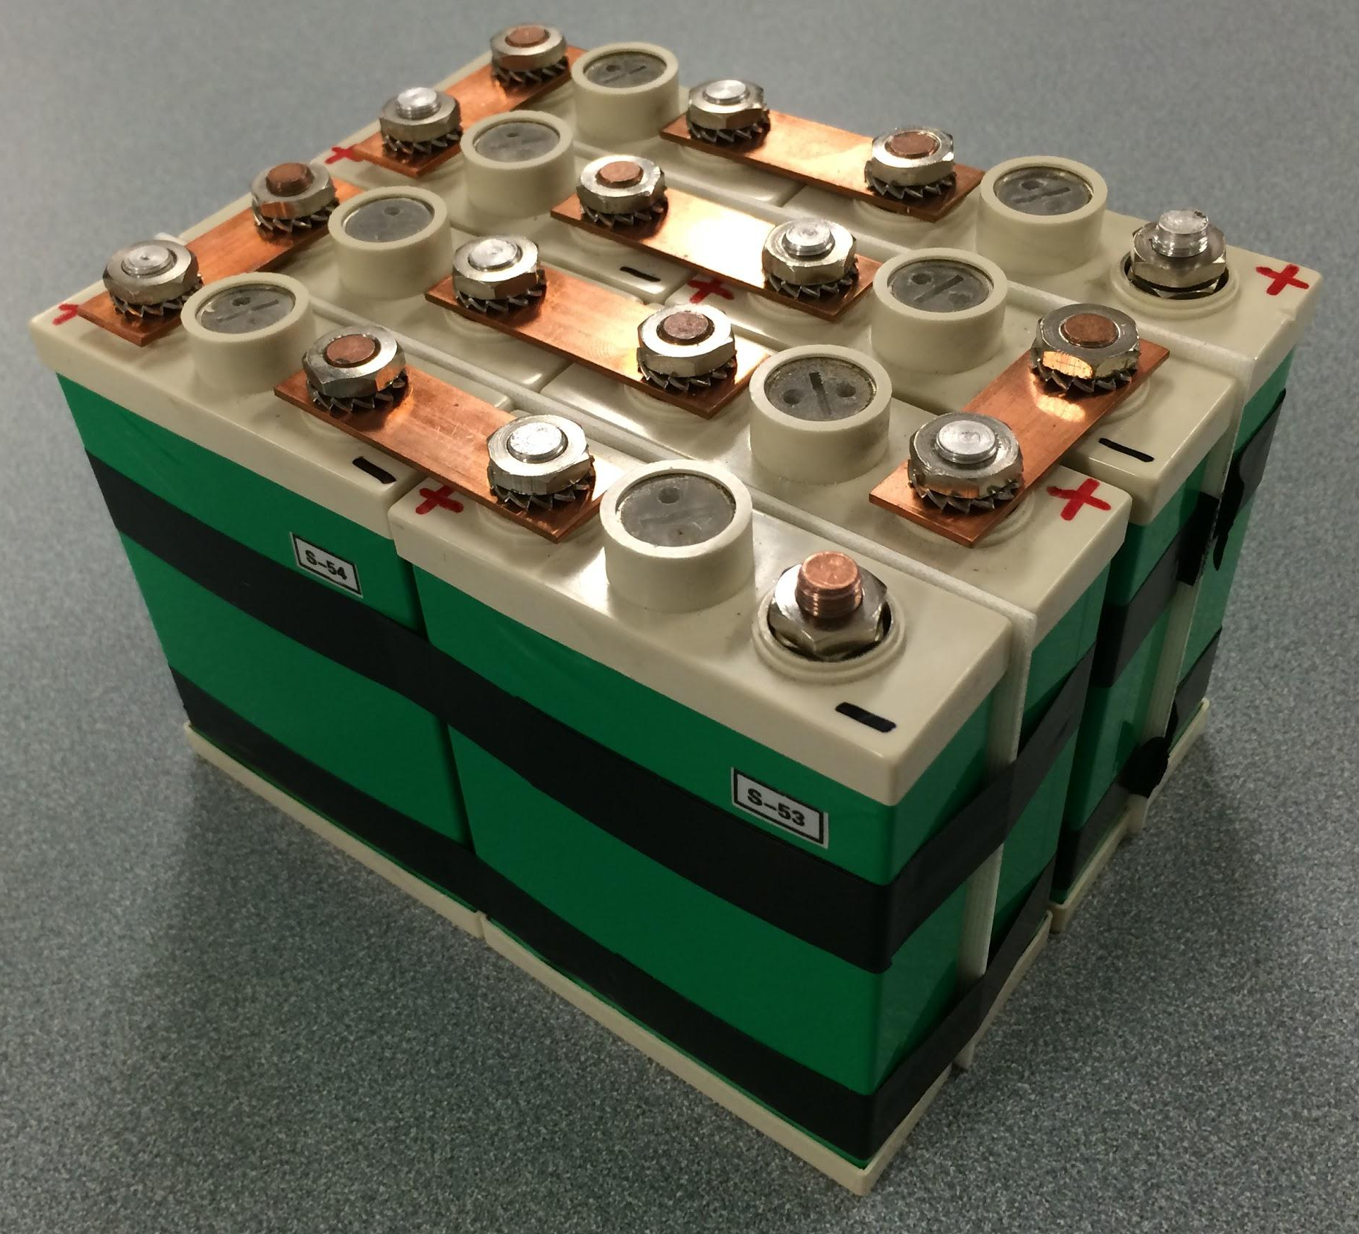
GLV Battery
Eight cells
24V
10Ah

Slide 61
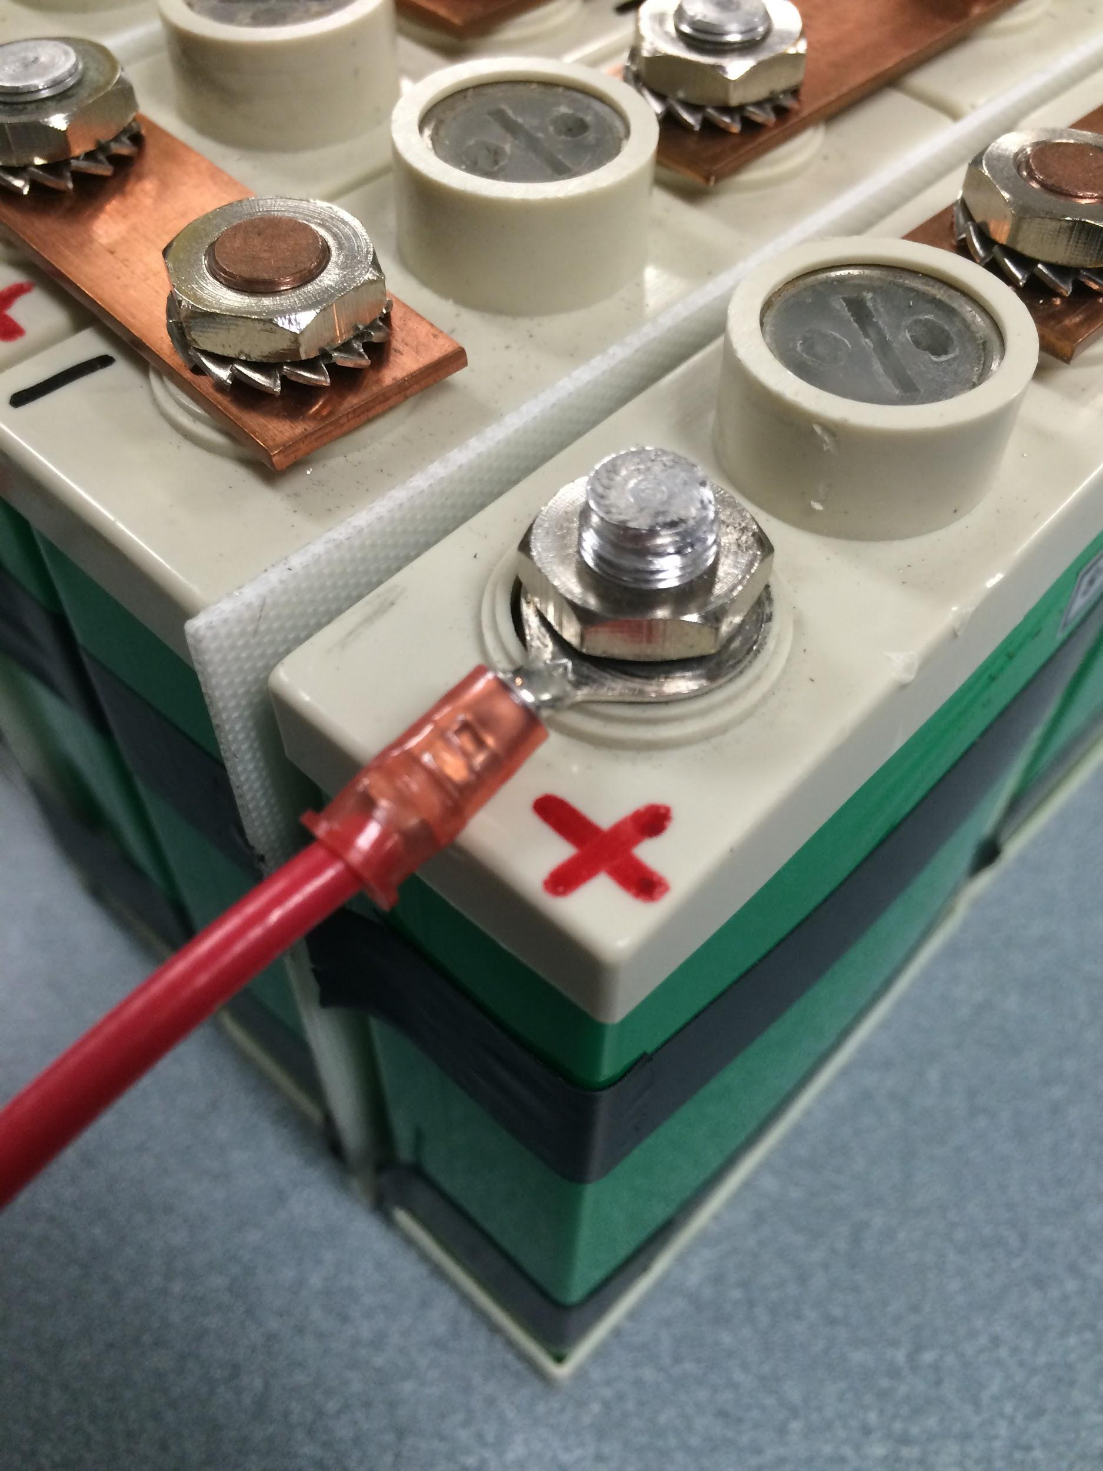
GLV Battery Connection
Crimped Terminal (Open Barrel)

Slide 62
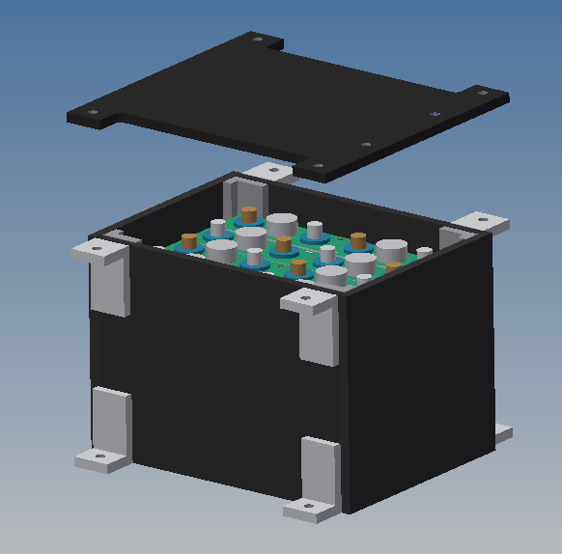
Battery Mounting
EV3.7.1- All GLV batteries must be attached securely to the frame.

Slide 63
GLV Battery Capacity Calculation
R006-1 The GLV system shall contain a rechargeable battery of sufficient capacity to run the car GLV systems for at least three hours.
Utilizes the measured power consumption of the VSCADA computer and a reasonable ceiling estimation for the screen.
GLV Relays (2.04W x 2) = 4.08W + 1W (for microcontrollers, relays)
AIRS (2.04W x 2) = 8.16W + ~100mW (CAN transceivers)
VSCADA 2.64W computer + 2W screen
Total 17.88W / 24V = 0.745A x 1.5 = 1.1175Ah 1hr
2.235Ah 2hr
3.3525Ah 3hr
4.47Ah 4hr
5.5875Ah 5hr

Slide 64
GLV Battery Capacity Calculation
R006-1 The GLV system shall contain a rechargeable battery of sufficient capacity to run the car GLV systems for at least three hours.
Utilizes the peak power consumption of the VSCADA computer and a higher ceiling estimation for the screen.
GLV Relays (2.04W x 2) = 4.08W + 1W (for microcontrollers, relays)
AIRS (2.04W x 2) = 8.16W + ~100mW (CAN transceivers)
VSCADA 5.28W computer + 4W screen
Total 25.52W / 24V = 1.06A x 1.5 = 1.595Ah 1hr
3.19Ah 2hr
4.785Ah 3hr
6.38Ah 4hr
9.57Ah 5hr

Slide 65
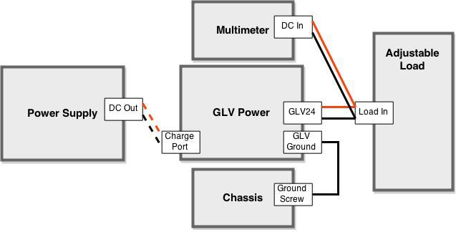
GLV Power and Battery Duration Test
R006-0 The GLV system shall provide DC supply voltage with sufficient current to supply all the power needs of the GLV systems and other non-tractive systems.
R006-1 The GLV system shall contain a rechargeable battery of sufficient capacity to run the car GLV systems for at least three hours.
Simplified Procedure:
Fully charge the battery.
Attach the Power Box to the adjustable load and set the current to simulate appropriate power consumption.
Record voltage at timing intervals.
Voltage must remain above designated value (21V) for three hours.

Slide 66
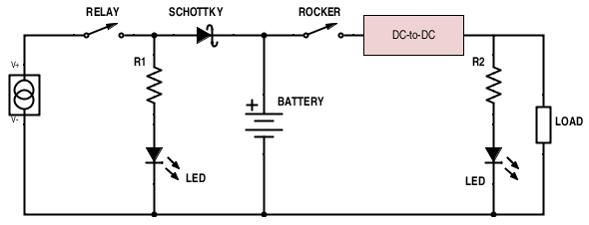
Charging Circuit

Slide 67
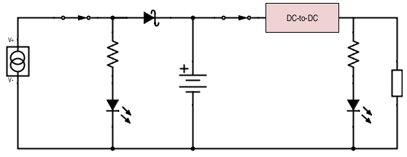
Charging Circuit - Charging
R006-2ii The charging system shall be capable of powering the GLV system indefinitely as it simultaneously charges the GLV battery in a plug and forget functionality.
+ < 0.46V -
(0.46V @ 15A)
24V <1.06A
~0.745A
+ 2V -
30V
27K
~5A
27K
32.5V
5.7A
“Charging” LED On
24V
28.5V max
“Battery Power” LED On

Slide 68
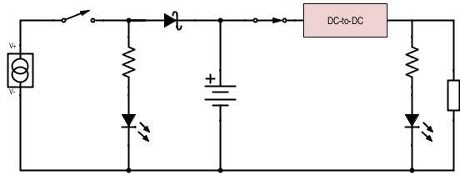
Charging Circuit - Discharging
24V <1.06A
~0.745A
~0.745A
27K
~24V
“Battery Power” LED On
“Charging” LED Off

Slide 69
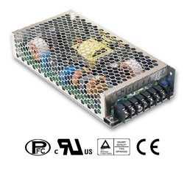
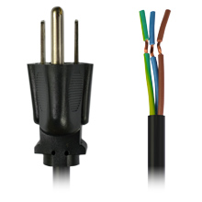
GLV Power - Charger
R006-2i The GLV system shall be rechargeable by means of a UL listed charging device that plugs into the 120 VAC mains.
www.trcelectronics.com
www.powergatellc.com

Slide 70
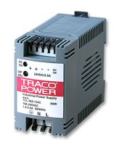
Battery Protection
R006-2iii It shall be possible to charge a fully discharged GLV battery without disassembly or special actions.
R006-2v The GLV battery shall be protected from full discharge, overcharge, overcurrent, and overvoltage.
Full Discharge:
The 24-24 DC-to-DC Converter has an under voltage shutdown of 15.7 VDC.
The solid-state relay controlling the charge circuit will be the normally closed type.
Overcharge:
Discussed on previous slides.
Overcurrent:
The 24-24 DC-to-DC Converter has a current limitation of 110% its typical, which is 2.5A for this device.
2.5A x 1.1 = 2.75A… Well above the expected range and below battery capabilities.
Overvoltage:
The 24-24 DC-to-DC Converter has an overvoltage protection trigger point of <42V.
uk.farnell.com

Slide 71
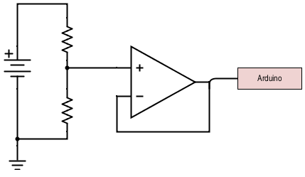
Voltage Sensing
R006- The GLV battery shall be protected from overcharge.
GLV voltage shall be measured by VSCADA.
< 28V
112K
< 5V
28K

Slide 72
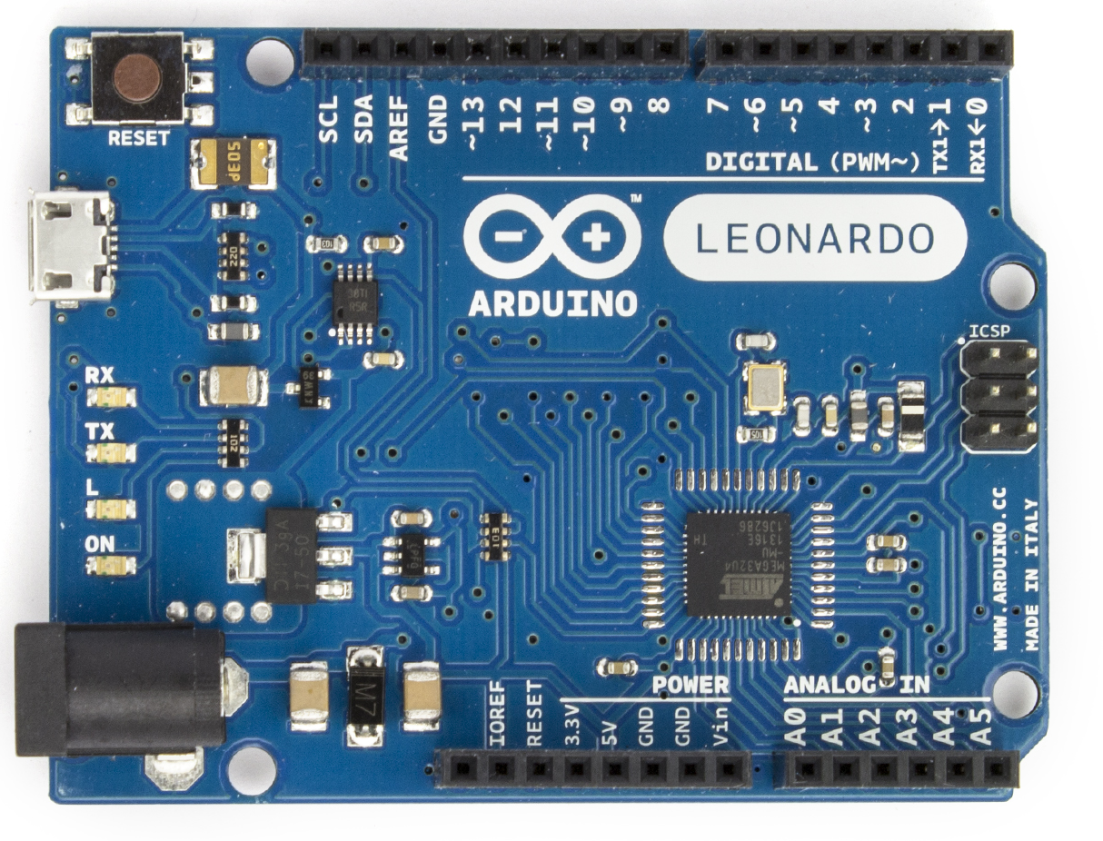
GLV Power Software
R006- GLV voltage, current, temperature, and SOC shall be measured by VSCADA.
GLV Power Arduino
Maintainability:
Code will be written in C which is not going extinct in the near future.
Files will be uploaded to the website containing the source code and Arduino ID.
www.arduino.cc

Slide 73
Roadmap
Meet the Morning Teams
Introduction: Motivation
Interface Control
System Assemblies Layout/Interfaces (Car)
System Assemblies Layout/Interfaces (Rack)
Interconnects
Panel Drawings and Hubs
Grounded Low Voltage (GLV)
Safety Loop
GLV Power
VCI
TSI
5. GLV BOM and Budget

Slide 74
Vehicle Computer Interface

Slide 75
VCI
Contains:
VSCADA Computer
Maintenance Panel Display
Safety Loop Control and Monitors
TSAL Circuit
RTD Sound Control

Slide 76
VCI
Contains:
VSCADA Computer
Maintenance Panel Display
Safety Loop Control and Monitors
TSAL Circuit
RTD Sound Control

Slide 77
VCI
TSAL
555 Timer in astable configuration
Active whenever the AIRs is open
Set for a frequency of 3.2 Hz
Physical TSAL Lamp not included
Tested using DDM
Expected output:
12V
50% duty cycle
0.3125 second period

Slide 78
VCI
Safety Loop Monitoring
Interfaced to the CAN Controller board
Safety Loop Monitor
AIRs State Monitor
Safety Loop Control
Controlled by VSCADA digital I/O
Gives Safety Loop control to system software

Slide 79
Roadmap
Meet the Morning Teams
Introduction: Motivation
Interface Control
System Assemblies Layout/Interfaces (Car)
System Assemblies Layout/Interfaces (Rack)
Interconnects
Panel Drawings and Hubs
Grounded Low Voltage (GLV)
Safety Loop
GLV Power
VCI
TSI
5. GLV BOM and Budget

Slide 80
Tractive System Interface (TSI)

Slide 81
TSI - Overview
High Voltage Relay Control
Precharge Protection
Tractive System Voltage Present Light (TSVP)
Insulation Monitoring Device (IMD)
GLV PD 24 to 12 stepdown
TSMP

Slide 82
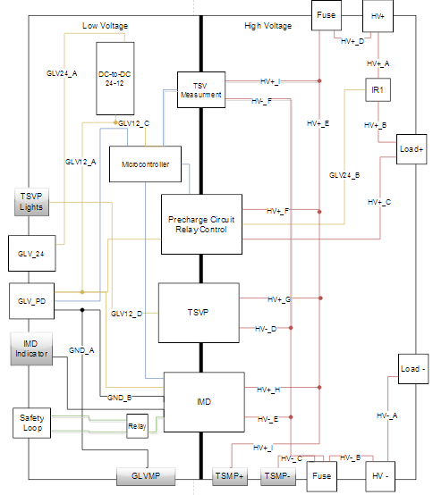
TSI

Slide 83
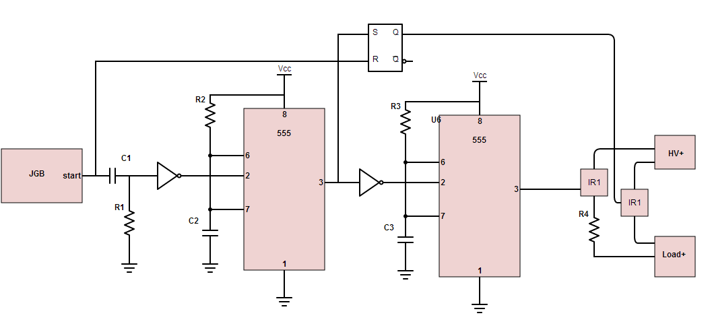
TSI - Pre-Charge/Relay Control
Precharge circuit prevents inrush current and damage to relay contacts
This configuration will take about 4 seconds for the motor controller to reach 96V

Slide 84
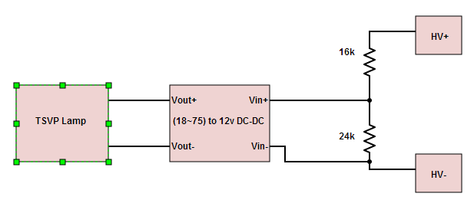
TSI - TSVP
Must be powered by TSV and grounded to GLV ground
Use a DC DC converter to satisfy this requirement and maintain isolation

Slide 85
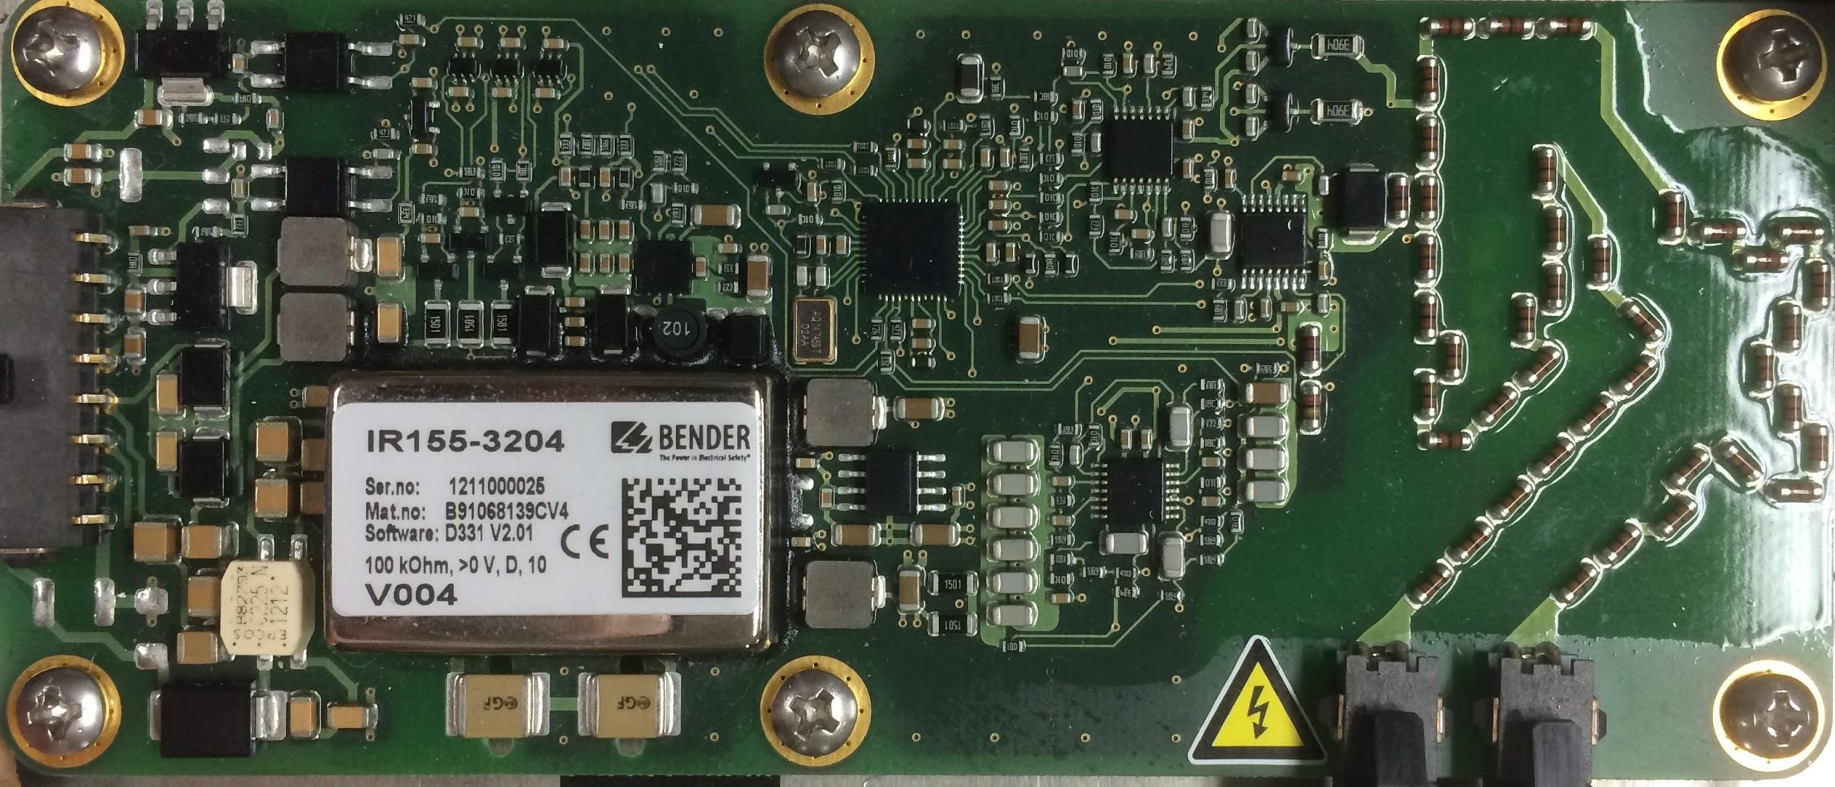
TSI - IMD
Pin 8 - Status Output High
Feeds directly to a relay on Safety Loop
Pin 8 output change opens Safety Loop (High → Low)

Slide 86
TSI - Other Components
GLV Power
24V to 12V DC-DC converter steps down the voltage from GLV24 to power the GLVPD at 12 Volts
TSMP
TSMP+ is a direct contact to the HV+ terminal
TSMP- is a direct contact to the HV- terminal
GLV GMP provides a reference to GLV ground

Slide 87
TSI - QA Configuration
Connect high voltage terminals to a high voltage power source
Connect the high voltage load terminals to the motor controller
Connect the GLV24 terminal to a low voltage power supply

Slide 88
TSI - QA Test Plan
TSVP Test
Apply 30 volts to high voltage power supply and check the TSVP output with a multimeter
Pre-charge/Relay Test
Put start signal high and measure time it takes relays to close
IMD Test
Using a multimeter, check for connection across the relay after shorting the ground

Slide 89
Roadmap
Meet the Morning Teams
Introduction: Motivation
Interface Control
System Assemblies Layout/Interfaces (Car)
System Assemblies Layout/Interfaces (Rack)
Interconnects
Panel Drawings and Hubs
Grounded Low Voltage (GLV)
Safety Loop
GLV Power
VCI
TSI
5. GLV BOM and Budget

Slide 90
GLV Bill of Materials
Description | Vendor Part Name | Quantity | Unit Price | Total Price
Te-Connectivity 2 pin/1 row parallel | 1-480699-0 | 4 | $0.28 | $1.12
Te-Connectivity 2 pin/1 row free | 1-480698-0 | 4 | $0.28 | $1.12
Te-Connectivity 3 pin/1 row parallel | 1-480701-0 | 6 | $0.28 | $1.68
Te-Connectivity 3 pin/1 row free | 1-480700-0 | 6 | $0.27 | $1.62
Te-Connectivity 8 pin/2 row parallel | 794954-8 | 4 | $0.25 | $1
Te-Connectivity 8 pin/2 row parallel | 794953-8 | 4 | $0.25 | $1
Te-Connectivity pin | 350561-3 | 10 | $0.14 | $1.38
Te-Connectivity socket | 350570-3 | 10 | $0.13 | $1.32
24V DIN Rail DC/DC Converter | TCL 060-124 DC | 1 | $80.62 | $80.62
DIN Rail DC/DC Converter | STMGFS152405-N2 | 1 | $69.05 | $69.05
36vdc PFC Power Supply | HRP-200-36 | 1 | $64.80 | $64.80
DIN Rail | 277-2064-ND | 1 | $9.82 | $9.82
DIN Rail Terminal Blocks | APC1281-ND | 50 | $1.33 | $66.63
SWITCH PUSH SPST-NO | CWI282-ND | 1 | $4.12 | $4.12
SWITCH KEYLOCK SP3T | KO129B606-ND | 1 | $9.80 | $9.80
DIODE SCHOTTKY 45V 7A | SB15H45-E3/73GITB-ND | 5 | $0.81 | $4.05
LED RED 1/4" HOLE 5V | L10021-ND | 5 | $2.17 | $10.85
Relay 5A 5V | Z2774-ND | 10 | $1.18 | $11.78
 |  |  | Grand Total | $341.76

Slide 91
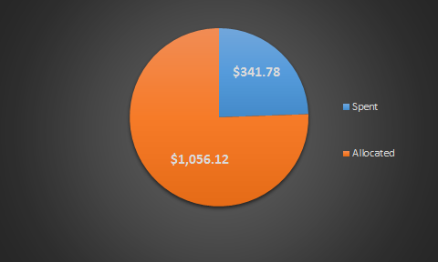
GLV Budget
Total Allocated Funds - $1397.90

Slide 92
Roadmap Cont.
Tractive System Voltage (TSV)
Overview
Safety
Mechanical
PacMan System
Charging
AMS
BoB
Acceptance Testing
Maintenance
6. Out of Scope: LFEV-2016
7. Conclusion

Slide 93
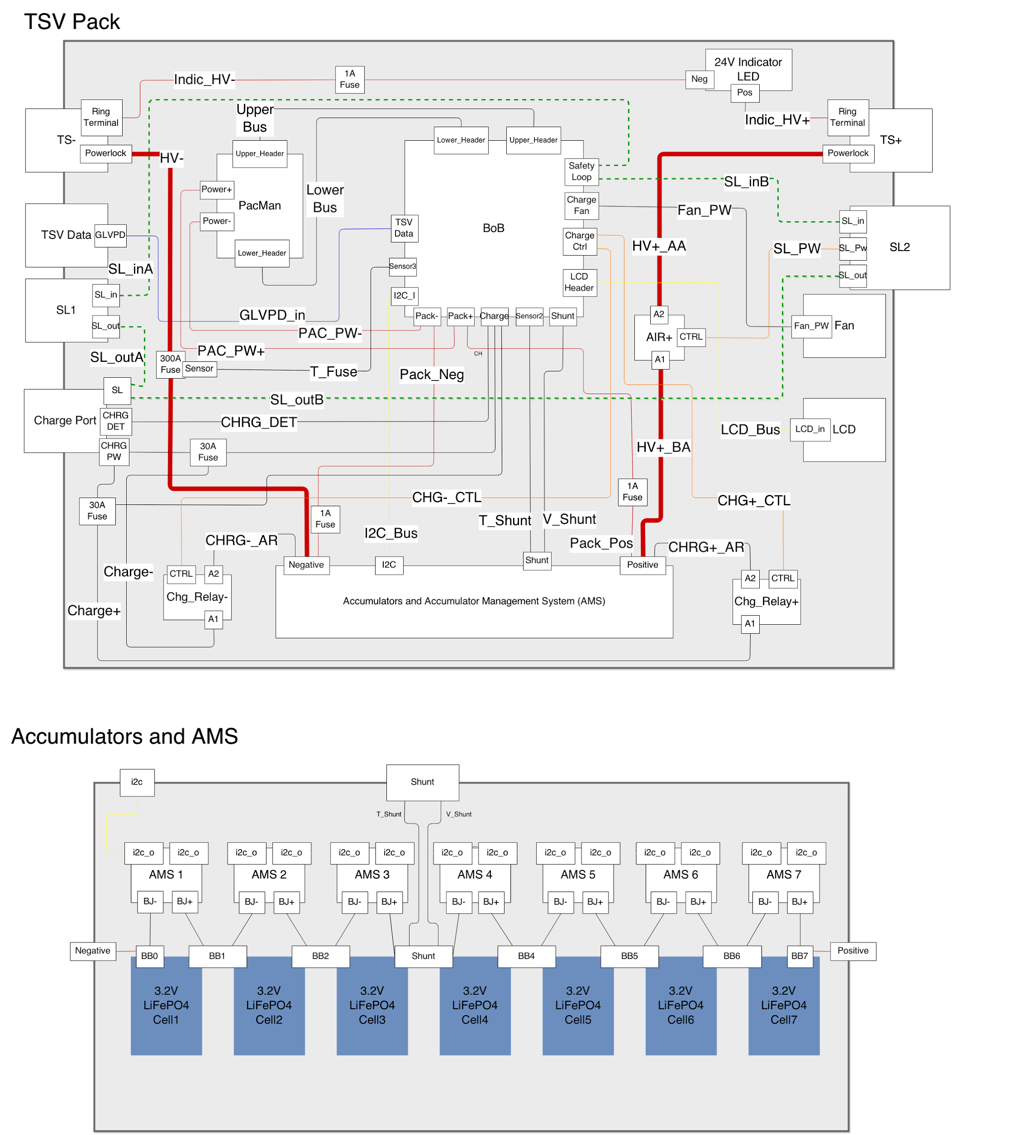
Tractive System Voltage

Slide 94
Main subsystems
Accumulator Managment System (AMS)
Breakout Board (BoB)
Pack Manager (PacMan)
7 3.2V 60A-hr LiFePO4 Cells

Slide 95
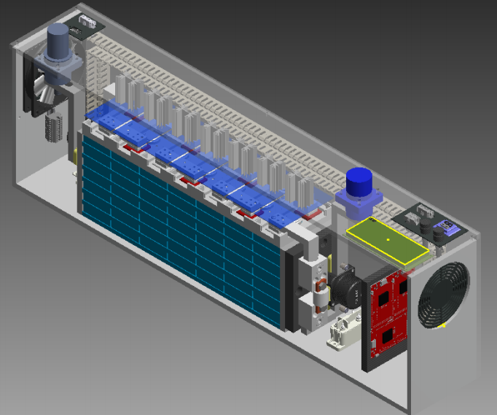

Slide 96
Roadmap Cont.
Tractive System Voltage (TSV)
Overview
Safety
Mechanical
PacMan System
Charging
AMS
BoB
Acceptance Testing
Maintenance
6. Out of Scope: LFEV-2016
7. Conclusion

Slide 97
TSV - Safety
Fusing
2 fuses for BoB
1 fuse for voltage present LED
1 large fuse for pack main current path
2 fuses for charge relay
Voltage present LED
turns on when voltage > 20V DC present at poles
can sustain voltage up to 96V
works even when a cell fails with all other packs connected
Safety protocols

Slide 98
Pack Safety Loop
One port at each end of the pack
Each contains safety loop and SL 24V/GND
SL 24V/GND used to power AIR
Safety path:

Slide 99
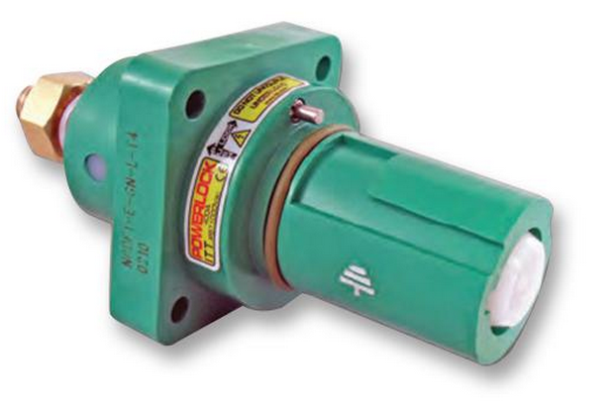
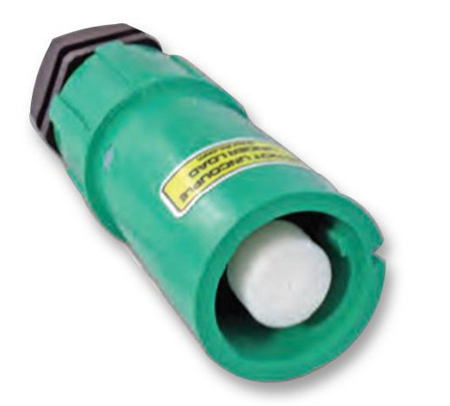
High Voltage Interfaces
4 “Danglies” one per pack
400A rated Newark 44W4352
Source Hangs off of pack with cable to + terminal
4 Panel mount female connectors
400A rated Newark 44W4361
Connected to - terminal bus bar
http://www.newark.com/itt-cannon/nls-3-gy-s120-m40a/line-source-line-3-grey-400a/dp/44W4352
http://www.newark.com/itt-cannon/npdft-3-gy-l-t4/panel-drain-line-3-grey-400a/dp/44W4361

Slide 100
Roadmap Cont.
Tractive System Voltage (TSV)
Overview
Safety
Mechanical
PacMan System
Charging
AMS
BoB
Acceptance Testing
Maintenance
6. Out of Scope: LFEV-2016
7. Conclusion

Slide 101
Mechanical Objectives
acceleration requirements
splash proof
internal wall
vibration
galvanic isolation

Slide 102
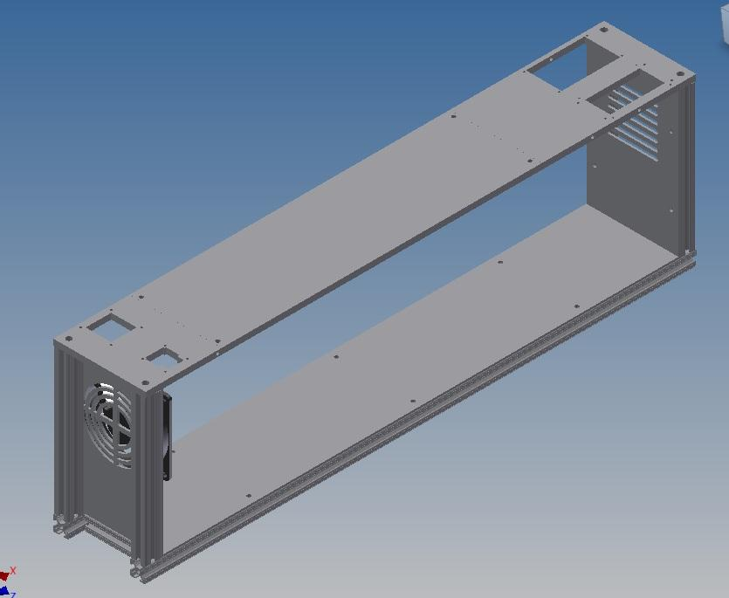
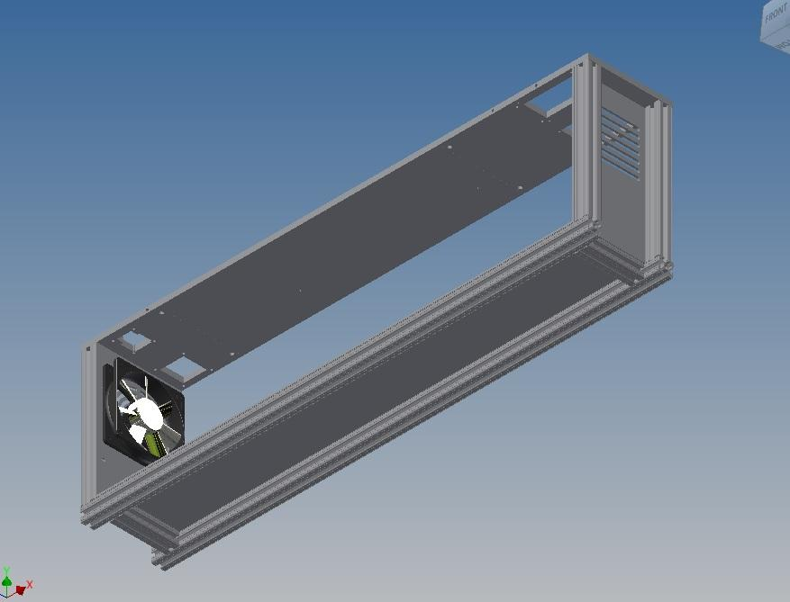
Mechanical- Frame/External Casing
Rigid 8020 Aluminum External Frame

Slide 103
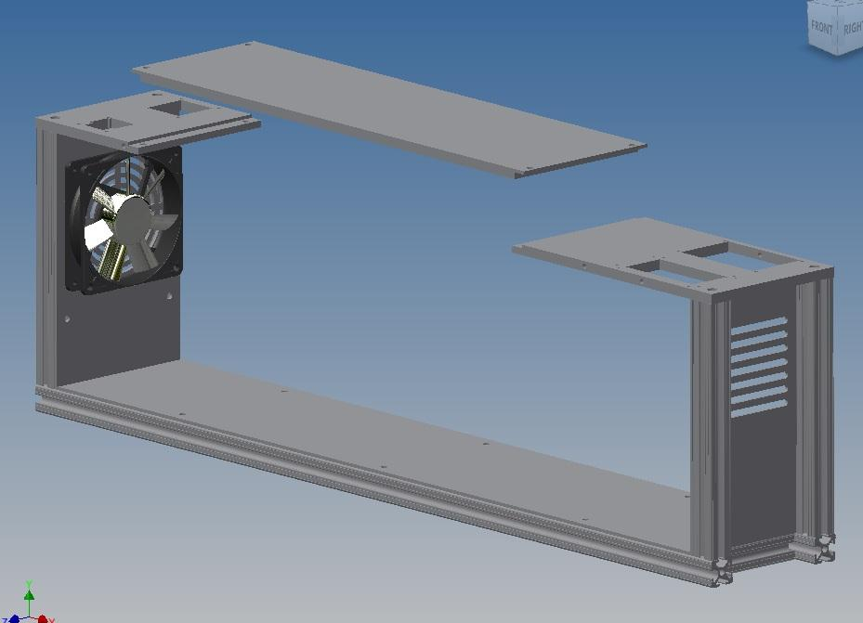
Mechanical- Frame/External Casing
-Removable Top For Quick Battery/BMS Access

Slide 104
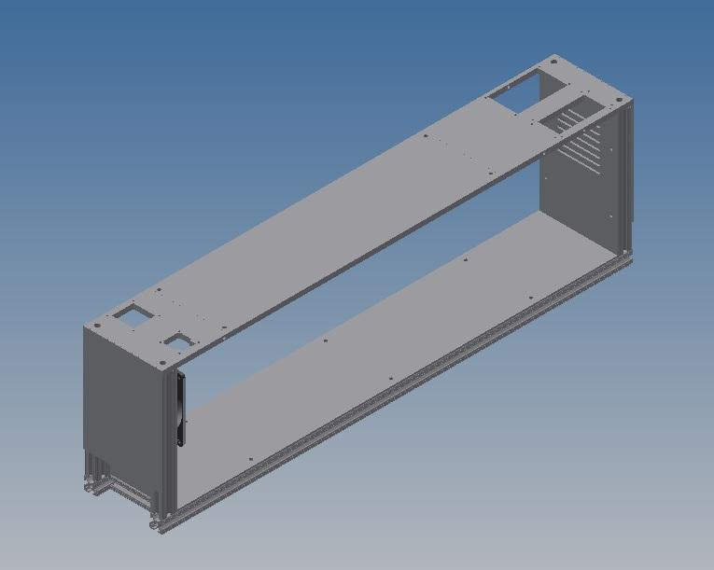
Mechanical- Frame/External Casing
-Splash Resistant Ventilation

Slide 105
Cell Restraint

Slide 106
Top Bars

Slide 107
Side Bars

Slide 108
End Plates

Slide 109
Integration with Container

Slide 110
BMS Restraint

Slide 111
BMS Removal

Slide 112
Added Components

Slide 113
Free Terminal

Slide 114
Mechanical - Conductor Bars
Carries large current
Low resistance

Slide 115
Mechanical - Current Measuring Shunt
Special conductor used to measure current
118μΩ at STP

Slide 116
Roadmap Cont.
Tractive System Voltage (TSV)
Overview
Safety
Mechanical
PacMan System
Charging
AMS
BoB
Acceptance Testing
Maintenance
6. Out of Scope: LFEV-2016
7. Conclusion

Slide 117
PacMan System
Receives and processes data from AMS
Receives and processes pack sensor data
Opens BoB safety loop
CAN communication with VSCADA and LCD
Implement charge and forget charging

Slide 118
PacMan Computer
https://www.embeddedarm.com/products/board-pictures.php?product=TS-7400-V2
Technologic Systems TS-7400-V2

Slide 119
PacMan Computer Hardware Specs
1.2W Typical power usage
6.67 Weeks for each pack
10mW sleep mode
15.35 years for each pack
I2C bus for AMS and LCD communication
CAN bus for VSCADA interface
4 ADC inputs for pack sensors
39 DIO ports for logic functions

Slide 120
PacMan Computer - Connections
5-28V DC Power
https://www.embeddedarm.com/products/board-pictures.php?product=TS-7400-V2

Slide 121
PacMan Computer - Connections
I2C Data
GND
I2C CLK
CPU 3.3V
Reg 5V
Reboot
GND
GND
Upper Header Pins
https://www.embeddedarm.com/products/board-pictures.php?product=TS-7400-V2

Slide 122
PacMan Computer - Connections
DIO_00
CPU 3.3V
DIO_01
DIO_02
DIO_03
DIO_04
DIO_05
DIO_02
DIO_07
DIO_04
DIO_09
GND
CAN_Rx0
CAN_Rx1
CAN_Tx0
CAN_Tx1
Reg 5V
ADC0
ADC1
ADC2
ADC3
Lower Header Pins
GND
https://www.embeddedarm.com/products/board-pictures.php?product=TS-7400-V2

Slide 123
PacMan Software
Debian 'Wheezy' Linux (Kernel 2.6.36)
Updates from 2014 team’s code
Correct State of Charge algorithm
Reboot should not invalidate state of charge
Temperature adjustment for current-measuring shunt
CAN communication with VSCADA

Slide 124
PacMan Safety Loop Control
Safety loop opened in 3 different ways
Charger plugged
Watchdog timeout
CPU DIO02 pin for software control
Watchdog fed by CPU DIO03 pin

Slide 125
VSCADA CAN Interface
No longer RS-485, new isolated chip
All 4 packs on the same main CAN line
When address prompted, will return all relevant data to VSCADA
CAN H
GLV 12V
CAN L
GLV GND
CAN
http://www.mouser.com/ProductDetail/TE-Connectivity-AMP/1-480705-0/?qs=OSEowtgdlxJxrUuPTLeZpA%3D%3D

Slide 126
Roadmap Cont.
Tractive System Voltage (TSV)
Overview
Safety
Mechanical
PacMan System
Charging
AMS
BoB
Acceptance Testing
Maintenance
6. Out of Scope: LFEV-2016
7. Conclusion

Slide 127
Charger-GENESYS 750W Half-Rack
http://www.testoon.com/images_produit/009789-full.jpg
http://sites.lafayette.edu/ece492-sp14/files/2014/02/LFEV-ESCM-2014-UsersManual.pdf

Slide 128
Charging
Anderson PowerPole connector used
Charge Detect
Charge Detect goes to BoB ends at PacMan
Charge +/-
Charge +/- go to charge relays
Safety Loop
Open when charging plug is plugged in
Closed when dummy plug is in charge port

Slide 129
Pack State Diagram

Slide 130
Charge Detect
Charger creates electrical connection between CHRG_DET1 and CHRG_DET2
Pulls CPU DIO06 pin high through optoisolator

Slide 131
Cooling
When bypassing cells, they get HOT
When charger is plugged, fan switches on
Fan powered by charger to not deplete batteries
Reducing heat sink to half height
Thermal resistance now 3.7 ℃/W @ 200 LFM
With 10.2W power, 37.74 ℃ rise
http://www.mouser.com/ProductDetail/ebm-papst/4414F/?qs=sGAEpiMZZMt8mcbdCMUjUxEnE1a%2fhD2SdPrUzYqJg8M%3d
http://www.digikey.com/product-detail/en/657-20ABP/345-1035-ND/340333?WT.z_cid=ref_octopart_dkc_buynow&site=us

Slide 132
Charge Relays
We will be using a normally closed charge relay
This fixes previous error where pack was unchargeable when depleted
Charging is finished when all AMS bypass
CPU DIO00 pin signals CHRG_TRIG to optoisolator for charge relays to open when charging is finished
Using relay - OMRON MGN1C-DC24
SPDT - can wire to be NO or NC
24V DC 30A

Slide 133
Roadmap Cont.
Tractive System Voltage (TSV)
Overview
Safety
Mechanical
PacMan System
Charging
AMS
BoB
Acceptance Testing
Maintenance
6. Out of Scope: LFEV-2016
7. Conclusion

Slide 134
Accumulators and AMS

Slide 135
Accumulator Management System Board
Boards monitor attributes of each assigned cell
Voltage levels
Current levels
Ability to bypass cell during charging
Reports back to PacMan through I²C
Board Reset
Software
Remote/Manual
Notes:
→ Each board is assigned an unique address upon configuration.

Slide 136
AMS Command List

Slide 137
AMS Software Bug
Bugs documented by LFEV-2013
No constraint to force PacMan to wait until the AMS board has processed a request
Results: incorrect data readings on the first response
2. Concurrency issues in memory: read/write collisions
Results: possible retrieval of unwanted data
LFEV-2015 Goals
Manipulate clocks so that no additional requests could be sent by PacMan until original request is processed.
Implement constraints so that data cannot be read and written at the same time
Notes:
→ Bug patched by LFEV-2014: they discard the first read and any reads that are all zeros
slave can hold the clock line

Slide 138
AMS Software Reset
Initialization: PacMan will attempt to communicate with each board
Failed attempt → reset of that board
Error & Reset will display on Pack LCD

Slide 139
AMS Remote Reset
LFEV 2014’s Design → LFEV 2015 utilizing it
Asserted by manual reset button through PacMan BoB
Notes:
Last Year’s Design: Asserting 3.3 V on RST_POS of J3/J2 of the AMS board will reset it.
This Year: including manual reset button to assert this through

Slide 140
Roadmap Cont.
Tractive System Voltage (TSV)
Overview
Safety
Mechanical
PacMan System
Charging
AMS
BoB
Acceptance Testing
Maintenance
6. Out of Scope: LFEV-2016
7. Conclusion

Slide 141
PacMan Breakout Board
Acts as connector between TS-7400-V2 and the AMS boards and proper sensor relays
Contains circuitry used for current, temperature, and pack voltage measurements
Includes isolation chips to provide galvanic isolation between low and high voltage circuits

Slide 142
PacMan BoB Manual Reset
MB2000 series switch pushbutton (NKK Switches)
RESET_POS
RESET_NEG
J22
6N135 high-speed optocoupler (Vishay Semiconductors)
U16
Notes:
PUSHBUTTON
meets requirements: splashproof & waterproof
UL standards

Slide 143
PacMan BoB Layout Errata

Slide 144
Roadmap Cont.
Tractive System Voltage (TSV)
Overview
Safety
Mechanical
PacMan System
Charging
AMS
BoB
Acceptance Testing
Maintenance
6. Out of Scope: LFEV-2016
7. Conclusion

Slide 145
Acceptance Testing
Overview
Designed around requirements
Minimizing time and charge cycles needed
Repeatable for individual packs
Focus
Safety
Plug-and-forget charging
Accuracy of measurands
New SoC algorithm

Slide 146
Acceptance Testing Cont.
Test configuration A

Slide 147
Acceptance Testing Cont.
Test configuration B

Slide 148
Acceptance Testing Cont.
T000: Pack Display and Safety Qualification
Prerequisite for all other tests
Configuration A
No active load
Measurement accuracy verification
Safety checks (isolation, sensor readings)
Controls/reset tests

Slide 149
Acceptance Testing Cont.
T001: Low Current Discharge Test
Discharge cycle
Configuration A
Safety features tested (safety loop, low-voltage protection, temp/voltage sensors)
Un-balances cells for subsequent tests
Measurement accuracy verification
SoC tested

Slide 150
Acceptance Testing Cont.
T002: Charge Cycle Test
Complete charge cycle
Configuration B
Charges at two different rates to test SoC
Safety loop tested
Measurement accuracy verification
Cell-balancing tested
Plug-and-forget feature tested

Slide 151
Acceptance Testing Cont.
T003: High/low Current Discharge Test
Discharge cycle
Configuration A
Discharge at 3 different rates (high/low/paused)
Max current performance tested
Measurement accuracy verification
Safety features tested
SoC tested
Simulates real-life use case

Slide 152
Roadmap Cont.
Tractive System Voltage (TSV)
Overview
Safety
Mechanical
PacMan System
Charging
AMS
BoB
Acceptance Testing
Maintenance
6. Out of Scope: LFEV-2016
7. Conclusion

Slide 153
Maintainability
Hardware
MTTR = 1 day for most parts when spare parts on hand
MTTR < 8 days for most parts when no spare parts available
Full analysis in maintainability plan

Slide 154
Maintainability Cont.
Software
PacMan software and AMS firmware
Source control
Backup/restore
Instructions for programming
Compatibility with VSCADA

Slide 155
TSV BOM & Budget

Slide 156
AMS

Slide 157
PacMan & BOB

Slide 158
Pack Electrical Parts (page 1)

Slide 159
Pack Electrical Parts (page 2)

Slide 160
Budget
Initially allocated money:
Dyno - $148
SCADA - $715
GLV - $1397.90
TSV - $2739.10

Slide 161
Budget
Money Spent so far
Dyno - $362
TSV - $1026.03
SCADA - $304.26
GLV - $10.24

Slide 162
Budget
Current status of money:

Slide 163
Roadmap Cont.
Tractive System Voltage (TSV)
Overview
Safety
Mechanical
PacMan System
Charging
AMS
BoB
Acceptance Testing
Maintenance
6. Out of Scope: LFEV-2016
7. Conclusion

Slide 164
Out of Scope: LFEV-2016
GLV
Implement AIR failure sensors

Slide 165
Out of Scope: LFEV-2016 Cont.
TSV
Implement AIR failure sensors
Low voltage indicator light
Building 4 complete packs

Slide 166
Roadmap
Tractive System Voltage (TSV)
Overview
Safety
Mechanical
PacMan System
Charging
AMS
BoB
Acceptance Testing
Maintenance
6. Out of Scope: LFEV-2016
7. Conclusion

Slide 167
Conclusion

