Slide 1
Lafayette Electric Vehicle 2015
ECE 492: Senior Design II
Afternoon Critical Design Review
March 11, 2015
Hugel 100

Slide 2
Roadmap
Meet the Afternoon Teams
Interface Control Review
Vehicle Supervisory Control and Data Acquisition (VSCADA)
Daemon
Interfacing
User Applications
Data Storage
Dynamometer (DYNO)
Decomposition and Definition
Integration and Recomposition

Slide 3
Roadmap
Meet the Afternoon Teams
Interface Control Review
Vehicle Supervisory Control and Data Acquisition (VSCADA)
Daemon
Interfacing
User Applications
Data Storage
Dynamometer (DYNO)
Decomposition and Definition
Integration and Recomposition

Slide 4
Meet the Afternoon Teams
Vehicle Supervisory Control and Data Acquisition (VSCADA)
Yiming Chen
Bikram Shrestha
Rameel Sethi
John Gehrig
Sam Cesario
Adam Cornwell
Dynamometer (DYNO)
Steve Mazich
Brendan Malone
John Bloore
Nate Hand
Alex Hytha

Slide 5
Roadmap
Meet the Afternoon Teams
Interface Control Review
Vehicle Supervisory Control and Data Acquisition (VSCADA)
Daemon
Interfacing
User Applications
Data Storage
Dynamometer (DYNO)
Decomposition and Definition
Integration and Recomposition

Slide 6
Interface Control
An Interface Control Document was created to accurately and completely define all (electrical, mechanical, semantic) aspects of top-level interfaces to allow different designers to coordinate with each other successfully.
Next, we will discuss these top-level interfaces.

Slide 7
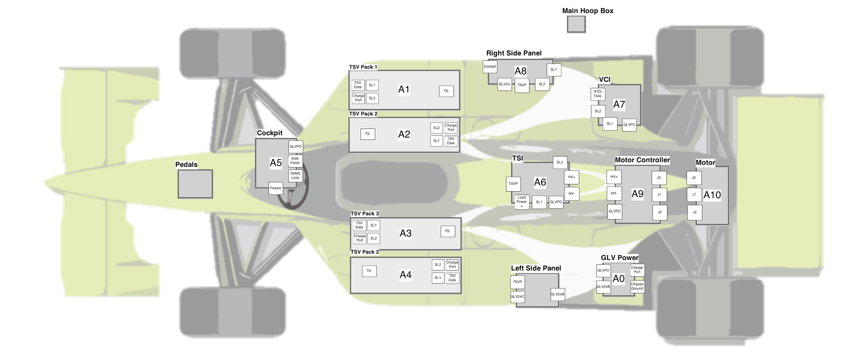
System Assemblies Layout - Top View

Slide 8
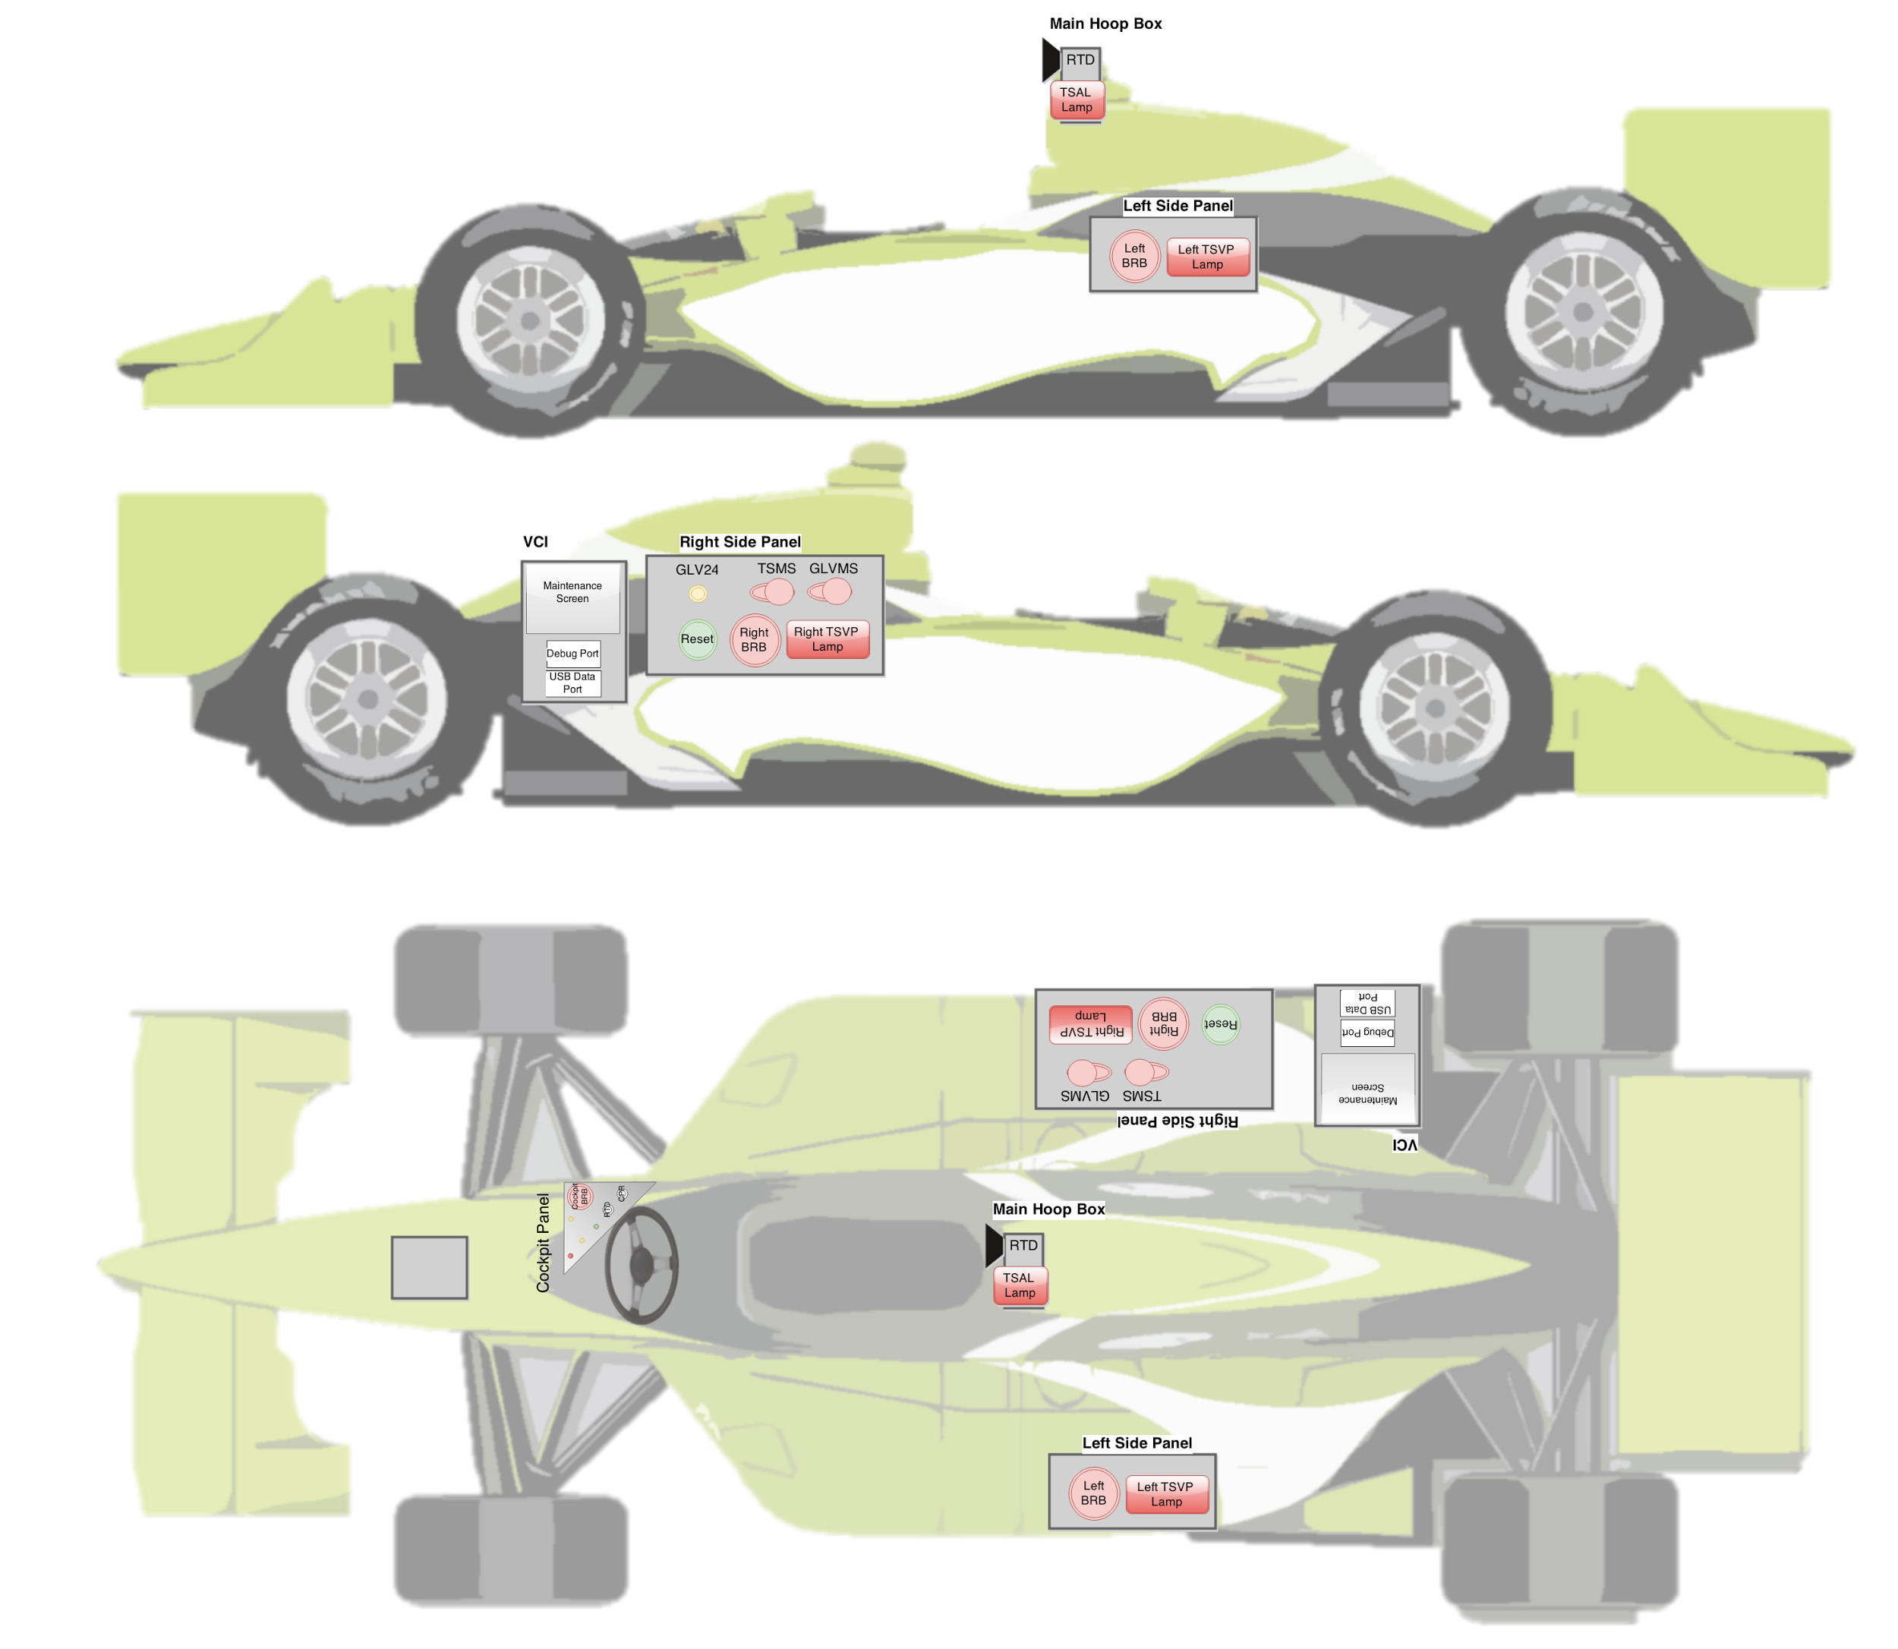
Physical Interfaces Layout - Side View

Slide 9
Physical Interfaces Layout - Top View

Slide 10
System Assemblies Layout

Slide 11
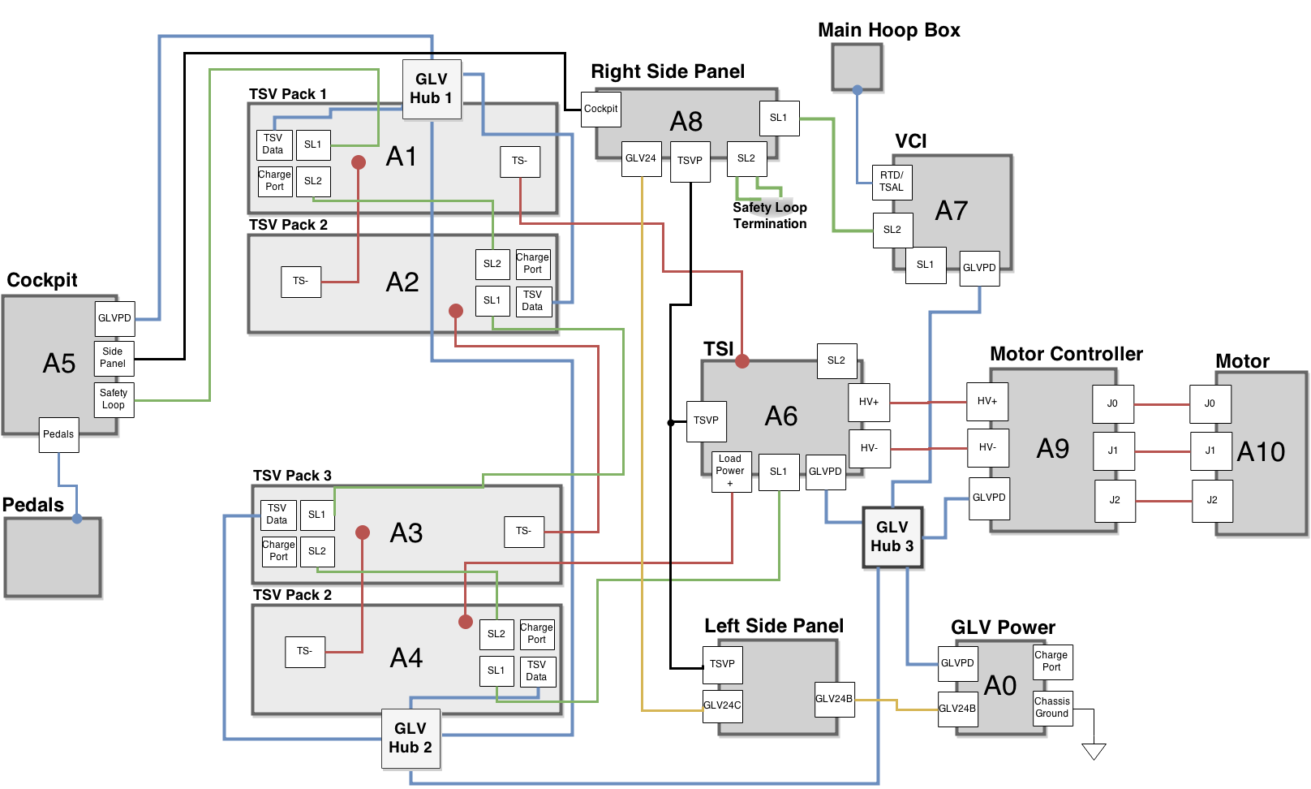
Notes:
Close to physical layout on car -Sam

Slide 12
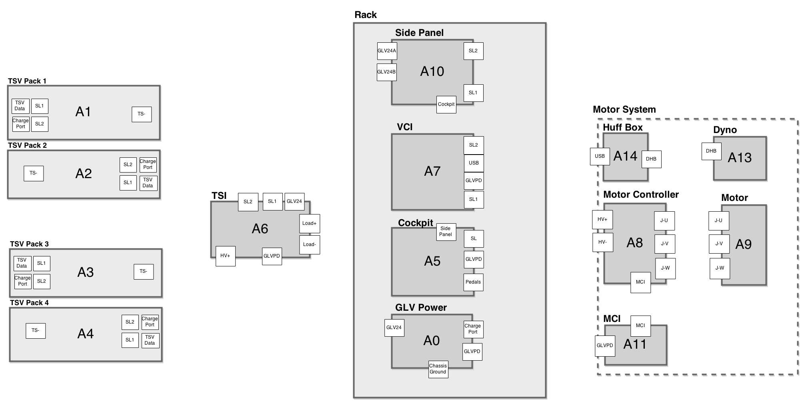
Notes:
Look in Lab -Sam

Slide 13
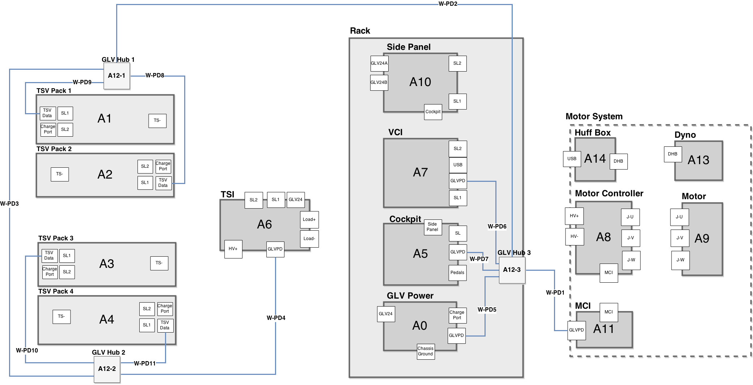
Notes:
GLV Connections, Hubs are JGB’s?? -Sam

Slide 14
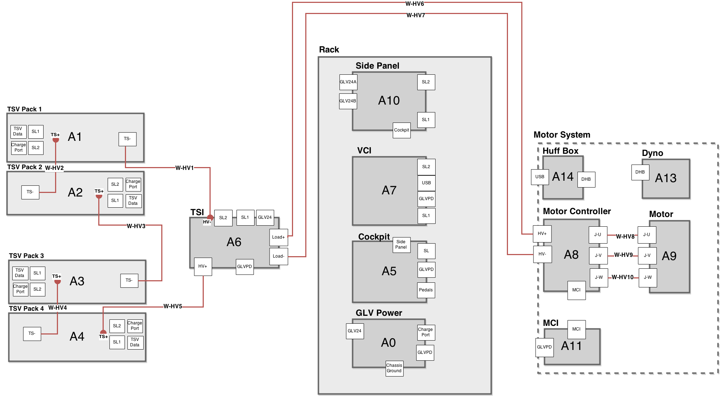
Notes:
High Voltage for DYNO -DYNO

Slide 15
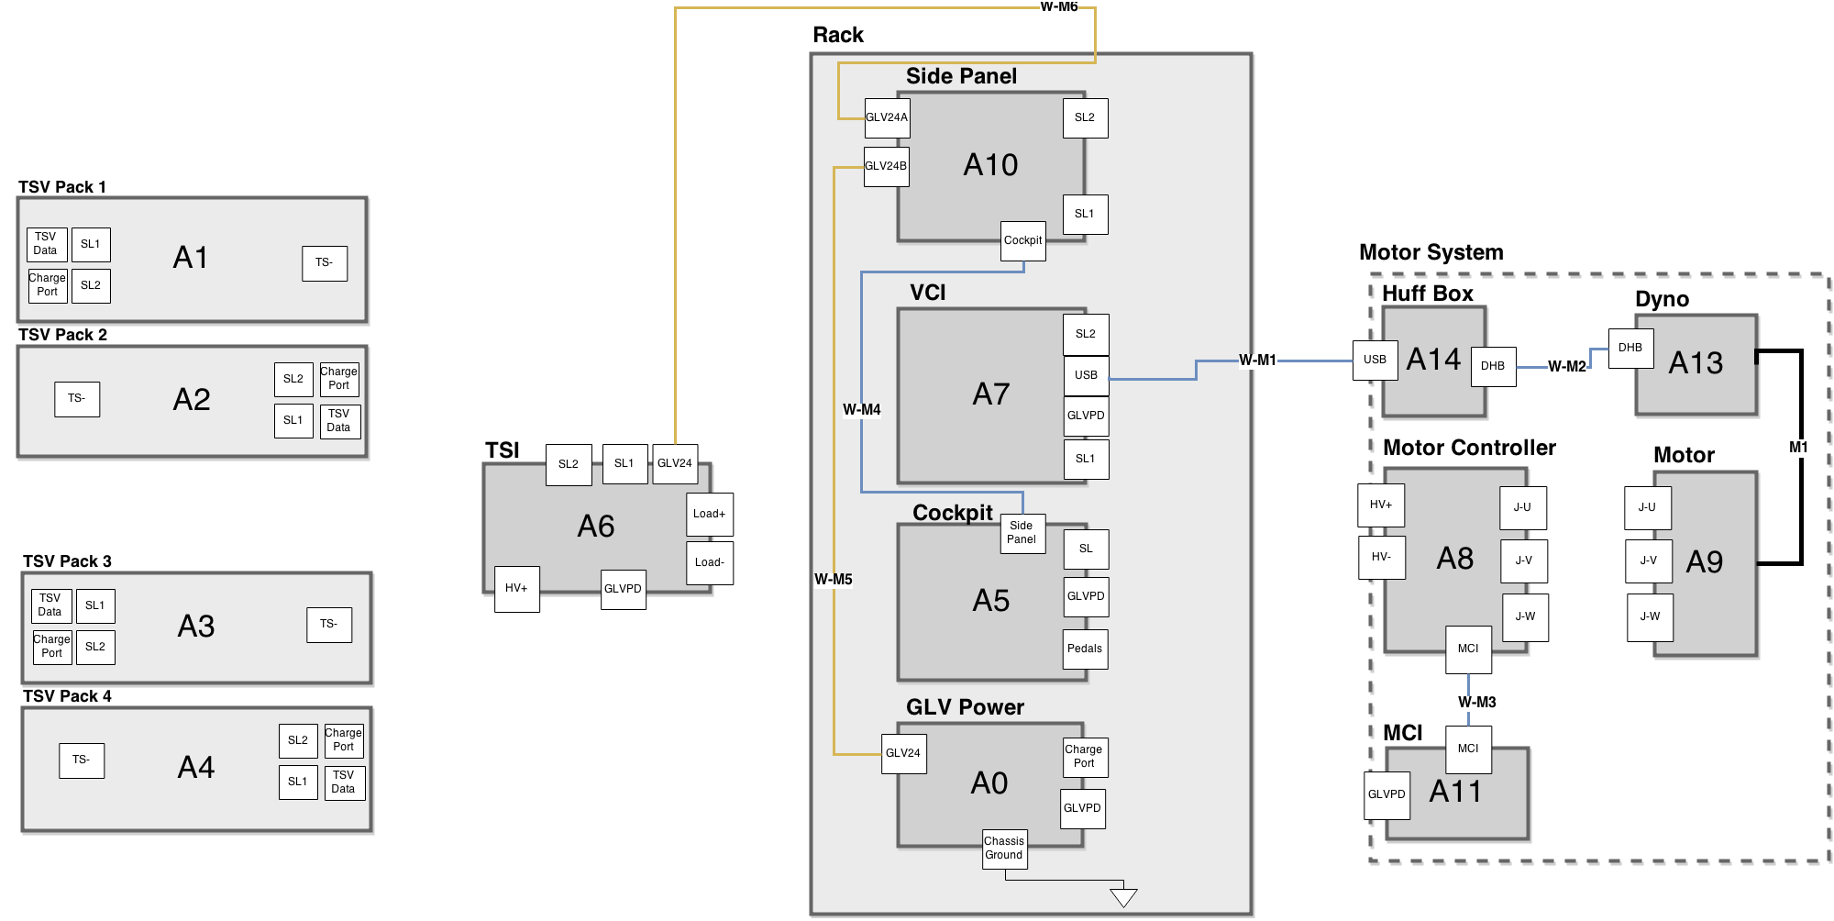
Notes:
More DYNO connections -DYNO

Slide 16
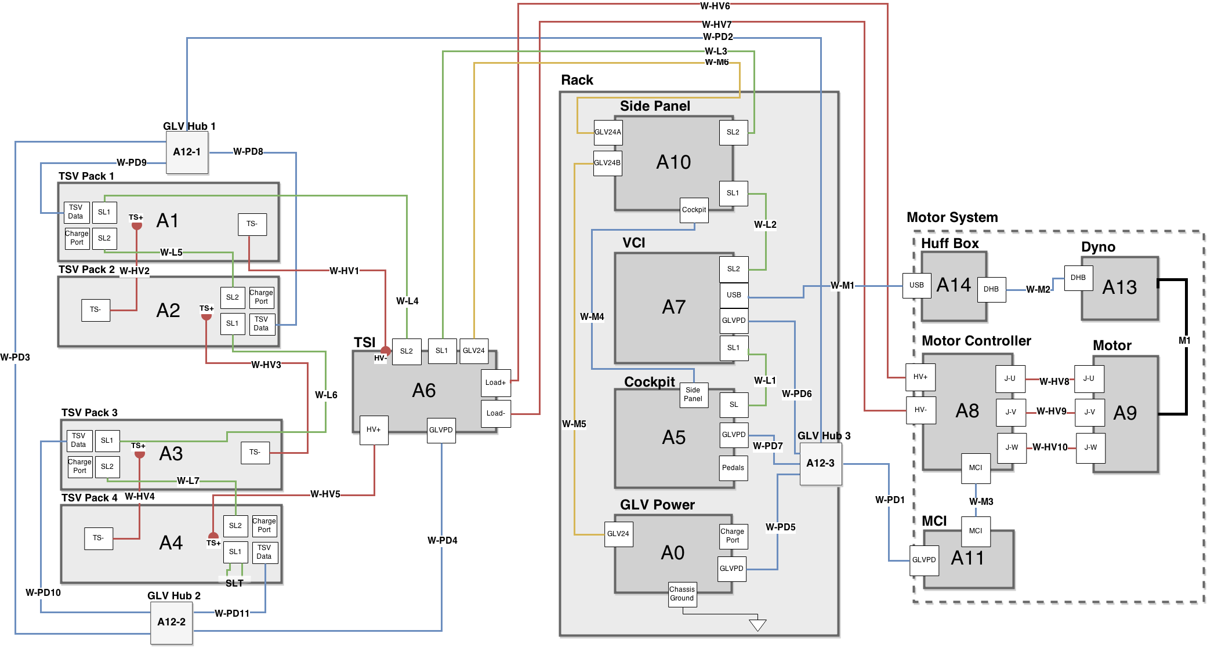
Notes:
Full System ICD -Sam

Slide 17
Roadmap
Meet the Afternoon Teams
Interface Control Review
Vehicle Supervisory Control and Data Acquisition (VSCADA)
Daemon
Interfacing
User Applications
Data Storage
Dynamometer (DYNO)
Decomposition and Definition
Integration and Recomposition

Slide 18
VCI

Slide 19
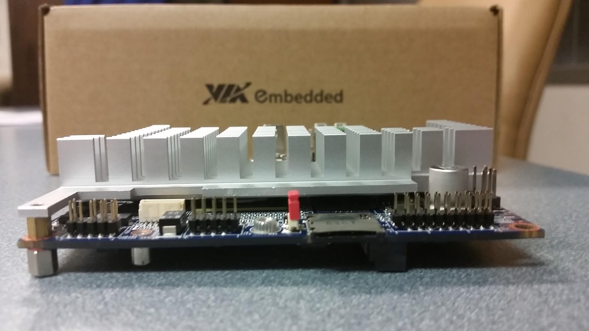
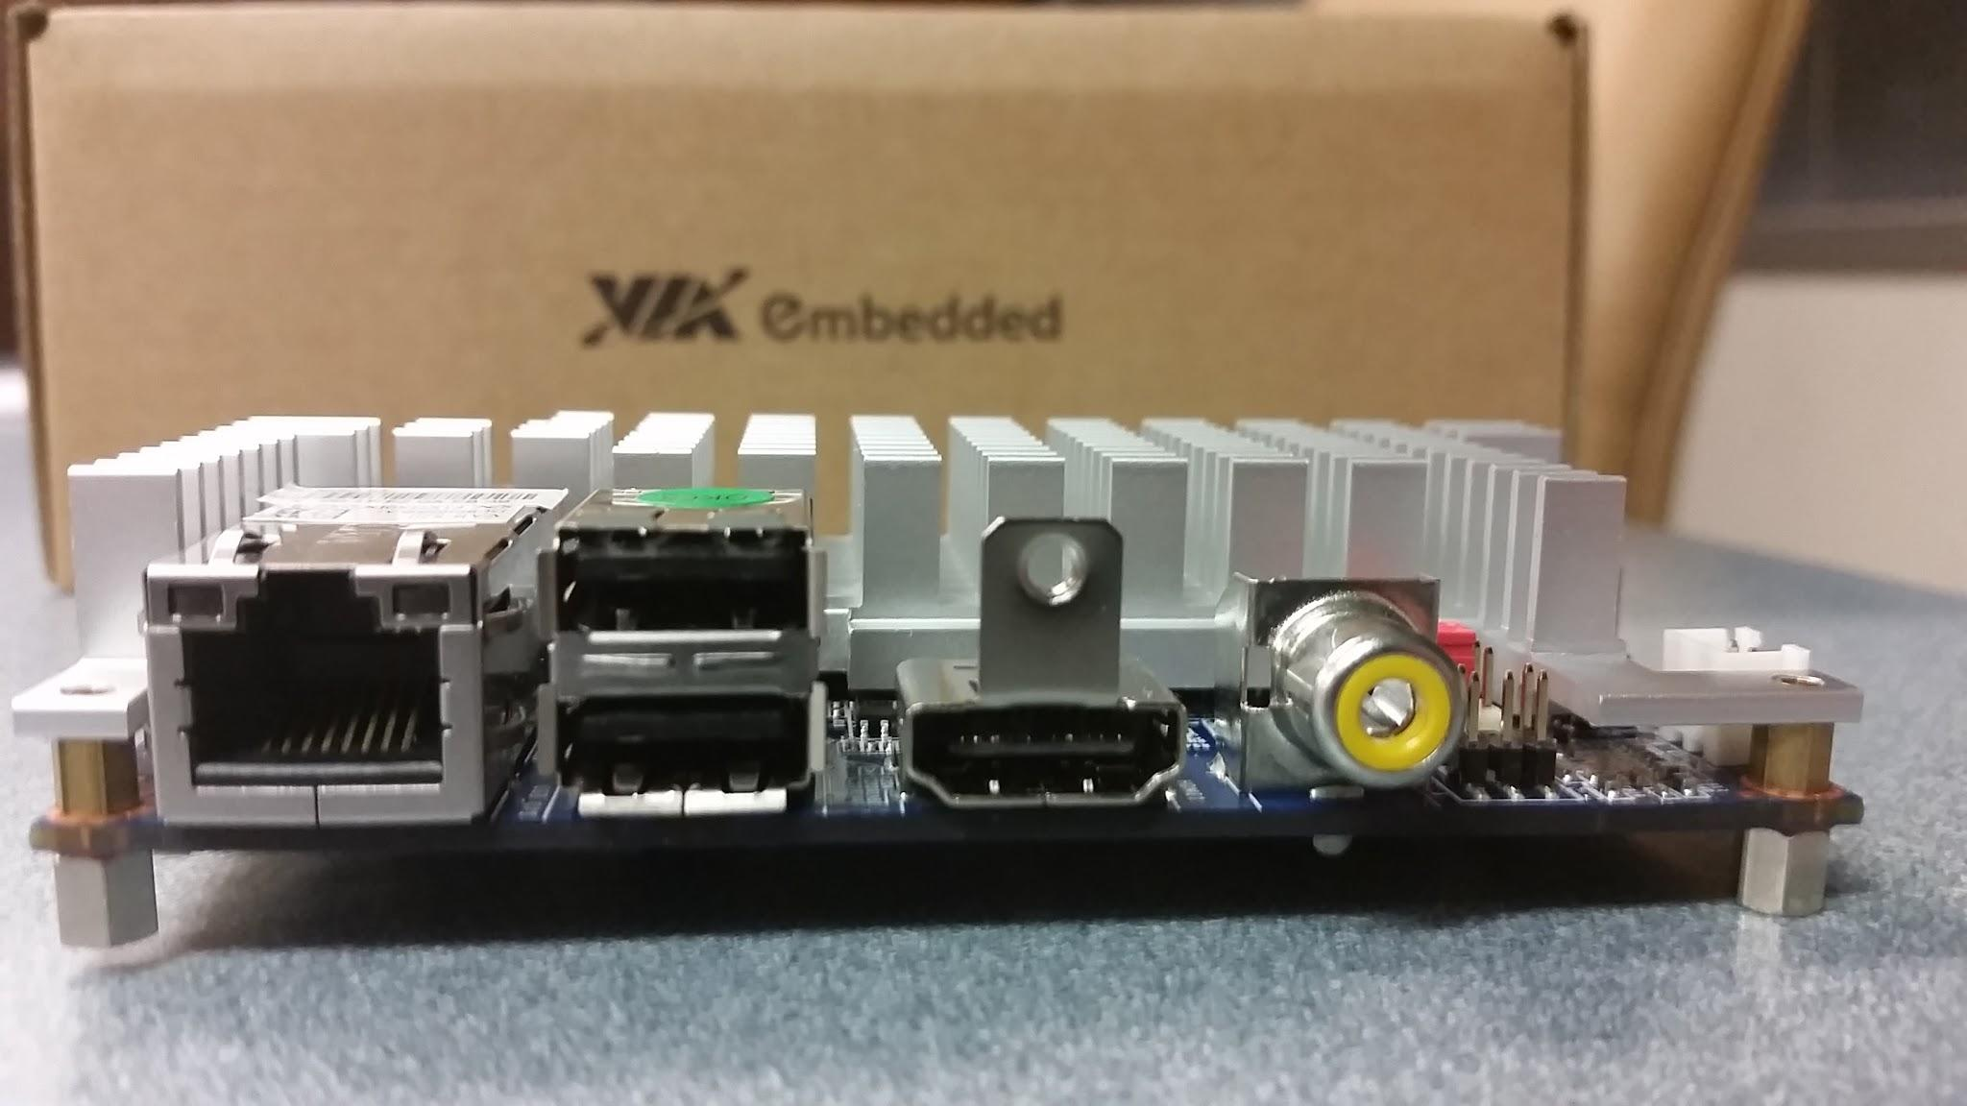
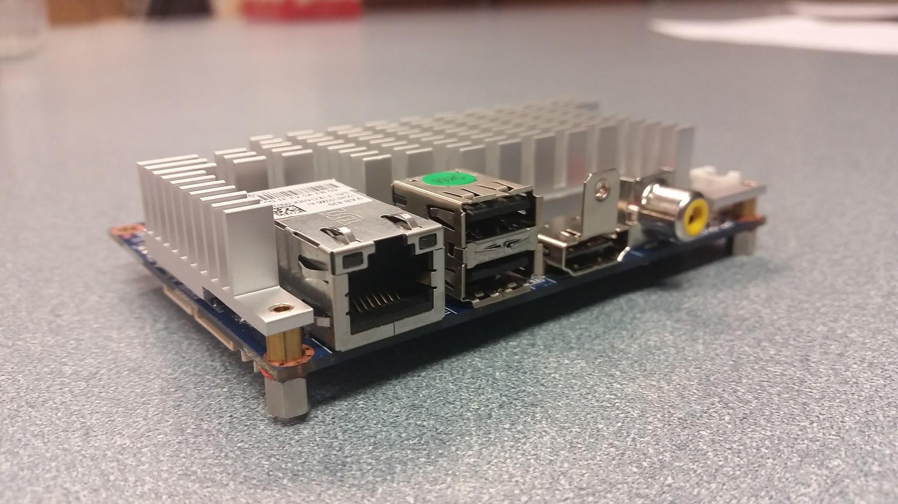
Embedded Computer: VAB-820

Slide 20
VSCADA
Notes:
Block Diagram inside the Cockpit - Yiming

Slide 21
Roadmap
Meet the Afternoon Teams
Interface Control Review
Vehicle Supervisory Control and Data Acquisition (VSCADA)
Daemon
Interfacing
User Applications
Data Storage
Dynamometer (DYNO)
Decomposition and Definition
Integration and Recomposition

Slide 22
Logging/Daemons - Main Program
VSCADA uses systemd to initially launch the main program
systemd has most major linux distributions support
The main program will run in the background as the server with PID registered
The main program will start by doing system startup procedures

Slide 23
Logging/Daemons - Startup
VSCADA uses systemd to initially launch the main program
systemd has most major linux distributions support
The main program will run in the background as the server with PID registered
The main program will start by doing system startup procedures

Slide 24
System Startup

Slide 25
System States and Exceptions
Startup Stage
When system boots up and will goto one of the following stages
Good to Go Stage
No error or warning and is ready to be driven
Driving Stage
The car is drving
Vehicle Boot Up Error Stage
VSCADA is functional but other subsystems are not
VSCADA Boot Up Error Stage
VSCADA is not functional
Failed Stage
VSCADA failed to boot up
You are not allowed to drive if in these error stages

Slide 26
System States and Exceptions
Sensor Errors:
Logic:
Errors are configurable and specific
If happens before driving, then the car is disabled from driving;
else take actions according to sensor configuration
Possible Errors:
OverHeating
UnderCharged
System Errors:
Snytax error
Failed Stage
VehicleStartupConfigLoadException
Other Boot Up Error Stage
DatabaseLoadException
VSCADA Boot Up Error Stage
RRDFileNotFoundException
VSCADA Boot Up Error Stage
VehicleStartupTimeoutException
Other Boot Up Error Stage
SensorCheckingTimeoutException
Other Boot Up Error Stage
SystemFailureError
Failed Stage
OtherCommunicationException
Vehicle Boot Up Error Stage
OtherSystemException
VSCADA Boot Up Error Stage

Slide 27
Logging/Daemons - Logging
Have 5 levels, in their respective order:
Debug: detailed information, mainly used for debugging
Info: general information, should contain important data
Warning: Need user’s attention
Error: Need user to check the source of the error
Critical: Opps.
Logs are stored in syslog of Linux
syslog handles storage, update, filter, etc.
Python and other library support for syslog
Can be viewed by clients over the TCP protocol
Levels can be set by configuration. Info level by default

Slide 28
Roadmap
Meet the Afternoon Teams
Interface Control Review
Vehicle Supervisory Control and Data Acquisition (VSCADA)
Daemon
Interfacing
User Applications
Data Storage
Dynamometer (DYNO)
Decomposition and Definition
Integration and Recomposition

Slide 29
Interfaces
TSV Communication
Send/Receive Packets of data from the four PACMAN via CAN
will follow API
GLV Communication
JGB act as a hub for groups of sensors via CAN
DYNO Communication
Control Throttle via JGB board
Motor Controller CAN
Dynamometer - USB interface to read RPM and torque, set valve

Slide 30
CAN Interface
SocketCAN -Linux Drivers
Python-CAN

Slide 31
TSV Pack LevelCAN Frame
BYTE 0
BYTE 1
BYTE 2
BYTE 3
BYTE 4
BYTE 5
BYTE 6
BYTE 7
Byte 0 - 1,Pack#(1-4)
Byte 1 - Voltage (High)
Byte 2 - Voltage (Low)
Byte 3 - Current (High)
Byte 4 - Current (Low)
Byte 5 - SOC (High)
Byte 6 - SOC (Low)
Byte 7 - Fuse Temp

Slide 32
TSV(1) AMS Level CAN Frame
BYTE 0
BYTE 1
BYTE 2
BYTE 3
BYTE 4
BYTE 5
BYTE 6
BYTE 7
Byte 0 - x1,Pack#(1-4)
Byte 1 - AMS#(1-7)
Byte 2 - Voltage (High)
Byte 3 - Voltage (Low)
Byte 4 - Current (High)
Byte 5 - Current (Low)
Byte 6 - Temperature (High)
Byte 7 - Temperature (Low)

Slide 33
GLV(2) Cockpit CAN Frame
BYTE 0
BYTE 1
BYTE 2
BYTE 3
BYTE 4
BYTE 5
BYTE 6
BYTE 7
Byte 0 - x21 (Cockpit)
Byte 1 - Ambient_temp (High)
Byte 2 - Ambient_temp (Low)
Byte 3 - Failure_LED (High)
Byte 4 - Failure_LED (High)
Byte 5 - Warning_LED(High)
Byte 6 - Ok_LED (High)
Byte 7 - Ok_LED (Low)

Slide 34
GLV(2) TSI CAN Frame
BYTE 0
BYTE 1
BYTE 2
BYTE 3
BYTE 4
BYTE 5
BYTE 6
BYTE 7
Byte 0 - x22 (TSI)
Byte 1 - Temperature (High)
Byte 2 - Temperature (Low)
Byte 3 - x00
Byte 4 - x00
Byte 5 - x00
Byte 6 - x00
Byte 7 - x00

Slide 35
GLV(3) GLV_Power CAN Frame
BYTE 0
BYTE 1
BYTE 2
BYTE 3
BYTE 4
BYTE 5
BYTE 6
BYTE 7
Byte 0 - x13
Byte 1 - Voltage (High)
Byte 2 - Voltage (Low)
Byte 3 - Current (High)
Byte 4 - Current (Low)
Byte 5 - Temperature (High)
Byte 6 - Temperature (Low)
Byte 7 - SOC

Slide 36
Motor Controller CAN Frames (1 / 2)
BYTE 0
BYTE 1
BYTE 2
BYTE 3
BYTE 4
BYTE 5
BYTE 6
BYTE 7
Byte 0 - RPM (High)
Byte 1 - RPM (Low)
Byte 2 - Motor Temp
Byte 3 - Controller Temp
Byte 4 - RMS Current (High)
Byte 5 - RMS Current (Low)
Byte 6 - Capacitor V (High)
Byte 7 - Capacitor V (Low)

Slide 37
Motor Controller CAN Frames (2 / 2)
BYTE 0
BYTE 1
BYTE 2
BYTE 3
BYTE 4
BYTE 5
BYTE 6
BYTE 7
Byte 0 - Stator Freq (High)
Byte 1 - Stator Freq (Low)
Byte 2 - Controller Fault P
Byte 3 - Controller Fault S
Byte 4 - Throttle Input
Byte 5 - Brake Input
Byte 6 - System Bits
Byte 7 - (UNUSED)

Slide 38
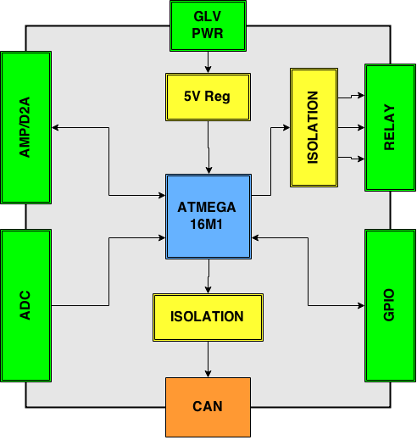
CAN Microcontroller Board (JGB)
Automotive AVR
CAN Bus
LIN
UART (RS-232)
Board Inputs/Outputs
Internal Temperature
5 ADC Channels
3 PWM Channels
1 DAC Channel
6 GPIO/SPI
2 Differential ADC
USB - UART

Slide 39
Microcontroller Firmware Design
UART
Send/Receive Test/Debugging Information
CAN
SCADA Communication
TIMER
PWM, Sensor Timing
WATCHDOG TIMER
Crash Prevention
I/O
System Control Interface

Slide 40
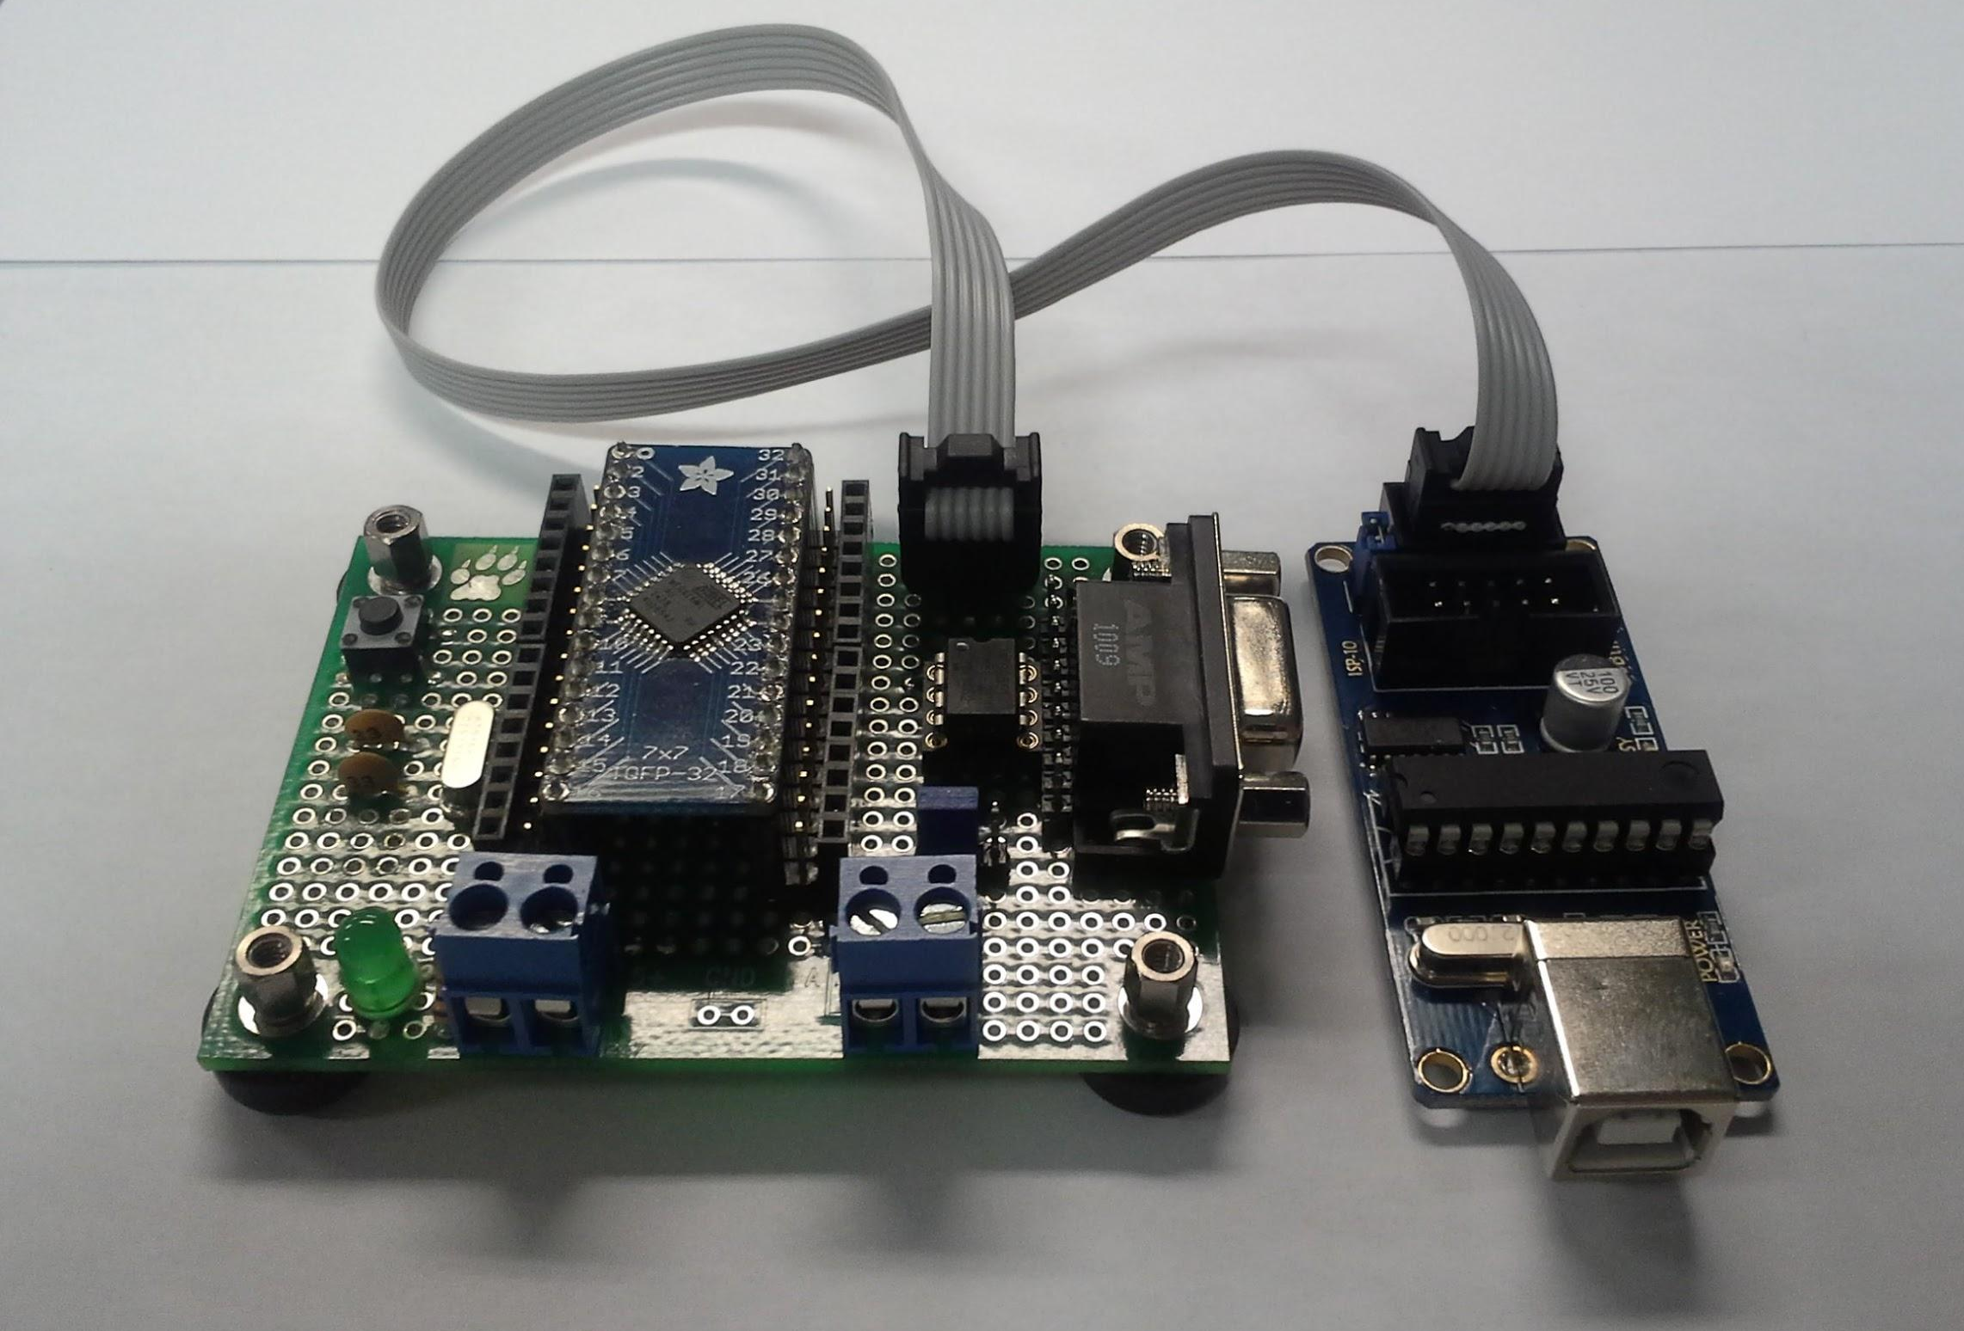
Microcontroller Prototype Hardware
WORKING:
ADC
D2A
PWM
GPIO
NOT WORKING:
CAN
UART

Slide 41
Microcontroller CAN Frames
BYTE 0
BYTE 1
BYTE 2
BYTE 3
BYTE 4
BYTE 5
BYTE 6
BYTE 7
Byte 0 -
Byte 1 -
Byte 2 -
Byte 3 -
Byte 4 -
Byte 5 -
Byte 6 -
Byte 7 -

Slide 42
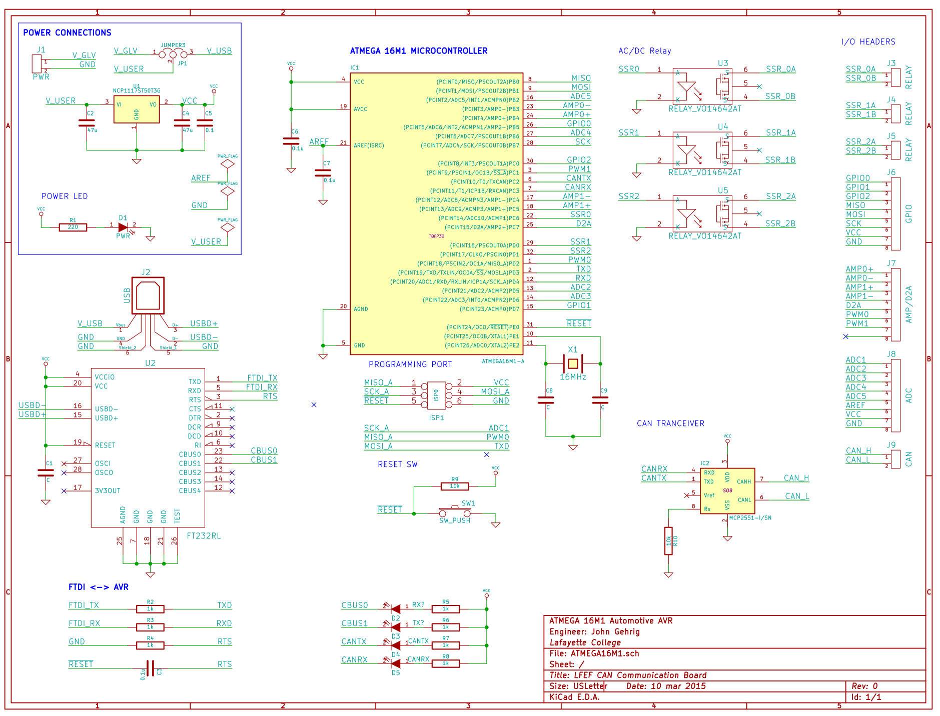

Slide 43
Microcontroller Code/Toolchain
{INSERT CODE HERE/TOOLCHAIN IMAGES}

Slide 44
Client - Server Architecture
SERVER
(IP)
CLIENT
(WIRELESS)
CLIENT
(LOCAL)
TCP
TCP
Request - Response Model
Client Initiates Request
Server Responds to Request
JSON Object Passing
Unix-Style Commands
Modular, Flexible, Expandable

Slide 45
Server Command Architecture
Server Command Syntax:
CMD NAME
FLAGS
OPTIONS
ARGUMENTS
CMD NAME -
Unique command name, identifies specific server task to carry out.
FLAGS -
Enables or disables specific command functionality or output.
OPTIONS -
Utilized to pass data from the client to server.
ARGUMENTS -
End objects affected by the server command.
Syntax Notes:
All command Options, Flags, Arguments space separated.
Flags begin with the “-” character.
Options are followed by a string containing no spaces.

Slide 46
Server - Client Demonstration
{INSERT VM/Host Images Here}

Slide 47
Server - Client Code Review
{INSERT PYTHON TCP SERVER CODE HERE}

Slide 48
Roadmap
Meet the Afternoon Teams
Interface Control Review
Vehicle Supervisory Control and Data Acquisition (VSCADA)
Daemon
Interfacing
User Applications
Data Storage
Dynamometer (DYNO)
Decomposition and Definition
Integration and Recomposition

Slide 49
Front-End User Application
VSCADA Maintenance Application
Contains all required user functionality in one program
Runs on remote PC (pit station PC) and vehicle embedded computer with touchscreen
Demo mode can be selected in the maintenance application
Password is used to protect maintenance mode from unauthorized access

Slide 50
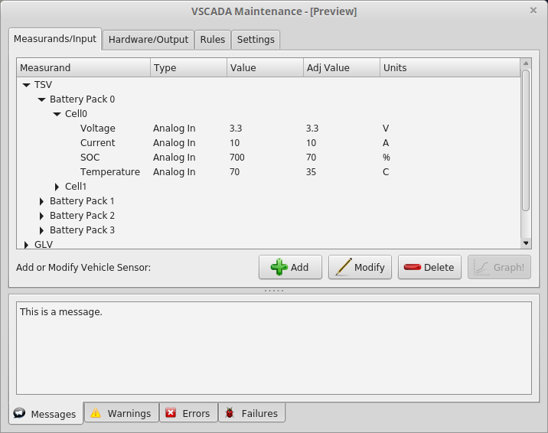
Maintenance App - Measurands/Input

Slide 51
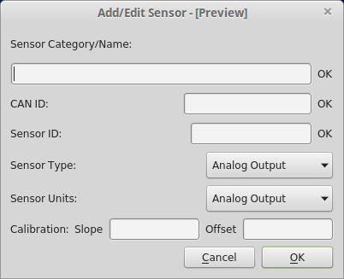
Maintenance App - Add/Edit Sensor Window

Slide 52
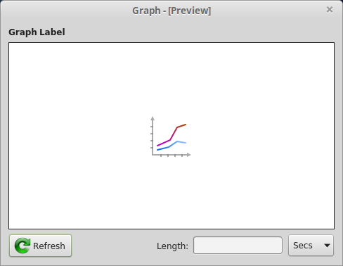
Maintenance App - Measurand Graph Window

Slide 53
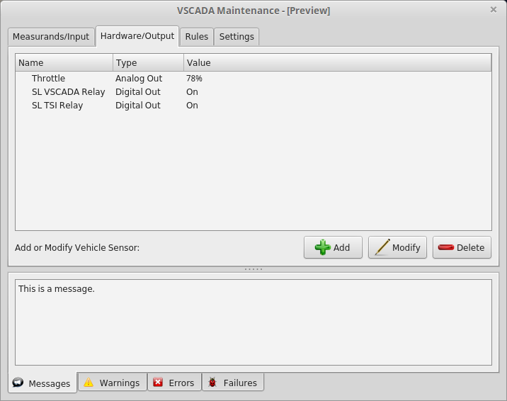
Maintenance App - Hardware/Output

Slide 54
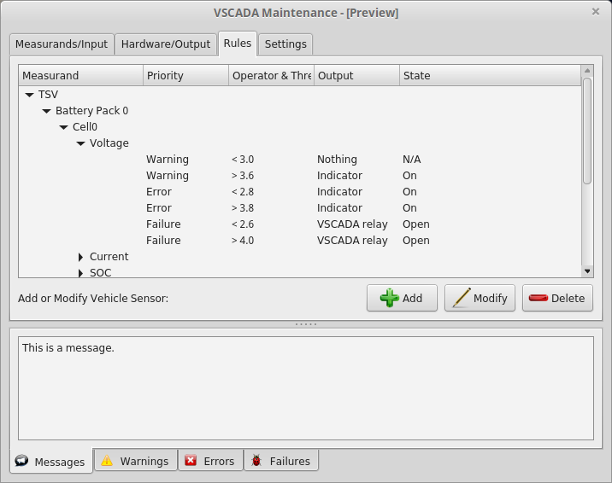
Maintenance App - Rules

Slide 55
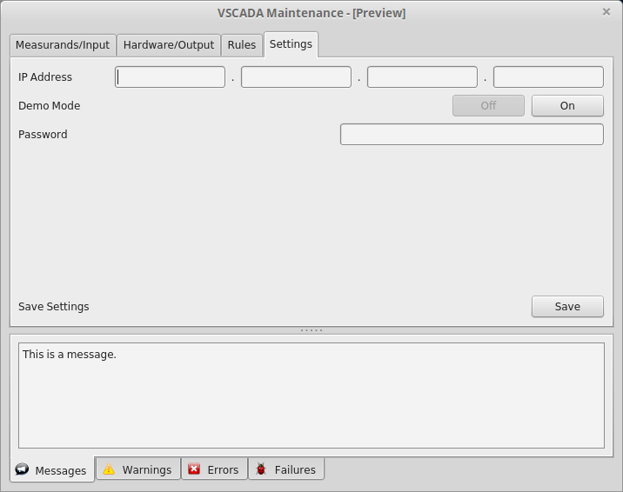
Maintenance App - Settings

Slide 56
Roadmap
Meet the Afternoon Teams
Interface Control Review
Vehicle Supervisory Control and Data Acquisition (VSCADA)
Daemon
Interfacing
User Applications
Data Storage
Dynamometer (DYNO)
Decomposition and Definition
Integration and Recomposition

Slide 57
Round Robin Database (RRD)
High performance data logging and graphing system for time series data
Uses circular buffer to store data
Data size does not expand with time.
Overwrite the data once it reach the starting point
Framework for storing measurement averages, min,max and derivative
Graphical presentation for both stored and archived data.

Slide 58
RRD Creation
Size of the database can be determined at creation time.
Specify the step time (rate at which the database update the data)
Specify the step time for archives too. For different archives, different time step can be applied.

Slide 59
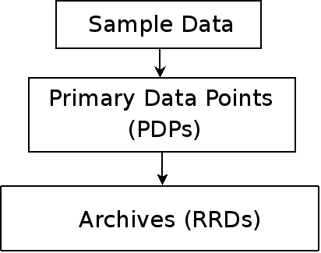
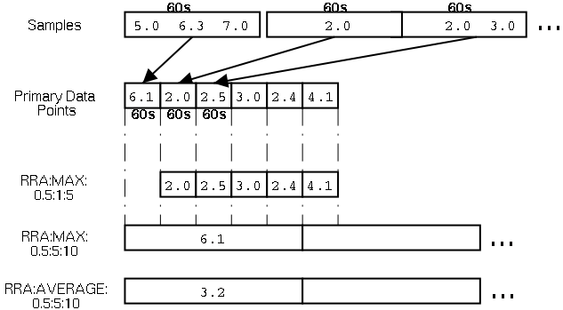
Round Robin Archives (RRA)
Average
Minimum
Maximum
Last
Data Source

Slide 60
RRD for this project
Monitor the time series data.
Take care of time and space complexity.
Very simple in structure.
Manipulate the stored data and archived the data.
Graphing tools.

Slide 61
Database and Configuration
Database for sensor list and most of the configurations
Text files for logic related (startup procedures, logic switches, etc)

Slide 62
Database
SQL is used for the followings:
Table 1: restoring sensor information
sensor hierarchy
CAN id
sampling rate
rrd file reference
This means, all data is going to be stored in RRD, but a reference is kept in SQL as a cleaner solution
Table 2: type of sensor
analog in, analog out, digital in, digital out
need to know this for sending out data on CAN

Slide 63
Database
Table 3: warning/error threshold
High and low values for warnings, errors and failures
Reaching these values will trigger some certain actions, which is referred in the next table
Table 4: warning/error actions
Each of the actions here is generic and configurable
Table 5: calibration
have slop and offsets

Slide 64
SQL DB: ‘Sensor_Table’
Name | id_CAN | id_Sensor | Type | Sample_Rate
Overwrite_Period | Units | Factor | Offset | RRD_DB

Slide 65
SQL DB: ‘Sensor_Type’
id | Description | Type | Direction

Slide 66
SQL DB: ‘Sensor_Levels’
id | Warning_Low | Warning_High | Error_Low | Error_High | Fail_Low | Fail_High

Slide 67
SQL DB: ‘Sensor_Actions’
id | Action_Name | Priority_Level | Effector_Name | Effector_State

Slide 68
id | Name | id_CAN | id_Sensor | Type | Sample_Rate | Overwrite_Period | Units | Factor | Offset | RRD_DB
1 | TSV/Pack1/Voltage | 0 | 1 | Analog | 20 | 24 | V | 1 | 0 | /data/TSV/pack1/voltage.rrd
2 | TSV/Pack1/Current | 1 | 2 | Analog | 21 | 25 | A | 1 | 0 | /data/TSV/pack1/current.rrd
3 | TSV/Pack1/SOC | 2 | 3 | Analog | 22 | 26 | % | 1 | 0 | /data/TSV/pack1/SOC.rrd
4 | TSV/Pack1/Fuse_Temperature | 3 | 4 | Analog | 23 | 27 | °C | 1 | 0 | /data/TSV/pack1/fuse_temperature.rrd
5 | TSV/Pack1/AMS1/Temperature | 4 | 5 | Analog | 24 | 28 | °C | 1 | 0 | /data/TSV/pack1/AMS1/temperature.rrd
6 | TSV/Pack1/AMS1/Voltage | 5 | 6 | Analog | 25 | 29 | V | 1 | 0 | /data/TSV/pack1/AMS1/voltage.rrd
7 | TSV/Pack1/AMS1/Current | 6 | 7 | Analog | 26 | 30 | A | 1 | 0 | /data/TSV/pack1/AMS1/current.rrd
8 | TSV/Pack1/AMS2/Temperature | 7 | 8 | Analog | 27 | 31 | °C | 1 | 0 | /data/TSV/pack1/AMS2/temperature.rrd
9 | TSV/Pack1/AMS2/Voltage | 8 | 9 | Analog | 28 | 32 | V | 1 | 0 | /data/TSV/pack1/AMS2/voltage.rrd
10 | TSV/Pack1/AMS2/Current | 9 | 10 | Analog | 29 | 33 | A | 1 | 0 | /data/TSV/pack1/AMS2/current.rrd
11 | TSV/Pack1/AMS3/Temperature | 10 | 11 | Analog | 30 | 34 | °C | 1 | 0 | /data/TSV/pack1/AMS3/temperature.rrd
12 | TSV/Pack1/AMS3/Voltage | 11 | 12 | Analog | 31 | 35 | V | 1 | 0 | /data/TSV/pack1/AMS3/voltage.rrd
13 | TSV/Pack1/AMS3/Current | 12 | 13 | Analog | 32 | 36 | A | 1 | 0 | /data/TSV/pack1/AMS3/current.rrd
14 | TSV/Pack1/AMS4/Temperature | 13 | 14 | Analog | 33 | 37 | °C | 1 | 0 | /data/TSV/pack1/AMS4/temperature.rrd
15 | TSV/Pack1/AMS4/Voltage | 14 | 15 | Analog | 34 | 38 | V | 1 | 0 | /data/TSV/pack1/AMS4/voltage.rrd
16 | TSV/Pack1/AMS4/Current | 15 | 16 | Analog | 35 | 39 | A | 1 | 0 | /data/TSV/pack1/AMS4/current.rrd
17 | TSV/Pack1/AMS5/Temperature | 16 | 17 | Analog | 36 | 40 | °C | 1 | 0 | /data/TSV/pack1/AMS5/temperature.rrd
18 | TSV/Pack1/AMS5/Voltage | 17 | 18 | Analog | 37 | 41 | V | 1 | 0 | /data/TSV/pack1/AMS5/voltage.rrd
19 | TSV/Pack1/AMS5/Current | 18 | 19 | Analog | 38 | 42 | A | 1 | 0 | /data/TSV/pack1/AMS5/current.rrd
20 | TSV/Pack1/AMS6/Temperature | 19 | 20 | Analog | 39 | 43 | °C | 1 | 0 | /data/TSV/pack1/AMS6/temperature.rrd
21 | TSV/Pack1/AMS6/Voltage | 20 | 21 | Analog | 40 | 44 | V | 1 | 0 | /data/TSV/pack1/AMS6/voltage.rrd
22 | TSV/Pack1/AMS6/Current | 21 | 22 | Analog | 41 | 45 | A | 1 | 0 | /data/TSV/pack1/AMS6/current.rrd
23 | TSV/Pack1/AMS7/Temperature | 22 | 23 | Analog | 42 | 46 | °C | 1 | 0 | /data/TSV/pack1/AMS7/temperature.rrd
24 | TSV/Pack1/AMS7/Voltage | 23 | 24 | Analog | 43 | 47 | V | 1 | 0 | /data/TSV/pack1/AMS7/voltage.rrd
25 | TSV/Pack1/AMS7/Current | 24 | 25 | Analog | 44 | 48 | A | 1 | 0 | /data/TSV/pack1/AMS7/current.rrd
26 | TSV/Pack2/Voltage | 25 | 26 | Analog | 45 | 49 | V | 1 | 0 | /data/TSV/pack2/voltage.rrd
27 | TSV/Pack2/Current | 26 | 27 | Analog | 46 | 50 | A | 1 | 0 | /data/TSV/pack2/current.rrd
28 | TSV/Pack2/SOC | 27 | 28 | Analog | 47 | 51 | % | 1 | 0 | /data/TSV/pack2/SOC.rrd
29 | TSV/Pack2/Fuse_Temperature | 28 | 29 | Analog | 48 | 52 | °C | 1 | 0 | /data/TSV/pack2/fuse_temperature.rrd
30 | TSV/Pack2/AMS1/Temperature | 29 | 30 | Analog | 49 | 53 | °C | 1 | 0 | /data/TSV/pack2/AMS1/temperature.rrd
31 | TSV/Pack2/AMS1/Voltage | 30 | 31 | Analog | 50 | 54 | V | 1 | 0 | /data/TSV/pack2/AMS1/voltage.rrd
32 | TSV/Pack2/AMS1/Current | 31 | 32 | Analog | 51 | 55 | A | 1 | 0 | /data/TSV/pack2/AMS1/current.rrd
33 | TSV/Pack2/AMS2/Temperature | 32 | 33 | Analog | 52 | 56 | °C | 1 | 0 | /data/TSV/pack2/AMS2/temperature.rrd
34 | TSV/Pack2/AMS2/Voltage | 33 | 34 | Analog | 53 | 57 | V | 1 | 0 | /data/TSV/pack2/AMS2/voltage.rrd
35 | TSV/Pack2/AMS2/Current | 34 | 35 | Analog | 54 | 58 | A | 1 | 0 | /data/TSV/pack2/AMS2/current.rrd
36 | TSV/Pack2/AMS3/Temperature | 35 | 36 | Analog | 55 | 59 | °C | 1 | 0 | /data/TSV/pack2/AMS3/temperature.rrd
37 | TSV/Pack2/AMS3/Voltage | 36 | 37 | Analog | 56 | 60 | V | 1 | 0 | /data/TSV/pack2/AMS3/voltage.rrd
38 | TSV/Pack2/AMS3/Current | 37 | 38 | Analog | 57 | 61 | A | 1 | 0 | /data/TSV/pack2/AMS3/current.rrd
39 | TSV/Pack2/AMS4/Temperature | 38 | 39 | Analog | 58 | 62 | °C | 1 | 0 | /data/TSV/pack2/AMS4/temperature.rrd
40 | TSV/Pack2/AMS4/Voltage | 39 | 40 | Analog | 59 | 63 | V | 1 | 0 | /data/TSV/pack2/AMS4/voltage.rrd
41 | TSV/Pack2/AMS4/Current | 40 | 41 | Analog | 60 | 64 | A | 1 | 0 | /data/TSV/pack2/AMS4/current.rrd
42 | TSV/Pack2/AMS5/Temperature | 41 | 42 | Analog | 61 | 65 | °C | 1 | 0 | /data/TSV/pack2/AMS5/temperature.rrd
43 | TSV/Pack2/AMS5/Voltage | 42 | 43 | Analog | 62 | 66 | V | 1 | 0 | /data/TSV/pack2/AMS5/voltage.rrd
44 | TSV/Pack2/AMS5/Current | 43 | 44 | Analog | 63 | 67 | A | 1 | 0 | /data/TSV/pack2/AMS5/current.rrd
45 | TSV/Pack2/AMS6/Temperature | 44 | 45 | Analog | 64 | 68 | °C | 1 | 0 | /data/TSV/pack2/AMS6/temperature.rrd
46 | TSV/Pack2/AMS6/Voltage | 45 | 46 | Analog | 65 | 69 | V | 1 | 0 | /data/TSV/pack2/AMS6/voltage.rrd
47 | TSV/Pack2/AMS6/Current | 46 | 47 | Analog | 66 | 70 | A | 1 | 0 | /data/TSV/pack2/AMS6/current.rrd
48 | TSV/Pack2/AMS7/Temperature | 47 | 48 | Analog | 67 | 71 | °C | 1 | 0 | /data/TSV/pack2/AMS7/temperature.rrd
49 | TSV/Pack2/AMS7/Voltage | 48 | 49 | Analog | 68 | 72 | V | 1 | 0 | /data/TSV/pack2/AMS7/voltage.rrd
50 | TSV/Pack2/AMS7/Current | 49 | 50 | Analog | 69 | 73 | A | 1 | 0 | /data/TSV/pack2/AMS7/current.rrd
51 | TSV/Pack3/Voltage | 50 | 51 | Analog | 70 | 74 | V | 1 | 0 | /data/TSV/pack3/voltage.rrd
52 | TSV/Pack3/Current | 51 | 52 | Analog | 71 | 75 | A | 1 | 0 | /data/TSV/pack3/current.rrd
53 | TSV/Pack3/SOC | 52 | 53 | Analog | 72 | 76 | % | 1 | 0 | /data/TSV/pack3/SOC.rrd
54 | TSV/Pack3/Fuse_Temperature | 53 | 54 | Analog | 73 | 77 | °C | 1 | 0 | /data/TSV/pack3/fuse_temperature.rrd
55 | TSV/Pack3/AMS1/Temperature | 54 | 55 | Analog | 74 | 78 | °C | 1 | 0 | /data/TSV/pack3/AMS1/temperature.rrd
56 | TSV/Pack3/AMS1/Voltage | 55 | 56 | Analog | 75 | 79 | V | 1 | 0 | /data/TSV/pack3/AMS1/voltage.rrd
57 | TSV/Pack3/AMS1/Current | 56 | 57 | Analog | 76 | 80 | A | 1 | 0 | /data/TSV/pack3/AMS1/current.rrd
58 | TSV/Pack3/AMS2/Temperature | 57 | 58 | Analog | 77 | 81 | °C | 1 | 0 | /data/TSV/pack3/AMS2/temperature.rrd
59 | TSV/Pack3/AMS2/Voltage | 58 | 59 | Analog | 78 | 82 | V | 1 | 0 | /data/TSV/pack3/AMS2/voltage.rrd
60 | TSV/Pack3/AMS2/Current | 59 | 60 | Analog | 79 | 83 | A | 1 | 0 | /data/TSV/pack3/AMS2/current.rrd
61 | TSV/Pack3/AMS3/Temperature | 60 | 61 | Analog | 80 | 84 | °C | 1 | 0 | /data/TSV/pack3/AMS3/temperature.rrd
62 | TSV/Pack3/AMS3/Voltage | 61 | 62 | Analog | 81 | 85 | V | 1 | 0 | /data/TSV/pack3/AMS3/voltage.rrd
63 | TSV/Pack3/AMS3/Current | 62 | 63 | Analog | 82 | 86 | A | 1 | 0 | /data/TSV/pack3/AMS3/current.rrd
64 | TSV/Pack3/AMS4/Temperature | 63 | 64 | Analog | 83 | 87 | °C | 1 | 0 | /data/TSV/pack3/AMS4/temperature.rrd
65 | TSV/Pack3/AMS4/Voltage | 64 | 65 | Analog | 84 | 88 | V | 1 | 0 | /data/TSV/pack3/AMS4/voltage.rrd
66 | TSV/Pack3/AMS4/Current | 65 | 66 | Analog | 85 | 89 | A | 1 | 0 | /data/TSV/pack3/AMS4/current.rrd
67 | TSV/Pack3/AMS5/Temperature | 66 | 67 | Analog | 86 | 90 | °C | 1 | 0 | /data/TSV/pack3/AMS5/temperature.rrd
68 | TSV/Pack3/AMS5/Voltage | 67 | 68 | Analog | 87 | 91 | V | 1 | 0 | /data/TSV/pack3/AMS5/voltage.rrd
69 | TSV/Pack3/AMS5/Current | 68 | 69 | Analog | 88 | 92 | A | 1 | 0 | /data/TSV/pack3/AMS5/current.rrd
70 | TSV/Pack3/AMS6/Temperature | 69 | 70 | Analog | 89 | 93 | °C | 1 | 0 | /data/TSV/pack3/AMS6/temperature.rrd
71 | TSV/Pack3/AMS6/Voltage | 70 | 71 | Analog | 90 | 94 | V | 1 | 0 | /data/TSV/pack3/AMS6/voltage.rrd
72 | TSV/Pack3/AMS6/Current | 71 | 72 | Analog | 91 | 95 | A | 1 | 0 | /data/TSV/pack3/AMS6/current.rrd
73 | TSV/Pack3/AMS7/Temperature | 72 | 73 | Analog | 92 | 96 | °C | 1 | 0 | /data/TSV/pack3/AMS7/temperature.rrd
74 | TSV/Pack3/AMS7/Voltage | 73 | 74 | Analog | 93 | 97 | V | 1 | 0 | /data/TSV/pack3/AMS7/voltage.rrd
75 | TSV/Pack3/AMS7/Current | 74 | 75 | Analog | 94 | 98 | A | 1 | 0 | /data/TSV/pack3/AMS7/current.rrd
76 | TSV/Pack4/Voltage | 75 | 76 | Analog | 95 | 99 | V | 1 | 0 | /data/TSV/pack4/voltage.rrd
77 | TSV/Pack4/Current | 76 | 77 | Analog | 96 | 100 | A | 1 | 0 | /data/TSV/pack4/current.rrd
78 | TSV/Pack4/SOC | 77 | 78 | Analog | 97 | 101 | % | 1 | 0 | /data/TSV/pack4/SOC.rrd
79 | TSV/Pack4/fuse_Temperature | 78 | 79 | Analog | 98 | 102 | °C | 1 | 0 | /data/TSV/pack4/fuse_temperature.rrd
80 | TSV/Pack4/AMS1/Temperature | 79 | 80 | Analog | 99 | 103 | °C | 1 | 0 | /data/TSV/pack4/AMS1/temperature.rrd
81 | TSV/Pack4/AMS1/Voltage | 80 | 81 | Analog | 100 | 104 | V | 1 | 0 | /data/TSV/pack4/AMS1/voltage.rrd
82 | TSV/Pack4/AMS1/Current | 81 | 82 | Analog | 101 | 105 | A | 1 | 0 | /data/TSV/pack4/AMS1/current.rrd
83 | TSV/Pack4/AMS2/Temperature | 82 | 83 | Analog | 102 | 106 | °C | 1 | 0 | /data/TSV/pack4/AMS2/temperature.rrd
84 | TSV/Pack4/AMS2/Voltage | 83 | 84 | Analog | 103 | 107 | V | 1 | 0 | /data/TSV/pack4/AMS2/voltage.rrd
85 | TSV/Pack4/AMS2/Current | 84 | 85 | Analog | 104 | 108 | A | 1 | 0 | /data/TSV/pack4/AMS2/current.rrd
86 | TSV/Pack4/AMS3/Temperature | 85 | 86 | Analog | 105 | 109 | °C | 1 | 0 | /data/TSV/pack4/AMS3/temperature.rrd
87 | TSV/Pack4/AMS3/Voltage | 86 | 87 | Analog | 106 | 110 | V | 1 | 0 | /data/TSV/pack4/AMS3/voltage.rrd
88 | TSV/Pack4/AMS3/Current | 87 | 88 | Analog | 107 | 111 | A | 1 | 0 | /data/TSV/pack4/AMS3/current.rrd
89 | TSV/Pack4/AMS4/Temperature | 88 | 89 | Analog | 108 | 112 | °C | 1 | 0 | /data/TSV/pack4/AMS4/temperature.rrd
90 | TSV/Pack4/AMS4/Voltage | 89 | 90 | Analog | 109 | 113 | V | 1 | 0 | /data/TSV/pack4/AMS4/voltage.rrd
91 | TSV/Pack4/AMS4/Current | 90 | 91 | Analog | 110 | 114 | A | 1 | 0 | /data/TSV/pack4/AMS4/current.rrd
92 | TSV/Pack4/AMS5/Temperature | 91 | 92 | Analog | 111 | 115 | °C | 1 | 0 | /data/TSV/pack4/AMS5/temperature.rrd
93 | TSV/Pack4/AMS5/Voltage | 92 | 93 | Analog | 112 | 116 | V | 1 | 0 | /data/TSV/pack4/AMS5/voltage.rrd
94 | TSV/Pack4/AMS5/Current | 93 | 94 | Analog | 113 | 117 | A | 1 | 0 | /data/TSV/pack4/AMS5/current.rrd
95 | TSV/Pack4/AMS6/Temperature | 94 | 95 | Analog | 114 | 118 | °C | 1 | 0 | /data/TSV/pack4/AMS6/temperature.rrd
96 | TSV/Pack4/AMS6/Voltage | 95 | 96 | Analog | 115 | 119 | V | 1 | 0 | /data/TSV/pack4/AMS6/voltage.rrd
97 | TSV/Pack4/AMS6/Current | 96 | 97 | Analog | 116 | 120 | A | 1 | 0 | /data/TSV/pack4/AMS6/current.rrd
98 | TSV/Pack4/AMS7/Temperature | 97 | 98 | Analog | 117 | 121 | °C | 1 | 0 | /data/TSV/pack4/AMS7/temperature.rrd
99 | TSV/Pack4/AMS7/Voltage | 98 | 99 | Analog | 118 | 122 | V | 1 | 0 | /data/TSV/pack4/AMS7/voltage.rrd
100 | TSV/Pack4/AMS7/Current | 99 | 100 | Analog | 119 | 123 | A | 1 | 0 | /data/TSV/pack4/AMS7/current.rrd
101 | GLV/VCI/Safety_Loop_Monitor | 100 | 101 | GPIO Input | 120 | 124 | ON/OFF | 1 | 0 | /data/GLV/VCI/safety_Loop_Monitor.rrd
102 | GLV/VCI/AIR_Loop_Monitor | 101 | 102 | GPIO Input | 121 | 125 | ON/OFF | 1 | 0 | /data/GLV/VCI/AIR_Loop_Monitor.rrd
103 | GLV/VCI/Safety_Loop_Control | 102 | 103 | RELAY | 122 | 126 | ON/OFF | 1 | 0 | /data/GLV/VCI/Safety_Loop_Control.rrd
104 | GLV/Cockpitbox/Ambient_Temperature | 103 | 104 | Analog | 123 | 127 | °C | 1 | 0 | /data/GLV/cockpitbox/ambient_temperature.rrd
105 | GLV/Cockpitbox/Failure_LED | 104 | 105 | GPIO Output | 124 | 128 | ON/OFF | 1 | 0 | /data/GLV/cockpitbox/failure_LED.rrd
106 | GLV/Cockpitbox/Warn_LED | 105 | 106 | GPIO Output | 125 | 129 | ON/OFF | 1 | 0 | /data/GLV/cockpitbox/warn_LED.rrd
107 | GLV/Cockpitbox/OK_LED | 106 | 107 | GPIO Output | 126 | 130 | ON/OFF | 1 | 0 | /data/GLV/cockpitbox/ok_LED.rrd
108 | GLV/TSI/Temperature | 107 | 108 | Analog | 127 | 131 | °C | 1 | 0 | /data/GLV/TSI/temperature.rrd
109 | GLV/GLV_Power/Voltage | 108 | 109 | Analog | 128 | 132 | V | 1 | 0 | /data/GLV/GLV_power/voltage.rrd
110 | GLV/GLV_Power/Temperature | 109 | 110 | Analog | 129 | 133 | °C | 1 | 0 | /data/GLV/GLV_power/temperature.rrd
111 | GLV/GLV_Power/Current | 110 | 111 | Analog | 130 | 134 | A | 1 | 0 | /data/GLV/GLV_power/current.rrd
112 | GLV/GLV_Power/SOC | 111 | 112 | Analog | 131 | 135 | % | 1 | 0 | /data/GLV/GLV_power/SOC.rrd
113 | Dyno/Motor_RPM | 112 | 113 | Analog | 132 | 136 | RPM | 1 | 0 | /data/Dyno/motorRPM.rrd
114 | Dyno/Motor_Temperature | 113 | 114 | Analog | 133 | 137 | °C | 1 | 0 | /data/Dyno/motor_temperature.rrd
115 | Dyno/Controller_Temperature | 114 | 115 | Analog | 134 | 138 | °C | 1 | 0 | /data/Dyno/controller_temperature.rrd
116 | Dyno/RMS_Current | 115 | 116 | Analog | 135 | 139 | A | 1 | 0 | /data/Dyno/RMS_current.rrd
117 | Dyno/Capacitor_Voltage | 116 | 117 | Analog | 136 | 140 | V | 1 | 0 | /data/Dyno/capacitor_voltage.rrd
118 | Dyno/Stator_Frequency | 117 | 118 | Analog | 137 | 141 | Hz | 1 | 0 | /data/Dyno/stator_frequency.rrd
119 | Dyno/Controller_Fault_Primary | 118 | 119 | Analog | 138 | 142 | ERR CODE | 1 | 0 | /data/Dyno/controller_fault_primary.rrd
120 | Dyno/Controller_Fault_Secondary | 119 | 120 | Analog | 139 | 143 | ERR CODE | 1 | 0 | /data/Dyno/controller_fault_secondary.rrd
121 | Dyno/Throttle_In | 120 | 121 | Analog | 140 | 144 | % | 1 | 0 | /data/Dyno/throttle_in.rrd

Slide 69
Configuration
Bash style
Read during startup, and bad syntax will raise exceptions and the car will be disabled from driving
Switches can be updated and modified by maintenance app
Will be stored under same directory and database in a separate folder
Is accessible from debug port

Slide 70
Acceptance Testing
http://img.talkandroid.com/uploads/2011/08/seal-of-approval.jpg
Show that VSCADA meets all requirements as both:
part of integrated LFEV system
standalone software system
Strive for maximum amount of test automation/avoid recompiling software
Main criteria:
Exception handling
Automated hardware detection/configuration
Logging, plotting and storing of measurands
Controlling system state

Slide 71
Acceptance Testing (cont.)
Test configurations:
Config A: VSCADA powered by 12 V power source
Config B: VSCADA interfaced with GLV
Config C: VSCADA interfaced with GLV and TSV
Config D: VSCADA interfaced with GLV, TSV and DYNO

Slide 72
Acceptance Testing (cont.)
T000 - System Startup/Shutdown and GLV Data Logging
Config B
Tests:
Automatic startup without user interaction once GLV power is provided
Logging of GLV measurands
Keeping of backup in case of unexpected shutdown

Slide 73
Acceptance Testing (cont.)
T001 - Safety Checking/Exception Handling
Config D
Tests:
Lighting of Ready LED on cockpit if all subsystems are in a safe state when Ready-to-Drive buttton pressed
Lighting of warning LEDs to warn user and prevent drive mode being activated by Ready-to-Drive button if unsafe condition occurs (exception handling)
Examples are open safety loop, voltage threshold exceeded, temperature threshold exceeded, missing config file for sensors

Slide 74
Acceptance Testing (cont.)
T002 - Maintenance App Operation
Config D
Tests:
Requirement of proper user credentials to login to maintenance mode
Logging and storing of all subsystem measurands (TSV pack/cell voltages, currents, temperatures, GLV voltage, current, Dyno torque, RPM)
Allowing user to control all aspects of VSCADA such as disabling safety checks, disabling data logging, and programming individual shutdown rules

Slide 75
Acceptance Testing (cont.)
T003 - Drive Mode Operation
Config D, then repeat with Config A (simulated throttle)
Tests:
Accurate reporting of measurands while driving
Logging of exceptions should unsafe condition occur while driving
Demo operation of vehicle through software throttle if other subsystems not available

Slide 76
Acceptance Testing (cont.)
T004 - Pack Charging/Discharging
Config C
Tests:
Displaying that accumulator is charging
Displaying that accumulator is discharging

Slide 77
Acceptance Testing (cont.)
T005 - Reliability Test
Config D
Tests:
System can run through series of drive modes/simulations and maintenance configuration changes over period of 24 hours without failure

Slide 78
Acceptance Testing (cont.)
T006 - Maintainability Test
Config D
Tests:
Novice user can solve frequently occurring problem
Expert maintenance individual can solve unexpected problem
New sensors can be added to system without software recompilation
VSCADA software can be installed easily using “make/install” on different computer

Slide 79
Schedule
Week 9
Demonstration System Integration & Debugging
System parts designed in the past six weeks will be integrated into a cohesive system demonstration for CDR, and for displaying system capabilities to other groups.
CAN Communication PCB Fabrication
The General Sensor CAN Communication PCB GERBER files will be ready for fabrication and sent out for production.
Week 10
Preliminary Demonstration System
A primitive scada system will be functioning, and ready for demonstration to other groups. This system should be capable of allowing groups to test communications between themselves and the SCADA system in the future.
Week 11
SCADA Server Maintenance Mode
The main system server will be capable of performing all 'Maintenance Mode' tasks, and interfacing with all 'Maintenance Mode' client interfaces.
QA Report Submitted
Deliverable D006 (QA Report) will be submitted.

Slide 80
Schedule cont’d
Week 12
System Integration & Debugging
Any remaining components not added to the SCADA system will be added at this time. Debugging and integration into other vehicle sub-systems.
SCADA Server Demo Mode
The main system server will be capable of performing 'Demo Mode' tasks.
Week 13
Final ATR Report Submitted
Deliverable D005 (ATR Report) will be submitted.
System Integration & Debugging
Any remaining components not added to the SCADA system will be added at this time. Debugging and integration into other vehicle sub-systems.
Dynamometer Communication Library
The main system is capable of sending messages to the Huff Box over serial ports.

Slide 81
Schedule cont’d
Week 14
System Integration & Debugging
Any remaining components not added to the SCADA system will be added at this time. Debugging and integration into other vehicle sub-systems.
System Documentation
All project documentation will be finalized and completed.
Completed Maintenance Manual Submitted
A VSCADA Maintenance Manual Working Draft will be submitted.
Week 15
Final Report & Maintenance Manual Submitted
Deliverable D003 (Final Report) will be submitted.
System Errata Documentation
Any known bugs, and system errata will be documented for use by future students.

Slide 82
Budget
Item/Group | Total
SCADA
Embedden Computer System | 270
Dashboard LCD display and controller | 80
Wireless Radio | 50
Slave Sensor Micro Controller Hardware | 100
Debugger | 80
Programmer | 10
Total | 590
Budget: | 715

Slide 83
Roadmap
Meet the Afternoon Teams
Interface Control Review
Vehicle Supervisory Control and Data Acquisition (VSCADA)
Daemon
Interfacing
User Applications
Data Storage
Dynamometer (DYNO)
Decomposition and Definition
Integration and Recomposition

Slide 85
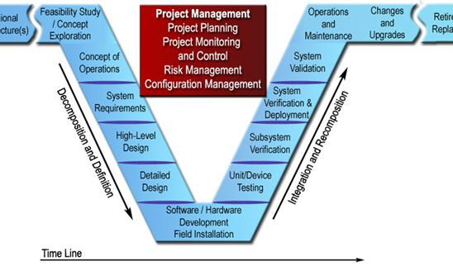
http://ops.fhwa.dot.gov/publications/seitsguide/images/image068.jpg
Notes:
our presentation follows the V-model of design;
we’ll first walk you through the high level theory, then dig into the detailed design
At the very bottom, you should understand how the system is supposed to work, and we’ll begin explaining testing

Slide 86
Roadmap
Meet the Afternoon Teams
Interface Control Review
Vehicle Supervisory Control and Data Acquisition (VSCADA)
Daemon
Interfacing
User Applications
Data Storage
Dynamometer (DYNO)
Decomposition and Definition
Integration and Recomposition

Slide 87
Concepts of Operation
Generate a torque curve
Develop a software simulation of the car
Develop a hardware simulation of the car
Determine the car gear ratio
Notes:
our goals for the project are the following: (read slide)
The hardware simulation is the most important; it allows the other systems to interact as if the car is complete

Slide 88
System Requirements
Motor/Dyno Selection
Motor Controller
Software
Data Acquisition
Throttle Control
Interfaces
VSCADA
GLV
TSV
Safety
Notes:
First, here are the actual system requirements: (read list)
motor/dyno/controller have been selected for us
data software was provided, throttle software was designed
we have to interface these systems to our components
it must all be safe

Slide 89
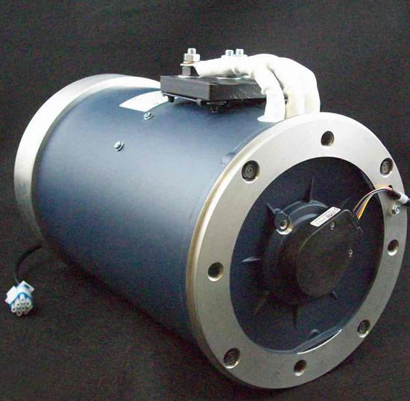
Motor Selection
HPEVS AC 50-27.28
Photo: HPEVS
Notes:
-8” Hydraulic Pump Motor
-Capable of producing 71 Horsepower, 120 ft-lbs of torque
-Operating Voltage: 72-108 V
-Max RPM: 6500

Slide 90
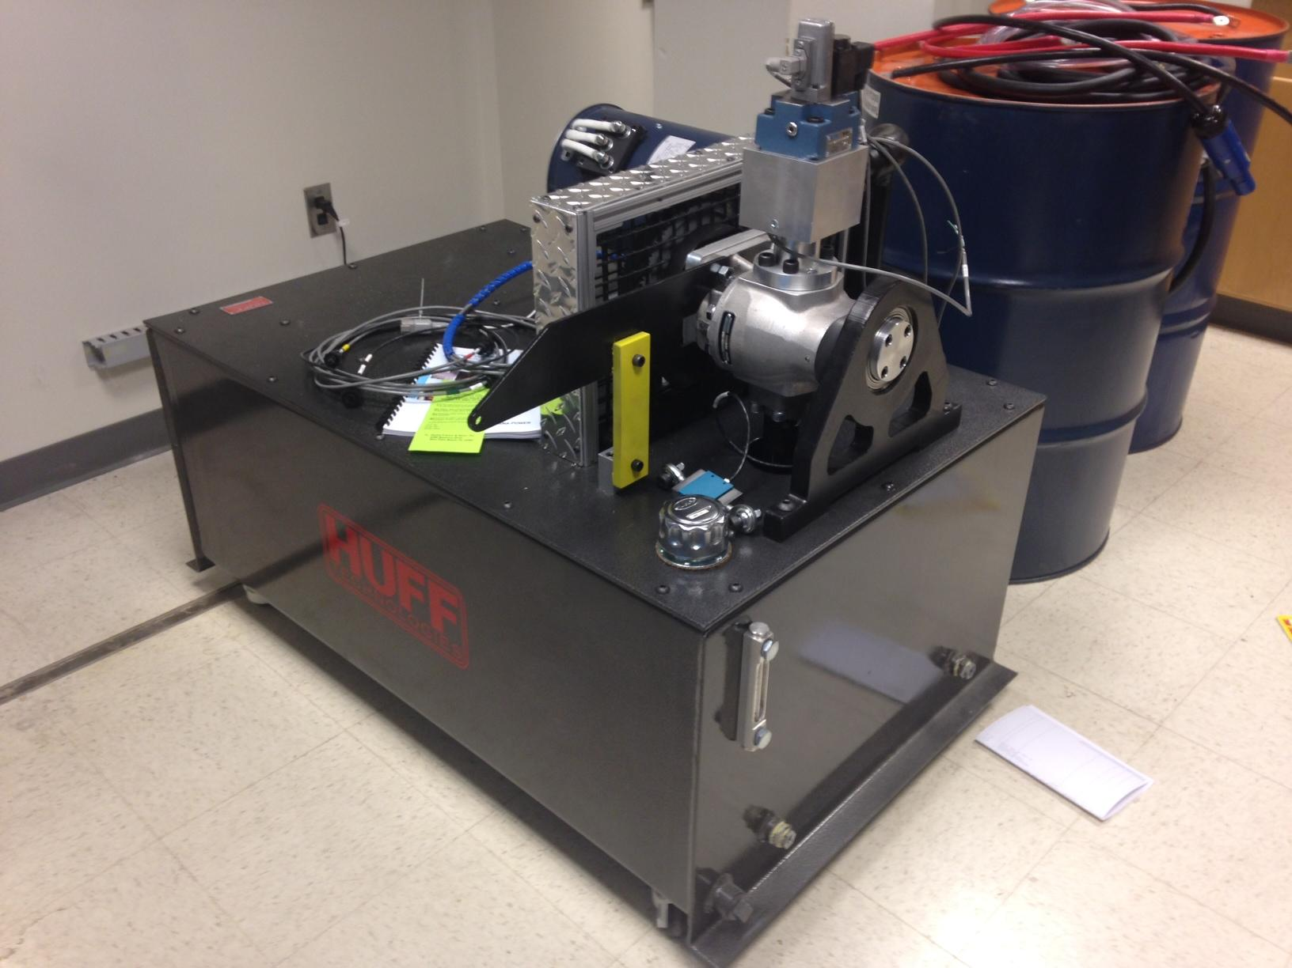
Dynamometer Selection
Huff HTH-100
Notes:
-Torque capacity: 150 ft-lbs
-Max RPM: 11,250

Slide 91
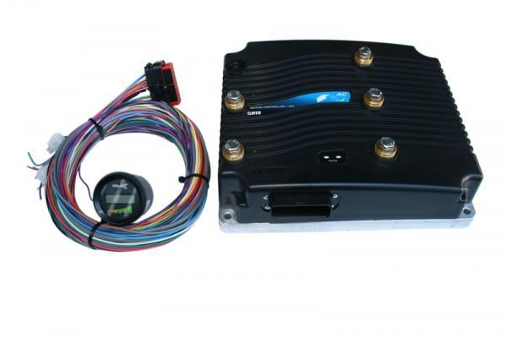
Motor Controller
Curtis 1238R-7601
Photo: evwest.com
Notes:
-Battery Voltage: 72-96 V
-Pre-programmed by HPEVS to operate with the AC 50 motor

Slide 92
Interfaces
VSCADA - Interface for data acquisition and throttle control
GLV - Interface for power and data transmission
TSV - Interface to power supply

Slide 93
Software
VSCADA - Dyno
Data Acquisition
RPM
Torque
Temp - Motor and Controller
RMS Current
Voltage
Throttle Control

Slide 94
Safety
Emergency Shutoff
Must be have an emergency stop
Must be shut down when GLV is down
Oil Temperature Shutoff
Must shut down when temperature limit is exceeded
Galvanic Isolation
Must separate high and low voltage subsystems
Motor Controller Contact Shield
Prevents accidental contact with terminals
Notes:
Must have all of the following for safety reasons

Slide 95
High-Level Design
ICD Layouts
Safety Shutoff
Throttle
HUFF - VSCADA Interface
Motor Controller
Cooling
Safety
Galvanic Isolation
Notes:
So here are the components that needed to be designed: (read list)
There is no given solution to these problems, so we’ve developed designs to solve them

Slide 96
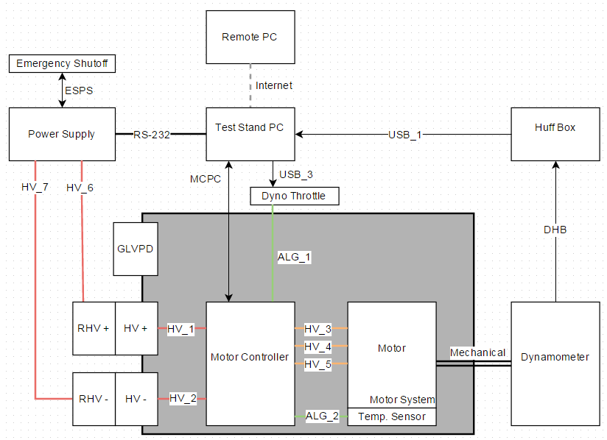
ICD Layout
Two configurations
Dyno Testing Configuration:

Slide 97
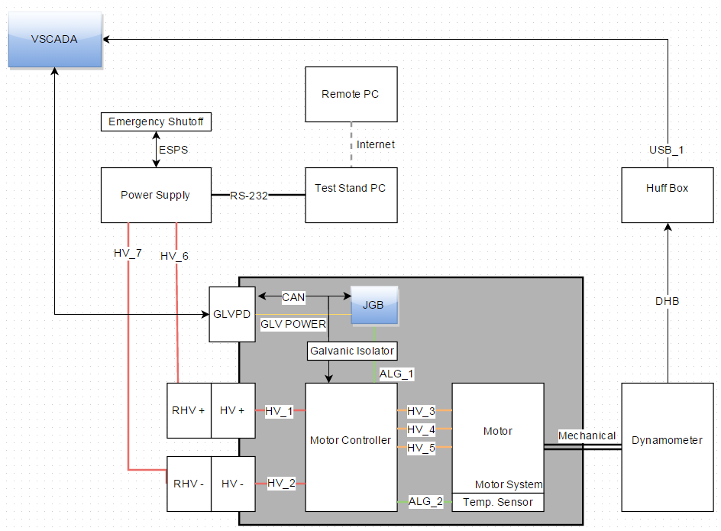
ICD Layout
Two configurations
Integrated Design Configuration:

Slide 98
Safety Shutoff
Requirements -
Must include emergency stop
Must include temperature shutoff
Design -
Use the power supply control inputs. These control mechanical contactors.
Notes:
the system can’t be run without a safety system in place
must include an estop and temp shutoff - we’ll get to how these are integrated in the detailed design
the power supply ha

Slide 99
Huff - VSCADA interface
USB interface
Utilizes serial communication
Based on a call and response system
Used to acquire data and set values
Protocol is defined by the chip on data acquisition board

Slide 100
Motor Controller Cooling
Must regulate MC temperature
Storage ambient temperature range:-40°C to 95°C
Operating ambient temperature range:-40°C to 50°C
Internal heatsink operating temperature range:-40°C to 95°C
Utilize a Water Cooling system
Pump→ MC→ Radiator→ Pump
Mounted Cooling Housing
Effectiveness to be determined upon delivery of parts
Notes:
Linear cutback starts at 85C, Complete cutoff starts at 95C and -40C

Slide 101
Motor Controller Safety
Must prevent conductive injury from
MC ports
High Voltage
Cover all electrical hazards to prevent accidental contact
Use non-conductive plastic cover

Slide 102
Throttle
Must control the throttle input of the MC
Throttle input is 0 to +5 volts
VSCADA must be connected
Must be scriptable for testing
Use two systems:
Use a VSCADA CANbus node with an analog output for the integrated system
Use an Arduino connected over USB to control an analog output

Slide 103
Galvanic Isolation
High/Low voltage CAN must be separated
High/Low Voltage Throttle must be separated

Slide 104
Layout Review:

Slide 105
Detailed Design
Simulations
Motor
Car
Track
Safety
Independent shutoff
Insulating covers
Throttle
Independant solution
VSCADA solution
Motor Controller
Isolation
Parameters
Wiring Diagram
Cooling
Safety
Room Wiring
Testing config
Integrated config
Notes:
Here’s the meat of our design: the detailed design section
This should explain everything about how these designs function

Slide 106
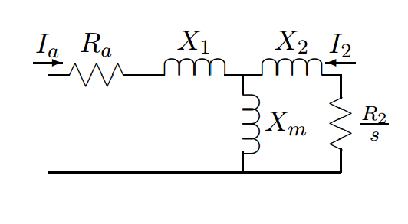
Simulations - Motor
Using IEEE circuit equivalent model developed the following torque curve

Slide 107
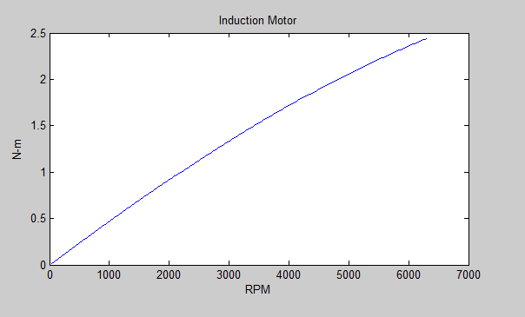

Slide 108
Simulations - Car/Track
Car will be reduced down to a singular body in order to simplify the static and dynamic equations required.
The track will be simulated by an array of values that will dictate the curvature and incline of the track based on position.

Slide 109
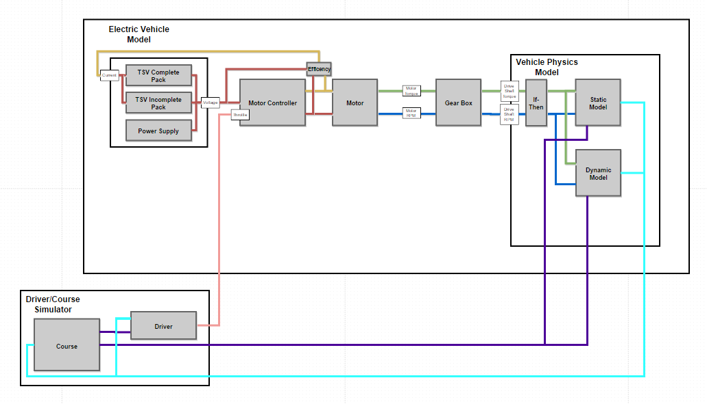
Simulations Layout

Slide 110
Safety - Independent Shutoff
Use the input control lines
Directly linked to mechanical contactors
Interface is a 37-pin D-Sub connector
Need only the start and stop inputs
Notes:
So the safety system is interfaced with a 37 pin D-Sub connector on the back of the power supply
These pins allow external control of the start, stop, and interlock functions
They must be enabled on the power supply, but the setting is persistent across reboots]
We only need the start and stop functions. To activate them, we need a short to the +5 volt line

Slide 111
Safety - Independent Shutoff
Solution: simple rack mounted unit
Notes:
To act as an emergency stop, we decided to use a normally open locking button and the temperature switch in parallel.
The start button is not entirely necessary, but it’s easy to implement.
This system has been tested, and it works in practice

Slide 112
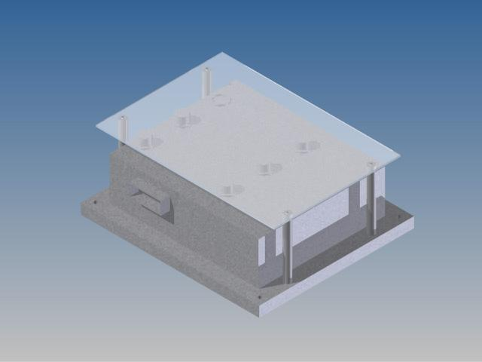
Safety - Insulating Covers
Plastic Cover
Non-conductive
Transition temperature higher than cutoff temp
Aluminum connecting rods
Notes:
non-conductive, transition temp of 105C (>95C which is the cutoff for MC)

Slide 113
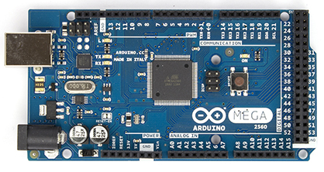
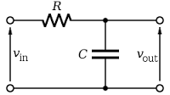
Throttle - Independent Solution
Need to control throttle from a computer
Arduino with USB connection
No analog outputs
Low pass filter on a PWM
Scripting
Write values in a python script
http://arduino.cc/en/uploads/Main/ArduinoMega2560_R3_Fronte.jpg
https://www.python.org/static/community_logos/python-logo.png
Notes:
an arduino is the fastest solution, if not elegant.
there is no analog output, so we can use PWM with a low pass filter
we can script the input using python

Slide 114
Throttle - Independent Solution
Python script writes PWM values, which are filtered to analog voltages
Notes:
Here’s the implementation of our solution, with the filter coefficients.
It has been verified to output a stable analog value within a few percent of the serial input.
It hasn’t been tested on the motor controller yet

Slide 115
Throttle - VSCADA Solution
USB connection from VSCADA to Huff Box
Serial communication
Call and response
Protocol dictated by DAQ chip
Generate PWM signal
Relates RPM to voltage
PWM is low pass filtered

Slide 116
Motor controller - Isolation
Isolates motor controller from GLV systems
Isolate CANbus
Using TI ISO1050DUBR
Voltage step down using LM7805
Isolate throttle
Using 6N135 optocoupler
low pass filter PWM signal

Slide 117
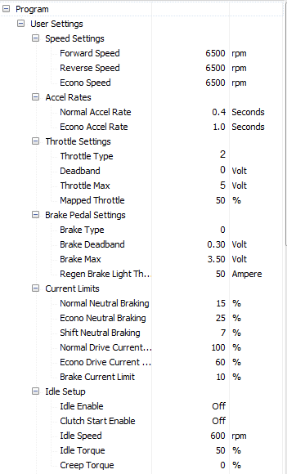
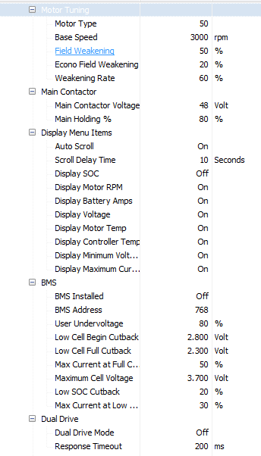
Motor Controller - Parameters
Notes:
Important: Throttle Settings, Speed Settings

Slide 118
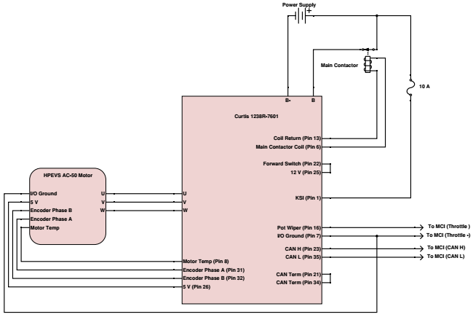
Motor Controller - Wiring
Testing w/ Power Supply

Slide 119
Motor Controller - Wiring
Testing w/ TSV Packs

Slide 120
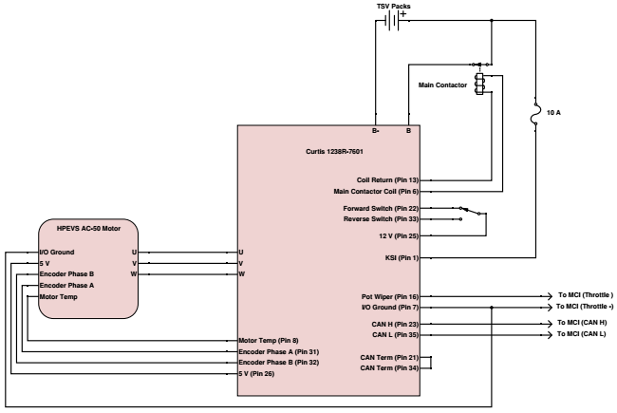
Motor Controller - Wiring
Suggested in-vehicle wiring

Slide 121
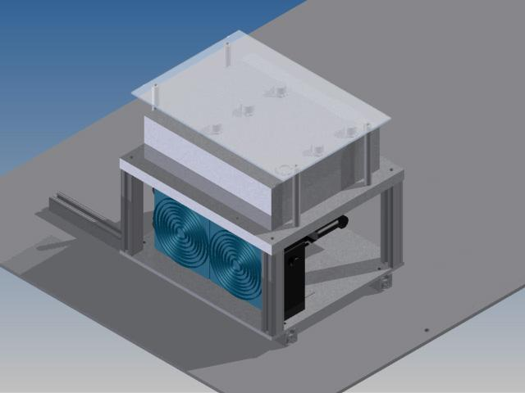
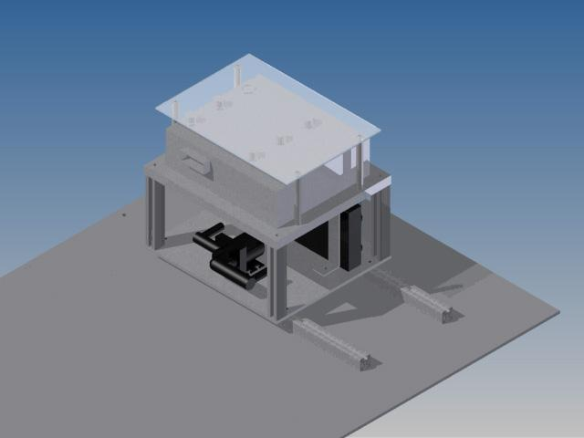
Motor Controller - Cooling

Slide 122
Room Wiring - Testing Config
Notes:
This, as you can clearly see, is the wiring model for room 400.
This is all of the wires connected to the dynamometer systems.

Slide 123
Room Wiring - Integrated Config
Notes:
these are the wires in the rest of the integrated system.
The only wires that move are the motor controller power wires.

Slide 124
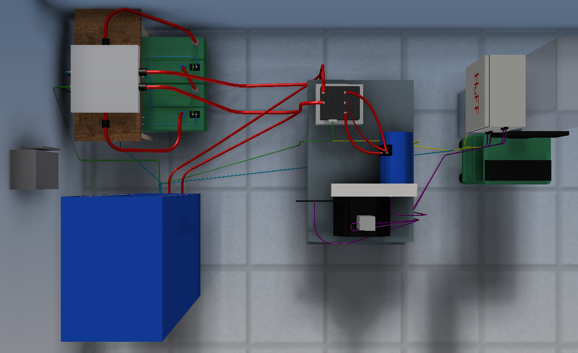
System Integration
Two configurations
Dyno Testing Configuration
Integrated Design Configuration
Notes:
So that’s the wiring of the two systems. the first in Dyno only, the second is the integrated system

Slide 125
Dynamometer
Dyno Testing Configuration
Utilizes Windows PC with software
Records RPM and Torque
Controls dynamometer
Integrated Design Configuration
Utilizes VSCADA computer
Records RPM and Torque
Controls dynamometer

Slide 126
System Wide
VSCADA
CAN data acquisition
Dyno data acquisition and control
Throttle
TSI
Galvanic isolation from TSV packs
TSV
Supplies power

Slide 127
Budget
Wires/Tubing: $203.92
Water cooling tubes - $15.30
Power supply cables - $188.62
Transistor/Electrical Parts - $43.22
Button switches - $15.76
Transistors - $27.46
Connectors - $108.52
Panels - $107.37
Pin Connector - $1.15
Total - $362.19

Slide 128
Roadmap
Meet the Afternoon Teams
Interface Control Review
Vehicle Supervisory Control and Data Acquisition (VSCADA)
Daemon
Interfacing
User Applications
Data Storage
Dynamometer (DYNO)
Decomposition and Definition
Integration and Recomposition

Slide 129
Unit/Device Testing
Throttle Testing
Safety Shutoff
Galvanic Isolation
Notes:
So, on to device testing
the only designs we need to test are the throttle, the safety shutoff, and the galvanic isolation

Slide 130
Throttle Testing
Independant Solution - T001-2
Using Arduino system
Sweep the throttle in increments of 100 RPM
Value must be within 5 RPM with 90% confidence
if complete:
VSCADA Solution - T002-3
Using VSCADA system
Sweep the throttle in increments of 100 RPM
Value must be within 5 RPM with 90% confidence

Slide 131
Safety Shutoff
Emergency Stop - T000-1
Press the stop, check that the system powers down
Oil Temp. Shutoff - T000-3
Heat up sensor, check that the system powers down

Slide 132
Subsystem Verification
Data Acquisition
Verification tests for:
Torque
Velocity
Current
Voltage
Temperature
Load control
Simulation Results Comparison

Slide 133
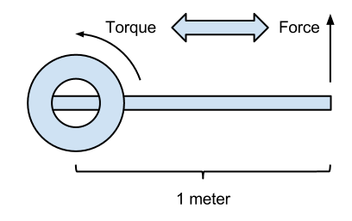
Data Acquisition
Verify sensor accuracy - T001-1
Torque - verified with first principles
Calibrate with weights on the arm
Verify calibration with different weights

Slide 134
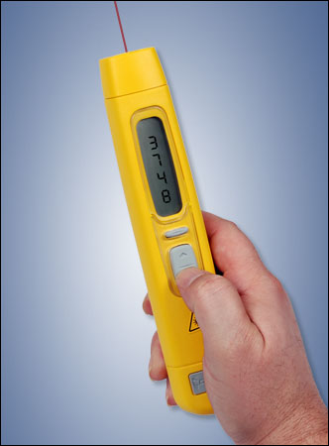
Data Acquisition
Verify sensor accuracy - T001-2
Motor Velocity - redundant measurements
Dynamometer encoder
Motor encoder
Handheld tachometer
Verified statistically
http://www.abqindustrial.net/store/images//products/ET-2109LSR/main_small.jpg

Slide 135
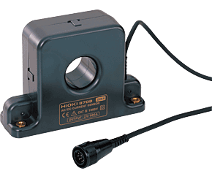
Data Acquisition
Verify sensor accuracy - T001-3
Motor Current - redundant measurements
Motor controller output
Clamp sensor
Verified statistically
http://www.hiokiusa.com/images/products/m9709.gif

Slide 136
Data Acquisition
Verify sensor accuracy - T001-4
Motor Voltage - redundant measurements
Motor controller output
Power supply reading
Verified statistically
http://www.magna-power.com/products/programmable-dc-power-supplies/ts-series

Slide 137
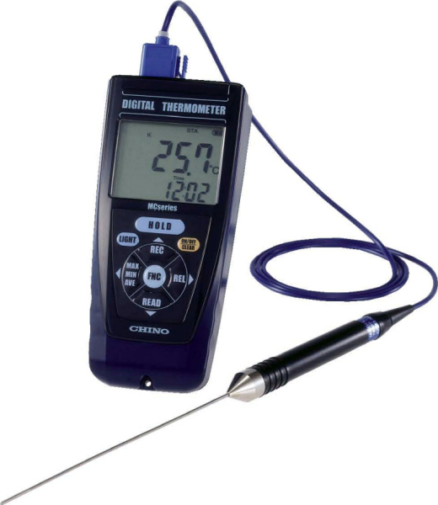
Data Acquisition
Verify sensor accuracy - T001-5
System Temperature - redundant measurements
Motor controller output (Motor/Controller temp.)
Handheld sensor
Verified statistically
http://www.chinoamerica.com/products/sensors/mc1000/img/sensor_mc1000.jpg

Slide 138
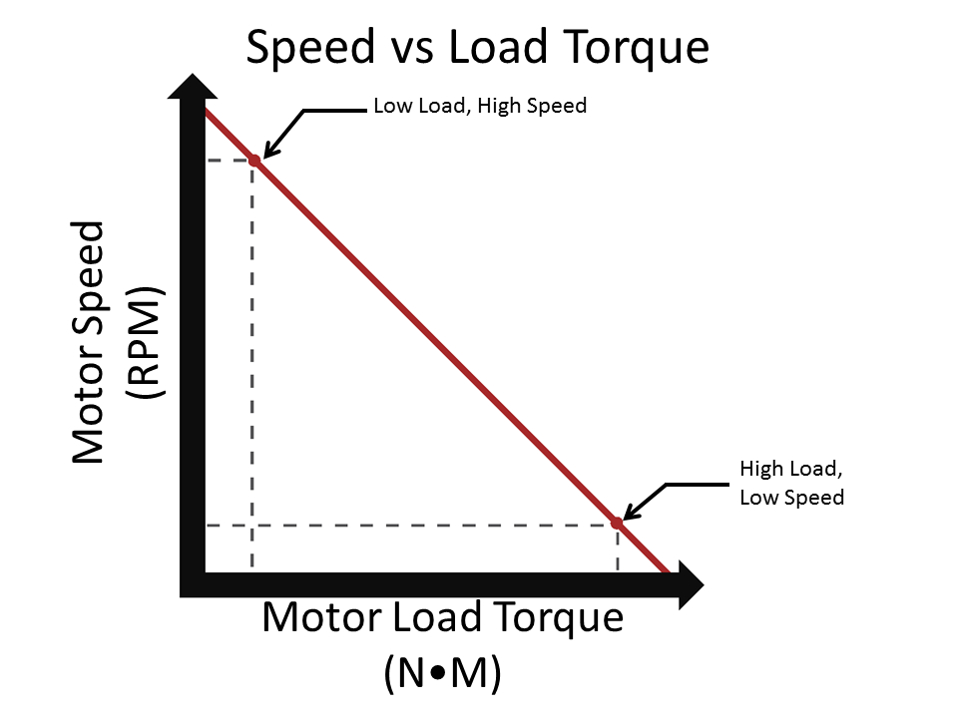
Data Acquisition
Verify sensor accuracy - T001-6
Load Variance - check torque response
Use steady motor RPM
Vary load and check that torque varies
http://curriculum.vexrobotics.com/sites/default/files/7.7.1%20Torque%20vs.%20Speed.PNG

Slide 139
Simulation Results Comparison
Create scripts to mimic the MATLAB simulations in hardware. This will be done in automatically controlling the valve opening in the dynamometer.

Slide 140
System Verification
VSCADA Tests
Data acquisition
Throttle control
TSI Tests
Checks for galvanic isolation
TSV Pack Tests
With 4 packs
With 1 pack

Slide 141
VSCADA Tests
VSCADA data acquisition via CAN
VSCADA data acquisition from Huff Box
VSCADA throttle control
Uses data from CAN and Huff Box
Control Dynamometer valve via Huff Box

Slide 142
TSI Tests
Run the dynamometer with the TSI attached
T002-4 (assumes the TSI works properly)
If the system powers down:
It is not galvanically isolated
If the system runs:
It is properly isolated

Slide 143
TSV Tests
Run the dynamometer with TSV power
If 4 packs have been completed:
Connect the packs to the TSI
If only 1 pack has been completed:
Connect the pack in series with the power supply
Power supply will make up voltage difference

Slide 144
System Validation
Gear Ratio
Torque Curve
Final Demonstration

Slide 145
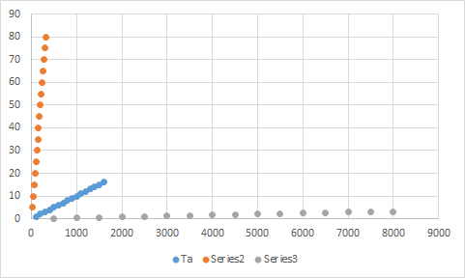
Gear Ratio
Knowing the maximum rpm and our desired maximum velocity we can solve for the gear ratio

Slide 146
Torque Curve
At minimum:
Must show velocity vs. torque at an estimated load
Goal:
Will show velocity vs. torque at several load points
Will show power consumption
Ideal:
3D graph of velocity, torque, and load

Slide 147
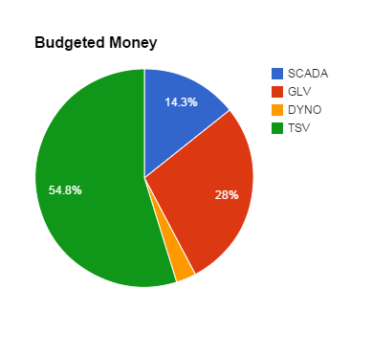
Budget
Initially allocated money:
Dyno - $148
SCADA - $715
GLV - $1397.90
TSV - $2739.10

Slide 148
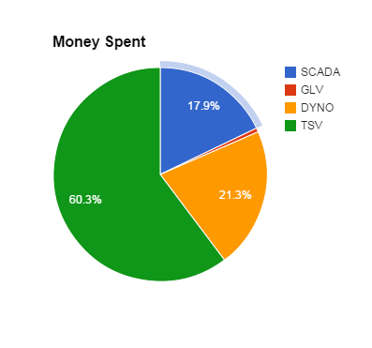
Budget
Money Spent so far
Dyno - $362
TSV - $1026.03
SCADA - $304.26
GLV - $10.24

Slide 149
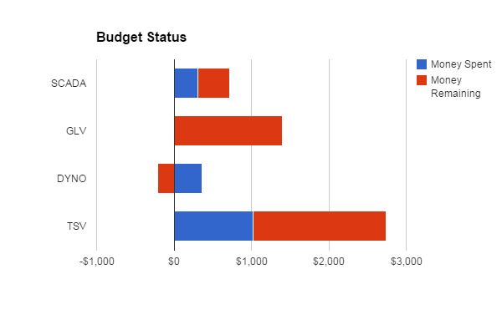
Budget
Current status of money:

