Slide 1
VSCADA Preliminary Design Report
PDR Covering the LFEV Software Design

Slide 2
Road Map
Resource Availability
Project Overview
Risk Assessment
Requirements Analysis
System Design and Subsystem Overview
Interface
System Control States
System Test Plan
Software Maintainability Plan
Cost Analysis
Team Schedule Overview
image reference: New York Metro

Slide 3
Resource Availability
Need to find a balance of the three resource components
Time:
Limited time (need to be finished earlier)
Flexible schedule between individuals
Resources
~$1000
24 hours available computer labs
Advice from Professors
Design from previous years
Scope
Need to be cut down
Major structure done in week 9
Other requirements can be addressed later
Scope
Time
Resources

Slide 4
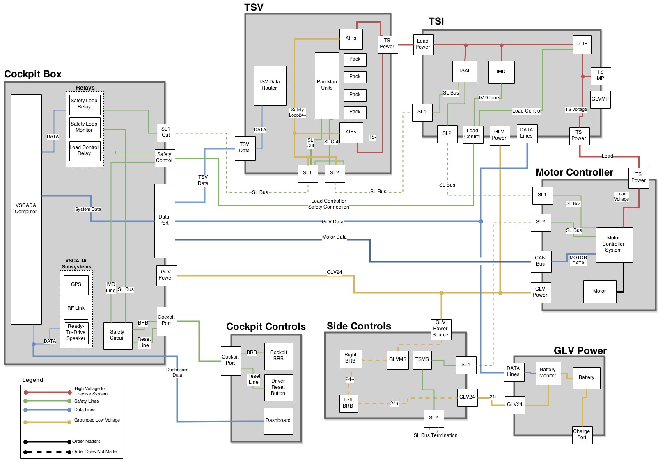

Slide 5
VSCADA Interface
cockpit box
Pit Computer
Embedded System
RF link
debug
ethernet
To packman
CAN
Motor Controller
io
Video
To Dyno Computer
linux
microcontroller
sensor
safety loop
relay
load control
relay
sensor
safety loop
monitor
linux
dashboard
image reference: github, microsoft

Slide 6
Deliverable
Maintenance Mode
Minimal restriction, ability to overwrite config files
Drive Mode
Minimal display, load and clear
Demonstration Mode
Pre-programed, labelled “Demo”
API
SDK
Database
Datalogging
Configuration management, no recompile
image reference: Charles Waller

Slide 7
Requirements Out of Scope
Mobile App (~S009)
Automatic Hardware Configuration (still check for sensors) (S017)
GPS (S034)
Long-term shutdown mode (S023)
Plug-in and forget charging (S025)
Plot data (S038)
Dynamometer data acquisition (S042)
Automated Charging of TSV (S013)
Pre-Charge Discharge Circuits (EV 4.9)
image reference: Windows 95

Slide 8
Risk Assessment
Coding Style
Maintenance mode
Warning/Fault Detection
On-board Computer Handling
Project Physical & Mental Health Effects

Slide 9
Requirements Analysis
Back End Software
GLVIS - Grounded Low Voltage Interface Software
TSVIS - Tractive System Voltage Interface Software
MIS - Motoro Interface Software
DB - Data Base
DAA - Data Acquisition and Analysis
DOC - Documentation
Front End Software
UI- User Interface
Comm - Communication

Slide 10
System Design
VSCADA gathers information from other systems in electric vehicle and monitors these systems.
Communicate with three different systems.
TSV(PacMan) using Ethernet
GLV using CAN bus protocol
Dyno(Motor Controller) using CAN bus protocol
Safety loop is also included in case of emergency and system shut down.
Operates on Linux OS.
image reference: linux.com, Namco

Slide 11
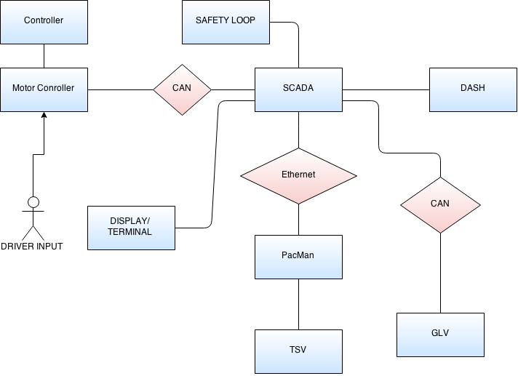
System Design Overview

Slide 12
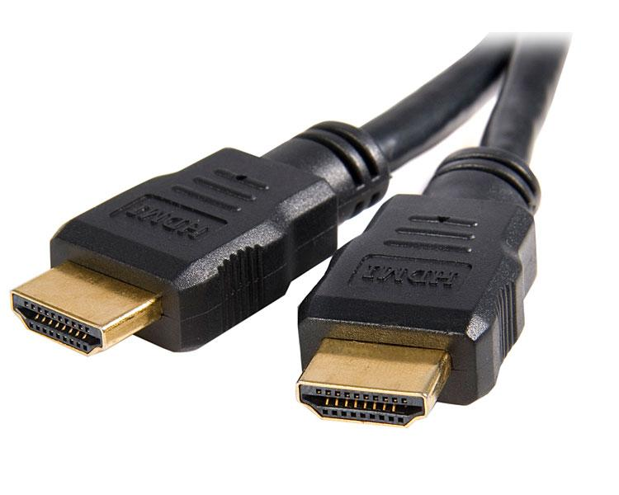
System Hierarchical BreakDown
VSCADA is divided into two subsystems frontend and backend.
Backend and Frontend are further divided into smaller subsystems.
Frontend (User Interface)
Dashboard Interface
Mobile Interface
Pit Station Interface
Maintenance Mode
Drive Mode
Demo Mode
Backend
Data Acquisition
Vehicle control
DataBase
Computer System

Slide 13
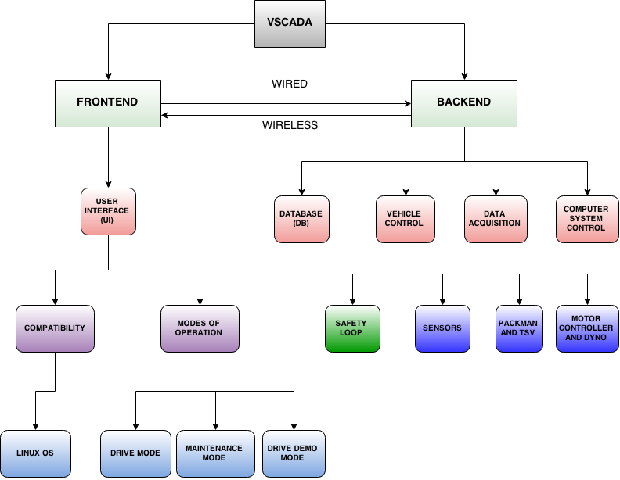
Fig. 2. System
Hierarchical Breakdown

Slide 14
Interface
Dedicated I/O
GPS
TSV
General Sensor Interface
GLV
General Sensor Interface
DYNO
General Sensor Interface
Motor Controller (CAN)
NETWORK BUS
120 Ω
120 Ω
TSV
VSCADA System
Ethernet
Front End GUI
General Sensor Interface
GLV
Wireless
CAN Bus
VSCADA
(Master)
Sensor/IO
(Slave)
DYNO
Motor Controller Interface
CAN Bus

Slide 15
System Control States
Flowcharts created represent:
System Startup Logic
Drive Mode
Maintenance Mode
Demonstration Mode

Slide 16
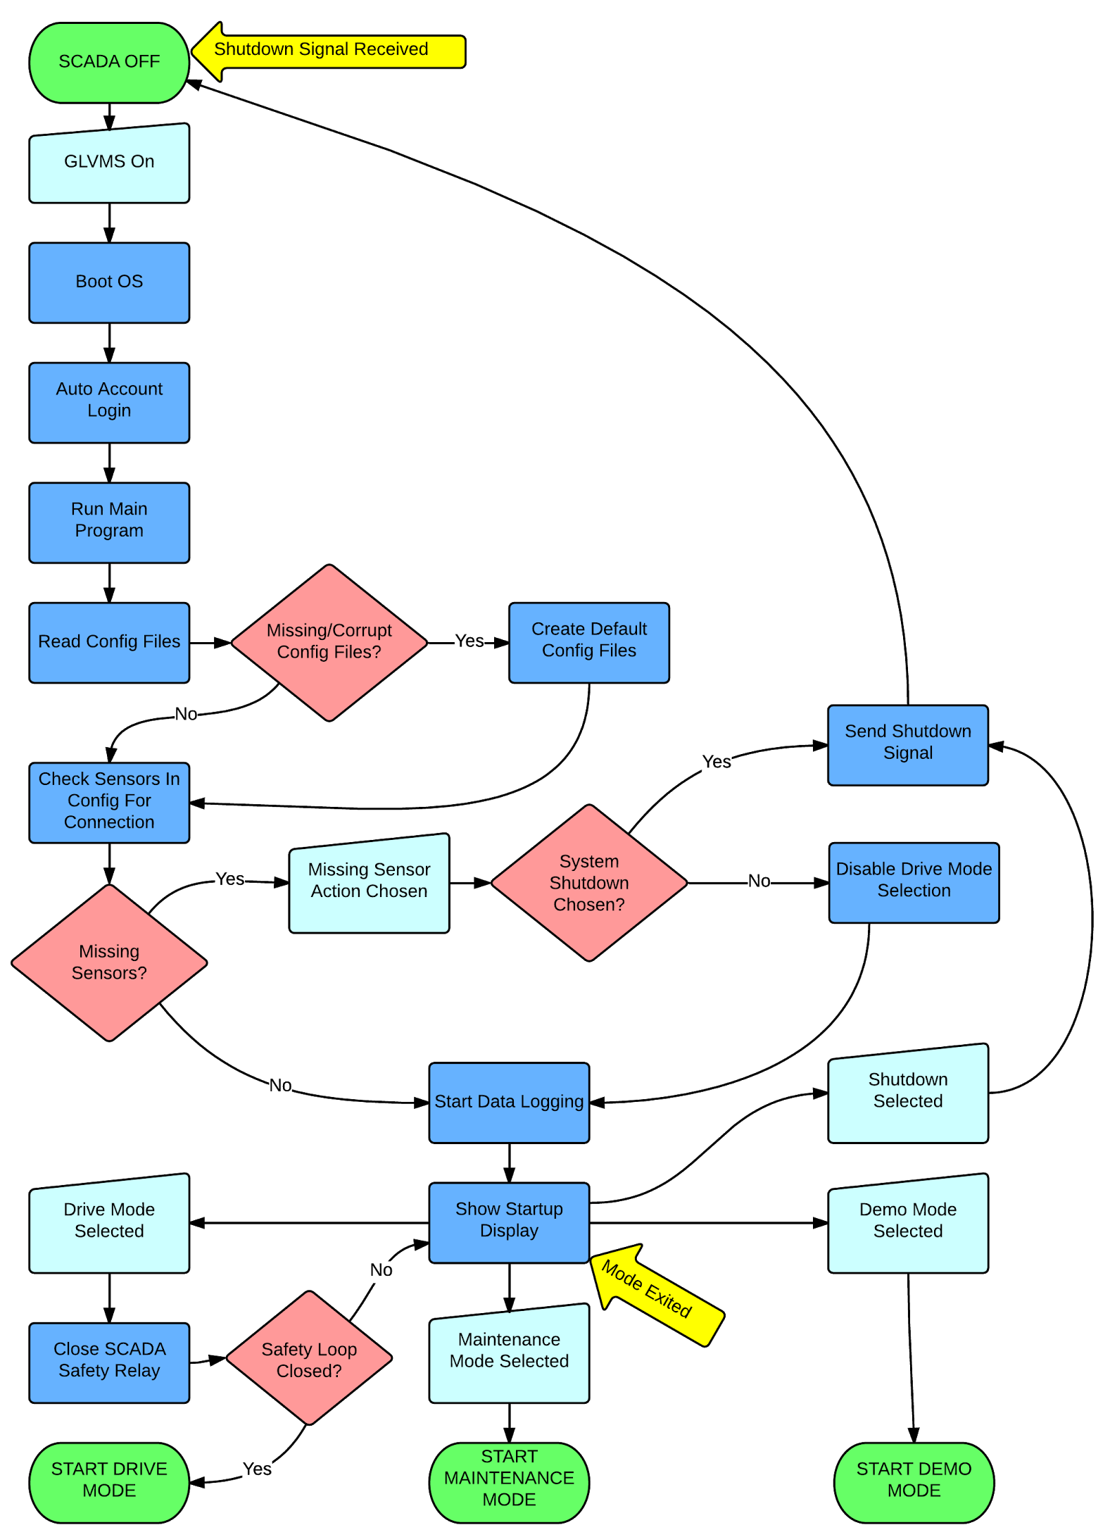
Startup States

Slide 17
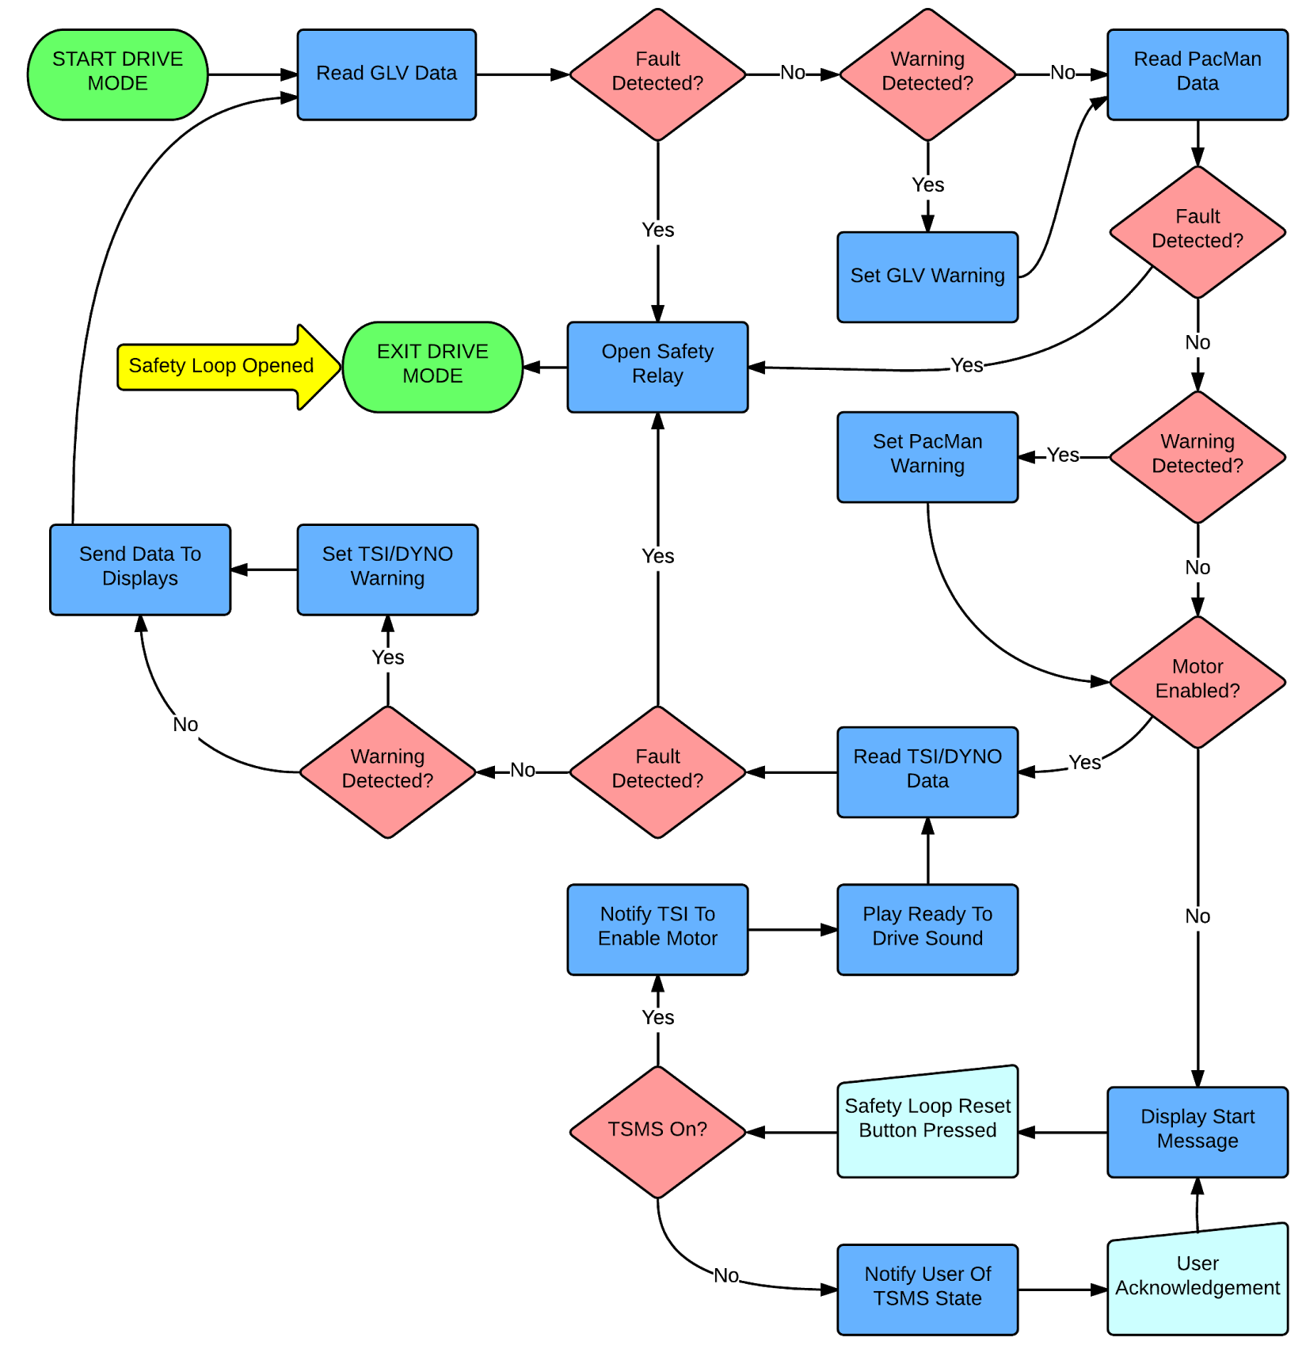
Drive Mode States

Slide 18
Maintenance Mode States

Slide 19
Demonstration Mode States

Slide 20
Acceptance Test Strategy
Show that all requirements are met
High-level outline to be expanded into ATP
Compliance can be proved by
Analysis
Inspection
Test

Slide 21
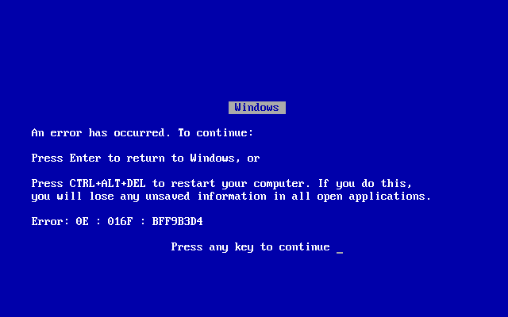
ATP Test Outlines
T000 - System Startup Test
Tests successful VSCADA startup on GLV power without human interaction
T001 - TSV Communication Test
Tests communication of VSCADA with Pacman using 2014 protocol
T002 - System Failure Recovery Test
Tests ability of system to recover in event of unexpected failure

Slide 22
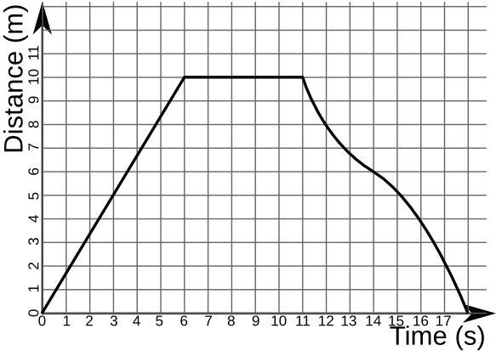
ATP Test Outlines (cont.)
T003 - Motor Controller Test
Tests ability of VSCADA system communicating with motor controller
T004 - User Interface Test
Tests simultaneously functionality across all physical interfaces
T005 - Data Logging Test
Tests successful and accurate logging and plotting of measurands

Slide 23
ATP Test Outlines (cont.)
T006 - Wireless Link Communication Test
Tests successful communication between interfaces with minimal latency over wireless link
T007 - Hardware Detection Test
Tests autodetection of sensors without software recompilation
T008 - Rules Test
Tests setting of user defined alarm/shutdown rules

Slide 24
Cost Analysis
Embedded Computer
The ‘Brain’ of VSCADA
Embedded Linux System
LCD Display
Driver Dashboard Display
Miscellaneous Hardware
Supporting Hardware
Connectors
Unexpected Costs
Budget Summary
EXPENSE DESCRIPTION | TOTAL COST
Embedded Computer | $200.00
Dashboard LCD Display | $100.00
Wireless Radios | $100.00
Power/Safety Loop Electronics | $55.00
Interface Demonstration Microcontrollers | $60.00
Miscellaneous Hardware Costs | $235.00
TOTAL | $750.00

Slide 25
Team Schedule Overview
15 week project
first 9 weeks should design, build and test a simplified, working version
Crucial deadlines:
Deliverables
PDR materials | 2/8/2015
user manual | 2/13/2015
calibration and accuracy | 2/16/2015
acceptance test plan | 2/19/2015
maintainability plan | 2/26/2015
CDR materials | 3/9/2015
QA audit report | 4/8/2015
acceptance test report | 4/17/2015
final report | 4/27/2015
milestones
Name | Due Date
PDR presentation | 2/10/2015
CDR presentation | 3/11/2015
phase one demonstration | 3/25/2015
acceptance test | 4/13/2015
final demonstration | 5/1/2015

Slide 26
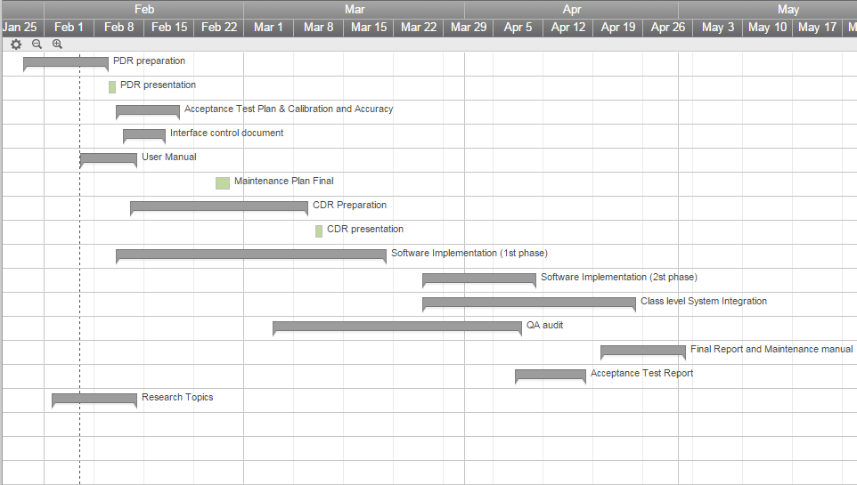
Team Schedule Overview (cont.)
Timeline
Has 12 main tasks, each with sub tasks

Slide 27
Team Schedule Overview (cont.)
example part of the full task list
shows tasks completed for PDR
total of 103 tasks
TASK NAME | ID | LENGTH (DAYS) | START | FINISH
CDR Preparation | 34
Summary of Approved System Level Test Plan | 35 | 2 | 2/20 | 2/23
Safety Plan | 36 | 1 | 2/13 | 2/13
Updated System Design/System report draft | 37 | 4 | 2/16 | 2/19
Detailed Specifications for each subsystems | 38 | 3 | 2/17 | 2/19
Enhanced requirement analysis | 39 | 3 | 2/17 | 2/19
Program budget | 40 | 2 | 2/23 | 2/24
Revised Program schedule | 41
Update with current progress | 42 | 1 | 2/25 | 2/25
List of completed/incomplete tasks | 43 | 1 | 2/26 | 2/26
CDR material check/revisit | 44 | 3 | 3/3 | 3/5
CDR write up/slide show | 45 | 2 | 3/6 | 3/9
CDR Presentation | 46 | 1 | 3/11 | 3/11

Slide 28
Team Schedule Overview (cont.)
Individual tasks
Some are short tasks, required a day or two
Some are more complicated and may take more than one week, and the assignees are responsible for proposing his detailed weekly plan
task id 1 | task name PDR preparation | Start Date | End Date
5 | Requirements Analysis | 1/29/2015 | 2/3/2015
7 | Risk Assessment | 2/3/2015 | 2/4/2015
101 | Research sensors/protocols already on the system and possible additions | 2/4/2015 | 2/9/2015
22 | User manual: Block Diagram | 2/9/2015 | 2/10/2015
26 | User manual: FAQ | 2/10/2015 | 2/12/2015
39 | Enhanced requirement analysis | 2/17/2015 | 2/19/2015
44 | CDR material check/revisit | 3/3/2015 | 3/5/2015
67 | VCI: Dyno | 2/27/2015 | 3/6/2015

Slide 29
Conclusion
VSCADA is a subsystem of LFEV-Y3-2015 project. This preliminary design will serve as a baseline for the VSCADA team to enter a more detailed design phase.
Moving forward, the VSCADA team will
expand and complete the Acceptance Test Plan
develop a user manual
finalize the breakdown of the system into implementable software modules
decide on the libraries and software tools to use
purchase the main interface, an embedded Linux device

Slide 30
Questions?

