Slide 1
The Lifelong Student?: Pursuing Graduate School
ES101 Brownbag
Wednesday, September 25, 2013

Slide 2
Today’s Brownbag
Is graduate school for you?
What does graduate school entail?
Master’s vs. Ph.D.?
Slides will be available on Lafayette chapter AICHE sites (sites.lafayette.edu/aiche)

Slide 3
A Few Notes to Start…
Perspective of a chemical engineer
Most statements provided here true for all engineering disciplines, but potentially not all.
This presentation will not cover
Medical school (http://healthprofessions.lafayette.edu/)
Engineers make attractive med school candidates.
Law school (http://prelaw.lafayette.edu/)
Select your electives wisely.

Slide 4
Why Choose Graduate School?
Graduate school is not for everyone.
On average, a 5-6 year (Ph.D.) investment of time
Master’s programs usually run 1-2 years.
People who enter grad school should be:
Self-motivated
Inquisitive about engineering AND science
Interested in why things are happening, not just what is happening
Willing to handle failure and uncertainty and learn from it
Unafraid to ask questions

Slide 5
Undergraduate vs. Graduate
UG is (primarily) closed-ended problems where a solution can be found following some procedure.
A Ph.D. involves solving open-ended problems where the solution is unknown and the path to solving the problem is often murky at best.
You will be the expert.
Graduate school will enhance and develop your analytical skills to allow you to solve any problem.

Slide 6
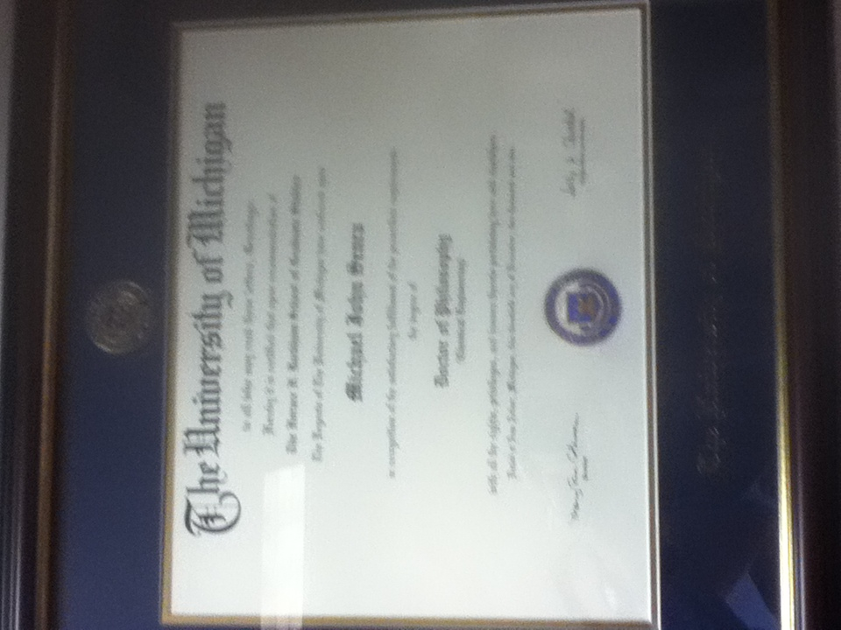
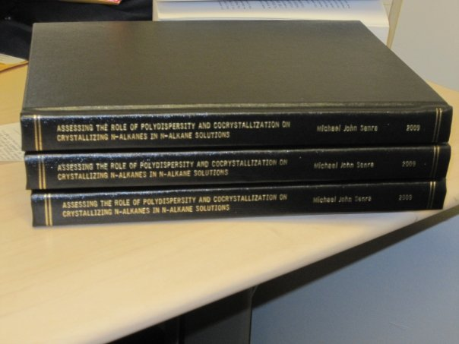
What are the Requirements of a ChE Ph.D.?
Grouping | Description
Coursework | Advanced courses in thermo, transport, kinetics and applied math. Science/engineering electives Most completed in first two years
Qualifiers | Show competence in coursework and/or ability to conduct research
Teaching (most) | 1 or 2 courses as a teaching assistant
Oral/Poster Presentation | Work presented at symposiums or conferences
Publications | 1-4 (Varies from school to school and from research group to research group)
Thesis | Compilation of original research Final approval from research advisor and thesis committee (2 or 3 in department, at least 1 external)

Slide 7
Am I Going to Accumulate Loans?
In virtually all ChemE Ph.D. programs (and most other science/engineering), no.
Research is funded by a wide range of entities.
Covers cost of “employees” (grad students et al.)
Tuition/fees
Stipend (~$20-30,000, dependent on school)
Health care (typically)
Attendance at conferences (% coverage varies)

Slide 8
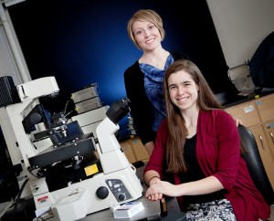
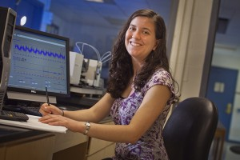
Fellowships
Highly competitive (grades, research, etc.)
Typically (slightly) higher stipend than other graduate students
Potentially more freedom in advisor selection.
Sample fellowships:
NSF (National Science Foundation, http://www.nsfgrfp.org/)
NDSEG (National Defense Science and Engineering, http://ndseg.asee.org/)
Hertz Foundation (http://www.hertzfoundation.org)
Ashley Kaminski (‘13) NSF Recipient (now at Cornell BME)
Lauren Huyett (‘11) NSF Recipient (now at UC Santa Barbara ChE)

Slide 9
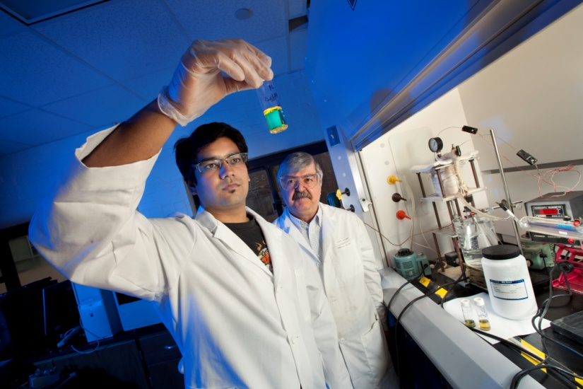
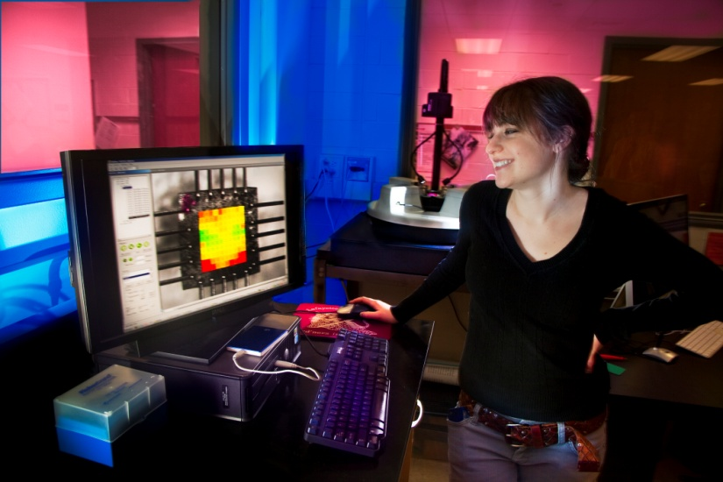
Will I Like Research?
The best way to find out is by actually completing research.
At Lafayette
Excel program (the earlier, the better)
Can go outside of the major
Externally
Summer REU programs (http://www.nsf.gov/crssprgm/reu/list_result.cfm?unitid=10006)
Other federal/university level organizations (NSF, NIH, etc.)
Ankit Chandra (‘12) (now at Cornell ChBE)
Hallie Zeller (ME, ‘12) (now at Brown ME)

Slide 10
Sample ChBE Honors Theses
Student | Thesis Title | Advisor | Current
Asad Akram (‘12) | Shell Encapsulation and Formation in Microfluidic Channels | Levinson | Bioformix Inc. (Process Engr.)
Scott Albert (’12) | Numerical Simulation of Blood Flow in the Renal Arteries: Influence of the Renal Ostium Flow Diverter | J. Rossmann (ME) | Johns Hopkins (BME Ph.D.)
Melissa Gordon (‘10) | Breaking the Mold: Optimization of Voxel Resolution in Materials-Additive Manufacturing | Ferri | Princeton (ChE Ph.D.)
Aaditya Khanal (‘11) | Microalgae to biodiesel: Investigating the growth rate and lipid content of several microalgae strains | Tavakoli, Piergiovanni | U. of Houston (ChE Ph.D.)
Kevin Ling (‘11) | Gene expression on thermo-responsive polymer brushes with a tunable LCST | L. Anderson | Georgia Tech (ChE Ph.D.)
Hallie Zeller (‘11 ME) | Deconvoluting cohesion and adhesion in E. coli D21g biofilms | Ferri | Brown (ME Ph.D.)

Slide 11
Applying For Grad School
Typically due around January 1 (variation exists)
Requirement | Description
Transcript | Imperfect grades can be overcome by quality undergrad research
GRE | Not as important as you may think, but still required
Personal Statement | 1-2 pages discussing why you want to attend grad school (and the particular school) and what makes you a good candidate.
Letters of Recommendation | 3 letters is a typical minimum. All recommenders do not have to be from the major. Provide ample time, a resume and an update to your recommenders.
Application Cost | Money (Some schools waive application fees.)

Slide 12
What Can I Do with a Ph.D. (Besides be a Professor)?
Your thesis research will represent a little slice of science/engineering that you are the expert.
You may be expected to:
Conduct research to answer an industrial question
Oversee others completing experiments/simulations
Types of jobs:
Senior Engineer
Research Scientist (R&D (generally) has a glass ceiling without a Ph.D.)
Consultant

Slide 13
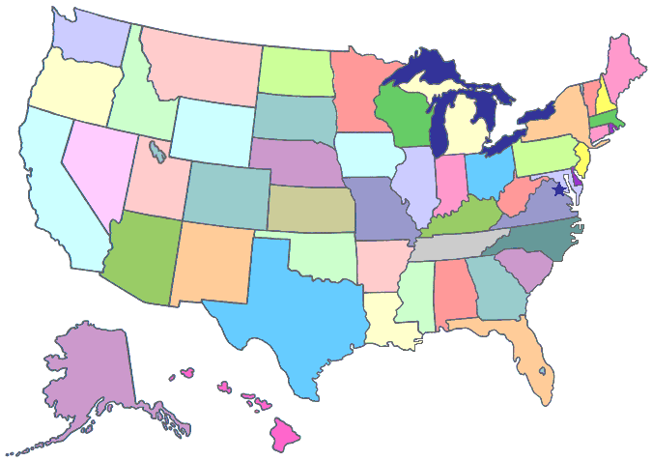
Where are They Now?: Jobs

Slide 14
Where Have They Went?: Laf ChBE Grad Schools (Classes of 2011-2013)
PhD in ChE
PhD in BME or Polymers
Master’s

Slide 15
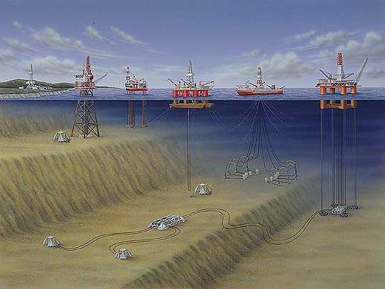
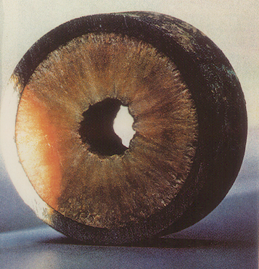
A Brief Aside: My Story
My thesis title: “Assessing the Role of Polydispersity and Cocrystallization on Crystallizing n-Alkanes in n-Alkane Solutions”

Slide 16
Some Pros and Cons of Graduate School
You lead the path
Cutting-edge research and equipment
Meet and work with experts in the field
Conference travel
Scheduling flexibility
College environment
Launching point for more lucrative work
You lead the path
Can be (at times) isolating
Frustrating
Not 9 (or 8) to 5 job
Financial issues
College environment
Tough (NOT impossible) to start a family

Slide 17
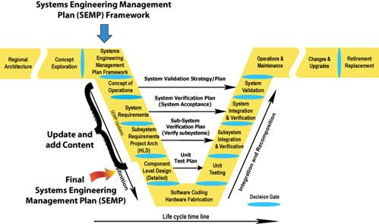
Master’s Degrees
Useful if desired to gain particular specialization
Polymer science
Environmental science
Biotechnology
Business (MBA’s)
Engineering management
Master’s in ChE w/bachelor’s in ChE is not generally useful.
Generally, minimal to no financial assistance provided
Company funded MBA is an exception.

Slide 18
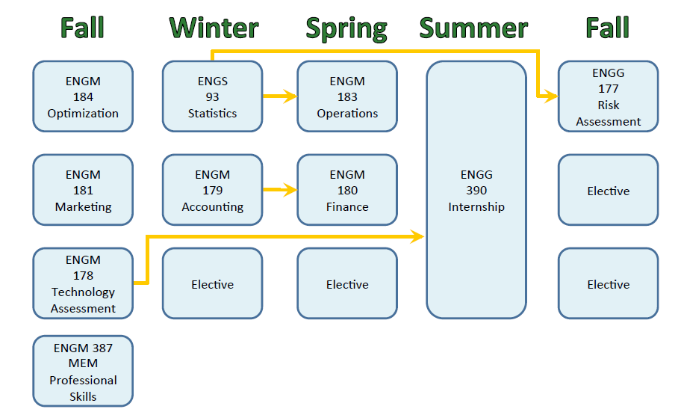
Master’s of Engineering Management
Degree gaining popularity in the last five to ten years.
Known as “the Engineer’s MBA”
Combination of professional engineering practice and core business principles
Jobs can range from financial analyst to plant manager to strategy consulting manager
Related to engineering studies
Good resource to start: http://www.mempc.org/index.htm

Slide 19
A Few Parting Words
Grad school will change the way you think and approach problems.
Grad school is not just a Ph.D.
Don’t choose grad school solely because finding a job is difficult.
Take advantage of research opportunities at Lafayette or elsewhere.

