Slide 1
Internships & Career Fair Brownbag
September 15, 2015

Slide 2
Navigating the Career Fair for a ChE
http://careerservices.lafayette.edu/files/2015/09/New-CF-layout-one-page-per-2015.pdf to see list of companies
Research each company so you are informed
Name & type
Locations
Internship & Job Opportunities
Good companies for ChEs (just some of the many)
B. Braun - Pharmaceuticals
ExxonMobil - Petroleum
Air Products - Industrial Gases
Linde - Industrial Gases
Johnson & Johnson - Healthcare products & Pharmaceuticals
West Pharmaceuticals - Healthcare & Pharmaceuticals

Slide 3
What to bring
Business dress (It is required for entry.)
Folder with resumés (15-20)
Splurge on high quality resume paper.
List of companies you find interesting
Some questions to ask
How established is the program?
What are the biggest challenges for this position/company?
What they like most and least about the company?
Something of interest gained in your information acquisition about the company

Slide 4
When you are there
Wait in line but be bold.
Talk to everybody, don’t limit yourself to your preset list.
Give your resumé out.
Network network network. (At minimum, ask for business cards)
Talk yourself up… but not too much.
Take the free stuff if offered. (You’ll actually make the career fair reps happy.)

Slide 5
After the fair
Send Thank You notes
Written best, particularly for interviewers (later)
Follow up with connections you made
Interview and hiring decisions are made based on a number of things: making an impression on someone is most certainly one.
Check CareerSpot for internship positions and interview schedules
https://lafayette-csm.symplicity.com/

Slide 6
GOOD LUCK!

Slide 7
Meet the Speakers
Hayden Jarboe ‘16
jarboej@lafayette.edu
Kristen Pogozelski ’16
pogozelk@lafayette.edu
Christopher ‘Barker’ Carlock ’17
carlockc@lafayette.edu
Paige Adams ’16
adamsp@lafayette.edu

Slide 8
Kristen Pogozelski – NRG Energy, Inc.

Slide 9
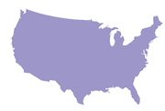
NRG Energy
3,000,000
recurring retail customers
Nearly
NRG Energy, Inc.
53K
MWs of global, diverse energy*
3rd largest renewable generation company in the U.S.
$3 billion+
Invested on environmental improvements
Enough generation capacity to power nearly 1/3 of the US population
Largest independent power producer in U.S.
Fortune 200
- and – S&P 500 Index
*NRG and NRG Yield Assets excluding 1,346 MW thermal and 50 MW of Home Solar
Notes:
Yes, we have a strong foundation.
It’s a great position to build on. And to become a company that is both big and innovative. As you can see here, it’s already happening.
[Note: Highlight any or all of these points, depending on audience and length of presentation]
We have more than 53,000 MW net of fossil fuel, nuclear, solar, wind and thermal capacity at almost 150 generating locations. NRG’s unparalleled foundation of physical generating assets supports the growth and expansion of our retail businesses in the Northeast and other competitive markets, emulating our successful integrated retail-wholesale business model in Texas. We believe our integrated approach is the best business model in an industry that is subject to volatile commodity prices. NRG has a diversified generation portfolio, distinguished by its range in geography, fuel source and dispatch level.
We are the nation’s largest competitive power generator with dual headquarters in Princeton, New Jersey and Houston, Texas, and major management presences in the East, Gulf Coast, and West regions of the country.
NRG’s retail businesses collectively serve almost 3 million customers in 16 states (Washington, Oregon, California, Arizona, Texas, Minnesota, Illinois, Ohio, Maryland, Delaware, Pennsylvania, New Jersey, New York, Connecticut, Massachusetts, and Washington, D.C.)
3rd largest renewable generation company in the U.S. – Ranked by Energy Intelligence Group Oct 23, 2014
We also have invested more than$3 billion on environmental improvements at our various locations since 2000, including investments made by previous ownership. NRG plans to spend about $650 million through 2016 on additional environmental improvements that will lead to significant reductions in emissions.
Movin’ on up: NRG now ranks 244th on Fortune magazine’s annual Fortune 500 list. This is up an impressive 48 notches from last year’s ranking of 244. See our listing here on Fortune’s site. and Standard and Poor’s lists NRG Energy in the S&P 500 Index*, which includes 500 leading companies in leading industries of the U.S. economy.
We have a strong foundation to be the energy company for the 21st century
-----------------------------------------------------------------------------------------------------------------------------------------------
Additional information:
Standard and Poor’s lists NRG Energy in the S&P 500 Index, which includes 500 leading companies in leading industries of the U.S. economy. Widely regarded as the best single gauge of the U.S. equities market, this world-renowned index includes 500 leading companies in leading industries of the U.S. economy. Although the S&P 500® focuses on the large cap segment of the market, with approximately 75% coverage of U.S. equities, it is also an ideal proxy for the total market. S&P 500 is part of a series of S&P U.S. indices that can be used as building blocks for portfolio construction.
Cut and paste the link below into your browser for more info on S&P500:
http://www.standardandpoors.com/indices/sp-500/en/us/?indexId=spusa-500-usduf--p-us-l--
A Cleaner NRG: NRG is committed to operating our generation assets as cleanly and efficiently as possible.
*Added to S&P 500 Feb 2010

Slide 10
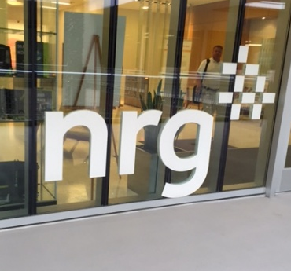
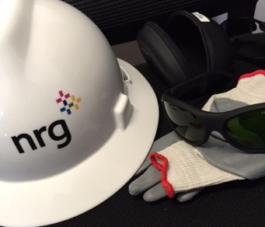
East Region Business Development
Plant Operations
Business-to-business Sustainability Solutions
Hyatt Hotels
AeroFarms
MedStar Southern Maryland Hospital
Pyramid Management Group
DataGryd
Fisk/Crawford power plant redevelopment
Chicago, IL
Canal 3 & Canal Community Solar projects
Sandwich, MA
Business Planning/Budgeting Process
EFORd Analysis
Plant Tours/Trips
Concentrated solar thermal (Ivanpah, CA)
Combined cycle (Gettysburg, PA)
Traditional natural gas (Staten Island, NY)

Slide 11
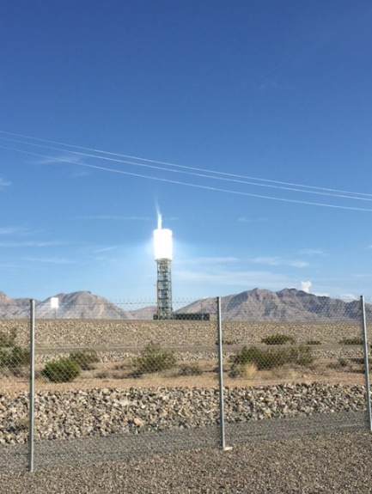
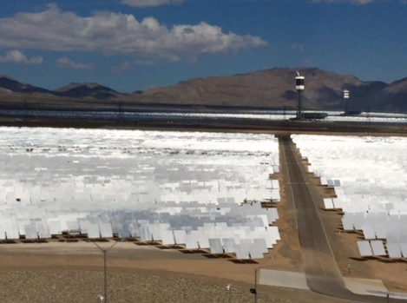
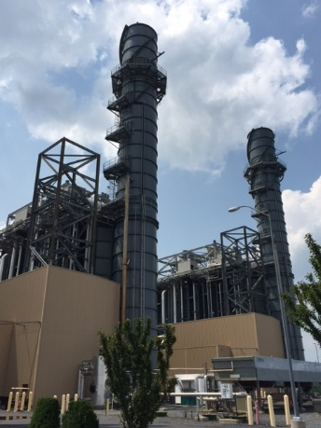
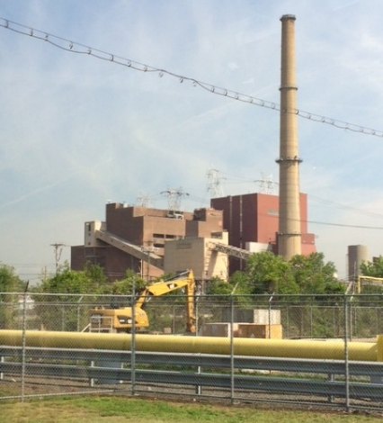
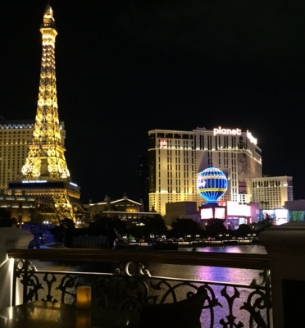
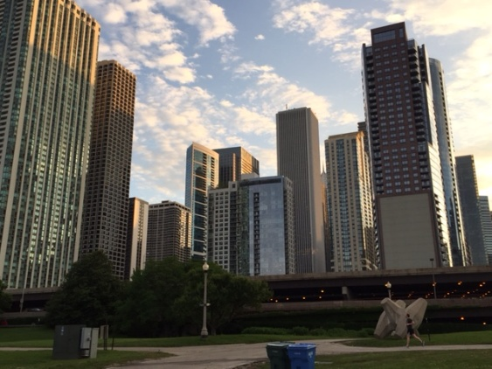
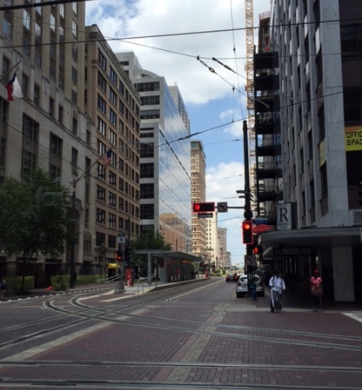
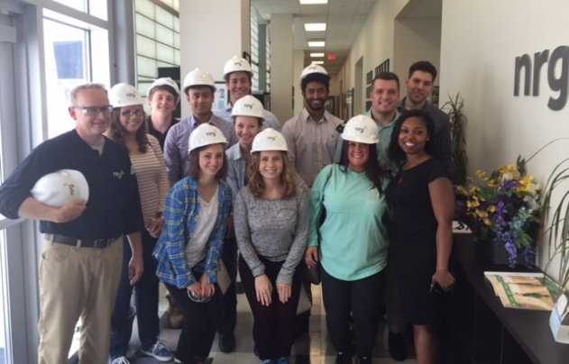
Oh, the Places You’ll Go!
Ivanpah, CA
Hunterstown, PA
Arthur Kill, NY
Las Vegas, NV
Chicago, IL
Houston, TX
Princeton Healthcare System, NJ
Notes:
Pictures of all my trips

Slide 12
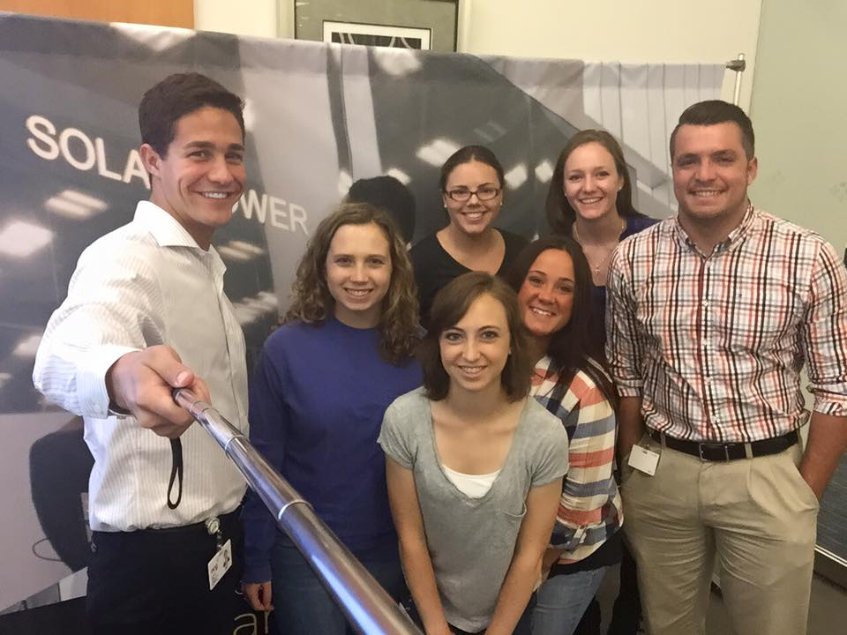
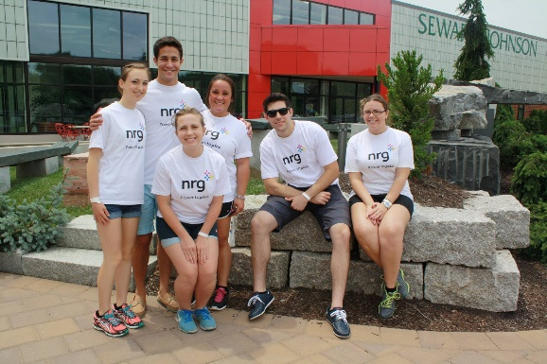
The Inside Scoop
How did I find/get this internship?
Google search
Lafayette Career Services – Gateway counselor, AlumNet database
Most Favorite Part:
Everything (company culture, “real-life” job, one-on-one networking, trips, etc…)
Least Favorite Part:
The commute
ChemE Courses Used:
CHE 324 (Process Control)
CHE 222 (Thermodynamics)
CHE 370 (Alternative Energy Sources)
CHE 312/322 (Experimental Design I/II)
Notes:
How I got the internship, Most/Least favorite parts, CHE courses used

Slide 13
Barker Carlock – ExxonMobil

Slide 14
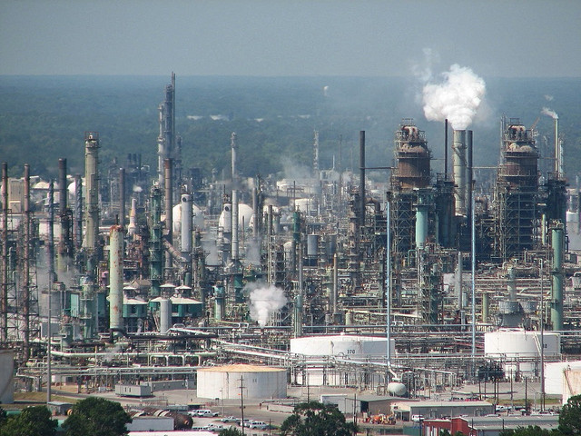
ExxonMobil Summer 2015
Baton Rouge, LA
Supply Chain Intern
Classes Used:
Thermodynamics, Organic Chemistry, ES-101, and M&E
Projects
Analysis of HCD reactives issue in Resin Production
Risk assessment of the liquid overfill potential at ACT
HCP variation of HCD railcars
Development for BR dashboard to track MRP metrics from SAP
HCP deviation renewal of IPA marine loading
Favorite/Least Favorite Parts:
Safety Stewardship and Community Involvement
The slow moving “Large Ship”
How did I get this internship?
Attended brownbag and visited career fair table
On campus interview & phone interview
Intern Activities
Crawfish Boil, Tiki Tubing, Painting with a Twist, and Louisiana Culinary Institute
Volunteering at the Food Bank, Bernard Harris Science Camp, and YMCA
Trips to New Orleans, Ultimate Frisbee, and Bulldog happy hour

Slide 15
Paige Adams – West Pharmaceuticals

Slide 16
How?
Career Services
On campus career fair
Career Vault

Slide 17
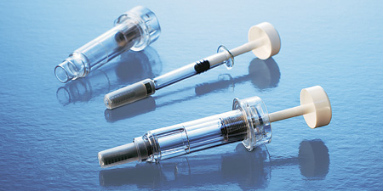
What?
Mechanical Engineering
Prototyping
“Now that we have a design lets figure out what's wrong with it”
3D Printing
Tests
Exposure to multiple parts of the business

Slide 18
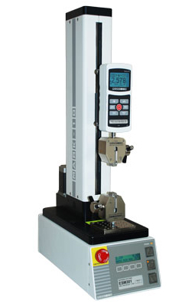
Lafayette Correlation
No particular classes were used.
Nature of Materials and Composites gave me some background on the materials we used.
Statics and Physics helped with simple force tests.
Teamwork skills
Minitab Analysis
Excel
Troubleshooting

