Slide 1
Leaving College Hill So Soon?: Advanced Academic Training
AIChE/ES 101 Brownbag
Tuesday, October 27, 2015

Slide 2
Today’s Brownbag
What types of degrees are available after graduation?
Is graduate school for you?
What does graduate school entail?
Master’s vs. Ph.D.?
Slides will be available on Lafayette chapter AICHE sites (sites.lafayette.edu/aiche)

Slide 3
$240,000+ Later and…?
After BS in engineering, approximately 30% of students go back to school
Some immediately, others after a few years
Not required for success in many industrial jobs
Why bother?
Develop skill sets in other area(s)
Required for desired job (lawyer, doctor, upper management, etc.)
Passion for research/understanding things from the conceptual side

Slide 4
Typical Advanced Degrees for Engineers
Immediately after graduation
M.S./M.Eng in a scientific field
M.D.
Ph.D.
MEM
Usually a few years after graduation
Aforementioned degrees
J.D. (patent law particularly)
M.B.A.

Slide 5
Engineers: Lawyers? Doctors?
Because of critical thinking skills developed as engineers, they make great candidates for both medical school and law school.
ChBE easiest to get degree with med school requirement
Chem 121/2 (Gen Chem) and Chem 221/2 (Orgo) can satisfy both degree and med school req’s.
Interested? (Check up on these now or soon.)
Medical school: http://healthprofessions.lafayette.edu/
Law school: http://prelaw.lafayette.edu/

Slide 6
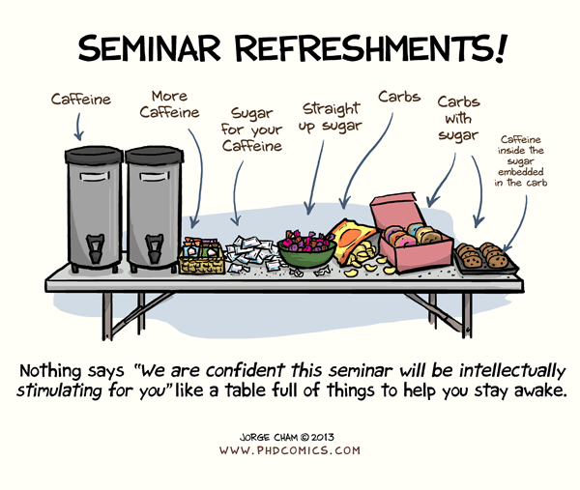
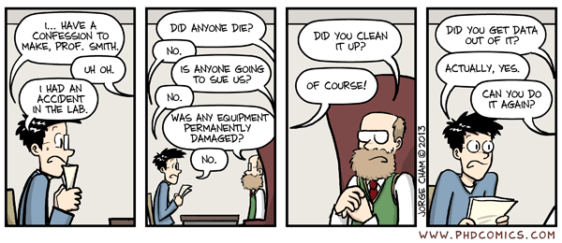
Why Choose Graduate School in Engineering?
Graduate school is not for everybody.
On average, a 5-6 year (Ph.D.) investment of time
Master’s programs usually run 1-2 years.
People who enter grad school should be:
Self-motivated
Inquisitive about engineering AND science
Interested in why things are happening, not just what is happening
Willing to handle failure and learn from it
Unafraid to ask questions

Slide 7
Undergraduate vs. Graduate
UG is (primarily) closed-ended problems where a solution can be found following some procedure.
A Ph.D. involves solving open-ended problems where the solution is unknown and the path to solving the problem is often murky at best.
You will be the expert.
Graduate school will enhance and develop your analytical skills to allow you to solve any problem.

Slide 8
Am I Going to Accumulate Loans?
In virtually all ChemE Ph.D. programs (and most other science/engineering), no.
Research is funded by a wide range of entities.
Covers cost of “employees” (grad students et al.)
Tuition/fees
Stipend (~$20-30,000, dependent on school)
Health care (typically)
Attendance at conferences (% coverage varies)

Slide 9
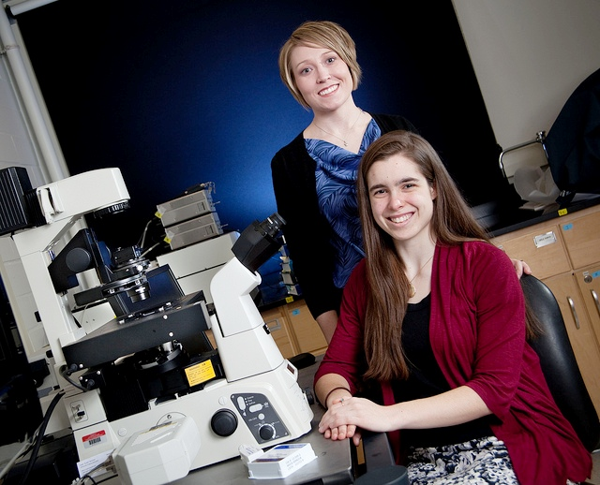
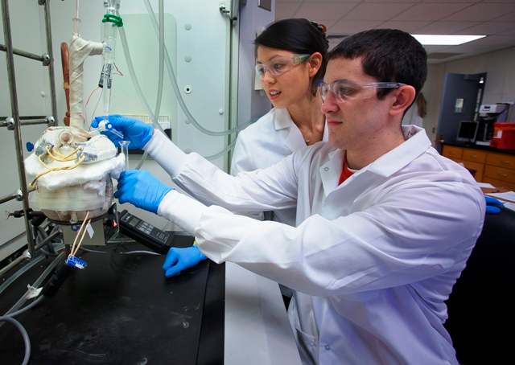
Will I Like Research?
The best way to find out is by actually completing research.
At Lafayette
Excel program (the earlier, the better)
Can go outside of the major
Externally
Summer REU programs (http://www.nsf.gov/crssprgm/reu/list_result.cfm?unitid=10006)
Other federal/university level organizations (NSF, NIH, etc.)
Ashley Kaminski (‘13) (now at Cornell BME)
Christopher Verni (‘15) (now at Penn ChBE)

Slide 10
What Can I Do with a Ph.D. (Besides be a Professor)?
Your thesis research will represent a little slice of science/engineering that you are the expert.
You may be expected to:
Conduct research to answer an industrial question
Oversee others completing experiments/simulations
Types of jobs:
Senior Engineer
Research Scientist (R&D (generally) has a glass ceiling without a Ph.D.)
Consultant

Slide 11
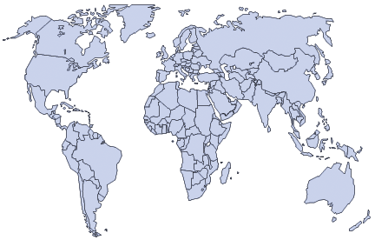
After Graduation: Postdocs

Slide 12
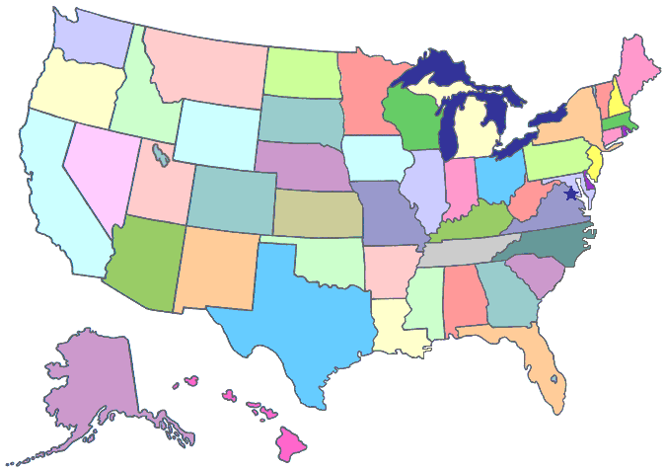
After Graduation: Jobs

Slide 13
Where Have They Went?: Laf ChBE Grad Schools (Classes of 2011-2015)
PhD in ChE
PhD in BME or Polymers
Master’s Degrees

Slide 14
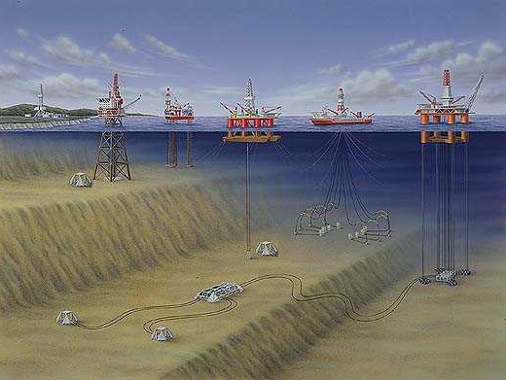
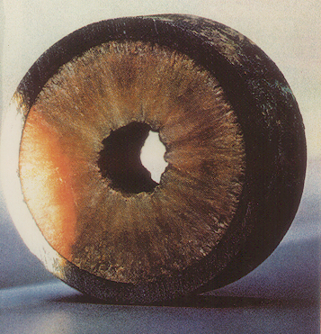
A Brief Aside: My Story
My thesis title: “Assessing the Role of Polydispersity and Cocrystallization on Crystallizing n-Alkanes in n-Alkane Solutions”

Slide 15
Some Pros and Cons of Pursuing a Ph.D.
You lead the path
Cutting-edge research and equipment
Meet and work with experts in the field
Conference travel
Scheduling flexibility
College environment
Launching point for more lucrative work
You lead the path
Can be (at times) isolating
Frustrating
Not 9 (or 8) to 5 job
Financial issues
College environment
Tough (NOT impossible) to start a family

Slide 16
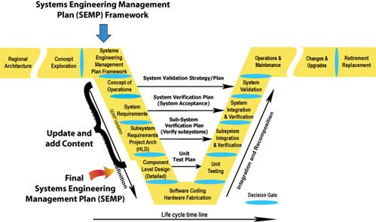
Master’s Degrees
Useful if desired to gain particular specialization
Polymer science
Environmental science
Biotechnology
Business (MBA’s)
Engineering management
Master’s in ChE w/bachelor’s in ChE is not generally useful.
Minimal to no financial assistance provided
Company funded MBA is an exception.

Slide 17
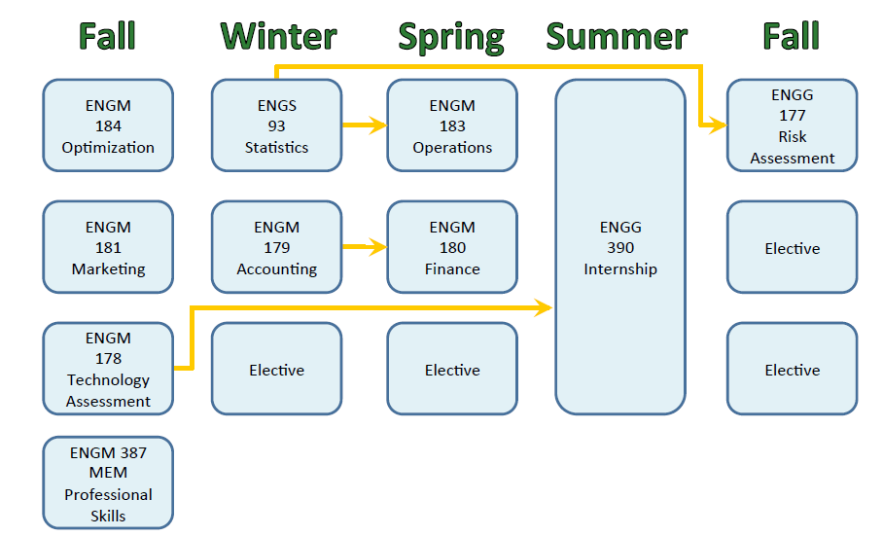
Master’s of Engineering Management
Degree gaining popularity in the last five to ten years.
Known as “the Engineer’s MBA”
Combination of professional engineering practice and core business principles
Jobs can range from financial analyst to plant manager to strategy consulting manager
Related to engineering studies
Good resource to start: http://www.mempc.org/index.htm

Slide 18
A Few Parting Words
Don’t choose grad school solely because finding a job is difficult.
Grad school will change the way you think and approach problems.
Even though it’s not industry, networking is just as important in grad school.
What you get out of grad school is directly related to what you put into it.

